Slide 1
white wine in the United States
NAME :
INSTITUTION:

Slide 2
Introduction
White wine is the was made in united state, which is fermented without coming into contact with the skin.
Sauvignon Blanc, a white grape win, is the best variety of wine is well known for its refreshing, crispness and its dryness.
It was made in France at the regions of Loire valley and Bordeaux.
The grape varieties of white wine include Moscato, Chardonnay and Gewurztraminer.
Some varieties of white wine were made still or buddy.
Regions of Loire valley and Bordeaux produced the best varieties of white wine.
Conquering of the northern regions enabled the Romans to cultivate the lighter wine. The port of Monemvasia was known for the high exportation of White win.
Notes:
White win which is made in the regions of Loire valley and Bordeaux in France. its known for its refreshing, crispness and dryness. Besides, the grape varieties of white win includes the Moscato, Chardonnay and Gewurztraminer.

Slide 3
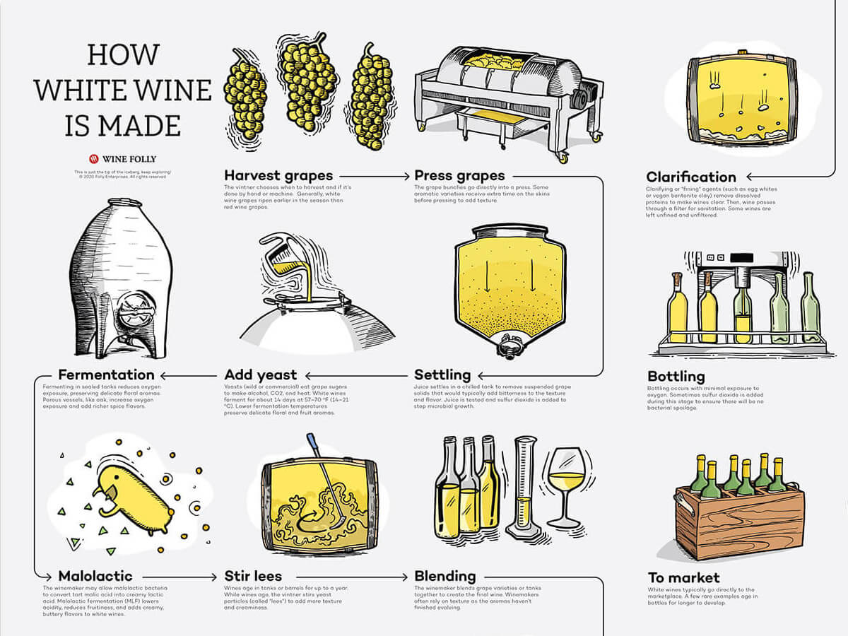
Production of the White Wine
White win was produced in over 7500 years ago by the French winemakers.
The wine makers from French came up with a terroir concept by doing observations from different vineyards, regions or different sections of the same vineyard.
French started the concept of terror crystallization which was a different aspect of the region which shaped and influenced the wine that is made from it (Chikere et al., 2021).
In ancient world, before the coming of the French, the regions of making win had already identified a concept of different region with the potentiality of producing a distinct and different wine from the same grapes.
Notes:
The concept of terroir crystallization shaped and influenced making of the white wine.

Slide 4
Major periods in the Production of White Wine
The antiquity period.
Middle age period.
Modern era period.
Contemporary period (Warschefsky & Rieseberg, 2021).
Notes:
There were three periods that took place in the production of white wine, the antiquity period, middle age period, modern era period and the contemporary period.

Slide 5
Terroir or the Environmental Factors
Elements or the components of terroir includes the type of the soil, the climate, other organism growing on, in and around the vine plots and geomorphology.
Influence of viticulture and winemaking.
The commercial aspect.
Human controlled elements.
The appellation systems (Chikere et al., 2021).
Notes:
The environmental factors that favors production of wine were components of terroir such as climate, and soil, the viticulture, human control elements, the commercial aspects and the appellation systems such as the AOC.

Slide 6
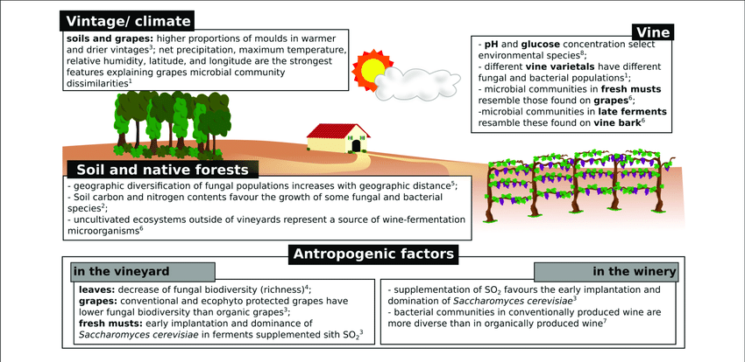
What Makes Terroir of Growing vineyard Distinctive Or Unique
The deep elements of terroir affects the taste and composition of the wine making the white wine more unique
The farm making decisions made vinify the grapes making a great difference to the white wine.
Aspects used in the growth of grapes was independent and was largely impervious to the influence of man kind.
Terroir is mostly down to microbes making it thrive during rainy season but struggle when there no water.
Whether in cave or winery, Flora and Fauna were not given enough credit therefore inhibiting the terroirs.
The type of the soil improved the sweet taste of the vineyard making the wine more distinctive (Hutson, 2021).
Notes:
The uniqueness of the white wine terroir was brought about by compositions and taste of the wine, the decisions made at the time of manufacturing the wine, the independence growth of grapes, and the terroir made the vineyard to thrive during the rainy
season.

Slide 7
Varieties of grapes that were grown for the production of White Wine and the todays styles of Wine
Examples of varieties that were used in making of the white win in the United States were the Riesling, chardonnay and Sauvignon Blanc (Ross et al., 2021).
The todays styles of wine includes the Marsanne, Garganega, Verdicchio, Albarino, Roussanne and Airen.
In the 17th century, Sauvignon Blanc was the most grape variety that was mostly planted in the world.
Notes:
The todays varieties of grapes that were grown after the 21st century were chardonnay, Sauvignon Blanc and Riesling. Furthermore, the todays grape varieties are the Albarino, Roussanne, Garganega, Verdicchio and Airen.

Slide 8
Characteristics of White Wine
It has pouilly- fume which is mostly known for its tree fruit and citrus flavous.
Traditionally, the wine produces a tree fruit tone giving a romantic nuance.
In early 1939 the win that was produce from Muscadet grape had a musky aroma or flavor that was more associated with many modern wine experts (Warschefsky & Rieseberg, 2021).
It have a dominant flavor and aroma.
Notes:
Good characteristics of white wine have been attracting thousands and thousands of people in the United States.

Slide 9
Production Regulations and Appellations
There are more than 87 appellations which are under VDQS and AOC pay system.
Across Loire valley there are only two generic designations.
The classification systems were passed as laws in 2012.
After the laws were passed, the producers of the wine had to submit the wine for tasting. Besides, it was to be made from certain blends or varieties (Ross et al., 2021).
The wine region map in France are Loire valley, Burgundy, Alsace, Bordeaux, champagne and Languedoc.
The white win producers includes the Domaine vacheron, domaine de larogotiere and domain pascal joviet with Sauvignon Blanc as their main wine.
Notes:
The regulations and appellations of the white wine are significant in ensuring that the wine is good for customers satisfaction.

Slide 10
Conclusion
The white wine mainly comes from grapes which tends to be yellow or green in color.
Many regions in Loire valley are known for higher production of white win and also the best world wide.
Majority of white wine production comes from Sauvignon, Chenin and melon Bourgogne (Spikes, 2021).
Most of the Known regions that produces the best white wine are the pouilly and Sancerre.
Notes:
Among other types of wine, the most common wine from ancient period to today in the united states is the white wine. It is well known for its flavor, color, and aroma.

Slide 11
References
Chikere, C. O., Hobben, E., Faisal, N. H., Kong-Thoo-Lin, P., & Fernandez, C. (2021). Electroanalytical determination of gallic acid in red and white wine samples using cobalt oxide nanoparticles-modified carbon-paste electrodes. Microchemical journal, 160, 105668.
Hutson, K. (2021). The Politics of Taxation: An Economic Analysis of Politically Motivated Tariffs Placed on French Wine by the United States.
Ross, C. S., Henehan, E. R., Alger, C., & White, L. F. (2021). Evaluation of Monitoring Youth Exposure to Alcohol Advertising on Cable Television, United States 2016‐2019. Addiction.
Spikes, A. (2021). Talking White Trash: Mediated Representations and Lived Experiences of White Working-class People, by Dunn, Tasha R.
Warschefsky, E. J., & Rieseberg, L. H. (2021). Laying the groundwork for crop wild relative conservation in the United States. Proceedings of the National Academy of Sciences, 118(4).

