Slide 1
Franklin d. Roosevelt
Student Name
Institutional affiliation
Course Name
Due Date

Slide 2
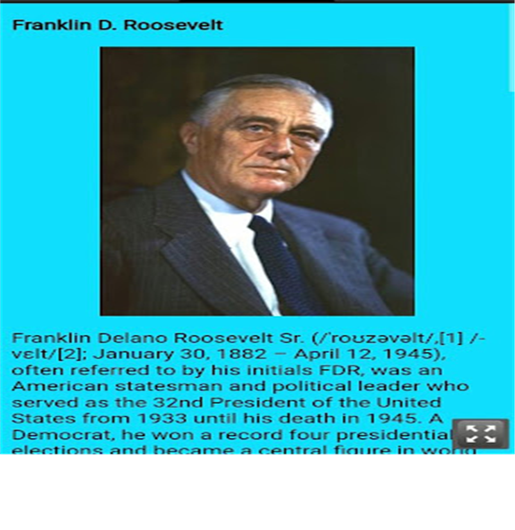
Franklin d. Roosevelt

Slide 3
Franklin D. Roosevelt
Franklin D. Roosevelt was Americas 32nd president as a democrat.
Roosevelt served the America for 12 years since 1933 until his death in 1945.
Roosevelt was president of the United states at the time the great depression was at its peak.
The main task that faced president Roosevelt at the time when people had lost faith.

Slide 4
Franklin D. Roosevelt
Roosevelts first 100 days were marked with great changes in policies with the aim of resurrecting the economy of America in the face of the Great Depression.
Roosevelt responded to the rejection he was facing by enacting new reforms.
He enacted; social security
greater taxes on wealthy people
work relief programs for the people who were not employed

Slide 5
Franklin D. Roosevelt
The policy issues Roosevelt had to deal were classified into three R’s;
a. Relief for the unemployed
b. Recovery of the economy
c. reforms in the financial system.
Roosevelt however faced challenges that came from opposition since his fight was against the minority rich.

Slide 6
Franklin D. Roosevelt
Roosevelt came into power immediately after the reign of Hoover who left Americans angry as a result of his poor handling of matters surrounding the great depression.
Roosevelt was able to make reforms on; the constitution and protect it against the elites.
He expanded the reach of democratic principles into the market economy.
As a result, radical alternatives such as Communist party remained relevant in the political culture

Slide 7
Franklin D. Roosevelt
Roosevelt had several goals at the time he got into power;
positive government in solving the Depression
Federal relief
Public works
Unemployment insurance
restoration of public faith in the role of banks.

Slide 8
Franklin D. Roosevelt
Roosevelt was not ignorant to the fact that people required to get jobs faster than practically possible.
He then signed the Wagner- Peyser Act creating United States Employment service.
Roosevelt authorized some $500 million to be given as grants for people in small businesses.

Slide 9
Franklin D. Roosevelt
Roosevelt also took the advantage to built the infrastructure using the unemployed Americans to; Repair bridges
Build roads and airports among other public projects.
In these projects there approximately four million Americans benefiting (Richard, 2021).

Slide 10
References
Https://www.youtube.com/watch?v=_d-v_faao7E
Richard W.S (2021)Franklin D. Roosevelt and his foreign policy critics

