Slide 1
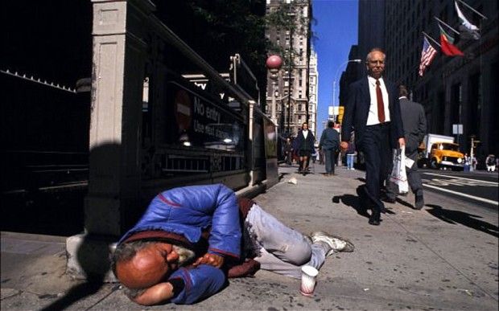

Sociology 207: Social Inequality
Module #1 – Part I

Slide 2

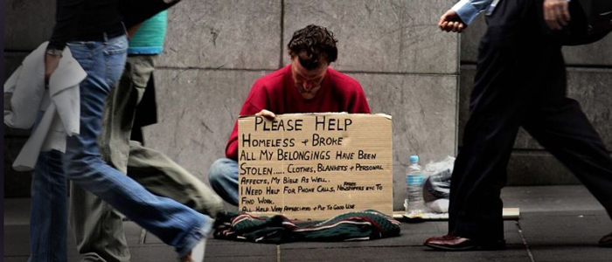
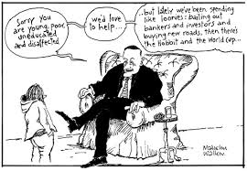
Three forms of Inequality:
Economic:
Social:
Political

Slide 3
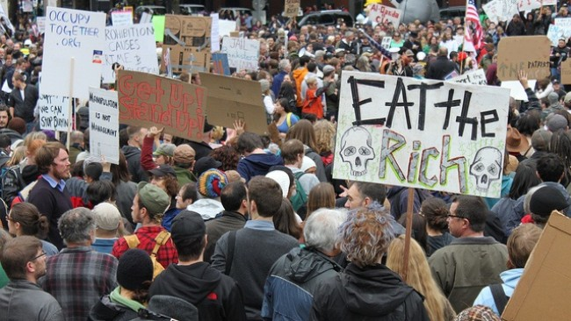
Economic Inequality is about material resources and access to wealth
HEALTH INSURANCE
HOUSING
TRANSPORTATION
EDUCATION
Lack of inequality in these areas means: reduced life chances.

Slide 4
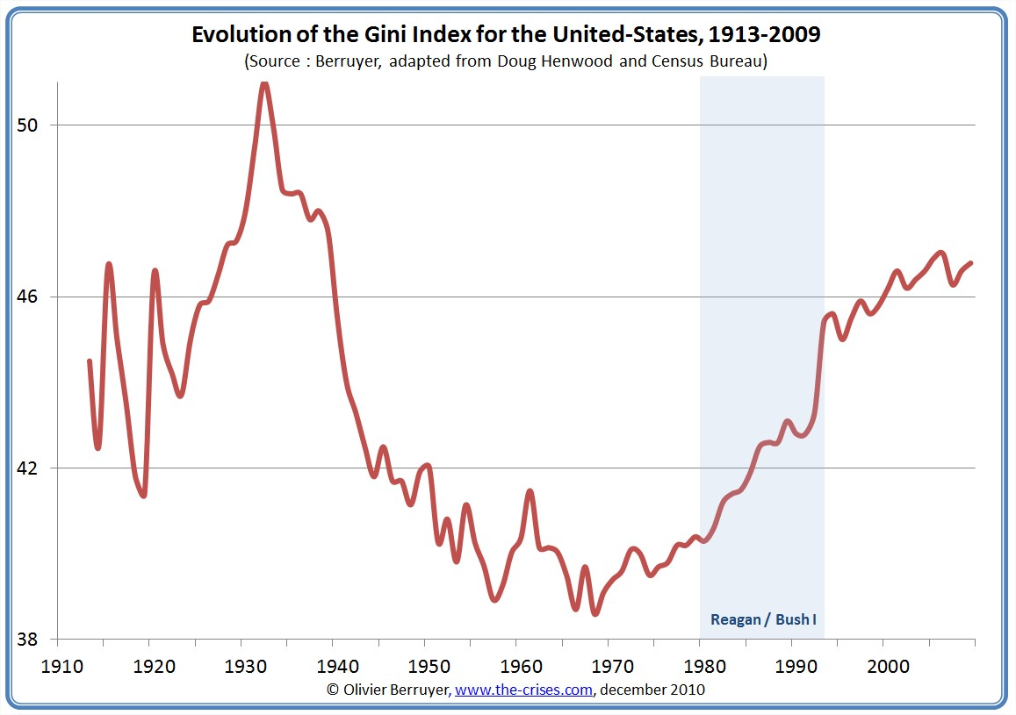

Slide 5
Infant Mortality Rates (CIA)
1 | Afghanistan | 117.23 | 2014 est.
2 | Mali | 104.34 | 2014 est.
3 | Somalia | 100.14 | 2014 est.
4 | Central African Republic | 92.86 | 2014 est.
5 | Guinea-Bissau | 90.92 | 2014 est.
6 | Chad | 90.30 | 2014 est.
7 | Niger | 86.27 | 2014 est.
8 | Angola | 79.99 | 2014 est.
9 | Burkina Faso | 76.80 | 2014 est.
10 | Nigeria | 74.09 | 2014 est.

Slide 6
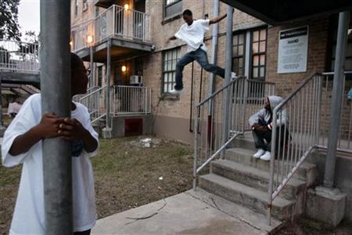
Housing Segregation
Throughout the 20th century, African Americans have endured more housing segregation than any other racial group. This is still true today.

Slide 7



Social Inequality
(Top 5) High Prestige Jobs (what do you think these
are?)
1.
2.
3.
4.
5.

Slide 8

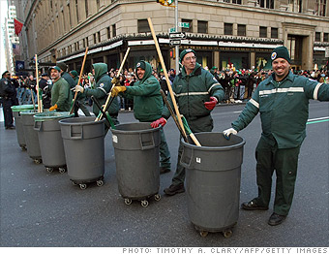
(Bottom 5) Low Prestige Jobs (what do you
think?)
1.
2.
3.
4.
5.

Slide 9
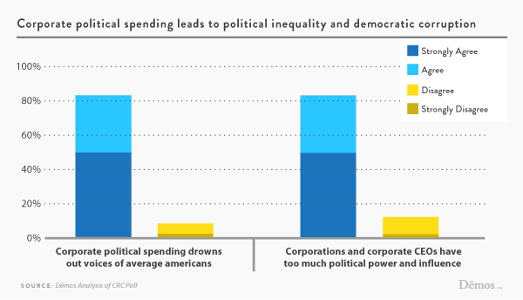
Political Inequality: Power and Authority
*Gaining access to politicians through campaign contributions
($123,200 bi-annually from an individual – 2012-13 election cycle)
*Super PACs (political action committees) Ex: in 2012 – Sheldon Adelson donated 91.8 million to conservative superPACs

Slide 10

For Next time:
Read your syllabus– let me know if you have questions!
Make sure you can access the Blackboard site and BSU email
The “real work”
Do the assigned readings for next
class (and take notes)
Review your first written assignment
(guidelines posted).

