Slide 1
Better Vaccination Policies
Instructor:
Student Name:
Student id:

Slide 2


Slide 3
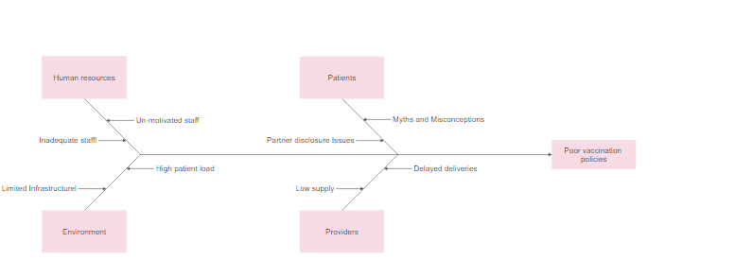

Slide 4
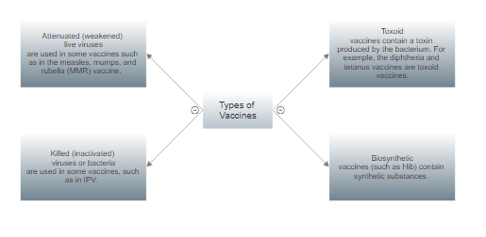

Slide 5
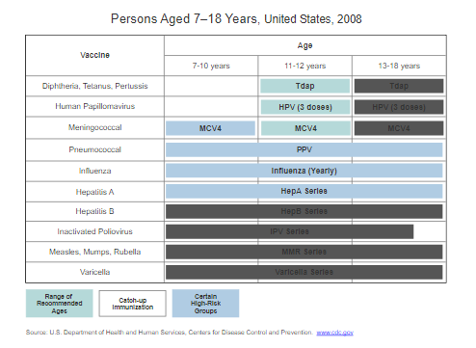

Slide 6


Slide 7
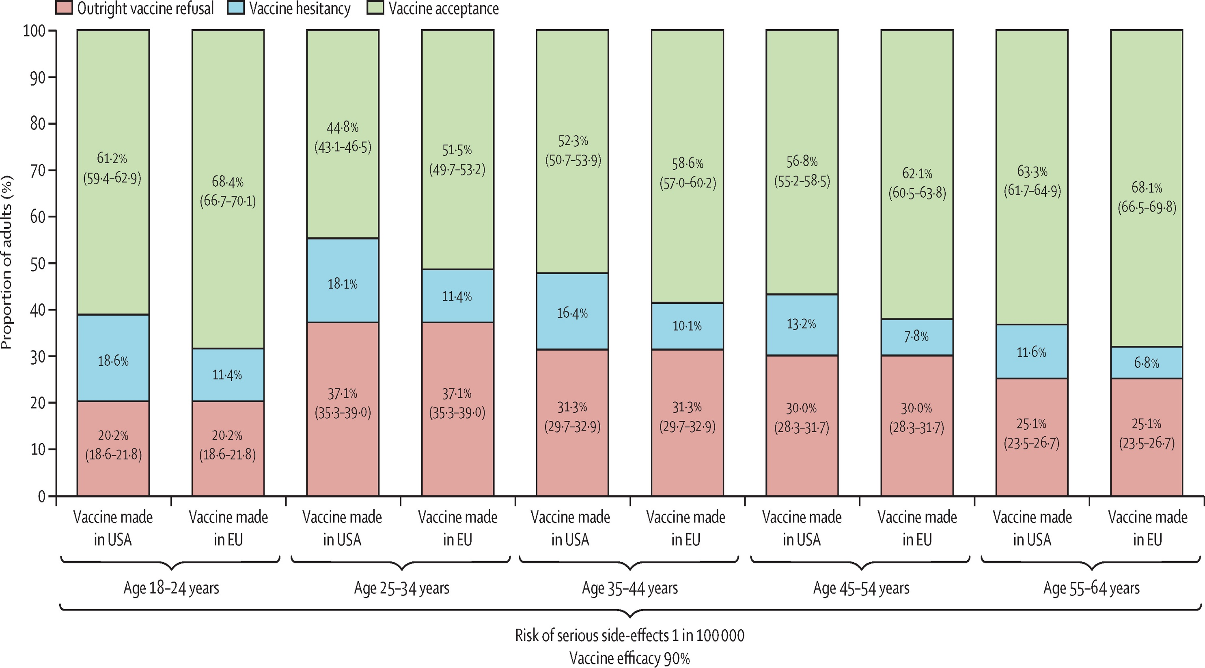

Slide 8


