Slide 1
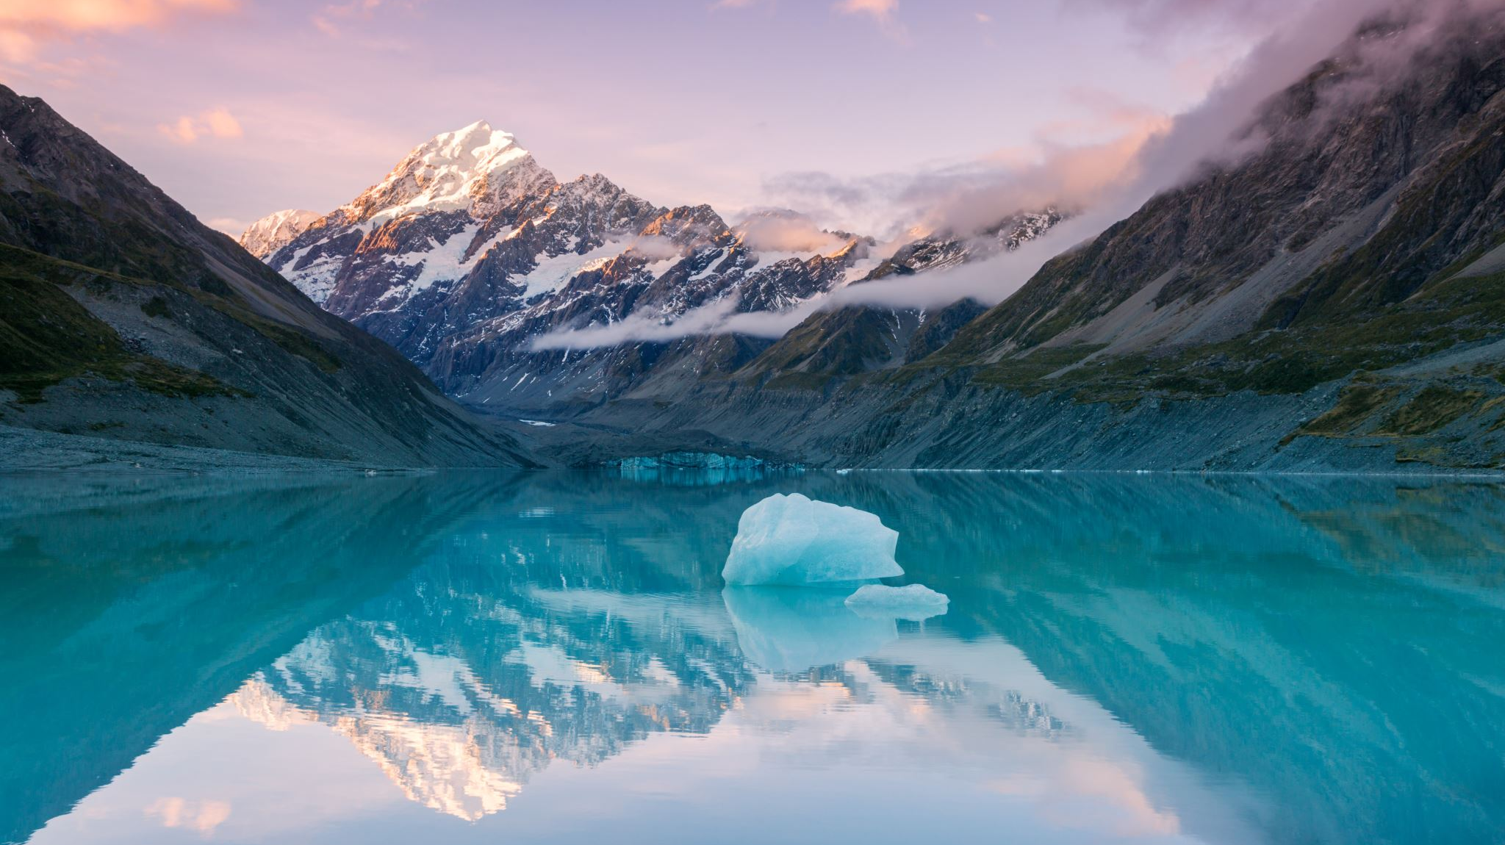

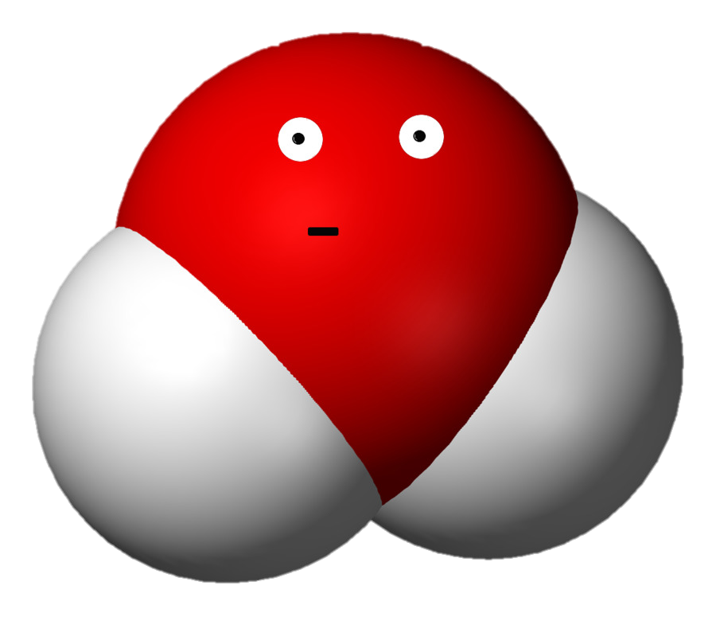
Journal Logs
July 4, 2009
November 11, 2013
May 27, 2015
September 30, 2019
R, WATT E.

Slide 2
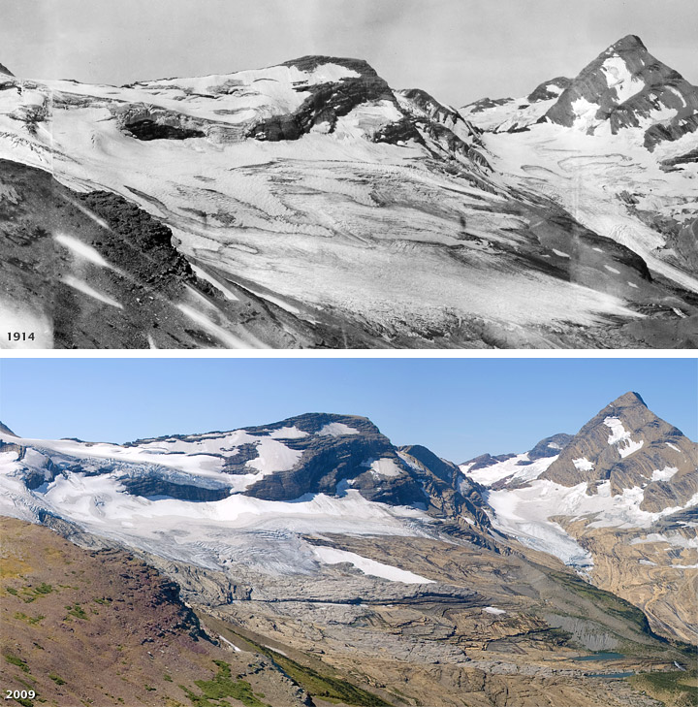
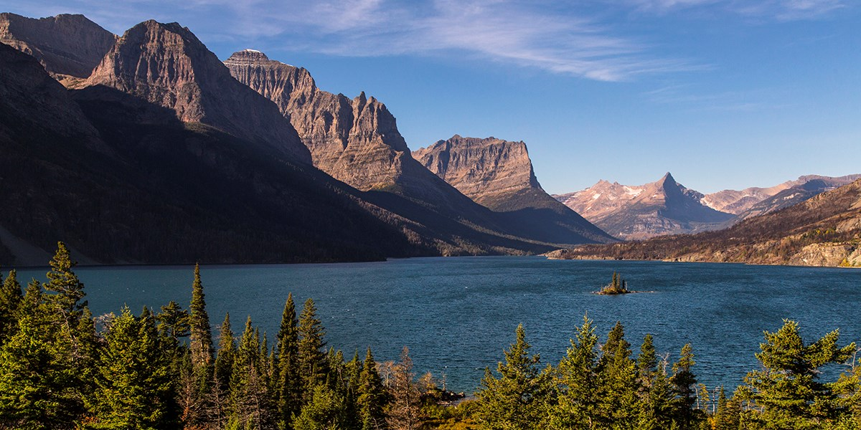
The Beginning
I was frozen in ice in Glacier National Park in Montana, U.S.A.
Then, due to global warming, my kin and I found ourselves melting. It was July 4, 2009.
From our solid state as ice, we were now liquid water in St. Mary’s Lake.
We spent quite some time together in the lake, but over time those of us in the surface started evaporating into water vapor, and soon it was my turn.
Notes:
References:
https://earthobservatory.nasa.gov/features/Water/page2.php
https://www.nps.gov/glac/planyourvisit/openingplan.htm

Slide 3
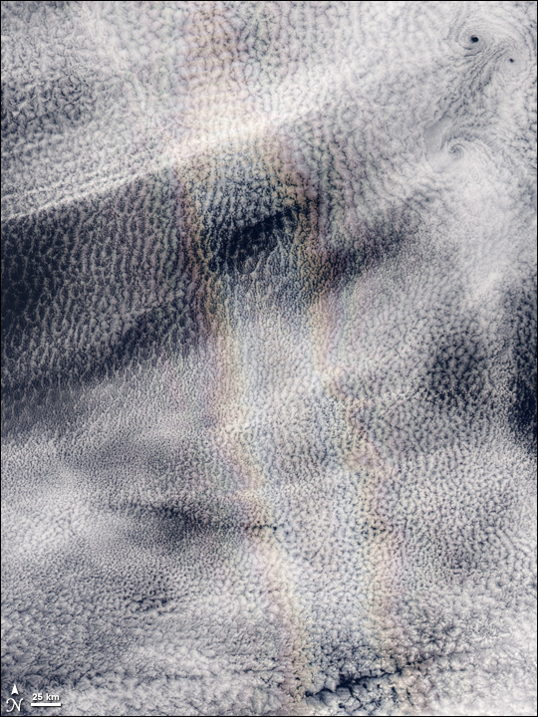
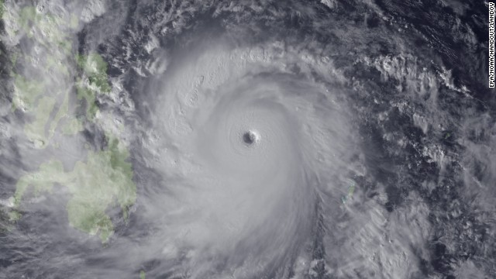
The Pacific Ocean and Asia
We travelled as condensed clouds and eventually made our way over the great Pacific Ocean. I don’t mean to brag, but we do look photogenic, don’t we? Anyway, we didn’t last long as clouds. Eventually, we fell as rain on the Pacific Ocean, and I found myself surrounded by even more of my kin. This was perhaps the longest part of my trip, as I spent years in the Pacific Ocean. The ocean currents eventually took us closer to Asia, and on November 3, 2013, we began to vaporize and form the Typhoon Haiyan. Some of us fell as torrential rains in the Philippines, Southern China, Taiwan, and Vietnam. I was one of the last to leave, as I fell as rain in Guanxi, China on November 11, 2013.
Notes:
References:
https://earthobservatory.nasa.gov/images/8805/glory-over-pacific-ocean-clouds
http://edition.cnn.com/2013/11/07/world/asia/philippines-typhoon-haiyan/index.html
https://www.worldvision.org/disaster-relief-news-stories/2013-typhoon-haiyan-facts

Slide 4
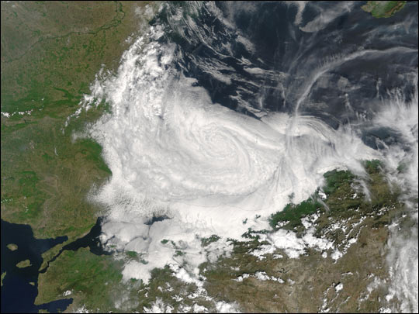
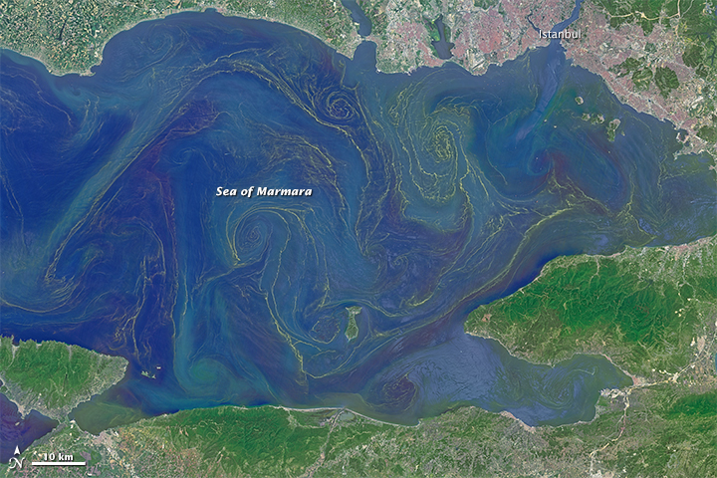
Europe
I travelled for a couple more years from one place to another, evaporating from one place and falling as rain on another country. Eventually, I evaporated from Turkey and fell as rain over the Black Sea, and travelled through the Bosphorus Strait into the Sea of Marmara. I had finally made my way to Europe on May 27, 2015.
Notes:
References:
https://earthobservatory.nasa.gov/images/4469/clouds-over-the-black-sea
https://earthobservatory.nasa.gov/images/85947/blooms-in-the-sea-of-marmara

Slide 5
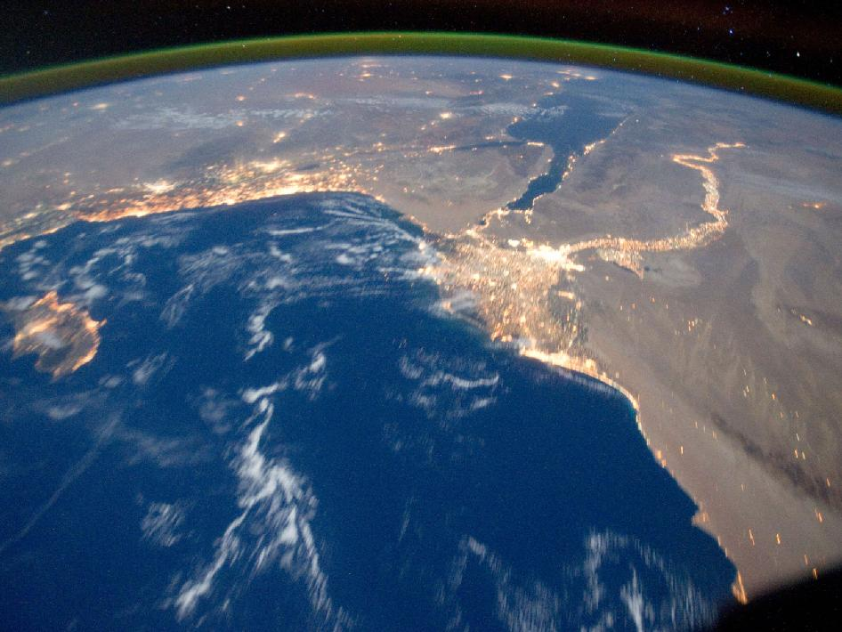
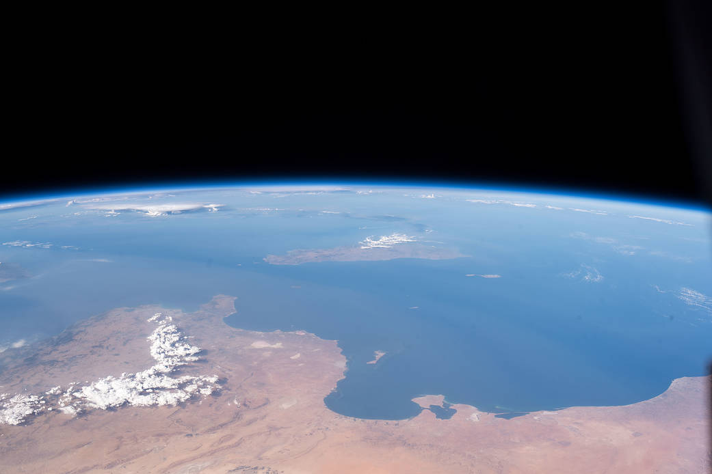
Africa
From the Sea of Marmara, I made my way through the Strait of Dardanelles, into the Aegean Sea and finally the Mediterranean Sea. Lots of other water molecules were in this place, so I stayed in this place for quite a while before once again changing states. From the surface of the Mediterranean Sea, I evaporated and condensed into clouds over Africa (NASA just takes wonderful pictures). Of course, I fell as rain over Africa on September 30, 2019 (Wasn’t a famous song about Africa released on this date?).
Notes:
References:
https://www.nasa.gov/mission_pages/station/multimedia/gallery/iss029e031157.html
https://www.nasa.gov/image-feature/viewing-the-mediterranean-coasts-of-tunisia-and-libya-from-the-space-station

Slide 6
Works Cited
Blooms in the Sea of Marmara. (n.d.). Retrieved June 16, 2020, from https://earthobservatory.nasa.gov/images/85947/blooms-in-the-sea-of-marmara
Clouds over the Black Sea. (n.d.). Retrieved June 16, 2020, from https://earthobservatory.nasa.gov/images/4469/clouds-over-the-black-sea
Dunbar, B. (n.d.). Mediterranean Sea Area. Retrieved June 16, 2020, from https://www.nasa.gov/mission_pages/station/multimedia/gallery/iss029e031157.html
Glacier National Park Reopening Plan. (n.d.). Retrieved June 16, 2020, from https://www.nps.gov/glac/planyourvisit/openingplan.htm
Glory Over Pacific Ocean Clouds. (n.d.). Retrieved June 16, 2020, from https://earthobservatory.nasa.gov/images/8805/glory-over-pacific-ocean-clouds
Mullen, J. (2013, November 8). Super Typhoon Haiyan, one of strongest storms ever, hits central Philippines. Retrieved from http://edition.cnn.com/2013/11/07/world/asia/philippines-typhoon-haiyan/index.html
Reid, K. (2020, June 5). 2013 Typhoon Haiyan: Facts, FAQs, and how to help. Retrieved from https://www.worldvision.org/disaster-relief-news-stories/2013-typhoon-haiyan-facts
Smith, Y. (2019, July 30). Viewing the Mediterranean Coasts of Tunisia and Libya from the Station. Retrieved from https://www.nasa.gov/image-feature/viewing-the-mediterranean-coasts-of-tunisia-and-libya-from-the-space-station
The Water Cycle. (n.d.). Retrieved June 16, 2020, from https://earthobservatory.nasa.gov/features/Water/page2.php

