Slide 1
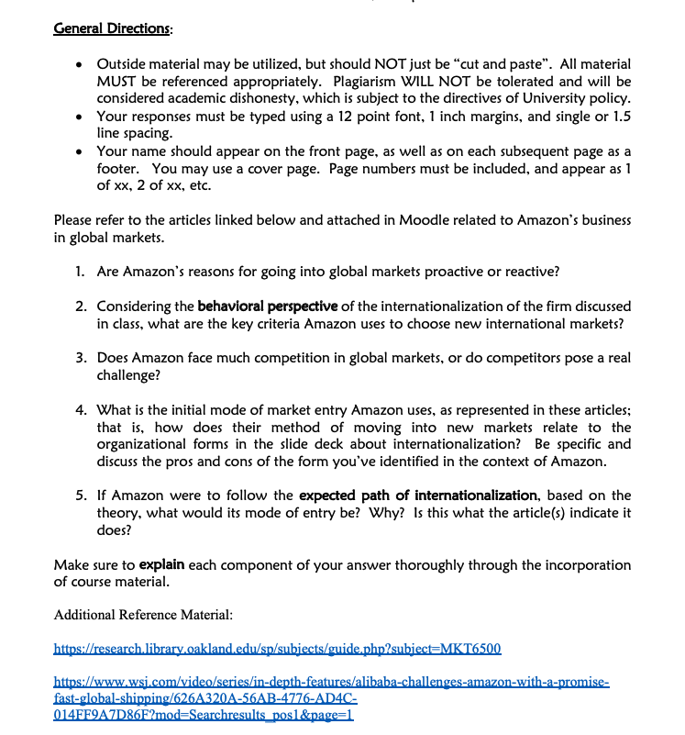

Slide 2
Articles for reference
ARTICLE 1: next page

Slide 3


Slide 4


Slide 5
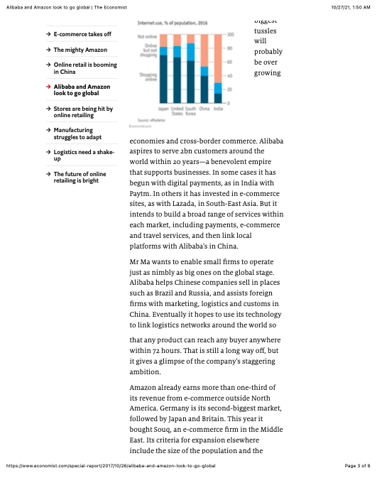

Slide 6
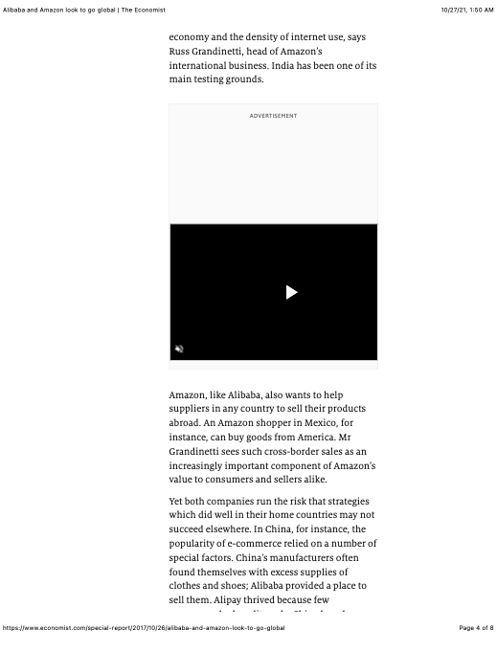

Slide 7
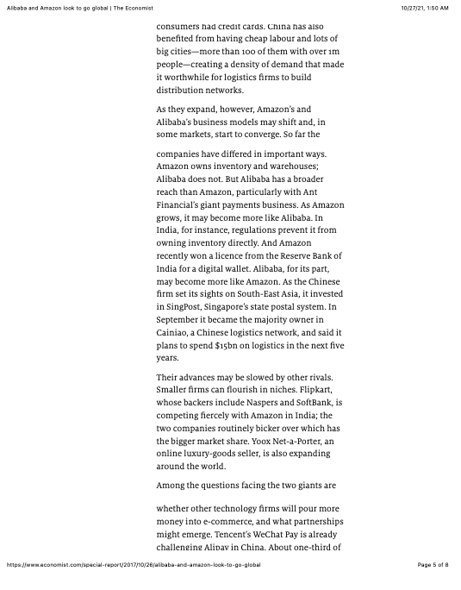

Slide 8
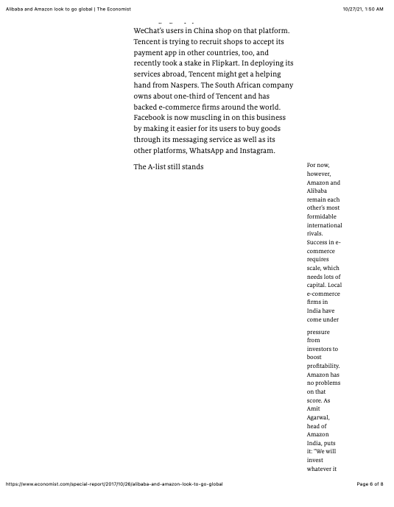

Slide 9
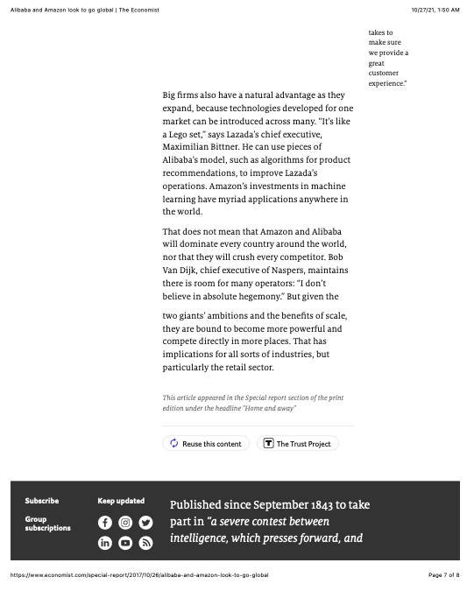

Slide 10
Articles for reference
ARTICLE 2: next page

Slide 11


Slide 12
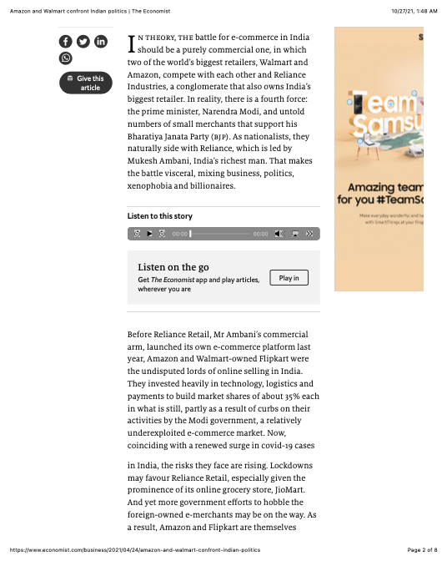

Slide 13
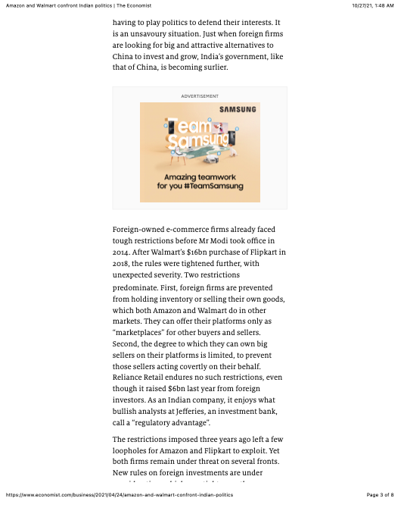

Slide 14


Slide 15
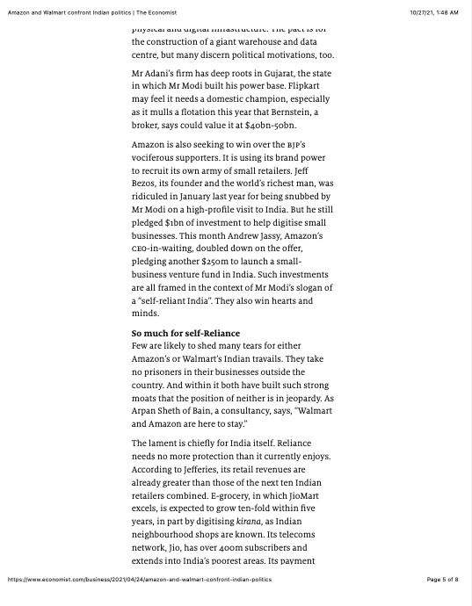

Slide 16


Slide 17
ARTICLE 3:

Slide 18


Slide 19


Slide 20
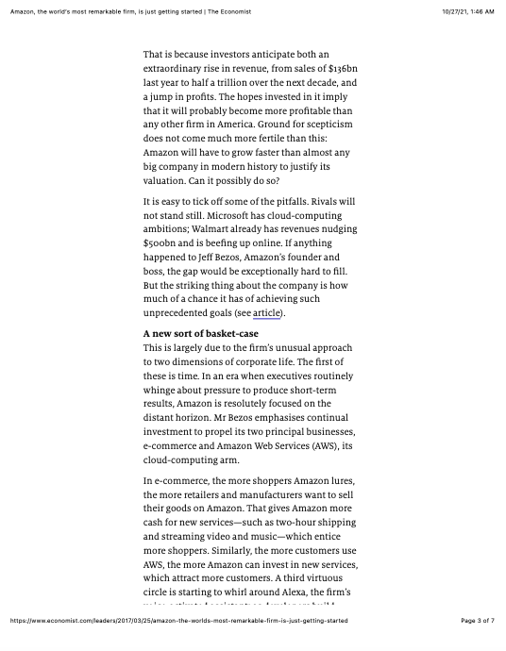

Slide 21
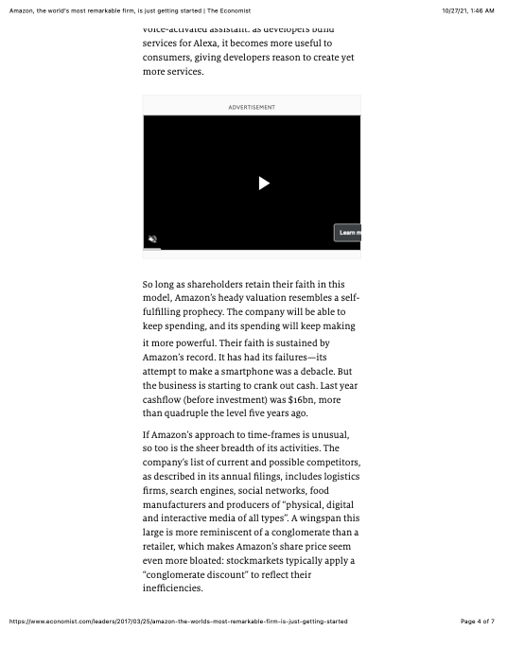

Slide 22
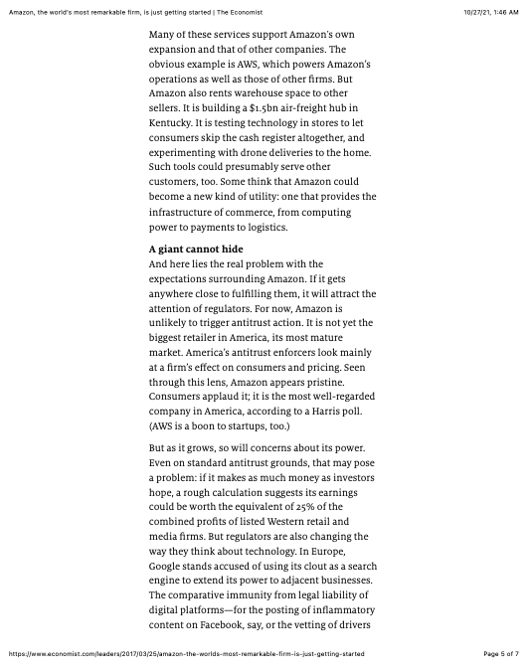

Slide 23


