Slide 1
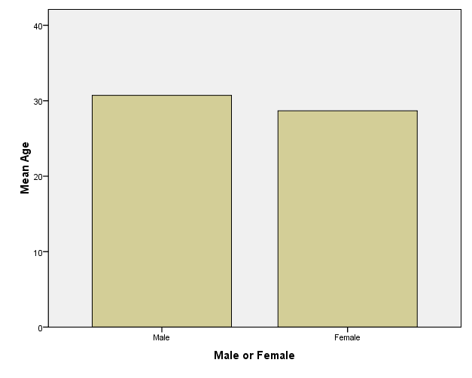
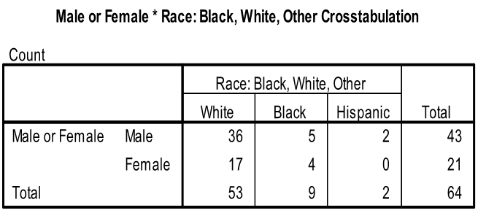
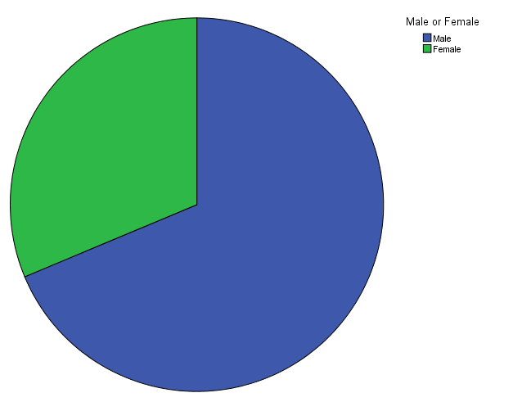
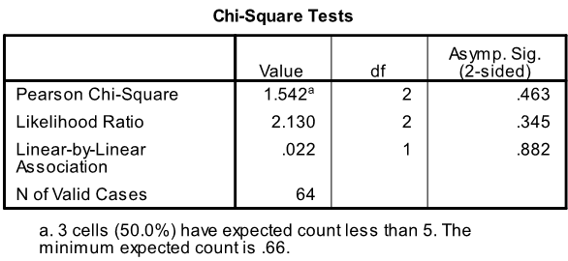
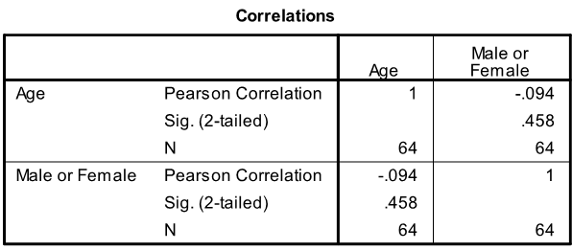
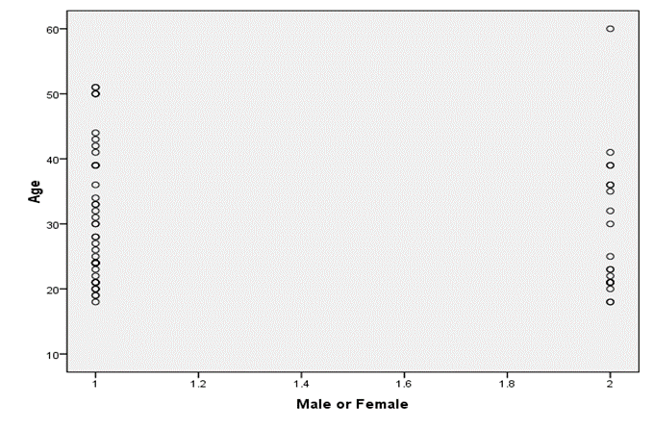
Hypothesis 1: There is no difference between the mean age of female and male.
Variable | Measurements
Age | Scale
Gender | Ordinal
The chi-square test shows that there is no significance difference in the cross tabulation between gender and race.
. The t-test shows there is a significant difference in the mean age between the males and females
 | mean | Std | Confidence intervals
Education | 1.8730 | 0.9587 | 1.60 | 2.99
HandgunExp | 2.300 | 2.793 | 1.6316 | 2.1148
Hypothesis 1 is rejected by t-test analysis between the mean age of female and male. The t-test results show that the relationship has a p-value of 0.458 hence the differences are significant at 95% significance level.

