Slide 1
Decision Making in Automotive Industry
Student Name
Institution Affiliations
Date

Slide 2
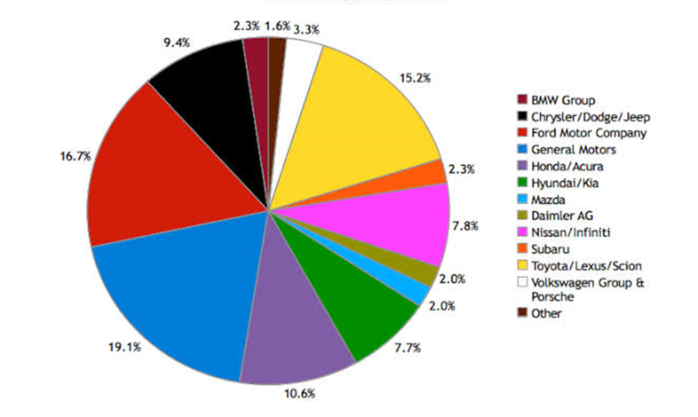
US Automotive Manufacturing Industry
Notes:
The current state of the U.S. automotive manufacturing industry
The US automotive industry comprises of light vehicles accounting for almost 96% of the total vehicles sold in the country (Wagner, 2021). With the Covid-19 outbreak, the industry experienced drastic drop in the automotive industry. the current car and automobile manufacturing market size is US$ 82.6 Billion (IBIS World, 2021).

Slide 3
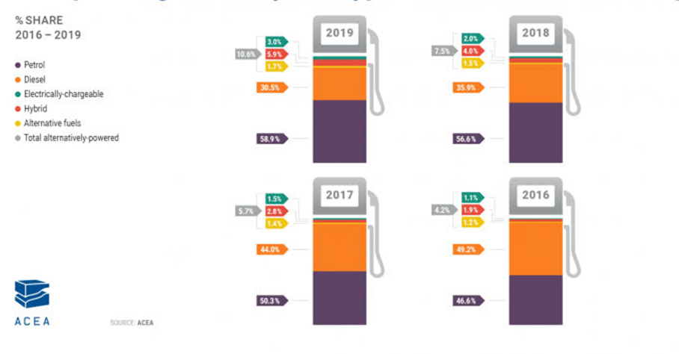
Automotive Fuel Types
Notes:
Trends in Sales by fuel type
The main automobile in the car industry are the light trucks that operate on gasoline-fueled engines (ICE). Cars also use gasoline making it to have a market share of about 52% (Wagner, 2021). Besides, some cars and light trucks consume alternative fuels such as diesel.

Slide 4
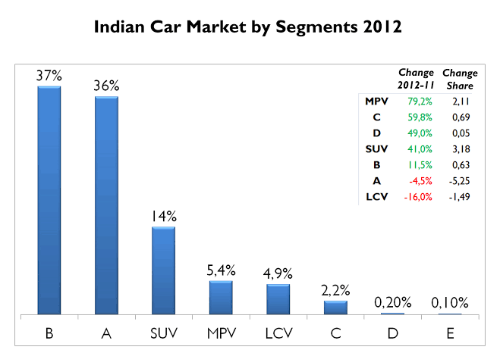
Automotive Types
Notes:
Current automotive industry trends
Most companies in the automotive manufacturing industry in the US are involved in the production of mid-sized and large sedans with compact and non-compact passenger cars and luxury vehicles. In the recent past five years, the performance of the industry has been strong and indicates an upward positive growth (IBIS World, 2021).

Slide 5
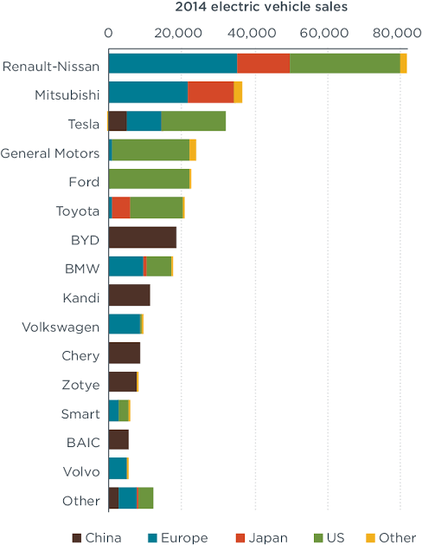
Electric Car Manufacturers
Notes:
The major automobile industries mainly manufacture electric cars.
The major electric car manufacturers in the United States include American Honda Co. BMW North America, Ford Motor Co., General motors, Hyundai, Mazda and Tesla Inc.

Slide 6
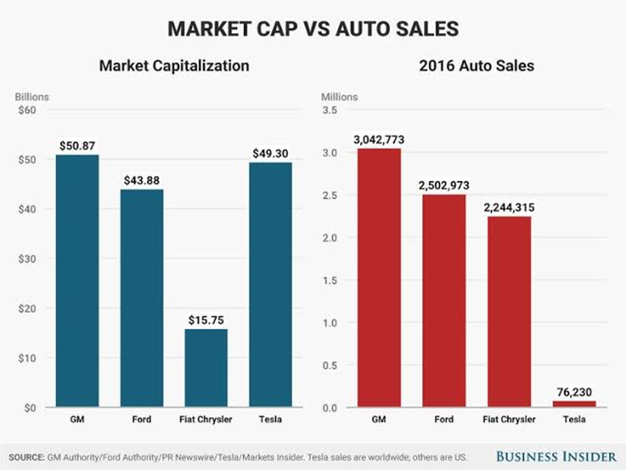
Types of Vehicles Sold
Notes:
Trends in the body types of vehicles sold
The largest automobiles manufacturing companies in the United States are Honda, Toyota, Tesla Inc, and Ford Motor Companies among others. These companies mainly manufacture cars and automobile chassis. Light trucks such as SUVs, vans, cars, and pick-ups are the most manufactured. Heavy trucks and motorcycles are excluded from the US automobile industry. vehicle types include compact and subcompact cars, mid-size sedans, large cars, luxury cars and sonstiges.

Slide 7
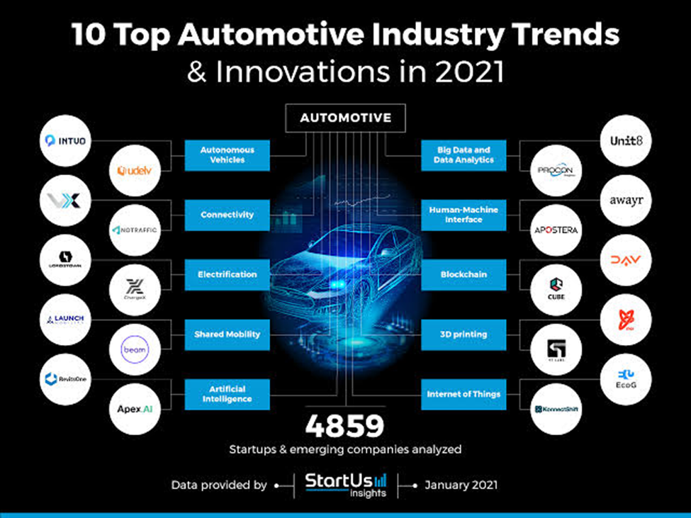
Types of Products and services Offered
Notes:
Trends in the new industry Expected growth areas Sales by type of products or services offered
With the changing technology, there has been a shift in the production of vehicles from fuel emission automobiles to production of electric vehicles. Also, the growth in environmental concerns have resulted in the establishment of electric vehicle with fuel efficient engines.

Slide 8
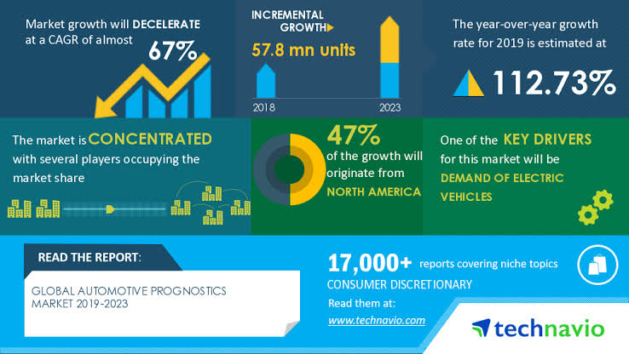
Customer demands
Notes:
Trends in customer demands
Trends in consumption of automobiles are highly evolutionary. Car owners rely on changing technologies to maintain safety while new buyers rely on comfort speed and safety. The recent studies by (Andres Laya, 2020) indicate that car ownership among the younger generation has declined in the country. despite the decline in interests, 76% of Americans still thinks important to own cars for their abilities to perform different chores and activities.

Slide 9
DECISION-MAKING MODELS
The Rational Model
The Intuitive Model
The Recognition-Primed Model

Slide 10
a) The Rational Model
The rational decision-making model makes use of objective data and logical analysis instead of subjectivity and intuition to solve problems.
Steps in Rational Decision-Making process
Verify and define the problem
Research and brainstorm on possible solution
Set standards for both success and failure of the solutions
Outline potential results for each solution
Choose and test the best solution
Track and analyze the results of the test
Implement the solution if the test is successful, else, test a new one.
Notes:
The Rational Model
The rational decision-making model makes use of objective data and logical analysis instead of subjectivity and intuition to solve problems.
Steps in Rational Decision-Making process
Verify and define the problem
Research and brainstorm on possible solution
Set standards for both success and failure of the solutions
Outline potential results for each solution
Choose and test the best solution
Track and analyze the results of the test
Implement the solution if the test is successful, else, test a new one.

Slide 11
b) The Intuitive Model
The Intuitive decision-making model involves making decisions based on intuition rather than rational.
Psychological research shows that part of the brain works simultaneously with the human conscious thoughts, acts and intelligence system.
Through guided experience, intuition can be properly used to make desirable decisions.
Decision failure will have little consequence, and intuition provides a quick selection.
Intuitive decisions are simple, unimportant, and in many cases may result in habit.
Decisions that involve emotions are often subject to a fair amount of intuition and play a major role in personal relationships.
Emotions can change, and intuition can no longer generatee the outcomes you expect.
Notes:
The Intuitive Model
The Intuitive decision-making model involves making decisions based on intuition rather than rational. Psychological research shows that part of the brain works simultaneously with the human conscious thoughts, acts and intelligence system. Therefore, when guided by experience, intuition can be properly used to make desirable decisions. Starting with the easy case, it certainly is reasonable to use intuitive decision making for trivial or low value decisions. Decision failure will have little consequence, and intuition will provide for a quick selection. These decisions are simple, unimportant, and in many cases may result in habit. Decisions that involve emotions are often subject to a fair amount of intuition and will often play a major role in personal relationships. However, emotions can change, and when relationships run into difficulty, do not be surprised if your intuition is no longer generating the outcomes you expect.

Slide 12
c) The Recognition-Primed Model
This is a decision-making approach that functions in situations that require quick essential, poorly defined goals and incomplete information.
Steps in Recognition-Primed Model
Experience the Situation
Analyze the Situation
Implement the decision
In Recognition-Primed model, decisions are made based on a mentally developed model through experience.
Notes:
The Recognition-Primed Model
This is a decision-making approach that functions in situations that require quick essential, poorly defined goals and incomplete information.
Steps in Recognition-Primed Model
Experience the Situation
Involves taking in all the possibilities of solving a situation. Appropriate decisions cannot be made at this step, and hence, data gathering through listening to the involved parties and accessing the urgency level required.
Analyze the Situation
Involves basic understanding of the problem and formulating ways to provide solutions. Also at this level, one needs to select the best move which will facilitate development of positive resolutions.
Implement the decision
This step entails timely delivery of decision made and provision of ways to implement the decision. Besides, assessment of the practicalities and the specialists required to facilitate the implementation of the made decisions.
In Recognition-Primed model, decisions are made based on a mentally developed model through experience.

Slide 13
Conclusion
Of the three decision making models, the most efficient for making a conclusion about the US automotive manufacture industry is the Recognition-Primed decision model. Decisions are based on a mental model that has been developed through experience rather than by considering a series of alternative courses of action.
The mental model used is based on cues and indicators that let them recognize patterns.
Based on these patterns and the decision they have to make, the decision maker will select the first course of action that is not rejected. This is known as an ‘action script’.
Notes:
Decisions are based on a mental model that has been developed through experience rather than by considering a series of alternative courses of action.
The mental model used is based on cues and indicators that let them recognise patterns.
Based on these patterns and the decision they have to make, the decision maker will select the first course of action that is not rejected. This is known as an ‘action script’.

Slide 14
References
Chi, C. (2021). Rational Decision Making: the 7-Step Process for Making Logical decisions. Accessed online at https://www.homeworkforyou.com/static_media/uploadedfiles/rational-decision-making.html
Management Books. (2021). Decision Making: The Recognition-Primed Decision Model. Accessed online at http://www.free-management-ebooks.com/news/recognition-primed-decision-model/
Matzler, K., Ballom, F. and Mooradlan, T. (2007, Fall). Intuitive Decision Making. MIT Sloan Management Review. Accessed online at http://sloanreview.mit.edu/the-magazine/files/pdfs/49108SxW.pdf

