Slide 1


Module #1, Pt. II: Introduction to basic concepts

Slide 2

Stratification – Unequal Layers
Do we all have the same chance for success?
What limits your chances?

Slide 3
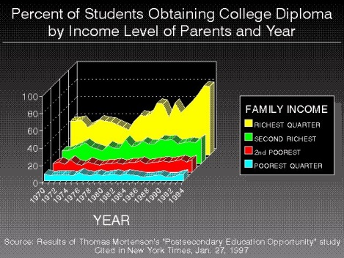
Stratification – Unequal Layers

Slide 4
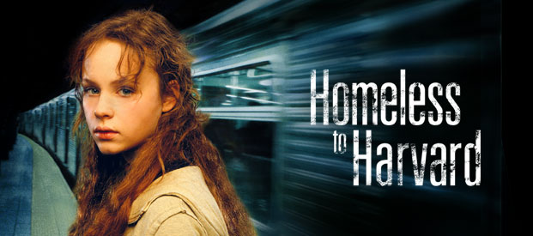
Systems of Stratification in Societies
Caste System: A closed system in which your rank is fixed at birth and for life. You are born into a caste – and you remain there.
Open Class System: An open system in which effort and ability determine position.

Slide 5
1. The College of William and Mary
George Washington (surveyor’s certificate)
Thomas Jefferson
James Monroe
John Tyler
2. Harvard University
John Adams
John Quincy Adams
Theodore Roosevelt
Franklin D. Roosevelt
John F. Kennedy
3. Princeton University
John F. Kennedy (transferred to Harvard)
James Madison
Woodrow Wilson
4. Yale University
Williams Howard Taft
George H.W. Bush
George Bush
5. United State Military Academy
Ulysses S. Grant
Dwight D. Eisenhower
IRONY of inequality
US – All created equal
Take a look at how many
Presidents come from
elite schools

Slide 6


Davis + Moore (Ch. 2)
STRATIFICATION IS NECESSARY – It motivates people to take certain jobs.
Training -> Rewards of positions

Slide 7

Highest Ranking Positions: greatest societal rewards, highest degree of training or talent.

Slide 8
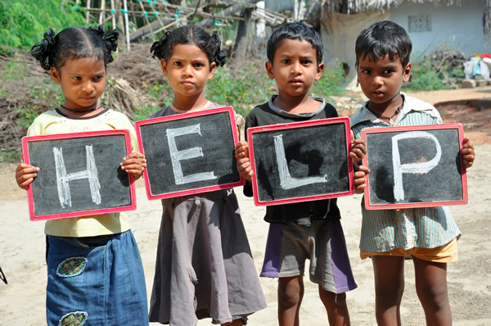
Ch. 3 – Fischer, et. al.
Why do some people succeed?
Why are societies more/less stratified?
Who gets ahead/falls behind = a function of social environment.

Slide 9
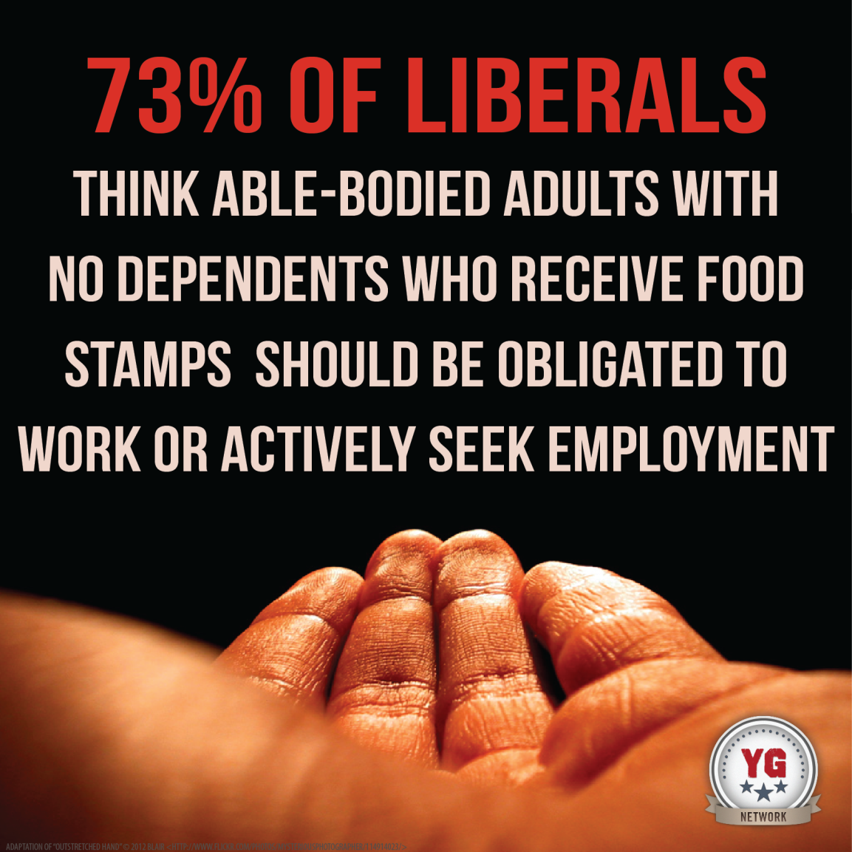

Policies shape the structure of rewards
Welfare policy
Education

Slide 10
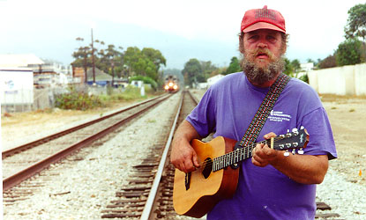
SUCCESS or FAILURE – PERSONAL ATTRIBUTES

Slide 11

Ch. 4 – Krueger
What is the right balance b/w incentives and harm?

Slide 12


Education and Training

Slide 13
https://www.ted.com/talks/timothy_bartik_the_economic_case_for_preschool#t-281283

Slide 14
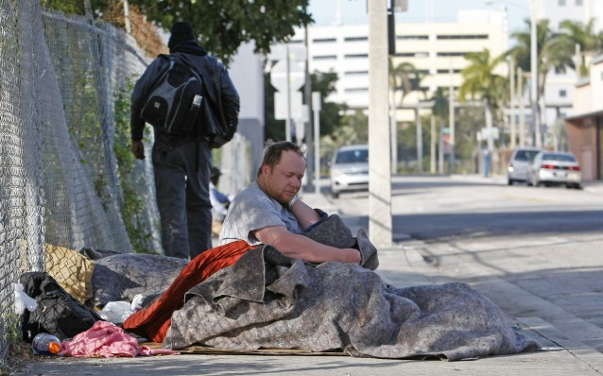
Economic vs. Moral Arguments
Poverty
Leaving Homeless Person On The Streets: $31,065. Giving Them Housing: $10,051.

Slide 15

In Massachusetts:
*Over 1,800 families are living in motel rooms
*4,800 families are living in shelters statewide
(this is more than 100% increase since 1990)
*3,000 children are living in emergency shelters
IRONY: It is LESS EXPENSIVE to provide housing than shelter

Slide 16
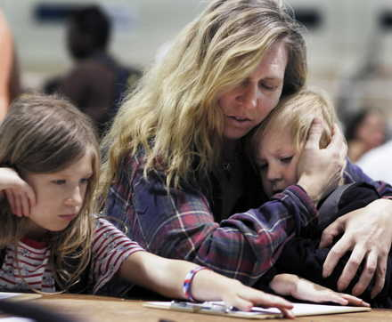
SHELTER costs an average of $3,000 per month
SUBSIDIZED HOUSING costs an average of $1,200 to $2,000 per month

Slide 17
This concludes MODULE #1 – Please be sure to read thoroughly to write a convincing first essay!

