Slide 1
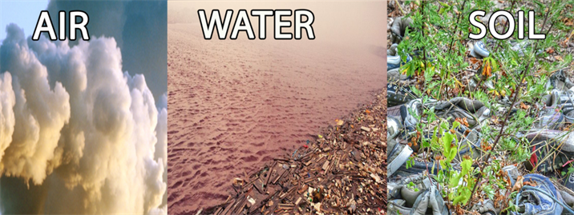
Importance of protecting quality of air, water, soil in order to maintain bio-diversity
Student’s Name
Professor’s Name
Date:

Slide 2
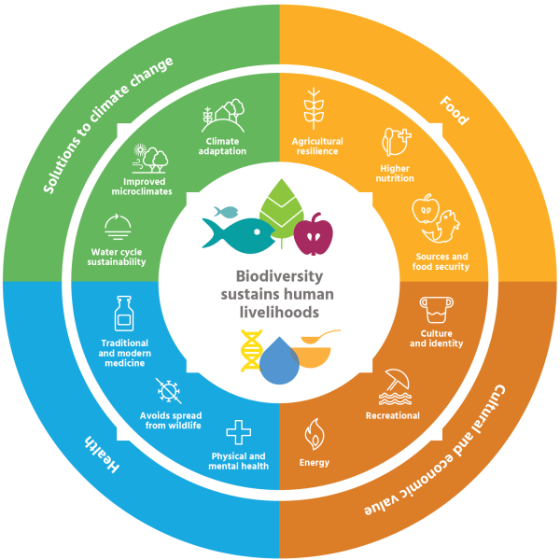
Notes:
Biodiversity sustains human livelihoods by offering solutions to climate change, health and cultural and economic values.

Slide 3

Agenda
Importance of Protecting quality of air
Importance of protecting quality of water
Importance of protecting quality of soil
Importance of maintaining biodiversity
Biodiversity protecting human and environment health

Slide 4

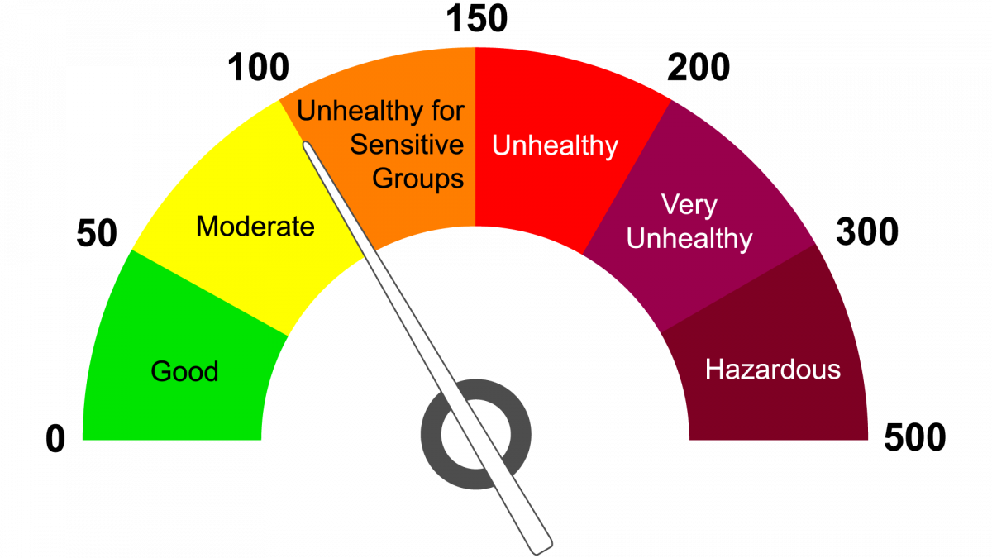
Importance of protecting quality of air
Reduced air affects health
Protecting acidification of ecosystem
Avoiding loss of biodiversity
Reducing global warming
Climate change
Notes:
Poor quality of air leads to long term and medium term effects effects such as heart diseases, lung cancer and other respiratory diseases. Protected air quality ensures that cases of acidic rain are reduced due to acidification of ecosystem. Poor quality air leads to loss of biodiversity like decline in number of species and biological communities in a given area.

Slide 5
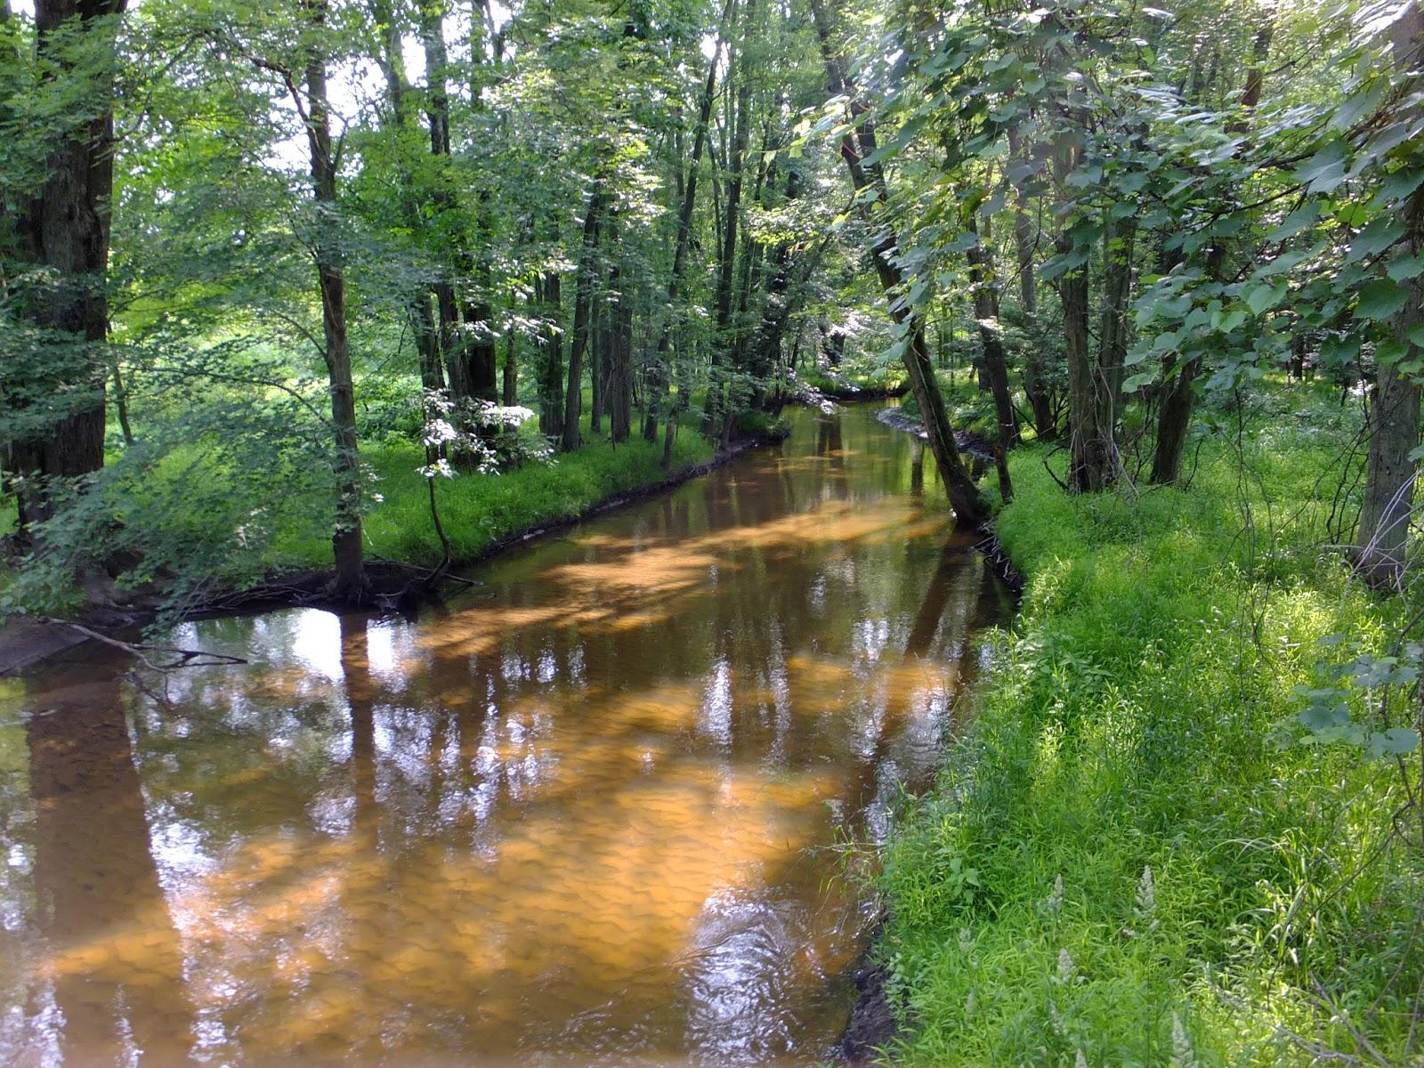
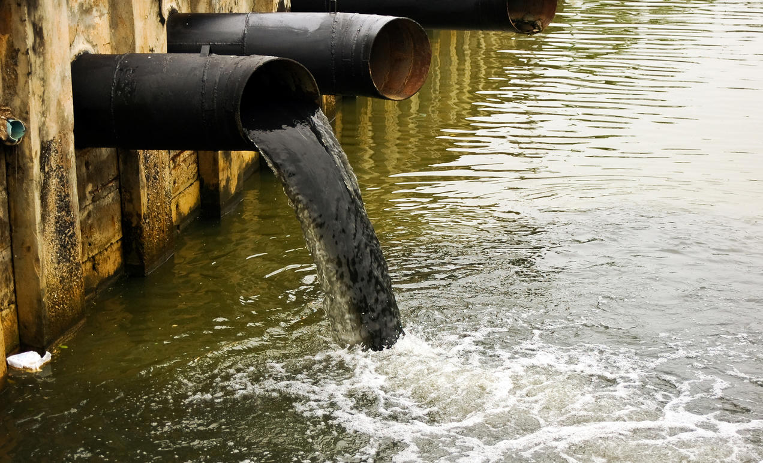
Importance of maintaining quality of water
Biodiversity
Positive impact on health
Improved economy
Cost to taxpayers
Potable water
Notes:
Water quality is a very significant topic to discuss when it comes to overall health. Poor quality water has direct impact on aquatic life. Excessive nutrients and other contaminants from water pollution affect organisms living in water. If quality of water is maintained economy will be improved because all industries depend on clean water. Cost to taxpayers will be reduced because a lot of resources from the taxpayers have been used in improving the quality of water. Potable water will be available if the quality of water is maintained.

Slide 6
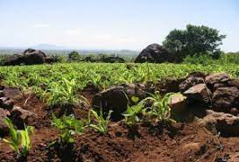
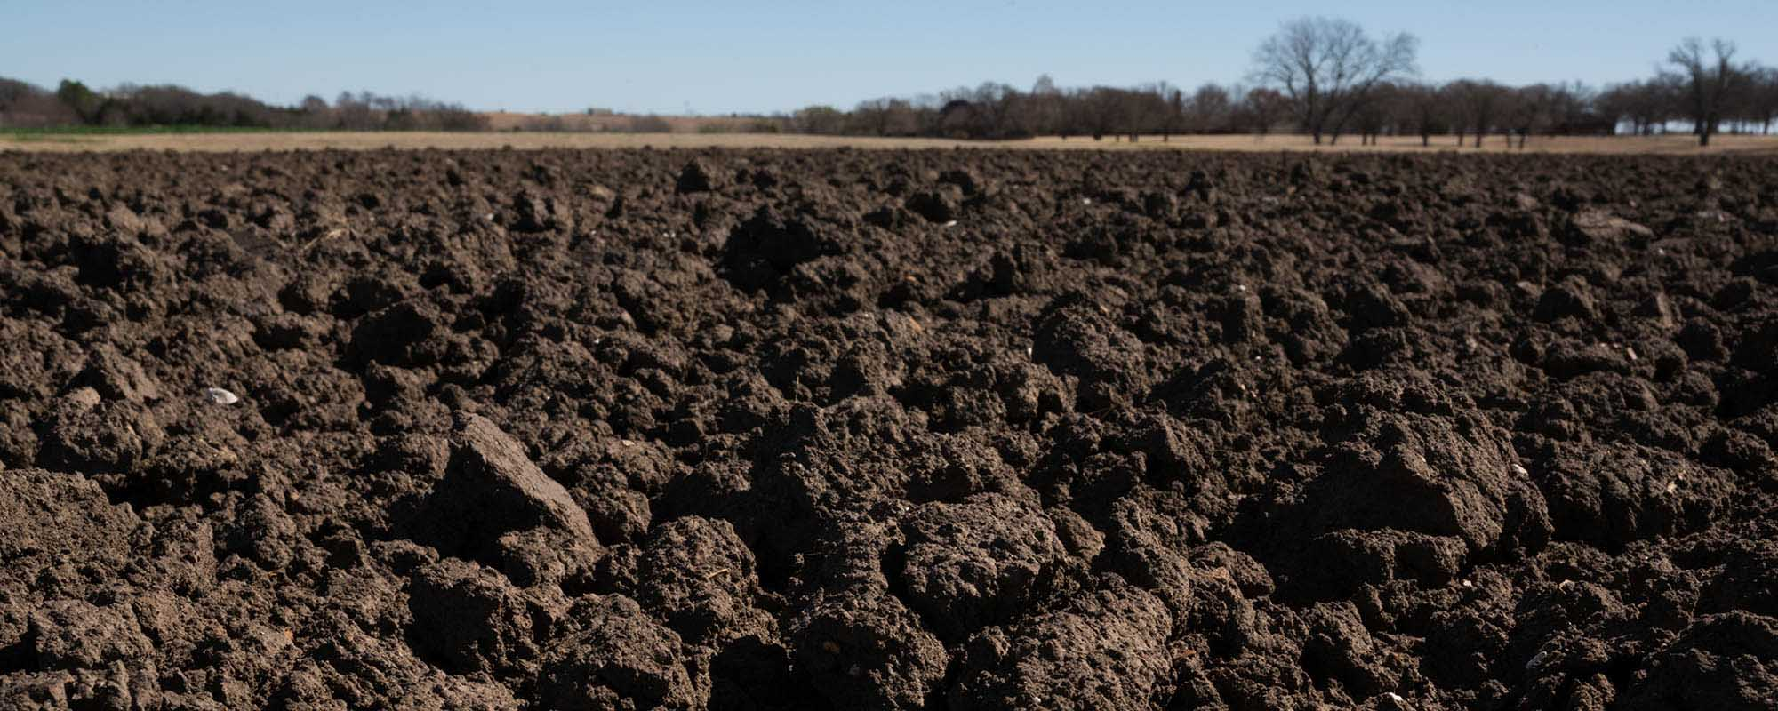
Importance of protecting quality of soil
Maximum efficiency in crop productivity
Quality green house gases
Reduced effects on human health
Increased soil fertility
Notes:
Soil is the source of all resources so the quality of the soil should be maintained. Soil free from pollution ensures that productivity of crops is greatly increased due to increased soil fertility. When certain substances such as heavy metals are in the soil they may be toxic to human beings(Raven & Wackernagel, 2020).

Slide 7
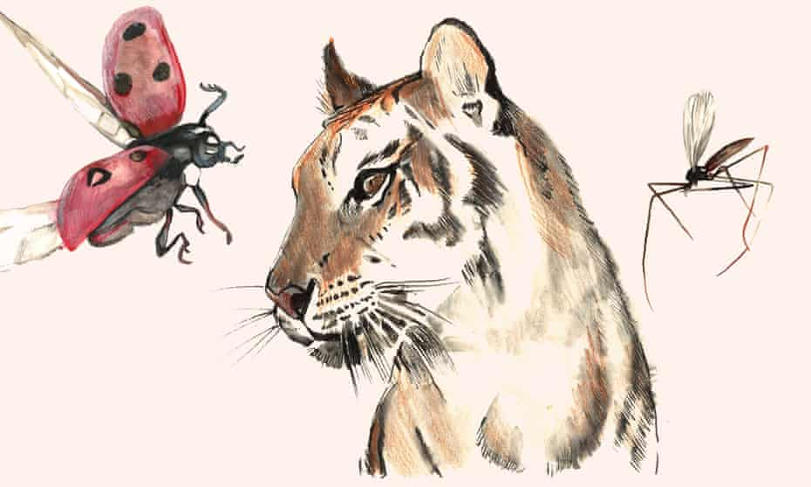
Importance of maintaining biodiversity
Boosts ecosystem productivity
Offers natural services
Species depend upon each other
Interdependent marine systems
Interdependence vs Human intervention
Notes:
Biodiversity improves the productivity in ecosystem, a large number of species ensures sustainability of all life forms(Ete, 2012).
A healthy biodiversity provides natural services for everyone. This ensures that water resources are highly protected and the nutrients storage is recycled.

Slide 8
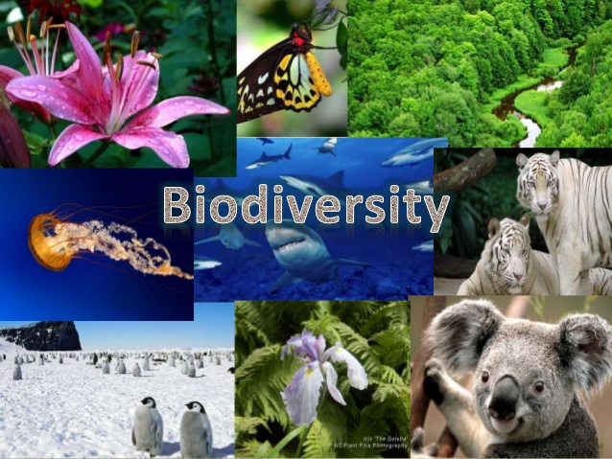
Biodiversity protecting human health and environment
Sustainable food production
Ecosystem and genetic diversity
Availability of traditional medicines
Ecological life support
Recreation
Notes:
Biodiversity provides many essential services to life on earth. Proper management of natural resources improves health in a community. Biodiversity supports human needs such as increased food production. Biodiversity loss can have a direct impact on ecosystem and human health.
Traditional medicine continue to play a key role in health care which relies on plants(Wood et al., 2014)
Biodiversity provides a functioning ecosystem that supplies clean water, clean air and other ecosystem services
Biodiversity provides unique recreation facilities to humans such as fishing and hiking

Slide 9
Conclusion
Biodiversity is the important indicator of a healthy ecosystem
Even though the ecosystem is affected by pollution the species may find a way to adapt
Biodiversity provides clean water, clean air to breathe and many ecosystem services

Slide 10
References
Ete. (2012). The Importance of Biodiversity. Ete.cet.edu. Retrieved 20 April 2021, from http://ete.cet.edu/gcc/?/biodiversity_importance/.
Raven, P., & Wackernagel, M. (2020). Maintaining biodiversity will define our long-term success. Plant Diversity, 42(4), 211-220. https://doi.org/10.1016/j.pld.2020.06.002
Wood, C., Lafferty, K., DeLeo, G., Young, H., Hudson, P., & Kuris, A. (2014). Does biodiversity protect humans against infectious disease?. Ecology, 95(4), 817-832. https://doi.org/10.1890/13-1041.1

