Slide 1

Nutrition & You
Fifth Edition
Chapter 12 Lecture
Consumerism and Sustainability: From Farm to Table
    Slides in this presentation contain hyperlinks. JAWS users should be able to get a list of links by using INSERT+F7
Copyright © 2020 Pearson Education, Inc. All Rights Reserved
Notes:
If this PowerPoint presentation contains mathematical equations, you may need to check that your computer has the following installed:
1) MathType Plugin
2) Math Player (free versions available)
3) NVDA Reader (free versions available)

Slide 2
Objectives for Chapter 12
12.1 Describe how food advertising and marketing affect your food choices.
12.2 Recognize where your food comes from.
12.3 Describe what factors contribute to a sustainable food system.
12.4 Describe the benefits and risks of using hormones, antibiotics, and pesticides in food production.
12.5 Describe the benefits and risks of using biotechnology, including genetic engineering, in agriculture.
12.6 Explain how food policy affects the foods that are available to you to buy and consume.
12.7 Recognize how label terms can help you know how food was produced.

Slide 3
How Do Advertising and Marketing Influence Your Food Choices?
As food consumers, we have influence over food industry, but advertising and marketing control many of our choices
Food companies spend close to $10 billion annually to promote their products
  Much promotion for nutritionally dubious products
  Advertising for fruits, vegetables almost nonexistent
    Yale Rudd Center for Food Policy and Obesity Fast Food Facts in 2012
      McDonald’s spent 3x as much advertising on products as did others advertising fruit, vegetables, bottled water, or milk
College-aged and young adults are increasingly targets of advertisers

Slide 4
Where Does Your Food Come From? (1 of 7)
Much of your food comes from small, family-run American farms
  To be a farm in the United States, must produce and sell at least $1,000 of agricultural products/year
  Just over 2 million farms, most in Midwest, Great Plains, California
    80,000 fewer farms in 2012 than in 2007, continues to decline
  Fewer than 960,000 American farmers (1% of population) produce food for population of 300+ million

Slide 5
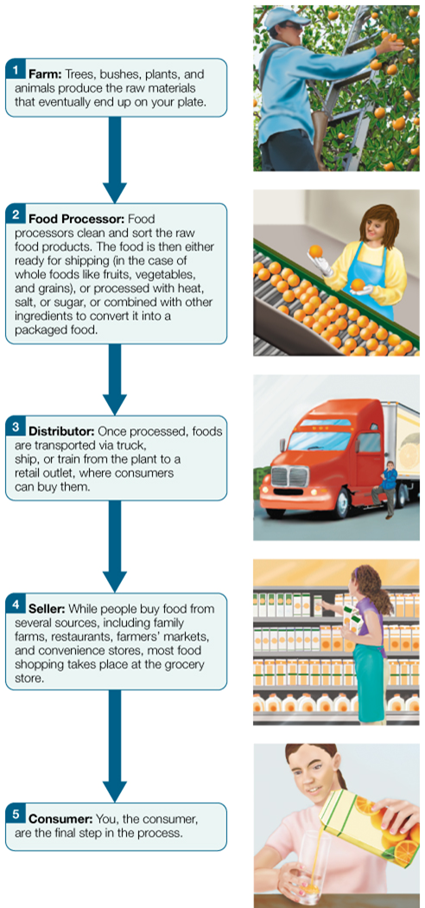
Figure 12.1 From Farm to Consumer

Slide 6
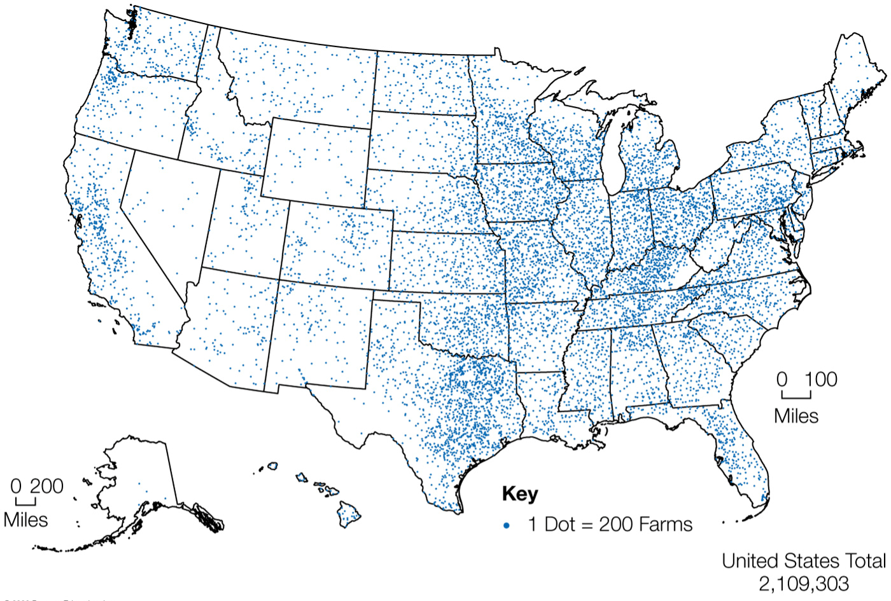
Figure 12.2 The Location and Number of Farms in the United States, 2012

Slide 7
Table 12.1 Types of Farms in the United States
Farm Type | Number of Farms | Percent of Total Farms
Small Family Farms | Small Family Farms | Small Family Farms
(annual sales less than $250,000) | 1,925,799 | 87.3
Large Farms | Large Farms | Large Farms
(annual sales greater than $250,000) | 278,993 | 12.7
Nonfamily | 91,177 | 4.1
Family | 187, 816 | 8.6
Total Farms in the United States | 2,204,792 | 100

Slide 8
Where Does Your Food Come From? (2 of 7)
Challenges of farming
  High costs
  Demand for low food prices
  Competition
  Dependence on nature's cooperation
Technology, government support aid farmers
  Computers, Internet allow for precision agriculture
  Government subsidies for commodity crops (e.g. corn, soybean, and wheat)

Slide 9
Where Does Your Food Come From? (3 of 7)
The role of agribusiness
  Agribusiness: blending of agricultural and business entities that affect how food, clothes, home goods are developed, processed, distributed, and purchased
    Food portion includes food production, agricultural chemicals, finance and trade, management, environmental considerations, land development
  Agriculture sector employs about 11 percent of U.S. population ~21 million Americans
    Food processing companies comprise large share

Slide 10
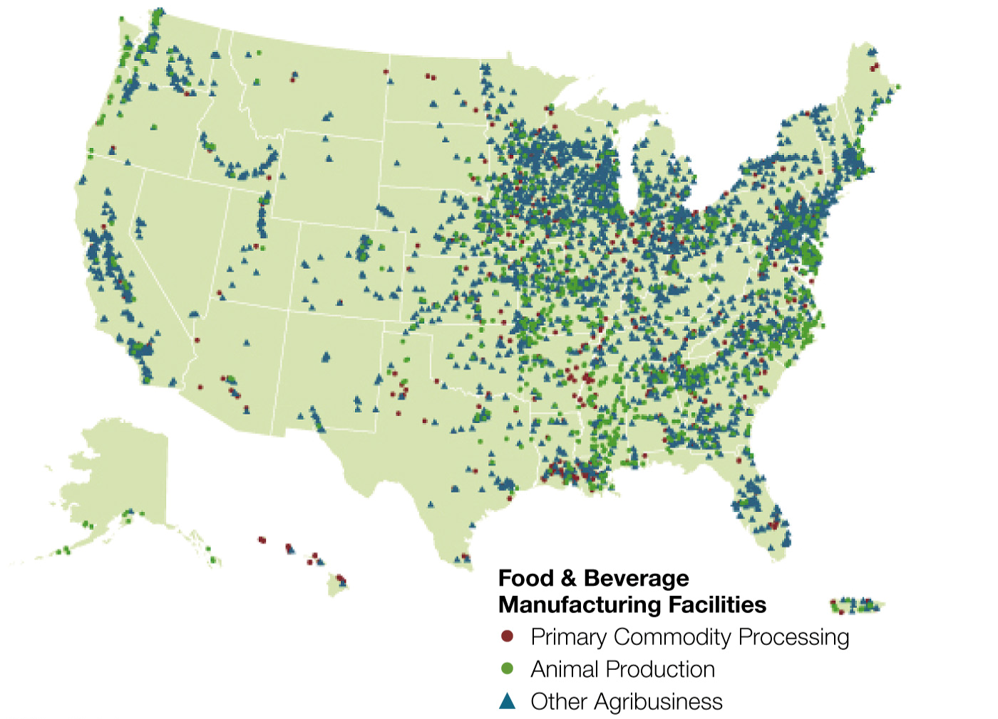
Figure 12.3 The Location and Number of Food- and Beverage-Processing Facilities, 2007

Slide 11
Where Does Your Food Come From? (4 of 7)
Crops grown for food
  Top three food crops in United States: corn, soybeans, wheat
    World's largest corn producer: 10 billion bushels from >400,000 farms in Corn Belt
      Most of the corn in the U.S. ends up as feed for livestock, poultry, and fish
    50 percent of world's soybeans from >290,000 U.S. farms
      70% of soybeans used to feed livestock
    13 percent of world's wheat from >160,000 farms in Great Plains
      70% used for food, 22% used for animal feed, rest used to replenish crops
  Most staple crops used for animal feed, not humans

Slide 12
Table 12.2 Major Agricultural Crops Produced in the United States, 2016
Crop | Harvested Area (millions of acres 2016)
Corn for grain | 86.7
Soybeans | 82.7
Hay | 53.5
Wheat | 43.8
Cotton | 9.5
Sorghum for grain | 6.1
Vegetables | 1.5
Source: https://www.nass.usda.gov/Publications/Ag_Statistics/2017/Chapter01.pdf

Slide 13
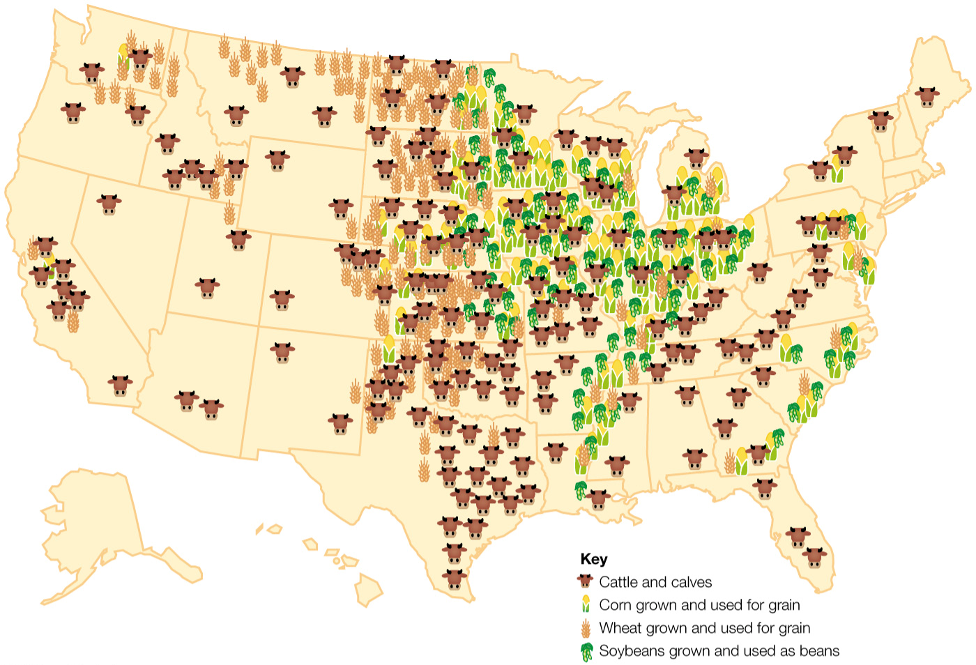
Figure 12.4 Major U.S. Centers of Cattle, Corn, Wheat, and Soybean Products

Slide 14
Where Does Your Food Come From? (5 of 7)
Animals raised for food on feedlots
  Dominant food animals in United States: cows, pigs, chickens
Exporting foods: the good and bad news
  U.S. farmers help feed world
    Estimated 30 percent of farm income from foreign trade
  Also exporting unhealthy eating habits
    Shift to high-calorie, high-fat, processed food diet
    Globesity (growing incidence of obesity worldwide) becoming a global threat

Slide 15
Where Does Your Food Come From? (6 of 7)
Food production outside the United States
  U.S. exports more agricultural products than it imports
    Most coffee, cocoa, and spices in the U.S. is imported from other countries
    Most coffee comes from Colombia and Brazil

Slide 16
Where Does Your Food Come From? (7 of 7)
Importing foods: the good and bad news
  Two primary reasons for U.S. food imports
    Demand for variety of products year round
    Demand for cheap food
  Problems:
    Environmental costs of long-distance shipping
    Potential for food contamination overseas
      Because of the tremendous volume of imports, the F D A only inspects less than 2 percent of all food products brought into the United States

Slide 17
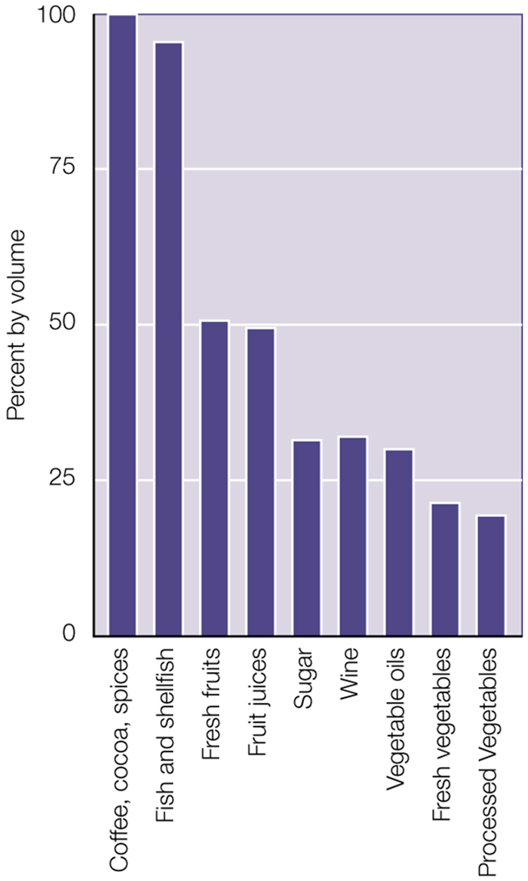
Figure 12.5 Percent of Selected Foods and Beverages Consumed in the United States That Are Imported, by Volume

Slide 18
What Is a Sustainable Food System? (1 of 3)
A sustainable food system is one that addresses concerns regarding the health of individuals, the community, and the environment in a way that intends to provide healthy food for the world's population for generations to come
A sustainable food system must:
  Be environmentally friendly
  Economically viable
  Socially equitable
Many food systems degrade environment, reduce biodiversity, pollute air and water

Slide 19
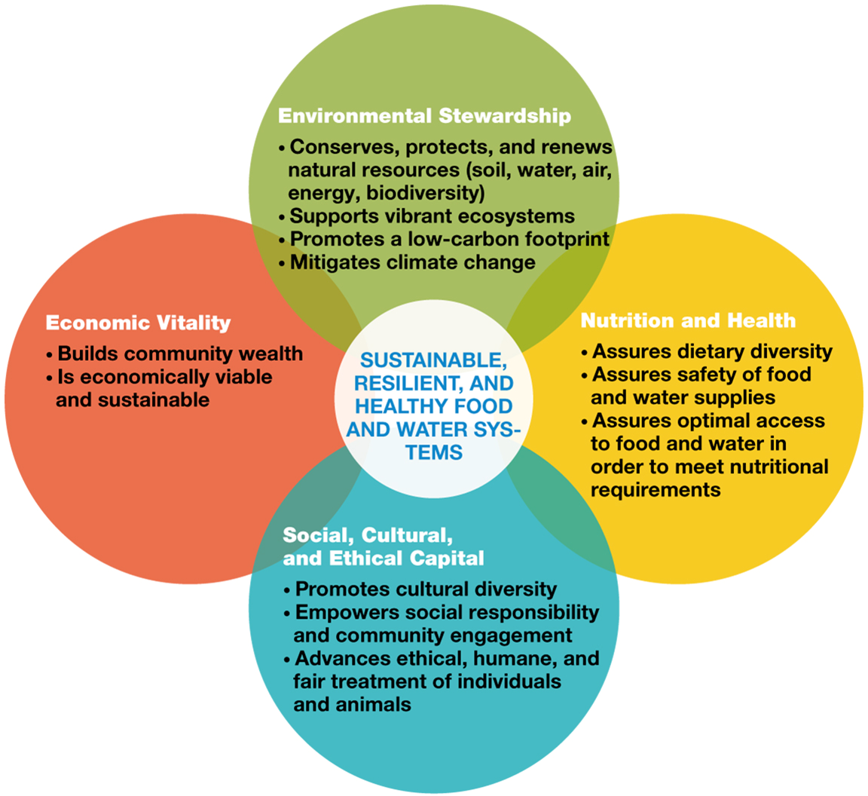
Figure 12.6 Sustainable Food Systems Model

Slide 20
What Is a Sustainable Food System? (2 of 3)
Concerns about:
  Soil use: improper use degrades topsoil, endangers food soil web
  Energy use: fossil fuels harm environment
    Using alternatives aids sustainability
  Water use: growing consumption
    Conservation is necessary
  Reducing food waste is part of sustainability
    30-40% of all food produced is wasted
Being a more sustainable food consumer
  Adopting "greener" habits can help
    Examples: eating less meat

Slide 21
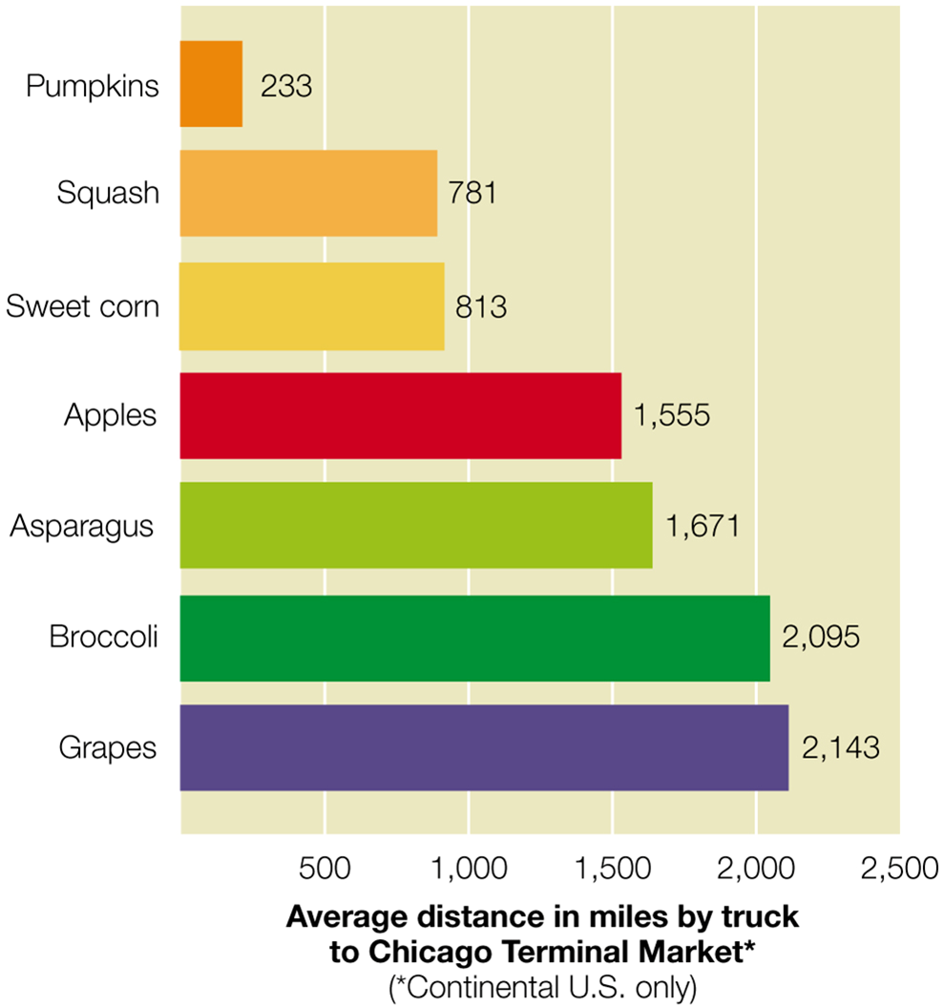
Figure 12.7 How Far Did Your Food Travel?

Slide 22
What Is a Sustainable Food System? (3 of 3)
The most sustainable foods are locally grown and plant-based
  Plant based diets are also more health promoting
Small farms often provide foods to people living in their communities through:
  Community-supported agriculture (C S A)
  Farmers' markets
  Contracts through local grocery stores
Buying food from local farms doesn't guarantee that foods were grown in a sustainable way, nor does being from a distant farm mean that those farmers didn't practice sustainable agriculture.

Slide 23
Table 12.3 Food Miles in a Meal
Food Item | Local Source | Distance Traveled from Local Source | Conventional Source | Distance Traveled through Conventional Channels
Chuck roast | Local grass-fed beef farm | 75 miles | Colorado | 675 miles
Potatoes | Farmers’ market | 10–15 miles | Idaho | 1,300 miles
Carrots | Backyard garden | 40 feet | California | 1,700 miles
Green beans | Backyard garden | 40 feet | California | 1,700 miles

Slide 24
Table 12.4 Concerns and Regulations for G E Foods
Concern | F D A Regulation
Undesirable genetic modification | Genes used in G E foods must not have prior evidence of encoding any harmful substances. The genes must also be stably inserted into the plant in order to avoid any rearranging of genetic information that would produce an undesirable substance.
Introduction of allergens | G E foods must be monitored for food allergens. Protein encoded from common allergen food sources (such as milk, eggs, fish, tree nuts, and legumes) should be presumed to be allergens and should be labeled as such on the G E food.
Excessive level of toxins | G E foods should not contain natural toxins at levels that are higher than those found naturally in plants.
Changes in nutrients | All G E foods should be monitored to assess unintentional changes in the nutrient levels in the plants and their ability to be utilized in the human body as compared with their conventional counterparts.
Creation of new substances | If the genes that are introduced into plants encode substances that are different in structure and function than those normally found in foods, these substances must be approved by the F D A, as would any other food additive. However, if these substances are “substantially equivalent” to substances that already exist in foods, they are generally recognized as safe (G R A S) and do not require premarket approval from the F D A.
Unsafe animal feeds | G E animal feeds must meet the same strict safety standards that are in place for food that is grown for humans.

Slide 25
Nutrition in the Real World: You as a Sustainable Farmer: Growing Vegetables in a Container
Almost anyone can be a home gardener
  Requirements:
    Container: ceramic pot, planter box, or other
    Potting mixture: soil mix
    Plant: various vegetables
    Fertilizing: enrich soil with powdered fertilizer
    Watering: avoid under- or overwatering
    Harvesting: timing depends on plant type

Slide 26
Misc Table 12.1 Vegetables: From Plant to Plate
Vegetable | Minimum Container Size | Number of Plants | Amount of Sunlight | Approximate Number of Days to Harvest
Cabbage | 1 gallon | 1 plant | Partial shade | 48–53
Cucumbers | 1 gallon | 2 plants | Full sun | 46–66
Green beans | 1 gallon | 2–3 plants | Full sun | 37–58
Lettuce | 1 gallon | 4–6 plants | Partial shade | 41–56
Peppers | 2 gallon | 2 plants | Full sun | 82–112
Tomatoes | 3 gallon | 1 plant | Full sun | 84–124

Slide 27
How Do We Balance the World Population's Demand for Food with Sustainability? (1 of 4)
Costs and Benefits of Using Hormones
  Chemical compounds improve farm yields but also cause concern
  Hormones
    In cows, bovine growth hormone and its synthetic version, recombinant bovine somatotropin (r b S T), stimulate milk production
    F D A has found no negative effects, but some consumer groups question safety

Slide 28
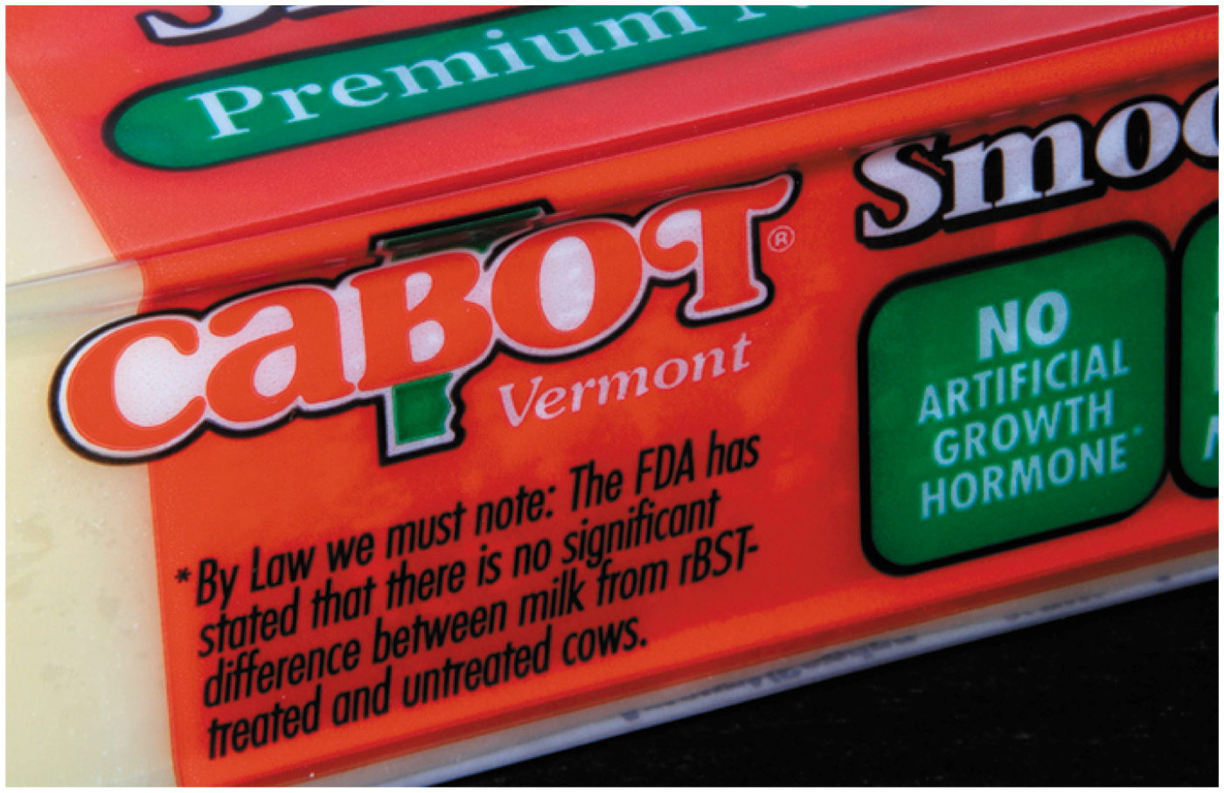
Figure 12.8 Milk Label Containing Information about the Use of r B G H

Slide 29
How Do We Balance the World Population's Demand for Food with Sustainability? (2 of 4)
Costs and Benefits of Using Antibiotics
  Whether injected or given via feed, antibiotics are used for three purposes:
    To treat animals that are sick
    To preventatively treat animals that may be at risk of being sick
    To promote growth
  Risks include growth of antibiotic-resistant bacteria, posing threat to humans when consumed
    Government agencies try to prevent overuse

Slide 30
How Do We Balance the World Population's Demand for Food with Sustainability? (3 of 4)
Costs and Benefits of Using Pesticides
  Control pests that threaten food supply
Types of pesticides
  Herbicides: kill weeds
  Antimicrobials: kill microorganisms (bacteria, viruses)
  Fungicides: kill fungi (mold)
  Biopesticides: derived from natural materials; include sex pheromones
  Organophosphates: affect nervous system of pests

Slide 31
How Do We Balance the World Population's Demand for Food with Sustainability? (4 of 4)
Risks and regulation of pesticides
  When not used responsibly, can cause harm to animals, environment, humans
  Use is heavily regulated in United States
  Risk assessment (by E P A) is process to determine potential human health risks posed by exposure
Alternatives to pesticides
  Integrated pest management uses methods to control pests but limit harmful impact on humans, environment
    Examples: crop rotation, pest-resistant crops, biopesticides, natural predators

Slide 32
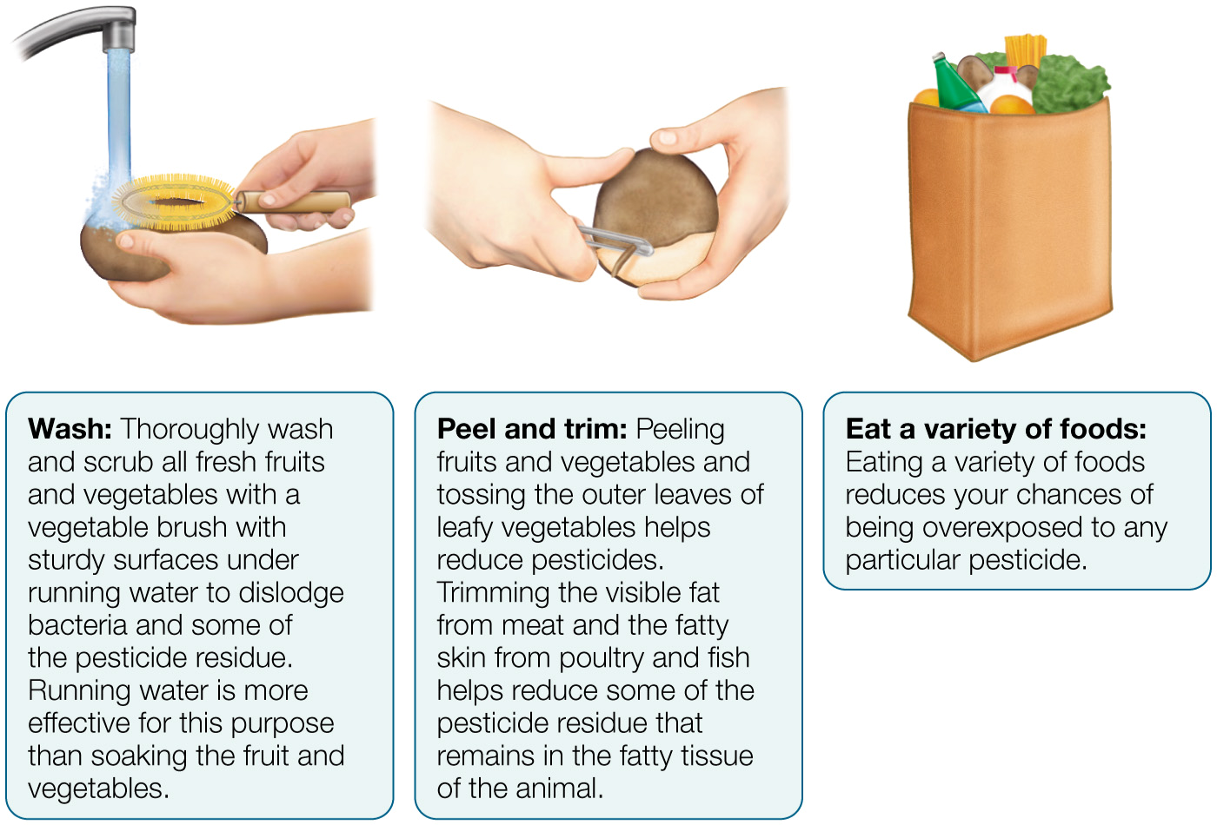
Figure 12.9 Reducing Pesticides in Food

Slide 33
What Are the Risks and Benefits of Using Biotechnology in Agriculture? (1 of 3)
Humans have been manipulating genes of food products for generations.
  Biotechnology: the application of biological techniques to living cells, which alters their genetic makeup
    Gene editing
  Plant breeding: a type of biotechnology in which two plants are crossbred to produce offspring with desired traits from both

Slide 34
What Are the Risks and Benefits of Using Biotechnology in Agriculture? (2 of 3)
Genetic engineering
  Genetic engineering (G E): the biological technique that isolates and manipulates the genes of organisms to produce a targeted, modified product
  Genetically modified organisms (G M Os): organisms genetically engineered to contain both original and foreign genes
  First G M O crops grown in early 1990s, designed to reduce pesticide, herbicide use
    Later versions added nutrients, improved shelf life
  Proponents believe G M Os are good for environment and food supply

Slide 35
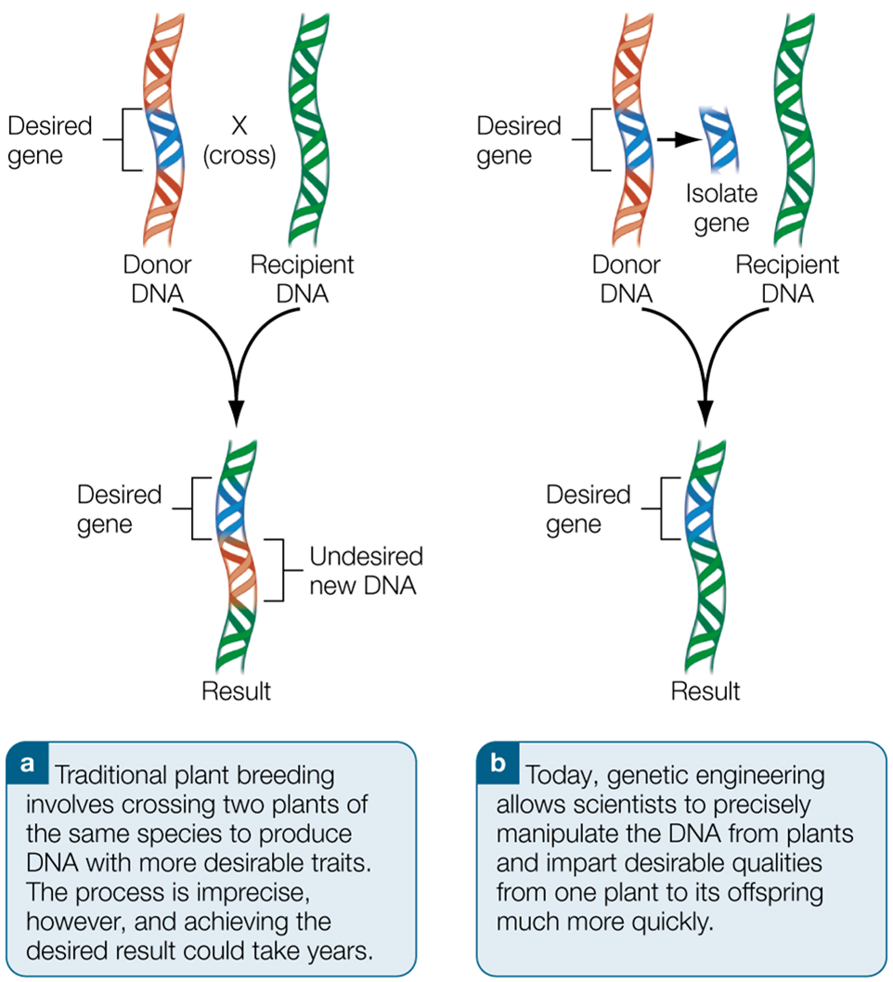
Figure 12.10 Plant Breeding versus Genetic Engineering

Slide 36
What Are the Risks and Benefits of Using Biotechnology in Agriculture? (3 of 3)
Concerns and regulations associated with G E foods
  Opponents fear creation of "frankenfoods," but industry is tightly regulated by F D A, U S D A, E P A
  Many unanswered questions, including:
    Effects on natural environment, ecological balance
    Production of plant toxins
    Introduction of new allergens into food
    Changes in nutrient content
    Unsafe animal feed

Slide 37
Table 12.4 Concerns and Regulations for G E Foods
Concern | F D A Regulation
Undesirable genetic modification | Genes used in G E foods must not have prior evidence of encoding any harmful substances. The genes must also be stably inserted into the plant in order to avoid any rearranging of genetic information that would produce an undesirable substance.
Introduction of allergens | G E foods must be monitored for food allergens. Protein encoded from common allergen food sources (such as milk, eggs, fish, tree nuts, and legumes) should be presumed to be allergens and should be labeled as such on the G E food.
Excessive level of toxins | G E foods should not contain natural toxins at levels that are higher than those found naturally in plants.
Changes in nutrients | All G E foods should be monitored to assess unintentional changes in the nutrient levels in the plants and their ability to be utilized in the human body as compared with their conventional counterparts.
Creation of new substances | If the genes that are introduced into plants encode substances that are different in structure and function than those normally found in foods, these substances must be approved by the F D A, as would any other food additive. However, if these substances are “substantially equivalent” to substances that already exist in foods, they are generally recognized as safe (G R A S) and do not require premarket approval from the F D A.
Unsafe animal feeds | G E animal feeds must meet the same strict safety standards that are in place for food that is grown for humans.

Slide 38
How Does Food Policy Affect the Foods Available to You to Buy and Consume? (1 of 2)
Various government agencies regulate the food industry and set food and nutrition policy
Food policy can help encourage food producers to create healthier products
  Example: Dietary Guidelines for Americans caused shift toward whole grains, improved diet
Food policy can lead to relabeling and reformulating without providing a healthier food product
  Example: Food producers replaced trans fat with saturated fat, with no net positive effect

Slide 39
Table 12.5 Who Oversees the Food Supply? (1 of 2)
Agency | Responsible for
United States Department of Agriculture (U S D A) | Monitoring agriculture and food production and ensuring safe and accurately labeled meat, poultry, and eggs. The U S D A enforces tolerances for pesticide residues in meat, poultry, and eggs set forth by the E P A.
Food and Drug Administration (F D A) | Overseeing domestic and imported foods except for meat and poultry products. Ensuring that these foods are safe, sanitary, nutritious, wholesome, and honestly and adequately labeled. Overseeing food-processing plants and approval and surveillance of food-animal drugs, feed additives, and all food additives. F D A enforces tolerances for pesticide residues that are set by the E P A.
Environmental Protection Agency (E P A) | Protecting you and the environment from harmful pesticides. E P A is responsible for the safe use of pesticides and fertilizers, as well as food-plant detergents and sanitizers on foods and in the environment. It establishes the safe tolerances for pesticide residues in or on food commodities and animal feed.

Slide 40
Table 12.5 Who Oversees the Food Supply? (2 of 2)
Agency | Responsible for
Animal and Plant Health Inspection Service (A P H I S) | Protecting against plant and animal pests and disease
National Marine Fisheries Service (N M F S) | Overseeing a voluntary seafood inspection for quality and a grading program
Centers for Disease Control and Prevention (C D C) | Surveillance and investigation of human and animal diseases
Federal Trade Commission (F T C) | Regulating food advertising
Department of Health and Human Services (H H S) | Protecting the health of and providing essential human services to Americans, including those who are less able

Slide 41
How Does Food Policy Affect the Foods Available to You to Buy and Consume? (2 of 2)
What are the politics of the food industry?
  Government programs are food consumers
    Federal government is nation's biggest food consumer
    Examples: National School Lunch Program, Summer Food Service Program, Emergency Food Assistance Program, Child and Adult Care Food Program
  Food lobbyists exert influence
    Example: 2009 push to tax sugared beverages was blocked in Congress

Slide 42
How Do You Know How Foods Were Produced? (1 of 2)
Label terms provide information about how foods were produced
  U S D A defines labeling for animal food products
    Prepackaged meat products:
      Certified
      Fresh poultry
      Free range
      Kosher
      Natural
      No hormones
      No antibiotics

Slide 43
How Do You Know How Foods Were Produced? (2 of 2)
Understand the meaning of the term organic
  Market for organics foods has grown rapidly
  U S D A developed National Organic Standards (N O S)
  Organic farming means grown without some synthetic pesticides and fertilizers, bioengineering, irradiation
    Some pesticides may be used
  No evidence that organic foods are nutritionally superior
    Advantages: Fewer synthetic pesticides and antibiotics; may have environmental benefits
    Disadvantages: Often more expensive than conventionally grown foods

Slide 44
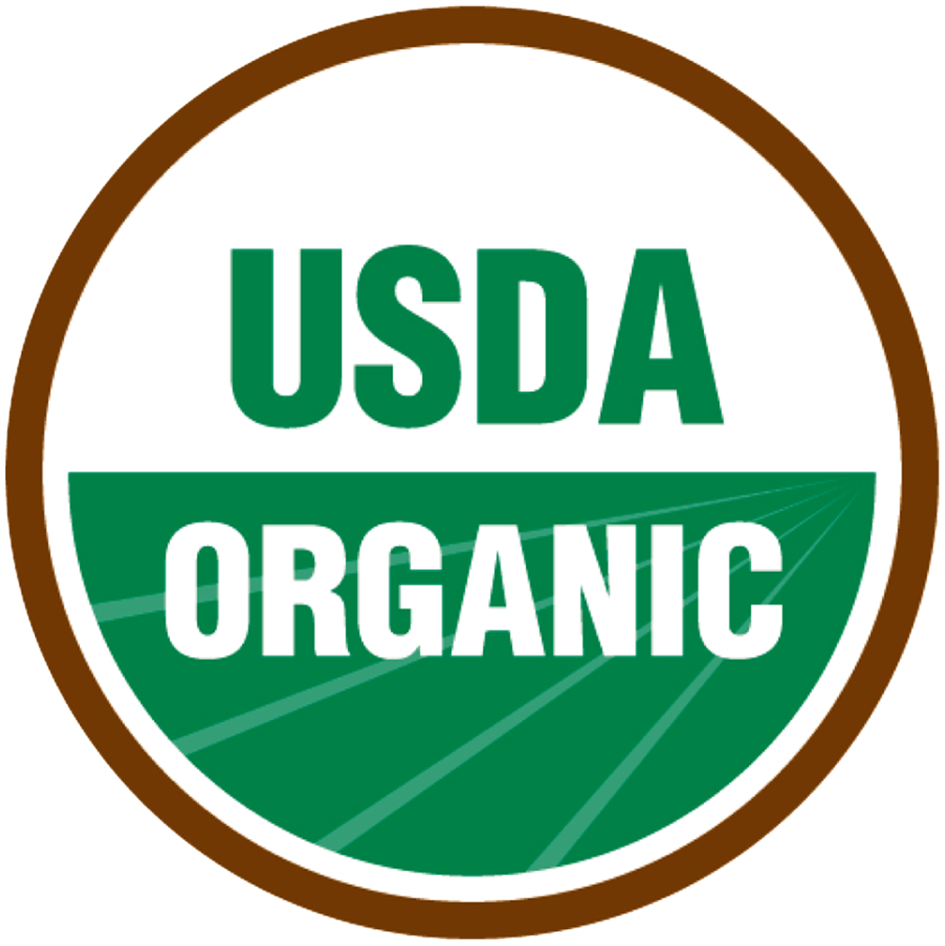
Figure 12.11 The U S D A Organic Seal

Slide 45
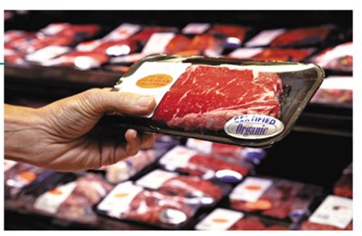
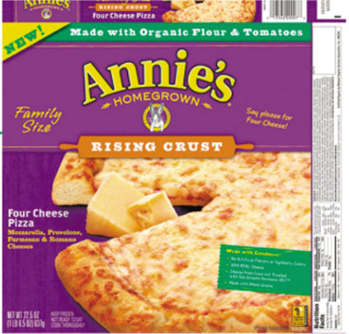
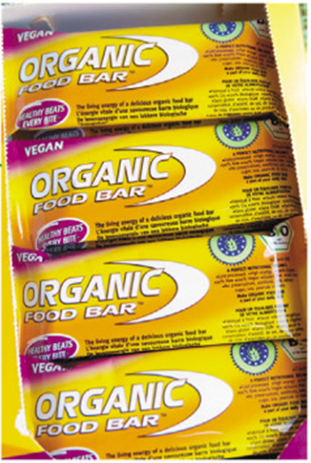
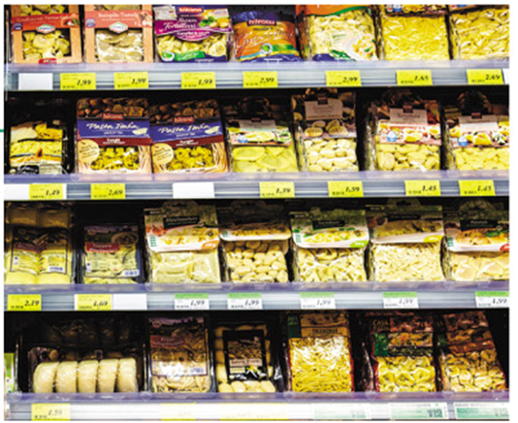
Table 12.6 Various Levels of Organic
If the label says “100% Organic” Then: The food must be composed entirely of organic ingredients. Note: These foods cannot contain sulfites and must declare the certifying agent. The U S D A Organic seal may be displayed. | A rack full of chocolates | the label says “Made with Organic Ingredients” Then: The food contains at least 70 percent organic ingredients. | A pack of cheese pizza
If the label says “Organic” and/or displays the U S D A Organic seal Then: The food contains at least 95 percent organic ingredients. | A pack of biscuits | If the label says nothing about organic claims Then: The food contains less than 70 percent organic ingredients, or the food producer or manufacturer decided not to disclose information about the organic ingredients. | A rack of snacks.

Slide 46

Copyright
This work is protected by United States copyright laws and is provided solely for the use of instructors in teaching their courses and assessing student learning. Dissemination or sale of any part of this work (including on the World Wide Web) will destroy the integrity of the work and is not permitted. The work and materials from it should never be made available to students except by instructors using the accompanying text in their classes. All recipients of this work are expected to abide by these restrictions and to honor the intended pedagogical purposes and the needs of other instructors who rely on these materials.

