Slide 1
Title
Name date

Slide 2
Summary
This research question is used to explore the relationship between variables

Slide 3
Introduction
The aim of the study is to show how the number of motor vehicle collisions is affected by the number of cell phone subscribers. According to a research conducted by Donald et al, they found out that using cellular telephones in motor vehicles was accompanied with a four times risk of collision on a brief call period. However, the decisions on how to regulate such telephones need to take into consideration of the benefits of technology and the of an individual’s responsibility. (Redelmeier, D. A., & Tibshirani, R. J., 1997).
The hypothesis is: what is the relationship between the number of cell phone subscribers and number of motor vehicle collisions?

Slide 4
BODY
Graphic organizer
Possible research questions
What is the relationship between number of cellphone subscribers and number of impaired drivind incedents.
What is the relationship between number of cell phone subscribers and number of motor vehicle collisins

Slide 5
I used what is the relationship between number of motor vehicle collisions and number of cell phone subscribers. Numeric data type which has the number of motor vehicle collisions and the number of cell phone subscribers at a certain range of years will help me investigate my question. The population is the total number of Canadians each year, from 1992 to 2011. The sample size is 100,000 for all the variables.
The data needed to support my hypothesis already exists.
Hypothesis:
a prediction of the relationship between the number of cell phone subscribers and number of motor vehicle collisions.

Slide 6
Findings
The websites related to my question of interest are:
Redelmeier, D. A., & Tibshirani, R. J. (1997). Association between cellular-telephone calls and motor vehicle collisions. New England Journal of Medicine, 336(7), 453-458, from https://www.nejm.org/doi/full/10.1056/NEJM199702133360701
McEvoy, S. P., Stevenson, M. R., McCartt, A. T., Woodward, M., Haworth, C., Palamara, P., & Cercarelli, R. (2005). Role of mobile phones in motor vehicle crashes resulting in hospital attendance: a case-crossover study. Bmj, 331(7514), 428, from https://www.bmj.com/content/331/7514/428?ehom

Slide 7
Laberge-Nadeau, C., Maag, U., Bellavance, F., Lapierre, S. D., Desjardins, D., Messier, S., & Saı̈di, A. (2003). Wireless telephones and the risk of road crashes. Accident Analysis & Prevention, 35(5), 649-660, from https://www.sciencedirect.com/science/article/pii/S000145750200043X
Canadian Wireless Telecommunications Association. (2014). Facts & Figures. Retrieved October 26, 2014, from http://cwta.ca/facts-figures/
Transport Canada. (2011). Canadian Motor Vehicle Traffic Collision Statistics 2011. Retrieved October 26, 2014, from https://www.tc.gc.ca/media/documents/roadsafety/TrafficCollisionStatisitcs_2011.pdf

Slide 8
The data I found in the above websites are valid, and hence they're related to my research question. The main source of the data is the Statistics Canada websites, which is reliable source because it is ranked as one of the top statistical agencies in the world.(Amara, N., & Landry, R., 2005) The data is from all reportable motor vehicle collisions and cell phone subscribers in Canada that the provinces and territories provide each year.
The data was collected from a sample of 100,000 of the population, which will allow me to make prediction of larger population. There is no evidence of bias in the data collection methods. The data can be organized to facilitate retrieval and analysis. For this project, I require numeric data for number of cell phone subscribers and number of motor vehicle collisions between the year 1992 to 2011. Since the data is available, I do not need to revise my research question.

Slide 9
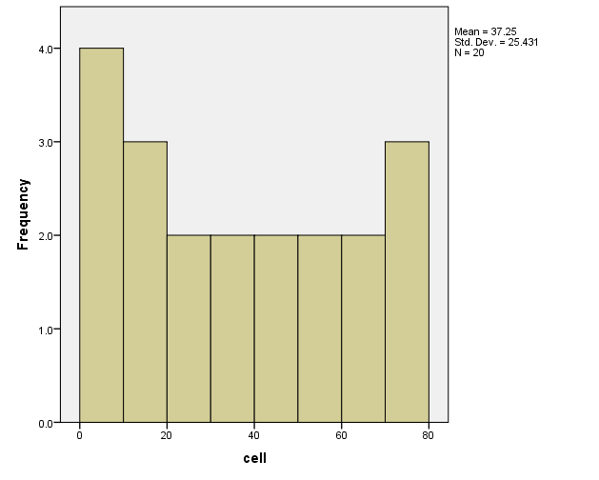
One Variable Analysis
First, I started by summarizing the number of cellphone subscribers variable. This variable contains data for number of cellular subscription per 100 people in Canada. For proper analysis and summary of data, I will plot a histogram and box-and-whisker plot using Statistics Package For Social Sciences(SPSS). I will declare variable number of cellphone as cell and number of motor vehicle collisions as motors.
Histogram.

Slide 10
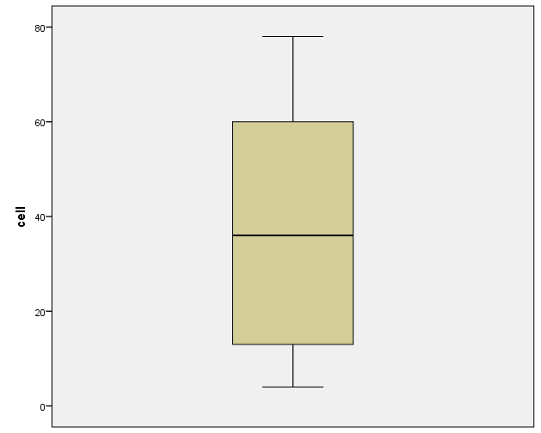
box- and- whisker plot

Slide 11
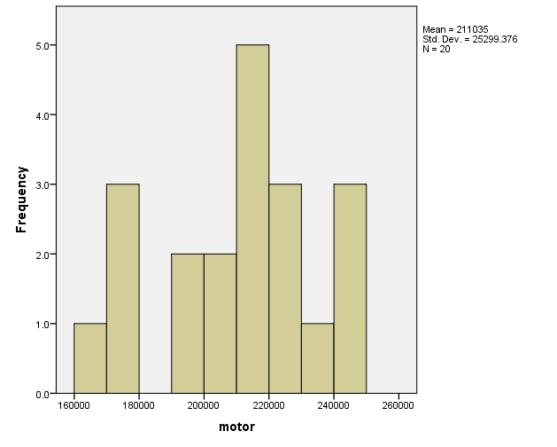
From the above observations, I noticed that there are no outliers in the data, and the median is approximately at the centre. Moreover, I checked for outliers using:
Next, I analysed a one way variable analysis for the number of motor vehicle collisions. I plotted a histogram and a box and whisker plot using SPSS and got the following outputs.
Histogram

Slide 12
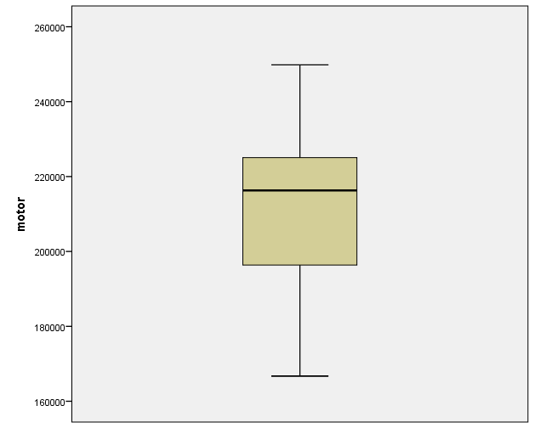
box- and- whisker plot

Slide 13
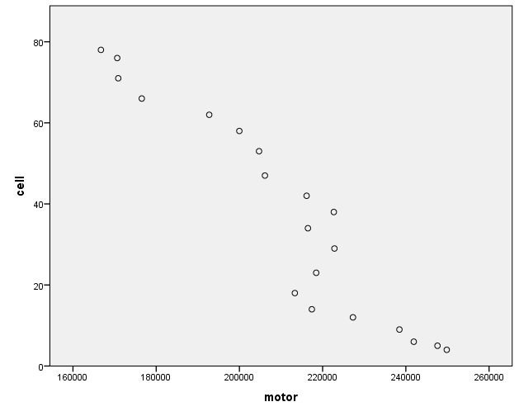
From the previous observation, I concuded that there are no outliers. Moreover, the median is a higher than the mean and mode.
two variable analysis
In this part, the the variables of analysis are number of cell phone subscribers and number of motor vehicles collision. To test for correlation, I used SPSS to generate a scatter plot. The following results were obtained:

Slide 14
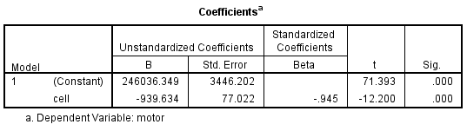
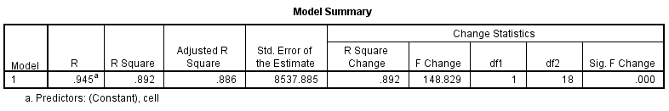
From the scatter plot, I noticed that the the data had a negative correlation. Assuming that all the regression assumptions hold, I conducted a linear regression model. The number of cell phone subscribers as my independent variable and number of motor vehicle collisions as my dependent variable. I obtained the following results:

Slide 15
Considering the R squared value(0.892), I concluded that the model is 89.2% significant(greater than 50%), implying that the model has no outliers.
Conclusion
From the coefficients table, I noticed that the coefficient of the independent variable is negative. This implies that, as the value of the independent variable increases, the value of the dependent variable increases, and vice versa. We reject the hypothesis and conclude that; as the number of cell phone subscribers increase, the number of motor vehicle collisions decrease. According to the R squared value, I was 89.2% evident that the model is significant.
Recommendations
Now, the question arising is: what is the relationship between the number of cellphone subscribers and number of impaired drivers in Canada?
Appendices.
For me to do a similar project in the future, I would Increase the sample size.

Slide 16
References
Amara, N., & Landry, R. (2005). Sources of information as determinants of novelty of innovation in manufacturing firms: evidence from the 1999 statistics Canada innovation survey. Technovation, 25(3), 245-259.
Beck, K. H., Yan, F., & Wang, M. Q. (2007). Cell phone users, reported crash risk, unsafe driving behaviors and dispositions: A survey of motorists in Maryland. Journal of safety research, 38(6), 683-688.
Canadian Wireless Telecommunications Association. (2014). Facts & Figures. Retrieved October 26, 2014, from http://cwta.ca/facts-figures/
Laberge-Nadeau, C., Maag, U., Bellavance, F., Lapierre, S. D., Desjardins, D., Messier, S., & Saı̈di, A. (2003). Wireless telephones and the risk of road crashes. Accident Analysis & Prevention, 35(5), 649-660, from https://www.sciencedirect.com/science/article/pii/S000145750200043X

Slide 17
Redelmeier, D. A., & Tibshirani, R. J. (1997). Association between cellular-telephone calls and motor vehicle collisions. New England Journal of Medicine, 336(7), 453-458.

