Slide 2
Purpose
The purpose of capillaries in the circulatory
system is to do the following:
Diffusion
Bulk flow
Pinocytosis /transcytosis.

Slide 3
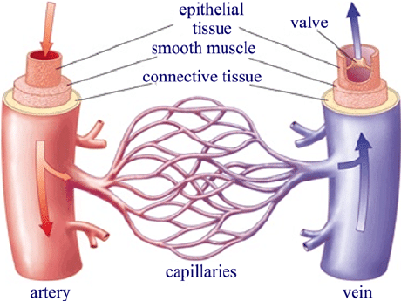
Purpose-Diffusion
1
Enabling the exchange between water, oxygen, carbon dioxide, nutrients and many other substances between blood and the surrounding tissues
https://www.researchgate.net/figure/llustration-of-the-extensive-branching-of-the-capillaries-including-arteries-venules-and_fig4_227343262

Slide 4
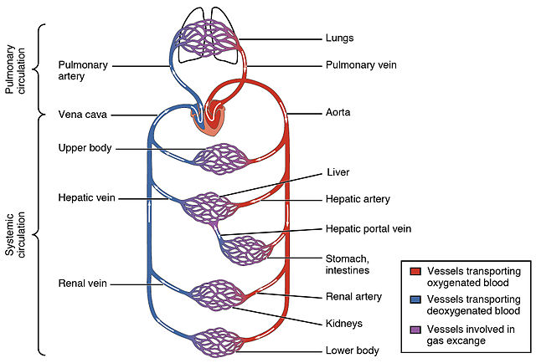
Purpose-Bulk flow
2
Connect the arterioles and venules to create uninterrupted blood flow through the body
http://pediaa.com/difference-between-oxygenated-and-deoxygenated-blood/

Slide 5
Purpose-Pinocytosis
This is movement of materials across capillary walls by using pinocytic vesicles.
Substances being transported from blood plasma to body cells are enclosed within tiny bodies known as pinocytic vesicles.
Transported materials first enter endothelial cells through endocytosis and later move cell to cell to external capillary wall through exocytosis.
The method is used for transport of large, lipid-insoluble molecules that cannot diffuse into body cells.

Slide 6

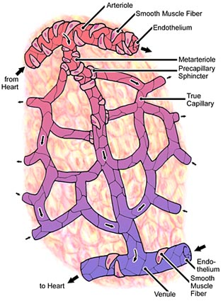
Overview
Capillaries are microscopic blood vessels that form networks between arterioles and venules
https://www3.nd.edu/~jsapirst/textbook/figures/fig241.html

Slide 7
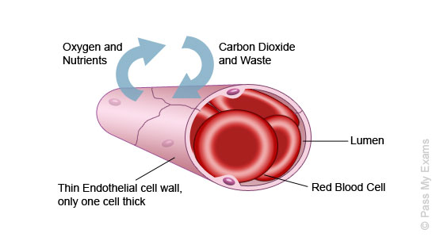
Overview
Capillaries have a diameter of around 5 to 10 micrometers
The thickness of the endothelial lining is only one layer of cells
http://www.passmyexams.co.uk/GCSE/biology/capillaries.html

Slide 8
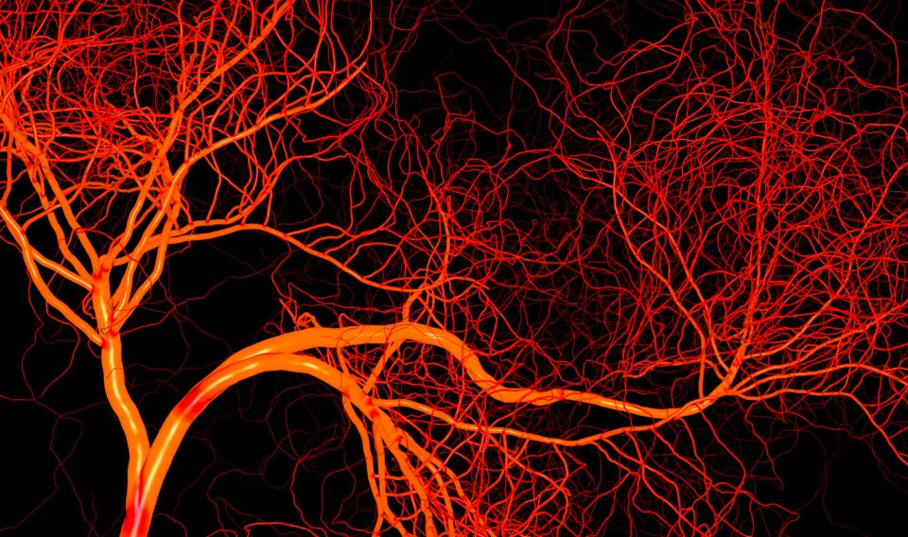
Overview
If all the capillaries in the human body were lined up in single file, the line would stretch over 100,000 miles
Only allows smaller molecules, such as water and ions to pass through their intercellular clefts
https://www.fi.edu/heart/blood-vessels

Slide 9
Importance of Capillaries
Capillaries facilitate transport and exchange of gasses, fluids, and nutrients in the body.
The capillaries receive carbon dioxide and other metabolic waste products from cells.
The waste products are then transported to the kidneys, liver and the lungs for separation and removal from the body.

Slide 10
Capillaries and Gaseous Exchange
Oxygen diffuses from the alveoli of the lungs into capillaries.
Inside the capillaries, oxygen is attached to haemoglobin.
Carbon dioxide from the capillaries into alveoli and id exhaled out of the body.

Slide 11
Nutrient Exchange
Important fluids and nutrients selectively diffuse from permeable capillaries into the tissues of the body.
Harmful and waste products after respiration are also absorbed into capillaries.
They are transported to kidneys and liver and are processed for elimination from the body.

Slide 12
Blood-brain Barrier
capillaries make up a blood-brain barrier in the central nervous system.
The barrier functions to limit the ability of toxins to cross into the brain.
Unfortunately, the barrier also limits the passage of chemotherapy agents into the brain making management of brain cancer cumbersome.

Slide 13
Capillary Structure
Diameter: Ranges from 3 to 4 micrometers (µm), however, some are as large as 40 µm.
Composition: Have a thin layer of epithelial cells and a basal lamina, referred to as tunica intima.
An incomplete layer of cells known as pericytes partially encloses the epithelial cells.

Slide 14
Blood Flow
Microvascular pericytes control blood pressure by contraction action in capillaries.
The process aids to improve the efficiency movement of materials between the capillary blood and body cells.
Flow of blood in capillaries is regulated by precapillary sphincters which is are smooth muscle bands that cover the metarterioles.

Slide 15
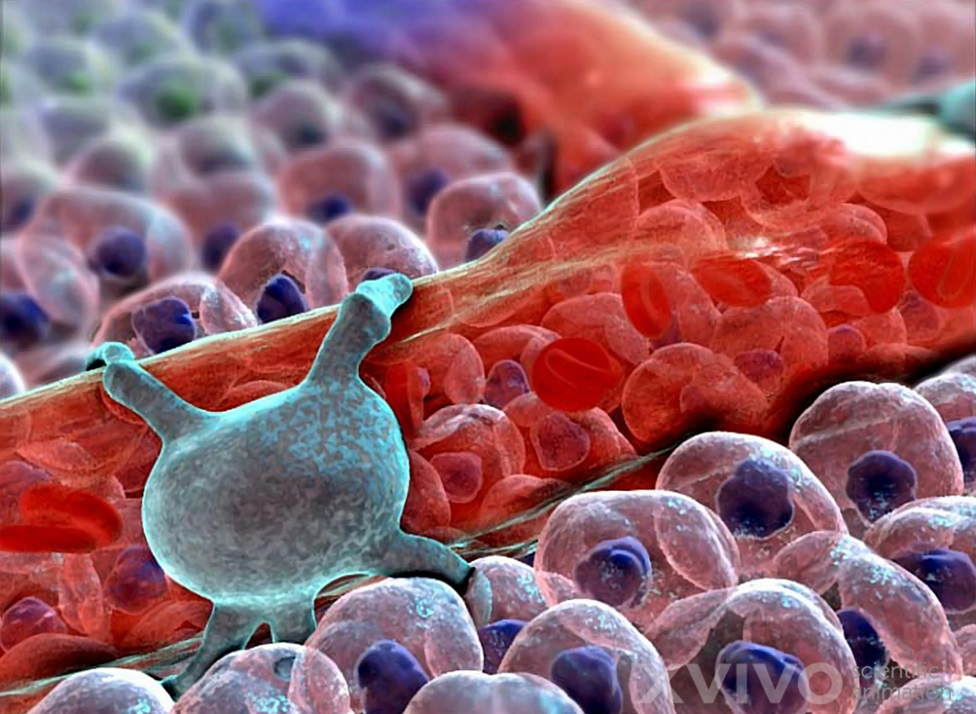
Overview
Capillaries and post-capillary venules have pericytes(shown left) around the epithelial cells
Pericytes are contractile cells that wrap around the endothelial cells
https://www.xvivo.net/blog/archives/illustration-new/pericyte-on-capillary/

Slide 16
Mode of exchange
waste products to be exchanged between tissues and the blood.
This occurs via passive diffusion and pinocytosis (ingestion of fluid by cells). White blood cells also enter tissues via the capillaries, attacking infections and repairing damage.

Slide 17
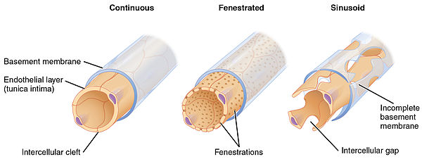
Types
Overview
There are three types of capillaries:
Types

Slide 18
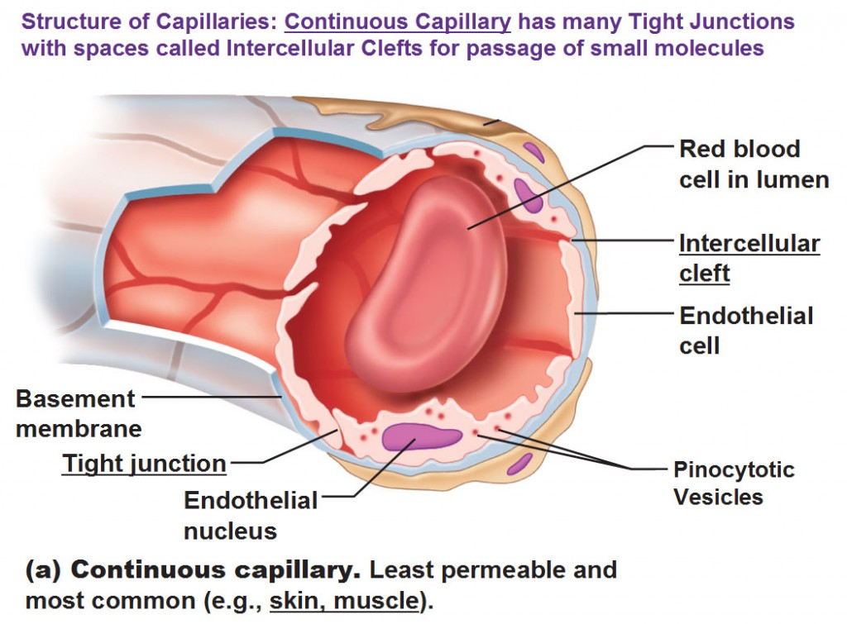
Overview
Continuous Capillaries
The most common type of capillary
Found in skin, muscle, brain, etc.
Junction between cells is called intercellular cleft
Only allows smaller molecules, such as water and ions to pass through their intercellular clefts
https://scblood.weebly.com/capillaries.html

Slide 19
These capillaries have endothelial cells with a lining that is uninterrupted.
Continuous capillaries only allow passage of very small molecules such as ions and water through them.
Such molecules pass through the intercellular clefts of the continuous capillaries.
Continuous capillaries also allow passage of certain lipid-soluble molecules through the endothelial cells membranes.
The have tight junctions which prevent water and solutes from leaking out but selectively allow passage of other materials out.

Slide 20
Continuous Capillaries
Tight junctions are only found in vertebrates and are of two subtypes:
Tight junctions that have numerous transport vesicles. They are found in fingers, skin and skeletal muscles.
Tight junctions with very few vesicles and are found in the central nervous system and form the blood-brain barrier
Continuous capillaries found in the lungs and muscle tissues have pinocytotic vesicles and fine filaments.

Slide 21
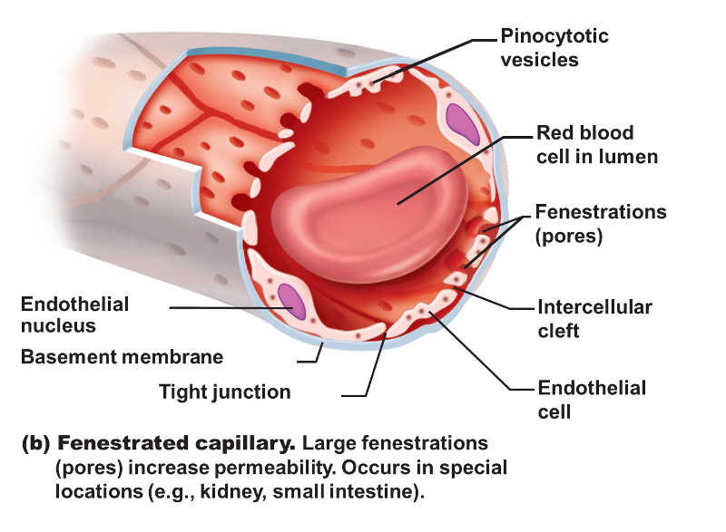
Overview
Fenestrated Capillaries
Larger pores (60-80 nanometers in diameter)
Found in in the mucosa of the intestinal tract, pancreas, endocrine organs, choroid plexus, and in the ciliary processes of the eye.
They allow larger molecules through
https://www.easynotecards.com/notecard_set/11327

Slide 22
Fenestrated Capillaries
Their name is derived from Latin word for “window.”
Fenestrated capillaries have pores in their endothelial cells
Their poles allow passed of small molecules and proteins to diffuse.
Mostly they occur in the glomeruli of the kidney.

Slide 23
They are located in tissues where extensive molecular exchange occurs with blood.
Such tissues include; small intestine, kidney and the endocrine glands.
They 'fenestrations' or pores that facilitate movement of large molecules.
Fenestrated capillaries are more permeable to molecules than continuous capillaries.

Slide 24
The capillaries pores have diaphragm which aids to close and open the pores.
However, the pores can open and close without the help of the diaphragm.
In kidneys, the diaphragm is crucial blood filtration as the urine is formed.

Slide 25
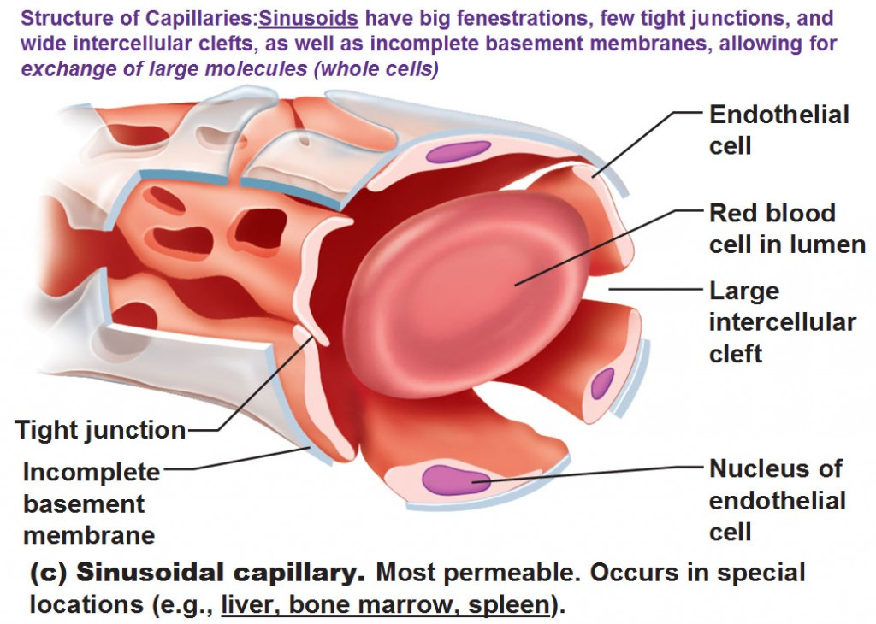
Overview
Sinusoidal Capillaries
Also known as a discontinuous, a special type of open-pore capillary, that have larger openings (30–40 µm in diameter) in the endothelium
Found in the liver, spleen, lymph nodes, bone marrow and some endocrine glands
https://scblood.weebly.com/capillaries.html

Slide 26
Sinusoidal Capillaries
Sinusoids have open pores.
Unlike fenestrated capillaries which have diaphragms, sinusoid capillaries have no diaphragm and no exposed open pore.
These open pores allow medium-sized and larges molecules such as albumin to pass through.
Sinusoids have a wide diameter compared to other types of capillaries.

Slide 27
Sinusoidal Capillaries
Sinusoidal capillaries allow passage of both red and white blood cells and serum proteins to pass through.
Passage of large molecules is aided by the presence of a discontinuous basal lamina.
They do not have pinocytotic vesicles thus passage of molecules occurs through cell junctions.
In the liver and the spleen, sinusoidal capillaries have no tight junctions in between the cells.

Slide 28
Capillary Microcirculation
Two forces: the hydrostatic pressure and osmotic pressure regulate movement of fluids between the capillaries and the interstitial tissues.
Hydrostatic pressure in the inside of the capillary is high and this pressure forces fluid and nutrients out.
The hydrostatic pressure on the outside side of the capillary is low.

Slide 29
Capillary Microcirculation
The osmotic pressure of the fluid within the capillary is low and draws fluids back into the capillary.
Osmotic pressure forces the movement of fluids and waste products from tissues into the capillary.

Slide 30
Distribution of Capillaries
Capillaries numbers in a tissue varies widely.
In the lungs large number of capillaries surrounding the alveoli to exchange oxygen and carbon dioxide.
Capillaries are generally more abundant in metabolically active tissues.

Slide 31
Special Focus: Systemic Capillary Leak Syndrome
It is a rare disorder which occurs due to leaking capillaries resulting into recurring constant nasal congestion and fainting.
It is caused by episodes of rapid drops in blood pressure among victims.

Slide 32
Special Focus-Disorders
Capillaries conditions can either be common and uncommon conditions.
They include:
Systemic capillary leak syndrome (SCLS)
Port Wine Stain (Birth Mark)
Capillary Malformation (Arteriovenous Malformation Syndrome)
Macular Degeneration

Slide 33
Port Wine Stain (Birth Mark)
They are areas of red or purple skin caused by dilated capillaries.
In United States, 1 in 300 children are born with Port Wine Stain.
They not painful instead they are a cosmetic problem.
In some people they bleed easily when irritated causing medical concerns.

Slide 34
Capillary Malformation
It is an inherited disorder.
It is commonly present in people of European ancestry.
It causes more blood flow near the skin than in normal individual through the capillaries.
As a result, pink and red dots appear on the skin of the affected.
It may occur alone, or along with other complications

Slide 35
Macular Degeneration
It is damage of capillaries in the retina of the eyes.
It is the leading cause of blindness in the United States.
It is majorly caused by diabetes condition during advanced stages.

Slide 36
Systemic Capillary Leak Syndrome
The condition is characterized by fluids and proteins leaking from capillaries into surrounding tissues.
The leaks can lead to dangerously low blood pressure levels (hypotension), decrease in plasma volume and hypoalubuminia.
Initial symptoms may include sudden increase in body weight, fatigue, nausea and abdominal pain.
Frequency of occurrence vary, with one episode in a lifetime or having several per year.

Slide 37
Causes
The cause is not known in many patients.
Some develop the condition after a viral infection.
Other cases of capillary leak are associated with various heart, kidney, or liver conditions.

Slide 38
Pathophysiology
Patients develop self-reversing episodes of fainting.
The endothelial cells of the capillaries separate for a few days causing massive leakage of plasma and other blood components.
The leaked blood components are deposited into neighbouring tissue sinuses and muscles.

Slide 39
Pathophysiology
Systemic capillary leak syndrome has two phases:
Capillary leak phase
Recruitment phase.
The condition causes hypotension, hemoconcentration, and hypoalbuminemia.
If it is not properly managed, it is a life threatning syndrome.

Slide 40
Symptoms
Condition Terms | Common Names
85%-95% of victims develop these symptoms
Edema of lower limbs | Fluid accumulation in legs
Leukocytosis | Increased white blood cells
35%-85% of victims show the following symptoms
Abdominal pains | Stomach pains
Frequent Diarrhoea | Watery stool appears many times
Fatigue | Tiredness of affected patient

Slide 41
Diagnosis
Diagnosis involves recurrence of symptoms, physical examination and laboratory tests.
Recurring episodes shows occurrence of monoclonal gammopathy.
Investigation of secondary capillary leak syndrome symptoms and abnormally low levels of protein in the blood shows a positive result.
The condition can be misdiagnosed with sepsis, polycythemia and polycythemia vera.

Slide 42
Treatment
There is no cure for the condition but management drugs include:
Intravenous administration of saline solution.
Intravenous administration of hetastarch or albumin and colloids.
Administration of glucocorticoids.

Slide 43
SCLS Management
Supportive care aim to stabilize symptoms and reduce severity of complications.
Involve stabilization of patients airways and breathing patterns.
Once a patient recover from symptoms diuretics are administered.
Preventive measure include treatment with IVIG.

Slide 44
Statistics
About 25% Indians suffer from Systemic capillary leak syndrome.
In USA, 10% among the total population suffer from this condition
USA victims predominantly demonstrate mmonoclonal gammopathy of the IgG-κ type.

