Slide 1
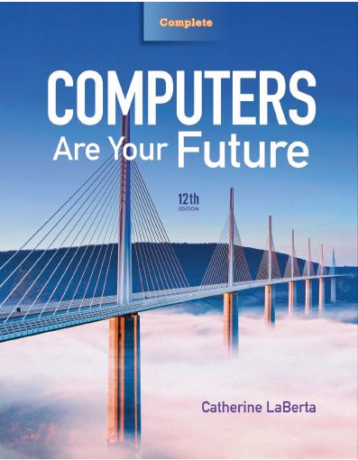
Computers Are Your Future
Twelfth Edition
Chapter 1: Computers and You

Slide 2
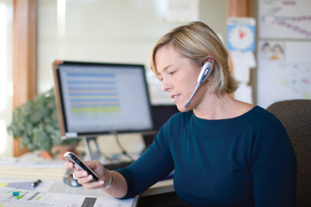
Computers and You

Slide 3
Objectives
Define the word computer and name the four basic operations that a computer performs.
Describe the two main components of a computer system: hardware and software.

Slide 4
Objectives
Provide examples of hardware devices that handle input, processing, output, and storage tasks.
Give an example of the information processing cycle in action.
Discuss the two major categories and the various types of computers.

Slide 5
Objectives
Explain the advantages and disadvantages of computer use.
Recognize the ethical and societal impacts of computer usage.
Discuss how computers affect employment.
List ways to be a responsible computer user.

Slide 6
Computers: Yesterday, Today, and Tomorrow
Computers
  Integral to our daily lives
  Millions use computers daily.
Applications
  Word processors
  Internet
  Online banking
  Online classes
  GPS systems
  ATM machines
  Mobile phones
  Weather prediction

Slide 7
Computers: Yesterday, Today, and Tomorrow
Computers (con’t.)
  Used at:
    Home
    Work
    School
  Embedded into:
    Cars
    Phones
    Cameras

Slide 8
Computers: Yesterday, Today, and Tomorrow
History of Computers 1939–1981
  Hewlett-Packard founded–1939
  ENIAC unveiled (increased computing speed by 1,000x)–1946
  Commodore Business Machines founded–1965
  Xerox opens Palo Alto Research Center–1970
  Steve Wozniak designed the Apple I–1976
  IBM introduced the PC–1981

Slide 9
Computers: Yesterday, Today, and Tomorrow
History of Computers 1990–2009
  HTML developed; World Wide Web born–1990
  Netscape and Yahoo founded–1994
  Microsoft releases Windows 95–1995
  Microsoft’s Bill Gates resigns–2000
  YouTube founded; Windows Vista announced–2005
  Amazon releases the Kindle; Google releases Android–2007
  Microsoft releases Windows 7–2009

Slide 10
Computers: Yesterday, Today, and Tomorrow
Before computers
  There were
    No telephone answering machines
    No handheld calculators
    No fax machines
    No personal computers
  People
    Wrote letters by hand or with a typewriter
    Kept track of data and numbers in ledgers
    Communicated in person or over the telephone

Slide 11
Computer Fundamentals
Computer—device that performs the information-processing cycle
Information-processing cycle
  Consists of four basic operations:
    Input
    Processing
    Output
    Storage

Slide 12
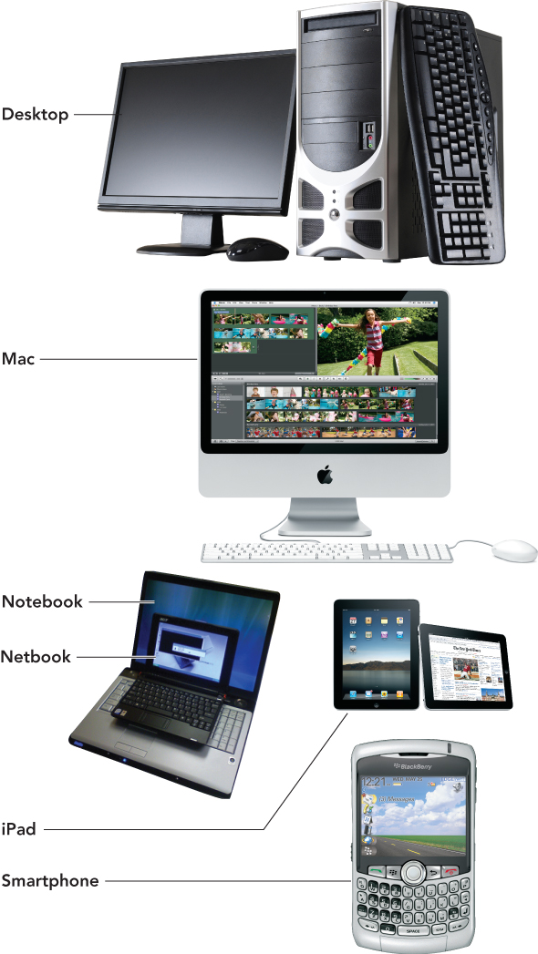
Computer Fundamentals

Slide 13
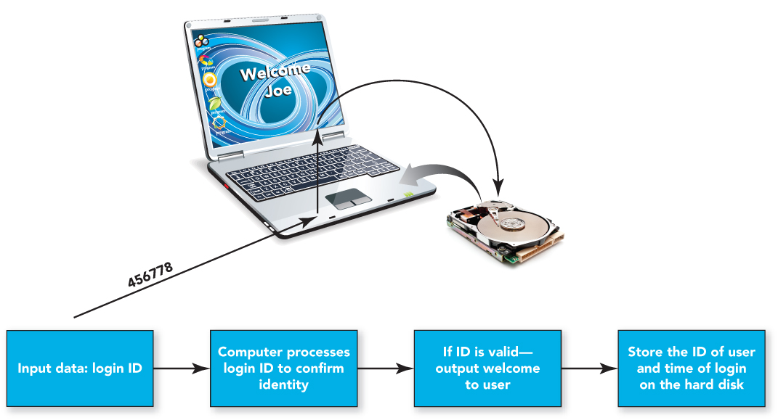
Computer Fundamentals

Slide 14
Computer Fundamentals
Computer system—group of associated components that work together
  Hardware
  Software

Slide 15
Computer Fundamentals
Hardware
  Physical parts of the computer
  Includes such components as the system unit, monitor, keyboard, and printer
Motherboard
  Circuit board that connects the central processing unit(s) to the other system components

Slide 16
Computer Fundamentals
System unit
  Base unit of the computer—made up of the plastic or metal enclosure, the motherboard, and the integrated peripherals

Slide 17
Computer Fundamentals
Input
  First operation of the information-processing cycle, enables the computer to accept data
  Data
    Facts that are raw and unorganized
    Entered into the computer for processing through the use of input devices such as a keyboard or mouse

Slide 18
Computer Fundamentals
Processing
  Second operation of the information-processing cycle, converts data into information
  Information refers to consolidated, organized, processed data.
  The central processing unit (CPU) processes data into information.
  Random access memory (RAM) temporarily stores programs and data needed by the CPU.

Slide 19
Computer Fundamentals
Output
  Third operation of the information-processing cycle, requires output devices, such as monitors and printers to display results for people to see or hear

Slide 20
Computer Fundamentals
Storage
  Fourth operation of the information-processing cycle, holds programs, software, and data that the computer system uses
  Storage devices
    Hard drives, CD and DVD drives, and media card readers—used with USB drives and flash memory cards

Slide 21
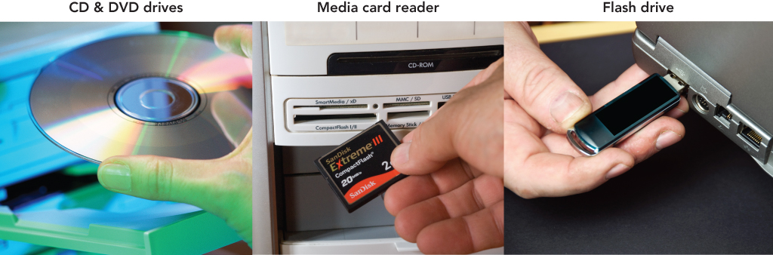
Computer Fundamentals

Slide 22
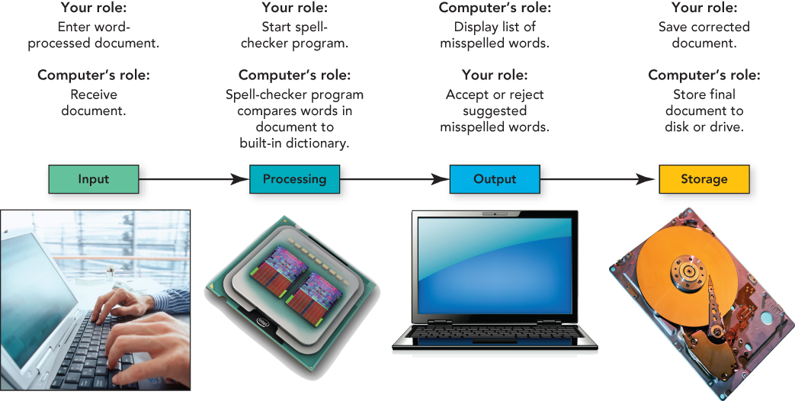
Computer Fundamentals

Slide 23
Computer Fundamentals
Communications
  High-speed movement of data or information
Communication device
  Hardware component that moves data in and out of a computer
Network
  Connects two or more computers to share input/output devices and other resources through the use of a network interface card

Slide 24
Types of Computers
Computers can be separated into two main types:
  Individual—designed for one user at a time
  Organization—designed to be used by many people at the same time

Slide 25
Types of Computers
Individual computers
  Personal computers (PCs)—either Mac (Apple’s Macintosh) systems or IBM-compatible systems
  Desktop computers—designed for home or office use, now include all-in-one computers that combine the system unit and the monitor
  Portable computers include notebooks, subnotebooks, and table PCs
    Notebooks—small enough for easy computer mobility
    Subnotebooks—run full desktop operating systems but have fewer components than notebooks, weigh less, are smaller
    Tablet PCs—input data with a keyboard or mouse; can write on the monitor with a special pen or stylus

Slide 26
Types of Computers
Individual computers (con’t.)
  Wireless devices—handheld computers, netbooks, personal digital assistants (PDAs), smartphones, e-books
    Netbooks—small, inexpensive notebooks designed primarily for wireless Web browsing and e-mail
    Smartphones—combine the capabilities of handheld computers, such as PDAs, and mobile phones
    Professional workstations—intended for technical applications that need powerful processing and output

Slide 27
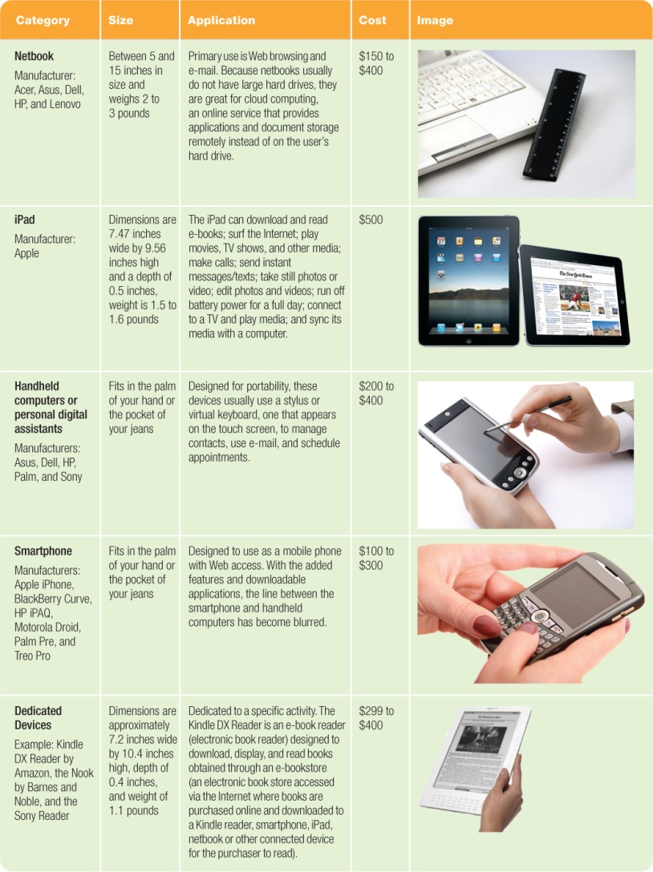
Types of Computers

Slide 28
Types of Computers
Organization computers
  Servers—enable users connected to a computer network to have access to the network’s programs, hardware, and data
  Clients—include the user computers connected to the network
  Client/server network—includes the use of client computers with centralized servers

Slide 29
Types of Computers
Organization computers (con’d.)
  Minicomputers (midrange servers)—designed to meet the needs of smaller companies or businesses
  Mainframes—very large processing jobs to meet the needs of large companies or agencies of the government
  Supercomputers—able to perform extremely high-speed processing and show underlying patterns

Slide 30
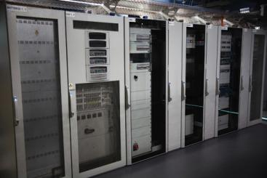

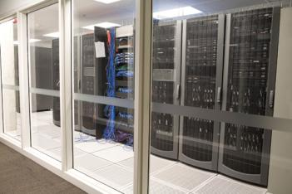
Types of Computers

Slide 31
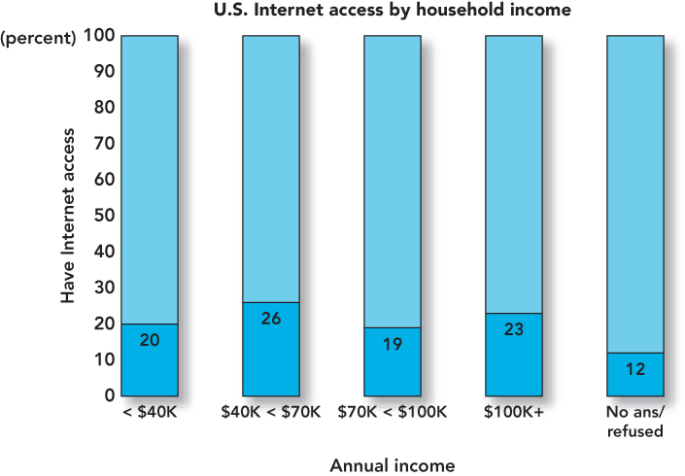
Computers, Society, and You
The Digital Divide

Slide 32
Computers, Society, and You
Web-based applications
  Internet messaging (IM)—free, real-time connection
    Two or more parties can use a buddy list to identify and restrict the contacts the person wishes to communicate with
  Social networks—include Facebook, MySpace, LinkedIn, and Twitter

Slide 33
Computers, Society, and You
Collaborative work
  Computer forensics—branch of forensic science that deals with legal evidence found on computers, and is used to find and apprehend criminals
  Collaborative software includes:
    Google Docs—free Web-based word processor and spreadsheet
    Wiki—collection of Web pages designed to let anyone with access contribute or modify content
    Google Groups—free service that helps users connect, share information, and communicate effectively over the Web

Slide 34
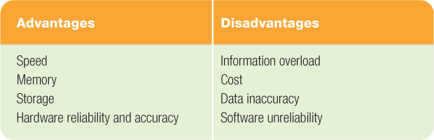
Computers, Society, and You
Advantages and Disadvantages of Computer Use

Slide 35
Computers, Society, and You
When using computer hardware:
  Do not plug too many devices into electrical outlets.
  Use surge protectors.
  Place hardware where it can’t fall or be damaged.
  Provide adequate space for air circulation around hardware.
  Securely fasten computer cables, cords,
  and wires.

Slide 36
Computers, Society, and You
Ergonomics—field of study concerned with the fit between people and their work environment
Carpal tunnel syndrome (repetitive strain injury or cumulative trauma disorder)—caused by repeated motions that damage nerves in hands, wrists, and arms

Slide 37
Computers, Society, and You
Promote safety and comfort
  Position top of your monitor at eye level
  Tilt the monitor back 10 to 20 degrees
  Place it at least 20” from your eyes
  Keep your wrists flat—use a wrist rest if needed
  Rest your eyes often by focusing on an object 20 or more feet away
  Stand and stretch periodically

Slide 38
Computers, Society, and You
Software programs
  Contain flaws
    Errors cause programs to run slowly or miscalculate.
    Bugs are almost impossible to eliminate completely.

Slide 39
Computers, Society, and You
Computer ethics
  Moral dilemmas relating to computer usage
Digital piracy
  Unauthorized reproduction and distribution of computer-based media
Unethical behavior
  Sending viruses, stealing credit card information, computer stalking, and installing illegitimate copies of software on computers

Slide 40
Computers, Society, and You
Computers provide those who are disabled and disadvantaged with added support and opportunities
E-learning
  Learning without requiring students to be at a specific location at a specific time

Slide 41
Computers, Society, and You
Automation
  Replacement of people by machines and computers
Outsourcing
  Subcontracting of portions of a job to a third party to reduce cost, time, and energy.
Computer technology
  Aided globalization and the resulting outsourcing of jobs, as well as structural unemployment—the obsolescence of certain jobs.

Slide 42
Computers, Society, and You
Be a responsible computer user:
  Understand how your computer use affects others.
  Obey laws and conform to requests regarding use of cell phones.
  Be aware of e-waste and the proper disposal of outdated computer hardware.

Slide 43
Computers, Society, and You
Advances in computer technology
  Upgrade software to obtain the latest software features.
  Stay informed to help avoid computer viruses.

Slide 44
Summary
Define the word computer and name the four basic operations that a computer performs.
Describe the two main components of a computer system: hardware and software.

Slide 45
Summary
Provide examples of hardware devices that handle input, processing, output, and storage tasks.
Give an example of the information processing cycle in action.
Discuss the two major categories and the various types of computers.

Slide 46
Summary
Explain the advantages and disadvantages of computer use.
Recognize the ethical and societal impacts of computer usage.
Discuss how computers affect employment.
List ways to be a responsible computer user.

Slide 47

All rights reserved. No part of this publication may be reproduced, stored in a retrieval system, or transmitted, in any form or by any means, electronic, mechanical, photocopying, recording, or otherwise, without the prior written permission of the publisher. Printed in the United States of America.
Copyright © 2012 Pearson Education, Inc.
Publishing as Prentice Hall

