Slide 1
Español 122
Estudios Culturales
Lección 5
Me llamo_____________
Fecha_________________
Mi profe se llama ___________________

Slide 2
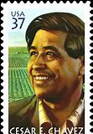
¿Quién es César Chávez?
He was an American labor leader and civil rights activists.
Founder of the National Farm Workers Association which was later on renamed the United Farm Workers union in 1962.
Fought for civil rights and was promoted by the American Labor Movement.

Slide 3
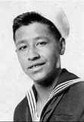
¿Me fascina la vida de César Chávez!
I love the life of Cesar Chavez because he proved to be a leader in a foreign country. He served as a leader for the union of the farmers. He was later promoted by the American Labor Movement. He fought for the improvement of the treatment, pay and working conditions for the farm workers.

Slide 4
1. Una meta (goal) de la marcha
La meta
Un ejemplo
One of the reason for the La Gran Marcha was that there was a need to show Americans that there is a need to understand more about all cultures of the world.
During the La Gran Marcha, those who took part wanted to make Americans (congress) recognize that there was a need to have a diverse range of cultures.

Slide 5
2. Una meta (goal) de la marcha
La meta
Un ejemplo
Another reason for the La Gran Marcha was that it was a display of values.
The Latino community’s families were threteaned to be broken up. The family is the most valued entity by the Latinos.

Slide 6
3. Una meta (goal) de la marcha
La meta
Un ejemplo
They wanted to be heard get allowed to move into the US in search of livelihood.
The Latinos marched asking for the provision of employment so that they can have better lives.

Slide 7
Did you know about the march previously?
Yes I did.
I came across the march as I was going through the internet. The site was rich in information concerning the history of the Mexican American in the past.
I developed interest in learning more about the history of the Latinos.
I think they are part of this great nation and we should agree in one accord that there is a need to have diverse culture.

Slide 8
Why is it important to study the march?
What impacts did it have at the time, and what lessons can we gather from this time period?
It made the Americans appreciate diversity in cultures.
It brought the attention of the evil things that were done to the Latinos. Both verbal and physical abuse had to stop.
One of the lessons that can be gathered from this time period is that all people should be equally treated regardless race, and ethnicity differences among others.
Secondly, rights of all people should be guarded.

Slide 9
Why is it important to have a commemorative march on campus?
Do you think most Americans today are aware of this social issue?
We can say that to some extent, some of the Americans are aware of this social issue since they have allowed for diversity in their nation. They have been acknowledging the need to have diverse culture within the nation. On the other hand, we have all witnessed the current President, Trump wanted to depot most of the immigrants. Also, he wants so much to build a Wall that separates the US and Mexico which is a clear indication that he does not like cultural diversity.

Slide 10
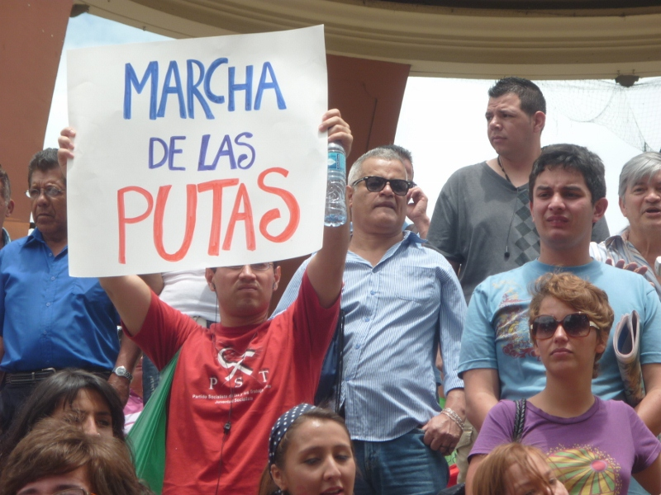
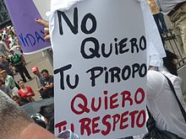
Mi proyecto: La pancarta

Slide 11
The Department Website will feature some of the students’ work. Please select statement (below) that best applies to you and include it in your powerpoint.
I am willing to have my powerpoint included on the department website with my name.

