Slide 1
Strategic and Operational Planning
CH. 4

Slide 2
Reading and Assignments: by Friday
Reading
  Ch. 4
Assignments
  Quiz 4

Slide 3
Learning Objectives
Describe the differences between corporate-, business-, and functional-level strategies
01
Describe how to write objectives
02
Explain why organizations analyze industries and competitive situations
03
Discuss the three growth strategies
04
Notes:
Describe the differences between corporate-, business-, and functional-level strategies
Describe how to write objectives
Explain why organizations analyze industries and competitive situations

Slide 4
Importance of Planning
Planning is one of the most important tasks managers do.
  Poor planning for the use of organizational resources can lead to failure.
Planning has three major benefits
  speedier decision making
  better management of resources,
  clearer identification of the action steps needed in order to reach important goals.
Notes:
Poor planning for the use of organizational resources can lead to failure. The solution to this is to improve the strategic and operational planning process in a company.

Slide 5
Poor Planning: 2010 Ryder Cup
The 2010 Ryder Cup golf competition was held at the Celtic Manor golf course in Newport, Wales. It was planned by Sun Mountain Sports as a key moment to dress captain Corey Pavin and his American team during wet weather. But the company’s RainFlex gear did not hold up in the rainy weather and did not keep players dry. Sun Mountain Sports owner Rick Reimers used Facebook to explain the poor implementation of what had appeared to be a good plan.

Slide 6
Reebok and CrossFit Games
Reebok has made significant gains in the fitness market by sponsoring CrossFit programs, For example, the best CrossFit athletes in the world come together to compete for the titles of Fittest Man and Fittest Woman on Earth at the Reebok CrossFit Games.
(M. Quirk, “6 Things to Know about the 2017 Reebok CrossFit Games,” Reebok.com [August 6, 2017].)

Slide 7
Strategic Planning
In strategic planning process, managers;
develop the mission (ppt. p 9)
analyze the environment (ppt. p 10-19)
set objectives (ppt. p 20-22)
develop strategies, and (ppt. p 23-31)
implement and control the strategies.
Cf) Operational Planning
management sets short-term objectives and determines in advance how they will be accomplished.
Concept check
What are three levels of strategies??
Notes:
Strategic planning is more a long-term planning compared to operational planning.
1. Developing the mission is the first step in the strategic process. The mission statement gives the organization its enduring sense of direction regarding what it would like to accomplish. For example, FIFA’s mission is to make the game of soccer better and to bring the game to the world.
Three levels of strategies
Corporate : organizations plan for managing multiple lines of businesses
Business: organization’s plan for managing one line of business
Functional: organization’s plan for managing one area of the business such as marketing and production.

Slide 8
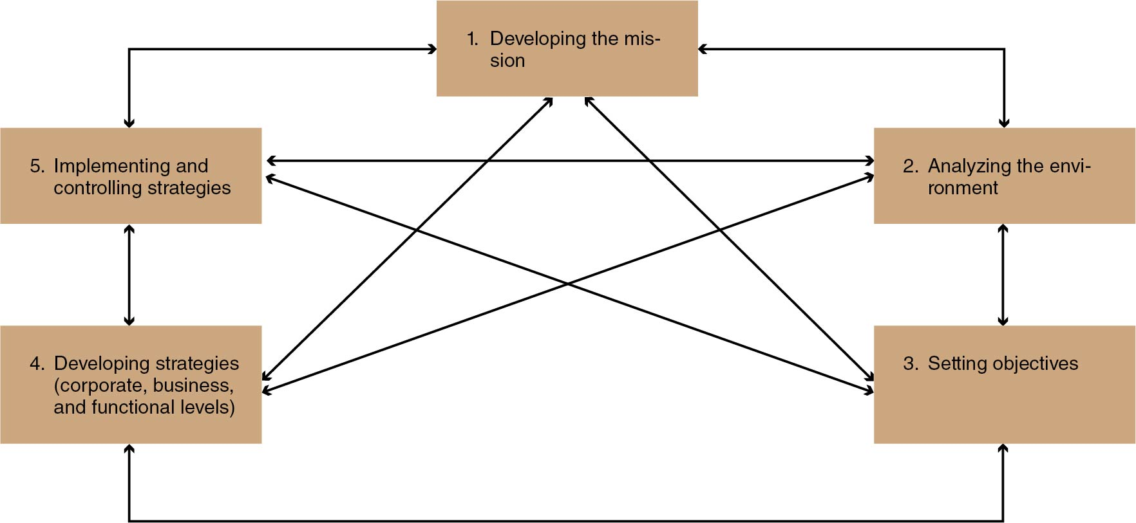
Figure 4.1 The Strategic Process
Notes:
Developing the mission
Analyzing the environment
Setting objectives
Developing strategies (corporate, business, and functional levels)
Implementing and controlling strategies
The process is not a linear one; there is interplay among the steps and levels.

Slide 9
1. Develop the mission
Developing the mission is the first step in the strategic process.
The mission statement gives the organization its enduring sense of direction regarding what it would like to accomplish.
  E.g.)FIFA’s mission is to make the game of soccer better and to bring the game to the world.

Slide 10
2. Analyze the environment/Situation
A situation analysis draws out those features in a company’s environment that most directly frame its strategic window of options and opportunities.
Three parts of situation analysis
  Analysis of the company’s industry and its competition (see ppt. 11-17)
  Analysis of the company’s particular situation (see ppt. 18)
  Analysis of the company’s competitive advantage (or lack thereof) (see ppt. 19)
Notes:
A. Industry Analysis and Five Competitive Forces. The analysis of the industry and competitive situation is used to determine the attractiveness of an industry.
B. Analysis of the Company Situation. The SWOT is a tool used to analyze the company and the industry. The internal strengths and weaknesses are matched against the external opportunities and threats.
C. Competitive Advantage. Competitive advantage specifies how the organization offers unique customer value.

Slide 11
Five Competitive Forces
1. Rivalry among competing firms
2. Potential development of substitute products and services
3. Potential entry of new competitors
4. Bargaining power of suppliers
5. Bargaining power of consumers

Slide 12
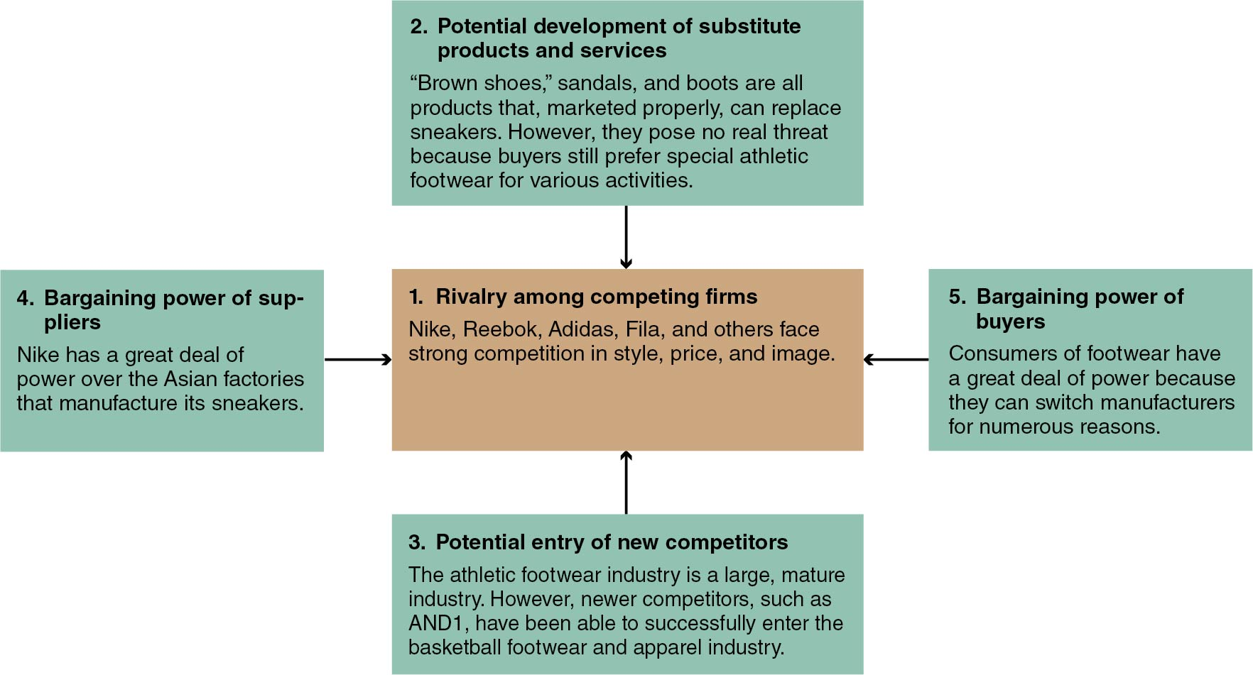
Figure 4.3 Nike’s Five-Forces Competitive Analysis
Notes:
At the center is 1. Rivalry among competing firms: Nike, Reebok, Adidas, Fila, and others face
strong competition in style, price, and image. Surrounding it, each with an arrow pointing back to it, are the following:
2. Potential development of substitute products and services “Brown shoes,” sandals, and boots are all products that, marketed properly, can replace sneakers. However, they pose no real threat because buyers still prefer special athletic footwear for various activities.
3. Potential entry of new competitors The athletic footwear industry is a large, mature industry. However, newer competitors, such as AND1, have been able to successfully enter the basketball footwear and apparel industry.
4. Bargaining power of suppliers Nike has a great deal of power over the Asian factories that manufacture its sneakers.
5. Bargaining power of buyers Consumers of footwear have a great deal of power because they can switch manufacturers for numerous reasons.

Slide 13
In the Athletic Footwear Industry: Nike
Rivalry of competing firms
Adidas/Reebok, Puma, and Fila are rivals in the athletic footwear industry. All three of these companies need to anticipate the moves of their competitors.

Slide 14
2. Potential Development of Substitutes
This occurs when companies from other industries try to move into the market.
Crocs is a slip-on shoe that has become popular in water sports and as a fashion item. Crocs normally come in bright colors and are easily recognizable. Crocs has recently formed an alliance with the NFL to sell its shoes in professional team colors.

Slide 15
3. Potential Entry of New competitors
Founded in 2016, Big Baller Brand (BBB) can be regarded as one of the new competitors in the athletic footwear market.

Slide 16
4. Bargaining Power of Suppliers
How dependent is the business on its suppliers? If the business has only one major supplier and no available alternatives, the supplier has great bargaining power.
Nike doesn’t actually make its own sneakers; it uses private contractors in Vietnam to produce them. Workers are paid very low wages, which indirectly gives Nike a great deal of power over these factory workers. In effect, since Nike can easily switch factories, it controls the suppliers.

Slide 17
5. Bargaining Power of Consumers
Consumers of athletic footwear have power because they can shift to other manufacturers on a mere whim or because of a new style, better price, higher quality, greater convenience, or any of a host of other reasons.
However, consumers lose power when they are loyal to a single business like Nike and want to buy only Nike footwear.

Slide 18
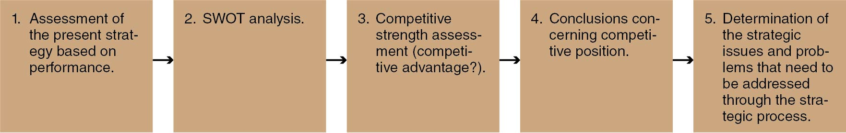
Figure 4.4 Steps in the Analysis of the Company Situation
Notes:
Step 1: Assessment of the present strategy based on performance measures(e.g., wins, championships, attendance, market share, sales, net profit etc. )
Step 2: SWOT analysis
Step 3: Competitive strength assessment (competitive advantage?): For a strategy to be effective, it must be based on a clear understanding of competitors. Looking at Critical Success Factors (CSFs) can help improve a company’s assessment of its competition.
Step 4: Conclusions concerning competitive position: How is the business doing compared with its competition?
Step 5: Determination of the strategic issues and problems that need to be addressed through the strategic process

Slide 19
Competitive Advantage
Competitive advantage;
  specifies how the organization offers unique customer value
  Identifies what makes a company different from and better than the competition
  Why should a person buy our product or service rather than the competitor’s

Slide 20
Goals Versus Objectives
Goals state general targets to be accomplished.
Objectives state what is to be accomplished in specific and measurable terms by a certain target date.

Slide 21
Writing Objectives
To write an objective:
Start with to.
Add an action verb.
Insert a single specific and
measurable result.
4. Choose a target date.
Example:
To
increase
sales in international markets by 7% to 9%
in each quarter of the next fiscal year (2020).

Slide 22
MBO
Management by objectives (MBO) is the process by which managers and their teams jointly set objectives, periodically evaluate performance, and reward according to the results.
Other names for MBO
  Work planning and review
  Goals management
  Goals and controls
  Management by results
Notes:
Three steps in the MBO process
Set individual objectives and plans
Give feedback and evaluate performance
Reward according to performance

Slide 23
Corporate-Level strategies
Grand Strategies
  Growth (see next page for more details)
  Stability
  Turnaround and Retrenchment
  Or some combination of these
Three levels of Strategies
Corporate
Business
Functional
Notes:
There are three levels of strategies (Corporate, business, and functional).
Three levels of strategies
Corporate : organizations plan for managing multiple lines of businesses
Business: organization’s plan for managing one line of business
Functional: organization’s plan for managing one area of the business such as marketing and production.
Grand strategies are corporate strategies for
1.growth: to increase their size through increased sales, market share, and fans.
2. stability: try to maintain their present size or to grow slowly. Many companies are satisfied with their status quo.
3. Turnaround: turnaround strategy is an attempt to reverse a declining business (most turnaround involves retrenchment)
4. retrenchment: a reduction in operating size by the divestiture or liquidation of assets and laying off employees
5. a combination of thereof.

Slide 24
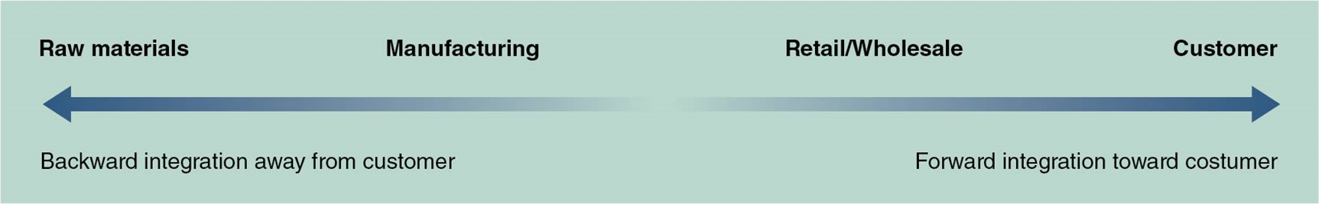
Corporate Growth Strategies
Concentration
Backward integration
Forward integration
Related and unrelated diversification
Mergers
Acquisitions
Notes:
Concentrate: grows its existing lines of business aggressively…e.g.) Dick’s sporting continues to open new stores.
Integrate: forward (the line of business is closer to the final consumer), backward ( the line of business is farther away from the final consumer (e.g., Spalding buy a rubber producing farm instead of buying rubber )
Diversify: goes into related or unrelated lines of products
Mergers and Acquisitions: organizations can also grow through M & A.

Slide 25
Corporate strategy: Business Portfolio Analysis
Corporations determine which lines of business they will be in and how they will allocate resources among the various lines.
A business line—also called a strategic business unit (SBU)—is a distinct business with its own customers that operates rather independently of the corporation’s other businesses.

Slide 26
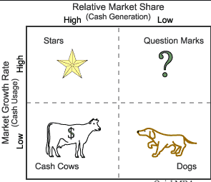
Business portfolio analysis: BCG Matrix
Notes:
The growth share matrix is, put simply, a portfolio management framework that helps companies decide how to prioritize their different businesses.
Each of the four quadrants represents a specific combination of relative market share, and growth:
Low Growth, High Share. Companies should milk these “cash cows” for cash to reinvest.
High Growth, High Share. Companies should significantly invest in these “stars” as they have high future potential.
High Growth, Low Share. Companies should invest in or discard these “question marks,” depending on their chances of becoming stars.
Low Share, Low Growth. Companies should liquidate, divest, or reposition these “dogs.”

Slide 27
Nike BCG Growth-Share Matrix
Cash cows: Athletic footwear
Question marks: NikeiD + Custom Shoes and Accessories
Stars: Nike Apparel
Dogs: Nike golf equipment business. Nike will stay in golf apparel, but it dropped clubs, bags, and balls in 2016.
(T. Hoium, “How Nike’s Big-Money Golf Strategy Failed.” https://www.fool.com/investing/2016/08/09/how-nikes-big-money-golf-strategy-failed.aspx [August 9, 2016].)

Slide 28
Business-Level Strategy
Business-level strategies are commonly called adaptive strategies
Adaptive strategies
  Prospecting: in fast-changing environment
  Defending: in slow-changing environment
  Analyzing: in moderately changing environment
Notes:
Business-level strategies are commonly called adaptive strategies. The emphasis is on adapting to changes in he external environment.
A prospector company aggressively offers new products or services or aggressively enters new markets. Prospecting is a growth strategy used in fast-changing environments with high growth potential. A defender company stays with its product line and markets. Defending is a stable strategy used in slow-changing environments with low growth potential. An analyzer company moves into new markets cautiously or offers a core product group and seeks new opportunities. Analyzing is a combination strategy used in moderately changing environments with moderate growth potential.

Slide 29
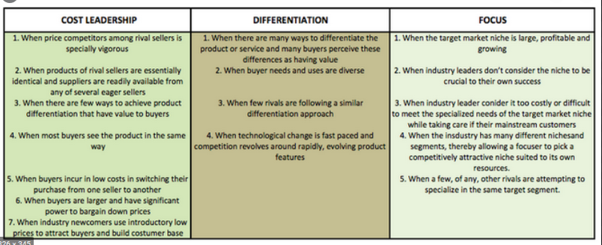
Business-Level Strategy
Competitive strategies: Michael Porter identifies three strategies—differentiation, cost leadership, and focus.
Notes:
Michael Porter identified three effective business-level competitive strategies: differentiation, cost leadership, and focus. Porter said that an organization cannot effectively compete using two of these strategies at once because this would lead to a “stuck-in-the-middle” syndrome. Others believe that you can use two of these strategies at once.

Slide 30
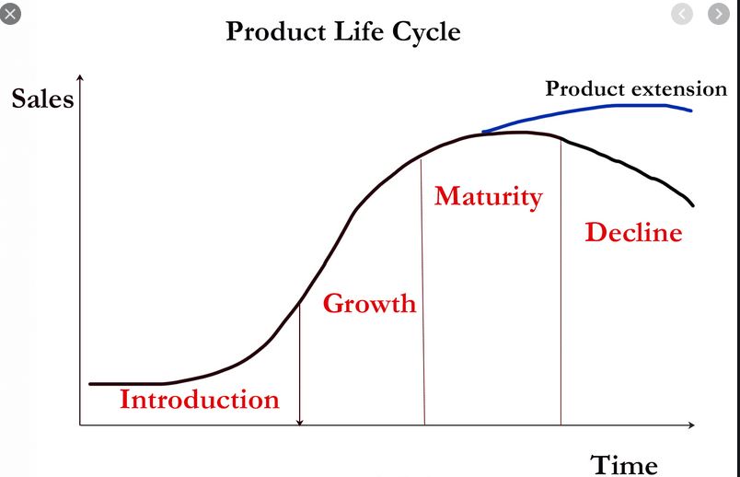
Business –Level Strategy
Product Life Cycle
  Introduction
  Growth
  Maturity
  Decline
Notes:
Introduction Stage – This stage of the cycle could be the most expensive for a company launching a new product. The size of the market for the product is small, which means sales are low, although they will be increasing. On the other hand, the cost of things like research and development, consumer testing, and the marketing needed to launch the product can be very high, especially if it’s a competitive sector. (companies are likely to charge a high price to recover investments).
Growth Stage – The growth stage is typically characterized by a strong growth in sales and profits, and because the company can start to benefit from economies of scale in production, the profit margins, as well as the overall amount of profit, will increase. This makes it possible for businesses to invest more money in the promotional activity to maximize the potential of this growth stage. New firms are likely to enter.
Maturity Stage – During the maturity stage, the product is established and the aim for the manufacturer is now to maintain the market share they have built up. This is probably the most competitive time for most products and businesses need to invest wisely in any marketing they undertake. They also need to consider any product modifications or improvements to the production process which might give them a competitive advantage.
Decline Stage – Eventually, the market for a product will start to shrink, and this is what’s known as the decline stage. This shrinkage could be due to the market becoming saturated (i.e. all the customers who will buy the product have already purchased it), or because the consumers are switching to a different type of product. While this decline may be inevitable, it may still be possible for companies to make some profit by switching to less-expensive production methods and cheaper markets.
* Product extension can lengthen the maturity stage of a product.

Slide 31
Functional-Level Strategies
Operational strategies are used by every functional-level department—marketing, operations, human resources, finance—to achieve corporate- and business-level objectives.
Notes:
Companies develop operational strategies in four major functional areas: marketing, operations, human resources, and finance. Other functional-level strategies are developed as needed, depending on the organization’s business and environment.

