Slide 1
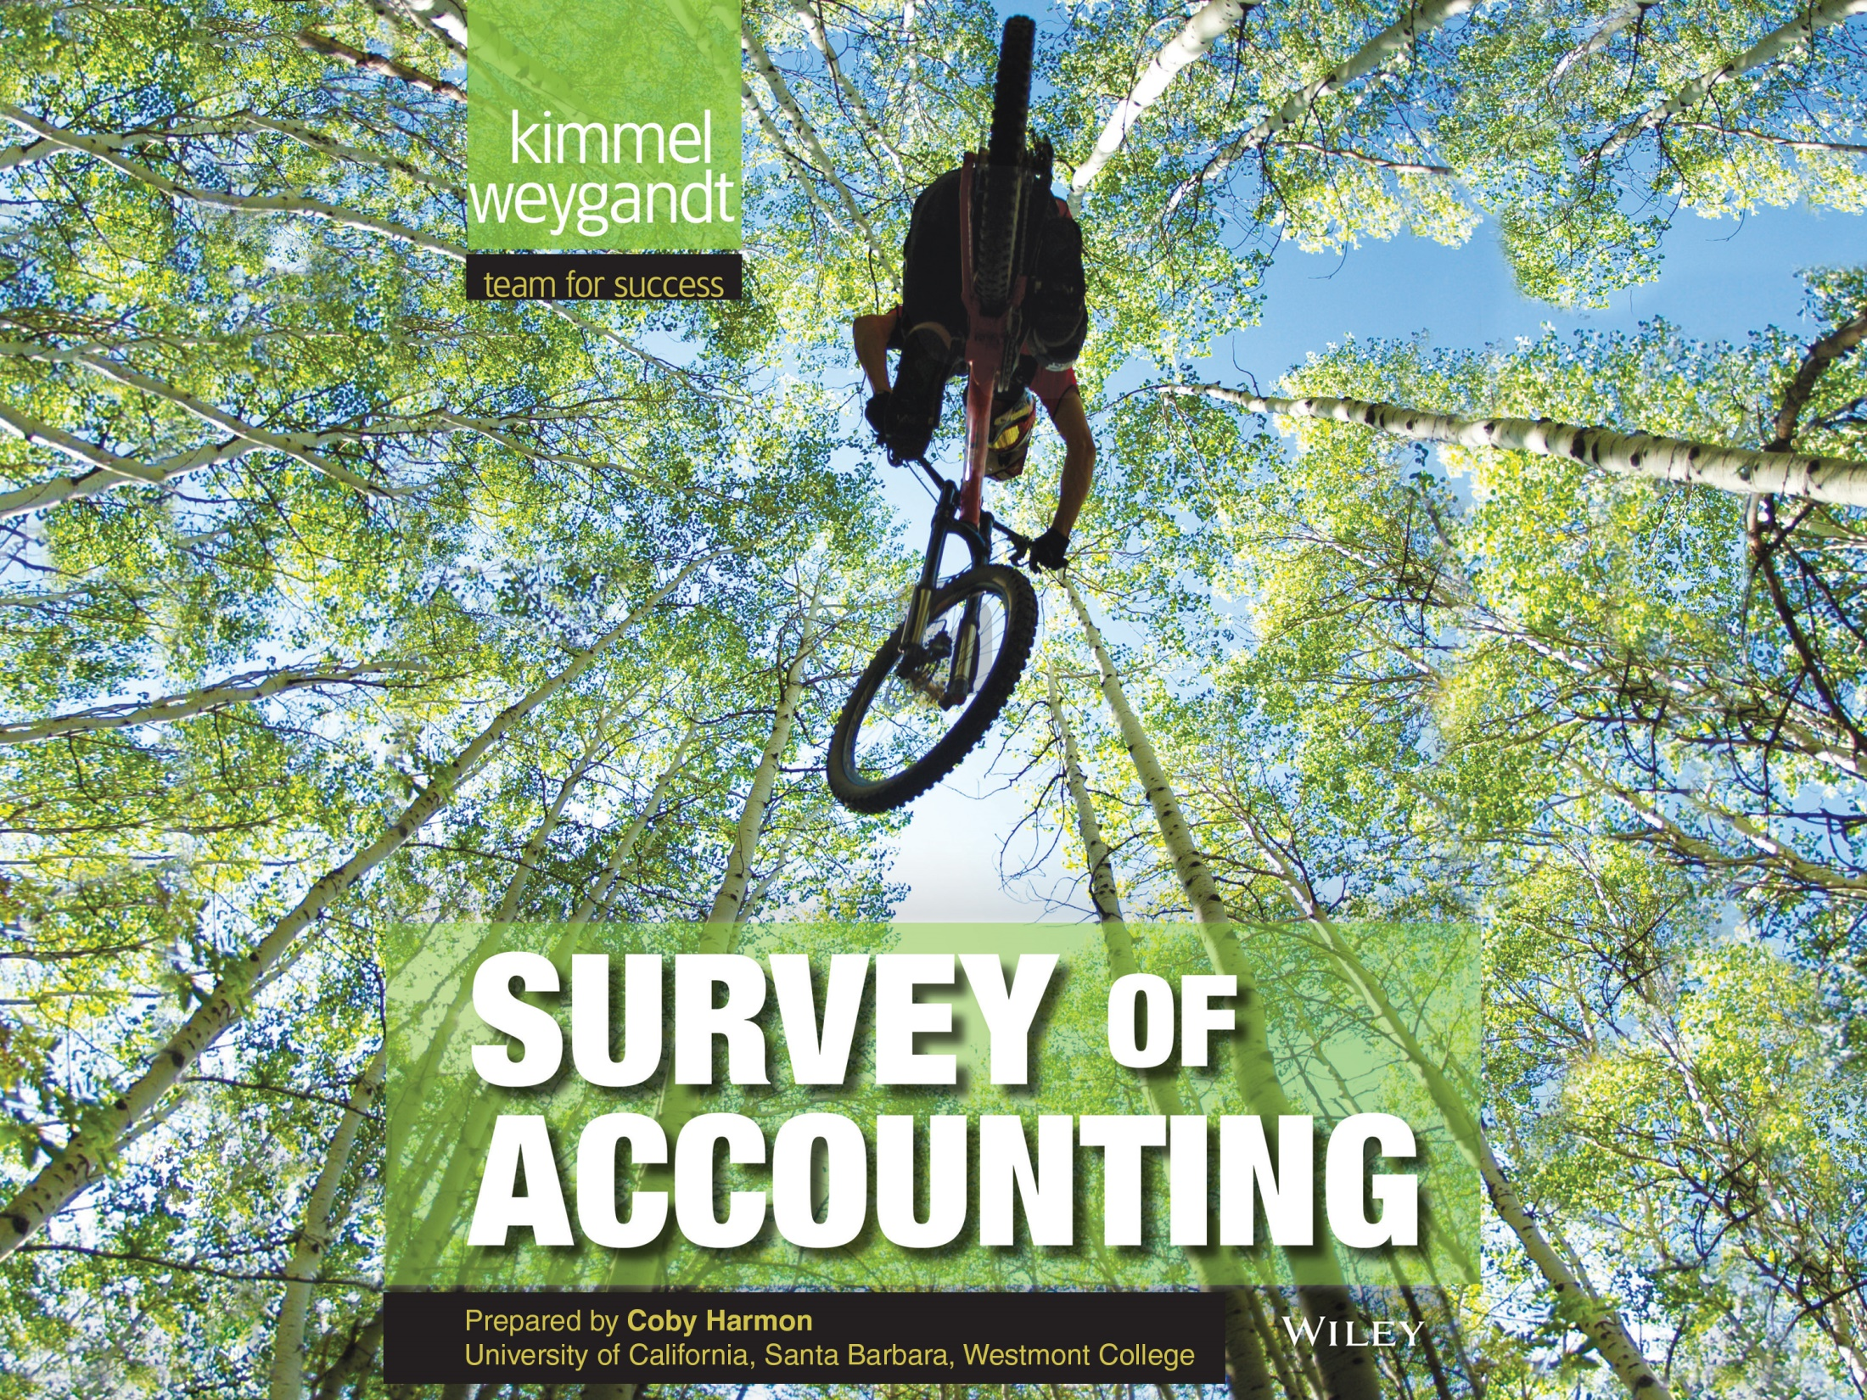

Slide 2
10
WILEY
Managerial Accounting
Kimmel ● Weygandt
Survey of Accounting, First Edition

Slide 3
CHAPTER OUTLINE
LEARNING OBJECTIVES
Identify the features of managerial accounting and the functions of management.
1
Describe the classes of manufacturing costs and the differences between product and period costs.
2
Demonstrate how to compute cost of goods manufactured and prepare financial statements for a manufacturer.
3
Discuss trends in managerial accounting.
4

Slide 4
LEARNING OBJECTIVE
1
Identify the features of managerial accounting and the functions of management.
Managerial accounting provides economic and financial information for managers and other internal users.
LO 1

Slide 5
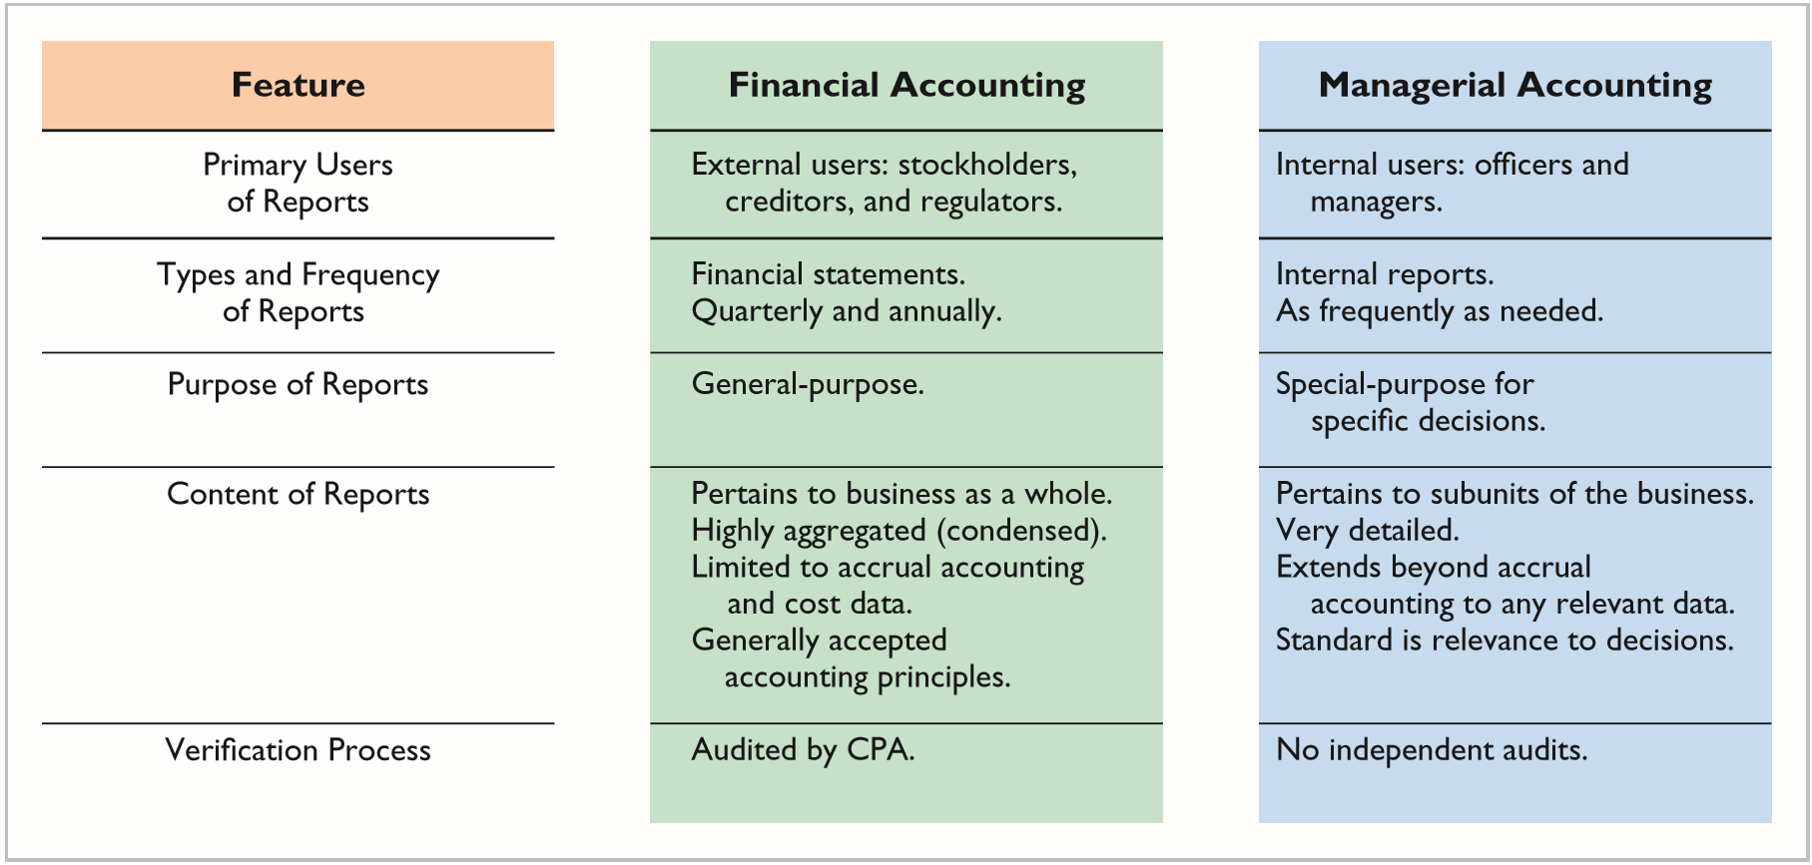
COMPARING MANAGERIAL AND FINANCIAL ACCOUNTING
ILLUSTRATION 10-1
Differences between financial and managerial accounting
LO 1

Slide 6
MANAGEMENT FUNCTIONS
Planning
Directing
Controlling
Maximize short-term profit and market share.
Commit to environmental protection and social programs.
Add value to the business.
Coordinate diverse activities and human resources.
Implement planned objectives.
Provide incentives to motivate employees
Hire and train employees.
Produce a smooth-running operation.
Keeping activities on track.
Determine whether goals are met.
Decide changes needed to get back on track.
May use an informal or formal system of evaluations.
LO 1

Slide 7
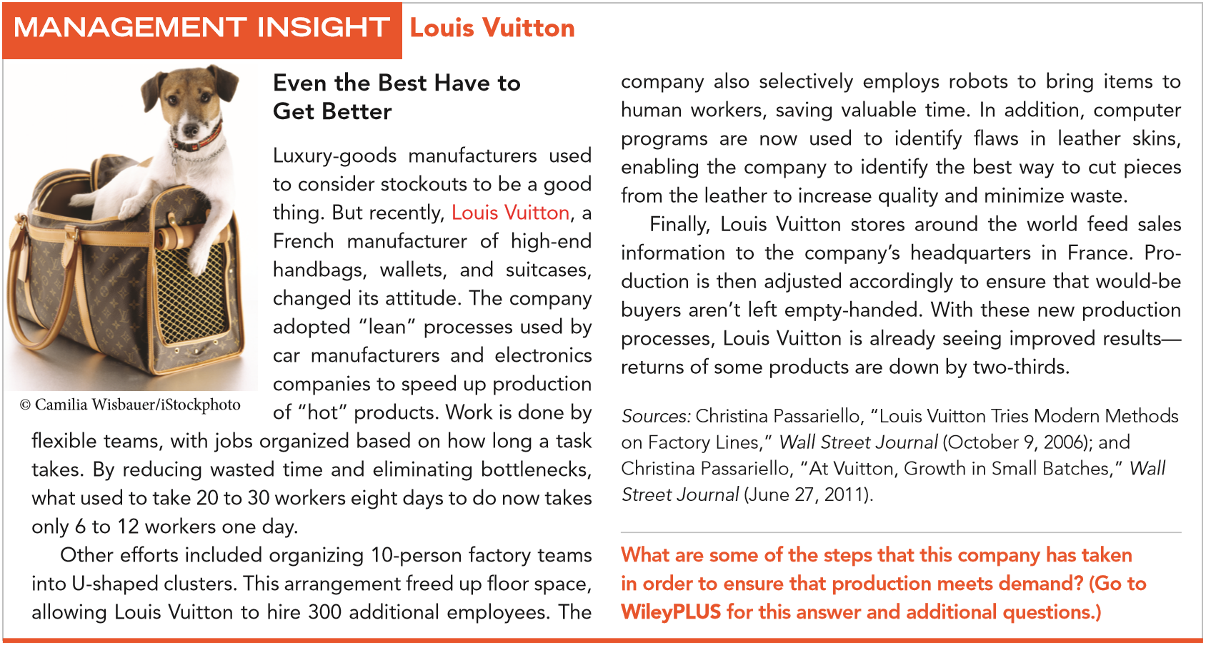
LO 1

Slide 8
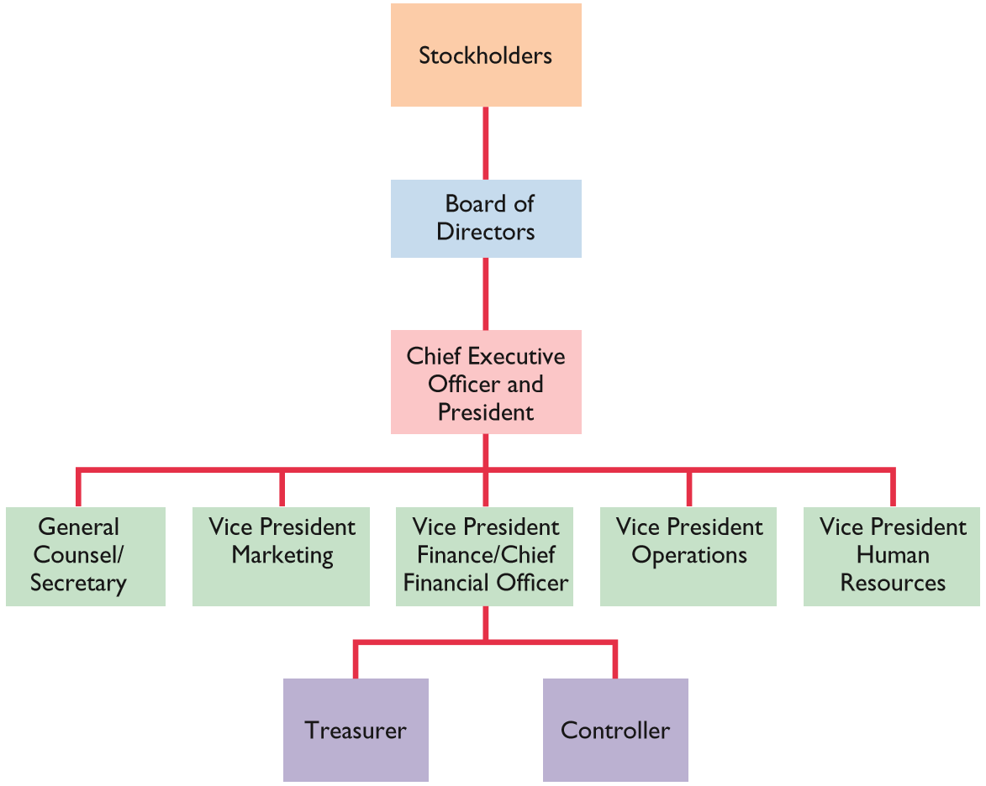
Organization charts show the interrelationships of activities and the delegation of authority and responsibility within the company.
ILLUSTRATION 10-2
A typical corporate
organization chart
LO 1

Slide 9
DO IT!
1
Managerial Accounting Overview
Indicate whether the following statements are true or false.
Managerial accountants have a single role within an organization, collecting and reporting costs to management.
Financial accounting reports are general-purpose and intended for external users.
Managerial accounting reports are special-purpose and issued as frequently as needed.
False
True
True
LO 1

Slide 10
DO IT!
1
Managerial Accounting Overview
Indicate whether the following statements are true or false.
Managers’ activities and responsibilities can be classified into three broad functions: cost accounting, budgeting, and internal control.
Managerial accounting reports must now comply with generally accepted accounting principles (GAAP).
False
False
LO 1

Slide 11
Describe the classes of manufacturing costs and the differences between product and period costs.
LEARNING OBJECTIVE
2
Managers should ask questions such as the following.
  What costs are involved in making a product or providing a service?
  If we decrease production volume, will costs decrease?
  What impact will automation have on total costs?
  How can we best control costs?
LO 2

Slide 12
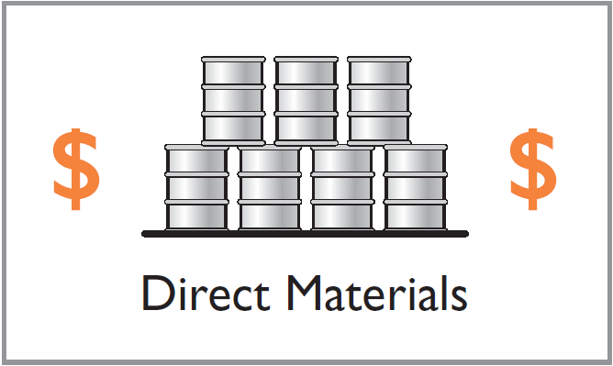
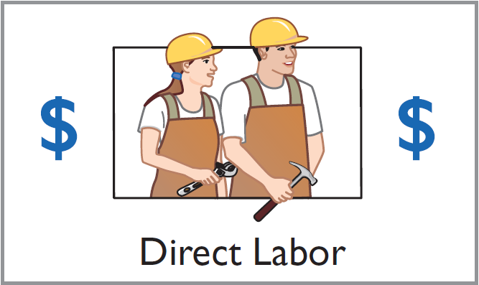
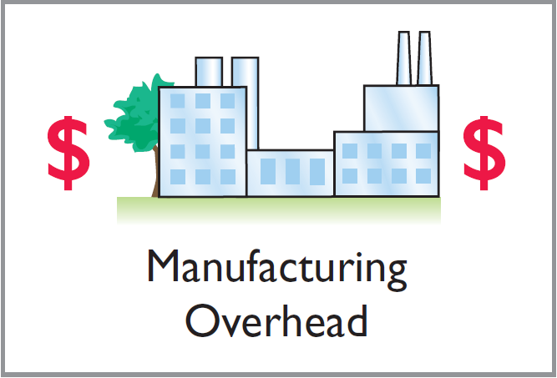
MANUFACTURING COSTS
Manufacturing consists of activities and processes that convert raw materials into finished goods.
LO 2

Slide 13
MANUFACTURING COSTS
Direct Materials
Raw Materials
Basic materials and parts used in manufacturing process.
Direct Materials
Raw materials that can be physically and directly associated with the finished product during the manufacturing process.
LO 2

Slide 14
MANUFACTURING COSTS
Direct Materials
Indirect Materials
  Not physically part of the finished product or
  they are an impractical to trace to the finished product because their physical association with the finished product is too small in terms of cost.
  Considered part of manufacturing overhead.
LO 2

Slide 15
MANUFACTURING COSTS
Direct Labor
Work of factory employees that can be physically and directly associated with converting raw materials into finished goods.
Indirect Labor
Work of factory employees that has no physical association with the finished product or for which it is impractical to trace costs to the goods produced.
LO 2

Slide 16
MANUFACTURING COSTS
Manufacturing Overhead
  Costs that are indirectly associated with manufacturing the finished product.
  Includes all manufacturing costs except direct materials and direct labor.
  Also called factory overhead, indirect manufacturing costs, or burden.
LO 2

Slide 17
Why Manufacturing Matters for U.S. Workers
Prior to 2010, U.S. manufacturing employment fell at an average rate of 0.1% per year for 60 years. At the same time, U.S. factory output increased by an average rate of 3.4%. As manufacturers relied more heavily on automation, the number of people they needed declined. However, factory jobs are important because the average hourly wage of a factory worker is $22, twice the average wage of employees in the service sector. Fortunately, manufacturing jobs in the United States increased by 1.2% in 2010, and they were forecast to continue to increase through at least 2015. Why?
Because companies like Whirlpool, Caterpillar, and Dow are building huge new plants in the United States to replace old, inefficient U.S. facilities. For many products that are ultimately sold in the United States, it makes more sense to produce them domestically and save on the shipping costs. In addition, these efficient new plants, combined with an experienced workforce, will make it possible to compete with manufacturers in other countries, thereby increasing export potential.
Sources: Bob Tita, “Whirlpool to Invest in Tennessee Plant,” Wall Street Journal Online (September 1, 2010); and James R. Hagerty, “U.S. Factories Buck Decline,” Wall Street Journal Online (January 19, 2011).
LO 2

Slide 18
PRODUCT VERSUS PERIOD COSTS
Product Costs
Direct materials
Direct labor
Manufacturing overhead
  Components:
  Costs that are an integral part of producing the product.
  Recorded in “inventory” account.
  Not an expense (COGS) until the goods are sold.
LO 2

Slide 19
PRODUCT VERSUS PERIOD COSTS
Period Costs
  Charged to expense as incurred.
  Non-manufacturing costs.
  Includes all selling and administrative expenses.
LO 2

Slide 20
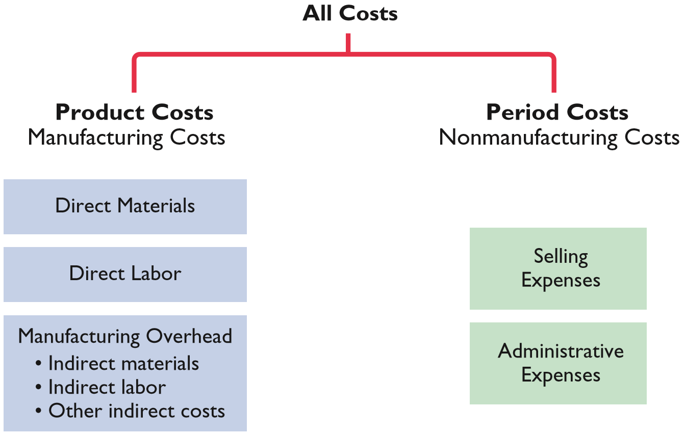
PRODUCT VERSUS PERIOD COSTS
ILLUSTRATION 10-3
Product versus period costs
LO 2

Slide 21
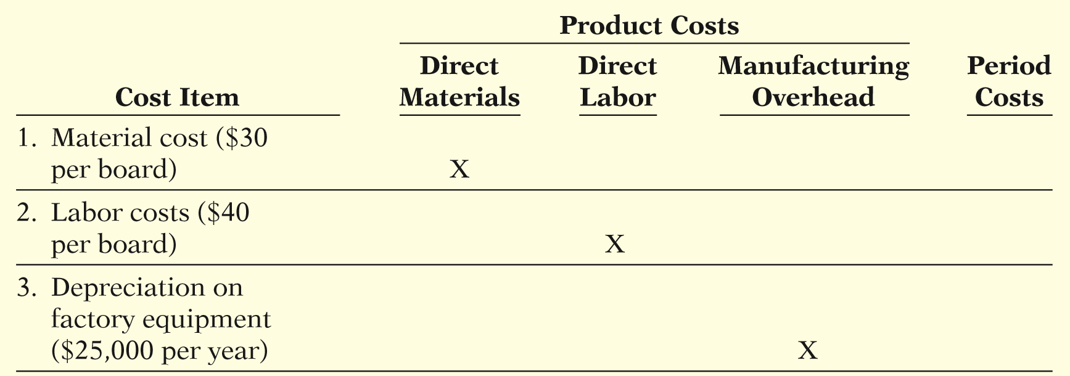


PRODUCT VERSUS PERIOD COSTS
Illustration: Suppose you started your own snowboard factory, KRT Boards. Here are some of the costs that your snowboard factory would incur. Assign the following costs:
ILLUSTRATION 10-4
Assignment of costs to cost categories
LO 2

Slide 22
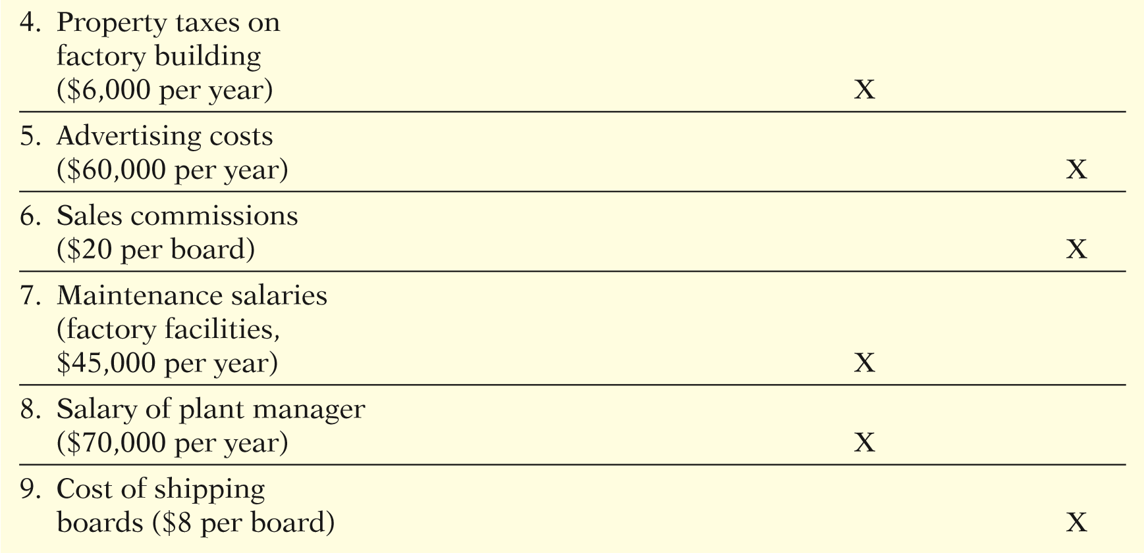
PRODUCT VERSUS PERIOD COSTS
ILLUSTRATION 10-4
LO 2

Slide 23
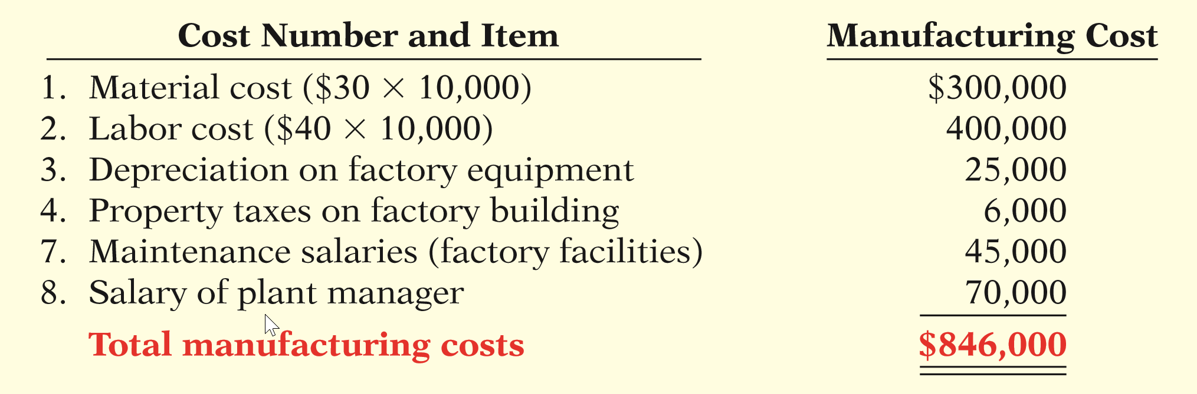
PRODUCT VERSUS PERIOD COSTS
If KRT Boards produces 10,000 snowboards the first year, what would be the total manufacturing costs?
ILLUSTRATION 10-5
Computation of total manufacturing costs
LO 2

Slide 24
DO IT!
2
Managerial Cost Concepts
A bicycle company has these costs: tires, salaries of employees who
put tires on the wheels, factory depreciation, advertising expenditures, lubricants, spokes, salary of factory manager, salary of accountant, handlebars, and salaries of factory maintenance employees. Classify each cost as direct materials, direct labor, overhead, or a period cost.
Direct Materials
Direct Labor
Overhead
Tires.
Spokes.
Handlebars.
Salaries of employees who put tires on the wheels.
Factory depreciation.
Lubricants
Salary of factory manager.
Salary of factory maintenance employees.
Advertising expenditures and salary of accountant are period costs.
LO 2

Slide 25
Demonstrate how to compute cost of goods manufactured and prepare financial statements for a manufacturer.
LEARNING OBJECTIVE
3
INCOME STATEMENT
Under a periodic inventory system, the income statements of a merchandiser and a manufacturer differ in the cost of goods sold section.
“COGS”
LO 3

Slide 26
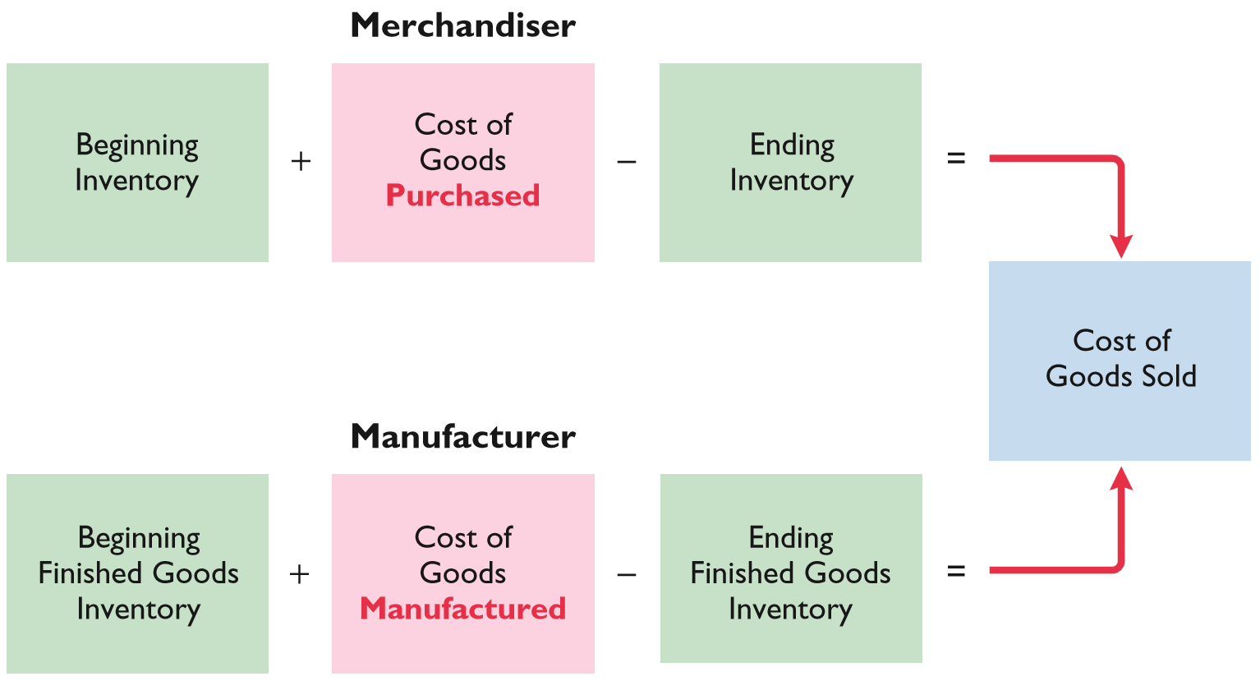
INCOME STATEMENT
Helpful Hint
Assume a periodic
inventory system in this illustration.
ILLUSTRATION 10-6
Cost of goods sold components
LO 3

Slide 27
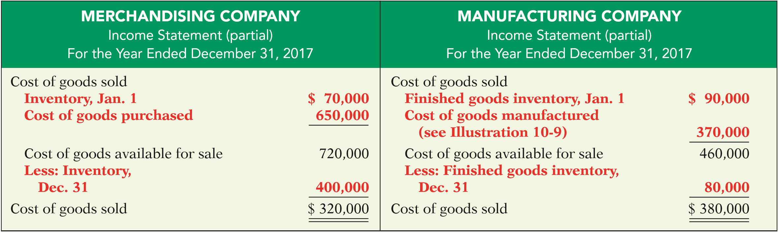
INCOME STATEMENT
Cost of goods sold sections of merchandising and manufacturing income statements
ILLUSTRATION 10-7
Cost of goods sold sections of merchandising and manufacturing Income statements
LO 3

Slide 28
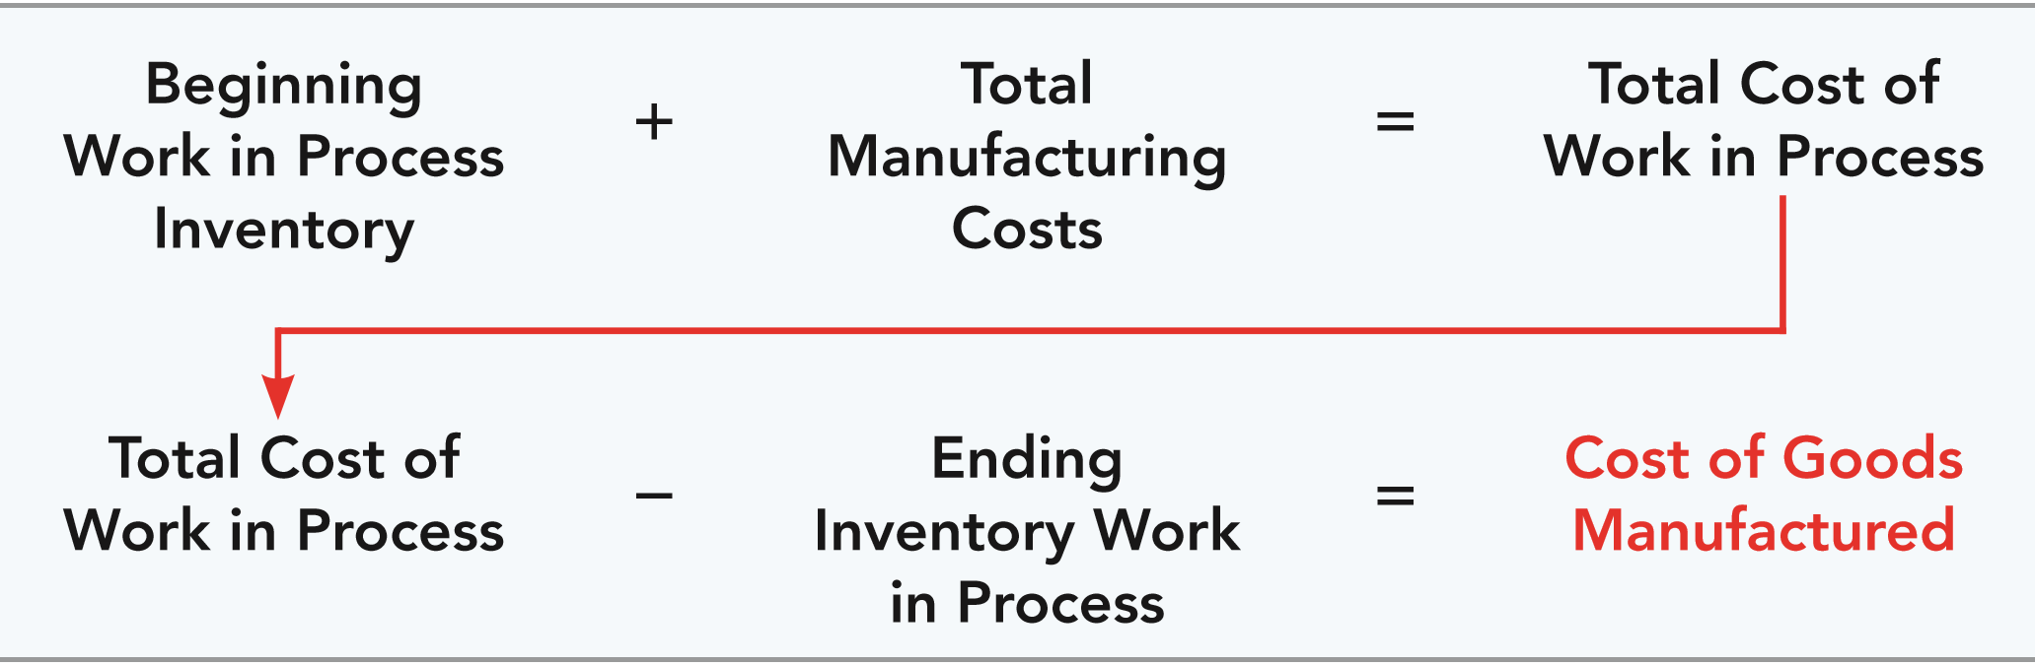
COST OF GOODS MANUFACTURED
Total Manufacturing Costs – sum of direct material costs, direct labor costs, and manufacturing overhead in the current year.
Total Work in Process – (1) cost of beginning work in process and (2) total manufacturing costs for the current period.
ILLUSTRATION 10-8
Cost of goods manufactured formula
LO 3

Slide 29
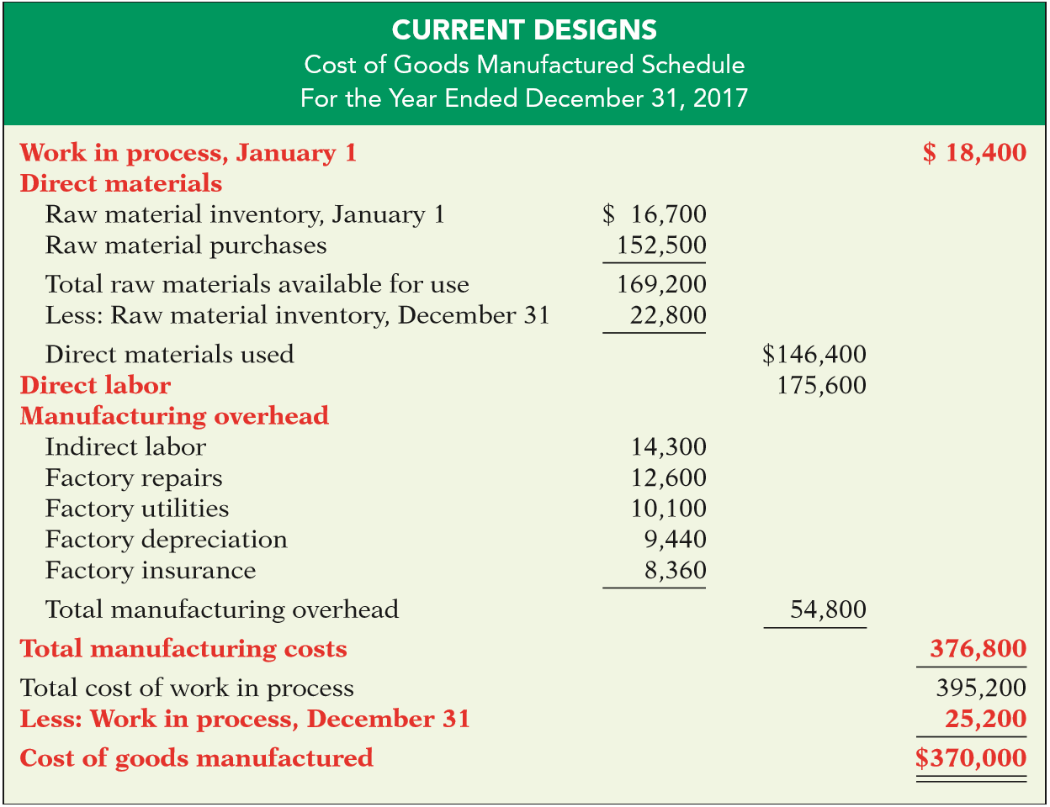
ILLUSTRATION 10-9
Cost of goods manufactured schedule
LO 3

Slide 30
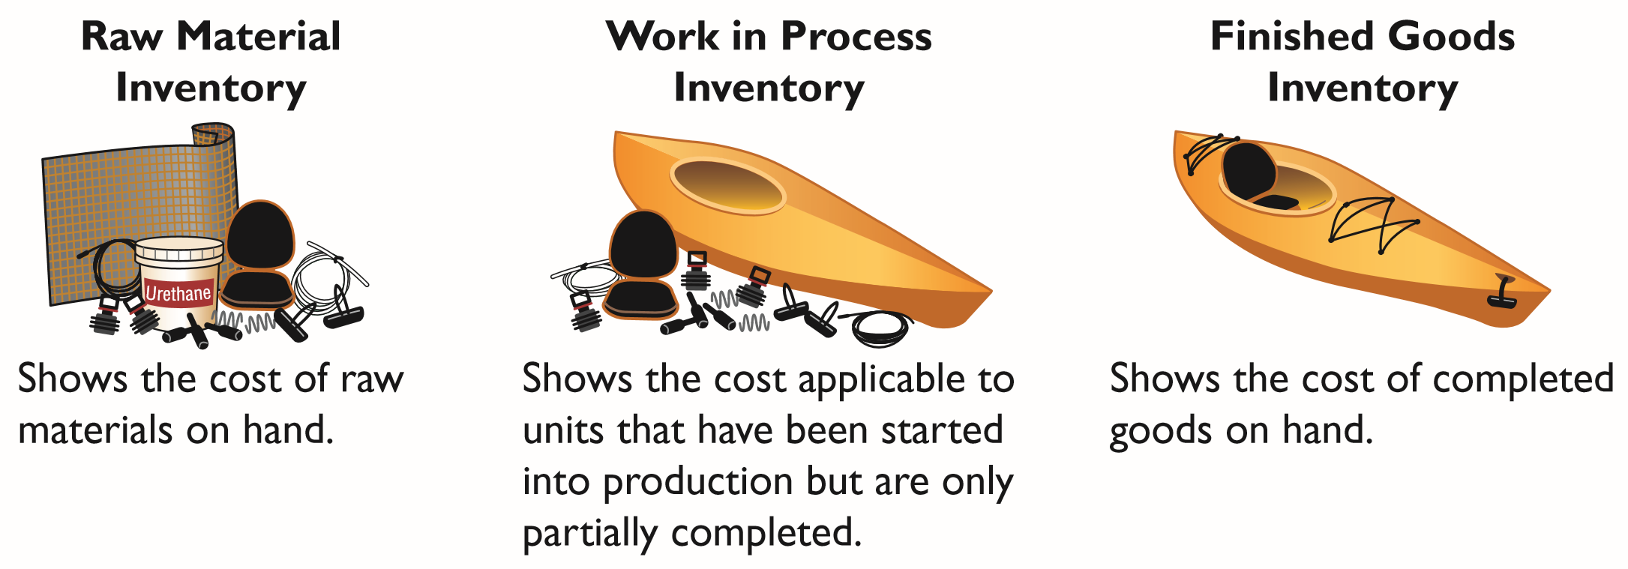
BALANCE SHEET
Inventory accounts for a manufacturer
ILLUSTRATION 10-10 Inventory accounts for a manufacturer
The balance sheet for a merchandising company shows just one category of inventory.
LO 3

Slide 31
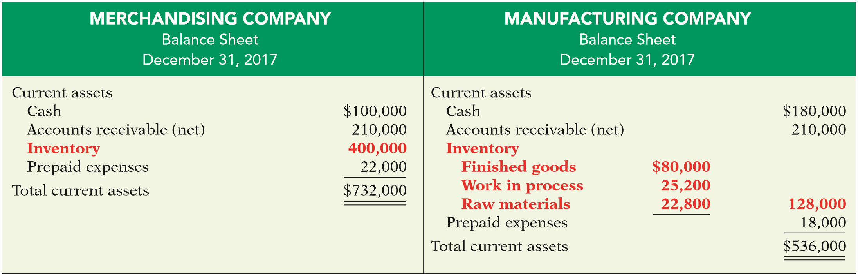
BALANCE SHEET
Current assets sections of merchandising and manufacturing balance sheets
ILLUSTRATION 10-11
Current assets sections of merchandising and manufacturing balance sheets
LO 3

Slide 32
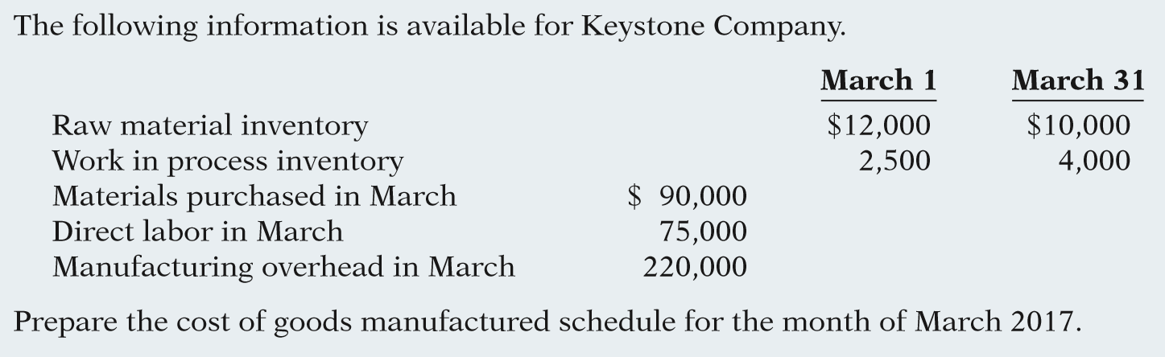
DO IT!
3
Cost of Goods Manufactured
LO 3

Slide 33
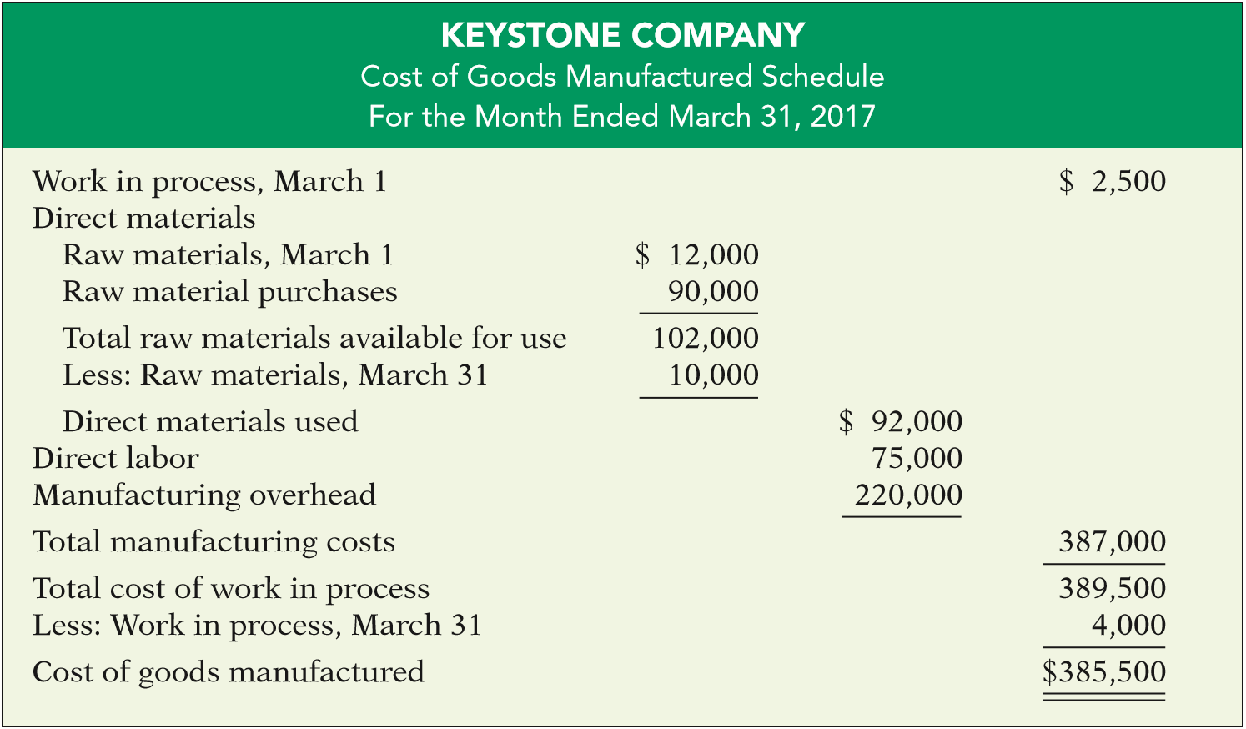
DO IT!
3
Cost of Goods Manufactured
LO 3

Slide 34
LEARNING OBJECTIVE
4
Discuss trends in managerial accounting
SERVICE INDUSTRIES
Much of the U.S. economy has shifted toward an emphasis on providing services rather than goods.
Over 50% of U.S. workers are now employed by service companies.
Most of the techniques learned for manufacturing firms are applicable to service companies.
LO 4

Slide 35
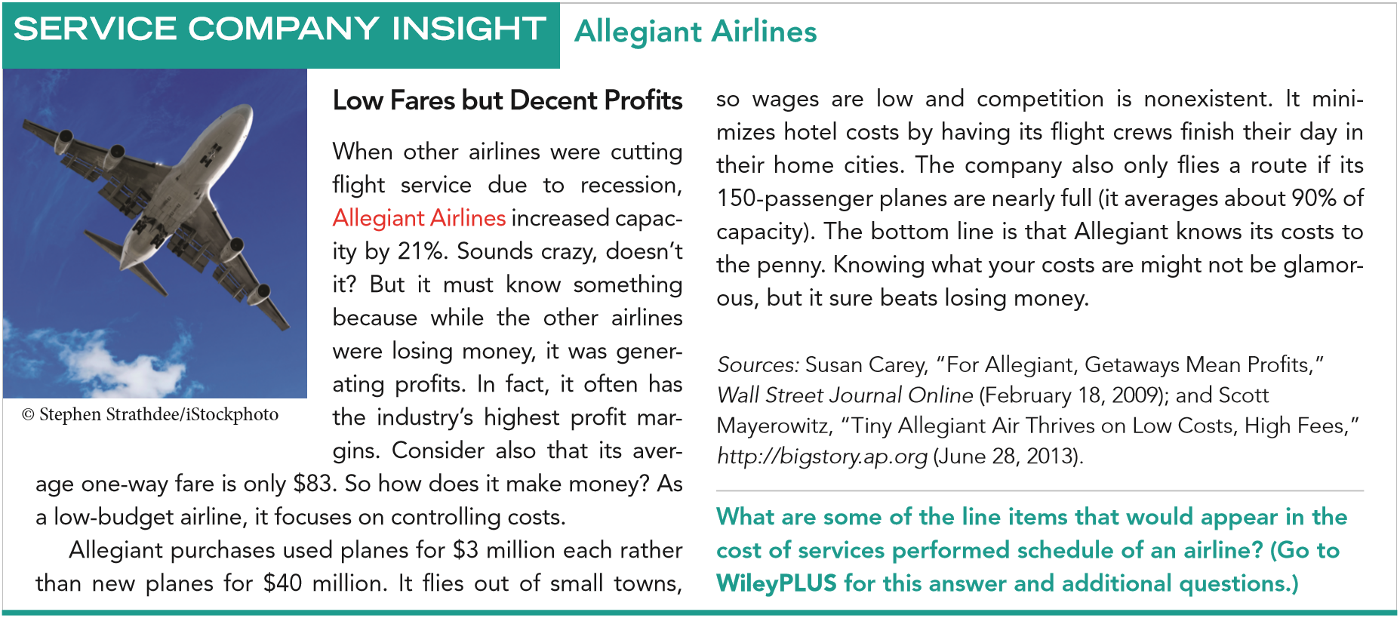
LO 4

Slide 36
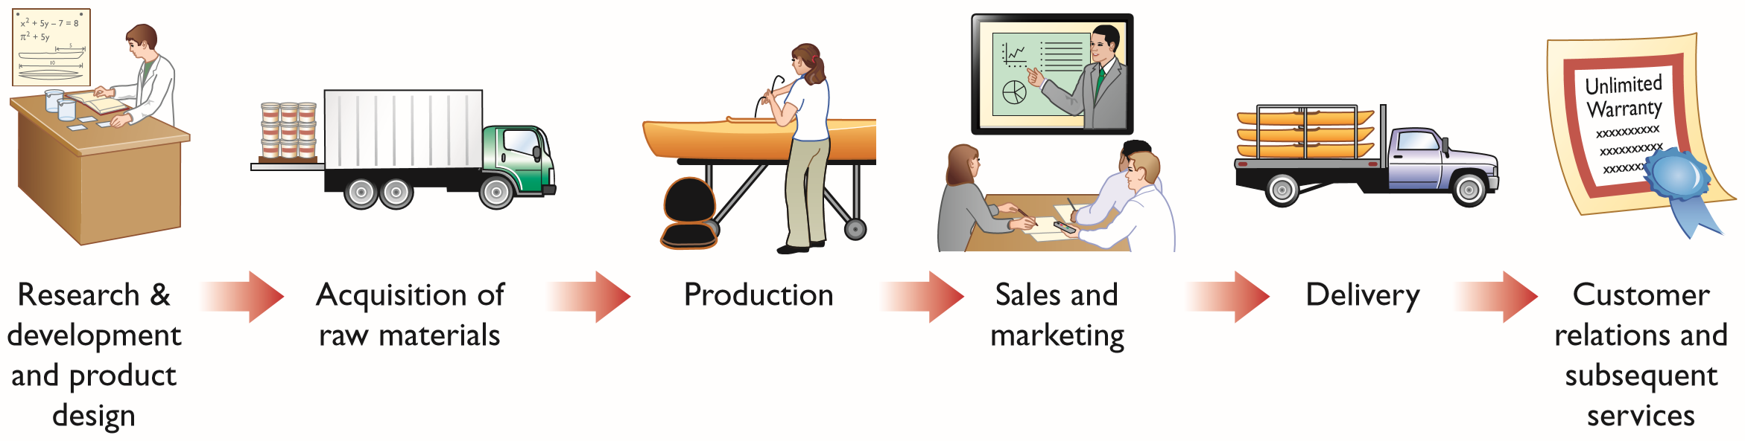
FOCUS ON THE VALUE CHAIN
Refers to all business processes associated with providing a product or service.
For a manufacturing firm these include the following:
ILLUSTRATION 10-12
A manufacturer’s value chain
LO 4

Slide 37
FOCUS ON THE VALUE CHAIN
Just-In-Time (JIT) Inventory Methods
Inventory system in which goods are manufactured or purchased just in time for sale.
Total Quality Management (TQM)
Reduce defects in finished products, with the goal of zero defects.
LO 4

Slide 38
FOCUS ON THE VALUE CHAIN
Theory of Constraints
Constraints (“bottlenecks” ) limit the company’s potential profitability.
A specific approach to identify and manage these constraints in order to achieve company goals.
Enterprise Resource Planning (ERP)
Software programs designed to manage all major business processes.
LO 4

Slide 39
FOCUS ON THE VALUE CHAIN
Activity-Based Costing (ABC)
Allocates overhead based on use of activities.
Results in more accurate product costing and scrutiny of all activities in the value chain.
LO 4

Slide 40
BALANCED SCORECARD
  Evaluates operations in an integrated fashion.
  Uses both financial and non-financial measures.
  Links performance to overall company objectives.
LO 4

Slide 41
BUSINESS ETHICS
Creating Proper Incentives
  Systems and controls sometimes create incentives for managers to take unethical actions.
  Controls need to be effective and realistic.
LO 4

Slide 42
BUSINESS ETHICS
Code of Ethical Standards
Sarbanes-Oxley Act (SOX)
  Clarifies management’s responsibilities.
  Requires certifications by CEO and CFO.
  Selection criteria for Board of Directors and Audit Committee.
  Substantially increased penalties for misconduct.
LO 4

Slide 43
CORPORATE SOCIAL RESPONSIBILITY
  Considers a company’s efforts to employ sustainable business practices with regard to its employees, society, and the environment.
  Is sometimes referred to as the triple bottom line because it evaluates a company’s performance with regard to people, planet, and profit.
  Recent reports indicate that over 50% of the 500 largest U.S. companies provide sustainability reports.
LO 4

Slide 44
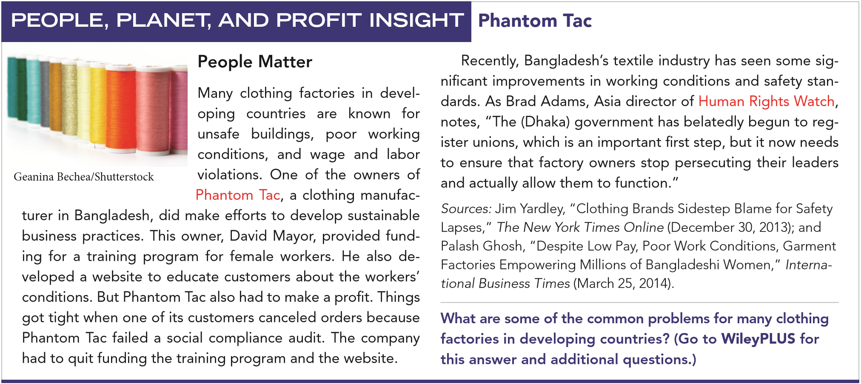
LO 4

Slide 45
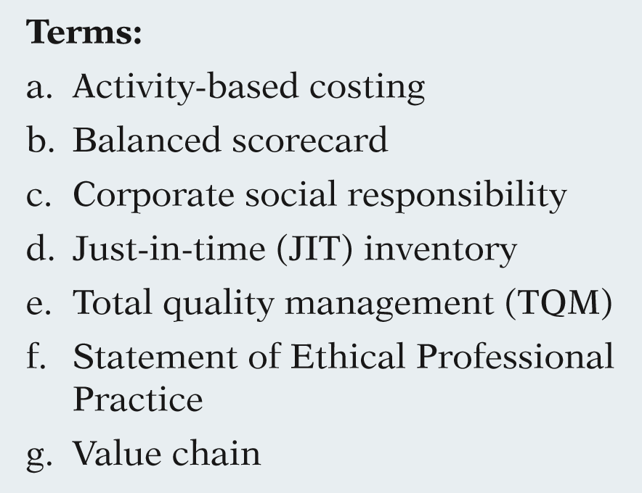
DO IT!
4
Trends in Managerial Accounting
Match the descriptions that follow with the corresponding terms.
1. ______ All activities associated with providing a product or performing service.
2. ______ A method of allocating overhead based on each product’s use of activities in making the product.
g
a
3. ______ Systems implemented to reduce defects in finished products with the goal of achieving zero defects.
e
LO 4

Slide 46
DO IT!
4
Trends in Managerial Accounting
Match the descriptions that follow with the corresponding terms.
4. ______ A performance-measurement approach that uses both financial and nonfinancial measures, tied to company objectives, to evaluate a company’s operations in an integrated fashion.
b
5. ______ Inventory system in which goods are manufactured or purchased just as they are needed for use.
d
LO 4

Slide 47
DO IT!
4
Trends in Managerial Accounting
Match the descriptions that follow with the corresponding terms.
6. ______ A company’s efforts to employ sustainable business practices with regards to its employees, society, and the environment.
c
7. ______ A code of ethical standards developed by the Institute of Management Accountants.
f
LO 4

Slide 48
Copyright
Copyright © 2017 John Wiley & Sons, Inc. All rights reserved. Reproduction or translation of this work beyond that permitted in Section 117 of the 1976 United States Copyright Act without the express written permission of the copyright owner is unlawful. Request for further information should be addressed to the Permissions Department, John Wiley & Sons, Inc. The purchaser may make back-up copies for his/her own use only and not for distribution or resale. The Publisher assumes no responsibility for errors, omissions, or damages, caused by the use of these programs or from the use of the information contained herein.

