Slide 1
11
WILEY
Cost-Volume-Profit
Kimmel ● Weygandt ● Kieso
Survey of Accounting, First Edition
Prepared by
Coby Harmon
University of California, Santa Barbara
Westmont College

Slide 2
CHAPTER OUTLINE
LEARNING OBJECTIVES
Explain variable, fixed, and mixed costs and the relevant range.
1
Apply the high-low method to determine the components of mixed costs.
2
Prepare a CVP income statement to determine contribution margin.
3
Compute the break-even point using three approaches.
4
Determine the sales required to earn target net income and determine margin of safety.
5

Slide 3
LEARNING OBJECTIVE
1
Explain variable, fixed, and mixed costs and the relevant range.
Cost Behavior Analysis is the study of how specific costs respond to changes in the level of business activity.
  Some costs change; others remain the same.
  Helps management plan operations and decide between alternative courses of action.
  Applies to all types of businesses and entities.
  Starting point is measuring key business activities.
LO 1

Slide 4
Cost Behavior Analysis
Cost Behavior Analysis is the study of how specific costs respond to changes in the level of business activity.
  Activity levels may be expressed in terms of:
    Sales dollars (in a retail company)
    Miles driven (in a trucking company)
    Room occupancy (in a hotel)
    Dance classes taught (by a dance studio)
  Many companies use more than one measurement base.
LO 1

Slide 5
Cost Behavior Analysis
Cost Behavior Analysis is the study of how specific costs respond to changes in the level of business activity.
  Changes in the level or volume of activity should be correlated with changes in costs.
  Activity level selected is called activity or volume index.
  Activity index:
    Identifies the activity that causes changes in the behavior of costs.
    Allows costs to be classified as variable, fixed, or mixed.
LO 1

Slide 6
VARIABLE COSTS
  Costs that vary in total directly and proportionately with changes in the activity level.
    Example: If the activity level increases 10 percent, total variable costs increase 10 percent.
    Example: If the activity level decreases by 25 percent, total variable costs decrease by 25 percent.
  Variable costs remain the same per unit at every level of activity.
LO 1

Slide 7
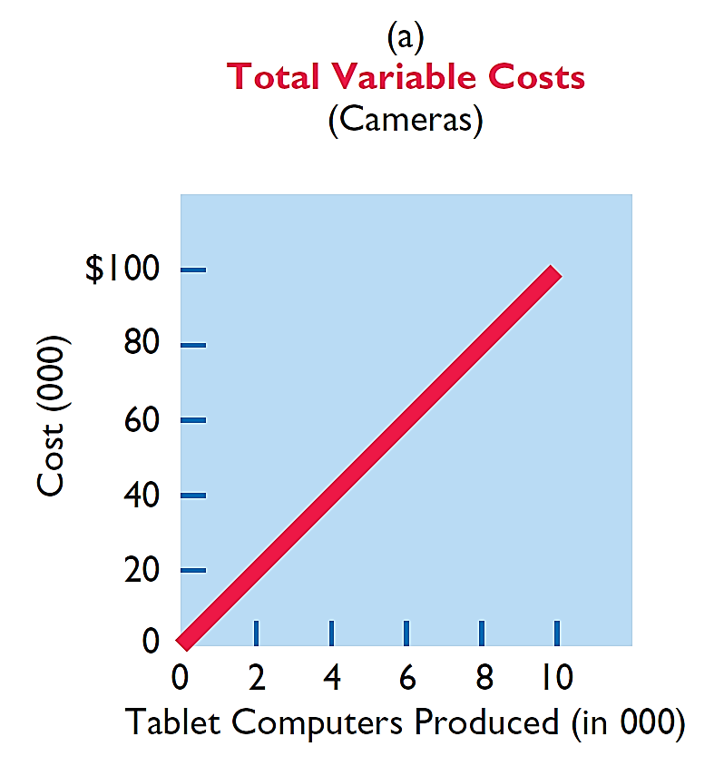
VARIABLE COSTS
Illustration: Damon Company manufactures tablet computers that contain a $10 camera. The activity index is the number of
tablets produced. As Damon manufactures each tablet, the total cost of the cameras used increases by $10. As part (a) of ILLUSTRATION 11-1 shows, total cost of the cameras will be $20,000 if Damon produces 2,000 tablets, and $100,000 when it produces 10,000 tablets. We also can see that a variable cost remains the same per unit as the level of activity changes.
ILLUSTRATION 11-1
Behavior of total and unit variable costs
LO 1

Slide 8
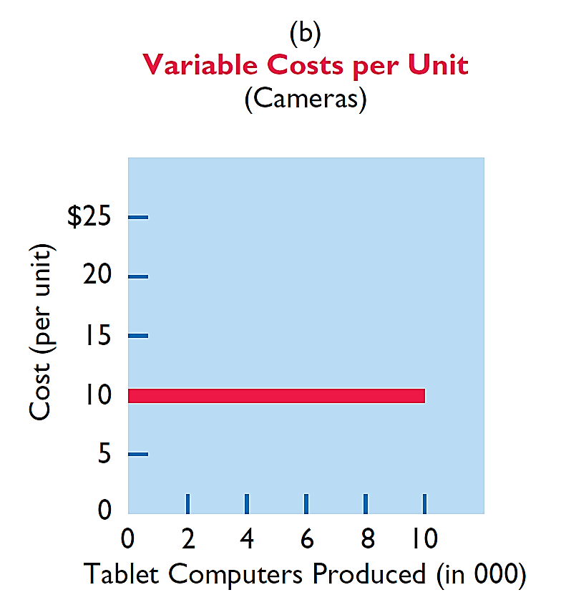
VARIABLE COSTS
Illustration: Damon Company manufactures tablet computers that contain a $10 camera. The activity index is the number of
tablets produced. As Damon manufactures each tablet, the total cost of the cameras used increases by $10. As part (b) of ILLUSTRATION 11-1 shows, the unit cost of $10 for the camera is the same whether Damon produces 2,000 or 10,000 tablets.
ILLUSTRATION 11-1
Behavior of total and unit variable costs
LO 1

Slide 9
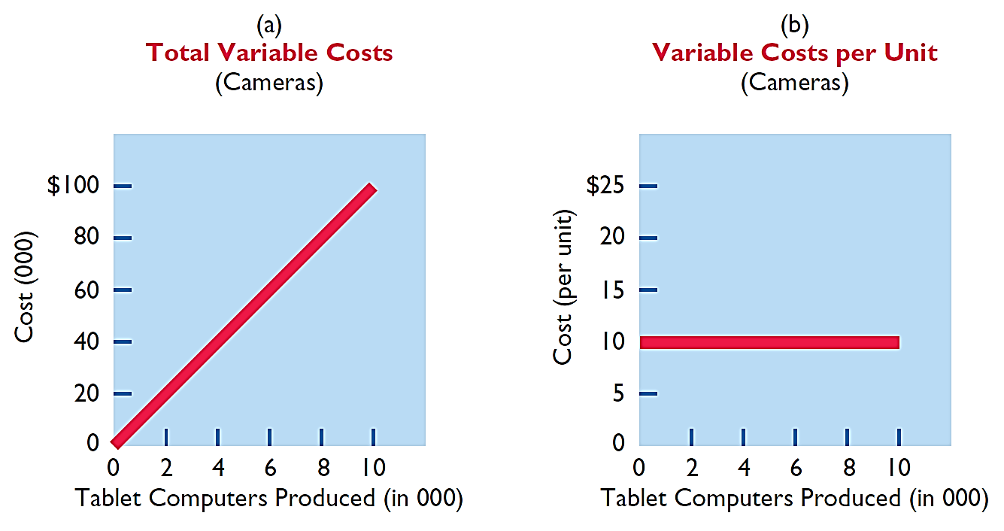
VARIABLE COSTS
ILLUSTRATION 11-1
Behavior of total and unit variable costs
LO 1

Slide 10
FIXED COSTS
  Costs that remain the same in total regardless of changes in the activity level within a relevant range.
  Fixed cost per unit cost varies inversely with activity: As volume increases, unit cost declines, and vice versa
  Examples:
    Property taxes
    Insurance
    Rent
    Depreciation on buildings and equipment
LO 1

Slide 11
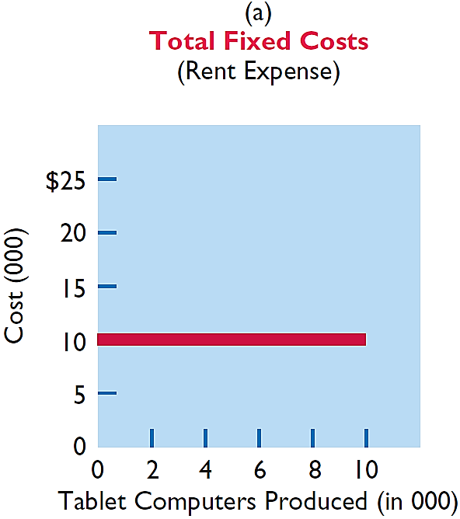
FIXED COSTS
Illustration: Damon Company leases its productive facilities at a cost of $10,000 per month. Total fixed costs of the
facilities will remain constant at every level of activity, as part (a) of ILLUSTRATION 11-2 shows.
ILLUSTRATION 11-2
Behavior of total and unit fixed costs
LO 1

Slide 12
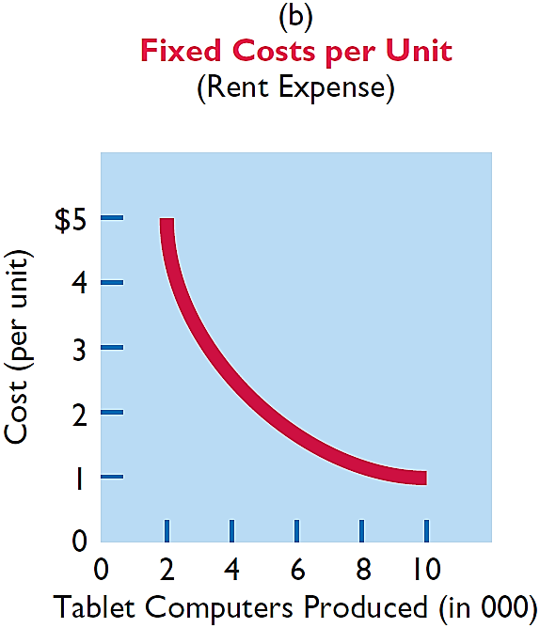
FIXED COSTS
Illustration: Damon Company leases its productive facilities at a cost of $10,000 per month. Total fixed costs of the
facilities will remain constant at every level of activity. But, on a per unit basis, the cost of rent will decline as activity increases, as part (b) of ILLUSTRATION 11-2 shows. At 2,000 units, the unit cost per tablet computer is $5 ($10,000 ÷ 2,000). When Damon produces 10,000 tablets, the unit cost of the rent is only $1 per tablet ($10,000 ÷ 10,000).
ILLUSTRATION 11-2
Behavior of total and unit fixed costs
LO 1

Slide 13
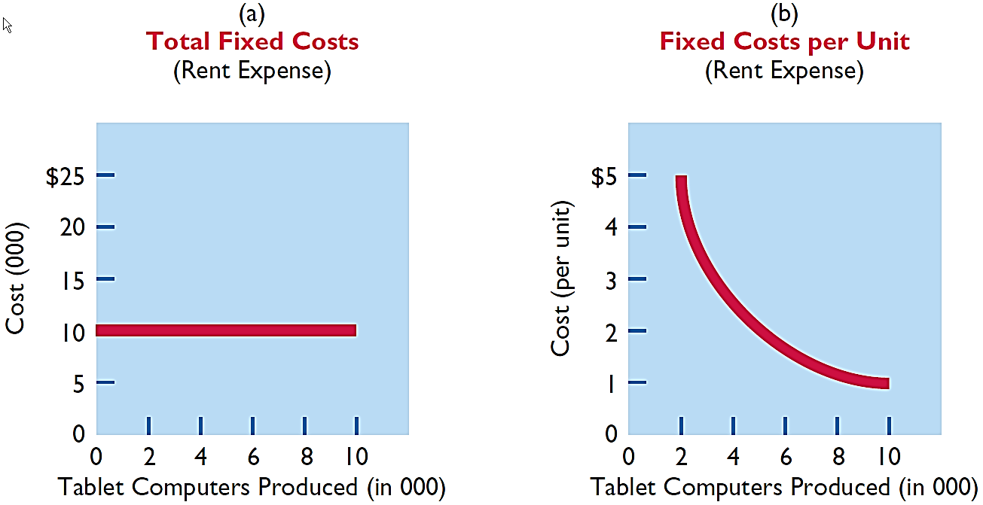
FIXED COSTS
ILLUSTRATION 11-2
Behavior of total and unit fixed costs
LO 1

Slide 14
FIXED COSTS
Question
Variable costs are costs that:
a. Vary in total directly and proportionately with changes in the activity level.
b. Remain the same per unit at every activity level.
c. Neither of the above.
d. Both (a) and (b) above.
LO 1

Slide 15

LO 1

Slide 16

RELEVANT RANGE
  Throughout the range of possible levels of activity, a straight-line relationship usually does not exist for either variable costs or fixed costs.
  Relationship between variable costs and changes in activity level is often curvilinear.
  For fixed costs, the relationship is also nonlinear – some fixed costs will not change over the entire range of activities, while other fixed costs may change.
LO 1

Slide 17
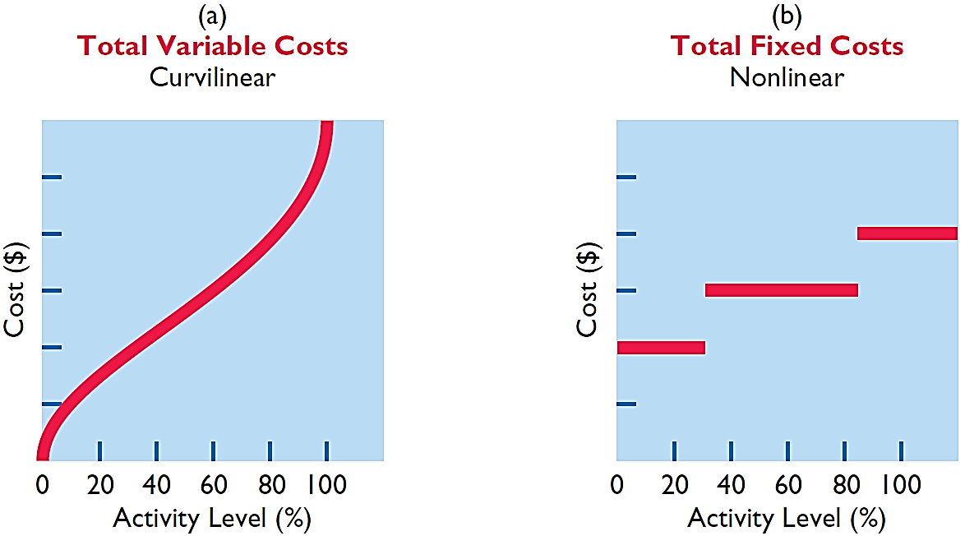
RELEVANT RANGE
ILLUSTRATION 11-3
Nonlinear behavior of variable and fixed costs
LO 1

Slide 18
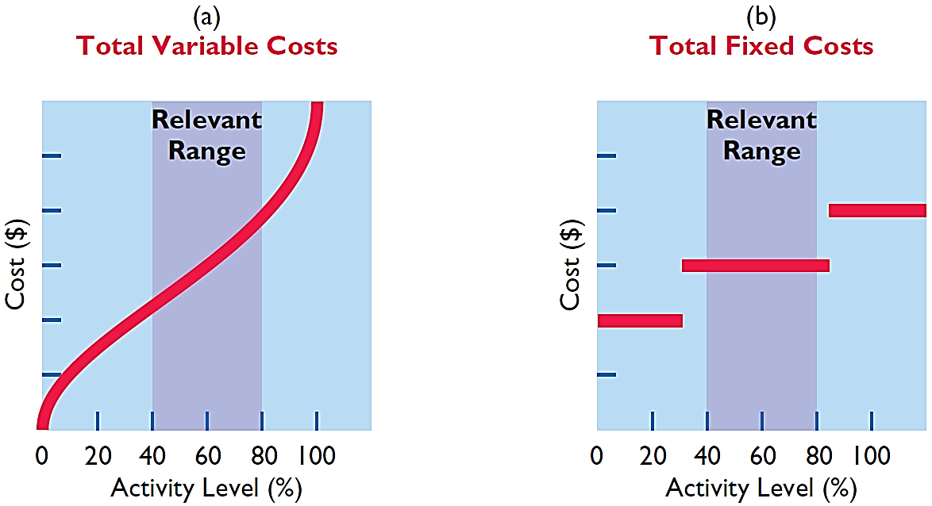
RELEVANT RANGE
Range of activity over which a company expects to operate during a year.
ILLUSTRATION 11-4
Linear behavior within relevant range
LO 1

Slide 19
RELEVANT RANGE
Question
The relevant range is:
The range of activity in which variable costs will be curvilinear.
The range of activity in which fixed costs will be curvilinear.
The range over which the company expects to operate during a year.
Usually from zero to 100% of operating capacity.
LO 1

Slide 20
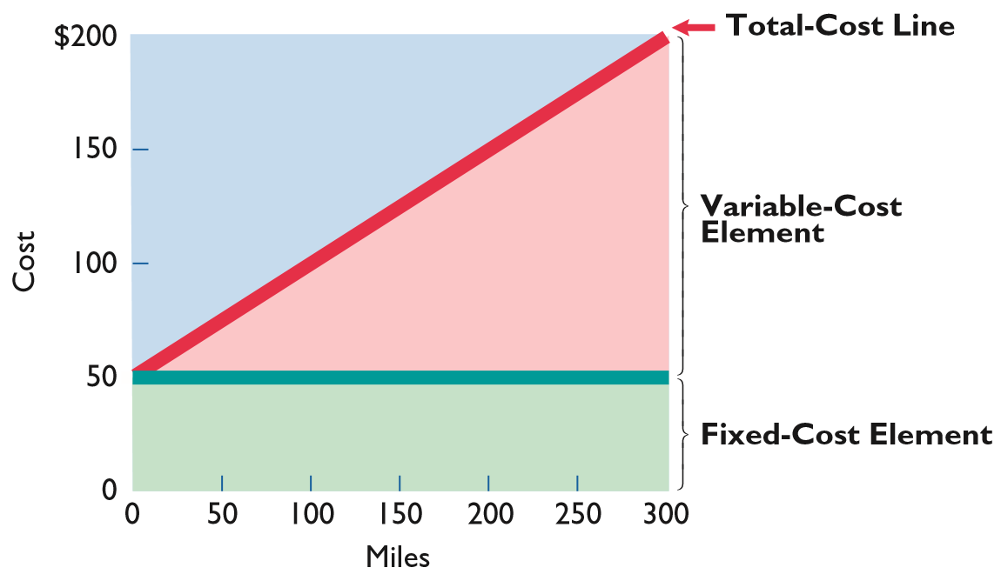
MIXED COSTS
  Costs that have both a variable element and a fixed element.
  Change in total but not proportionately with changes in activity level.
ILLUSTRATION 11-5
Behavior of a mixed cost
LO 1

Slide 21
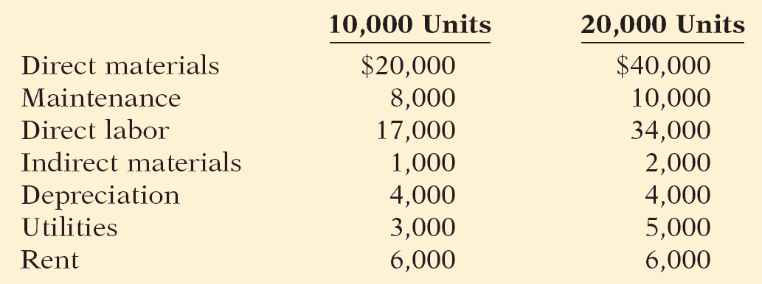
DO IT!
1
Types of Costs
Helena Company, reports the following total costs at two levels of production.
Classify each cost as variable, fixed, or mixed.
Variable
Fixed
Mixed
LO 1

Slide 22
LEARNING OBJECTIVE
2
Apply the high-low method to determine the components of mixed costs.
HIGH-LOW METHOD
  High-Low Method uses the total costs incurred at the high and the low levels of activity to classify mixed costs into fixed and variable components.
  The difference in costs between the high and low levels represents variable costs, since only variable-cost element can change as activity levels change.
LO 2

Slide 23
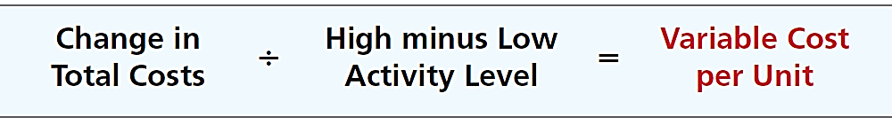
HIGH-LOW METHOD
  STEP 1: Determine variable cost per unit using the following formula:
ILLUSTRATION 11-6
Formula for variable cost per unit using high-low method
LO 2

Slide 24
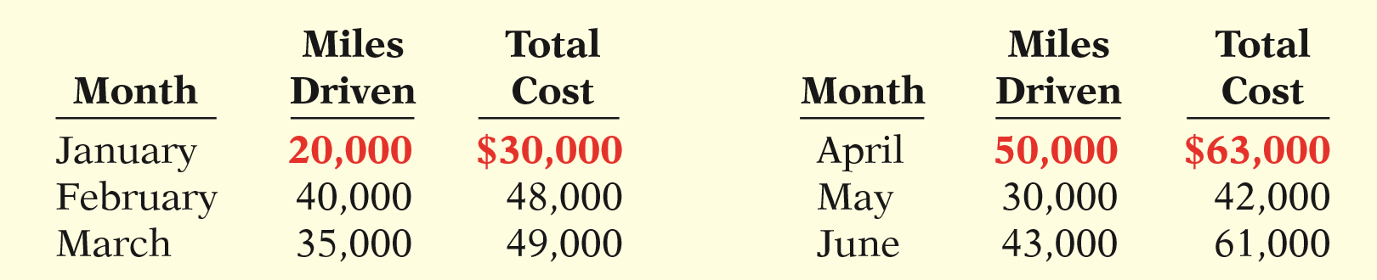
HIGH-LOW METHOD
Illustration: Metro Transit Company has the following maintenance costs and mileage data for its fleet of buses over a 6-month period.
ILLUSTRATION 11-7
Assumed maintenance costs and mileage data
Change in Costs
(63,000 - 30,000) $33,000
$1.10
=
High minus Low
(50,000 - 20,000) 30,000
cost per unit
LO 2

Slide 25
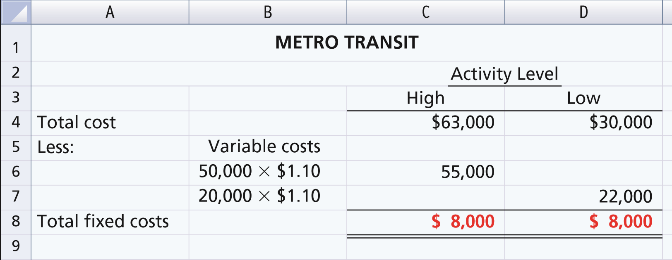
HIGH-LOW METHOD
STEP 2: Determine the fixed cost by subtracting the total variable cost at either the high or the low activity level from the total cost at that activity level.
ILLUSTRATION 11-8
High-low method computation of fixed costs
LO 2

Slide 26
HIGH-LOW METHOD
Maintenance costs are therefore $8,000 per month of fixed costs plus $1.10 per mile of variable costs. This is represented by the following formula:
Maintenance costs = $8,000 + ($1.10 x Miles driven)
Example: At 45,000 miles, estimated maintenance costs would be:
Fixed
$ 8,000
Variable
($1.10 x 45,000) 49,500
$57,500
LO 2

Slide 27
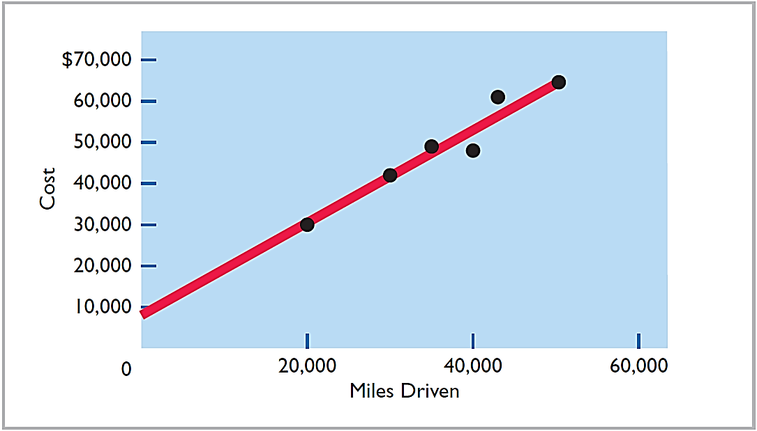
HIGH-LOW METHOD
ILLUSTRATION 11-9
Scatter plot for Metro Transit Company
LO 2

Slide 28
HIGH-LOW METHOD
Question
Mixed costs consist of a:
Variable cost element and a fixed cost element.
Fixed cost element and a controllable cost element.
Relevant cost element and a controllable cost element.
Variable cost element and a relevant cost element.
LO 2

Slide 29
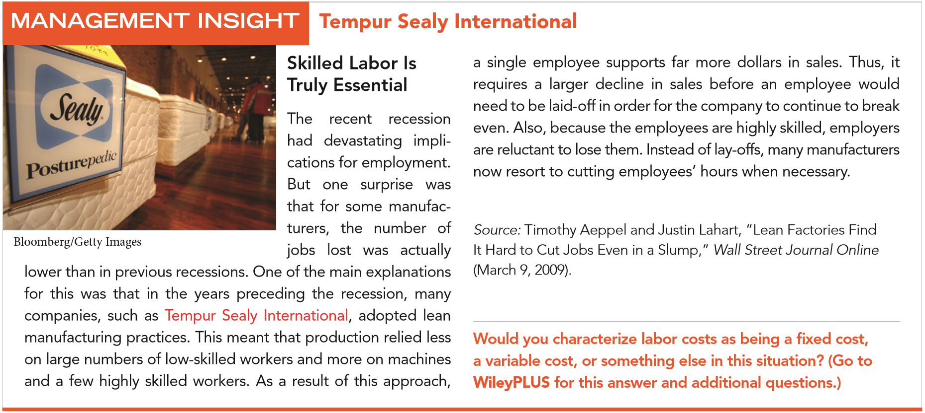
LO 2

Slide 30
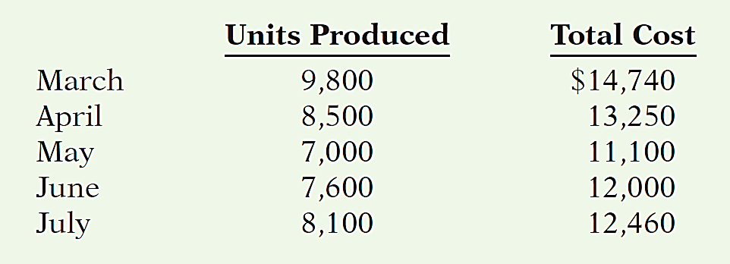
DO IT!
2
High-Low Method
Byrnes Company accumulates the following data concerning a mixed cost, using units produced as the activity level.
Compute the variable- and fixed-cost elements using the high-low method.
Estimate the total cost if the company produces 8,000 units.
LO 2

Slide 31
DO IT!
2
High-Low Method
Compute the variable and fixed cost elements using the high-low method.
Variable cost: ($14,740 - $11,100) / (9,800 - 7,000) = $1.30 per unit
Fixed cost: $14,740 - $12,740 ($1.30 x 9,800 units) = $2,000
or $11,100 - $9,100 ($1.30 x 7,000) = $2,000
LO 2

Slide 32
DO IT!
2
High-Low Method
Estimate the total cost if the company produces 8,000 units.
Total cost (8,000 units):
$2,000 + $10,400 ($1.30 x 8,000) = $12,400
LO 2

Slide 33
LEARNING OBJECTIVE
3
Prepare a CVP income statement to determine contribution margin.
Cost-volume-profit (CVP) analysis is the study of the effects of changes in costs and volume on a company’s profits.
  Important in profit planning.
  Critical factor in management decisions as
    Setting selling prices,
    Determining product mix, and
    Maximizing use of production facilities.
LO 3

Slide 34

Cost-Volume-Profit Analysis
BASIC COMPONENTS
ILLUSTRATION 11-10
Components of CVP analysis
LO 3

Slide 35
BASIC COMPONENTS
Assumptions
  Behavior of both costs and revenues is linear throughout the relevant range of the activity index.
  Costs can be classified accurately as either variable or fixed.
  Changes in activity are the only factors that affect costs.
  All units produced are sold.
  When more than one type of product is sold, the sales mix will remain constant.
LO 3

Slide 36
BASIC COMPONENTS
Question
Which of the following is not involved in CVP analysis?
Sales mix.
Unit selling prices.
Fixed costs per unit.
Volume or level of activity.
LO 3

Slide 37
Cost-Volume-Profit Analysis
CVP INCOME STATEMENT
  A statement for internal use.
  Classifies costs and expenses as fixed or variable.
  Reports contribution margin in the body of the statement.
    Contribution margin – amount of revenue remaining after deducting variable costs.
  Reports the same net income as a traditional income statement.
LO 3

Slide 38
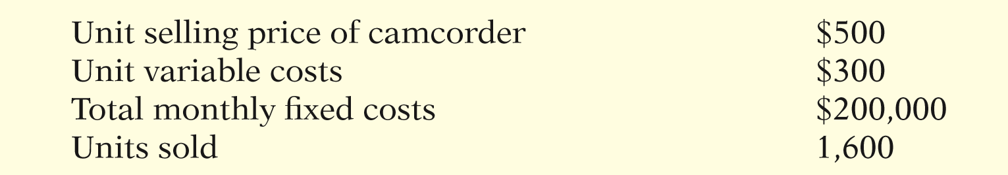
CVP INCOME STATEMENT
Illustration: Vargo Video Company produces a high-definition digital camcorder. Relevant data for the camcorders sold by this company in June 2017 are as follows.
ILLUSTRATION 11-11
Assumed selling and cost data for Vargo Video
LO 3

Slide 39
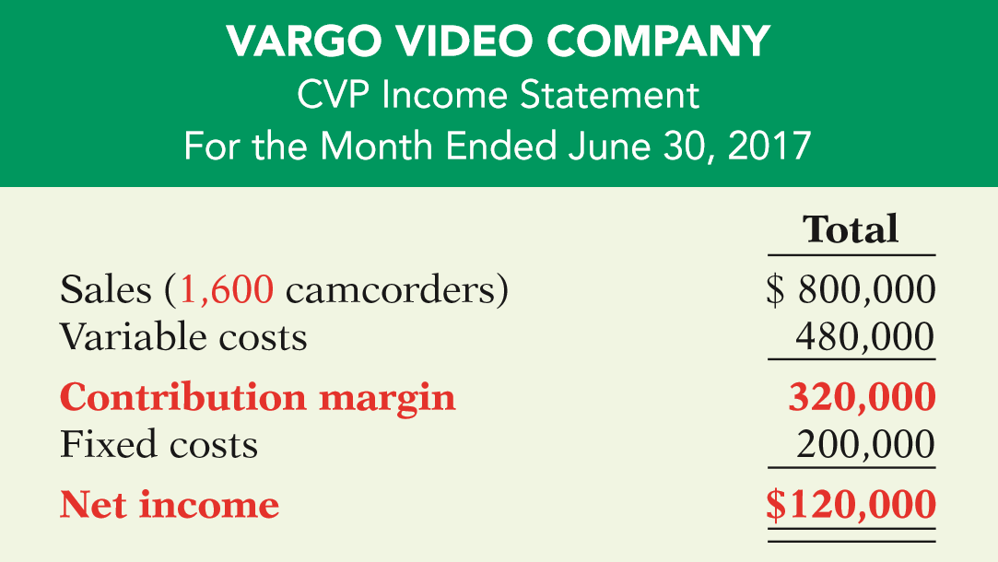
CVP INCOME STATEMENT
Illustration: The CVP income statement for Vargo Video therefore would be reported as follows.
ILLUSTRATION 11-12
CVP income statement, with net income
LO 3

Slide 40
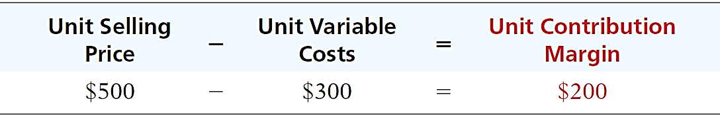
CVP INCOME STATEMENT
Unit Contribution Margin
  Contribution margin is available to cover fixed costs and to contribute to income.
  Formula for contribution margin per unit and the computation for Vargo Video are:
ILLUSTRATION 11-13
Formula for unit contribution margin
LO 3

Slide 41
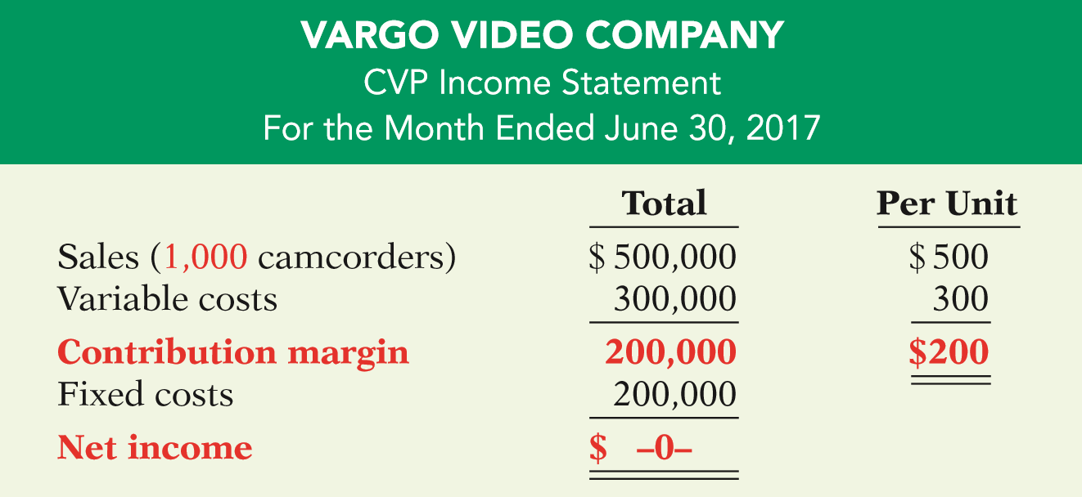
CVP INCOME STATEMENT
Unit Contribution Margin
Vargo’s CVP income statement assuming a zero net income.
ILLUSTRATION 11-14
CVP income statement, with zero net income
LO 3

Slide 42
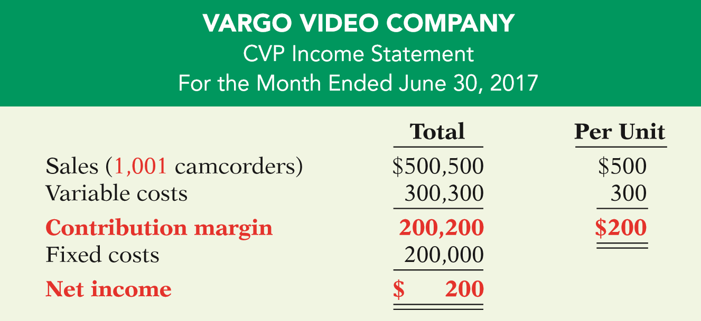
CVP INCOME STATEMENT
Unit Contribution Margin
Assume that Vargo sold one more camcorder, for a total of 1,001 camcorders sold.
ILLUSTRATION 11-15
CVP income statement, with net income and per unit data
LO 3

Slide 43
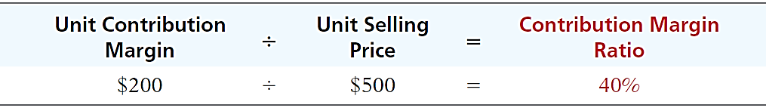
CVP INCOME STATEMENT
Contribution Margin Ratio
  Shows the percentage of each sales dollar available to apply toward fixed costs and profits.
  Formula for contribution margin ratio and the computation for Vargo Video are:
ILLUSTRATION 11-17
Formula for contribution margin ratio
LO 3

Slide 44
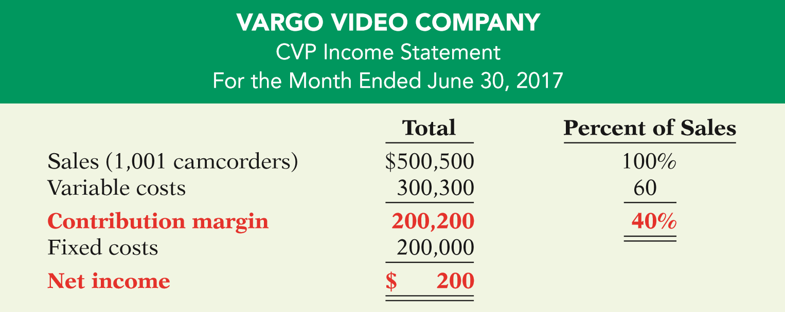
CVP INCOME STATEMENT
Contribution Margin Ratio
ILLUSTRATION 11-16
CVP income statement, with net income and percent of sales data
LO 3

Slide 45
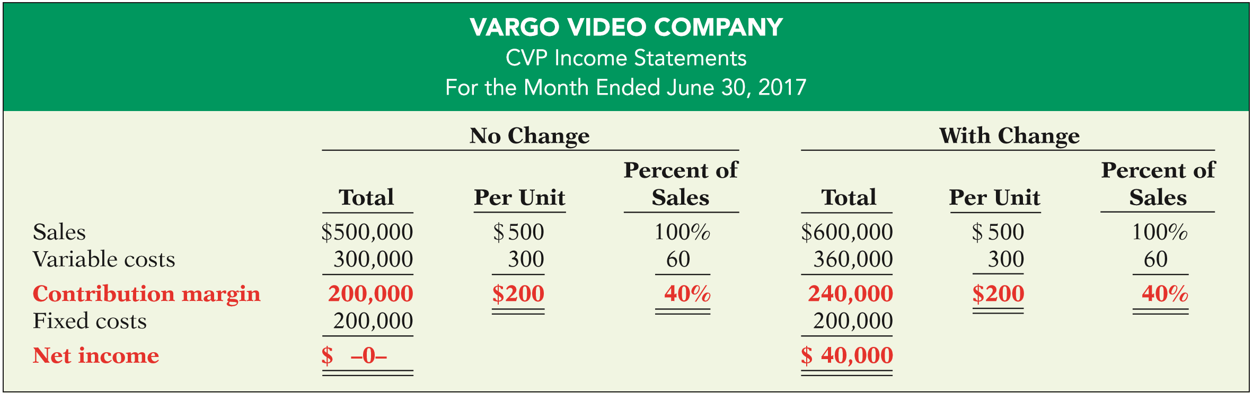
CVP INCOME STATEMENT
Contribution Margin Ratio
Assume Vargo Video’s current sales are $500,000 and it wants to know the effect of a $100,000 (200-unit) increase in sales.
ILLUSTRATION 11-18
Comparative CVP income statements
LO 3

Slide 46
CVP INCOME STATEMENT
Question
Contribution margin:
a. Is revenue remaining after deducting variable costs.
b. May be expressed as contribution margin per unit.
c. Is selling price less cost of goods sold.
d. Both (a) and (b) above.
LO 3

Slide 47
DO IT!
3
CVP Income Statement
Ampco Industries produces and sells a cell phone-operated thermostat. Information regarding the costs and sales of thermostats during September 2017 are provided below.
Unit selling price of thermostat $85
Unit variable costs $32
Total monthly fixed costs $190,000
Units sold 4,000
Prepare a CVP income statement for Ampco Industries for the month of September. Provide per unit values and total values.
LO 3

Slide 48
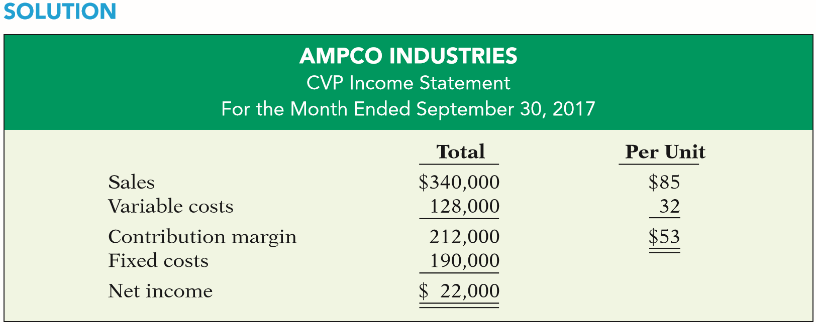

DO IT!
3
CVP Income Statement
Prepare a CVP income statement for Ampco Industries for the month of September. Provide per unit values and total values.
LO 3

Slide 49
LEARNING OBJECTIVE
4
Compute the break-even point using three approaches.
Break-Even Analysis
Process of finding the break-even point level of activity at which total revenues equal total costs (both fixed and variable).
Can be computed or derived
  from a mathematical equation,
  by using contribution margin, or
  from a cost-volume profit (CVP) graph.
Expressed either in sales units or in sales dollars.
LO 4

Slide 50
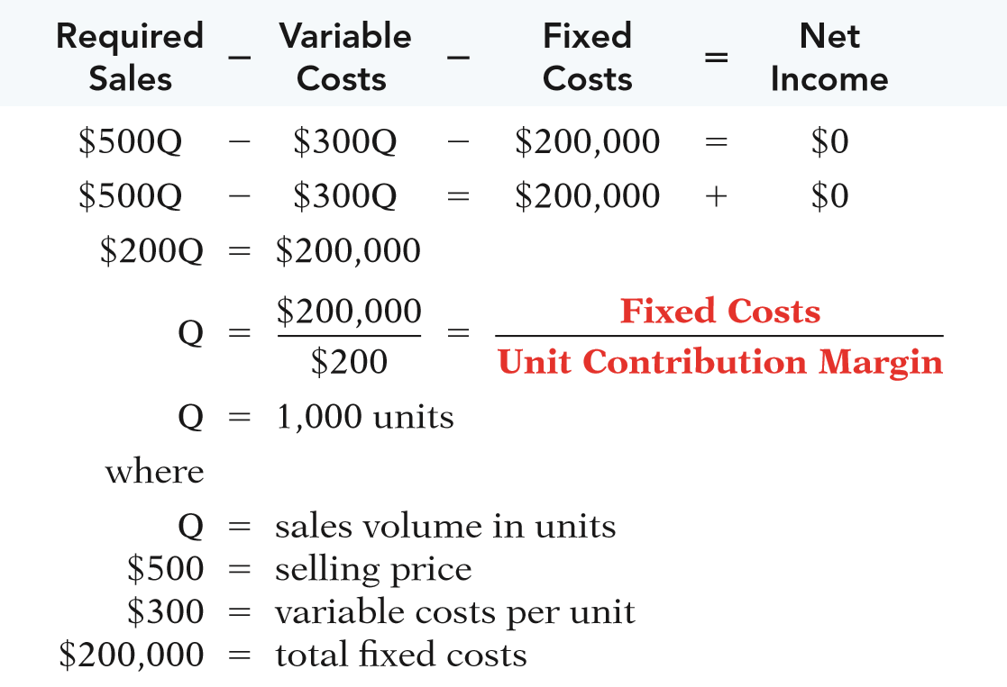
MATHEMATICAL EQUATION
Break-even occurs where total sales equal variable costs plus fixed costs; i.e., net income is zero
Computation of break-even point in units.
ILLUSTRATION 11-20
LO 4

Slide 51
CONTRIBUTION MARGIN TECHNIQUE
  At the break-even point, contribution margin must equal total fixed costs
(CM = total revenue – variable costs)
  Break-even point can be computed using either contribution margin per unit or contribution margin ratio.
LO 4

Slide 52
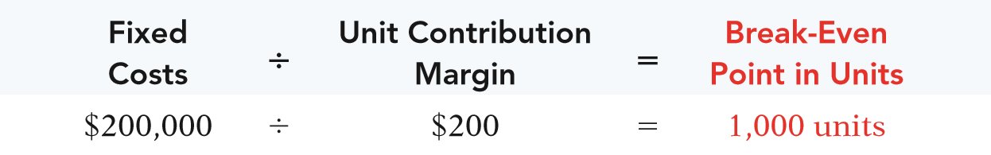
CONTRIBUTION MARGIN TECHNIQUE
Contribution Margin In Units
  When the break-even-point in units is desired, contribution margin per unit is used in the following formula which shows the computation for Vargo Video:
ILLUSTRATION 11-21
Formula for break-even point in units using unit contribution margin
LO 4

Slide 53
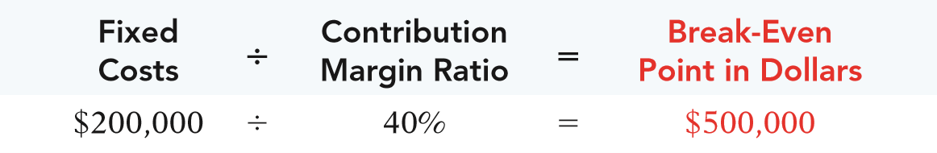
CONTRIBUTION MARGIN TECHNIQUE
Contribution Margin Ratio
  When the break-even-point in dollars is desired, contribution margin ratio is used in the following formula which shows the computation for Vargo Video:
ILLUSTRATION 11-22
Formula for break-even point in dollars using contribution margin ratio
LO 4

Slide 54

LO 4

Slide 55
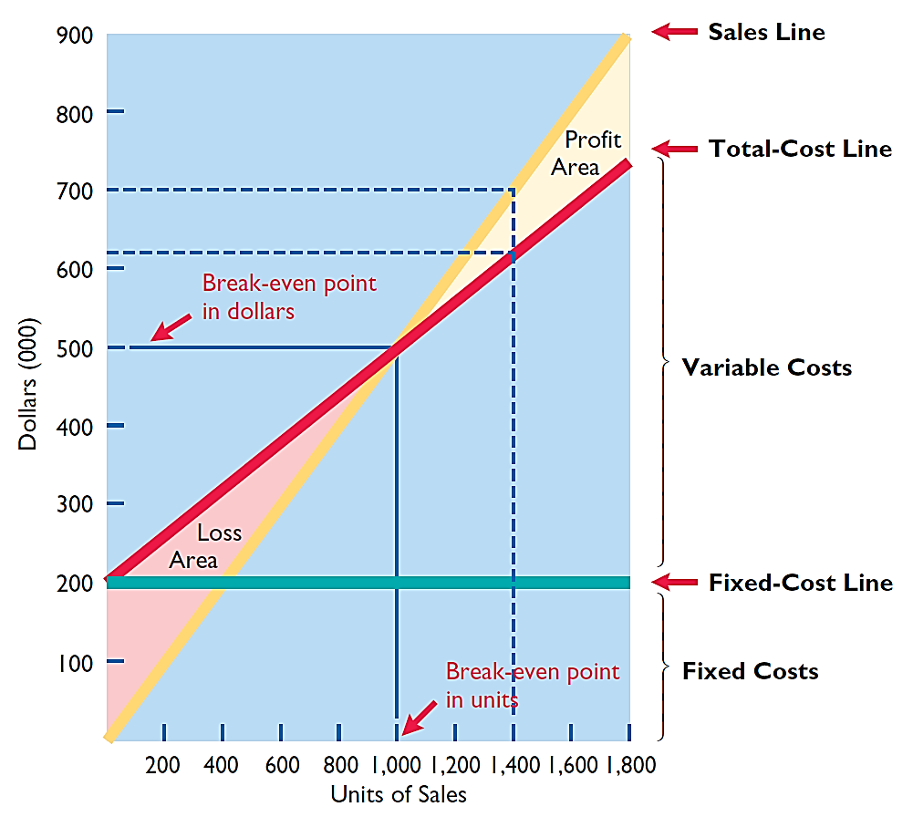
GRAPHIC PRESENTATION
Because this graph also shows costs, volume, and profits, it is referred to as a cost-volume-profit (CVP) graph.
ILLUSTRATION 11-23
CVP graph
LO 4

Slide 56
Break-Even Analysis
Question
Gossen Company is planning to sell 200,000 pliers for $4 per unit. The contribution margin ratio is 25%. If Gossen will break even at this level of sales, what are the fixed costs?
$100,000.
$160,000.
$200,000.
$300,000.
LO 4

Slide 57
DO IT!
4
Break-Even Analysis
Lombardi Company has a unit selling price of $400, variable costs per unit of $240, and fixed costs of $180,000. Compute the break-even point in units using (a) a mathematical equation and (b) contribution margin per unit.
ILLUSTRATION 11-19
Variable Costs
Fixed Costs
Net Income
Sales
-
-
=
$400Q
-
$240Q
-
$180,000
=
0
$160Q
-
$180,000
Q
=
1,125 units
LO 4

Slide 58
DO IT!
4
Break-Even Analysis
Lombardi Company has a unit selling price of $400, variable costs per unit of $240, and fixed costs of $180,000. Compute the break-even point in units using (a) a mathematical equation and (b) contribution margin per unit.
ILLUSTRATION 11-21
Fixed Costs
Contribution Margin per Unit
Break-Even Point in Units
÷
=
$180,000
÷
$160
=
1,125 units
LO 4

Slide 59
LEARNING OBJECTIVE
5
Determine the sales required to earn target net income and determine margin of safety.
TARGET NET INCOME
  Level of sales necessary to achieve a specified income.
  Can be determined from each of the approaches used to determine break-even sales/units:
    from a mathematical equation,
    by using contribution margin technique, or
    from a cost-volume profit (CVP) graph.
  Expressed either in sales units or in sales dollars.
LO 5

Slide 60

TARGET NET INCOME
Mathematical Equation
Formula for required sales to meet target net income.
ILLUSTRATION 11-24
Formula for required sales to meet target net income
LO 5

Slide 61
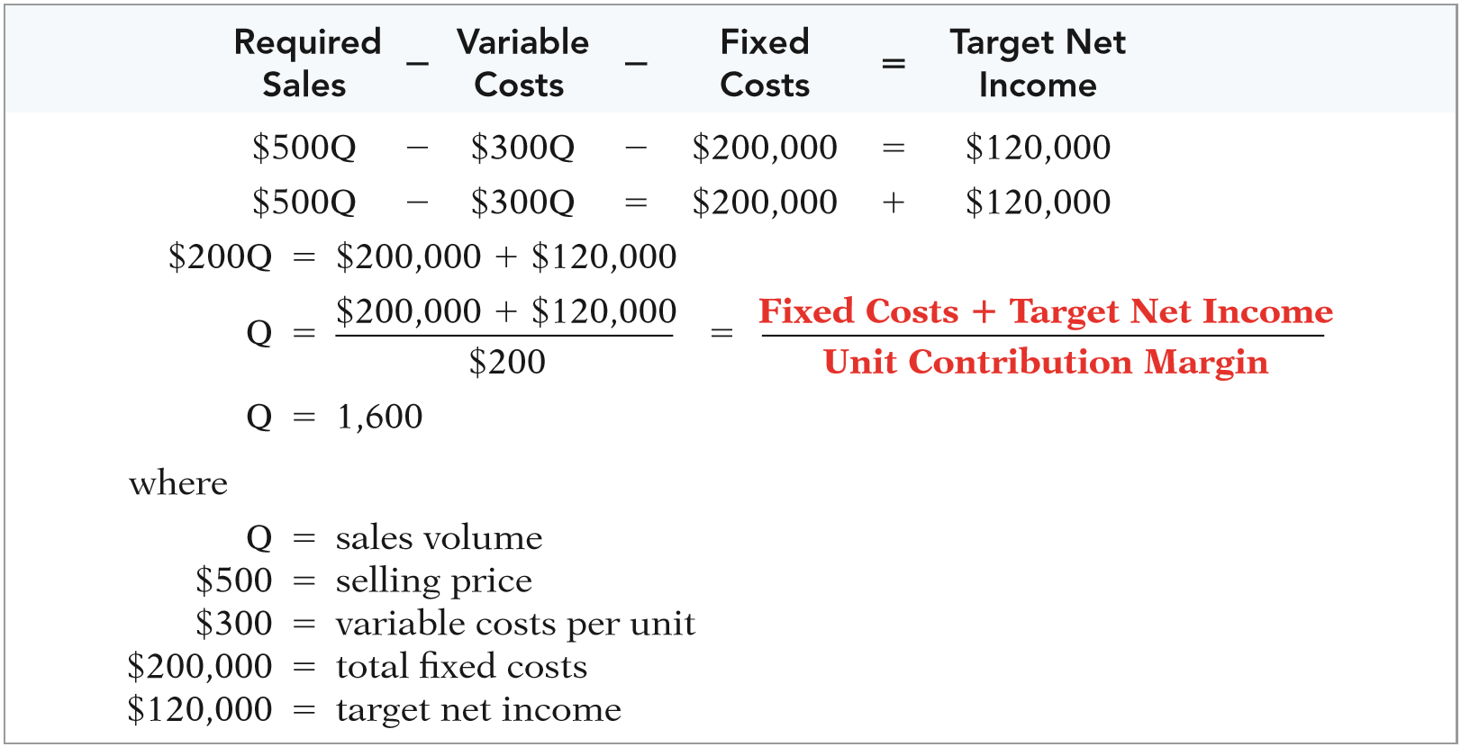
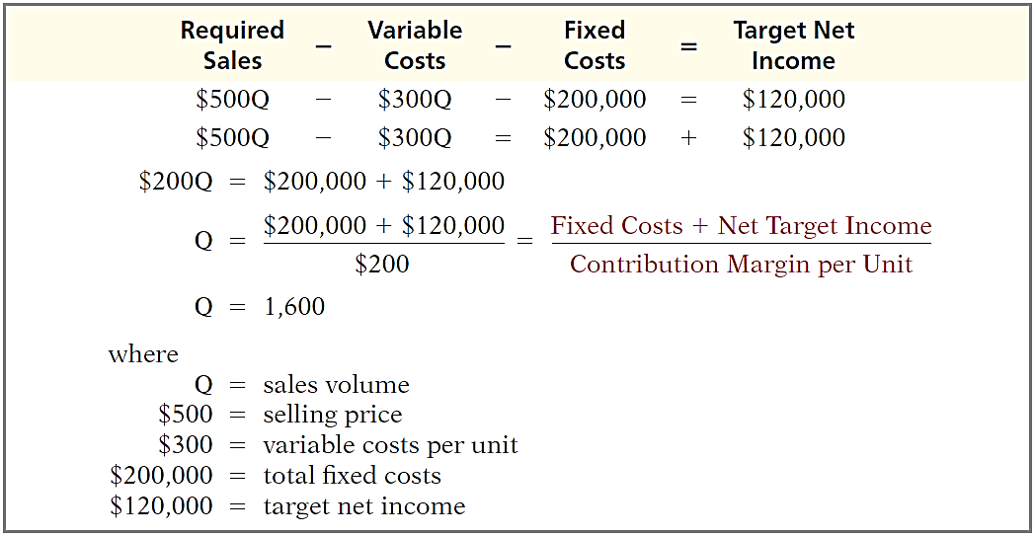
TARGET NET INCOME
Mathematical Equation
Using the formula for the break-even point, simply include the desired net income as a factor.
ILLUSTRATION 11-25
Computation of required sales
LO 5

Slide 62
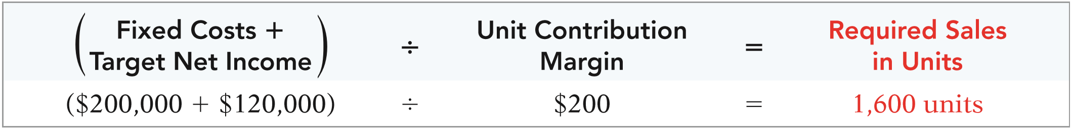
TARGET NET INCOME
Contribution Margin Technique
To determine the required sales in units for Vargo Video:
ILLUSTRATION 11-26
Formula for required sales in units using unit contribution margin
LO 5

Slide 63
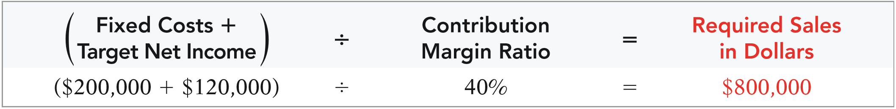
TARGET NET INCOME
Contribution Margin Technique
To determine the required sales in dollars for Vargo Video:
ILLUSTRATION 11-27
Formula for required sales in dollars using contribution margin ratio
LO 5

Slide 64
TARGET NET INCOME
Graphic Presentation
Suppose Vargo Video sells 1,400 camcorders. ILLUSTRATION 11-23 shows that a vertical line drawn at 1,400 units intersects the sales line at $700,000 and the total cost line at $620,000. The difference between the two amounts represents the net income (profit) of $80,000.
ILLUSTRATION 11-23
LO 5

Slide 65
TARGET NET INCOME
Question
The mathematical equation for computing required sales to obtain target net income is:
Required sales =
Variable costs + Target net income.
Variable costs + Fixed costs + Target net income.
Fixed costs + Target net income.
No correct answer is given.
LO 5

Slide 66
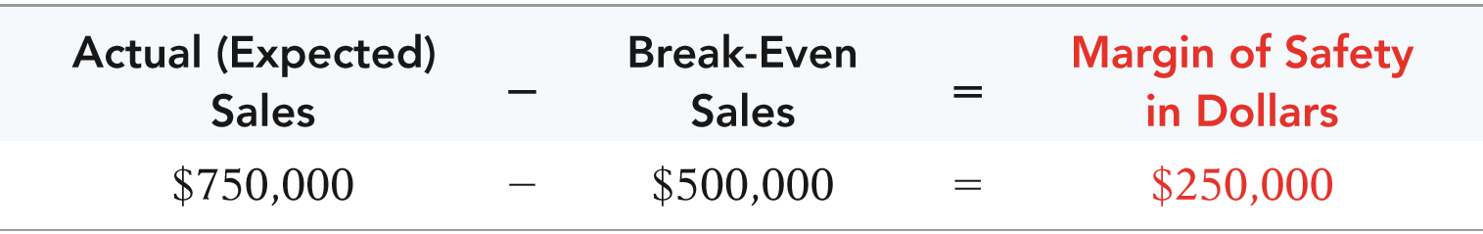
MARGIN OF SAFETY
  Difference between actual or expected sales and sales at the break-even point.
  Measures the “cushion” that a particular level of sales provides.
  May be expressed in dollars or as a ratio.
  Assuming actual/expected sales are $750,000:
ILLUSTRATION 11-28
Formula for margin of safety in dollars
LO 5

Slide 67
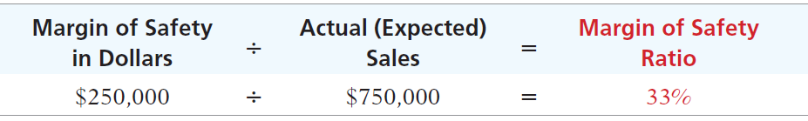
Margin of Safety Ratio
  Computed by dividing the margin of safety in dollars by the actual (or expected) sales.
  Assuming actual/expected sales are $750,000:
ILLUSTRATION 11-29
Formula for margin of safety ratio
  The higher the dollars or percentage, the greater the margin of safety.
LO 5

Slide 68
MARGIN OF SAFETY
Question
Marshall Company had actual sales of $600,000 when break-even sales were $420,000. What is the margin of safety ratio?
25%.
30%.
33 1/3%.
45%.
LO 5

Slide 69
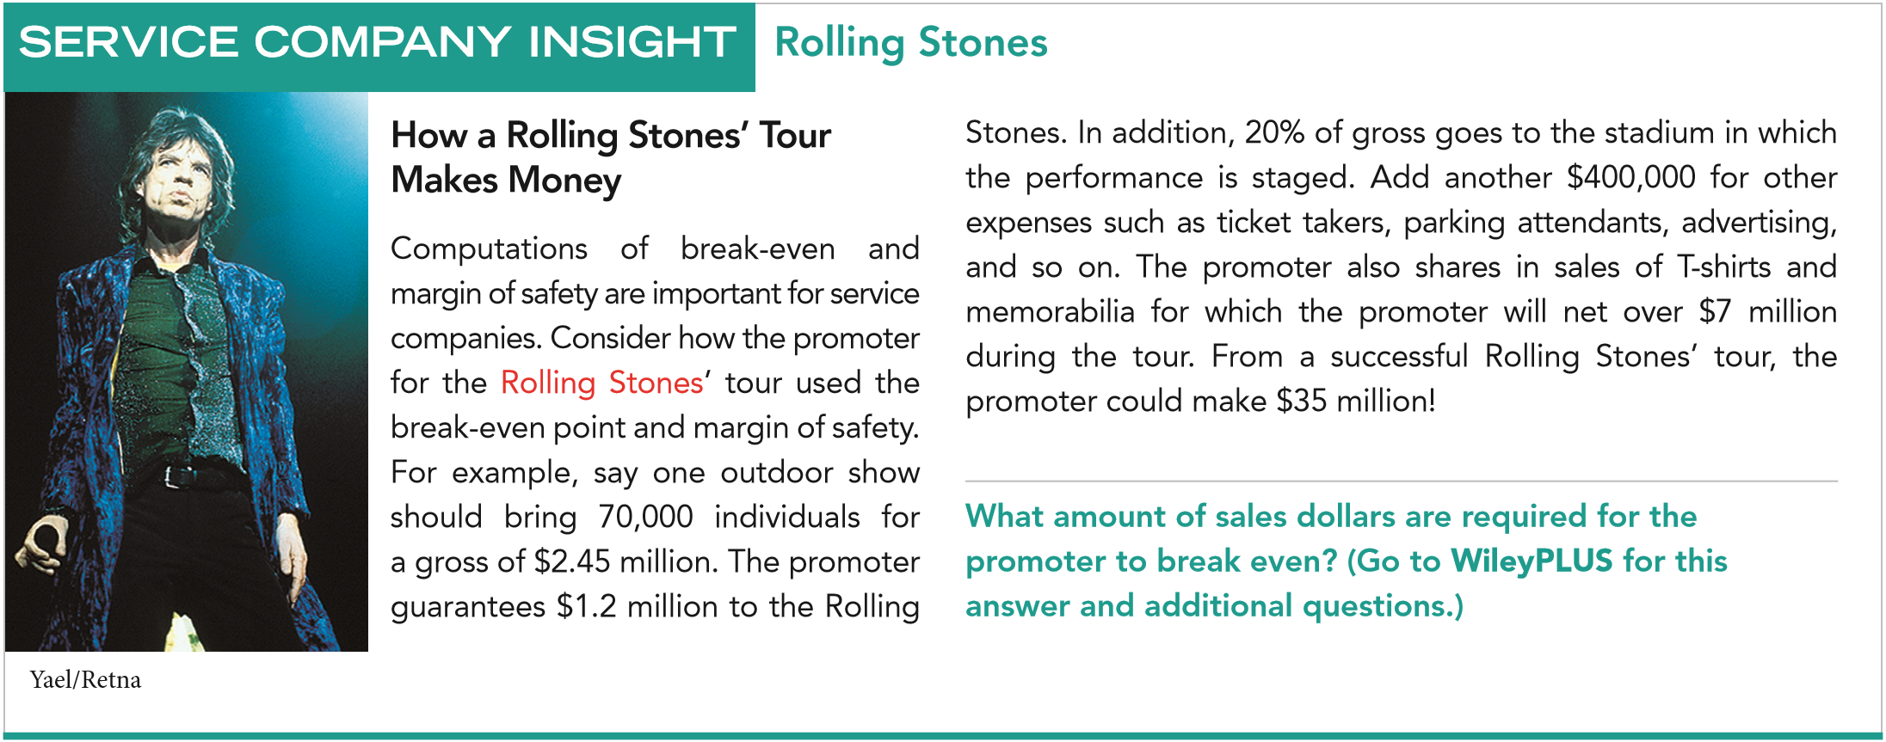
LO 5

Slide 70
Break-Even, Margin of Safety, and Target Net Income
DO IT!
5
Comprehensive
  Zootsuit Inc. makes travel bags that sell for $56 each. For the coming year, management expects fixed costs to total $320,000 and variable costs to be $42 per unit. Compute the following:
  break-even point in dollars using the contribution margin (CM) ratio;
  the margin of safety and margin of safety ratio assuming actual sales are $1,382,400; and
  the sales dollars required to earn net income of $410,000.
LO 5

Slide 71
Break-Even, Margin of Safety, and Target Net Income
DO IT!
5
Comprehensive
  Zootsuit Inc. makes travel bags that sell for $56 each. For the coming year, management expects fixed costs to total $320,000 and variable costs to be $42 per unit. Compute break-even point in dollars using the contribution margin (CM) ratio.
Contribution margin ratio = [($56 - $42) ÷ $56] = 25%
Break-even sales in dollars = $320,000 ÷ 25% = $1,280,000
LO 5

Slide 72
Break-Even, Margin of Safety, and Target Net Income
DO IT!
5
Comprehensive
Comprehensive
  Zootsuit Inc. makes travel bags that sell for $56 each. For the coming year, management expects fixed costs to total $320,000 and variable costs to be $42 per unit. Compute the margin of safety and margin of safety ratio assuming actual sales are $1,382,400.
Margin of safety = $1,382,400 - $1,280,000 = $102,400
Margin of safety ratio = $102,400 ÷ $1,382,400 = 7.4%
LO 5

Slide 73
Break-Even, Margin of Safety, and Target Net Income
DO IT!
5
Comprehensive
Comprehensive
  Zootsuit Inc. makes travel bags that sell for $56 each. For the coming year, management expects fixed costs to total $320,000 and variable costs to be $42 per unit. Compute the sales dollars required to earn net income of $410,000.
Required sales in dollars =
($320,000 + $410,000) ÷ 25% = $2,920,000
LO 5

Slide 74
Copyright
Copyright © 2017 John Wiley & Sons, Inc. All rights reserved. Reproduction or translation of this work beyond that permitted in Section 117 of the 1976 United States Copyright Act without the express written permission of the copyright owner is unlawful. Request for further information should be addressed to the Permissions Department, John Wiley & Sons, Inc. The purchaser may make back-up copies for his/her own use only and not for distribution or resale. The Publisher assumes no responsibility for errors, omissions, or damages, caused by the use of these programs or from the use of the information contained herein.

