Slide 1
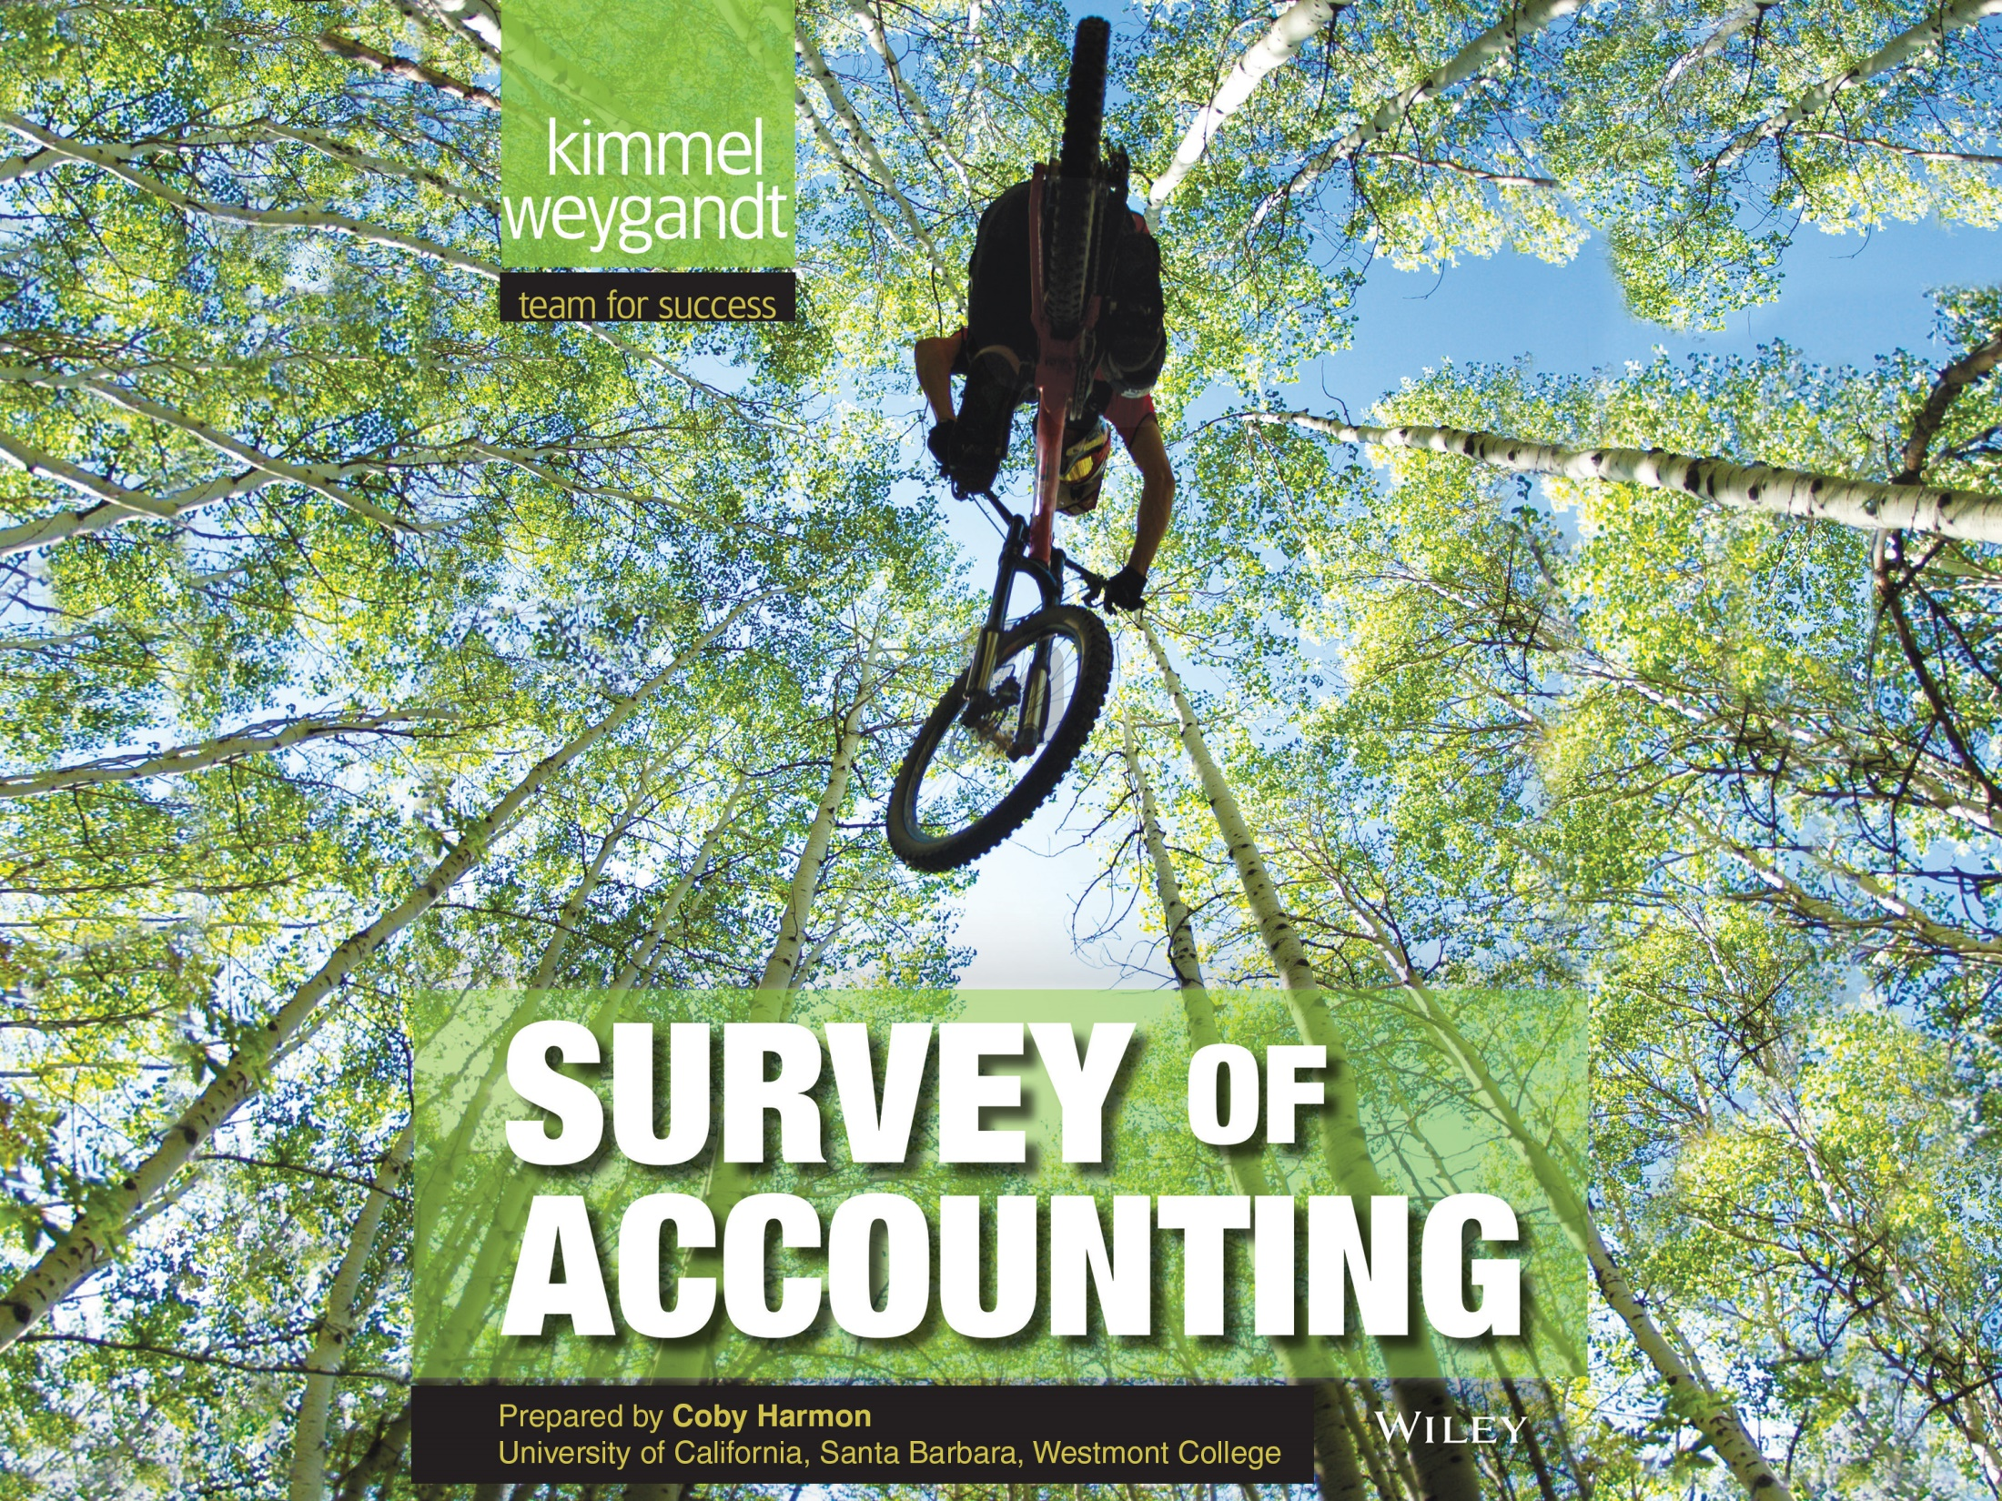

Slide 2
12
WILEY
Incremental Analysis
Kimmel ● Weygandt ● Kieso
Survey of Accounting, First Edition

Slide 3
CHAPTER OUTLINE
LEARNING OBJECTIVES
Describe management’s decision-making process and incremental analysis.
1
Analyze the relevant costs in accepting an order at a special price.
2
Analyze the relevant costs in a make-or-buy decision.
3
Analyze the relevant costs in determining whether to sell or process materials further.
4
Analyze the relevant costs to be considered in repairing, retaining, or replacing equipment.
5
Analyze the relevant costs in deciding whether to eliminate an unprofitable segment or product.
6

Slide 4
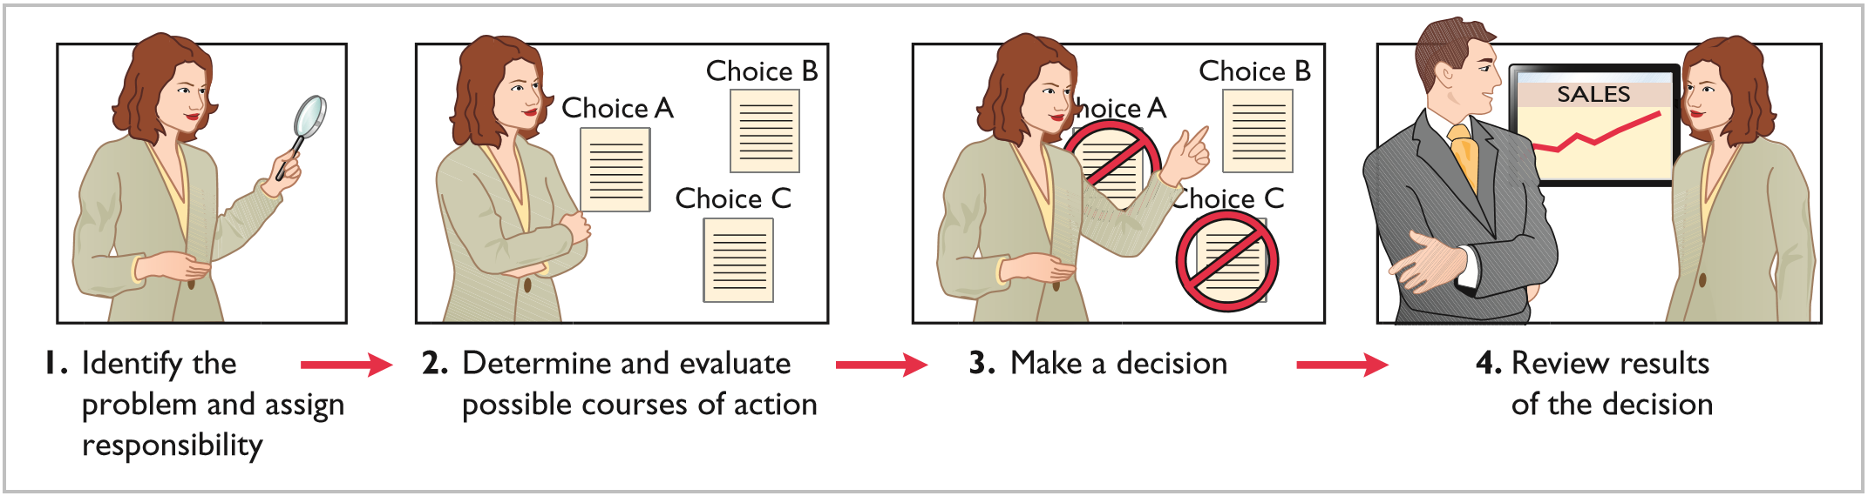
LEARNING OBJECTIVE
1
Describe management’s decision-making process and incremental analysis.
Making decisions is an important management function.
  Does not always follow a set pattern.
  Decisions vary in scope, urgency, and importance.
  Steps usually involved in process include:
ILLUSTRATION 12-1
Management’s decision-making process
LO 1

Slide 5
Decision-Making Process
In making business decisions,
  Considers both financial and non-financial information.
  Financial information
    Revenues and costs, and
    Effect on overall profitability.
  Nonfinancial information
    Effect on employee turnover
    The environment
    Overall company image.
LO 1

Slide 6
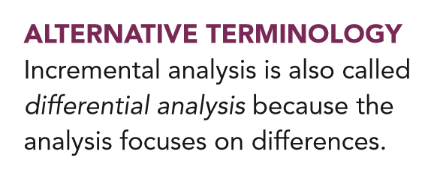
INCREMENTAL ANALYSIS APPROACH
  Decisions involve a choice among alternative actions.
  Process used to identify the financial data that change under alternative courses of action.
    Both costs and revenues may vary or
    Only revenues may vary or
    Only costs may vary
LO 1

Slide 7
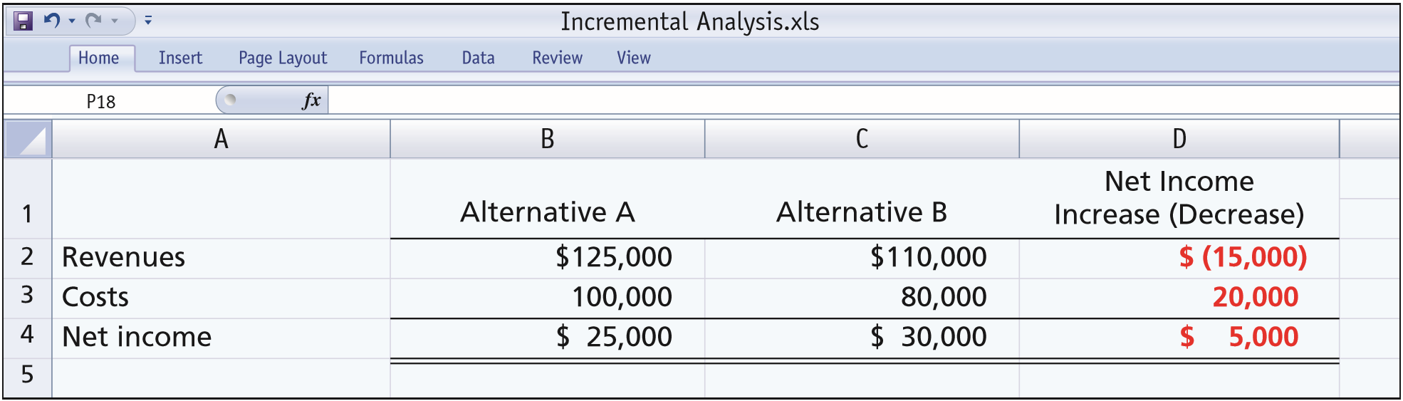
HOW INCREMENTAL ANALYSIS WORKS
ILLUSTRATION 12-2
Basic approach in incremental analysis
  Incremental revenue is $15,000 less under Alternative B.
  Incremental cost savings of $20,000 is realized.
  Alternative B produces $5,000 more net income.
LO 1

Slide 8
HOW INCREMENTAL ANALYSIS WORKS
Important concepts used in incremental analysis:
  Relevant cost.
  Opportunity cost.
  Sunk cost.
LO 1

Slide 9
HOW INCREMENTAL ANALYSIS WORKS
  Sometimes involves changes that seem contrary to intuition.
  Variable costs sometimes do not change under alternatives.
  Fixed costs sometimes change between alternatives.
LO 1

Slide 10
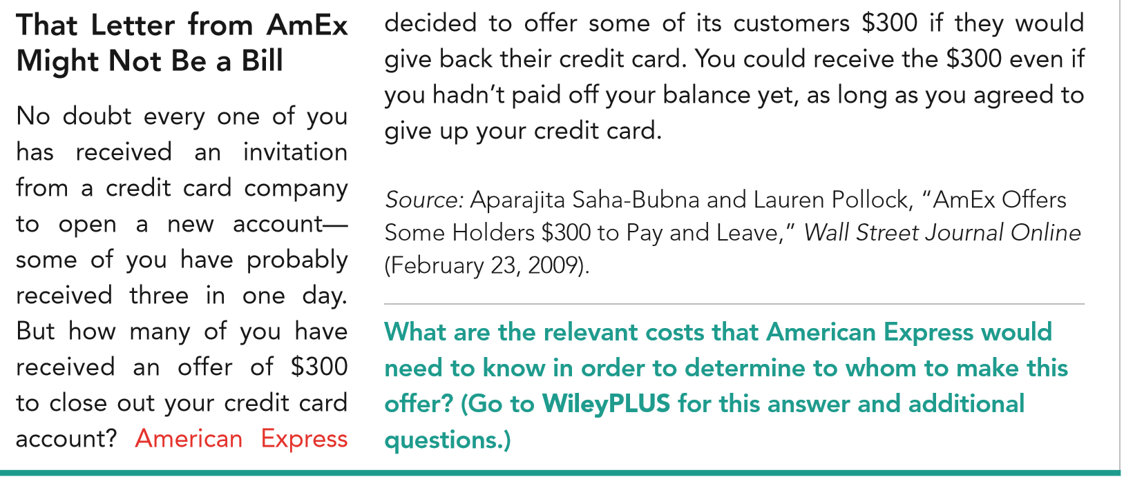
LO 1

Slide 11
TYPES OF INCREMENTAL ANALYSIS
Common types of decisions involving incremental analysis:
  Accept an order at a special price.
  Make or buy component parts or finished products.
  Sell or process further them further.
  Repair, retain, or replace equipment.
  Eliminate an unprofitable business segment or product.
LO 1

Slide 12
INCREMENTAL ANALYSIS
Question
Incremental analysis is the process of identifying the financial data that
a. Do not change under alternative courses of action.
b. Change under alternative courses of action.
c. Are mixed under alternative courses of action.
d. None of the above.
LO 1

Slide 13
DO IT!
1
Incremental Analysis
Owen T Corporation is comparing two different options. The company currently follows Option 1, with revenues of $80,000 per year, maintenance expenses of $5,000 per year, and operating expenses of $38,000 per year. Option 2 provides revenues of $80,000 per year, maintenance expenses of $12,000 per year, and operating expenses of $32,000 per year. Option 1 employs a piece of equipment that was upgraded 2 years ago at a cost of $22,000. If Option 2 is chosen, it will free up resources that will increase revenues by $3,000.
Complete the following table to show the change in income from choosing Option 2 versus Option 1. Designate any sunk costs with an “S.”
LO 1

Slide 14
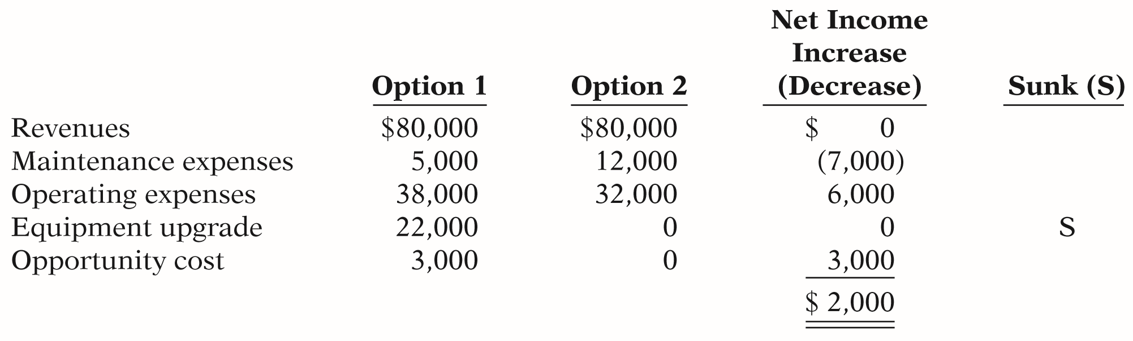
The company currently follows Option 1, with revenues of $80,000 per year, maintenance expenses of $5,000 per year, and operating expenses of $38,000 per year. Option 2 provides revenues of $80,000 per year, maintenance expenses of $12,000 per year, and operating expenses of $32,000 per year. Option 1 employs a piece of equipment that was upgraded 2 years ago at a cost of $22,000. If Option 2 is chosen, it will free up resources that will increase revenues by $3,000.
LO 1

Slide 15
LEARNING OBJECTIVE
2
Analyze the relevant costs in accepting an order at a special price.
Accept an Order at a Special Price
  Obtain additional business by making a major price concession to a specific customer.
  Assumes that sales of products in other markets are not affected by special order.
  Assumes that company is not operating at full capacity.
LO 2

Slide 16
















Accept an Order at a Special Price
Illustration: Sunbelt Company produces 100,000 Smoothie blenders per month, which is 80% of plant capacity. Variable manufacturing costs are $8 per unit. Fixed manufacturing costs are $400,000, or $4 per unit. The blenders are normally sold directly to retailers at $20 each. Sunbelt has an offer from Kensington Co. (a foreign wholesaler) to purchase an additional 2,000 blenders at $11 per unit. Acceptance of the offer would not affect normal sales of the product, and the additional units can be manufactured without increasing plant capacity. What should management do?
LO 2

Slide 17
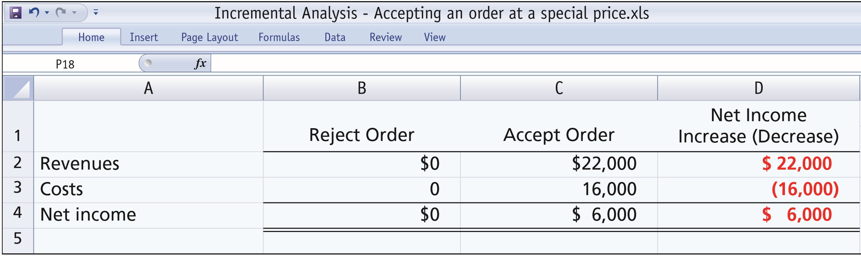

Accept an Order at a Special Price
ILLUSTRATION 12-4
Incremental analysis—accepting an order at a special price
Fixed costs do not change since within existing capacity – thus fixed costs are not relevant.
Variable manufacturing costs and expected revenues change – thus both are relevant to the decision.
LO 2

Slide 18
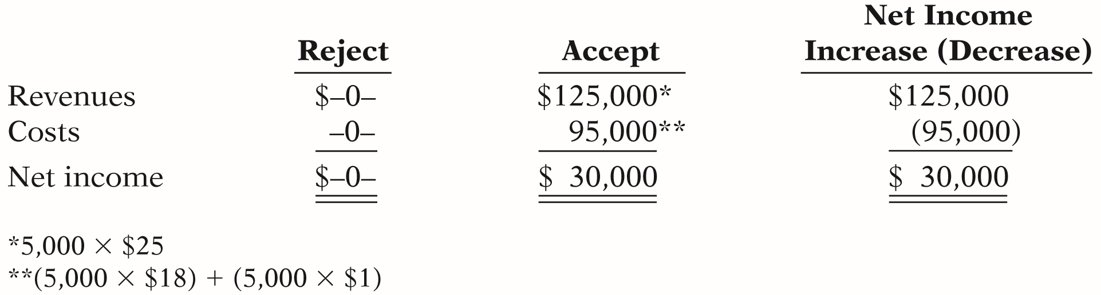
DO IT!
2
Special Orders
Cobb Company incurs costs of $28 per unit ($18 variable and $10 fixed) to make a product that normally sells for $42. A foreign wholesaler offers to buy 5,000 units at $25 each. Cobb will incur additional shipping costs of $1 per unit. Compute the increase or decrease in net income Cobb will realize by accepting the special order, assuming Cobb has excess operating capacity. Should Cobb Company accept the special order?
Accept or Reject?
Accept or Reject?
LO 2

Slide 19
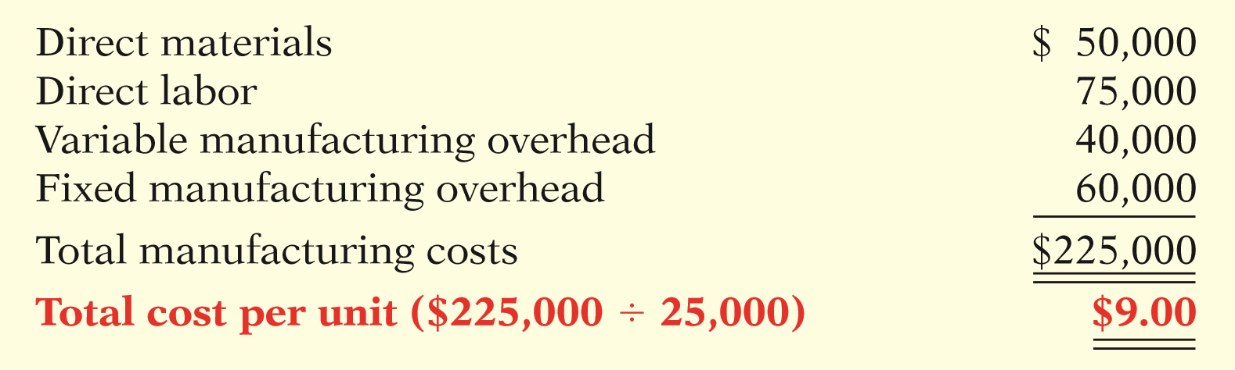
LEARNING OBJECTIVE
3
Analyze the relevant costs in a make-or-buy decision.
Illustration: Baron Company incurs the following annual costs in producing 25,000 ignition switches for motor scooters.
ILLUSTRATION 12-5
Annual product cost data
Instead of making its own switches, Baron
Company might purchase the ignition switches at
a price of $8 per unit. “What should management do?”
LO 3

Slide 20
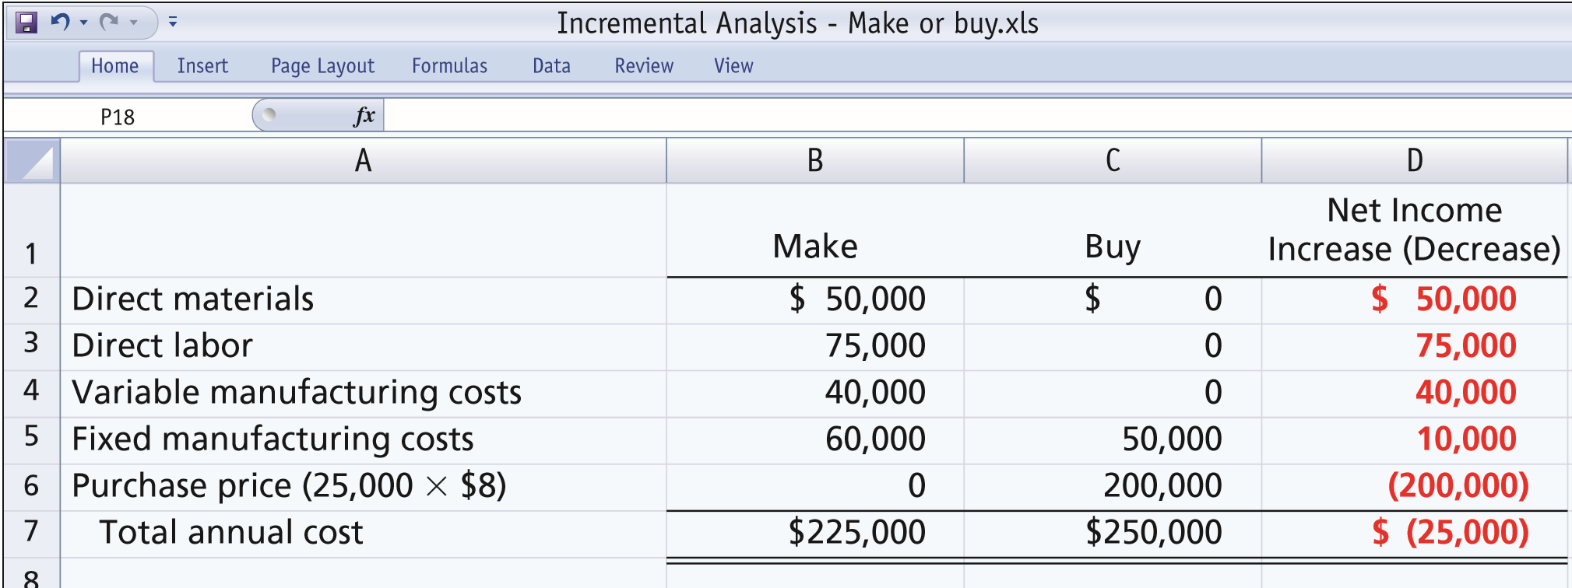

Make or Buy Decision
ILLUSTRATION 12-6
Incremental analysis—make or buy
Total manufacturing cost is $1 higher per unit than purchase price.
Must absorb at least $50,000 of fixed costs under either option.
LO 3

Slide 21
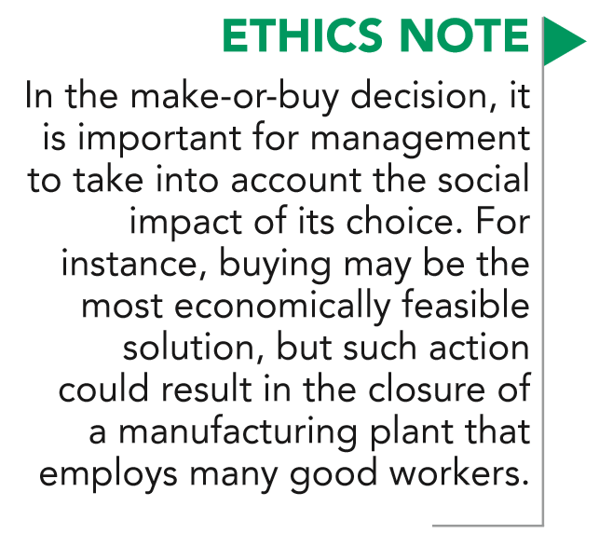
OPPORTUNITY COST
The potential benefit that may be obtained from following an alternative course of action.
LO 3

Slide 22
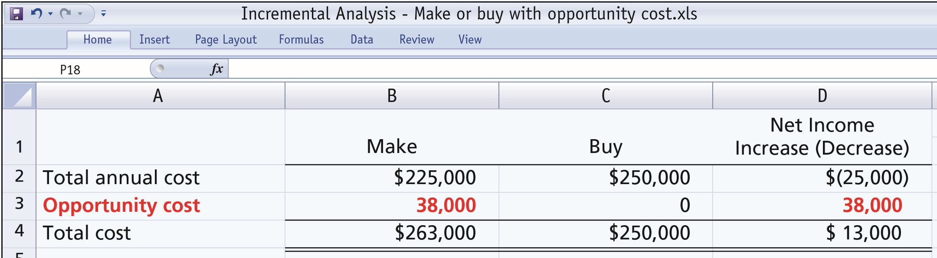
OPPORTUNITY COST
Illustration: Assume that through buying the switches, Baron Company can use the released productive capacity to generate additional income of $38,000 from producing a different product. This lost income is an additional cost of continuing to make the switches in the make-or-buy decision.
ILLUSTRATION 12-7
Incremental analysis—make or buy, with opportunity cost
LO 3

Slide 23
Make or Buy Decision
Question
In a make-or-buy decision, relevant costs are:
a. Manufacturing costs that will be saved.
b. The purchase price of the units.
c. Opportunity costs.
d. All of the above.
LO 3

Slide 24
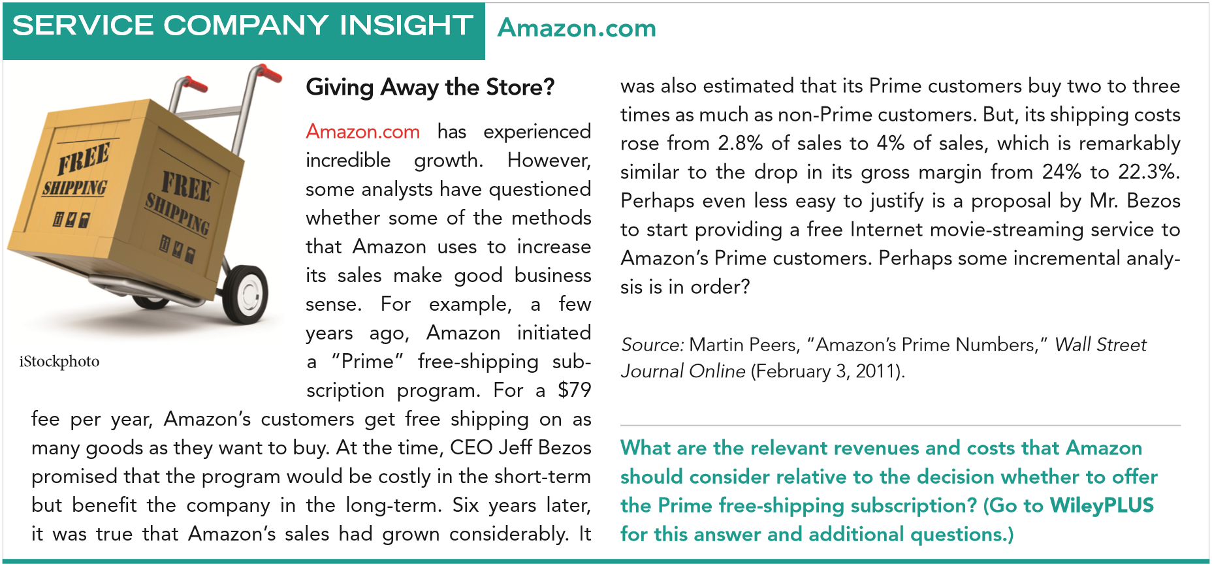
LO 3

Slide 25
DO IT!
3
Make or Buy
Juanita Company must decide whether to make or buy some of its components for the appliances it produces. The costs of producing 166,000 electrical cords for its appliances are as follows.
Direct materials $90,000 Variable overhead $32,000
Direct labor 20,000 Fixed overhead 24,000
Instead of making the electrical cords at an average cost per unit of $1.00 ($166,000 ÷ 166,000), the company has an opportunity to buy the cords at $0.90 per unit. If the company purchases the cords, all variable costs and one-fourth of the fixed costs will be eliminated.
(a) Prepare an incremental analysis showing whether the company should make or buy the electrical cords. (b) Will your answer be different if the released productive capacity will generate additional income of $5,000?
LO 3

Slide 26
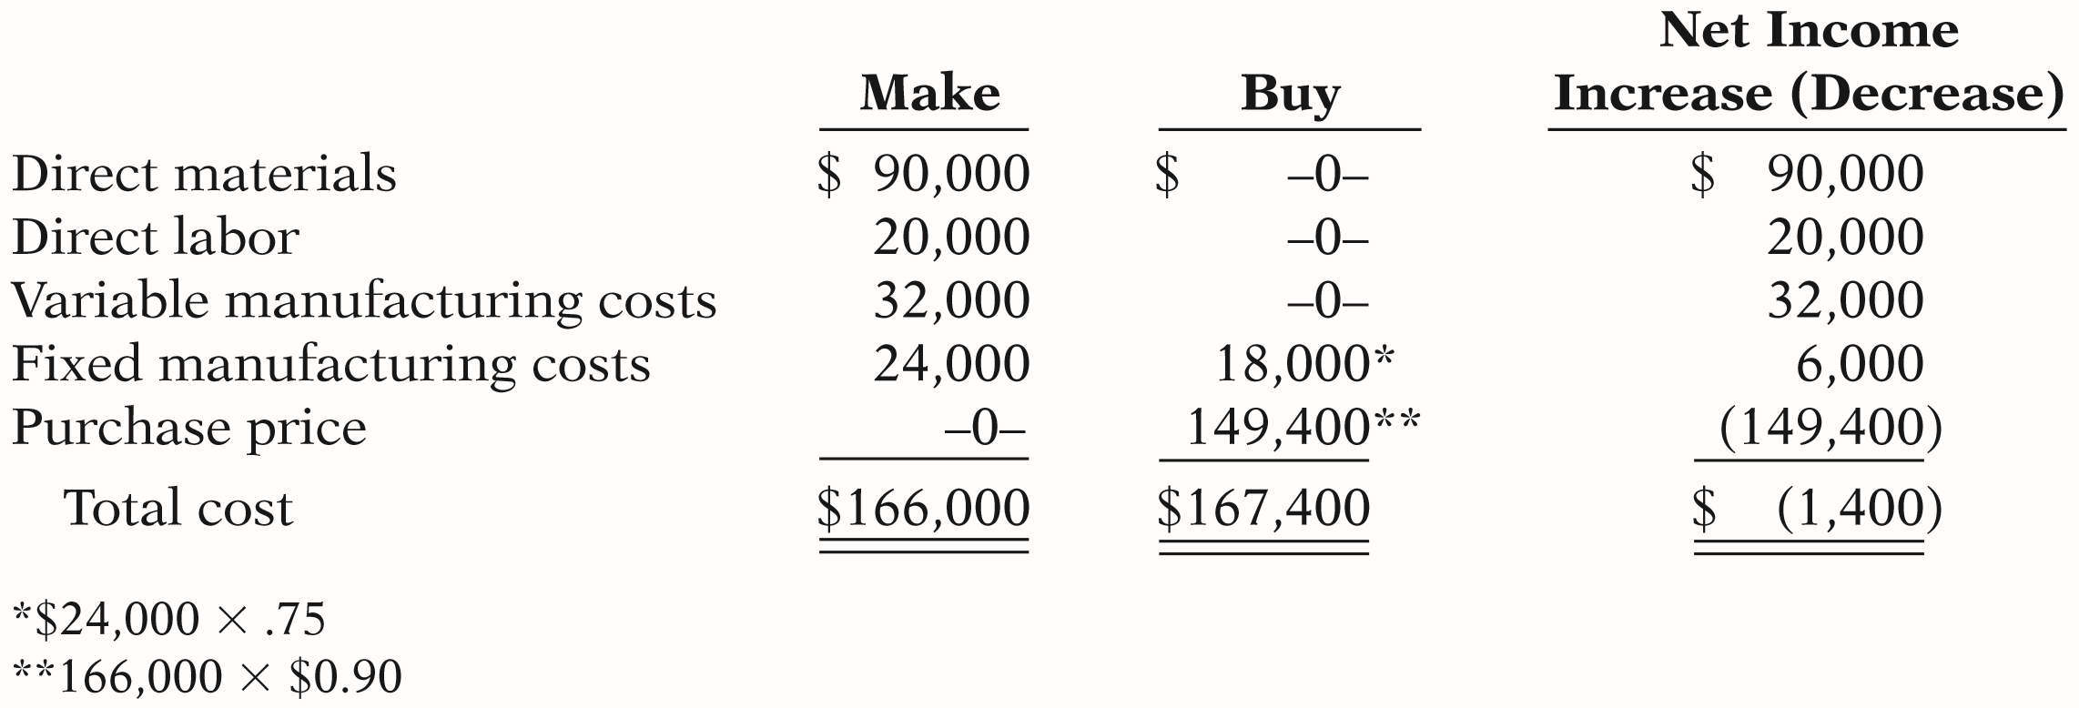
DO IT!
3
Make or Buy
(a) Prepare an incremental analysis showing whether the company should make or buy the electrical cords.
Juanita Company will incur $1,400 of additional costs if it buys the electrical cords rather than making them.
LO 3

Slide 27
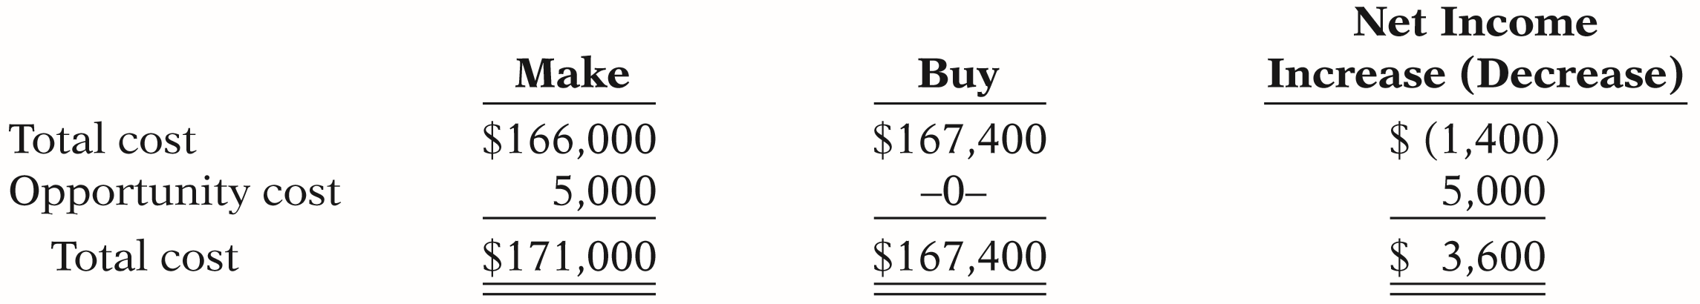
DO IT!
3
Make or Buy
Will your answer be different if the released productive capacity will generate additional income of $5,000?
Yes, net income will be increased by $3,600 if Juanita Company purchases the electrical cords rather than making them.
LO 3

Slide 28
LEARNING OBJECTIVE
4
Analyze the relevant costs in determining whether to sell or process materials further.
Sell or Process Further
  May have option to sell product at a given point in production or to process further and sell at a higher price.
  Decision Rule:
  Process further as long as the incremental revenue from such processing exceeds the incremental processing costs.
LO 4

Slide 29
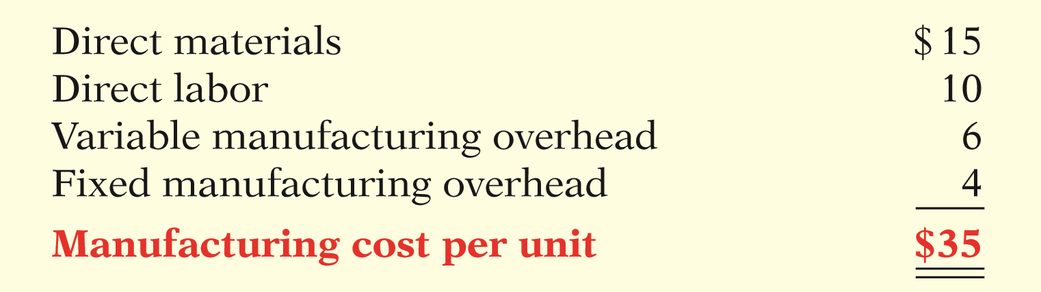
SINGLE-PRODUCT CASE
Illustration: Woodmasters Inc. makes tables. The cost to manufacture an unfinished table is $35. The selling price per unfinished unit is $50. Woodmasters has unused capacity that can be used to finish the tables and sell them at $60 per unit. For a finished table, direct materials will increase $2 and direct labor costs will increase $4. Variable manufacturing overhead costs will increase by $2.40 (60% of direct labor). No increase is anticipated in fixed manufacturing overhead.
ILLUSTRATION 12-8
Per unit cost of unfinished table
LO 4

Slide 30
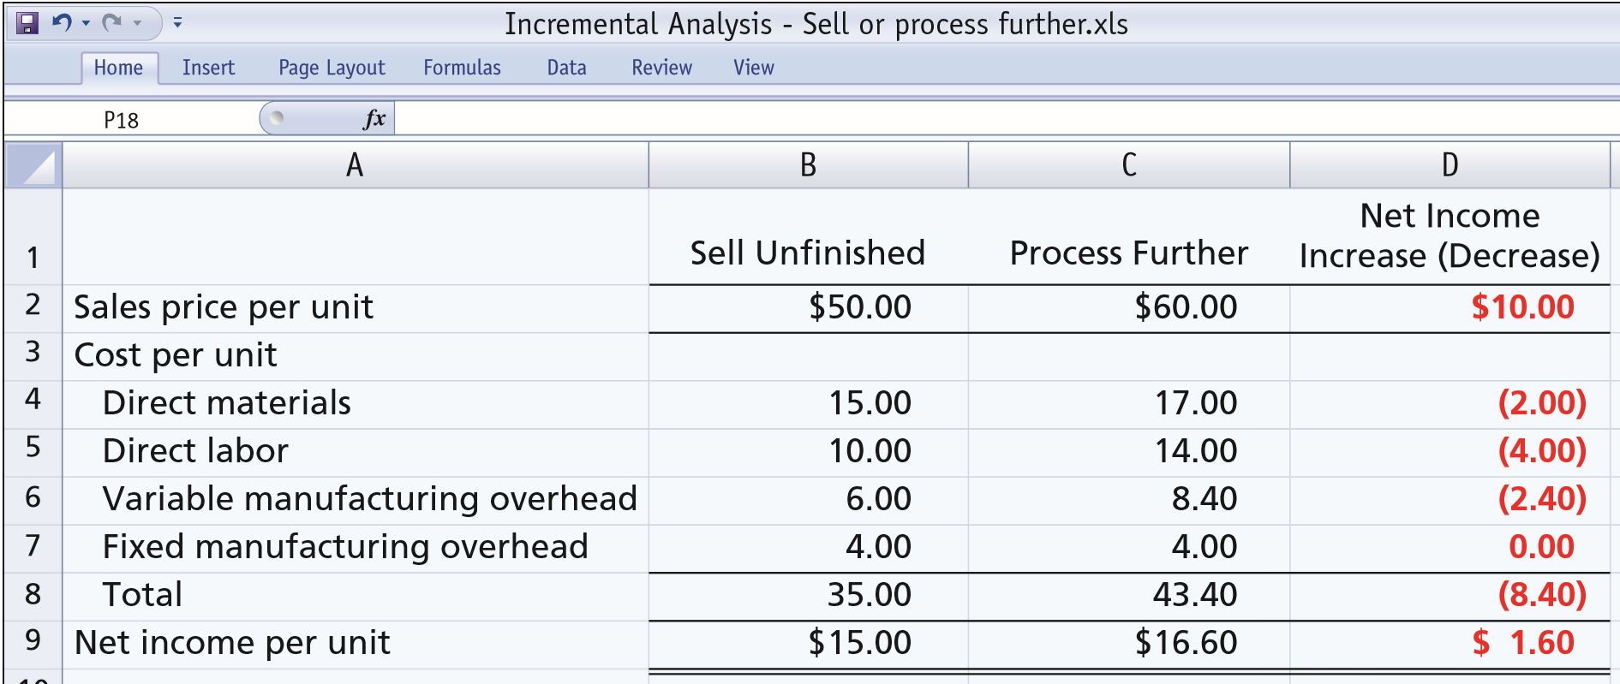
SINGLE-PRODUCT CASE
The incremental analysis on a per unit basis is as follows.
ILLUSTRATION 12-9
Incremental analysis—sell or process further
Should Woodmasters sell or process further.
Should Woodmasters sell or process further?
LO 4

Slide 31
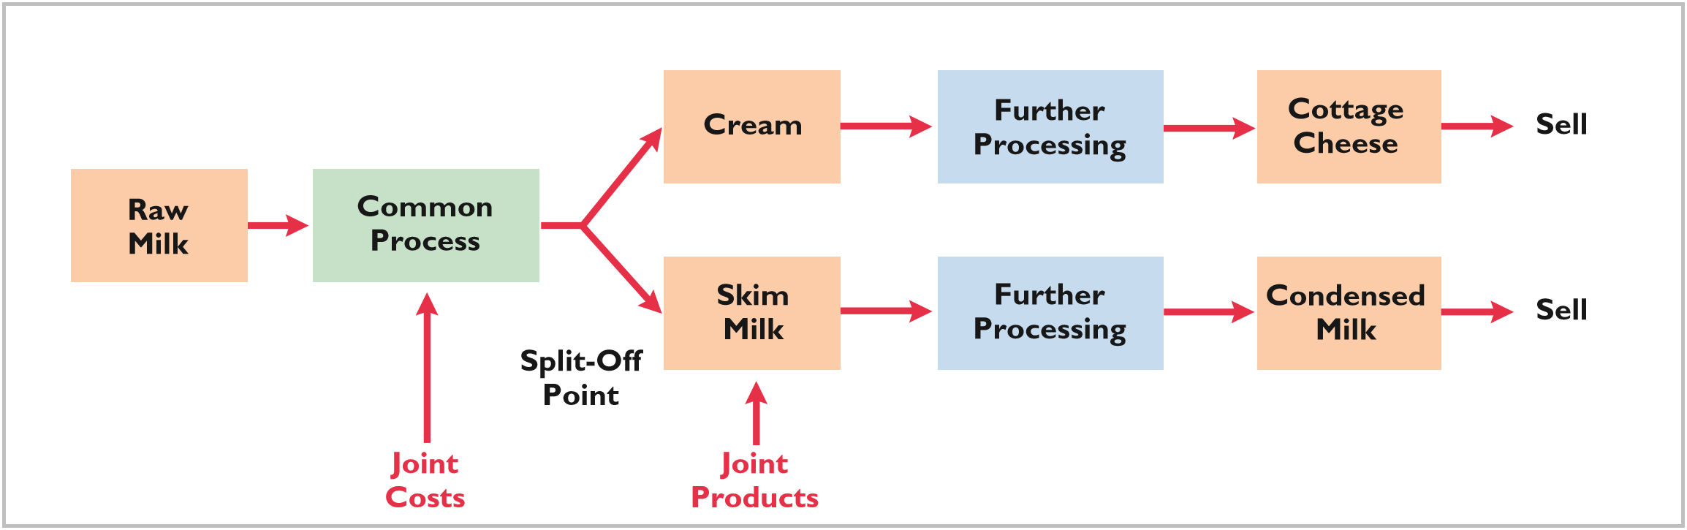
MULTIPLE-PRODUCT CASE
Joint product situation for Marais Creamery. Cream and skim milk are products that result from the processing of raw milk.
ILLUSTRATION 12-10
Joint production process—Creamery
Joint product costs are sunk costs and thus not relevant to the sell-or-process further decision.
LO 4

Slide 32
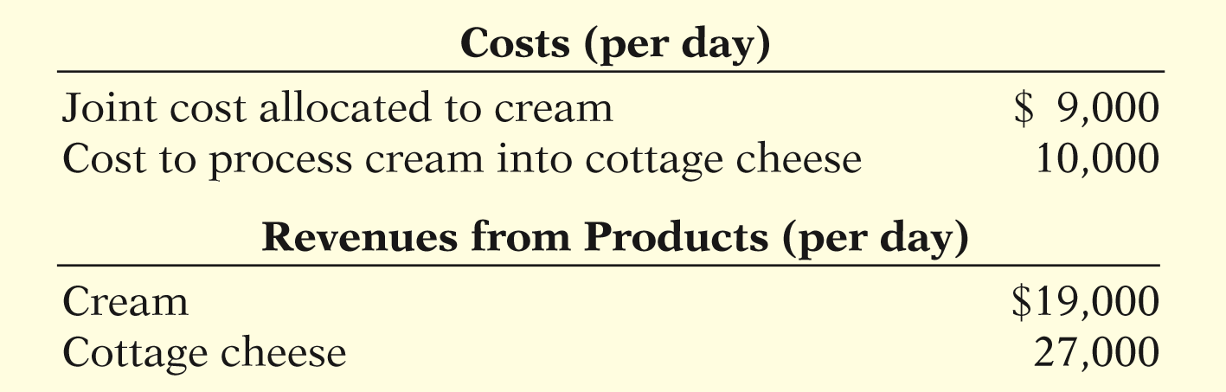
MULTIPLE-PRODUCT CASE
Cost and revenue data per day for cream.
ILLUSTRATION 12-11
Cost and revenue data per day for cream
Determine whether the company should simply sell the cream or process it further into cottage cheese.
LO 4

Slide 33
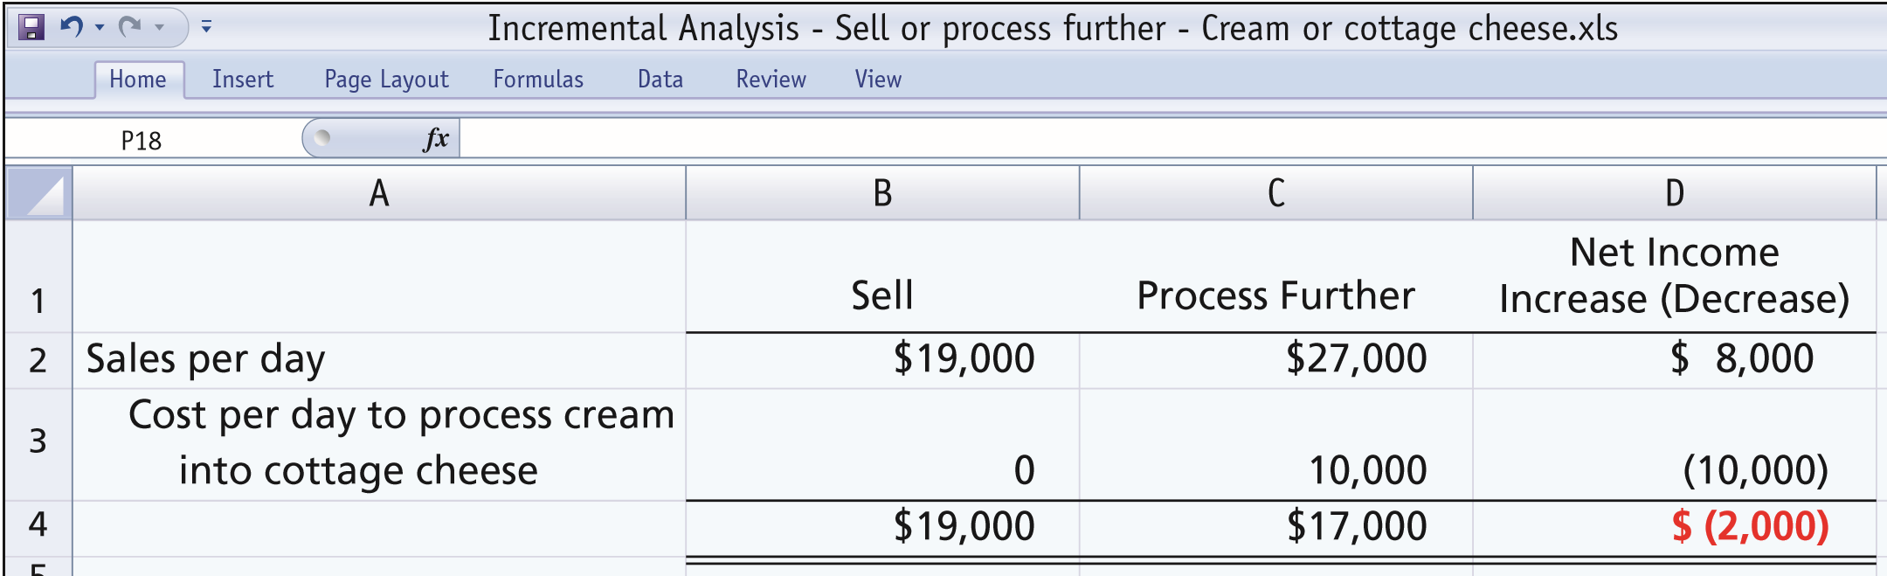
MULTIPLE-PRODUCT CASE
Analysis of whether to sell cream or process into cottage cheese.
ILLUSTRATION 12-12
Marais should or should not process the cream further?
Marais should or should not process the cream further?
LO 4

Slide 34
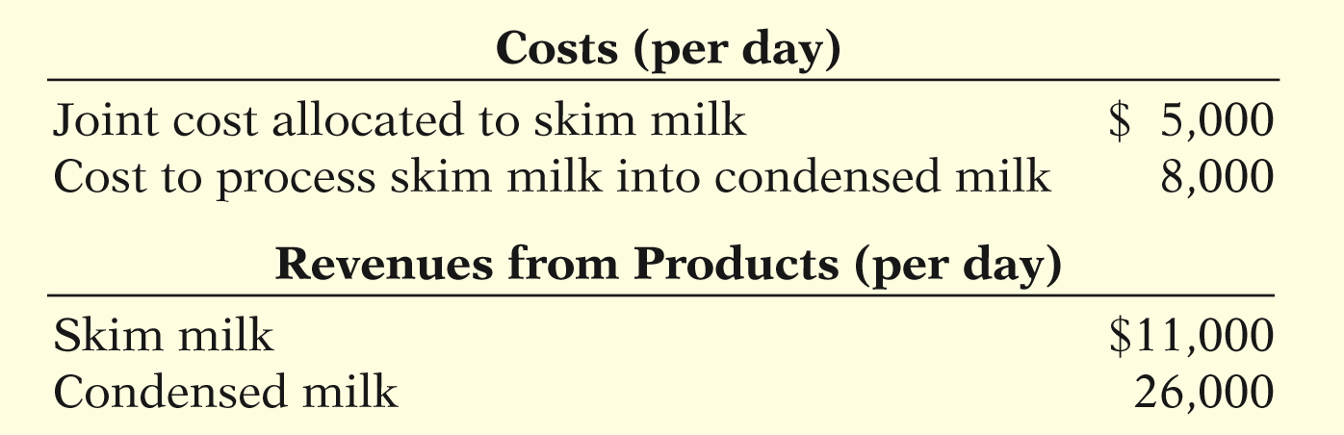
MULTIPLE-PRODUCT CASE
Cost and revenue data per day for skim milk.
ILLUSTRATION 12-13
Cost and revenue data per day for skim milk
Determine whether the company should sell the skim milk or process it further into condensed milk.
LO 4

Slide 35
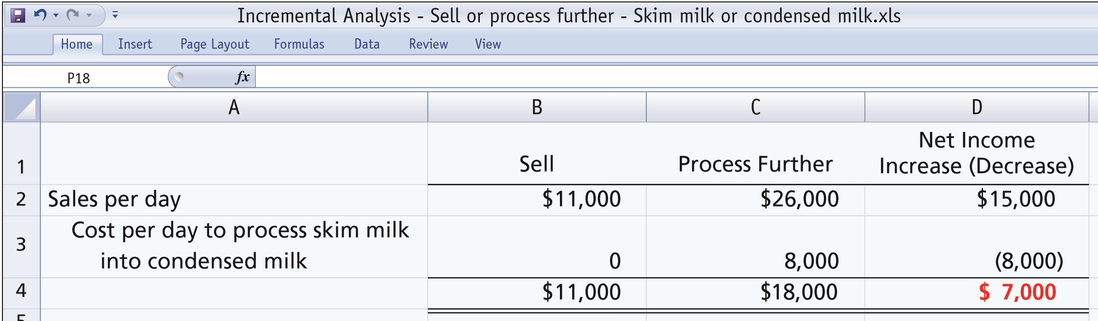
MULTIPLE-PRODUCT CASE
Analysis of whether to sell skim milk or process into condensed milk.
ILLUSTRATION 12-14
Marais should or should not process the milk further?
Marais should or should not process the milk further?
LO 4

Slide 36
Sell or Process Further
Question
The decision rule is a sell-or-process-further decision:
Process further as long as the incremental revenue from processing exceeds:
a. Incremental processing costs.
b. Variable processing costs.
c. Fixed processing costs.
d. No correct answer is given.
LO 4

Slide 37
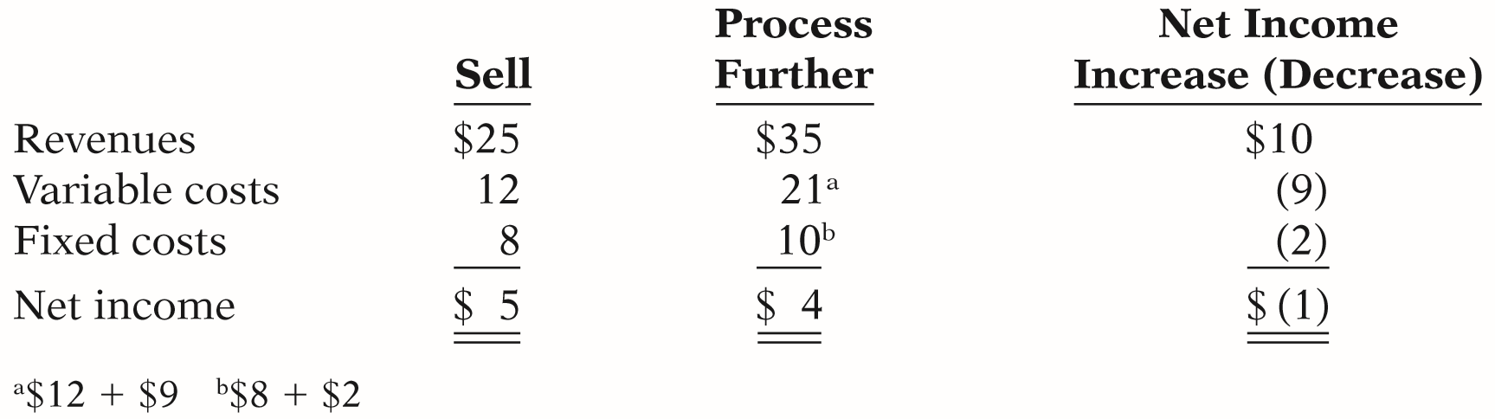
DO IT!
4
Sell or Process Further
Easy Does It manufactures unpainted furniture for the do-it-yourself (DIY) market. It currently sells a child’s rocking chair for $25. Production costs are $12 variable and $8 fixed. Easy Does It is considering painting the rocking chair and selling it for $35. Variable costs to paint each chair are expected to be $9, and fixed costs are expected to be $2. Prepare an analysis showing whether Easy Does It should sell unpainted or painted chairs.
SOLUTION
LO 4

Slide 38
LEARNING OBJECTIVE
5
Analyze the relevant costs to be considered in repairing, retaining, or replacing equipment.
Illustration: Jeffcoat Company is considering replacing a factory machine with a new machine. Jeffcoat Company has a factory machine that originally cost $110,000. It has a balance in Accumulated Depreciation of $70,000, so its book value is $40,000. It has a remaining useful life of four years. The company is considering replacing this machine with a new machine. A new machine is available that costs $120,000. It is expected to have zero salvage value at the end of its four-year useful life. If the new machine is acquired, variable manufacturing costs are expected to decrease from $160,000 to $125,000 and the old unit could be sold for $5,000. The incremental analysis for the four-year period is as follows.
LO 5

Slide 39
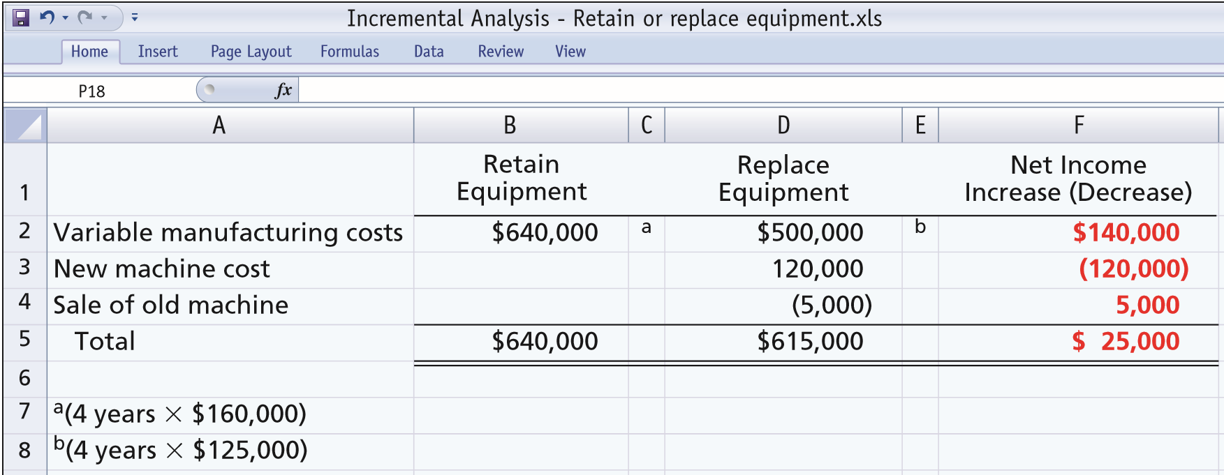
Repair, Retain, or Replace Equipment
Prepare the incremental analysis for the four-year period.
ILLUSTRATION 12-15
Incremental analysis—retain or replace equipment
Retain or Replace?
Retain or Replace?
LO 5

Slide 40
Repair, Retain, or Replace Equipment
Additional Considerations
  The book value of old machine does not affect the decision.
    Book value is a sunk cost.
    Costs which cannot be changed by future decisions (sunk costs) are not relevant in incremental analysis.
  However, any trade-in allowance or cash disposal value of the existing asset is relevant.
LO 5

Slide 41
DO IT!
5
Repair or Replace Equipment
Rochester Roofing is faced with a decision. The company relies very heavily on the use of its 60-foot extension lift for work on large homes and commercial properties. Last year, the company spent $60,000 refurbishing the lift. It has just determined that another $40,000 of repair work is required. Alternatively, Rochester Roofing has found a newer used lift that is for sale for $170,000. The company estimates that both the old and new lifts would have useful lives of 6 years. However, the lift is more efficient and thus would reduce operating expenses by about $20,000 per year. The company could also rent out the new lift for about $2,000 per year. The old lift is not suitable for rental. The old lift could currently be sold for $25,000 if the new lift is purchased. Prepare an incremental analysis that shows whether the company should repair or replace the equipment.
LO 5

Slide 42
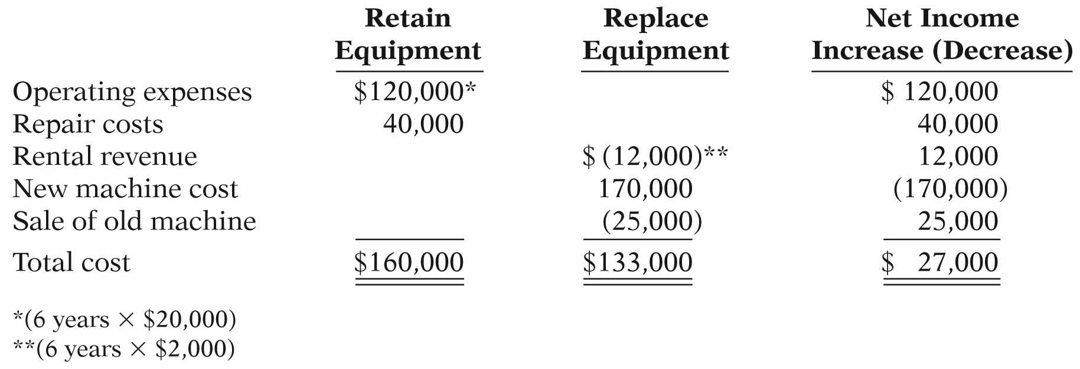
DO IT!
5
Repair or Replace Equipment
SOLUTION
The analysis indicates that purchasing the new machine would increase net income for the 6-year period by $27,000.
LO 5

Slide 43
Analyze the relevant costs in deciding whether to eliminate an unprofitable segment or product.
LEARNING OBJECTIVE
6
  Key: Focus on Relevant Costs.
  Consider effect on related product lines.
  Fixed costs allocated to the unprofitable segment must be absorbed by the other segments.
  Net income may decrease when an unprofitable segment is eliminated.
  Decision Rule: Retain the segment unless fixed costs eliminated exceed contribution margin lost.
LO 6

Slide 44
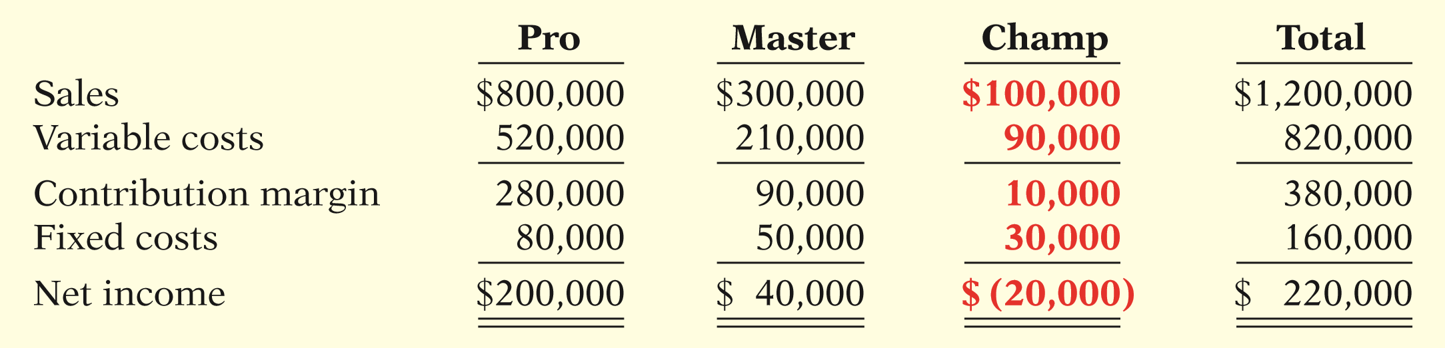
Eliminate an Unprofitable Segment or Product
Illustration: Venus Company manufactures three models of tennis rackets:
  Profitable lines: Pro and Master
  Unprofitable line: Champ
Should Champ be eliminated?
ILLUSTRATION 12-16
Segment income data
LO 6

Slide 45
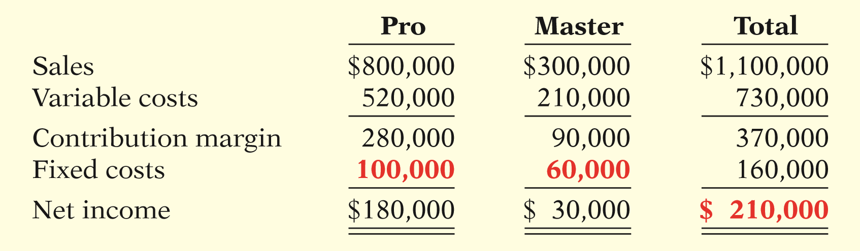

Eliminate an Unprofitable Segment or Product
Prepare income data after eliminating Champ product line. Assume fixed costs are allocated 2/3 to Pro and 1/3 to Master.
ILLUSTRATION 12-17
Income data after eliminating
unprofitable product line
Total income is decreased by $10,000.
LO 6

Slide 46
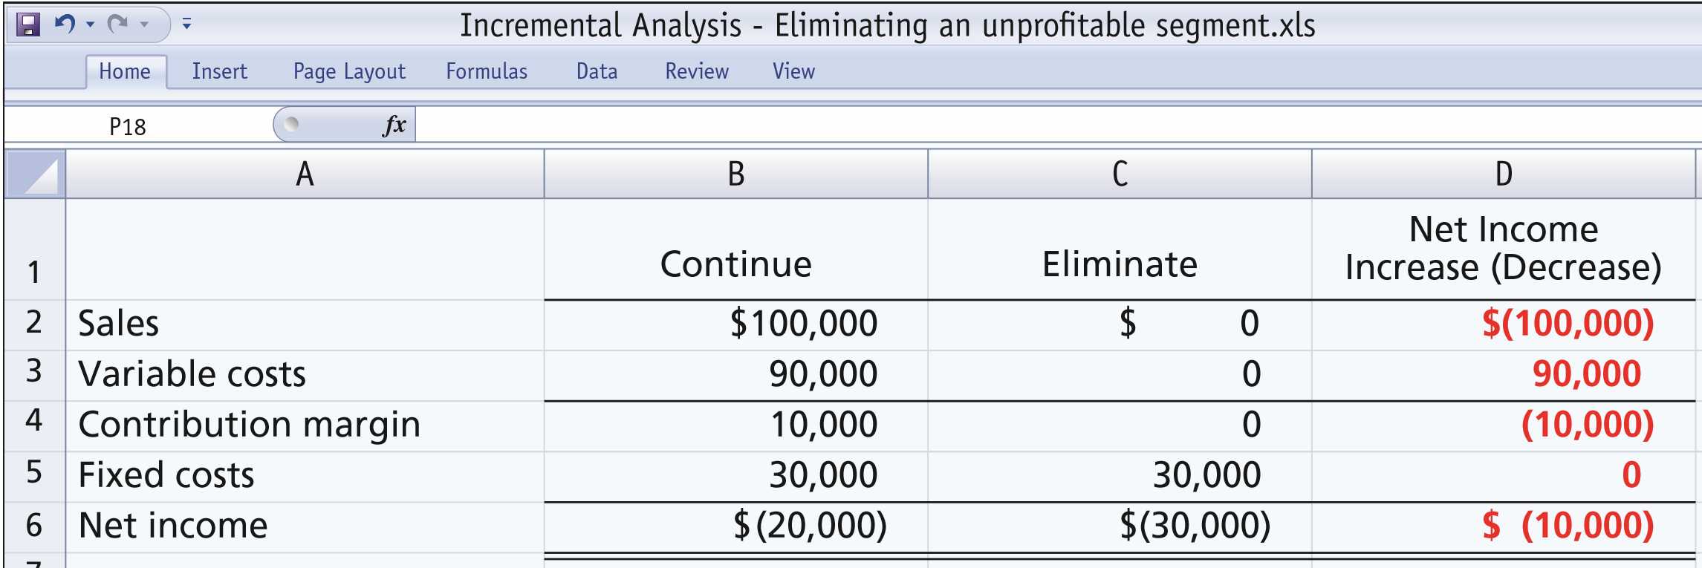
Eliminate an Unprofitable Segment or Product
Incremental analysis of Champ provided the same results:
Do Not Eliminate Champ
ILLUSTRATION 12-18
Incremental analysis—eliminating unprofitable
segment with no reduction in fixed costs
LO 6

Slide 47
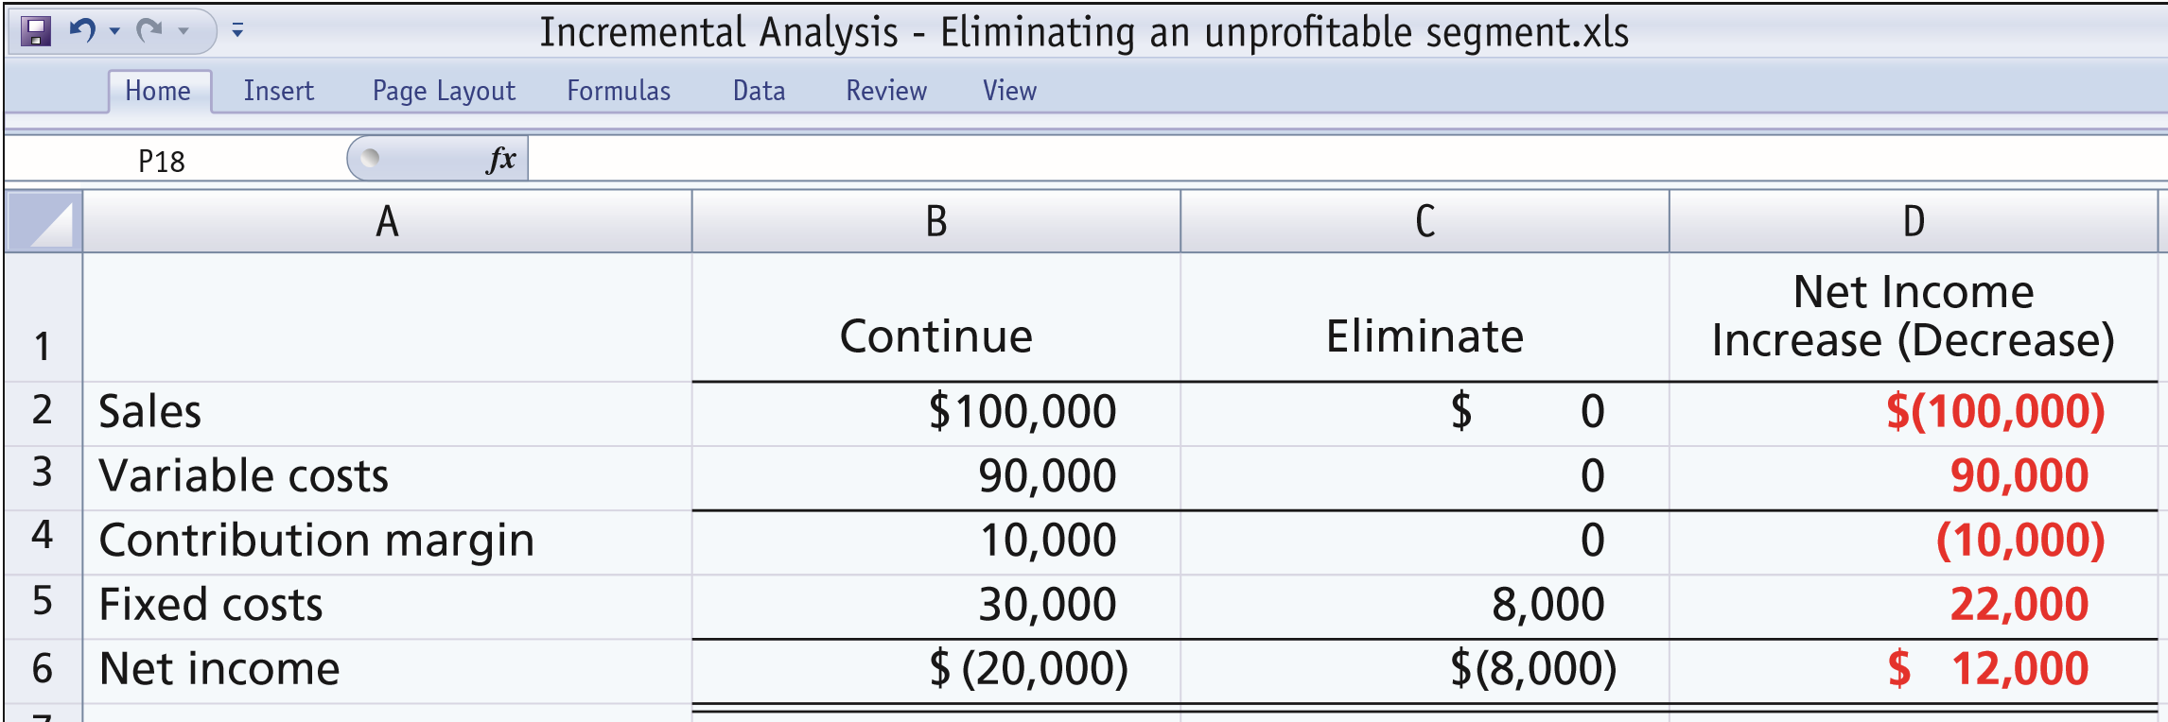
Eliminate an Unprofitable Segment or Product
Assume that $22,000 of the fixed costs attributed to the Champ line can be eliminated if the line is discontinued.
Eliminate Champ
ILLUSTRATION 12-19
Incremental analysis—eliminating unprofitable
segment with reduction in fixed costs
LO 6

Slide 48
Unprofitable Segment
Question
If an unprofitable segment is eliminated:
a. Net income will always increase.
b. Variable expenses of the eliminated segment will have to be absorbed by other segments.
c. Fixed expenses allocated to the eliminated segment will have to be absorbed by other segments.
d. Net income will always decrease.
LO 6

Slide 49
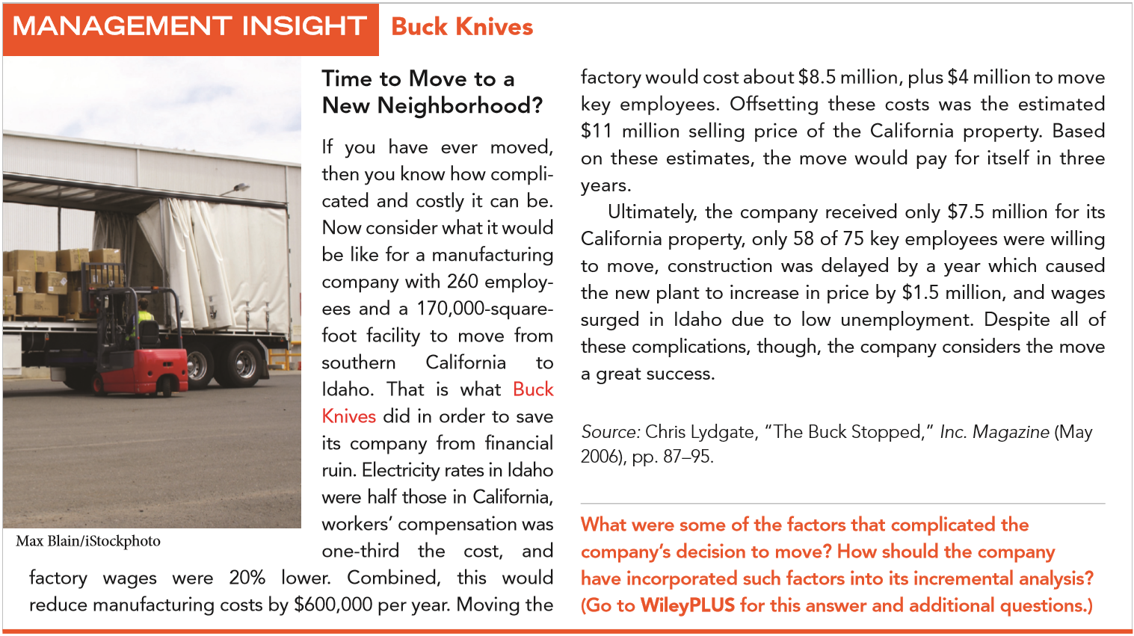
LO 6

Slide 50
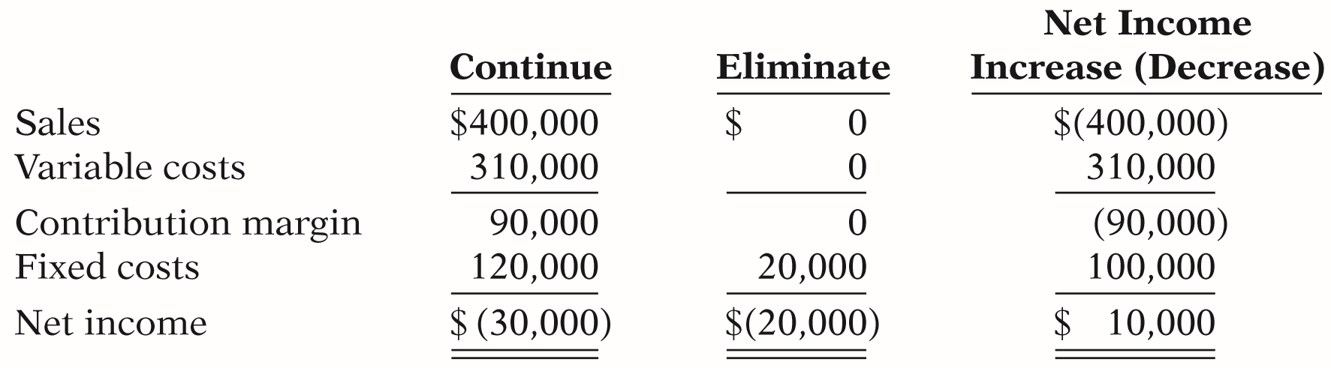
DO IT!
6
Unprofitable Segments
Lambert, Inc. manufactures several types of accessories. For the year, the knit hats and scarves line had sales of $400,000, variable expenses of $310,000, and fixed expenses of $120,000. Therefore, the knit hats and scarves line had a net loss of $30,000. If Lambert eliminates the knit hats and scarves line, $20,000 of fixed costs will remain. Prepare an analysis showing whether the company should eliminate the knit hats and scarves line.
LO 6

Slide 51
Copyright
“Copyright © 2017 John Wiley & Sons, Inc. All rights reserved. Reproduction or translation of this work beyond that permitted in Section 117 of the 1976 United States Copyright Act without the express written permission of the copyright owner is unlawful. Request for further information should be addressed to the Permissions Department, John Wiley & Sons, Inc. The purchaser may make back-up copies for his/her own use only and not for distribution or resale. The Publisher assumes no responsibility for errors, omissions, or damages, caused by the use of these programs or from the use of the information contained herein.”

