Slide 1
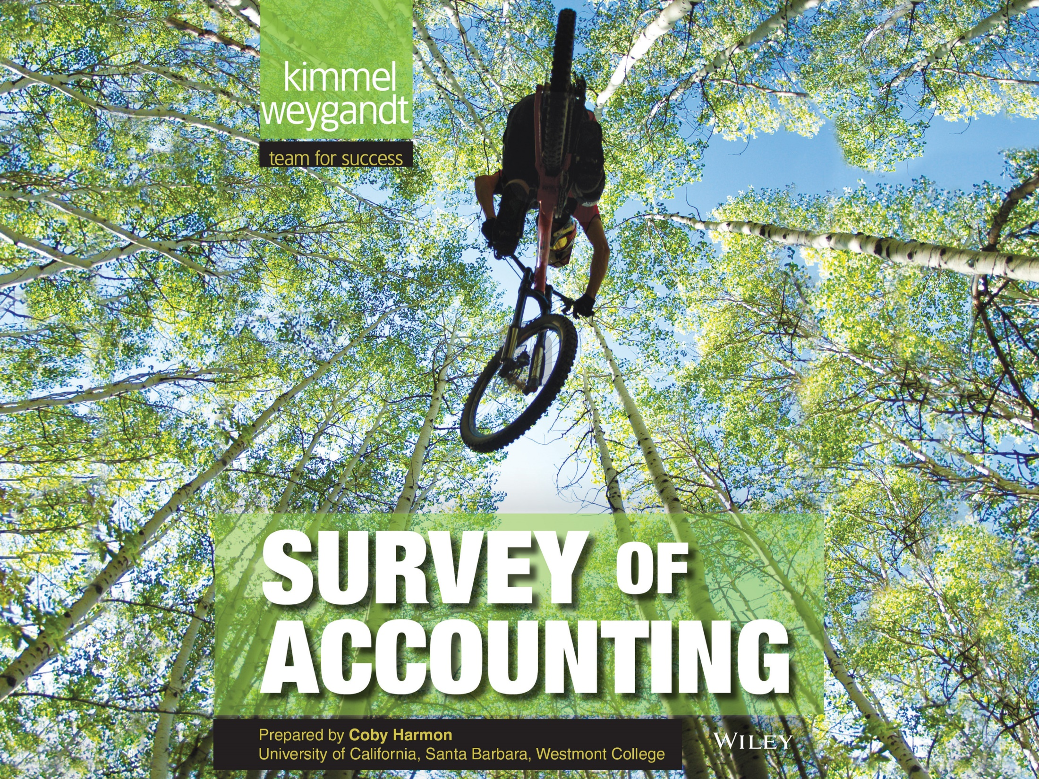

Slide 2
13
WILEY
Budgetary Planning
Kimmel ● Weygandt ● Kieso
Survey of Accounting, First Edition

Slide 3
CHAPTER OUTLINE
LEARNING OBJECTIVES
State the essentials of effective budgeting and the components of the master budget.
1
Prepare budgets for sales, production, and direct materials.
2
Prepare budgets for direct labor, manufacturing overhead, and selling and administrative expenses, and a budgeted income statement.
3
Prepare a cash budget and a budgeted balance sheet.
4
Apply budgeting principles to nonmanufacturing companies.
5

Slide 4
LEARNING OBJECTIVE
1
State the essentials of effective budgeting and the components of the master budget.
Budget: a formal written statement of management’s plans for a specified future time period, expressed in financial terms.
  Primary method of communicating agreed-upon objectives throughout the organization.
  Promotes efficiency.
  Control device - important basis for performance evaluation once adopted.
LO 1

Slide 5
BUDGETING AND ACCOUNTING
  Historical accounting data on revenues, costs, and expenses help in formulating future budgets.
  Accountants normally responsible for presenting management’s budgeting goals in financial terms.
  The budget and its administration are the responsibility of management.
LO 1

Slide 6
THE BENEFITS OF BUDGETING
  Primary benefits of budgeting:
  Requires all levels of management to plan ahead.
  Provides definite objectives for evaluating performance.
  Creates an early warning system for potential problems.
  Facilitates coordination of activities within the business.
  Results in greater management awareness of the entity’s overall operations.
  It motivates personnel throughout organization to meet planned objectives.
LO 1

Slide 7
THE BENEFITS OF BUDGETING
Question
Which of the following is not a benefit of budgeting?
Management can plan ahead.
An early warning system is provided for potential problems.
It enables disciplinary action to be taken at every level of responsibility.
The coordination of activities is facilitated.
LO 1

Slide 8
ESSENTIALS OF EFFECTIVE BUDGETING
  Depends on a sound organizational structure with authority and responsibility for all phases of operations clearly defined.
  Based on research and analysis with realistic goals.
  Accepted by all levels of management.
LO 1

Slide 9
ESSENTIALS OF EFFECTIVE BUDGETING
Length of the Budget Period
May be prepared for any period of time.
  Most common - one year.
  Supplement with monthly and quarterly budgets.
  Different budgets may cover different time periods.
Long enough to provide an attainable goal and minimize seasonal or cyclical fluctuations.
Short enough for reliable estimates.
LO 1

Slide 10
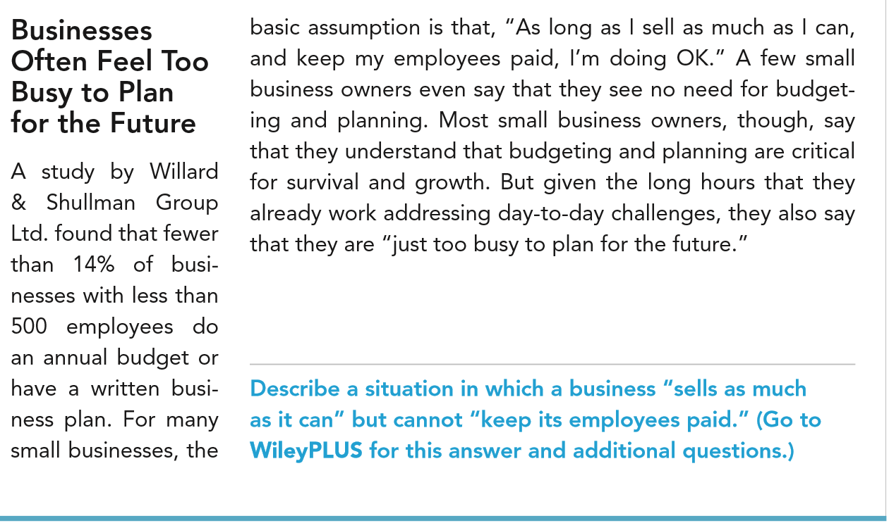
LO 1

Slide 11
ESSENTIALS OF EFFECTIVE BUDGETING
The Budgeting Process
Base budget goals on past performance
  Collect data from organizational units.
  Begin several months before end of current year.
Develop budget within the framework of a sales forecast.
  Shows potential industry sales.
  Shows company’s expected share.
LO 1

Slide 12
ESSENTIALS OF EFFECTIVE BUDGETING
The Budgeting Process
Factors considered in Sales Forecasting:
  General economic conditions
  Industry trends
  Market research studies
  Anticipated advertising and promotion
  Previous market share
  Price changes
  Technological developments
LO 1

Slide 13
ESSENTIALS OF EFFECTIVE BUDGETING
Budgeting and Human Behavior
Participative Budgeting: Each level of management should be invited to participate.
  May inspire higher levels of performance or discourage additional effort.
  Depends on how budget developed and administered.
LO 1

Slide 14
Budgeting and Human Behavior
Participative Budgeting
  Advantages:
    More accurate budget estimates because lower level managers have more detailed knowledge of their area.
    Tendency to perceive process as fair due to involvement of lower level management.
  Overall goal - produce budget considered fair and achievable by managers while still meeting corporate goals.
LO 1

Slide 15
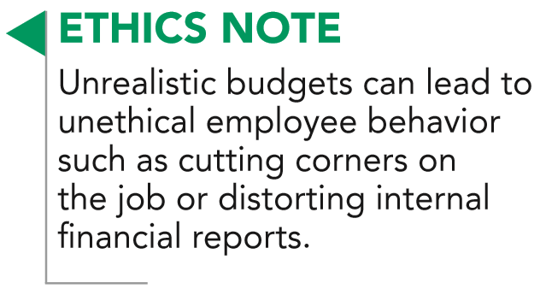
Budgeting and Human Behavior
Participative Budgeting
  Disadvantages:
    Can be time consuming and costly.
    Can foster budgetary “gaming” through budgetary slack.
LO 1

Slide 16
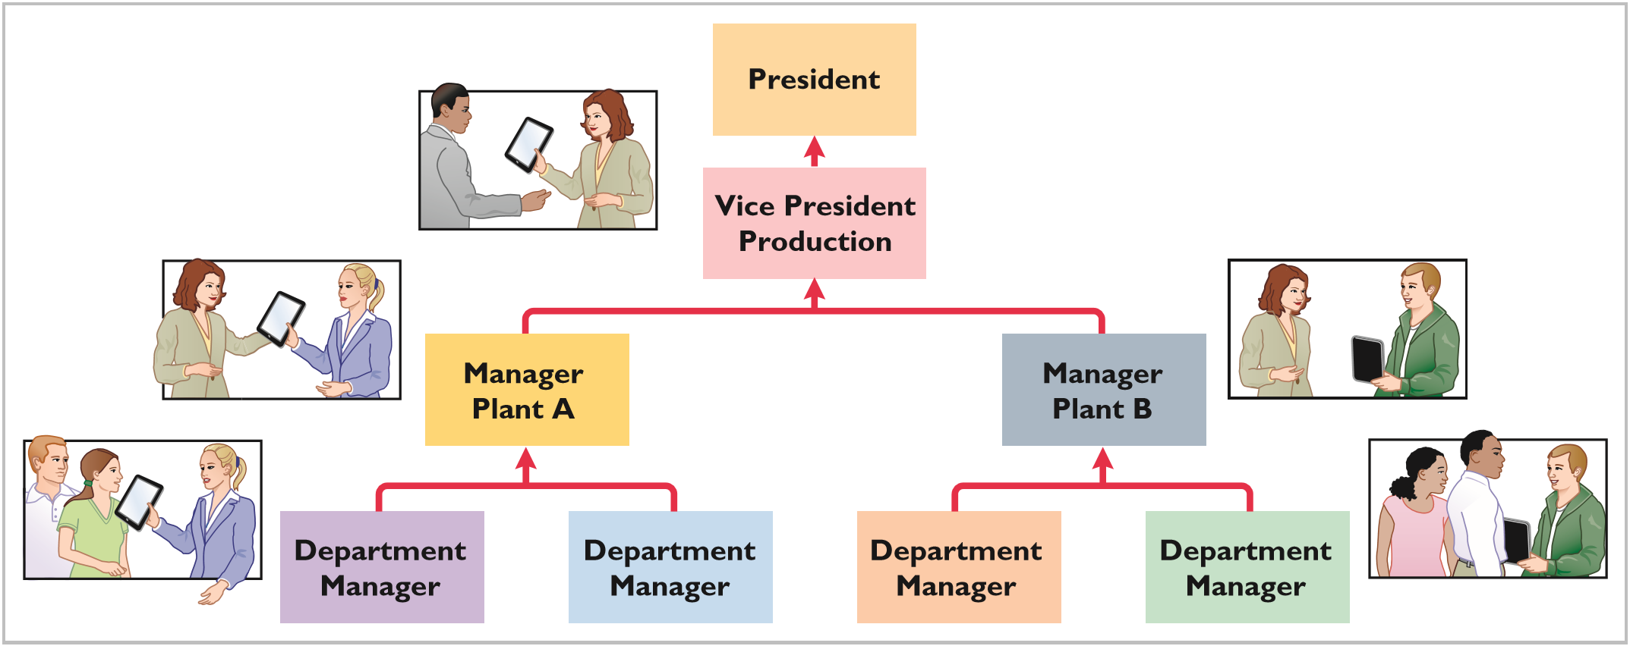
Budgeting and Human Behavior
ILLUSTRATION 13-1
Flow of budget data under
participative budgeting
LO 1

Slide 17
ESSENTIALS OF EFFECTIVE BUDGETING
Budgeting and Long-Range Planning
Three basic differences :
  Time period involved
  Emphasis
  Detail presented
Time period:
Budgeting is short-term – usually one year.
Long range planning – at least five years.
LO 1

Slide 18
ESSENTIALS OF EFFECTIVE BUDGETING
Question
The essentials of effective budgeting do not include:
a. Top-down budgeting.
b. Management acceptance.
c. Research and analysis.
d. Sound organizational structure.
LO 1

Slide 19
THE MASTER BUDGET
  Set of interrelated budgets that constitutes a plan of action for a specified time period.
  Contains two classes of budgets:
    Operating budgets.
    Financial budgets.
Individual budgets that result in the preparation of the budgeted income statement – establish goals for sales and production personnel.
LO 1

Slide 20
THE MASTER BUDGET
  Set of interrelated budgets that constitutes a plan of action for a specified time period.
  Contains two classes of budgets:
    Operating budgets.
    Financial budgets.
The capital expenditures budget, the cash budget, and the budgeted balance sheet – focus primarily on cash needs to fund operations and capital expenditures.
LO 1

Slide 21
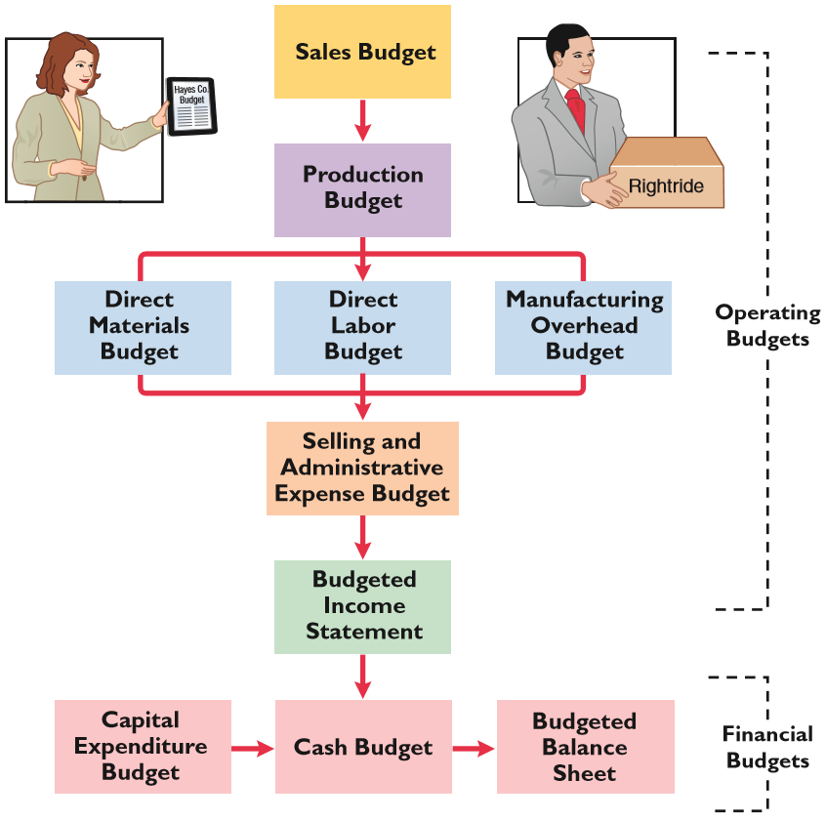
THE MASTER BUDGET
ILLUSTRATION 13-2
Components of the master budget
LO 1

Slide 22
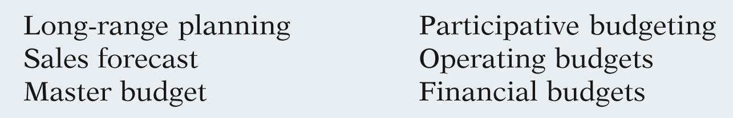
DO IT!
1
Budget Terminology
Use this list of terms to complete the sentences that follow.
  A sales forecast shows potential sales for the industry and a company’s expected share of such sales.
  Operating budgets are used as the basis for the preparation of the budgeted income statement.
LO 1

Slide 23
DO IT!
1
Budget Terminology
Use this list of terms to complete the sentences that follow.
  The master budget is a set of interrelated budgets that constitutes a plan of action for a specified time period.
  Long-range planning identifies long-term goals, selects strategies to achieve these goals, and develops policies and plans to implement the strategies.
LO 1

Slide 24
DO IT!
1
Budget Terminology
Use this list of terms to complete the sentences that follow.
  Lower-level managers are more likely to perceive results as fair and achievable under a participative budgeting approach.
  Financial budgets focus primarily on the cash resources needed to fund expected operations and planned capital expenditures.
LO 1

Slide 25
LEARNING OBJECTIVE
2
Prepare budgets for sales, production, and direct materials.
SALES BUDGET
  First budget prepared.
  Derived from the sales forecast.
    Management’s best estimate of sales revenue for the budget period.
  Every other budget depends on the sales budget.
  Prepared by multiplying expected unit sales volume for each product times anticipated unit selling price.
LO 2

Slide 26
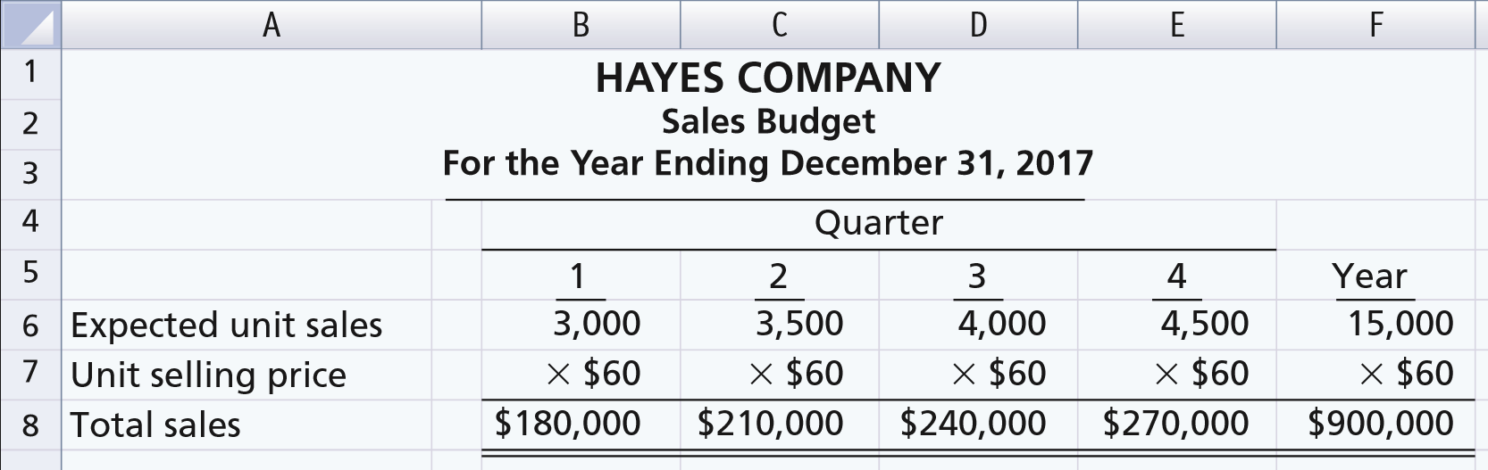
SALES BUDGET
Illustration – Hayes Company
Expected sales volume: 3,000 units in the first quarter with 500-unit increases in each succeeding quarter.
Sales price: $60 per unit.
ILLUSTRATION 13-3
Sales budget
LO 2

Slide 27
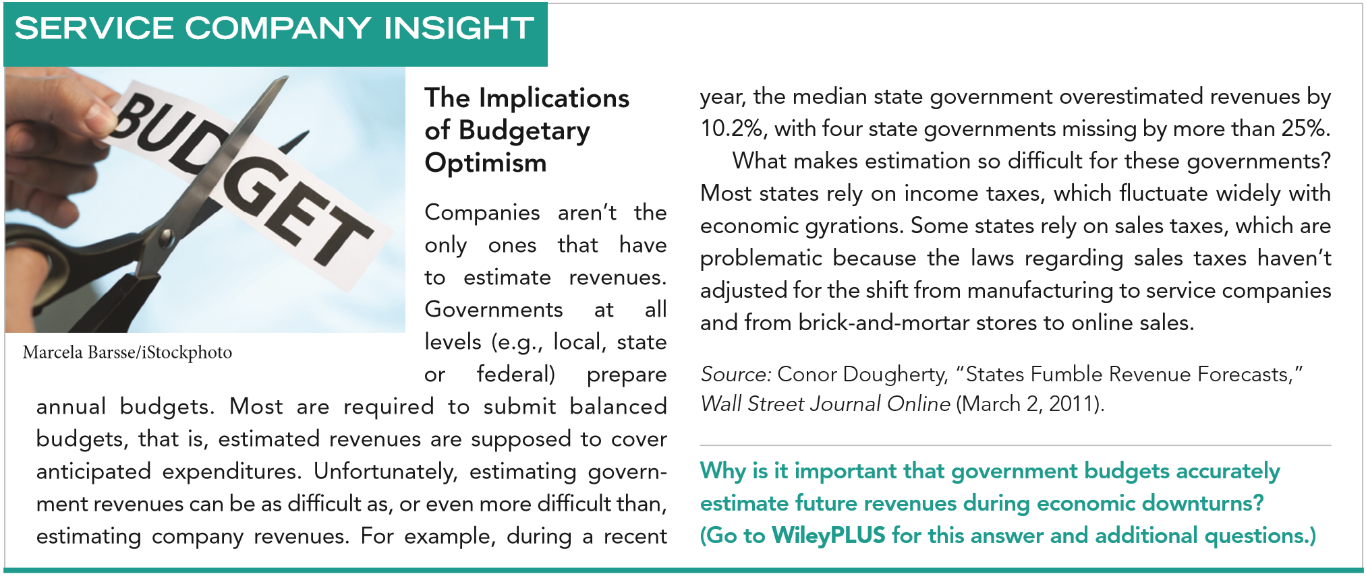
LO 2

Slide 28
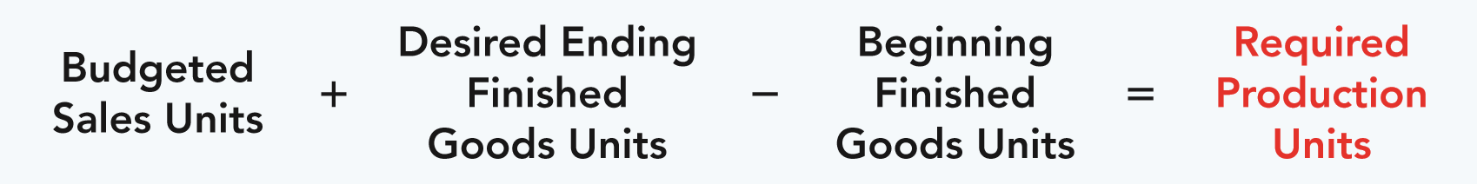
PRODUCTION BUDGET
  Shows units that must be produced to meet anticipated sales.
  Derived from sales budget plus the desired change in ending finished goods inventory.
  Essential to have a realistic estimate of ending inventory.
ILLUSTRATION 13-4
Production requirements formula
LO 2

Slide 29
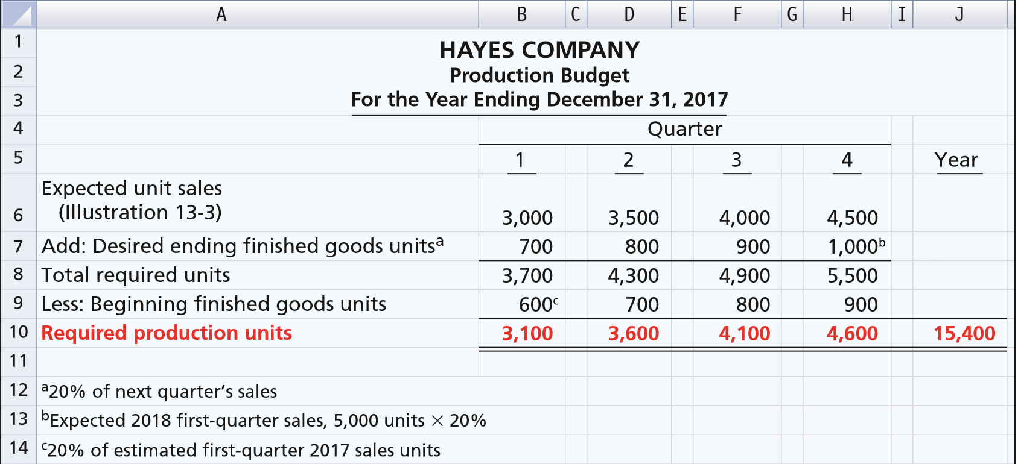
PRODUCTION BUDGET
Hayes Co. believes it can meet future sales needs with an ending inventory of 20% of next quarter’s budgeted sales volume.
ILLUSTRATION 13-5
Production budget
LO 2

Slide 30
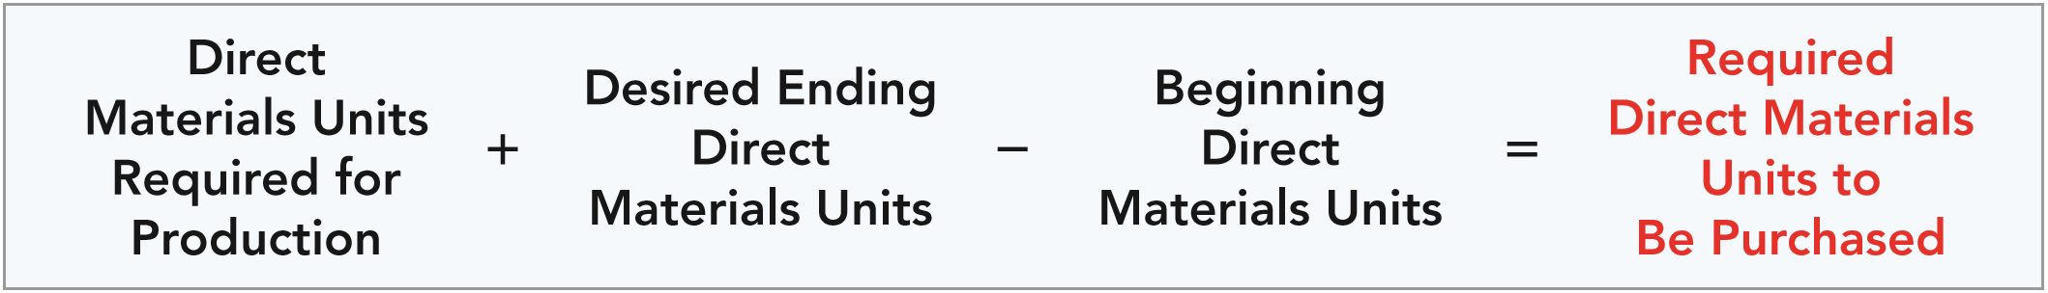
DIRECT MATERIALS BUDGET
  Shows both the quantity and cost of direct materials to be purchased.
  Formula for direct materials quantities.
ILLUSTRATION 13-6
Formula for direct materials quantities
ILLUSTRATION 13-6
  Budgeted cost of direct materials to be purchased = required units of direct materials x anticipated cost per unit.
  Inadequate inventories could result in temporary shutdowns of production.
LO 2

Slide 31
DIRECT MATERIALS BUDGET
Illustration – Hayes Company
  Because of its close proximity to suppliers,
    Hayes Company maintains an ending inventory of raw materials equal to 10% of the next quarter’s production requirements.
    The manufacture of each Rightride requires 2 pounds of raw materials, and the expected cost per pound is $4.
    Assume that the desired ending direct materials amount is 1,020 pounds for the fourth quarter of 2017.
    Prepare a Direct Materials Budget.
LO 2

Slide 32
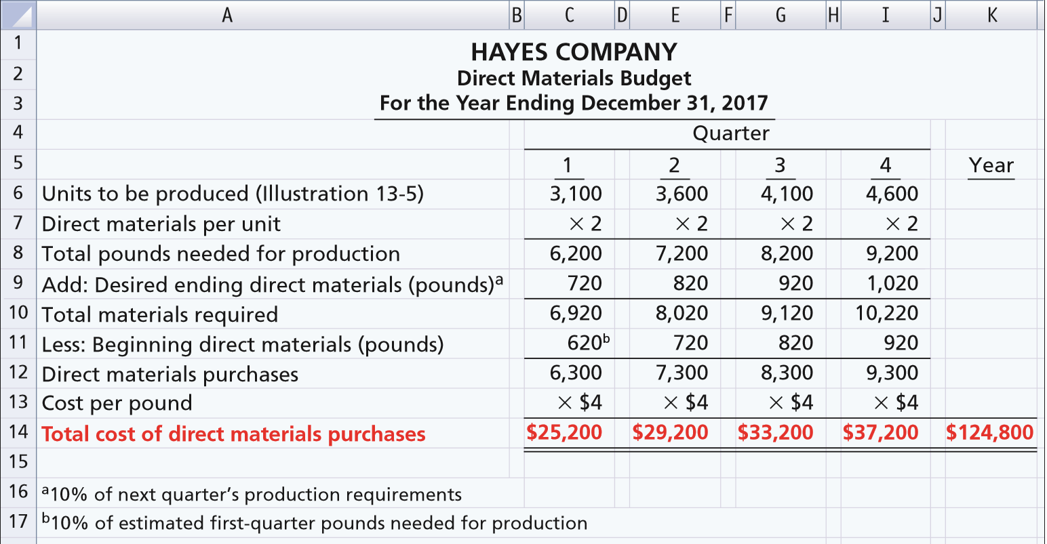
DIRECT MATERIALS BUDGET
ILLUSTRATION 13-7
Direct materials budget
LO 2

Slide 33
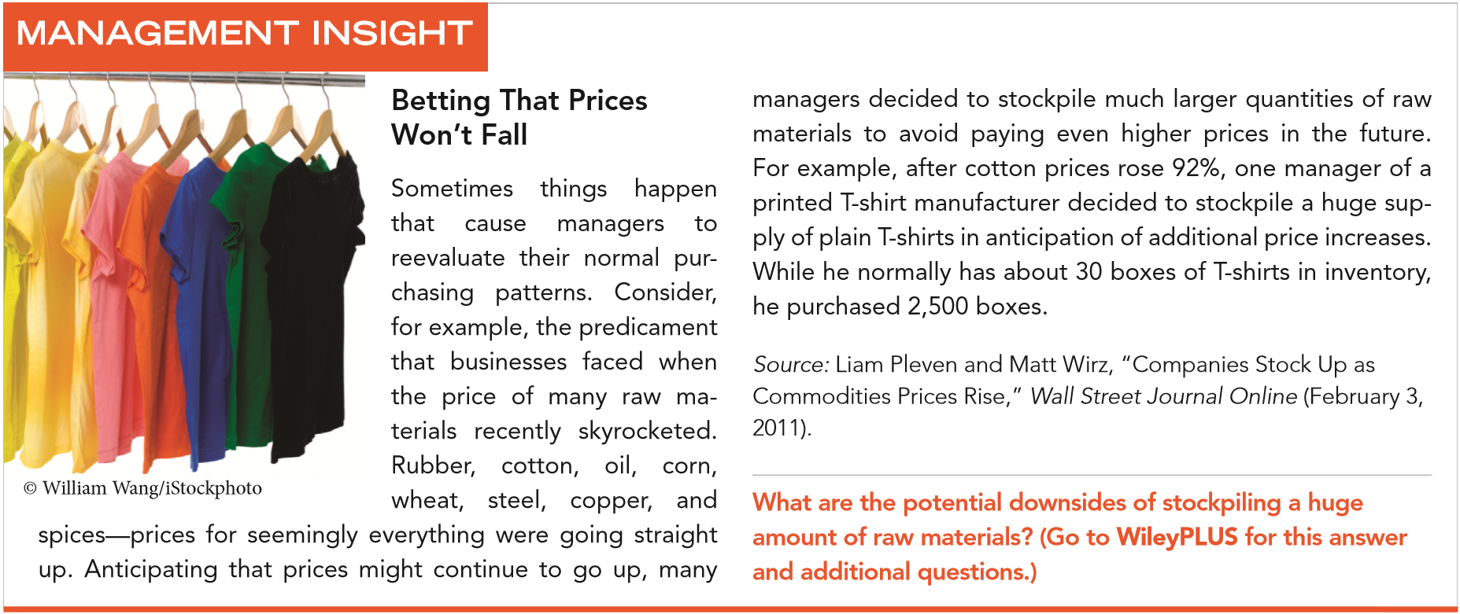
LO 2

Slide 34
2
Sales, Production, and Direct Materials Budgets
DO IT!
Soriano Company is preparing its master budget for 2017. Relevant data pertaining to its sales, production, and direct materials budgets are as follows:
Sales: Sales for the year are expected to total 1,200,000 units. Quarterly sales are 20%, 25%, 30%, and 25% respectively. The sales price is expected to be $50 per unit for the first three quarters and $55 per unit beginning in the fourth quarter. Sales in the first quarter of 2018 are expected to be 10% higher than the budgeted sales for the first quarter of 2017.
Production: Management desires to maintain ending finished goods inventories at 25% of next quarter’s budgeted sales volume.
Direct materials: Each unit requires 3 pounds of raw materials at a cost of $5 per pound. Management desires to maintain raw materials inventories at 5% of the next quarter’s production requirements. Assume the production requirements for the first quarter of 2018 are 810,000 pounds.
LO 2

Slide 35
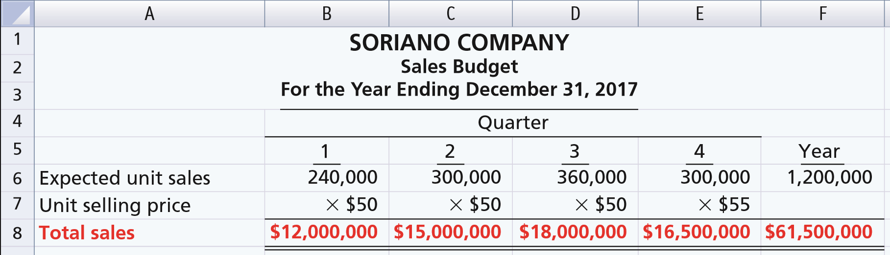

2
Sales, Production, and Direct Materials Budgets
DO IT!
Prepare the sales, production, and direct materials budgets by quarters for 2017.
LO 2

Slide 36
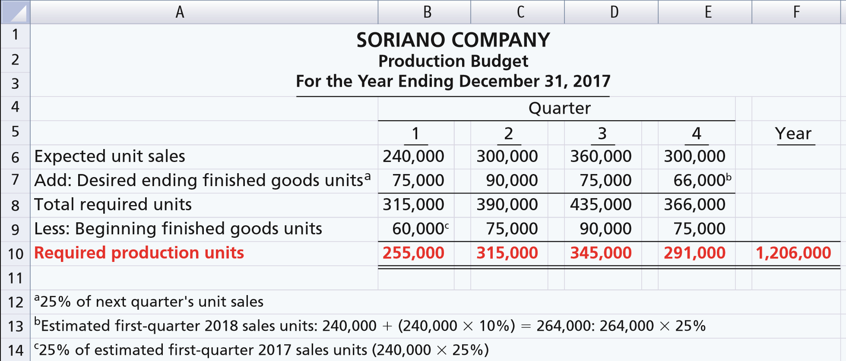
2
Sales, Production, and Direct Materials Budgets
DO IT!
Prepare the sales, production, and direct materials budgets by quarters for 2017.
LO 2

Slide 37
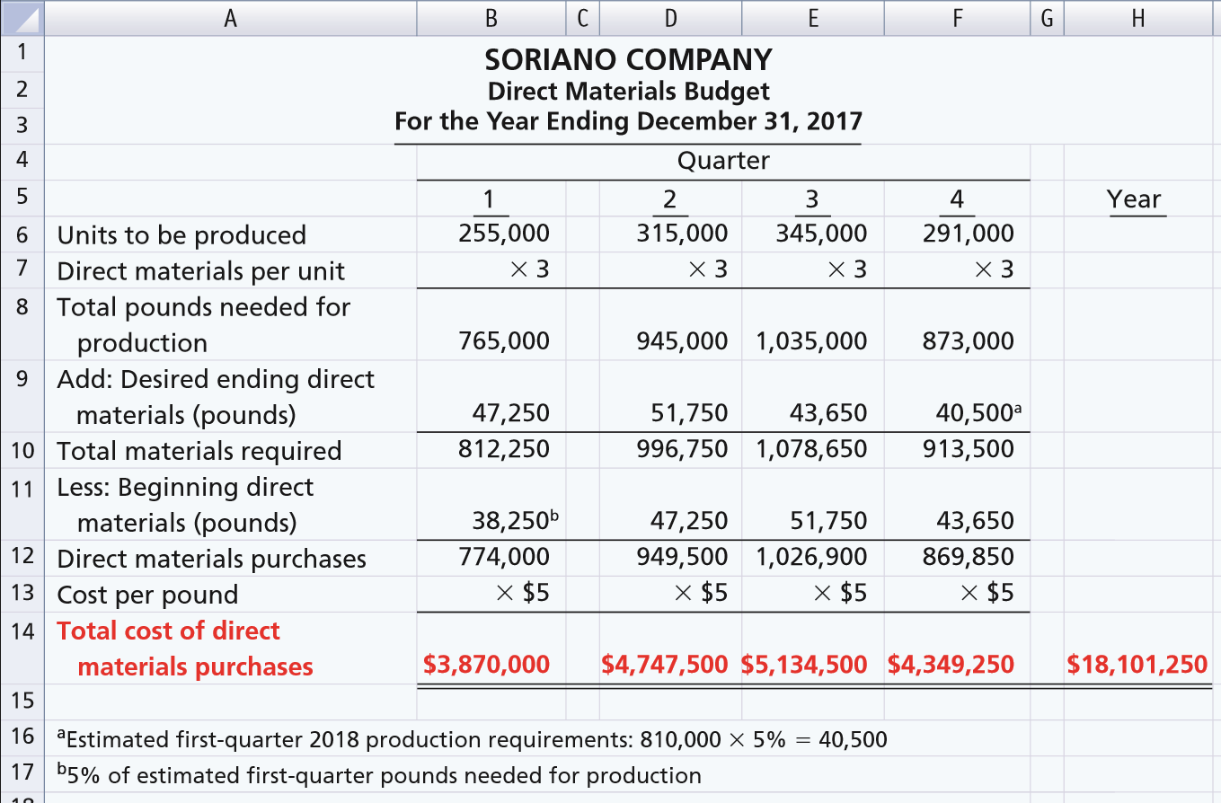
2
Sales, Production, and Direct Materials Budgets
DO IT!
Prepare the sales, production, and direct materials budgets.
LO 2

Slide 38
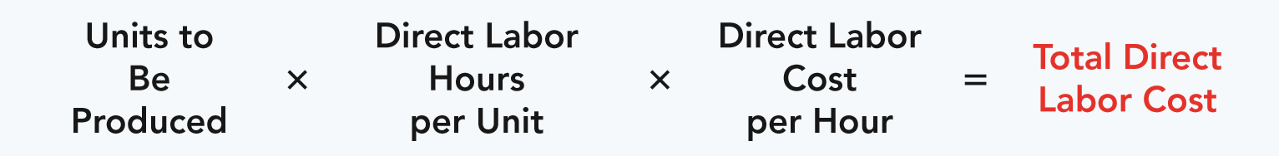
Prepare budgets for direct labor, manufacturing overhead, and selling and administrative expenses, and a budgeted income statement.
LEARNING OBJECTIVE
3
DIRECT LABOR BUDGET
  Shows both the quantity of hours and cost of direct labor necessary to meet production requirements.
  Critical in maintaining a labor force that can meet expected production.
  Total direct labor cost formula:
ILLUSTRATION 13-8
Formula for direct labor cost
LO 3

Slide 39
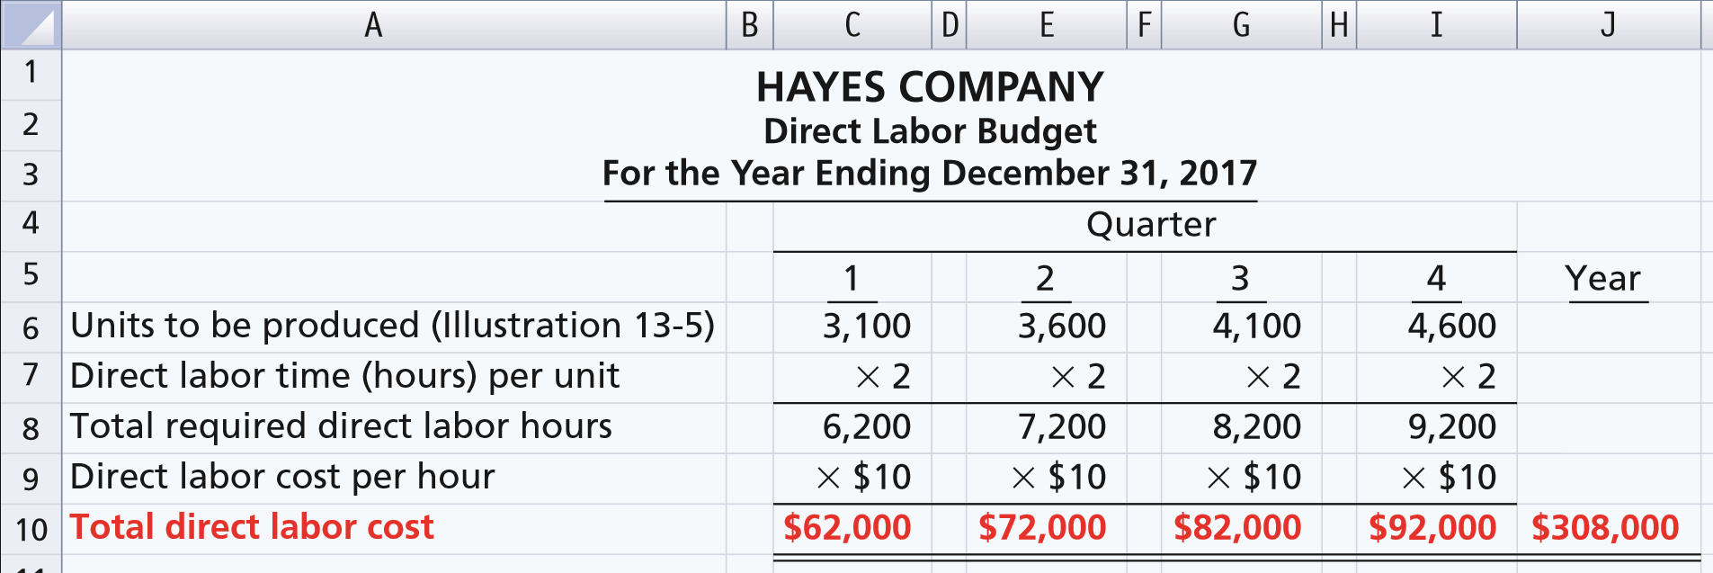
DIRECT LABOR BUDGET
Illustration: Direct labor hours are determined from the production budget. At Hayes Company, two hours of direct labor are required to produce each unit of finished goods. The anticipated hourly wage rate is $10.
ILLUSTRATION 13-9
Direct labor budget
LO 3

Slide 40
MANUFACTURING OVERHEAD BUDGET
  Shows the expected manufacturing overhead costs for the budget period.
  Distinguishes between fixed and variable overhead costs.
LO 3

Slide 41
MANUFACTURING OVERHEAD BUDGET
Illustration: Hayes Company expects variable costs to fluctuate with production volume on the basis of the following rates per direct labor hour: indirect materials $1.00, indirect labor $1.40, utilities $0.40, and maintenance $0.20. Thus, for the 6,200 direct labor hours to produce 3,100 units, budgeted indirect materials are $6,200 (6,200 x $1), and budgeted indirect labor is $8,680 (6,200 x $1.40). Hayes also recognizes that some maintenance is fixed. The amounts reported for fixed costs are assumed.
Prepare a Manufacturing Overhead Budget.
LO 3

Slide 42
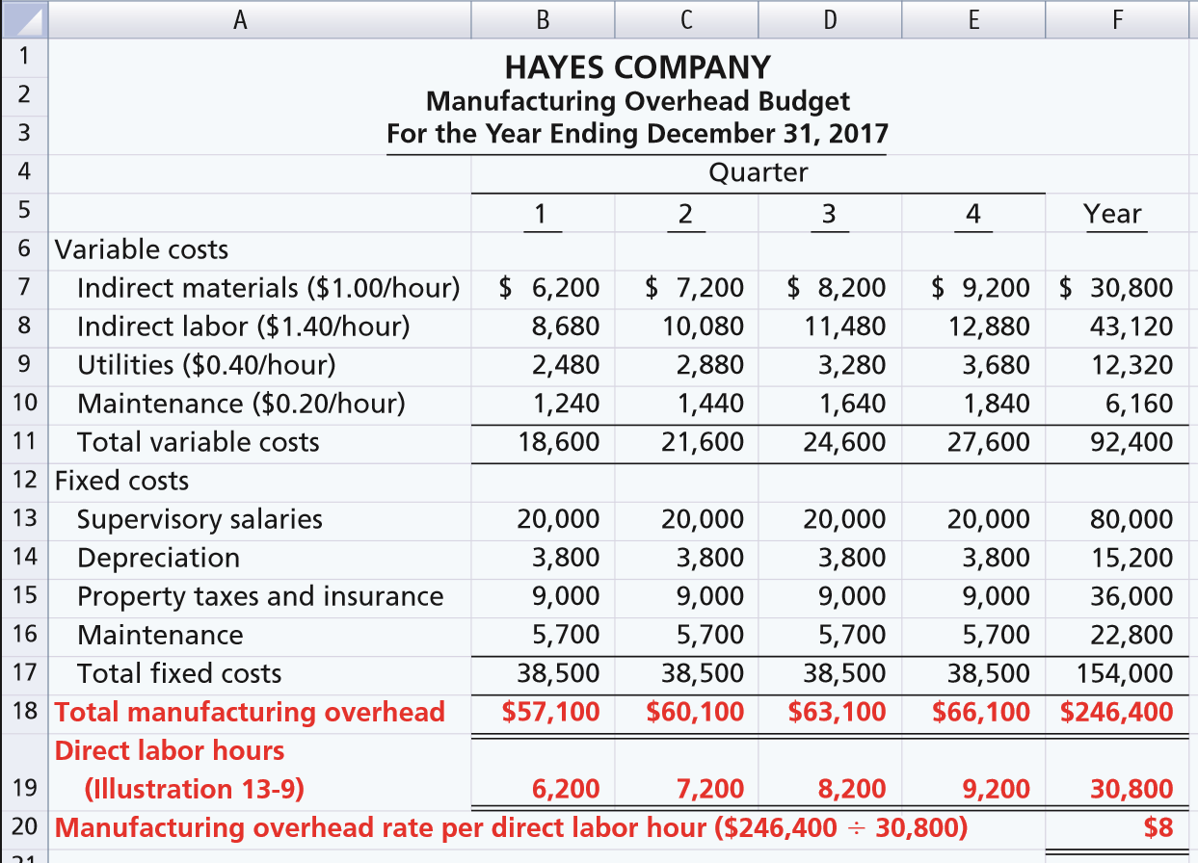
ILLUSTRATION 13-10
LO 3

Slide 43
SELLING AND ADMINISTRATIVE EXPENSE BUDGET
  Projection of anticipated operating expenses.
  Distinguishes between fixed and variable costs.
Illustration: Variable expense rates per unit of sales are sales commissions $3 and freight-out $1. Variable expenses per quarter are based on the unit sales from the sales budget (ILLUSTRATION 13-3). Hayes expects sales in the first quarter to be 3,000 units. Fixed expenses are based on assumed data.
Prepare a selling and administrative expense budget.
LO 3

Slide 44
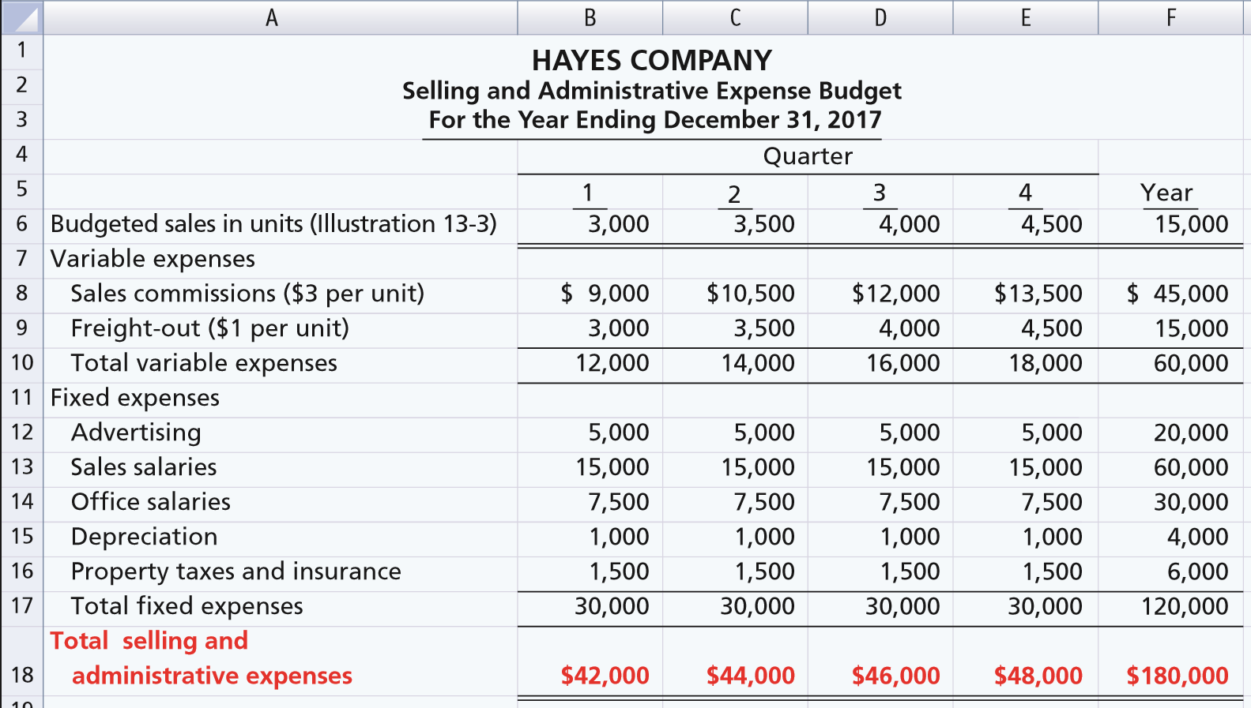
ILLUSTRATION 13-11
Selling and administrative expense budget
LO 3

Slide 45
BUDGETED INCOME STATEMENT
  Important end-product of the operating budgets.
  Indicates expected profitability of operations.
  Provides a basis for evaluating company performance.
  Prepared from the operating budgets:
Sales
Direct Materials
Direct Labor
Manufacturing Overhead
Selling and Administrative Expense
LO 3

Slide 46
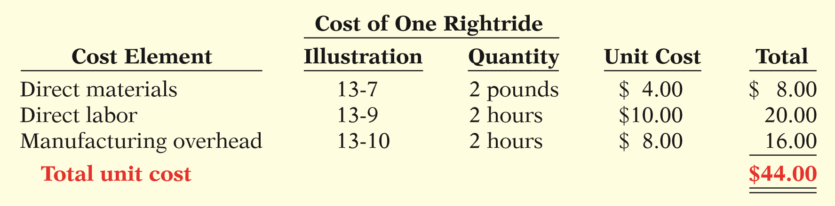
BUDGETED INCOME STATEMENT
Illustration: To find the cost of goods sold, it is first necessary to determine the total unit cost of producing one Rightride, as follows.
ILLUSTRATION 13-12
Computation of total unit cost
Second, determine Cost of Goods Sold by multiplying units sold times unit cost: 15,000 units x $44 = $660,000
LO 3

Slide 47
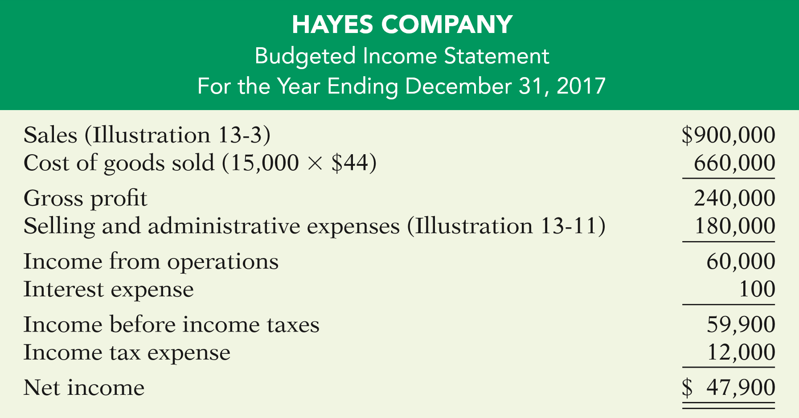
BUDGETED INCOME STATEMENT
Illustration: All data for the income statement come from the individual operating budgets except the following: (1) interest expense is expected to be $100, and (2) income taxes are estimated to be $12,000.
ILLUSTRATION 13-13
Budgeted multiple-step income statement
LO 3

Slide 48
BUDGETED INCOME STATEMENT
Question
Each of the following budgets is used in preparing the budgeted income statement except the:
a. Sales budget.
b. Selling and administrative budget.
c. Capital expenditure budget.
d. Direct labor budget.
LO 3

Slide 49
DO IT!
3
Budgeted Income Statement
Soriano Company is preparing its budgeted income statement for 2017. Relevant data pertaining to its sales, production, and direct materials budgets can be found on the following slide. Soriano budgets 0.5 hours of direct labor per unit, labor costs at $15 per hour, and manufacturing overhead at $25 per direct labor hour. Its budgeted selling and administrative expenses for 2017are $12,000,000. (a) Calculate the budgeted total unit cost. (b) Prepare the budgeted income statement for 2017.
LO 3

Slide 50
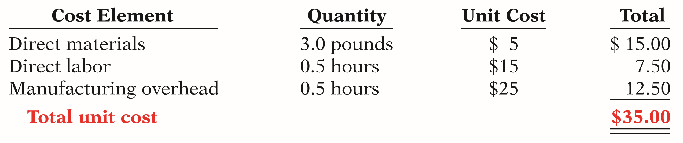
DO IT!
3
Budgeted Income Statement
Calculate the budgeted total unit cost and prepare the budgeted income statement for 2017.
(a)
LO 3

Slide 51
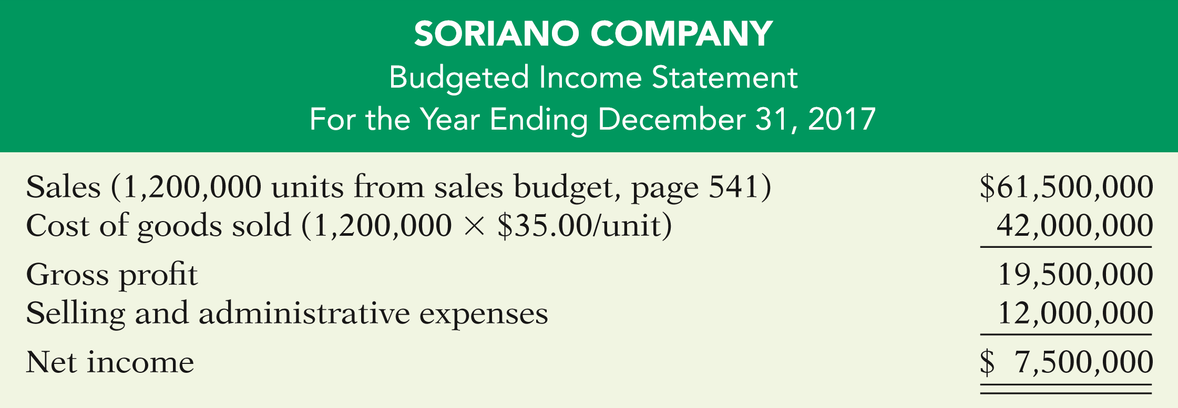


DO IT!
3
Budgeted Income Statement
Calculate the budgeted total unit cost and prepare the budgeted income statement for 2017.
(b)
LO 3

Slide 52
LEARNING OBJECTIVE
4
Prepare a cash budget and a budgeted balance sheet.
CASH BUDGET
  Shows anticipated cash flows.
  Often considered to be the most important output in preparing financial budgets.
  Contains three sections:
    Cash Receipts
    Cash Disbursements
    Financing
  Shows beginning and ending cash balances.
LO 4

Slide 53
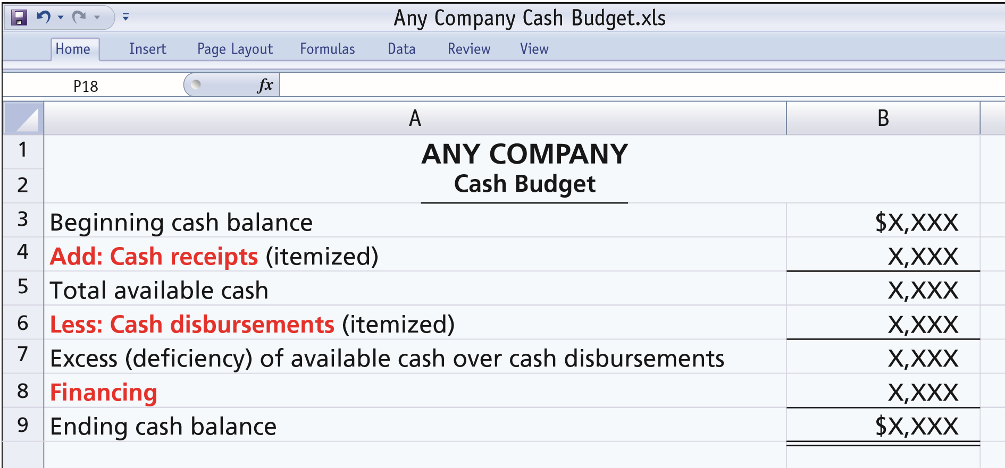
CASH BUDGET
ILLUSTRATION 13-14
Basic form of a cash budget
LO 4

Slide 54
CASH BUDGET
  Cash Receipts Section
    Expected receipts from the principal sources of revenue.
    Expected interest and dividends receipts, proceeds from planned sales of investments, plant assets, and the company’s capital stock.
  Cash Disbursements Section
    Expected cash payments for direct materials, direct labor, manufacturing overhead, and selling and administrative expenses.
  Financing Section
    Expected borrowings and repayments of borrowed funds plus interest.
LO 4

Slide 55
CASH BUDGET
  Must prepare in sequence.
  Ending cash balance of one period is the beginning cash balance for the next.
  Data obtained from other budgets and from management.
  Often prepared for the year on a monthly basis.
  Contributes to more effective cash management.
  Shows managers the need for additional financing before actual need arises.
  Indicates when excess cash will be available.
LO 4

Slide 56
CASH BUDGET
Illustration – Hayes Company Assumptions
The January 1, 2017, cash balance is expected to be $38,000. Hayes wishes to maintain a balance of at least $15,000.
Sales (Illustration 13-3): 60% are collected in the quarter sold and 40% are collected in the following quarter. Accounts receivable of $60,000 at December 31, 2016, are expected to be collected in full in the first quarter of 2017.
Short-term investments are expected to be sold for $2,000 cash in the first quarter.
Continued
LO 4

Slide 57
CASH BUDGET
Illustration – Hayes Company Assumptions
Direct materials (Illustration 13-7): 50% are paid in the quarter purchased and 50% are paid in the following quarter. Accounts payable of $10,600 at December 31, 2016, are expected to be paid in full in the first quarter of 2017.
Direct labor (Illustration 13-9): 100% is paid in the quarter incurred.
Manufacturing overhead (Illustration 13-10) and selling and administrative expenses (Illustration 13-11): All items except depreciation are paid in the quarter incurred.
LO 4

Slide 58
CASH BUDGET
Illustration – Hayes Company Assumptions
Management plans to purchase a truck in the second quarter for $10,000 cash.
Hayes makes equal quarterly payments of its estimated $12,000 annual income taxes.
Loans are repaid in the earliest quarter in which there is sufficient cash (that is, when the cash on hand exceeds the $15,000 minimum required balance).
Prepare a schedule of collections from customers.
LO 4

Slide 59
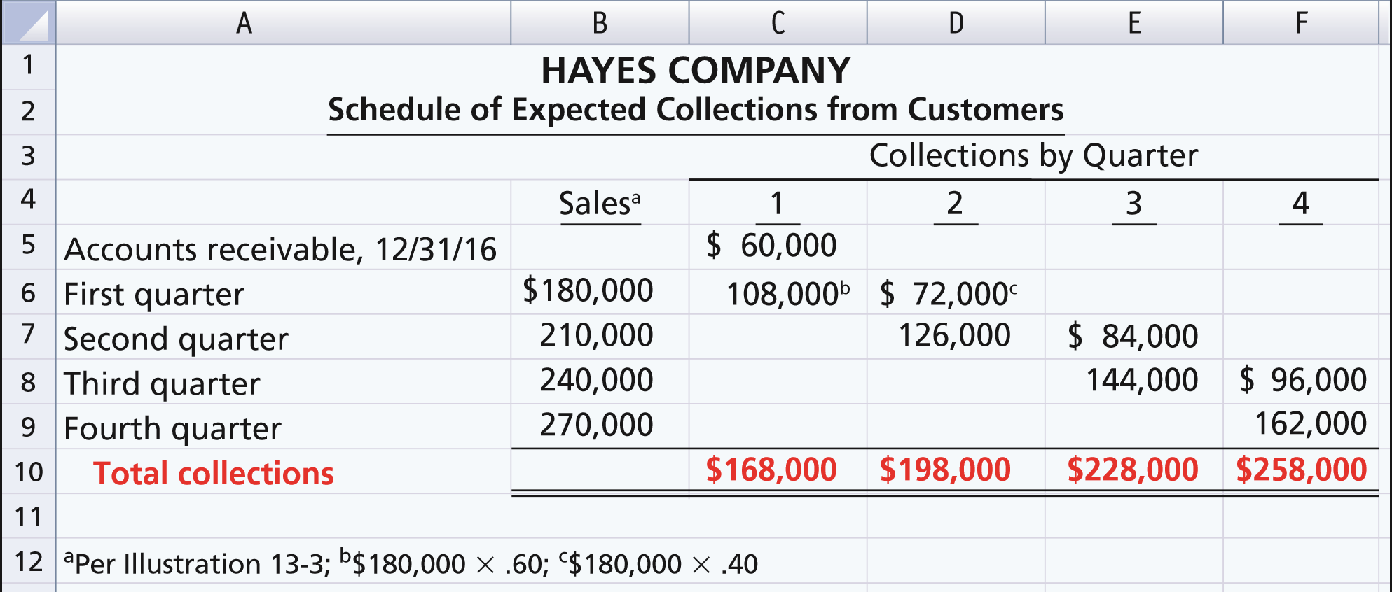
CASH BUDGET
Illustration – Prepare a schedule of collections from customers.
ILLUSTRATION 13-15
Collections from customers
LO 4

Slide 60
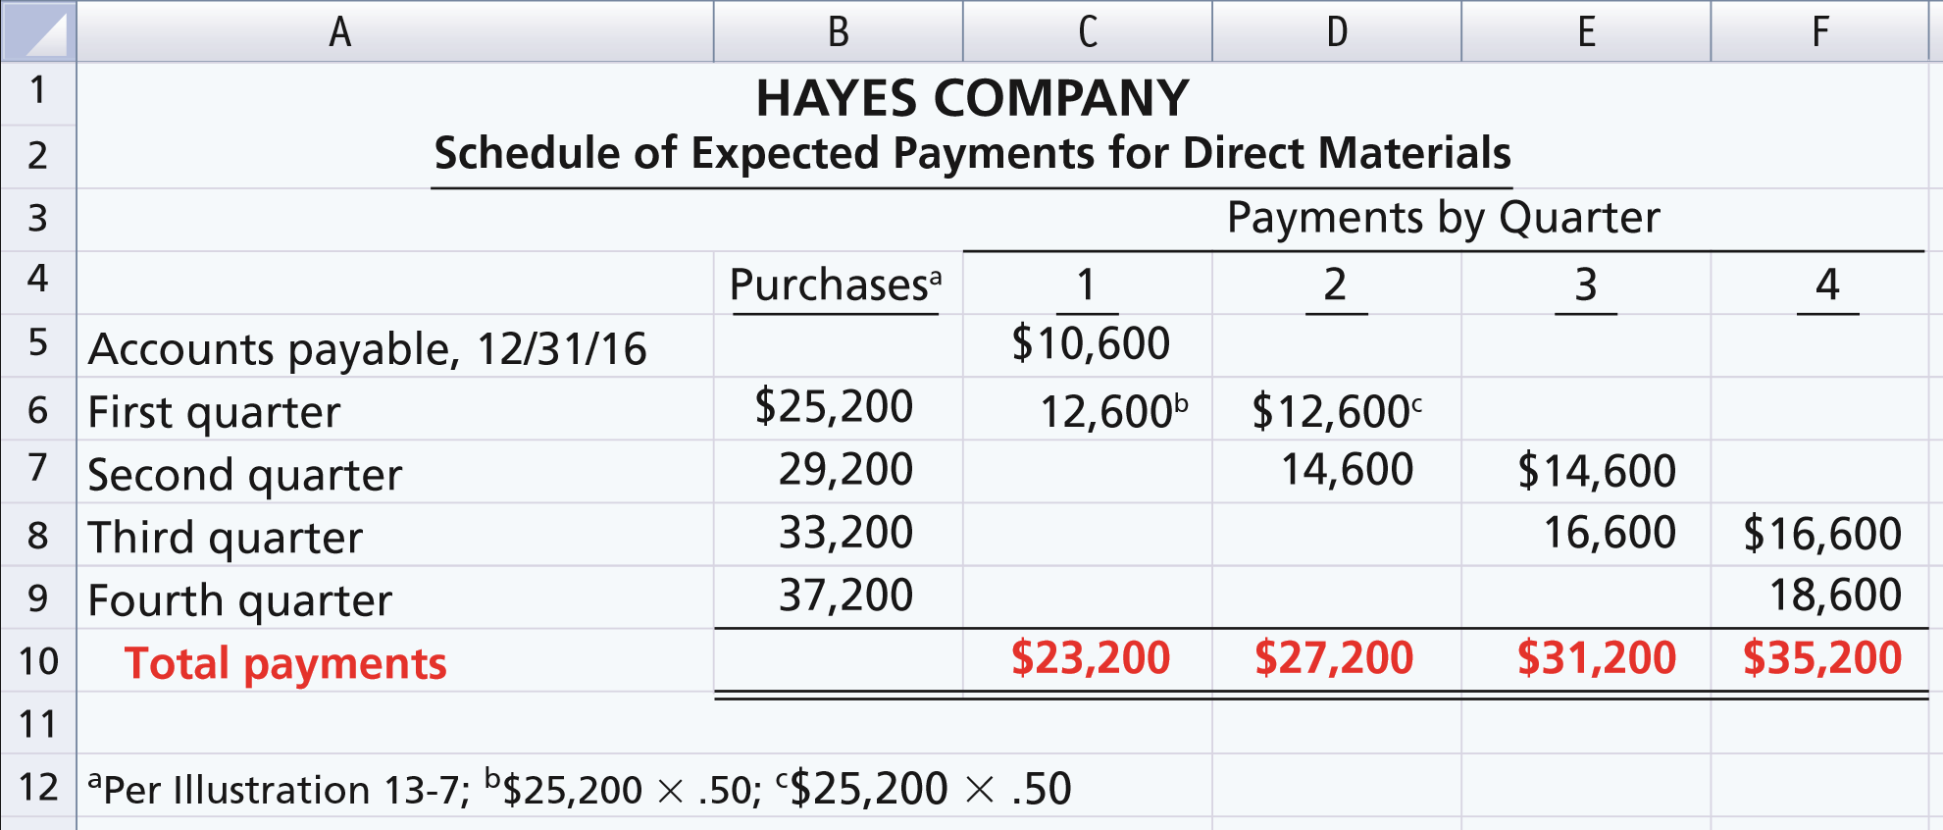
CASH BUDGET
Illustration – Prepare a schedule of cash payments for direct materials.
ILLUSTRATION 13-16
Payments for direct materials
LO 4

Slide 61
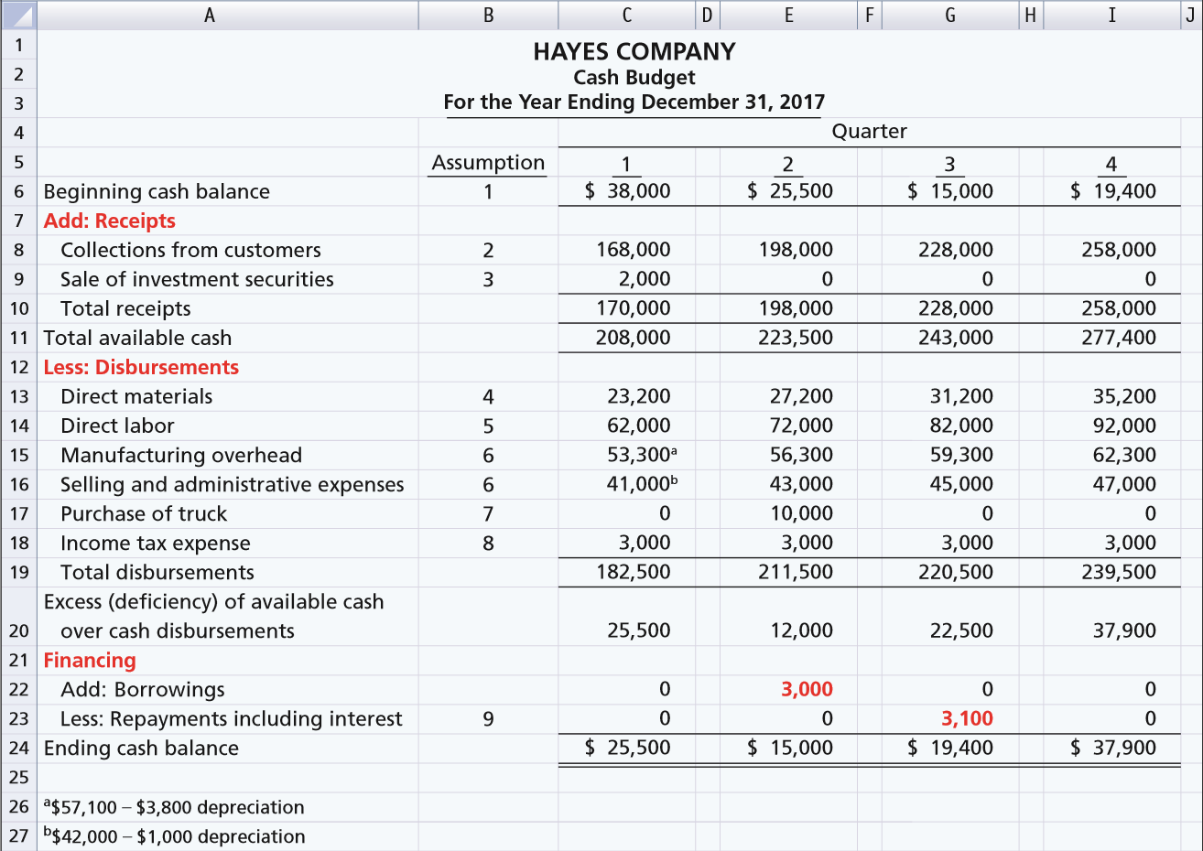
ILLUSTRATION 13-17
LO 4

Slide 62
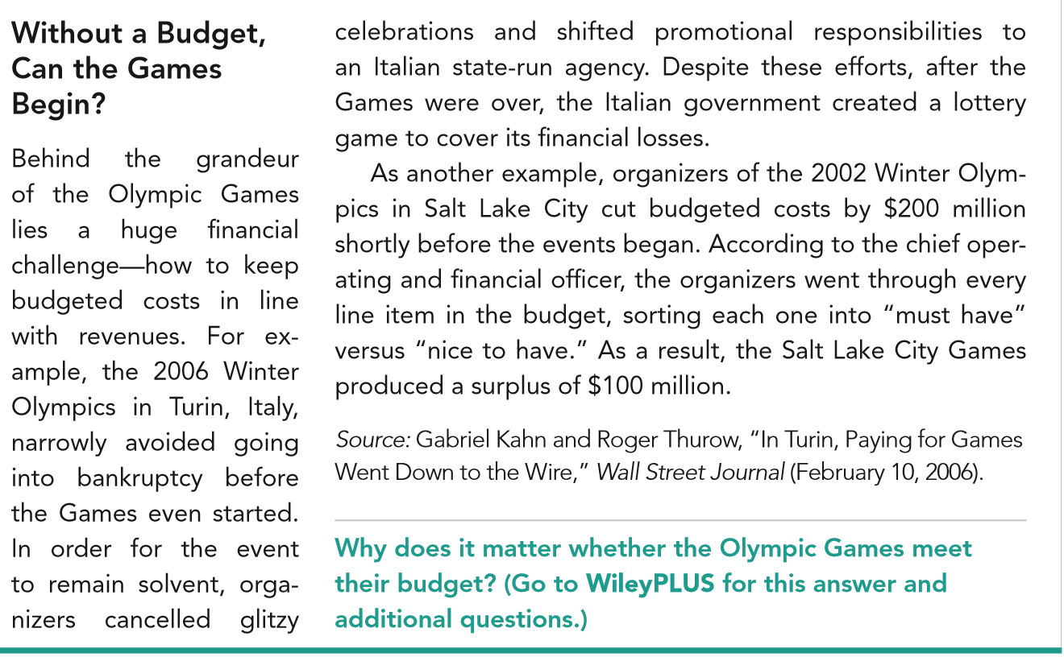
LO 4

Slide 63
BUDGETED BALANCE SHEET
Developed from the budgeted balance sheet for the preceding year and the budgets for the current year.
Illustration: Pertinent data from the budgeted balance sheet at December 31, 2016, are as follows.
Buildings and equipment $182,000
Common stock 225,000
Accumulated depreciation 28,800
Retained earnings 46,480
LO 4

Slide 64
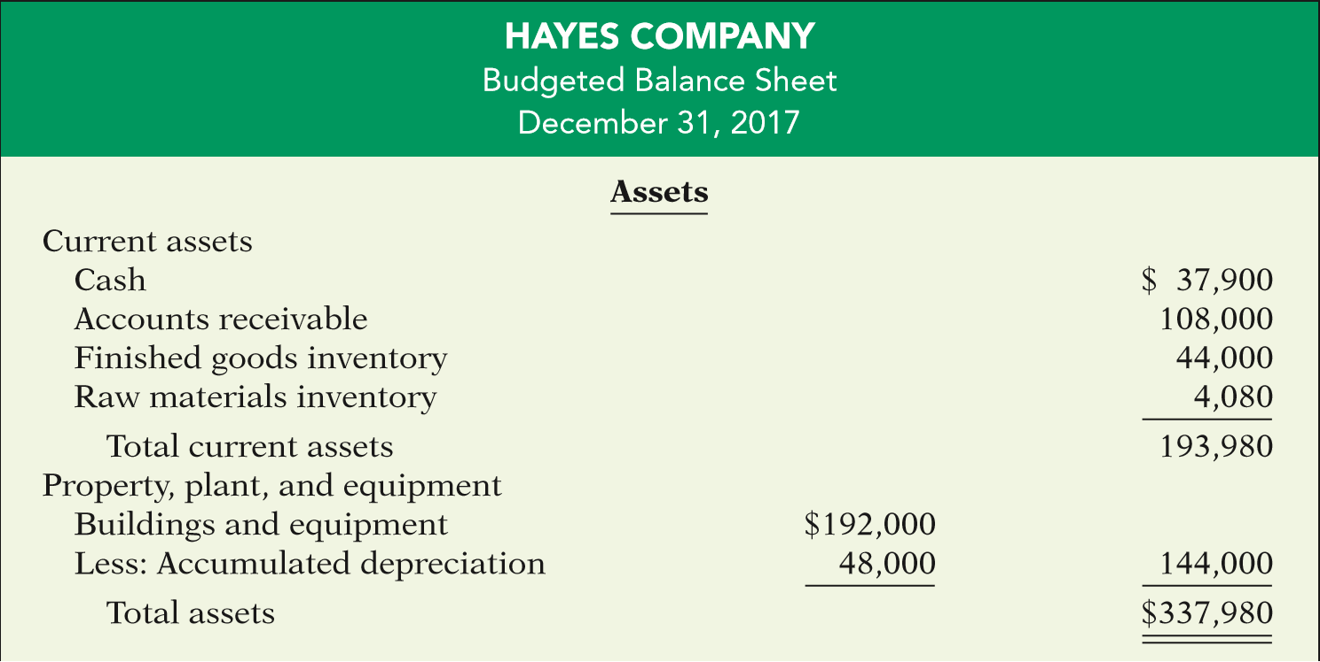
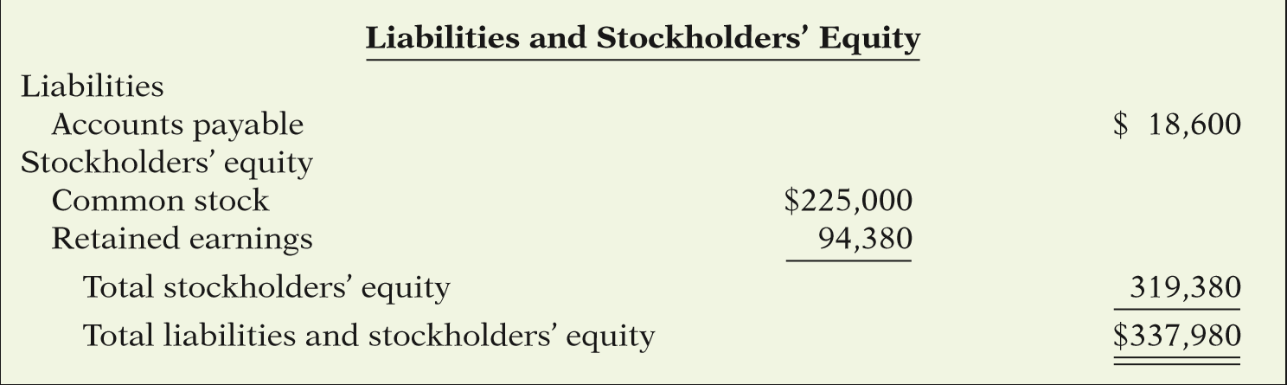
ILLUSTRATION 13-18
Budgeted classified balance sheet

Slide 65
BUDGETED BALANCE SHEET
Illustration: Pertinent data from the budgeted balance sheet at December 31, 2016, are as follows.
Buildings and equipment $182,000
Common stock 225,000
Accumulated depreciation 28,800
Retained earnings 46,480
Cash: Ending cash balance $37,900, shown in the cash budget (Illustration 13-17).
Accounts receivable: 40% of fourth-quarter sales $270,000, shown in the schedule of expected collections from customers (Illustration 13-15).
  Continued
LO 4

Slide 66
BUDGETED BALANCE SHEET
Finished goods inventory: Desired ending inventory 1,000 units, shown in the production budget (Illustration 13-5) times the total unit cost $44 (shown in Illustration 13-12).
Raw materials inventory: Desired ending inventory 1,020 pounds, times the cost per pound $4, shown in the direct materials budget (Illustration 13-7).
Buildings and equipment: December 31, 2016, balance $182,000, plus purchase of truck for $10,000 (Illustration 13-17).
Continued
LO 4

Slide 67
BUDGETED BALANCE SHEET
Accumulated depreciation: December 31, 2016, balance $28,800, plus $15,200 depreciation shown in manufacturing overhead budget (Illustration 13-10) and $4,000 depreciation shown in selling and administrative expense budget (ILLUSTRATION 13-11).
Accounts payable: 50% of fourth-quarter purchases $37,200, shown in schedule of expected payments for direct materials (Illustration 13-16).
Common stock: Unchanged from the beginning of the year.
Retained earnings: December 31, 2016, balance $46,480, plus net income $47,900, shown in budgeted income statement (Illustration 13-13).
LO 4

Slide 68
BUDGETED BALANCE SHEET
Question
Expected direct materials purchases in Read Company are $70,000 in the first quarter and $90,000 in the second quarter. Forty percent of the purchases are paid in cash as incurred, and the balance is paid in the following quarter. The budgeted cash payments for purchases in the second quarter are:
a. $96,000
b. $90,000
$78,000
$72,000
LO 4

Slide 69
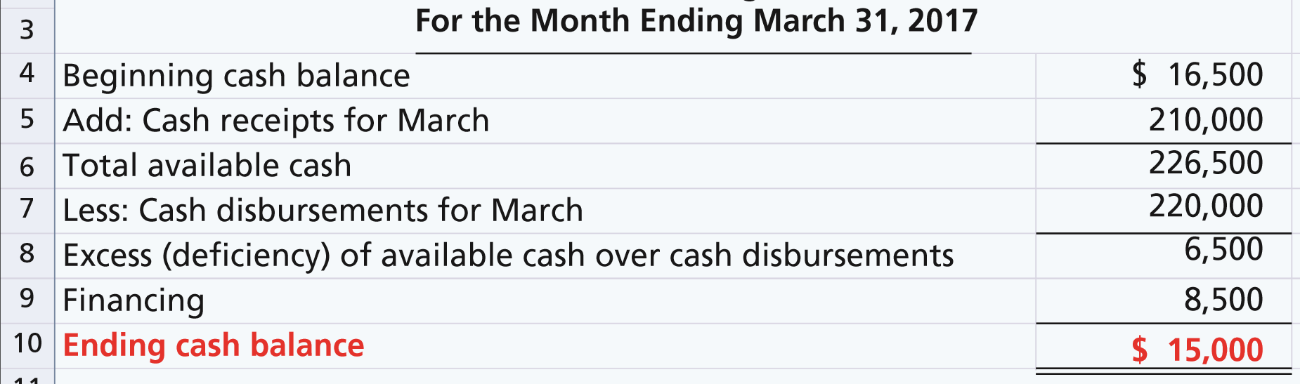
DO IT!
4
Cash Budget
Martian Company management wants to maintain a minimum monthly cash balance of $15,000. At the beginning of March, the cash balance is $16,500, expected cash receipts for March are $210,000, and cash disbursements are expected to be $220,000. How much cash, if any, must be borrowed to maintain the desired minimum monthly balance?
LO 4

Slide 70
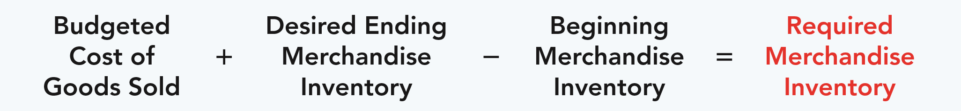
LEARNING OBJECTIVE
5
Apply budgeting principles to nonmanufacturing companies.
MERCHANDISERS
Sales Budget: starting point and key factor in developing the master budget.
Use a purchases budget instead of a production budget.
Does not use the manufacturing budgets (direct materials, direct labor, manufacturing overhead).
To determine budgeted merchandise purchases:
ILLUSTRATION 13-19
Merchandise purchases formula
LO 5

Slide 71
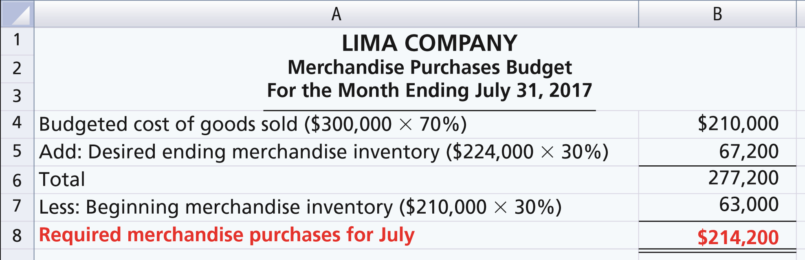
MERCHANDISERS
Illustration: Lima estimates that budgeted sales will be $300,000 in July and $320,000 in August. Cost of goods sold is expected to be 70% of sales. The company’s desired ending inventory is 30% of the followings month’s cost of goods sold. Required merchandise purchases for July are computed as follows.
ILLUSTRATION 13-20
LO 5

Slide 72
SERVICE COMPANIES
Critical factor in budgeting is coordinating professional staff needs with anticipated services.
Problems if overstaffed:
  Disproportionately high labor costs.
  Lower profits due to additional salaries.
  Increased staff turnover due to lack of challenging work.
Problems if understaffed:
  Lost revenues because existing and future client needs for services cannot be met.
  Loss of professional staff due to excessive work loads.
LO 5

Slide 73
NOT-FOR-PROFIT ORGANIZATIONS
Just as important as for profit-oriented company.
Budget process differs from profit-oriented company.
Budget on the basis of cash flows (expenditures and receipts), not on a revenue and expense basis.
Starting point is usually expenditures, not receipts.
Management’s task is to find receipts needed to support planned expenditures.
Budget must be followed, overspending often illegal.
LO 5

Slide 74
MERCHANDISERS
Question
The budget for a merchandiser differs from a budget for a manufacturer because:
a. A merchandise purchases budget replaces the production budget.
b. The manufacturing budgets are not applicable.
c. None of the above.
d. Both (a) and (b) above
LO 5

Slide 75
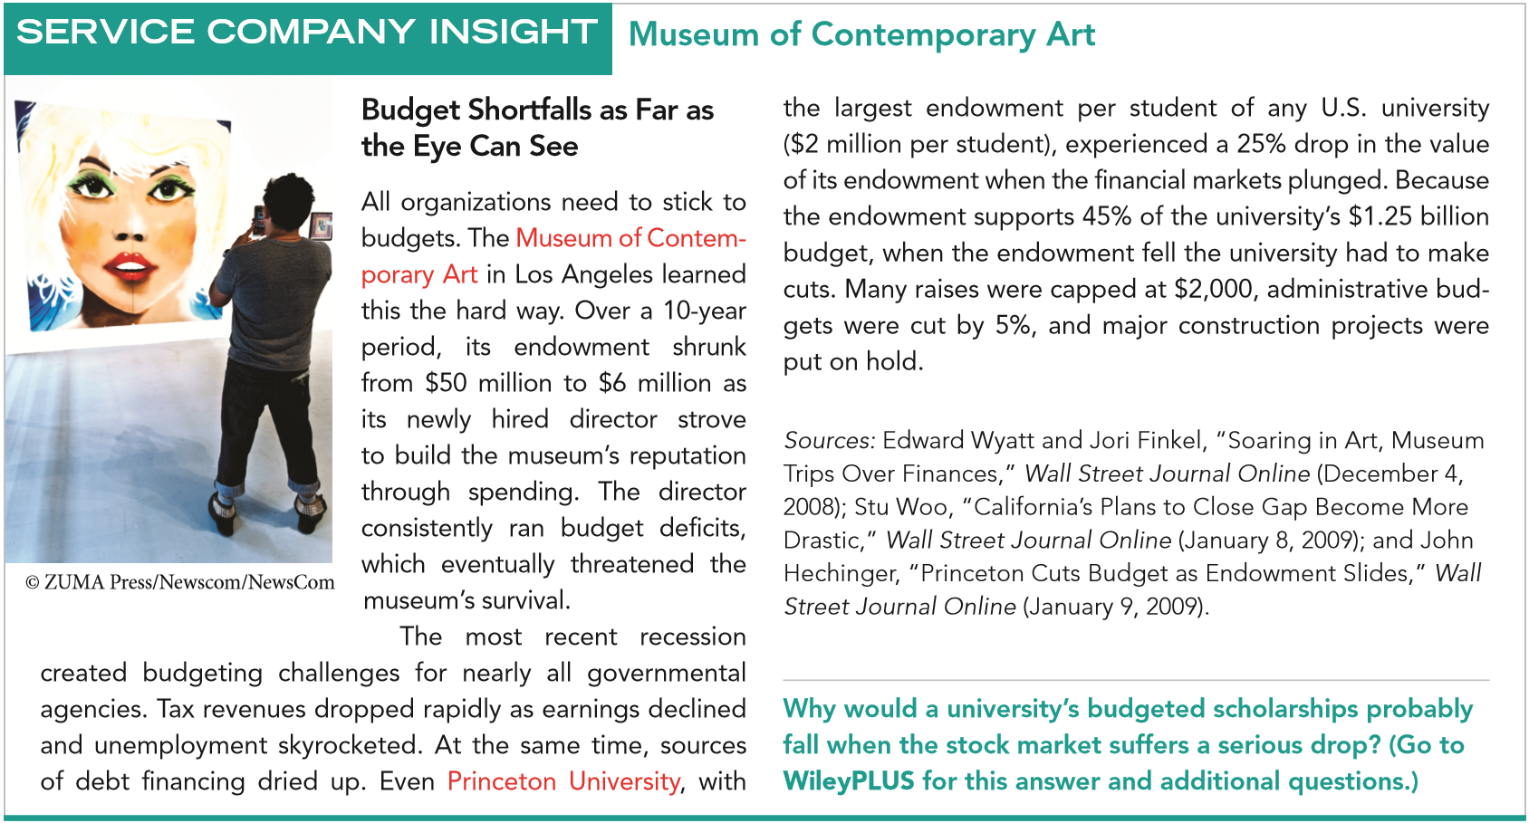
LO 5

Slide 76
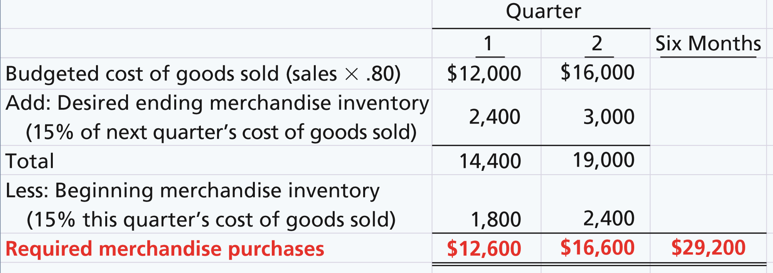
DO IT!
5
Merchandise Purchases Budget
Becker Company estimates that 2017 sales will be $15,000 in quarter 1, $20,000 in quarter 2, and $25,000 in quarter 3. Cost of goods sold is 80% of sales. Management desires to have ending finished goods inventory equal to 15% of the next quarter’s expected cost of goods sold. Prepare a merchandise purchases budget by quarter for the first six months of 2017.
LO 5

Slide 77
Copyright
“Copyright © 2017 John Wiley & Sons, Inc. All rights reserved. Reproduction or translation of this work beyond that permitted in Section 117 of the 1976 United States Copyright Act without the express written permission of the copyright owner is unlawful. Request for further information should be addressed to the Permissions Department, John Wiley & Sons, Inc. The purchaser may make back-up copies for his/her own use only and not for distribution or resale. The Publisher assumes no responsibility for errors, omissions, or damages, caused by the use of these programs or from the use of the information contained herein.”

