Slide 1
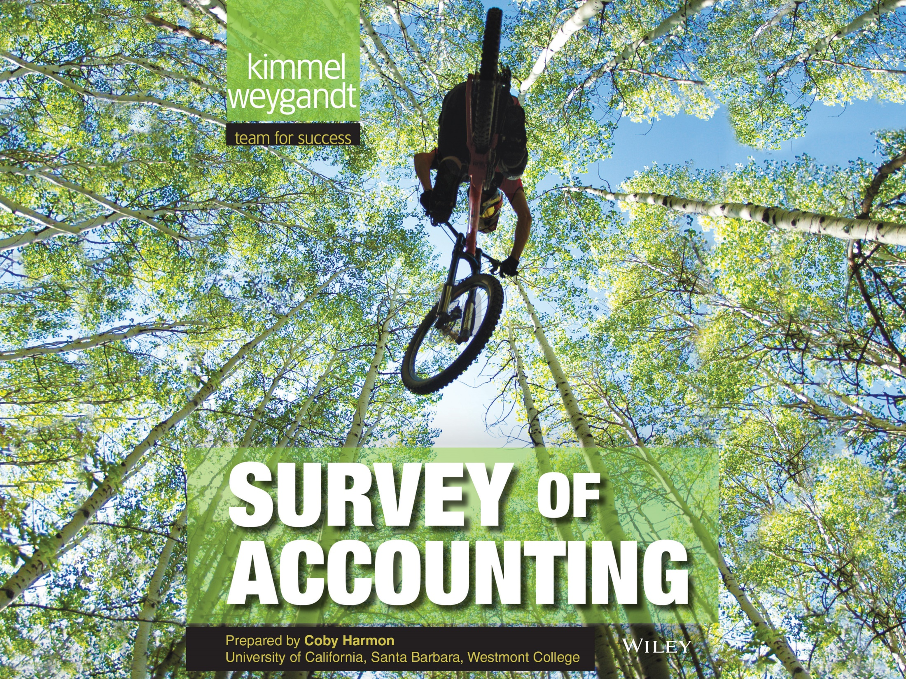

Slide 2
16
WILEY
Planning for Capital Investments
Kimmel ● Weygandt
Survey of Accounting, First Edition

Slide 3
CHAPTER OUTLINE
LEARNING OBJECTIVES
Describe capital budgeting inputs and apply the cash payback technique.
1
Use the net present value method.
2
Identify capital budgeting challenges and refinements.
3
Use the internal rate of return method.
4
Use the annual rate of return method.
5

Slide 4
LEARNING OBJECTIVE
1
Describe capital budgeting inputs and apply the cash payback technique.
Corporate capital budget authorization process:
  Proposals for projects are requested from departments, plants, and authorized personnel.
  Proposals are screened by a capital budget committee.
  Officers determine which projects are worthy of funding.
  Board of directors approves capital budget.
LO 1

Slide 5
CASH FLOW INFORMATION
For purposes of capital budgeting, estimated cash inflows and outflows are the preferred inputs.
Why?
Ultimately, the value of all financial investments is determined by the value of cash flows received and paid.
LO 1

Slide 6
CASH FLOW INFORMATION
Typical cash flows relating to capital budgeting decisions.
Cash Outflows
Initial investment
Repairs and maintenance
Increased operating costs
Overhaul of equipment
Cash Inflows
Sale of old equipment
Increased cash received from customers
Reduced cash outflows related to operating costs
Salvage value of equipment
ILLUSTRATION 16-2
LO 1

Slide 7
CASH FLOW INFORMATION
Capital budgeting decisions depend on:
  Availability of funds.
  Relationships among proposed projects.
  Company’s basic decision-making approach.
  Risk associated with a particular project.
LO 1

Slide 8
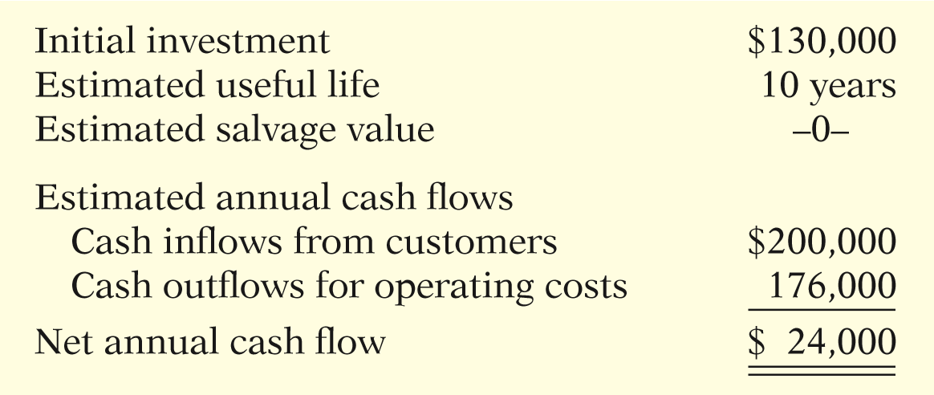
ILLUSTRATIVE DATA
Stewart Shipping Company is considering an investment of $130,000 in new equipment.
ILLUSTRATION 16-3
Investment information for Stewart Shipping example
LO 1

Slide 9
CASH PAYBACK
Cash payback technique identifies the time period required to recover the cost of the capital investment from the net annual cash inflow produced by the investment.
ILLUSTRATION 16-4 Cash payback formula
Cash payback period for Stewart is …
$130,000 ÷ $24,000 = 5.42 years
LO 1

Slide 10
CASH PAYBACK
Shorter payback period = More attractive the investment
In the case of uneven net annual cash flows, the company determines the cash payback period when the:
Cumulative net cash flows from the investment
Cost of the investment
=
LO 1

Slide 11
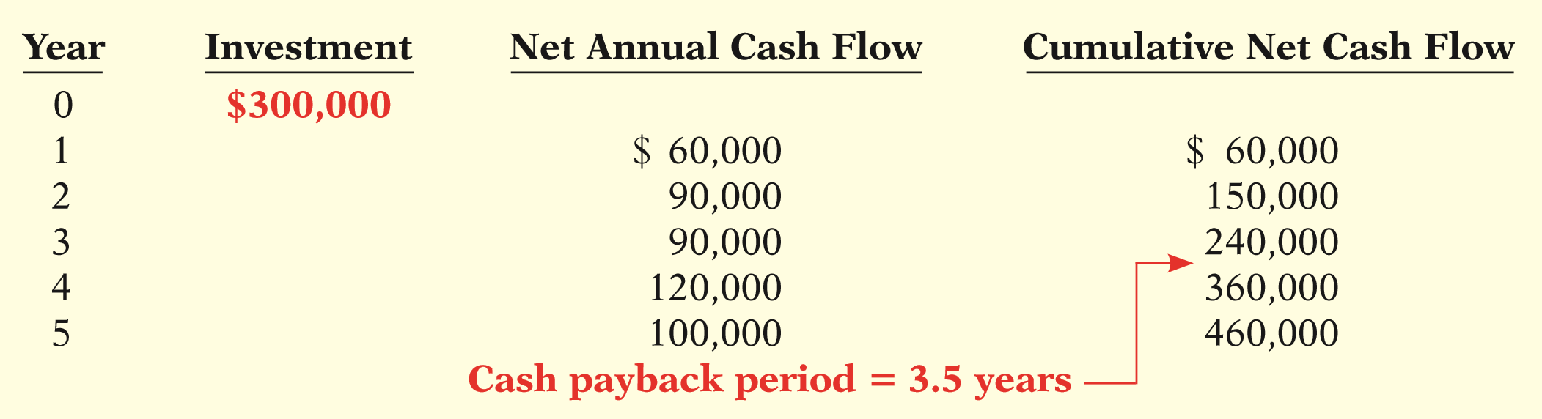

CASH PAYBACK
Illustration: Chen Company proposes an investment in a new website that is estimated to cost $300,000.
Cash payback should not be the only basis for the capital budgeting decision as it ignores the expected profitability of the project.
ILLUSTRATION 16-5
Computation of cash payback period— unequal cash flows
LO 1

Slide 12
CASH PAYBACK
Question
A $100,000 investment with a zero scrap value has an 8-year life. Compute the payback period if straight-line depreciation is used and net income is determined to be $20,000.
  8.00 years.
  3.08 years.
  5.00 years.
  13.33 years.
LO 1

Slide 13
DO IT!
1
Cash Payback Period
Watertown Paper Corporation is considering adding another machine for the manufacture of corrugated cardboard. The machine would cost $900,000. It would have an estimated life of 6 years and no salvage value. The company estimates that annual cash inflows would increase by $400,000 and that annual cash outflows would increase by $190,000. Compute the cash payback period.
SOLUTION
Estimated annual cash inflows $400,000
Estimated annual cash outflows 190,000
Net annual cash flow $210,000
Cash payback period = $900,000/$210,000 = 4.3 years.
LO 1

Slide 14
LEARNING OBJECTIVE
2
Use the net present value method.
Discounted cash flow technique:
  Generally recognized as the best approach.
  Considers both the estimated total cash inflows and the time value of money.
  Two methods:
    Net present value (NPV).
    Internal rate of return (IRR).
LO 2

Slide 15
Net Present Value (NPV) method
  Cash inflows are discounted to their present value and then compared with the capital outlay required by the investment.
  The interest rate used in discounting is the required minimum rate of return.
  Proposal is acceptable when NPV is zero or positive.
  The higher the positive NPV, the more attractive the investment.
LO 2

Slide 16
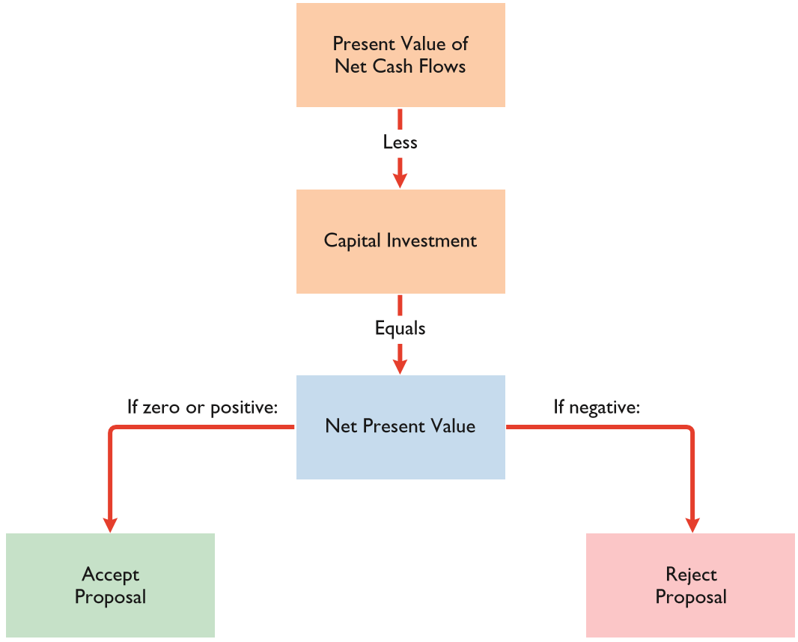
Net Present Value (NPV) method
ILLUSTRATION 16-6
Net present value decision criteria
Proposal is acceptable when net present value is zero or positive.
LO 2

Slide 17
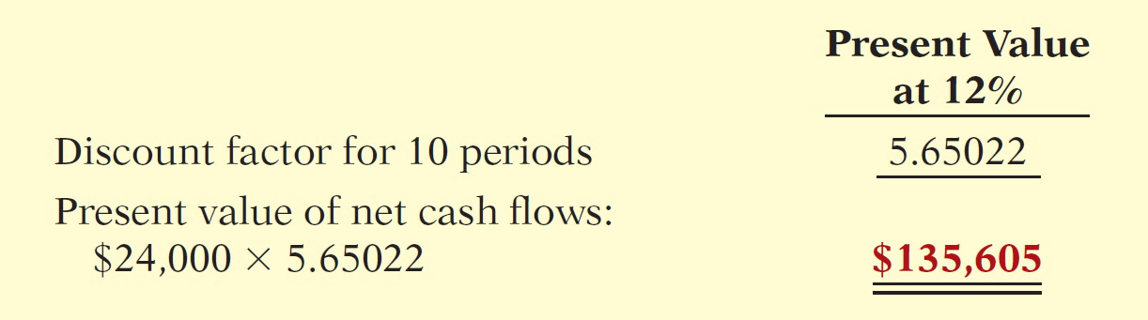
EQUAL ANNUAL CASH FLOWS
Illustration: Stewart Shipping Company’s annual cash flows are $24,000. If we assume this amount is uniform over the asset’s useful life, we can compute the present value of the net annual cash flows.
ILLUSTRATION 16-7
Computation of present value of equal net annual cash flows
LO 2

Slide 18
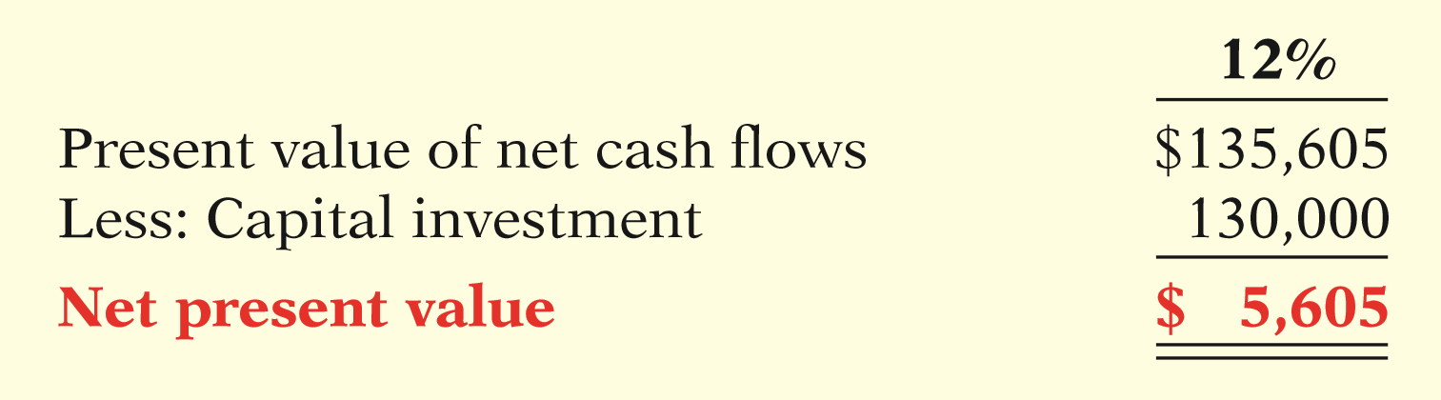

Equal Annual Cash Flows
Illustration: Calculate the present value.
ILLUSTRATION 16-8
Computation of net present value—equal net annual cash flows
The proposed capital expenditure is acceptable at a required rate of return of 12% because the net present value is positive.
LO 2

Slide 19
UNEQUAL ANNUAL CASH FLOWS
Illustration: Stewart Shipping Company expects the same total net cash flows of $240,000 over the life of the investment. Because of a declining market demand for the new product the net annual cash flows are higher in the early years and lower in the later years.
LO 2

Slide 20
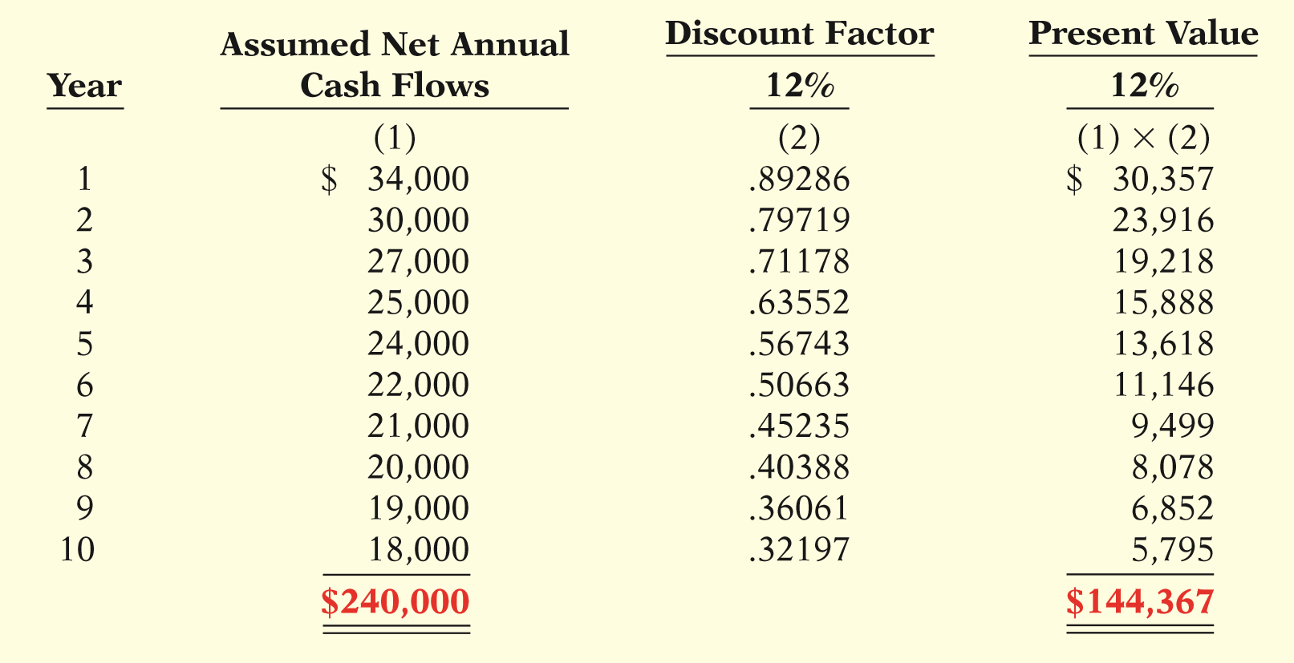
UNEQUAL ANNUAL CASH FLOWS
ILLUSTRATION 16-9
Computation of present value of unequal annual cash flows
LO 2

Slide 21
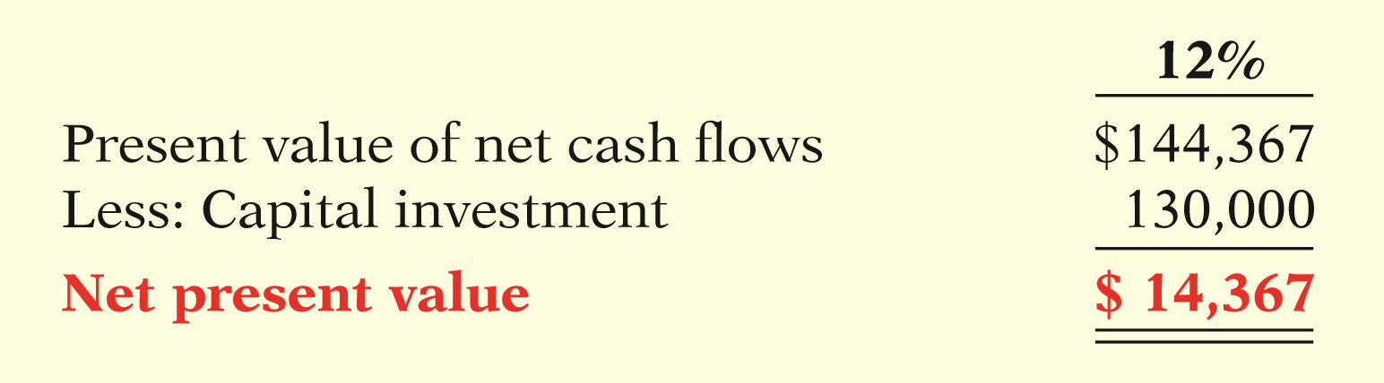
UNEQUAL ANNUAL CASH FLOWS
Illustration: Calculate the net present value.
ILLUSTRATION 16-10
Computation of net present value—unequal annual cash flows
Proposed capital expenditure is acceptable at a required rate of return of 12% because the net present value is positive.
LO 2

Slide 22
MANAGEMENT INSIGHT
Verizon
Can You Hear Me Me—Better?
What’s better than 3G wireless service? 4G. But the question for wireless service providers is whether customers will be willing to pay extra for that improvement. Verizon has spent billions on upgrading its networks in the past few years, so it now offers 4G LTE service to 97% of the nation. Verizon is hoping that its investment in 4G works out better than its $23 billion investment in its FIOS fiber-wired network for TV and ultrahigh-speed Internet. One analyst estimates that the present value of each FIOS customer is $800 less than the cost of the connection.
Sources: Martin Peers, “Investors: Beware Verizon’s Generation GAP,” Wall Street Journal Online (January 26, 2010); and Chad Fraser, “What Warren Buffett Sees in Verizon,” Investing Daily (May 30, 2014).
LO 2

Slide 23
CHOOSING A DISCOUNT RATE
In most instances a company uses a required rate of return equal to its cost of capital — that is, the rate that it must pay to obtain funds from creditors and stockholders.
Discount rate has two elements:
  Cost of capital
  Risk
Rate also know as
  required rate of return.
  hurdle rate.
  cutoff rate.
LO 2

Slide 24
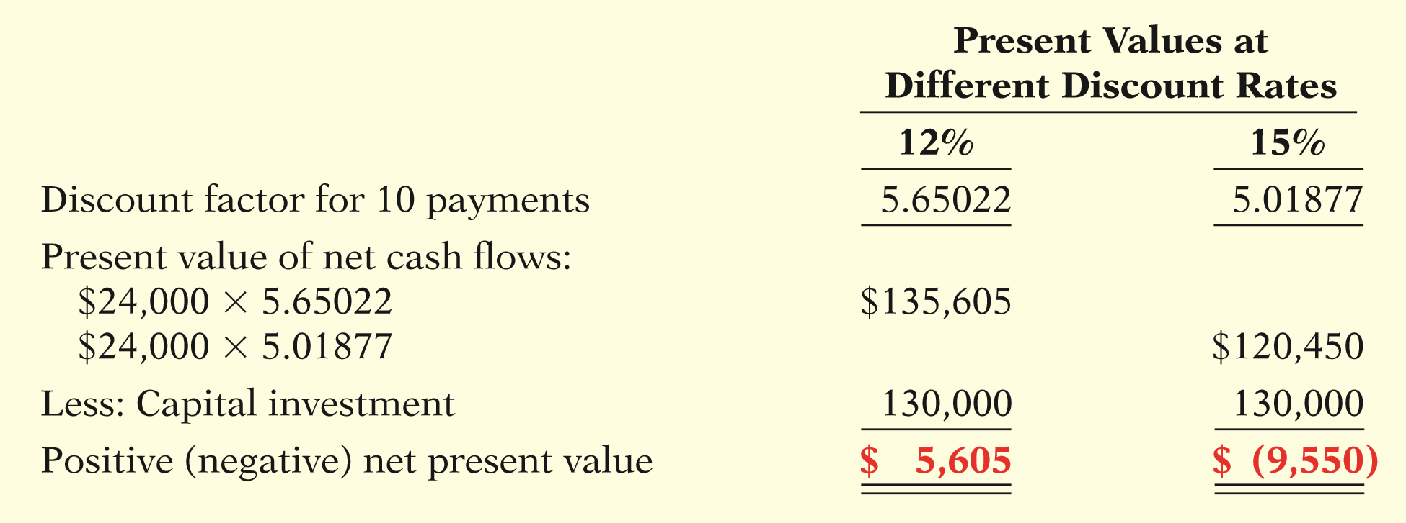
CHOOSING A DISCOUNT RATE
Illustration: Stewart Shipping used a discount rate of 12%. Suppose this rate does not take into account the risk of the project. A more appropriate rate might be 15%.
ILLUSTRATION 16-11
Comparison of net present values at different discount rates
LO 2

Slide 25
SIMPLIFYING ASSUMPTIONS
All cash flows come at the end of each year.
All cash flows are immediately reinvested in another project that has a similar return.
All cash flows can be predicted with certainty.
LO 2

Slide 26
Net Present Value (NPV) method
Question
Compute the net present value of a $260,000 investment with a 10-year life, annual cash inflows of $50,000 and a discount rate of 12%.
  $(9,062).
  $22,511.
  $9,062.
  $(22,511).
LO 2

Slide 27
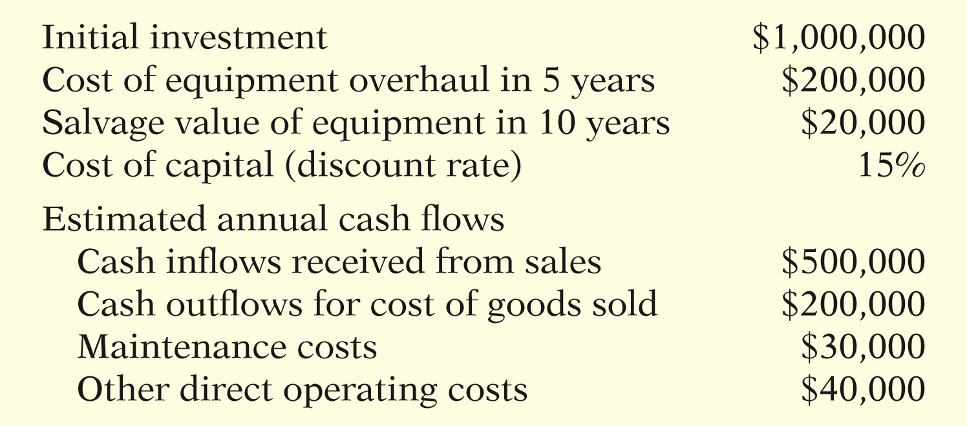
COMPREHENSIVE EXAMPLE
Best Taste Foods is considering investing in new equipment to produce fat-free snack foods.
ILLUSTRATION 16-12
Investment information for Best Taste Foods example
LO 2

Slide 28
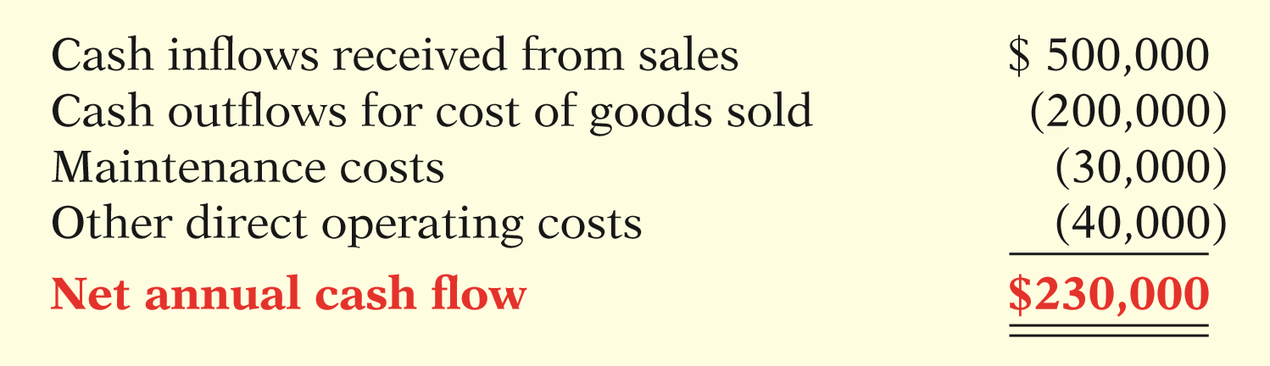
Comprehensive Example
Compute the net annual cash flow.
ILLUSTRATION 16-13
Computation of net annual cash flow
LO 2

Slide 29
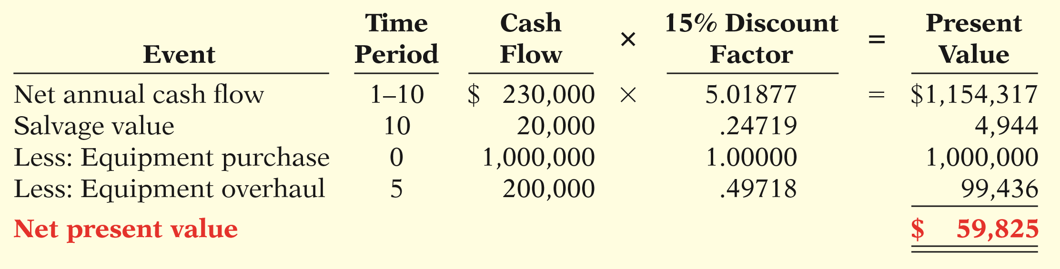
Comprehensive Example
Compute the net annual cash flow.
ILLUSTRATION 16-14
Computation of net present value for Best Taste Foods investment
LO 2

Slide 30
DO IT!
2
Net Present Value
Watertown Paper Corporation is considering adding another machine for the manufacture of corrugated cardboard. The machine would cost $900,000. It would have an estimated life of 6 years and no salvage value. The company estimates that annual cash inflows would increase by $400,000 and that annual cash outflows would increase by $190,000. Management has a required rate of return of 9%. Calculate the net present value on this project and discuss whether it should be accepted.
LO 2

Slide 31
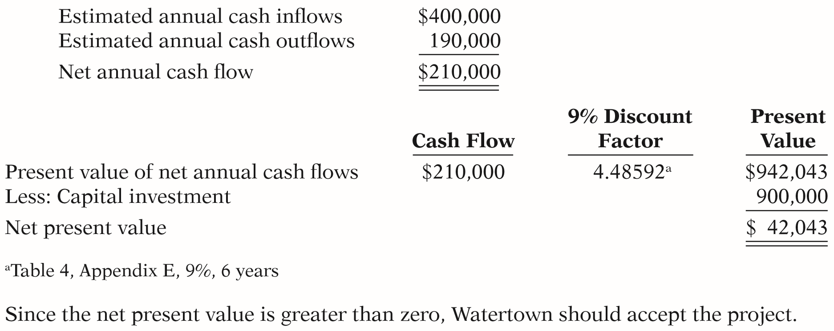
DO IT!
2
Net Present Value
Calculate the net present value on this project and discuss whether it should be accepted.
LO 2

Slide 32
LEARNING OBJECTIVE
3
Identify capital budgeting challenges and refinements.
INTANGIBLE BENEFITS
Intangible benefits might include increased quality, improved safety, or enhanced employee loyalty.
To avoid rejecting projects with intangible benefits:
  Calculate net present value ignoring intangible benefits.
  Project rough, conservative estimates of the value of the intangible benefits, and incorporate these values into the NPV calculation.
LO 3

Slide 33
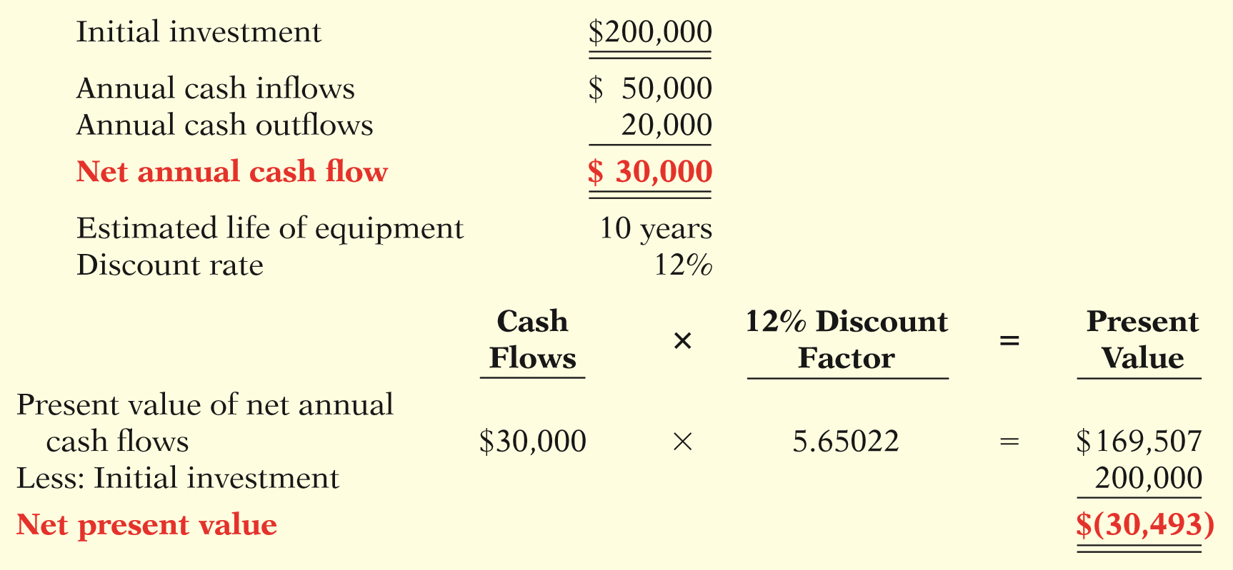
INTANGIBLE BENEFITS
Example - Berg Company is considering the purchase of a new mechanical robot.
ILLUSTRATION 16-15
Investment information for
Berg Company example
Based on the negative net present value of $30,493, the proposed project is not acceptable.
LO 3

Slide 34
Example
Berg estimates that sales will increase cash inflows by $10,000 annually as a result of an increase in quality. Berg also estimates that annual cost outflows would be reduced by $5,000 as a result of lower warranty claims, reduced injury claims, and missed work.
Using these conservative estimates of the value of the additional benefits, should Berg accept the project?
LO 3

Slide 35
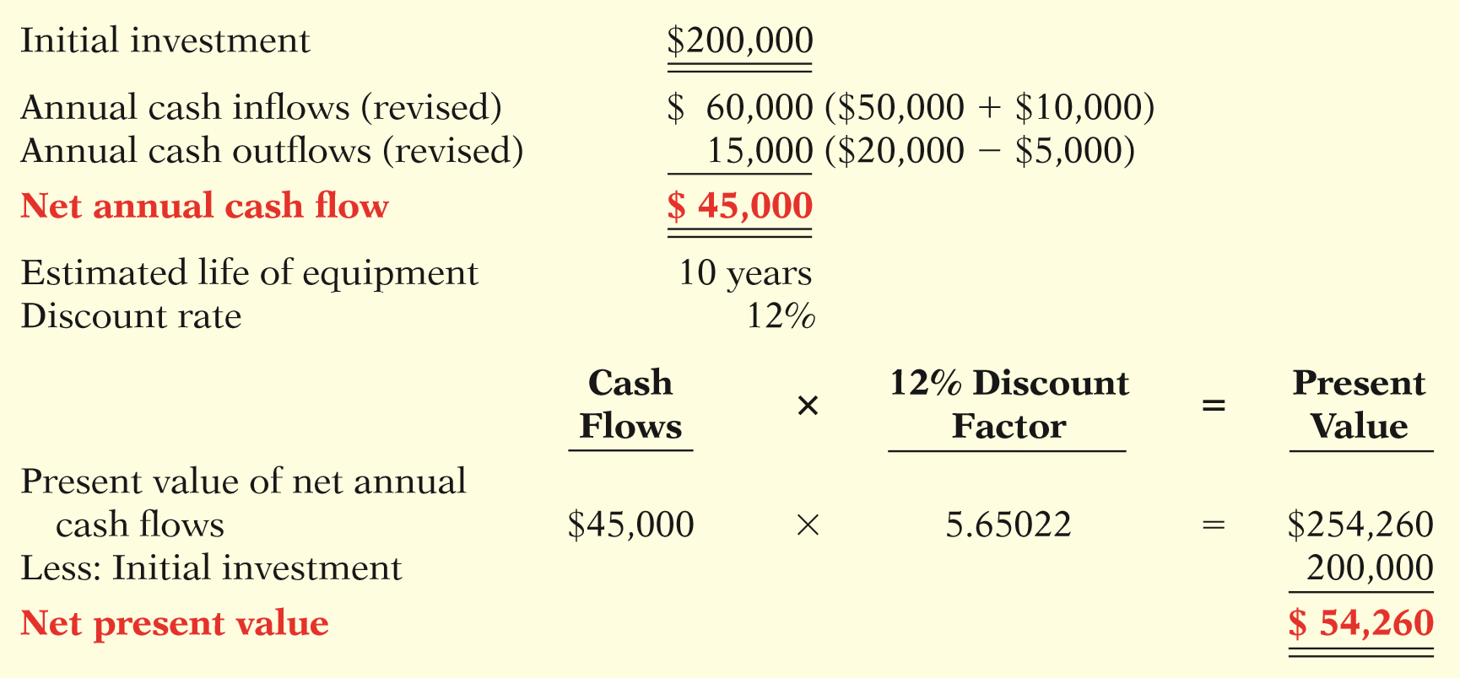
Example
ILLUSTRATION 16-16
Revised investment information
for Berg Company example,
including intangible benefits
Berg would accept the project.
LO 3

Slide 36
ETHICS INSIGHT
It Need Not Cost an Arm and a Leg
Most manufacturers say that employee safety matters above everything else. But how many back up this statement with investments that improve employee safety? Recently, a woodworking hobbyist, who also happens to be a patent attorney with a Ph.D. in physics, invented a mechanism that automatically shuts down a power saw when the saw blade comes in contact with human flesh. The blade stops so quickly that only minor injuries result. Power saws injure 40,000 Americans each year, and 4,000 of those injuries are bad enough to require amputation. Therefore, one might think that power-saw companies would be lined up to incorporate this mechanism into their saws. But, in the words of one power-tool company, “Safety doesn’t sell.” Since existing saw manufacturers were unwilling to incorporate the device into their saws, eventually the inventor started his own company to build the devices and sell them directly to businesses that use power saws.
Source: Melba Newsome, “An Edgy New Idea,” Time: Inside Business (May 2006), p. A16.
LO 3

Slide 37
PROFITABILITY INDEX FOR MUTUALLY EXCLUSIVE PROJECTS
  Proposals are often mutually exclusive.
  Managers often must choose between various positive-NPV projects because of limited resources.
  Tempting to choose the project with the higher NPV.
LO 3

Slide 38
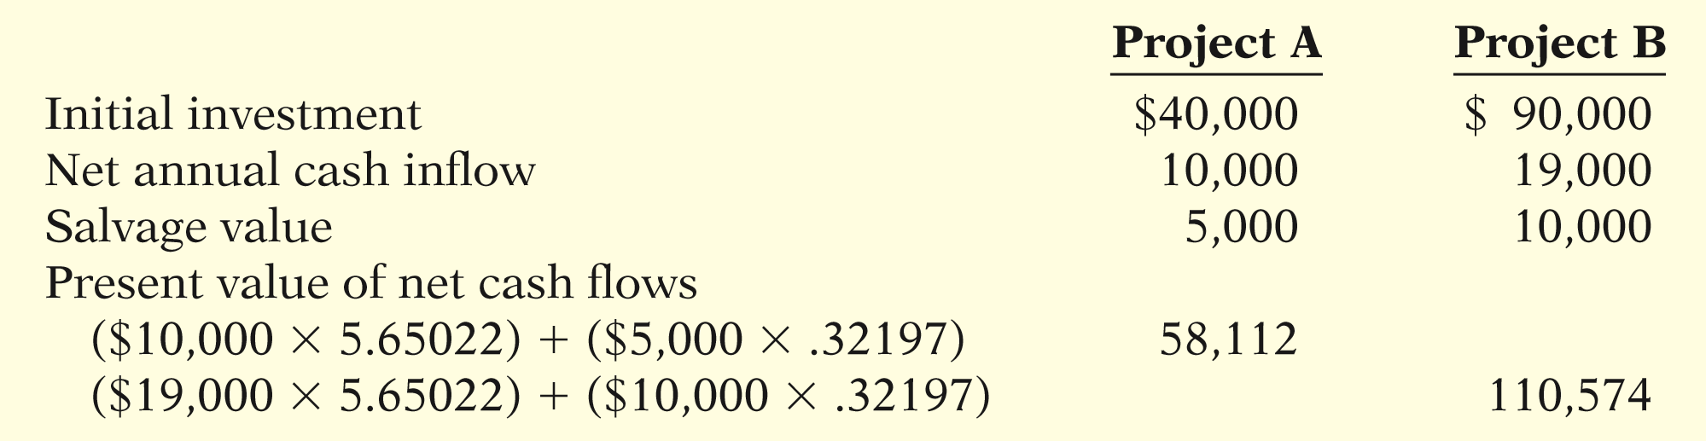
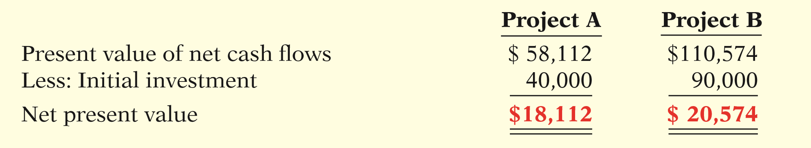
PROFITABILITY INDEX FOR MUTUALLY EXCLUSIVE PROJECTS
Illustration: Two mutually exclusive projects, each assumed to have a 10-year life and a 12% discount rate.
ILLUSTRATION 16-17
ILLUSTRATION 16-18
LO 3

Slide 39
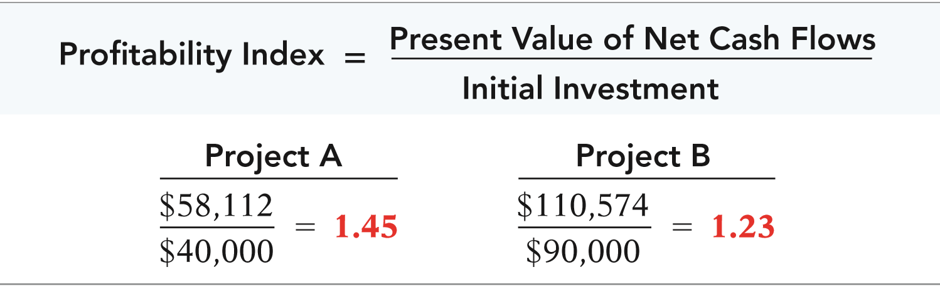
PROFITABILITY INDEX FOR MUTUALLY EXCLUSIVE PROJECTS
Illustration: One method of comparing alternative projects is the profitability index.
ILLUSTRATION 16-18
ILLUSTRATION 16-20
LO 3

Slide 40
PROFITABILITY INDEX FOR MUTUALLY EXCLUSIVE PROJECTS
Question
Assume Project A has a present value of net cash inflows of $79,600 and an initial investment of $60,000. Project B has a present value of net cash inflows of $82,500 and an initial investment of $75,000. Assuming the projects are mutually exclusive, which project should management select?
  Project A.
  Project B.
  Project A or B.
  There is not enough data to answer the question.
LO 3

Slide 41
RISK ANALYSIS
A simplifying assumption made by many financial analysts is that projected results are known with certainty.
  Projected results are only estimates.
  Sensitivity analysis is used to deal with uncertainty.
    Sensitivity analysis uses a number of outcome estimates to get a sense of the variability among potential returns.
LO 3

Slide 42
MANAGEMENT INSIGHT
Sharp
Wide-Screen Capacity
Building a new factory to produce 60-inch TV screens can cost $4 billion. But for more than 10 years, manufacturers of these screens have continued to build new plants. By building so many plants, they have expanded productive capacity at a rate that has exceeded the demand for big-screen TVs. In fact, during one recent year, the supply of big-screen TVs was estimated to exceed demand by 12%, rising to 16% in the future. One state-of-the-art plant built by Sharp was estimated to be operating at only 50% of capacity. Experts say that the price of big-screen TVs will have to fall much further than they already have before demand may eventually catch up with productive capacity.
Source: James Simms, “Sharp’s Payoff Delayed,” Wall Street Journal Online (September 14, 2010).
LO 3

Slide 43
POST-AUDIT OF INVESTMENT PROJECTS
Performing a post-audit is important.
  If managers know that their estimates will be compared to actual results they will be more likely to submit reasonable and accurate data when making investment proposals.
  Provides a formal mechanism to determine whether existing projects should be supported or terminated.
  Improve future investment proposals.
LO 3

Slide 44
DO IT!
3
Profitability Index
Taz Corporation has decided to invest in renewable energy sources to meet part of its energy needs for production. It is considering solar power versus wind power. After considering cost savings as well as incremental revenues from selling excess electricity into the power grid, it has determined the following.
Solar Wind
Present value of annual cash flows $78,580 $168,450
Initial investment $45,500 $125,300
Determine the net present value and profitability index of each project. Which energy source should it choose?
LO 3

Slide 45
DO IT!
3
Profitability Index
Solution
Solar Wind
Present value of annual cash flows $78,580 $168,450
Less: Initial investment 45,500 125,300
Net present value $33,080 $ 43,150
Profitability index 1.73* 1.34**
*$78,580 ÷ $45,500
**168,450 ÷ 125,300
While the investment in wind power generates the higher net present value, it also requires a substantially higher initial investment. The profitability index favors solar power, which suggests that the additional net present value of wind is outweighed by the cost of the initial investment. The company should choose solar power.
LO 3

Slide 46
Use the internal rate of return method.
LEARNING OBJECTIVE
4
  Differs from the net present value method in that it finds the interest yield of the potential investment.
  Internal rate of return (IRR) - interest rate that will cause the present value of the proposed capital expenditure to equal the present value of the expected net annual cash flows (NPV equal to zero).
  How does one determine the internal rate of return?
LO 4

Slide 47
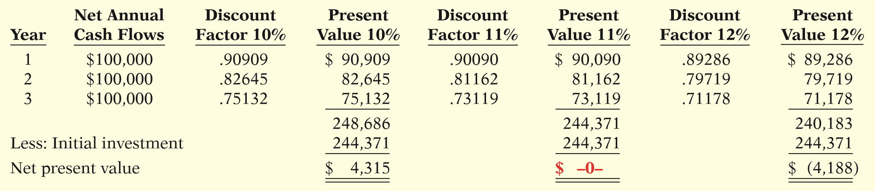
Internal Rate of Return Method
Illustration: Stewart Shipping Company is considering the purchase of a new front-end loader at a cost of $244,371. Net annual cash flows from this loader are estimated to be $100,000 a year for three years. Determine the internal rate of return on this front-end loader.
ILLUSTRATION 16-21
Estimation of internal rate of return
LO 4

Slide 48
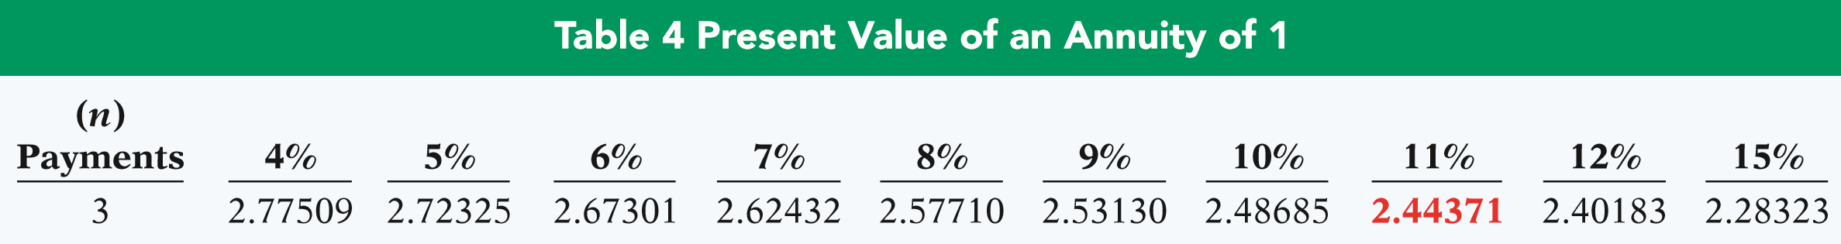
Internal Rate of Return Method
An easier approach to solving for the internal rate of return when net annual cash flows are equal.
ILLUSTRATION 16-22
Formula for internal rate of return—even cash flows
Applying the formula:
$244,371 ÷ $100,000 = 2.44371
ILLUSTRATION 16-23
Present value of a three-payment annuity
LO 4

Slide 49
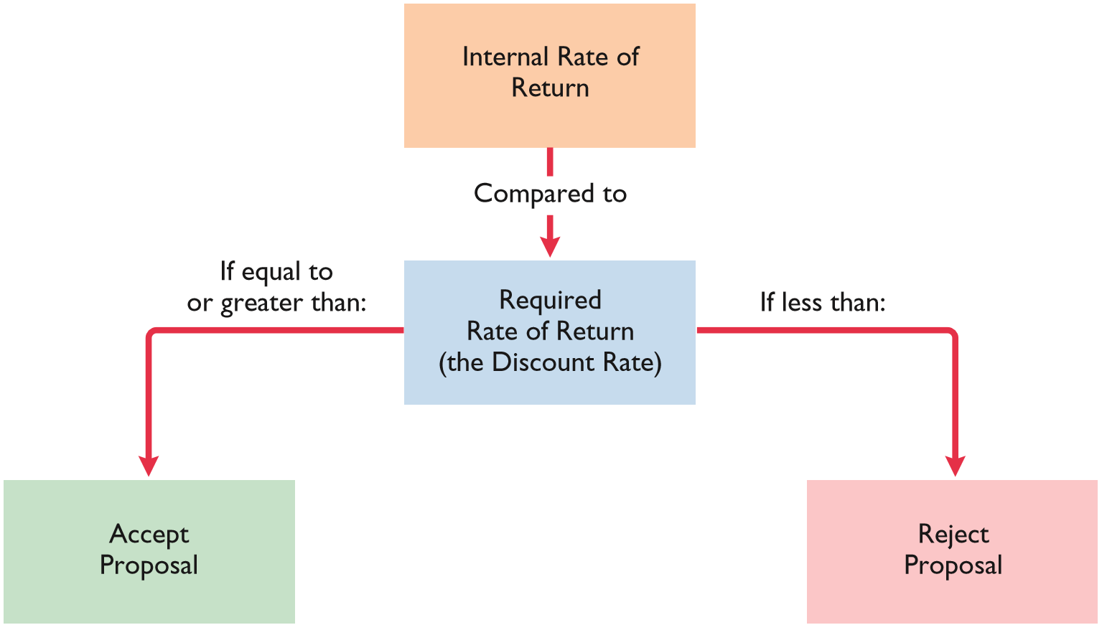
Internal Rate of Return Method
ILLUSTRATION 16-24
Internal rate of return
decision criteria
LO 4

Slide 50
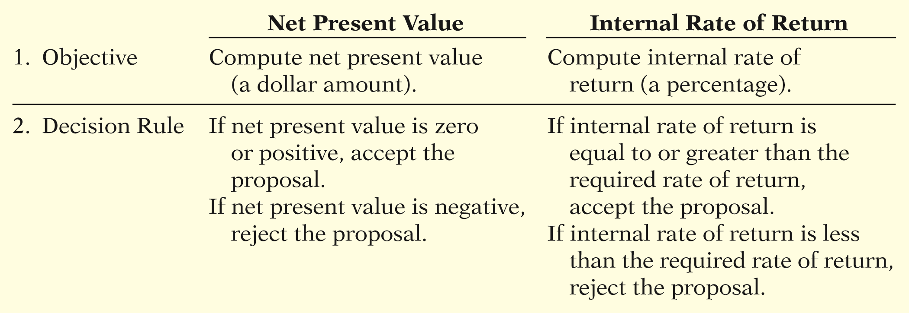
COMPARING DISCOUNTED CASH FLOW METHODS
ILLUSTRATION 16-25
Comparison of discounted cash flow methods
Either method will provide management with relevant quantitative data for making capital budgeting decisions.
LO 4

Slide 51
DO IT!
4
Internal Rate of Return
Watertown Paper Corporation is considering adding another machine for the manufacture of corrugated cardboard. The machine would cost $900,000. It would have an estimated life of 6 years and no salvage value. The company estimates that annual cash inflows would increase by $400,000 and that annual cash outflows would increase by $190,000. Management has a required rate of return of 9%. Calculate the internal rate of return on this project and discuss whether it should be accepted.
LO 4

Slide 52
DO IT!
4
Internal Rate of Return
Calculate the internal rate of return.
Estimated annual cash inflows $400,000
Estimated annual cash outflows 190,000
Net annual cash flow 210,000
Machine cost 900,000
Net annual cash flow 210,000
PV Factor 4.28571
+
÷
Now, find the rate that corresponds to the present value factor.
LO 4

Slide 53
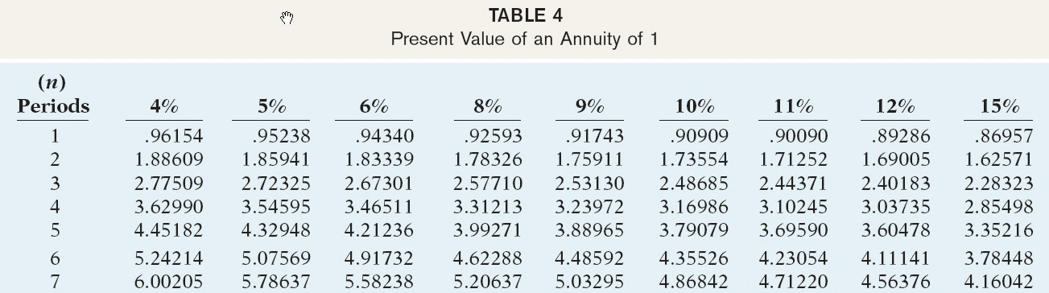
DO IT!
4
Internal Rate of Return
Find the rate that corresponds to the present value factor.
PV Factor 4.28571
Since the required rate of return is only 9%, the project should be accepted.
LO 4

Slide 54
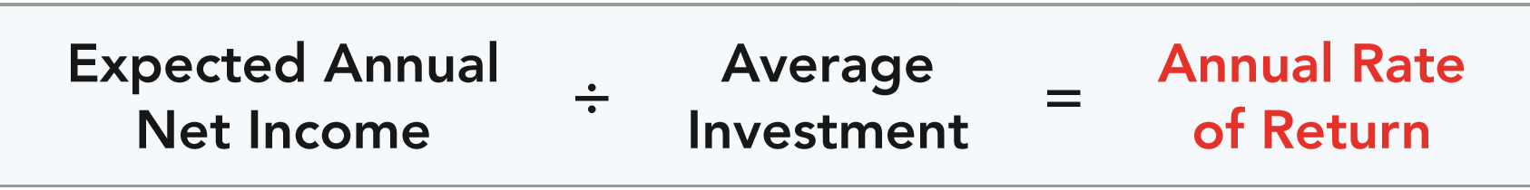
Use the annual rate of return method.
LEARNING OBJECTIVE
5
Indicates the profitability of a capital expenditure by dividing expected annual net income by the average investment.
ILLUSTRATION 16-26
Annual rate of return formula
LO 5

Slide 55
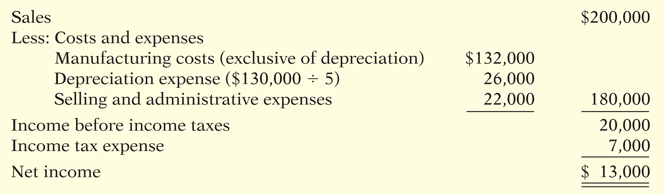
Annual Rate of Return
Illustration: Reno Company is considering an investment of $130,000 in new equipment. The new equipment is expected to last five years and have zero salvage value at the end of its useful life. Reno uses the straight-line method of depreciation.
ILLUSTRATION 16-27
Estimated annual net income from Reno Company’s capital expenditure
LO 5

Slide 56
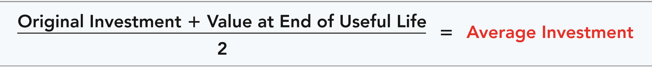
Annual Rate of Return
ILLUSTRATION 16-28
Formula for computing average investment
130,000 + 0
= $65,000
2
Expected annual rate of return
$13,000
= 20%
$65,000
A project is acceptable if its rate of return is greater than management’s required rate of return.
LO 5

Slide 57
DO IT!
5
Annual Rate of Return
Watertown Paper Corporation is considering adding another machine for the manufacture of corrugated cardboard. The machine would cost $900,000. It would have an estimated life of 6 years and no salvage value. The company estimates that annual revenues would increase by $400,000 and that annual expenses excluding depreciation would increase by $190,000. It uses the straight-line method to compute depreciation expense. Management has a required rate of return of 9%. Compute the annual rate of return.
LO 5

Slide 58
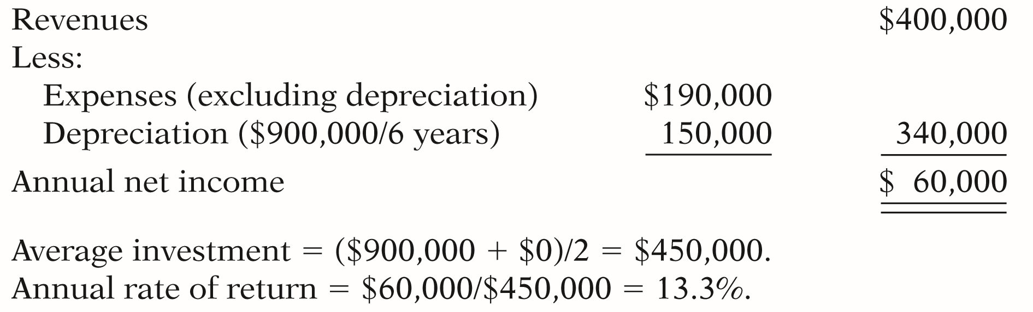
DO IT!
5
Annual Rate of Return
Compute the annual rate of return.
The proposed project is acceptable.
LO 5

Slide 59
Copyright
“Copyright © 2017 John Wiley & Sons, Inc. All rights reserved. Reproduction or translation of this work beyond that permitted in Section 117 of the 1976 United States Copyright Act without the express written permission of the copyright owner is unlawful. Request for further information should be addressed to the Permissions Department, John Wiley & Sons, Inc. The purchaser may make back-up copies for his/her own use only and not for distribution or resale. The Publisher assumes no responsibility for errors, omissions, or damages, caused by the use of these programs or from the use of the information contained herein.”

