Slide 1
Chapter 11: Marketing: Developing Programs That Respond to the Wants and Needs of the Priority Population

Slide 2
Key Terms – 1
Consumer-based
Program focused on the priority population’s wants, needs, desires, preferences, and so forth
Marketing
A set of processes for creating, communicating, and delivering value to customers; is concerned with a financial profit (American Marketing Association)
Social marketing – attempts to change behavior for improved health or social outcomes

Slide 3
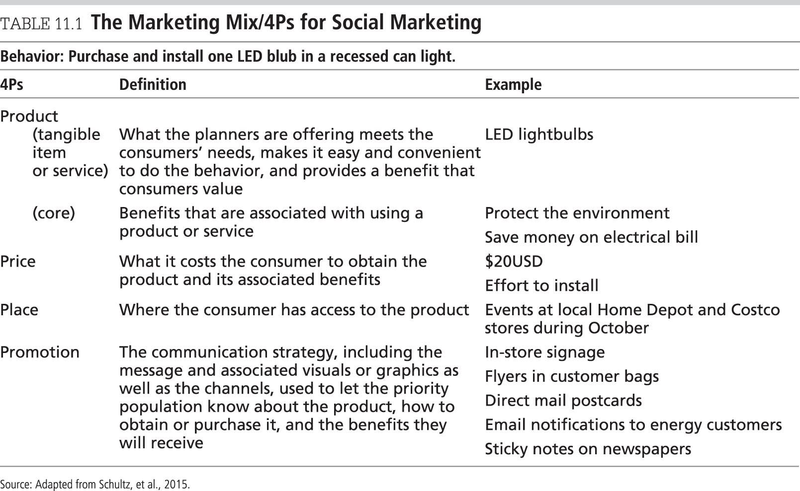
The Marketing Mix

Slide 4
Key Terms – 2
Market
“The set of all people who have an actual or potential interest in a product or service” (Kotler & Clarke, 1987, p.108)
Also called the consumer or target audience
Exchange
Trading a product for certain costs (financial or nonfinancial)
Items that can be marketed can be tangible or intangible: information, ideas, goods, services, events, or behaviors

Slide 5
The Marketing Process and Health Promotion Programs – 1
Consumer Orientation
All marketing-related program decisions—including the type of product that is developed, how it is offered, how much it will cost, how it is promoted, and the benefits promised—are based on what planners know about the priority population and their preferences.
Usually done during the formative research process and needs assessment process.

Slide 6
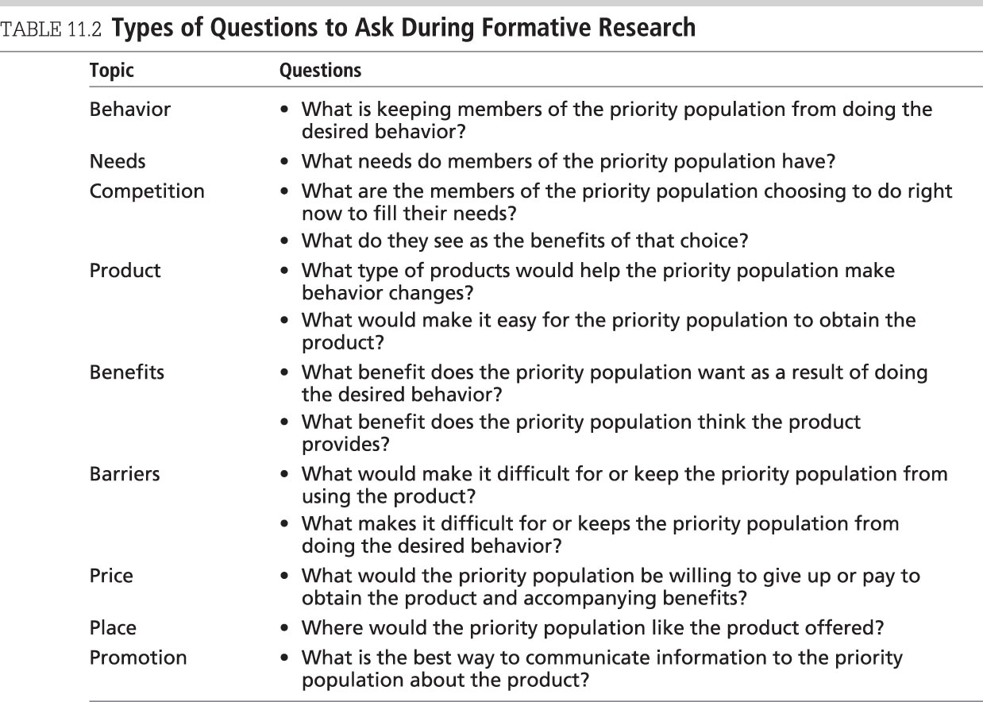
Questions for Formative Research

Slide 7
The Marketing Process and Health Promotion Programs – 2
Competition
Planners should identify the competition during the formative research phase.
Knowing what the priority population perceives is the competition and the benefits that they get from choosing that option can help planners make strategic decisions.
Segmentation
A way to divide the priority population into smaller, more homogeneous groups
The goal of segmentation is to create groups of people who share similar characteristics or qualities that are associated with being at risk for certain health problems and who will respond in a similar way to the intervention.

Slide 8
Segmentation – 1
Segmentation helps planners to narrow the focus of their marketing strategy.
Segmentation allows planners to better meet the needs of the consumer, allowing for a greater chance of an exchange taking place.

Slide 9
Segmentation – 2
Factors or variables used for segmentation:
Geographic
Demographic
Psychosocial
Behavioral
Most of the time, multiple factors are used to identify segments; no right or wrong way to segment; can be done a priori or a posteriori.

Slide 10
Segmentation – 3
The following five criteria can assist a program planner in choosing the appropriate segment to focus on:
Measurable
How many people are in each segment and can the factors be measured?
Substantial
Is the segment large and profitable enough to reach enough people to make a difference?
Accessible
Can the segment be reached and services delivered?
Differentiable
Are segments different enough that they will react differently to marketing strategies?
Actionable
Can products be created to attract segments?

Slide 11
Marketing Mix
Planners need to make strategic decisions related to four marketing variables (the four Ps):
Product – What?
Price – How much?
Place – Where?
Promotion – How?
These variables are referred to as the marketing mix.

Slide 12
Product
Product – what is being offered to meet the customers’ needs
Augmented products are the tangible items or services.
Examples include bike helmets, contraceptives, glasses, hand-washing facilities/containers, medicine.
Benefits that are associated with using a product or service are called “core products” or the “bundle of benefits” (Kotler & Lee, 2016).
They will become the motivation for people using the products to help them change behavior.
Examples include: makes us healthy; avoids costly fines and penalties from noncompliance; close loving bond; emotional benefits; crew dependability on fire scene.

Slide 13
Price – 1
Price – what it costs the priority population to obtain the product and its associated benefits
May be financial or nonfinancial
Social, mental, emotional, behavioral, or psychological costs
Barriers – what keep people from responding to an intervention or doing a behavior

Slide 14
Price – 2
Planners should answer seven questions regarding price:
Who are the clients?
What is their ability to pay?
Are co-payers involved?
Is the program covered under an insurance program?
What is the mission of the planner’s agency?
What are competitors charging?
What is the demand for the program or product?

Slide 15
Place
Place is where the priority population has access to the product.
Place includes:
Location (Where are services provided?)
Convenience (Can the priority population easily access the service?)
Safety (Is the service provided in a safe location?)
Time of day (Is the service provided at a good time for the priority population?)
Planners should make sure that it’s easy for the consumer to obtain the product or service.

Slide 16
Promotion – 1
Promotion – communication strategy used to let the priority population know about the product, how to obtain or purchase it, and the benefits they will receive
Purpose:
Inform—increase product awareness or inform consumers
Persuade—convince people to purchase the product
Reinforce—remind them that the product exists
Differentiate—position the product as being different from the competition

Slide 17
Promotion – 2
Routes of promotion:
Advertising
Direct marketing
Personal selling
Sales promotions
Public relations
Digital communication

Slide 18
Pretesting – 1
Pretesting ensures that planners have developed program components in response to, and reflective of the consumer’s needs, wants, and expectations.
There are two phases of pretesting.

Slide 19
Pretesting – 2
Phase 1 tests product concept.
How likely they would be to use the product
What they see as benefits to using the product
What they see as the barriers; what factors would keep them from using it
What product features they like
What product features they would change, and why
If the places selected to offer the product are convenient
If the product price is reasonable
If the benefits associated with product use are believable
If the product functions as designed
If instructions for how to use the product are clear
Phase 2 tests promotional strategy message and materials.

Slide 20
Pretesting – 3
Pretesting provides feedback and identifies red flags.
Methods depend on the aspect of marketing strategy being tested, the topics being explored, the amount of money available for pretesting, and the timeline.
Common methods include:
Focus groups
Central location intercept interview
Who should complete pretesting?
Priority population for understanding
Experts in field for content validity
Gatekeepers for acceptance and approval

Slide 21
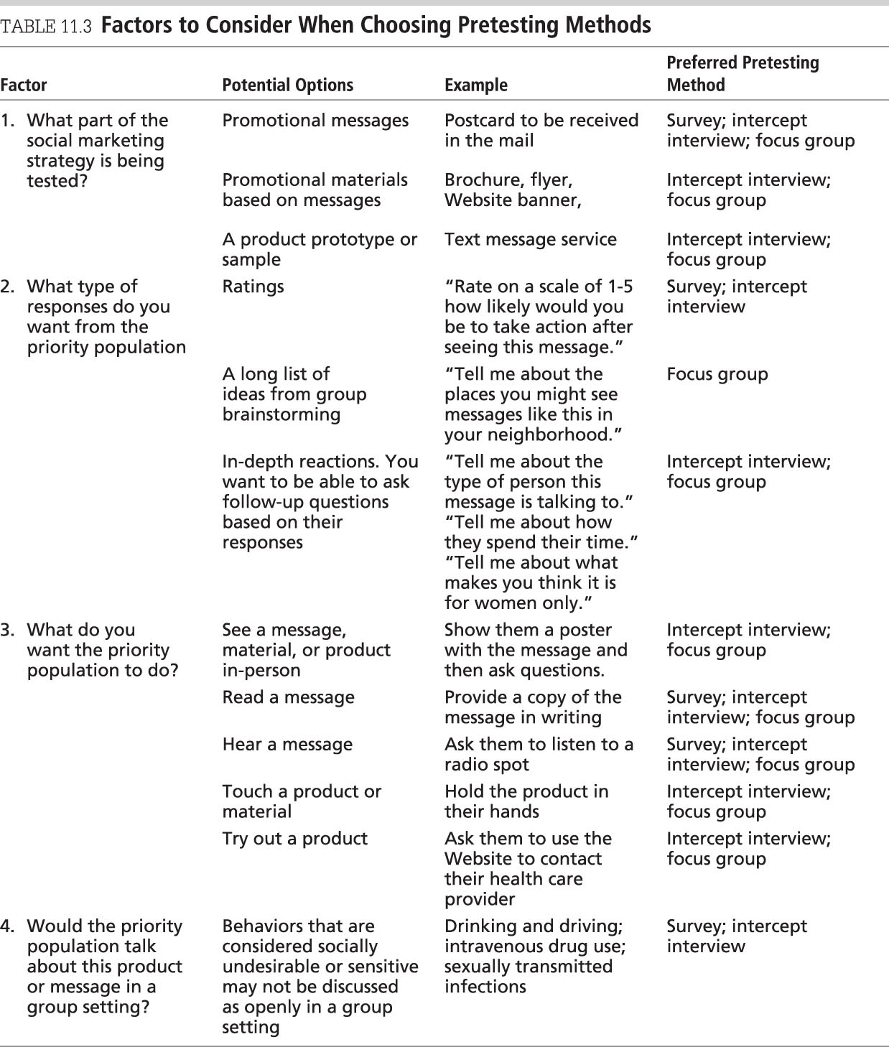
Choosing Pretesting Methods

Slide 22
Continuous Monitoring
Continuous monitoring determines if things are going as planned, if the program is operating below expectations, and whether changes noted indicate that the program is moving in the right direction (Andreasen, 1995).
Provides program planners with:
Data regarding level of program acceptance by the priority population
Reach of messages
Product distribution sites
What is working and what is not working
Continuous monitoring improves the effectiveness of the program by continually integrating feedback from the priority population.

