Slide 1
Chapter 12:
Implementation: Strategies and
Associated Concerns

Slide 2
Logic Models – 1
A logic model is a systematic and visual way for planners to share and present their understanding of the relationship among the resources they have to operate a program, the activities they plan to implement, and the outputs and outcomes they hope to achieve (CDC, 2008b; WKKF, 2004).
  Can help all stakeholders understand the “big picture” of how planning, implementing, and evaluating all fit together

Slide 3
Logic Models – 2
Three components of a logic model:
  Inputs (resources)
    Human resources, partnerships, equipment, supplies, materials, and community resources
  Outputs (activities)
    Products, services, and infrastructure
  Outcomes (results or effects)
    Short-term, mid-term, and long-term

Slide 4
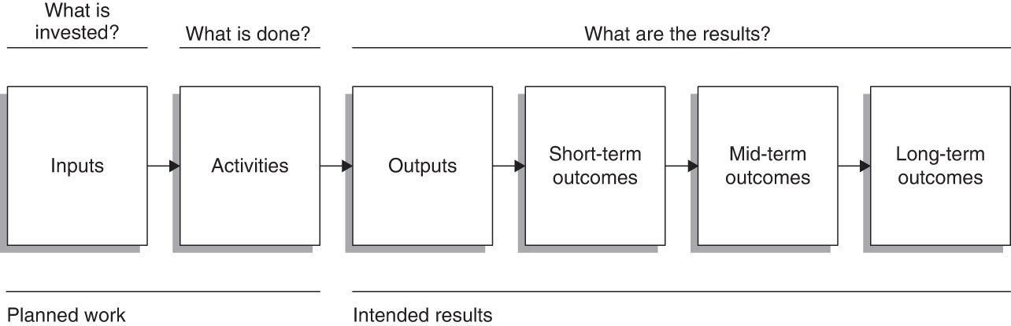
Basic Logic Model

Slide 5
Defining Implementation
“The act of converting planning, goals, and objectives into action through administrative structure, management activities, policies, procedures, and regulations, and organizational actions of new programs” (Timmreck, 1997, p. 328)
One of the three stages of program diffusion, with the other two being adoption and sustainability (Bartholomew et al., 2011)

Slide 6
Phases of Program Implementation
Phases are flexible in nature and can be modified to meet the many different situations and circumstances faced by planners.
Phases of implementation:
  Adoption of the program
  Identifying and prioritizing the tasks to be completed
  Establishing a system of management
  Putting the plans into action
  Ending or sustaining a program

Slide 7
Phase 1: Adoption of the Program
This phase is a part of the marketing process.
Great care must go into the marketing process to ensure that a relevant product (i.e., the health promotion program) is planned so that those in the priority population will want to participate in it.

Slide 8
Phase 2: Identifying and Prioritizing the Tasks to Be Completed – 1
Many tasks need to be completed when implementing a program.
  Examples: reserving space, ordering equipment, etc.
Tasks need to be identified and prioritized.
  Planning timetables and timelines can help with this process.

Slide 9
Phase 2: Identifying and Prioritizing the Tasks to Be Completed – 2
Types of timetables and timelines include:
  Basic timelines
  Task development timelines (TDTLs; Anspaugh, Dignan, & Anspaugh, 2000)
  Gantt charts
  PERT charts
  Critical path method (CPM)

Slide 10
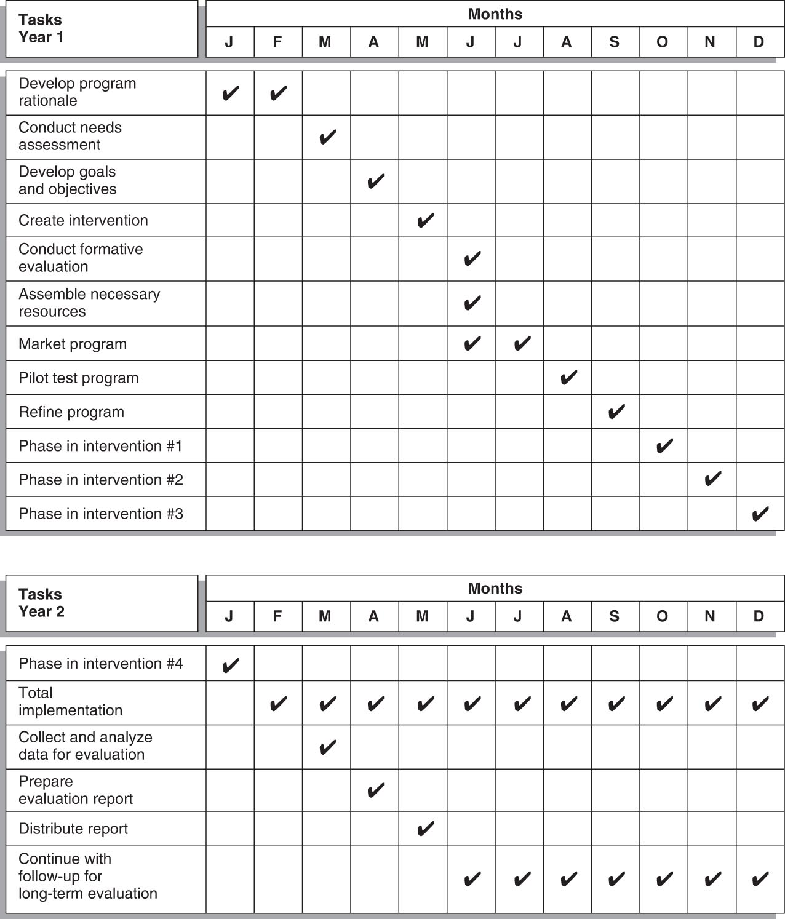
Sample Task Development Timeline

Slide 11
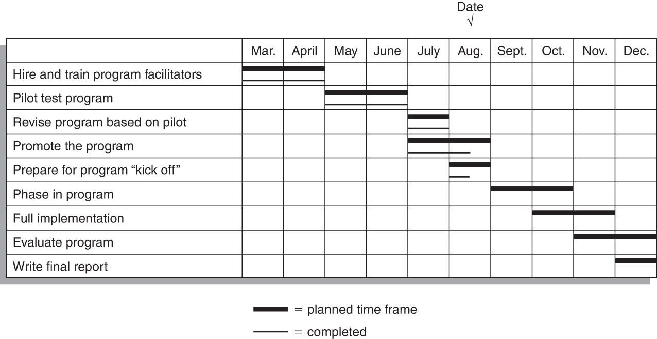
Sample Gantt Chart

Slide 12
Phase 3: Establishing a System of Management – 1
Management – “the process of assembling and using sets of resources in a goal-directed manner to accomplish tasks in an organizational setting” (Hitt, Black, & Porter, 2012, p. 483)
  Includes human, financial, and technical resources
“The efficient, satisfactory management of a health promotion program is vital to its long-term success” (Anspaugh et al., 2000, p. 124).

Slide 13
Phase 3: Establishing a System of Management – 2
Good management is needed to ensure that programs are
  Effective: meet stated goals and objectives
  Efficient: well-organized, cost effective
Managers need technical, interpersonal, and conceptual skills.
Human Resources Management (HRM)
  Four functions (or PADS):
    Planning – defining personnel
    Acquisition – hiring personnel
    Development – training personnel
    Sanction – discipline, rewards, safety
  Professional Development

Slide 14
Phase 3: Establishing a System of Management – 3
Financial Management
  “Process of developing and using system to ensure that funds are spent for the purpose for which they have been appropriated” (Klingner
  et al., 2010, p. 88)
    Accounting, fiscal year, fiscal accountability
    Audits – internal and external
Technical Resources Management
  All other resources besides human and financial
    Equipment, expertise, information, material, partnerships

Slide 15
Phase 4: Putting Plans into Action – 1
There are three major ways of putting plans into action: by phasing them in, in small segments; and by initiating the total program all at once.
  The strategies exist in a hierarchy and it is recommended that all programs go through all three.
Pilot testing – trying the program out with a small group from the priority population to identify any problems
Phasing in – limiting the number of people who are exposed, then gradually increasing the numbers; by offerings, by location, by ability, by number
Total program – all in priority population are exposed at same time

Slide 16
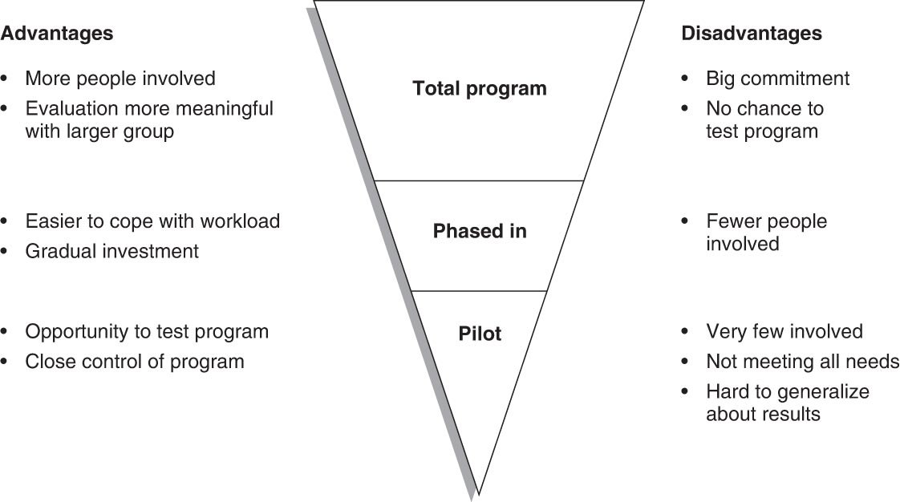
Putting Plans into Action

Slide 17
Phase 4: Putting Plans into Action – 2
First Day of Implementation
  Also referred to as program launch, program rollout, or program kickoff
Some special planning may be necessary:
  Decide on a first day.
    Consider launching to coincide with other already occurring event (e.g., weight loss program and New Year’s resolution).

Slide 18
Phase 4: Putting Plans into Action – 3
Some special planning may be necessary (cont’d)
  Kickoff in style.
    Create a special event; use celebrities.
  Seek news coverage, if appropriate.
    Inform appropriate media representatives of your plans.
    Make arrangements to meet the media representatives at the designated time and place.
    Use press releases, video releases, spokespeople.
    Consider a news hook; e.g., day in history.

Slide 19
Phase 4: Putting Plans into Action – 4
Monitoring Implementation
  Program monitoring involves the ongoing collection and analysis of data and other information to determine if the program is operating as planned.
Basic monitoring data and information for a program has the following utilities (USDJ, n.d.):
  It provides operating and descriptive data and information.
  It provides the basic information for comparing outcomes to the program objectives.
  It provides educational information about many aspects of the program.
  Monitoring data serve as a preventive maintenance function by tracking indicators of critical elements.

Slide 20
Phase 5: Ending or Sustaining a Program
Planners should determine how long to run a program.
If the program met its goals and objectives and the priority population has been served to the fullest extent necessary, then the program can be ended.
Sustaining a program is more difficult. Six techniques include:
  Working to institutionalize
  Seeking feedback
  Advocating for the program
  Partnering with others
  Revisiting and revising the rationale
  Establishing a resource development committee

Slide 21
Implementation of Evidence-Based Interventions
The focus of implementation science is to study how interventions, which have been shown to be effective in one setting, can be applied to sustain improvements to population health (Lobb & Colditz, 2013).
Tomioka and Braun (2013) created a four-step fidelity assurance protocol:
  Deconstruct the program into its components.
  Identify agencies that are ready to replicate the intervention.
  Closely monitor the fidelity of the program.
  Use the evaluation tools of the program to track progress.

Slide 22
Concerns Associated with
Implementation – 1
Safety and Medical Concerns
  Most programs are designed to improve health; thus give attention to the safety and medical concerns associated with the program.
  Informed consent
    Explain nature of program.
    Inform participants of risks or dangers and any possible discomfort.
    Explain expected benefits.
    Inform of alternative programs.
    Indicate that they are free to discontinue participation at any time.
    Allow participants to ask questions.
  Informed consent forms (waiver of liability or release of liability) do not protect planners from being sued.
    They just make participants aware of special concerns.

Slide 23
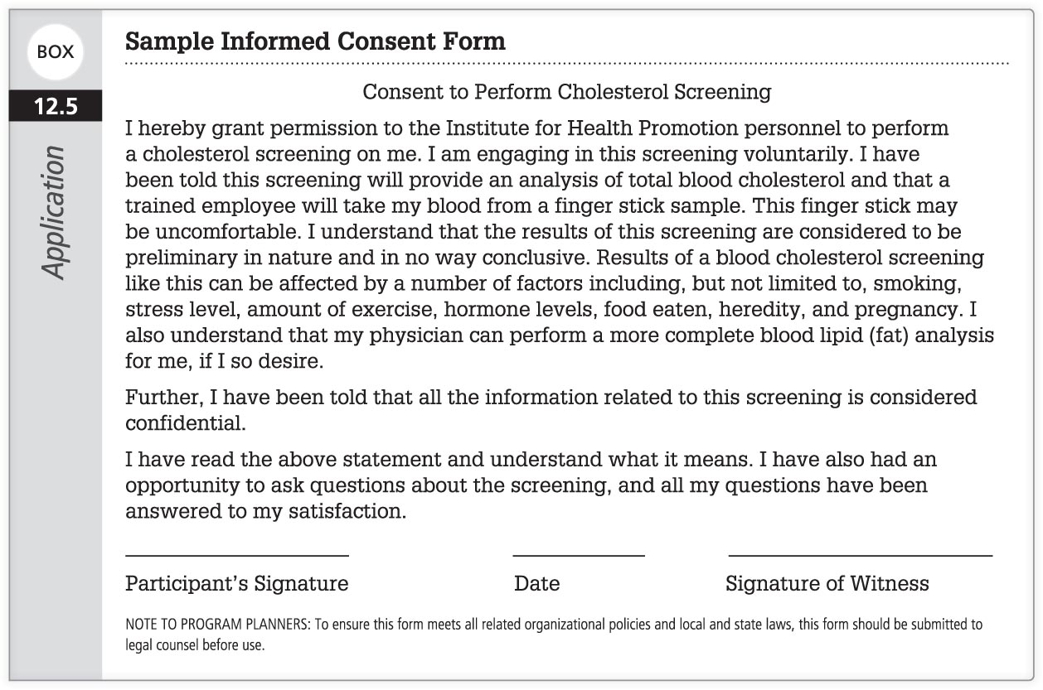
Example Informed Consent Form

Slide 24
Concerns Associated with
Implementation – 2
Safety and Medical Concerns (cont’d)
  If the act of participating in the program puts anyone at medical risk (e.g., cardiovascular exercise programs), then these individuals need to obtain medical clearance before participating.
    Medical clearance signed by a physician
  Steps must be taken to ensure the safety and health of all associated with the program:
    Safe program location; appropriate security
    Building codes met and facilities free from any hazards
    Qualified instructors
    Plan in case of emergency

Slide 25
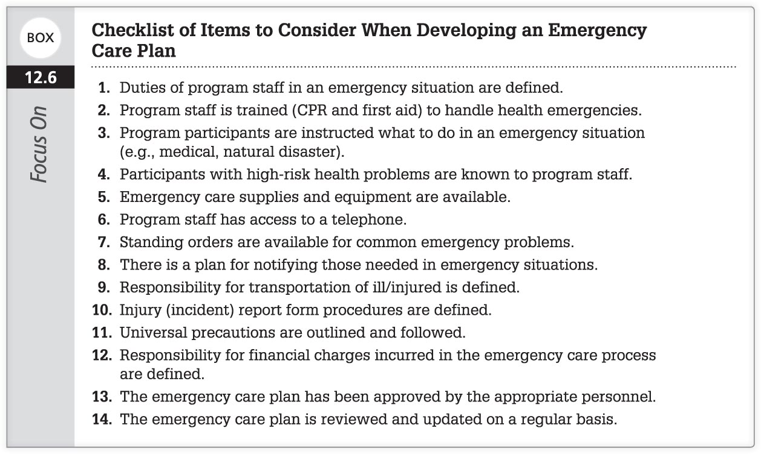
Checklist of Items to Consider When Developing an Emergency Care Plan

Slide 26
Concerns Associated with
Implementation – 3
Ethical Issues
  Situations where competing values are at play and judgment must be made on what is the most appropriate course of action
  Code of Ethics for the Health Education Profession guides the work of health educators.
    Planners should have integrity, and be honest, loyal, and accountable.
  The Belmont Report: Ethical Principles and Guidelines for the Protection of Human Subject Research has three fundamental ethical principles:
    Respect for persons
    Beneficence – maximizing benefits; doing good
    Justice – fairness

Slide 27
Concerns Associated with
Implementation – 4
Legal Concerns
  Negligence – failing to act in a prudent (reasonable) manner. Arises from two acts:
    Omission – doing nothing when you should
    Commission – doing something you should not

Slide 28
Concerns Associated with
Implementation – 5
Reducing the Risk of Liability – key to avoiding liability is to reduce risk by planning ahead
  Be aware of legal liabilities.
  Be aware of professional standards.
  Keep knowledge and skills up-to-date.
  Use certified instructors.
  Use good judgment.
  Require informed consent.
  Get medical clearance.
  Limit work to expertise.
  Provide a safe environment.
  Purchase insurance.

Slide 29
Concerns Associated with
Implementation – 6
Program Registration and Fee Collection
  Establish payment procedures and a system of payment
Procedures for Recordkeeping
  HIPAA
  Records should be kept, but ensure anonymity/confidentiality

Slide 30
Concerns Associated with
Implementation – 7
Procedural Manual and/or Participants’ Manual
  There may be a need to create a manual for the program to:
    Ensure that everyone understands the program and its parameters
    Standardize the intervention so it can be replicated and avoid Type III errors
    Provide ideas for facilitation
    Provide additional background information on the topic
    Provide citations for additional resources.
Program Participants with Disabilities
  Programs should meet the needs of participants with disabilities.

Slide 31
Concerns Associated with
Implementation – 8
Training for Facilitators
  Program facilitators need to be familiar with the intervention.
    Either by participating in the planning of the intervention or through a training session
Dealing with Problems
  Planners should anticipate and deal with problems that might arise.
Documenting and Reporting
  Keep others informed about the progress of the program for:
    accountability
    public relations
    motivation of present participants

