Slide 1
Chapter 13:
Evaluation:
An Overview

Slide 2
Background Information on Evaluation
Adequate and appropriate evaluation is necessary for any program regardless of size, nature, and duration.
Two critical purposes of program evaluation are
  Assessing and improving quality
  Determining program effectiveness
Conducting evaluation and research is a major area of responsibility for health education specialists.

Slide 3
Basic Terminology – 1
Evaluation
  The process of determining the value or worth of a health promotion program or any of its components based on predetermined criteria or standards of acceptability identified by stakeholders

Slide 4
Basic Terminology – 2
Formative Evaluation
  Purpose is to improve the overall quality of a program or any of its components before it is too late (i.e., the program concludes)
  Attempts to enhance program components before and during implementation
Process Evaluation
  Assesses the implementation process in general, and tracks and measures what went well and what went poorly and how these factors contributed to the success or failure of a particular program
  Measures the degree to which the program was successfully implemented and generally applies lessons learned in subsequent versions or implementations of the program
Formative and process evaluations are often used interchangeably and have become somewhat synonymous.

Slide 5
Basic Terminology – 3
Summative Evaluation
  Purpose is to assess the effectiveness of the intervention and the extent to which awareness, attitudes, knowledge, behavior, the environment, or health status changed as a result of a particular program
    An umbrella term
Impact Evaluation
  Focuses on intermediary measures such as behavior change or changes in attitudes, knowledge, and awareness
Outcome Evaluation
  Measures the degree to which end points such as diseases or injuries actually decreased
Impact and outcome evaluations together constitute summative evaluation.

Slide 6
Comparison of Evaluation Terms
Start of
Implementation
End of
Implementation
Planning
Formative
Summative
Process
Impact
Outcome

Slide 7
Purpose of Evaluation
To determine achievement of objectives related to improved health status
To improve program implementation
To provide accountability to funders, the community, and other stakeholders
To increase community support for initiatives
To contribute to the scientific base for community public health interventions
To inform policy decisions
(Capwell et al., 2000)

Slide 8
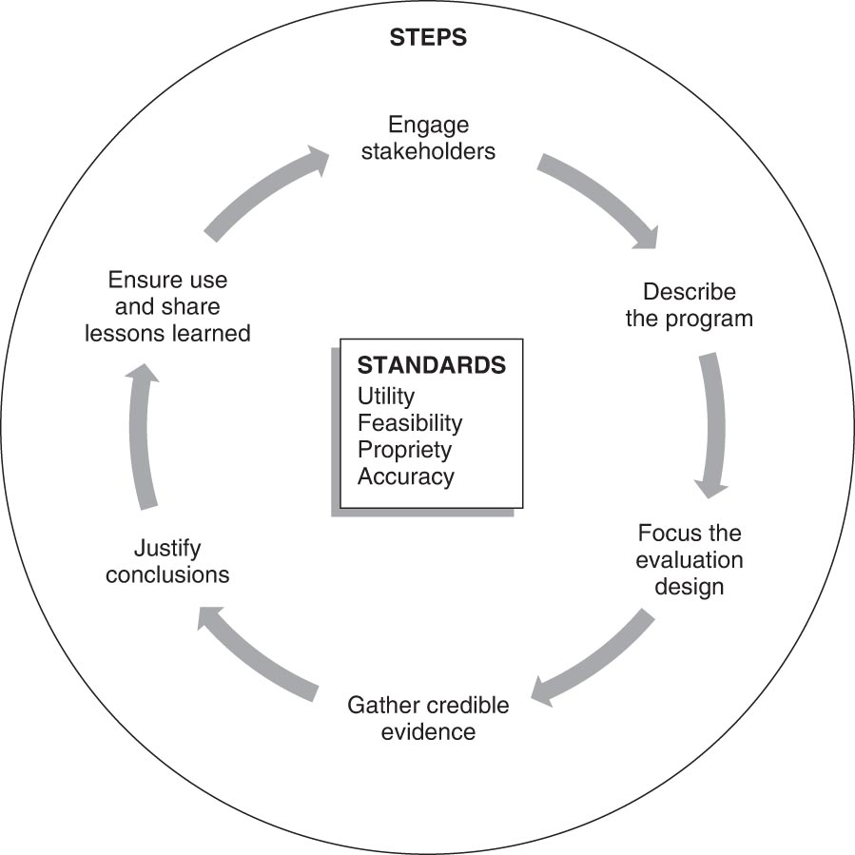
Framework for Program Evaluation – 1

Slide 9
Framework for Program Evaluation – 2
Step 1 – Engaging Stakeholders
  Who are the stakeholders?
    Those involved in program operations
    Those served or affected (directly or indirectly) by the program
    Primary users of the evaluation results
  The scope and level of stakeholder involvement will vary with each program being evaluated.
Step 2 – Describing the Program
  Sets the frame of reference for all subsequent decisions in the evaluation process
  Describes mission, goals, objectives, capacity to affect change, stage of development, and how it fits into the larger community
  Logic model can be used

Slide 10
Framework for Program Evaluation – 3
Step 3 – Focusing the Evaluation Design
  Makes sure the interests of stakeholders are addressed
  Identifies reason of evaluation, how it will be used, questions to be asked, design of evaluation, and finalizes any agreements about the process
Step 4 – Gathering Credible Evidence
  Decides on measurement indicators, sources of evidence, quality and quantity of evidence, and logistics for collecting evidence
  Organizes data including specific processes related to coding, filing, and cleaning

Slide 11
Framework for Program Evaluation – 4
Step 5 – Justifying Conclusions
  Comparing the evidence against the standards of acceptability
  Judging the worth, merit, or significance of the program
  Creating recommendations for actions based on results
Step 6 – Ensuring Use and Sharing Lessons Learned
  Use and dissemination of the results
  Needs of each group of stakeholders addressed
Four standards of evaluation:
  Utility standards
  Feasibility standards
  Propriety standards
  Accuracy standards

Slide 12
Practical Problems or Barriers in
Evaluation – 1
Planners either fail to build evaluation in the planning process or do so too late.
Adequate resources may not be available to conduct an appropriate evaluation.
Organizational restrictions may prevent hiring consultants and contractors.
Effects are often hard to detect because changes are sometimes small, come slowly, or do not last.
Length of time allotted for the program and its evaluation is not realistic.
Restrictions may limit the collection of data among the priority population.

Slide 13
Practical Problems or Barriers in
Evaluation – 2
It is difficult to make an association between cause and effect.
It is difficult to evaluate multi-strategy interventions.
Discrepancies between professional standards and actual practice exist with regard to appropriate evaluation design.
Evaluators’ motives to demonstrate success introduce bias.
Stakeholders’ perceptions of the evaluation’s value may vary too drastically.
Intervention strategies are sometimes not delivered as intended or are not culturally specific.

Slide 14
Evaluation in the Program Planning Stages
Evaluation design must reflect the goals and objectives of the program.
The evaluation must be planned in the early stages of development and be in place before program begins.
Baseline data – those reflecting the initial status or interests of the participants; from a needs assessment
Initial data regarding the program should be analyzed promptly to make any necessary adjustments to the program.
By creating the summative evaluation early in the planning process, planners can ensure that the results are less biased.

Slide 15
Ethical Considerations
Evaluation or research should never cause mental, emotional, or physical harm to those in the priority population.
Participants should always be informed of the purpose and potential risks and should give consent.
No individual should ever have his or her personal information revealed in any setting or circumstance.
When appropriate, evaluation plans should be approved by institutional review boards (IRBs).

Slide 16
Who Will Conduct the Evaluation? – 1
Internal Evaluation
  An individual trained in evaluation and personally involved with the program conducts the evaluation.
  Advantages
    More familiar with organization and program history
    Knows decision-making style of those in the organization
    Present to remind people of results now and in the future
    Able to communicate results more frequently and clearly
    Less expensive
  Disadvantages
    Possibility of evaluator bias or conflict of interest

Slide 17
Who Will Conduct the Evaluation? – 2
External Evaluation
  Conducted by someone who is not connected with the program (Evaluation consultant)
  Advantages
    More objective review and fresh perspective
    Can ensure unbiased evaluation outcome
    Brings global knowledge of working in a variety of settings
    Typically brings more breadth and depth of technical expertise
  Disadvantages
    More expensive
    Can be somewhat isolated, often lacking knowledge of and experience with the program
Evaluator should be credible and objective, have a clear role in evaluation design, and accurately report findings.

Slide 18
Evaluation Results
Who will receive the results of the evaluation?
Different aspects of the evaluation can be stressed, depending on the group’s particular needs and interests.
Different stakeholders may want different questions answered.
The planning for the evaluation should include a determination of how the results will be used.

