Slide 1
Chapter 14: Evaluation Approaches and Designs

Slide 2
Introduction
Approaches
Refers to formative, process, and summative evaluation and suggests these types of evaluation are clearly distinct
Designs
Relates to summative evaluation; experimental, quasi-experimental, and nonexperimental

Slide 3
Formative Evaluation
Formative evaluation focuses on the quality of program content and program implementation.
Collects data and informs stakeholders of important findings that could potentially improve a program or its delivery, and allows for appropriate changes before the program is fully implemented and completed
Occurs before the start of the implementation phase and helps ensure that a program and its elements have been conceptualized and developed appropriately
Informs and guides the development and implementation of a program as it actually unfolds
There are 15 elements of a comprehensive formative evaluation.

Slide 4
Elements of Formative Evaluation – 1
Justification
Degree to which program is mandated/approved by stakeholders
Evidence
Degree to which program is evidence-based
Capacity
Extent to which professionals have adequate knowledge, skills, and abilities to design and implement the program
Resources
Adequacy of resources (e.g., budget, community resources or assistance, assets, time, etc.)
Cost-identification analysis: compares different interventions available for a program to determine which intervention would be the least expensive

Slide 5
Elements of Formative Evaluation – 2
Resources (cont’d)
Cost-benefit analysis: looks at how resources can best be used. It will yield the dollar benefit received from the dollars invested in the program.
Cost-effectiveness analysis: quantifies the effects of a program in monetary terms.
Customer Orientation
Degree to which the program is adapted to the needs of the priority population
Multiplicity
Degree to which multiple components are built into the program
Support
Degree to which a support component is built into the intervention

Slide 6
Elements of Formative Evaluation – 3
Inclusion
Extent to which an adequate range and number of participants are involved in the program
Accountability
Extent to which the staff is fulfilling its responsibilities
Adjustment
Degree to which programs, services, or activities are modified based on feedback received from participants, partners, or other stakeholders
Recruitment
Degree to which members of the priority population are adequately recruited through appropriate channels and places consistent with cultural and other unique characteristics

Slide 7
Elements of Formative Evaluation – 4
Reach
Proportion of priority population given the opportunity to participate in the program
Response
Proportion of priority population actually participating in the program
Interaction
Quality of interactions between planners and the participants (e.g., customer service)
Satisfaction
Degree to which the needs of participants are being met, how satisfied they are with the program, service, or activity, and their belief that a positive impact is being made in their lives

Slide 8
Process Evaluation
In contrast to a formative evaluation, a process evaluation looks back on the implementation process and measures what went well and what went poorly.
Main objectives are to describe:
How closely the program implementation followed protocols
How successful it was in recruiting and reaching members of the priority population
How many people participated or how many products or services were distributed
Other factors that may have competed with or confounded program results

Slide 9
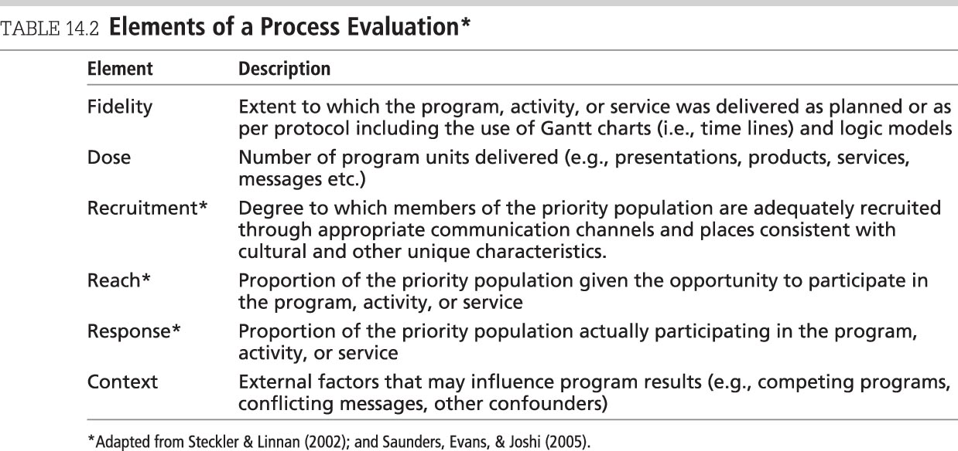
Elements of a Process Evaluation

Slide 10
Procedures Used in Formative Evaluation
Focus groups
Surveys
In-depth interviews
Informal interviews
Key informant interviews
Expert panel reviews
Quality circles
Protocol checklist
Gantt chart
Program and evaluation forms
Direct observation

Slide 11
Pretesting and Pilot Testing – 1
Pretesting
Testing components of a program prior to implementation–relates to formative evaluation
Collecting baseline data prior to program implementation that will be compared with posttest data to measure the effectiveness of programs
Assumes that program components have already been reviewed for evidence

Slide 12
Pretesting and Pilot Testing – 2
Pilot Testing (also called field testing or alpha testing)
Assesses programs in limited areas and/or time periods (NCI, 2002)
Allows for “dry runs” to measure overall program quality
Generally involves collecting data from program participants

Slide 13
Summative Evaluation
Though formative and process evaluation is critical in the success of effective programs, planners/evaluators must also measure program effectiveness.
Summative evaluation includes both impact (immediate indicators) and outcome (long-term program indicators) evaluation.
Confounding variable
An additional variable that modifies the relationship between a risk factor or some other determinant and an outcome
An evaluation design is used to organize a summative evaluation and to provide for planned, systematic data collection, analysis, and reporting.

Slide 14
Selecting an Evaluation Design – 1
The following questions may be helpful in the selection of a design for summative evaluation:
How much time do you have to conduct the evaluation?
What financial resources are available?
How many participants can be included in the evaluation?
Are you more interested in qualitative or quantitative data?
Do you have data analysis skills or access to statistical consultants?
Is it important to be able to generalize your findings to other populations?
Are the stakeholders concerned with validity and reliability?
Do you have the ability to randomize participants into experimental and control groups?
Do you have access to a comparison group?

Slide 15
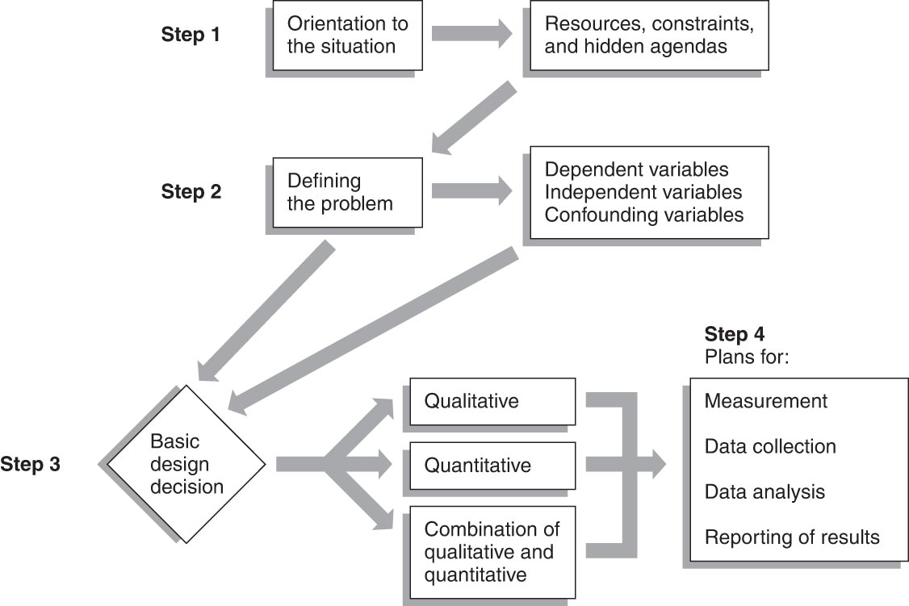
Steps in Selecting an Evaluation Design

Slide 16
Selecting an Evaluation Design – 2
Two possible methods of data collection:
Quantitative (deductive; applying principle to case)
Produces numeric (hard) data, such as counts, ratings, scores, or classifications
Suited to programs that are well defined
It is the method most often used in evaluation designs.
Qualitative (inductive; examining case to form principle)
Produces narrative data, such as words and descriptions
This is a good method to use for programs that emphasize individual outcomes or in cases where other descriptive information from participants is needed.
Useful in gathering information to improve the program during process evaluation.
Rather than choose one method, it may be advantageous to combine quantitative and qualitative methods.

Slide 17
Qualitative Methods Used in Evaluation*
Case studies
Content analysis
Delphi technique
Ethnographic studies
Film ethnography
Focus groups
Historical analysis
In-depth interviewing
Nominal group process
Participant-observer studies
Quality circle
Unobtrusive techniques
*(McDermott & Sarvela, 1999)

Slide 18
Experimental, Control, and Comparison Groups – 1
Experimental Group
The group of individuals who receive the intervention
Control Group
Should be similar to the experimental group, but the individuals in this group do not receive the intervention
Individuals should be randomly assigned to this group

Slide 19
Experimental, Control, and Comparison Groups – 2
Comparison Group
When individuals cannot be randomly assigned to an experimental or control group, a nonequivalent group may be formed.

Slide 20
Evaluation Designs – 1
Measurements used in evaluation designs can be collected at three different times:
After the program
Both before and after the program
Several times before, during, and after the program
Pretest
Measurement before the program begins
Posttest
Measurement after the completion of the program

Slide 21
Evaluation Designs – 2
There are three types of evaluation designs.
Experimental design
Offers the greatest control over the confounding variables
Involves random assignment to experimental and control groups with measurement of both groups
Produces the most interpretable and defensible evidence of effectiveness

Slide 22
Evaluation Designs – 3
Quasi-experimental
Results in interpretable and supportive evidence of program effectiveness
Usually cannot control all factors that affect the validity of the results
No random assignment to the groups
Comparisons are made on experimental and comparison groups.
Nonexperimental
Without the use of a comparison or control group, has little control over the factors that affect the validity of the results

Slide 23
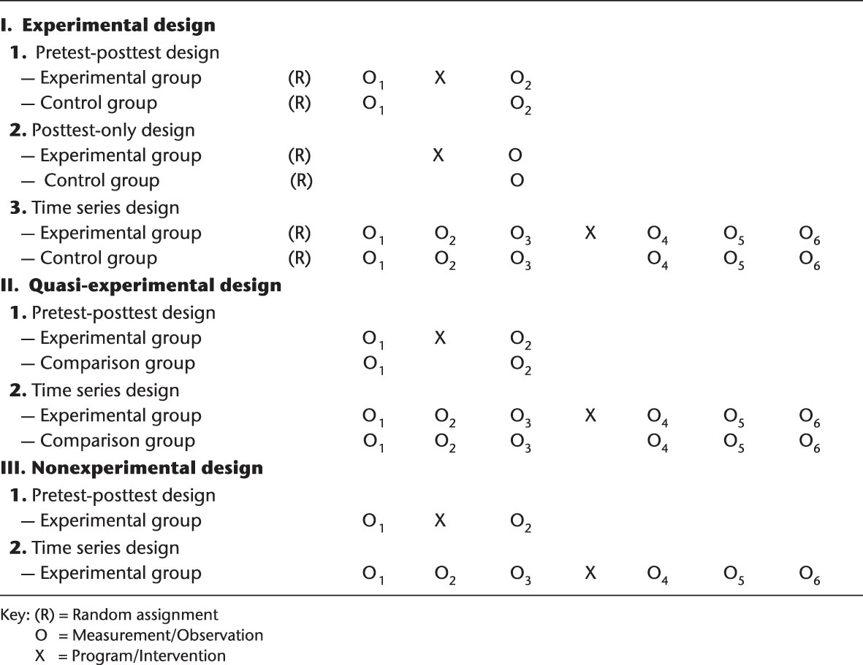
Evaluation Designs

Slide 24
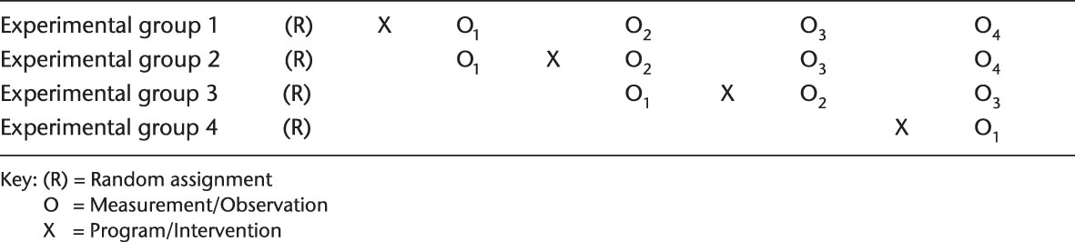
Staggered Treatment Design

Slide 25
Internal Validity
Internal Validity
The degree to which change that was measured can be attributed to the program and allows evaluators to speak with more confidence that the program itself actually made a difference (Issel, 2014)
Many factors can threaten internal validity, either singly or in combination, making it difficult to determine if the outcome was brought about by the program or some other cause.
Most threats to internal validity can be controlled through randomization.

Slide 26
Threats to Internal Validity
O₁ X O₂
History
Maturation
Testing (e.g., pretesting)
Instrumentation
Statistical regression
Selection
Attrition
Interaction
Compensatory equalization of treatments
Compensatory rivalry
Resentful demoralization
Interaction of several threats

Slide 27
External Validity – 1
External Validity
The extent to which the program can be expected to produce similar effects in other populations
Factors that threaten external validity are sometimes known as reactive effects, since they cause individuals to react in a certain way.

Slide 28
External Validity – 2
Threats to external validity can also be counteracted by making a greater effort to treat all subjects identically.
Blind study: the participants do not know to what group they have been assigned.
Double blind study: the type of group participants are in is not known by either the participants or the planners.
Triple blind study: this information is not available to the participants, planners, or evaluators.

Slide 29
Threats to External Validity
Social desirability
Expectancy effect
Hawthorne effect
Placebo effect
Priority Population #1
Priority Population #2

