Slide 1
Chapter 15: Data Analysis and Reporting

Slide 2
Data Management
Includes coding, cleaning, and organizing data into a usable format (preparing for analysis)
Coding
assigning labels so data can be read and understood by a computer
1 = yes, 2 = no
Cleaning
making sure the values are valid and consistent (e.g., if 1 = true and 2 = false, there should be no 3s)

Slide 3
Data Analysis – 1
Variables
Characteristics or attributes that can be measured or observed (Creswell, 2002)
Types of variables:
Independent
Controlled or cause or exert some influence
Gender, race, age
Dependent
Are outcome variables that are being studied
Attitudes, beliefs, knowledge, skills

Slide 4
Data Analysis – 2
Descriptive Statistics
Used to organize, summarize, and describe characteristics of a group
Inferential Statistics
Concerned with relationships and causality to make generalizations about a population based on findings from a sample
Three types of statistical analyses:
Univariate (one variable)
Bivariate (two variables)
Multivariate (more than two variables)
Not all analytical techniques can be used with all levels of measurement.

Slide 5
Data Analysis – 3
Parametric tests
Assume a normal distribution curve
Non-parametric tests
Assume the distribution curve is skewed
A more basic distinction between parametric and non-parametric tests is that if your measurement scale is nominal or ordinal then you use non-parametric statistics. If you are using interval or ratio scales, then use parametric statistics.

Slide 6
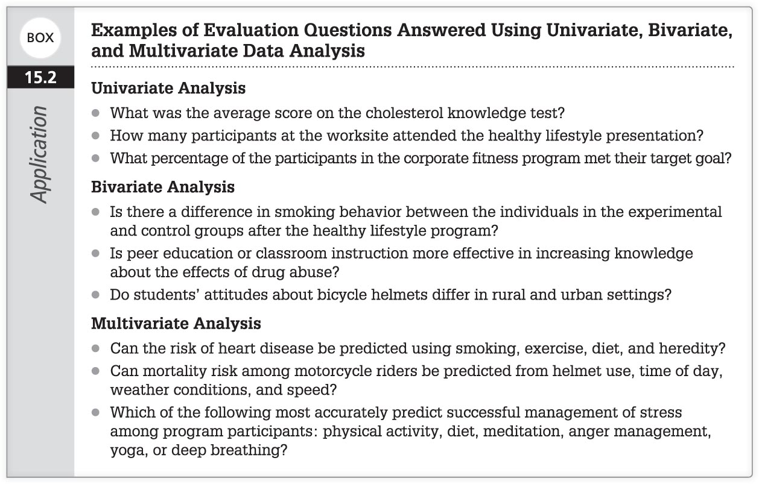
Examples of Evaluation Questions Answered Using Univariate, Bivariate, and Multivariate Data Analysis

Slide 7
Univariate Data Analyses
Examine one variable at a time.
Summary Counts
Frequency distributions
Measures of Central Tendency
Mean, median, and mode
All are useful in describing the results and will be helpful if extreme scores are found.
Measures of Spread or Variation
Range, standard deviation, variance
Used to determine whether scores from groups are similar or spread apart

Slide 8
Bivariate Analyses – 1
It is common to state evaluation questions in the form of hypotheses.
Types of hypotheses:
Null—no observed difference between groups
Alternative—there is a difference between groups
Statistical significance—“refers to whether the observed differences between the two or more groups are real or not, or whether they are chance occurrences” (McDermott & Sarvela, 1999, p. 300)

Slide 9
Bivariate Analyses – 2
Types of null hypothesis errors:
Type I error—failing to reject when the null hypothesis is true
Type II error—failing to reject when the null hypothesis is not true
Level of significance (alpha level)—probability of making a type I error; e.g., p < 0.01

Slide 10
Bivariate Analyses – 3
Statistical tests used in bivariate analysis include:
Chi-square:
Measures the association between two nominal and/or ordinal variables
t-test (numerical):
Studies group differences when the dependent variables involve interval or ratio data
Dependent (one group twice) or independent (two groups once)
Analysis of variance (ANOVA; numerical):
Like t-test, more commonly used to study differences between more than two groups
Correlations (numerical):
Used to study the strength and direction of relationships between two variables
Only indicates a relationship, not cause and effect

Slide 11
Correlations
positive
negative
greater

Slide 12
Multivariate Data Analyses – 1
Used to study three or more variables simultaneously
Examples of multivariate analyses include multiple regression, discriminant analysis, and factor analysis.
Multiple regression is the most commonly used.

Slide 13
Multivariate Data Analyses – 2
Multiple Regression
Useful in exploring relationships among variables or in exploring the independent effects of many variables on one dependent variable
Many types, including:
Stepwise
Logistic
General linear

Slide 14
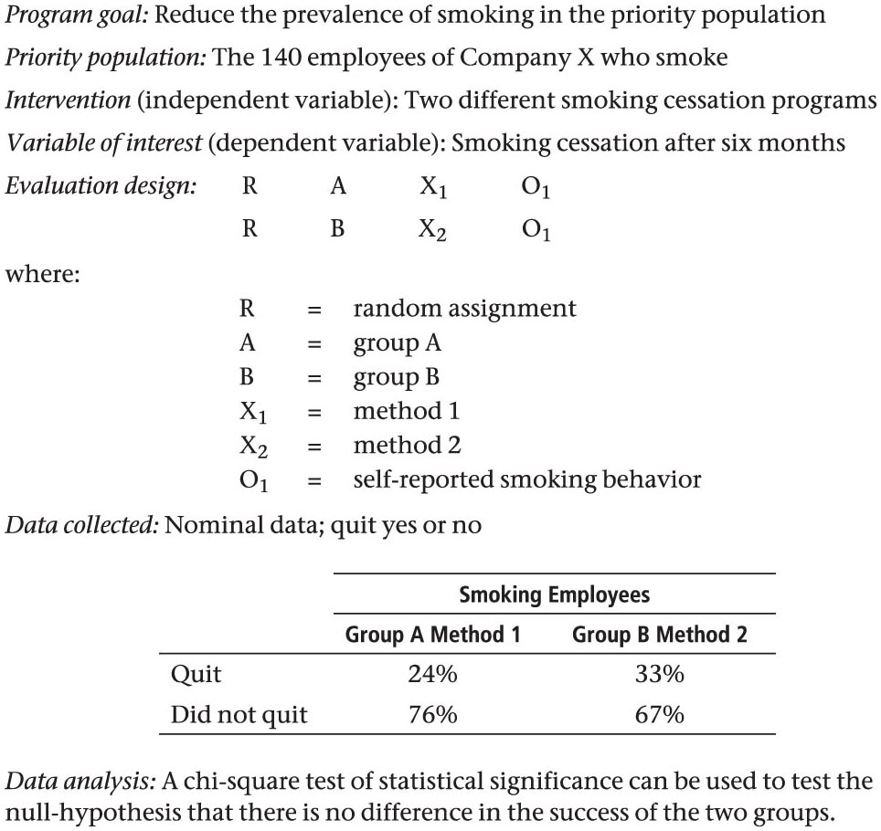
Application of Data Analyses – 1
Case #1

Slide 15
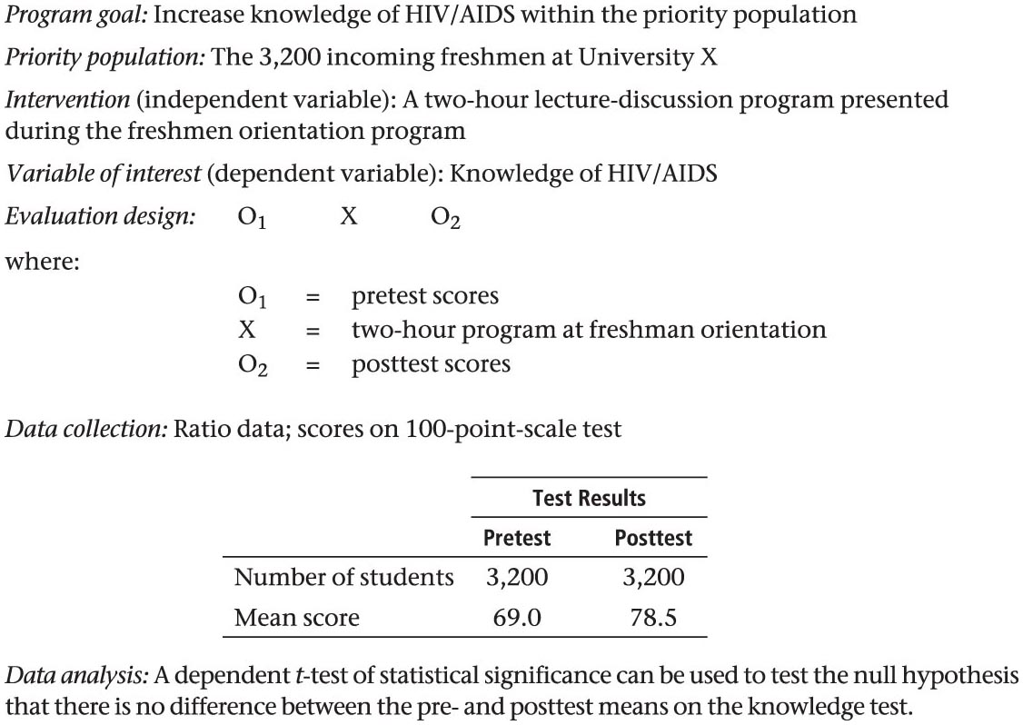
Application of Data Analyses – 2
Case #2

Slide 16
Interpreting the Data
To ensure that the interpretation is fair and as objective as possible, the interpretation should not be the sole responsibility of the evaluator or any other single person.
Program significance measures the meaningfulness of a program (based on stakeholder preferences), regardless of statistical significance.
Statistical significance is determined by statistical testing.
It is possible to have statistically significant results that indicate gains in performance but are not meaningful in terms of program goals.

Slide 17
Eight Methods of Interpreting Data*
Determining whether objectives have been achieved
Determining whether laws, democratic ideals, regulations, or ethical principles have been violated
Determining whether assessed needs have been reduced
Determining the value of accomplishments
Asking critical reference groups to review the data and to provide their judgments of successes and failures, strengths, and weaknesses
Comparing results with those reported by similar entities or endeavors
Comparing assessed performance levels on critical variables to expectations of performance or standards
Interpreting results in light of evaluation procedures that generated them
*(Fitzpatrick et al., 2004)

Slide 18
Evaluation Reporting – 1
An evaluation report is incorporated into a final report that is presented to stakeholders.
The evaluation report is essential and can provide (Wurzbach, 2002):
A critical analysis of the results
A tangible product
Evidence that program or materials were carefully developed
A record of activities for use in planning future programs
Assistance to others who may be interested in developing a similar program
A foundation for evaluation activities in the future

Slide 19
Evaluation Reporting – 2
The number and type of reports required are determined at the beginning of the evaluation based on the needs of the stakeholders.
Formative evaluation
Reports are needed early and may be provided on a weekly or monthly basis.
Summative evaluation
Report is more formal and may resemble a scientific paper that can be submitted to a journal for publication.

Slide 20
Evaluation Reporting – 3
At times, more than one method should be selected in order to meet the needs of all stakeholders.
The evaluator must fit the report to the audience as well as prepare for a negative response if the results of the evaluation are not favorable.

Slide 21
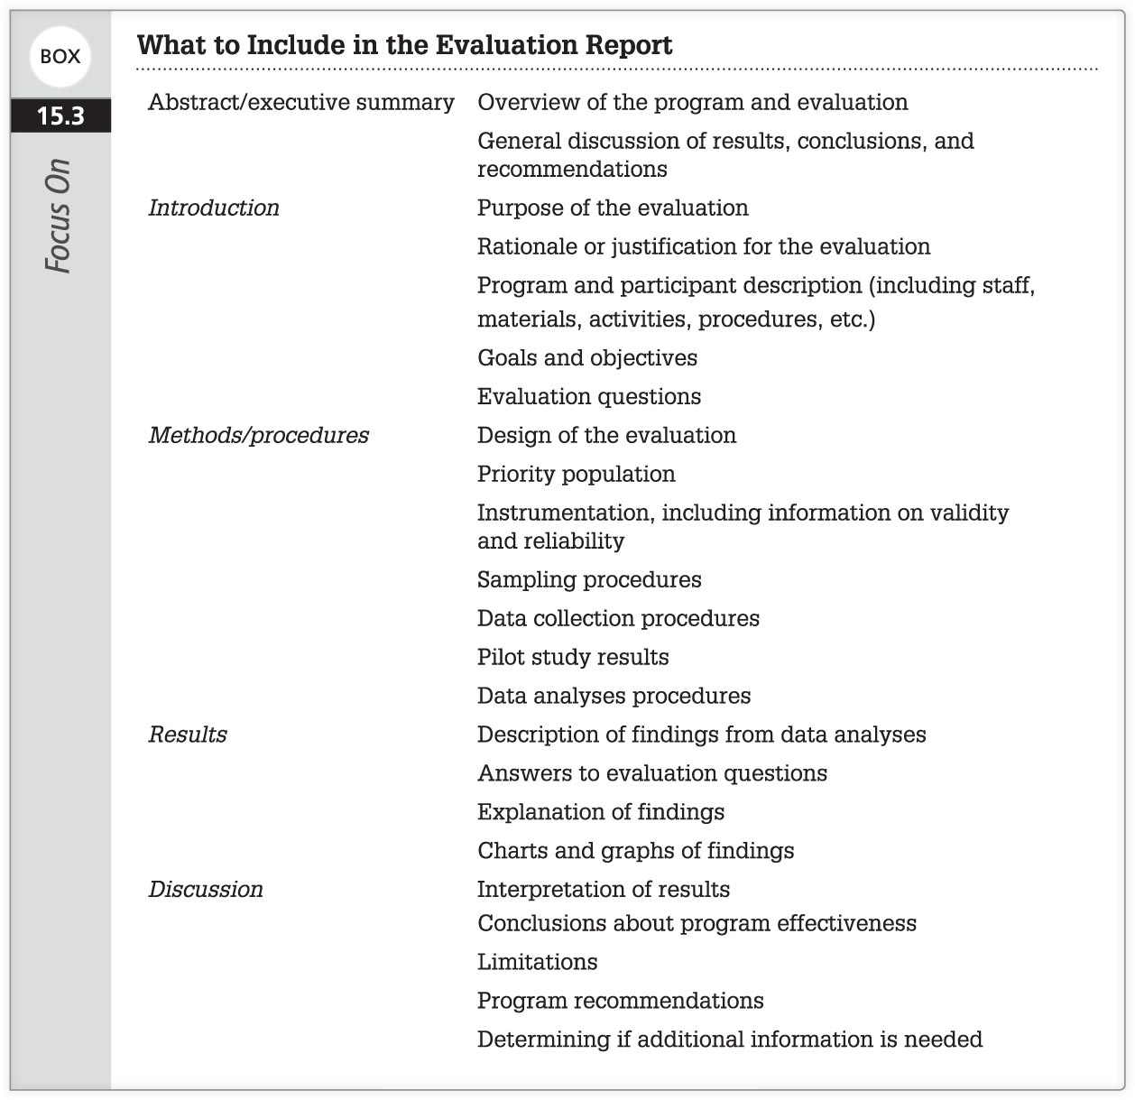
Designing the Written Report

Slide 22
Presenting Data – 1
Data presentation should be simple and straightforward.
Tables and graphs can
help illustrate certain findings
make reports easier to read
understand findings, be self-explanatory

Slide 23
Presenting Data – 2
Use graphic displays that are appropriate for the results.
Horizontal bar charts—focus attention on different categories
Vertical bar charts—focus attention to change over time
Cluster bar charts—to contrast one variable from others
Line graphs—to plot data and show a trend over time
Pie charts—to show distribution of a set of events or a total quantity
Brownie pans—to show proportions of data
Pictographs—to show pictorial representations of data

Slide 24
How and When to Present the Report
Evaluators must consider the logistics of presenting the evaluation findings and should be discussed with decision makers.
A few suggestions:
Give key decision makers advanced information of the findings.
Maintain anonymity of individuals, institutions, and organizations; use sensitivity to avoid judging or labeling; maintain confidentiality according to wishes of administrators; maintain objectivity (Windsor et al., 2004).
Choose ways of reporting that meet the needs of stakeholders.

Slide 25
Increasing the Utilization of the Results*
Plan the study with stakeholders in mind.
If the program changes after the planning stage, so should the evaluation.
Focus the evaluation on conditions about the program that the decision makers can change.
Reports should be written in a clear, simple manner.
The decision on making recommendations should be based on how clear the data are, how much is known about the program, and whether differences between programs are obvious.
Disseminate the results to all stakeholders using a variety of methods.
Integrate the evaluation findings with other research and evaluation about the program.
Provide high-quality research.
*(Weiss, 1984)

