Slide 1

Chipotle Business Assessment
Name:
Institution:
Date:

Slide 2
Introduction
International commerce and globalization require strategic management
Strategic management involve use of tools
Notable tool is PESTLE
PESTLE addresses:
Political Issues
Economic
Sociocultural changes
Technology and innovation
Legal parameter
Ecological actors

Slide 3
Background information
Chipotle Mexican Grill, Inn
Incorporated in Delaware
First head offices at New York and Denver, Colorado
Relocated in 2018
610 Newport Center Drive, Suite-1300 Newport Beach, California
SIC CODE 5812 : for Eating Places
NAICS Codes 722511: FULL-SERVICE RESTAURANT

Slide 4

History of the Chipotle
Founder and former CEO
Began as an experimental venture
From a loan of $85,000
Initial as sale target of 107 burritos per day
Surged to 1000 burritos per

Slide 5

International commerce: Reasons
Impetus for Going International
Need to Embrace Changes
Surpassing initial business targets
Maximize the new paradigm
Expand market growth
Excess capital
Need to embrace changes

Slide 6
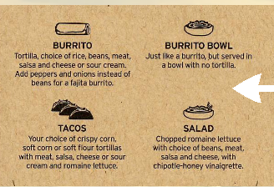
General market screening
Need Potential for Product
Star Portfolio
Revolution in Nordic food culture
Need for wellness and health food options
Consumers changes in preferences for casual-dining
Providing flexibility and variability
Enhance social engagement

Slide 7
Economic and financial scanning
Economic actors that influence living standards
Change in GDP per capita
Annual GDP growth
Consumption and Investment variations per year
Unemployment rate
Public Debt as a percentage of GDP
Financial conditions also affect the ability to buy goods and services

Slide 8
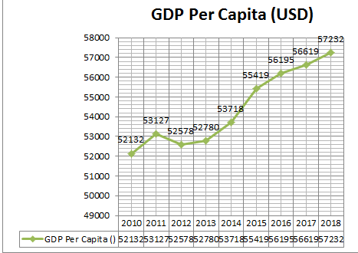
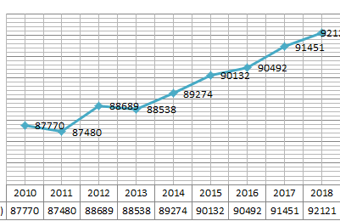
Economic trends for target markets
Sweden GDP per capita
Norway GDP per Capita

Slide 9
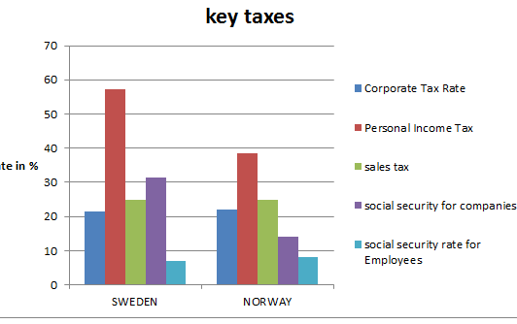
Political and Legal screening

Slide 10
Key taxes
Business consider the cadres of tax regimes before investing in a foreign market
Key taxes include;-
Corporate Tax-levied on the income generated
Sales tax- affects the revenue-maximization
Personal income tax- can discourage expatriates from joining
social security rate for employees influence the attractiveness from an expatriate standpoint

Slide 11
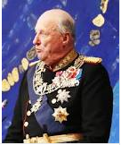
Political and Legal
Harald V of Norway
Political stability attract foreign investors
Both Norway and Sweden are stable
Constitutional monarchy and parliamentary democracy
Recently held elections

Slide 12
Sociocultural screening
Norway’s recent population =5,295,619
Sweden’s population= 10,230,000 people
High population provides ready market
life expectancy rate: Norway=82.90years
:Sweden=81.9 years
Life expectancy induces the type of living standard
Both target market have a high life expectance rate

Slide 13
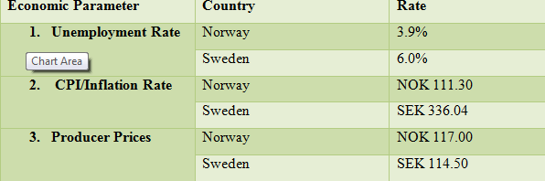
Competitive screening

Slide 14
Competitive screening
Key indicators of competitiveness of a target market;
Unemployment Rate: determines the standard of living.
Higher unemployment rate, low purchasing power
Norway has a low unemployment rate
Inflation Rate:
Affects the price of commodities
Higher inflation rate, reduces the demand

Slide 15
Levels of Entry Barriers
Swedish and Norwegian government strives to achieve zero barriers to entry
Favorable government policies and tax regime
Minimal limitation of profit expatriation
Norway rank 6 out of 286 countries on ease of doing business
Both countries are signatories to European Economic Area for Free Trade
Norway utilizes promotional programs

Slide 16
Political risks
Minimal for both Norway and Sweden
Continuous investment on anti-terrorism
Norway experienced an attack in 2011
77 lives lost due to terror-related crime
Norway has a better rating on transparency and minimal corruption cases
Corruption discourages foreign investors
Continuous investment from both government to eradicate unethical practices

Slide 17
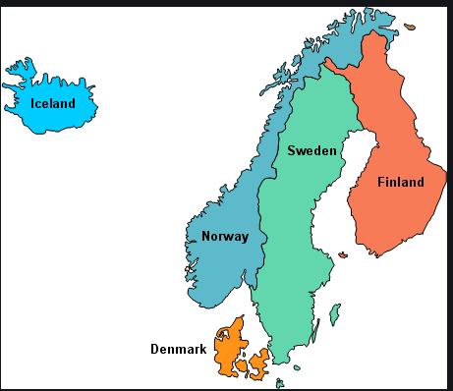
Topology of the Nordic Nations

Slide 18
Final screening: investment destination
Overall, SWEDEN provides an edge for the Chipotle Mexican Grill, Inc
Reasons:
High population and growth potential
The climatic condition in Sweden facilitate the company to plant key spices
Equal rainfall distribution in Sweden eliminate the spatial density population experience in Norway
Gender-egalitarian in Sweden enhances the attractiveness of the country to foreign investors

Slide 19
Plan for Future research
Chipotle should utilize a FDI entry strategy
The protracted political stability and economic growth sustain the attractiveness of the Swedish market
However, the use of FDI strategy requires continued scanning on the new market
PESTLE model provides the key parameters that influences the effectiveness of a market
E.g. Chipotle need to evaluate the political sphere after four years

Slide 20
Conclusion and recommendation
Need to maximize the benefits of international commerce
Business requires strategic management and assessment capabilities
Knowledge in PESTLE as a management tool is key
PESTLE tool outlays the attractiveness of Sweden market
The positive growth in the domestic market provides an impetus to venture into international market

Slide 21
References
Chipotle.com. (2019). Chipotle Mexican Grill, Inc.
Daszkowski, D. (2018, December 12). “The history of Chipotle Mexican Grill,” The Balanesmb.
European Custom Portal. (2019). HS code, customs tariff number, tariff guide-European Database, Brussels, Belgium: AUTHOR Focus-Economics. (2019, February 26). “Nordic economic outlook,” AUTHOR,
Mäkelä, J., Lillebø, K. & Lammi, M. (2011). Nordic young health: Possibilities and barriers for new healthy concepts in the fast food sector, Oslo, Norway: Nordic Innovation
Nordic Council of Minister. (2015). Proceedings from the Program New Nordic Food II, 2010-2014: For the final report on the emergence of a new Nordic food culture, (Pages 4-70), Copenhagen, Denmark: Norden. OECD (2019), Population (indicator).

Slide 22
references
Plowman, S. (April 2019), "A strategic audit of Chipotle Mexican Grill, Inc." Honors Theses, University of Nebraska-Lincoln, Issue 141
Rehn, C., Kindgren-Bengtsson, C., Myrén, J. & Norderyd, J., Lindahl, A. (2019, February 1). Doing business in Sweden: Overview, London, UK: Thomson-Reuters
SEC. (2018, December 31). Chipotle Mexican Grill, Inc. Form 10-K, Washington, DC.: AUTHOR
SICCODE.com. (2019). Chipotle Mexican Grill, Inc. AUTHOR.
Solberg, S. (2018, February 23). “Norway implements new rules controlling foreign ownership,” The Global Compliance News, Statistic Norway. (2019, November 20). “Key figure for the population,” AUTHOR. U.S. Department of State. (2015 May). 2015 Investment climate survey-Norway, Washington, DC: AUTHOR.
Weather Online. (n.d.). Climate of the world. Whitten, S. (2018, May 23). “Chipotle to close Denver, New York offices and move headquarters to Southern California,” The CBNC,). Economic Data, Washington, DC

