Slide 1

International Business: The New Realities
Fifth Edition
Chapter 2
Globalization of Markets and the Internationalization of the Firm
Slide in this Presentation Contain Hyperlinks. JAWS users should be able to get a list of links by using INSERT+F7
Copyright © 2020 Pearson Education, Inc. All Rights Reserved

Slide 2
Learning Objectives
2.1 Understand market globalization as an organizing
framework.
2.2 Learn the driving forces of globalization.
2.3 Understand the impact of technological advances and
globalization.
2.4 Learn the dimensions of globalization.
2.5 Understand firm-level consequences of market
globalization.
2.6 Understand the societal consequences of
globalization.

Slide 3
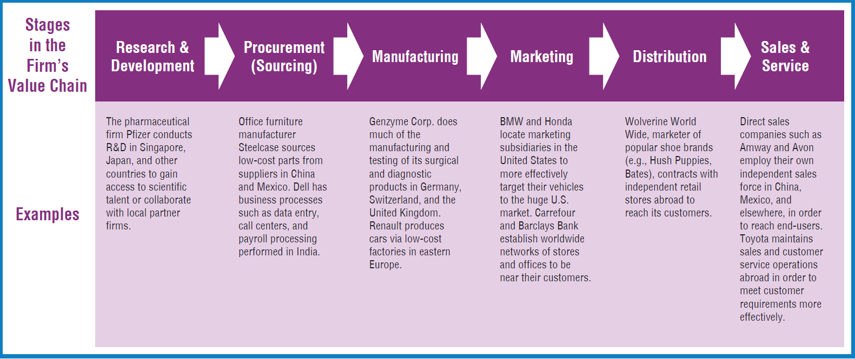
Internationalization of the Firm’s Value Chain (1 of 2)
The value chain refers to management expert and author Michael Porter's concept that shows the systematic process of products as they move through all value generating activities from initial development through final sale and service.

Slide 4

Overview on Globalization of Markets
Globalization and technological advances have altered the international business landscape more than any other trends.
In this class, globalization refers to the interconnectedness of national economies and
the growing interdependence of buyers, producers, suppliers, and governments around the world.
Globalization allows firms to view the world as one large marketplace for goods, services, capital, labor, and knowledge.

Slide 5

The System Approach to Globalization

Slide 6
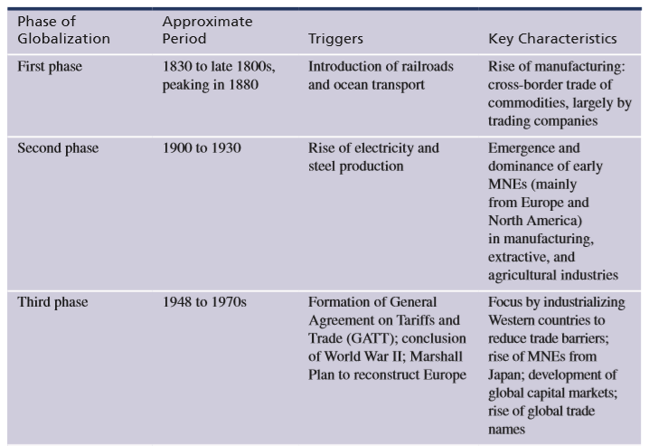
Phases of Globalization (1 of 2)
Notes:
Globalization of markets refers to the gradual integration and growing interdependence of national economies. Early civilizations in the Mediterranean, Middle East, Asia, Africa, and Europe all contributed to the growth of cross-border trade. Today’s international trade was triggered by world events and technological discoveries and has progressed in phases, particularly since the early 1800s. The current phase was stimulated particularly by the rise of IT, the Internet, digital platforms, and other advanced technologies.

Slide 7
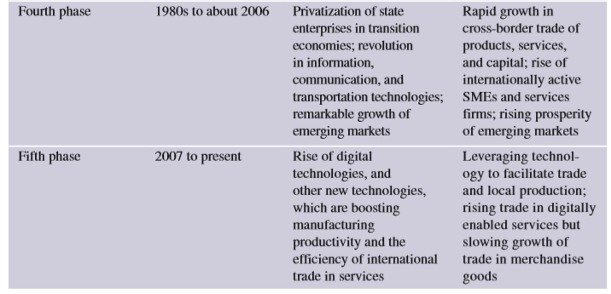
Phases of Globalization (2 of 2)

Slide 8
The Death of Distance
In This Time Period... | Fastest Transportation Was Via | At a Speed of...
1500 to 1840s | • Human-powered ships and horse-drawn carriages | 10 miles per hour
1850 to 1900 | • Steamships • Steam locomotive trains | 36 miles per hour 65 miles per hour
Early 1900s to today | • Motor vehicles • Propeller airplanes • Jet aircraft | 75 miles per hour 300-400 miles per hour 500-700 miles per hour

Slide 9

Globalization Explained

Slide 10
The Driving Forces, Dimensions, and
Consequences of Market Globalization (1 of 4)
Driving Forces of Market Globalization
Worldwide reduction of barriers to trade and investment
Market liberalization and adoption of free trade (e.g., in China, former Soviet Union countries, and elsewhere)
Industrialization, economic development, and modernization
Integration of world financial markets
Advances in technology

Slide 11
The Driving Forces, Dimensions, and
Consequences of Market Globalization (2 of 4)
2. Dimensions of Market Globalization
Integration and interdependence of national economies
Rise of regional economic integration blocs
Growth of global investment and financial flows
Convergence of buyer lifestyles and preferences
Globalization of production activities
Globalization of services

Slide 12
The Driving Forces, Dimensions, and
Consequences of Market Globalization (3 of 4)
3a. Firm-level Consequences of Market Globalization: Internationalization of the Firm’s Value Chain
Countless new business opportunities for internationalizing firms
New risks and intense rivalry from foreign competitors
More demanding buyers who source from suppliers worldwide
Greater emphasis on proactive internationalization
Internationalization of firm’s value chain

Slide 13
The Driving Forces, Dimensions, and
Consequences of Market Globalization (4 of 4)
3b. Societal Consequences of Market Globalization
Contagion: Rapid spread of financial or monetary crises from one country to another
Loss of national sovereignty
Offshoring and the flight of jobs
Effect on the poor
Effect on the natural environment
Effect on national culture

Slide 14

Dimensions of Market Globalization (1 of 3)
Integration and interdependence of national economies. Results from firms’ collective international activities. Governments contribute by lowering trade and investment barriers.
Rise of regional economic integration blocs. Free trade areas are formed by two or more countries to reduce or eliminate barriers to trade and investment, such as the E U, N A F T A, and M E R C O S U R.

Slide 15

Dimensions of Market Globalization (2 of 3)
Growth of global investment
and financial flows.
Associated with rapid growth
in foreign direct investment
(FDI), currency trading, and
global capital markets.
Convergence of buyer lifestyles and preferences. Facilitated by global media, which emphasize lifestyles found in the U.S., Europe, or elsewhere. Firms market standardized products.

Slide 16
Dimensions of Market Globalization (3 of 3)
Globalization of production. To cut costs, firms manufacture in low labor-cost locations such as Mexico and Eastern Europe. Firms also source services from abroad.
Globalization of services. Banking, hospitality, retailing, and other service industries are rapidly internationalizing. Firms outsource business processes and other services in the value chain to vendors overseas. And, in a new trend, many people go abroad to take advantage of low-cost services.

Slide 17
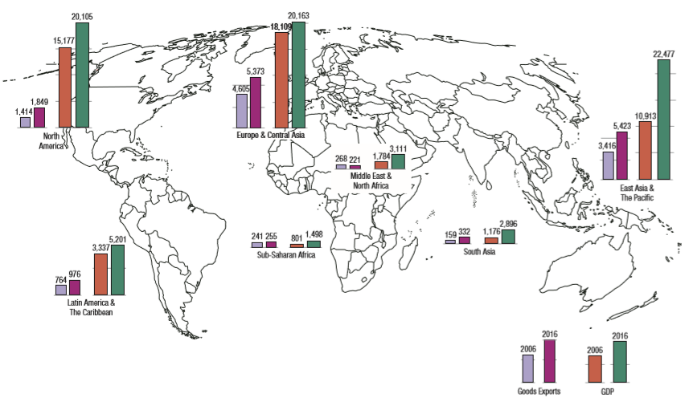
Relationship Between Trade and GDP Growth, in Billions of U.S. Dollars
Source: Based on World Bank, Data, 2018, www.worldbank.org.
Notes:
The exhibit shows the relationship between trade and gross domestic product (GDP). In this exhibit, trade is expressed as the volume of merchandise exports, and GDP measures the volume of goods and services production. The exhibit suggests that countries that undertake the most international trade, and whose trade levels have sharply increased in the past decade, also enjoy high and rapidly rising GDP.

Slide 18
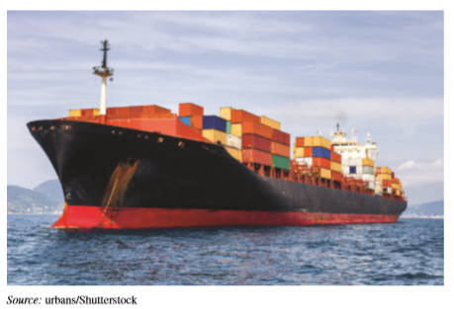
Driving Forces of Market Globalization (1 of 3)
Worldwide reduction of barriers to trade and investment. Over time, national governments have greatly reduced trade and investment barriers. The trend is partly facilitated by the World Trade Organization (W T O), an organization of some 150 member nations.
Market liberalization and adoption
of free markets. Free market reforms
in China, India, and other nations
opened about 1/3 of the world to freer
trade.

Slide 19

Driving Forces of Market Globalization (2 of 3)
Industrialization, economic development, and modernization. These trends transformed many developing economies from producers of low-value to higher-value goods, such as electronics and computers.
Simultaneously, rising
living standards have
made such countries
more attractive as
target markets for
sales and investment.

Slide 20
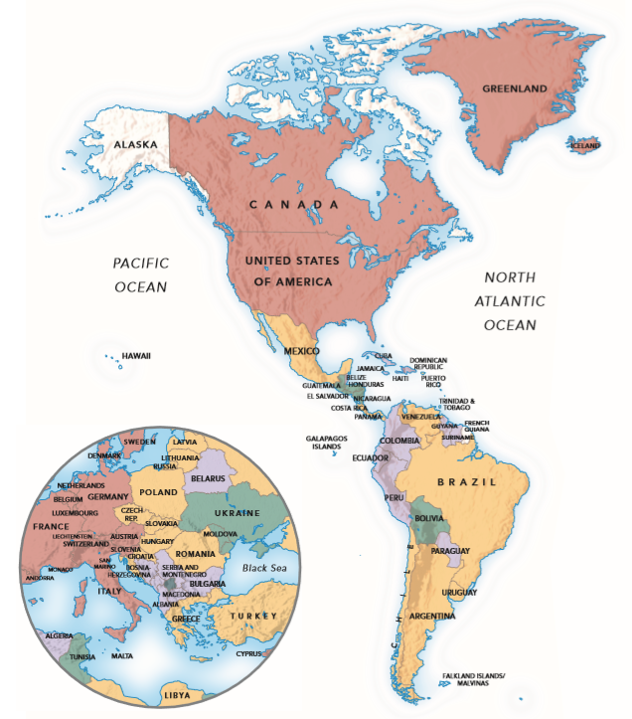
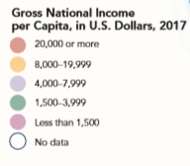
Gross National Income in U.S. Dollars (2017) (1 of 2)
SOURCE: Based on World Bank (2018); World Bank Development Indicator database, GNI per capita, Atlas method (current US$), www.data.worldbank.org.

Slide 21
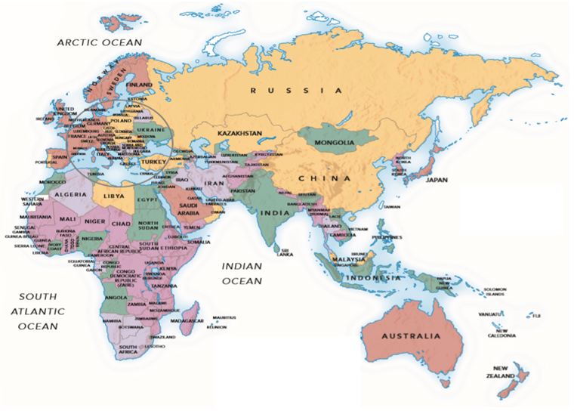
Gross National Income in U.S. Dollars (2017) (2 of 2)

Slide 22

Driving Forces of Market Globalization (3 of 3)
Integration of world financial markets.
Enables firms to raise capital, borrow
funds, and engage in foreign currency
transactions wherever they go.
Banks now provide a range of
services that facilitate global
transactions.
Advances in technology. Reduces the cost of doing business internationally, by allowing firms to interact cheaply with suppliers, distributors, and customers worldwide. Facilitates the internationalization of companies, including
countless small firms.

Slide 23

Digital Technologies
Profound advances have occurred in computers, digital technologies, telephony, and the Internet.
M N E s leverage digital technologies s to optimize their performance, managing operations around the world.
Digital technologies opened the global marketplace to firms that historically lacked
the resources to
internationalize.

Slide 24
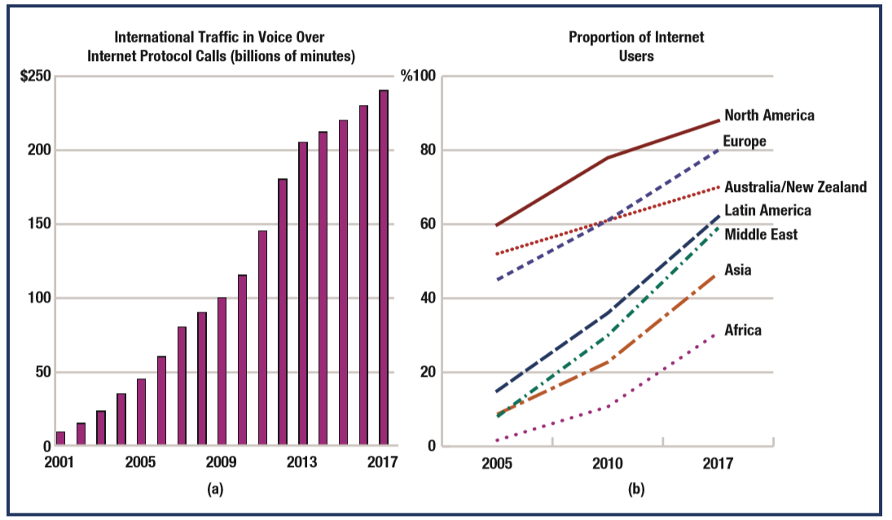
Declining Cost of Global Communication and Growing Number of Internet Users
Sources: BridgeVoicePluto, “Disrupting Wholesale Telecom: VoIP Market Trends and Predictions,” 2017, www.bridgevoice.com; IMF, World Economic Outlook (Washington, DC: International Monetary Fund, 2017); United Nations International Telecommunications Union, ICT Statistics, 2017, www. itu.int; Internet World Stats, Internet Usage Statistics, 2018, www.internetworldstats.com.
Notes:
Panel (a) of the Exhibit shows how the cost of international communications has fallen, expressed as the dramatic rise in the volume of international traffic in Voice over Internet Protocol (VoIP) calls. VoIP is the mother technology of Skype, FaceTime, and numerous other platforms that facilitate very low-cost international voice and video communications. Panel (b) of the Exhibit reveals the growth in Internet users in various regions since 2000. Africa has the fewest Internet users, whereas Europe and North America have the most, reflecting the level of economic and infrastructural development in each region.

Slide 25
Manufacturing and Transportation Technologies
Revolutionary developments facilitate low-scale and low-cost manufacturing; firms can make products cost-effectively even in short production runs. Online platforms are increasing the productivity of business and industrial activity.
In transportation, key advances include fuel-efficient jumbo jets, giant ocean-going freighters, and containerized shipping. The cost of international transportation has declined substantially, spurring rapid growth in global trade.
Collectively, technological advances have greatly reduced the costs of doing business internationally.

Slide 26
Company Internationalization and the Value Chain
The most significant implication of market globalization for companies is that a purely domestic focus is no longer viable in most cases.
Market globalization compels firms to internationalize their value chain, and access the benefits of international business.
Value chain: The sequence of value-adding activities performed by the firm in the process of developing, producing, and marketing a product or a service.
Globalization allows the firm to internationalize
its value chain, leading to various advantages.

Slide 27
Internationalization of the Firm’s Value Chain (1 of 2)

Slide 28
Internationalization of the Firm’s Value Chain (2 of 2)
The truly international firm configures its sourcing, manufacturing, marketing, and other value-adding activities on a global scale.
Rationale:
  cost savings
  increase efficiency, productivity, and flexibility of value chain activities
  access customers, inputs, labor, or technology
  benefit from foreign partner capabilities

Slide 29
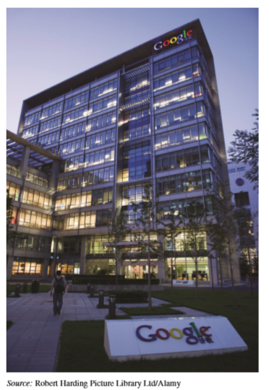
Societal Consequences of Globalization
Loss of National Sovereignty. M N E activities can interfere with governments’ ability to control of their own economies and social-political systems. Some firms are bigger than the economies of many nations (e.g., Walmart, Shell).
However, some argue that global competition in the context of global free trade makes M N E s less powerful (e.g., The U S auto industry declined as foreign rivals from Japan and Europe entered the U S market. Some day, Walmart may be overtaken by a giant Chinese retailer).

Slide 30
Societal Consequences of Globalization
Offshoring and the Flight of Jobs. Jobs are lost as firms shift production of goods and services abroad, in order to cut costs and obtain other advantages. Firms benefit, communities and industries are disrupted. However, some MNEs undertake reshoring – returning production to the home country to benefit from home-based advantages.
Effect on the Poor. In poor countries, while globalization usually creates jobs and raises wages, it also tends to disrupt local job markets. M N E s may pay low wages, and many exploit workers or employ child labor. Globalization’s benefits are not evenly distributed.

Slide 31
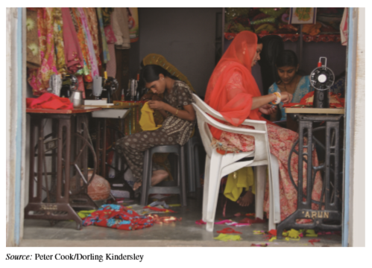
Societal Consequences of Globalization
Example
Many people in India are losing jobs as the hand-woven textiles industry is being gradually automated.

Slide 32
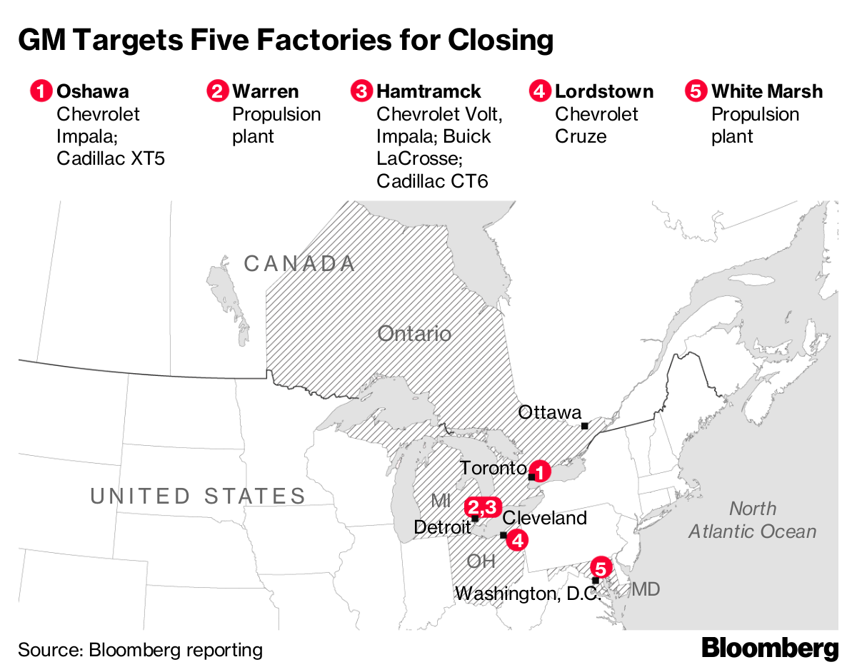
Societal Consequences of Globalization
Example: Many people in North America are losing jobs.

Slide 33
Example: Nike’s Foreign Factories
Nike has 100s of factories in Asia, Latin America, and elsewhere.
Nike was criticized for paying low wages and operating sweatshop conditions.
Labor exploitation and sweatshop conditions are genuine concerns in many developing economies.
However, consideration must be given to the other choices available to people in those countries.
Nike and many other MNEs have taken important steps to improve working conditions in their foreign plants.

Slide 34
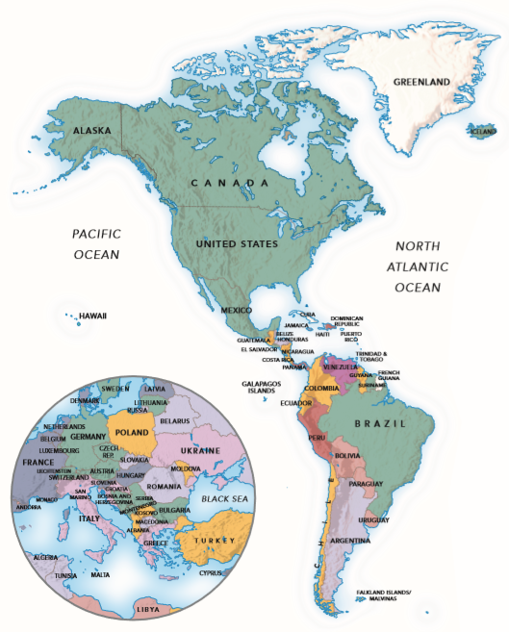
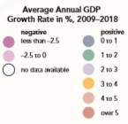
Growth of World G D P, Average Annual Percent Change, 2009-2018 (1 of 2)
Source: International Monetary Fund, World Economic Outlook database, 2018, www.imf.org.

Slide 35
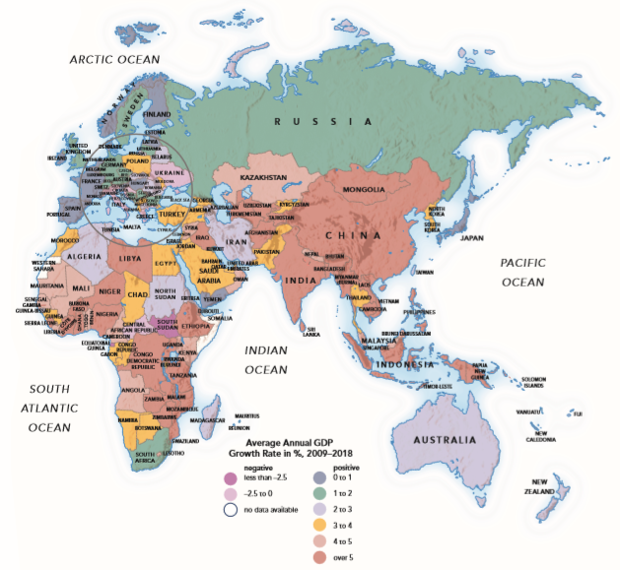
Growth of World G D P, Average Annual Percent Change, 2009-2018 (2 of 2)

Slide 36
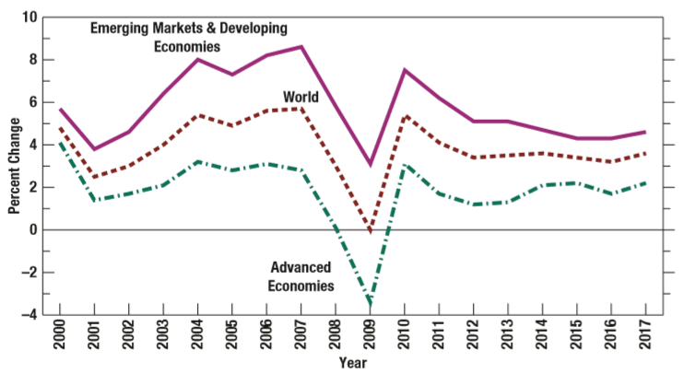
Percentage of Change in Annual GDP Growth
Sources: World Bank, Data, GDP Growth (Annual %), http:// data.worldbank.org, 2017; IMF, World Economic Outlook (Washington, DC: International Monetary Fund, September 2017); IMF, World Economic Outlook Database, 2017, www.imf.org; United Nations, UNData, “GDP Growth (annual %),” 2017, http:// data.un.org.

Slide 37
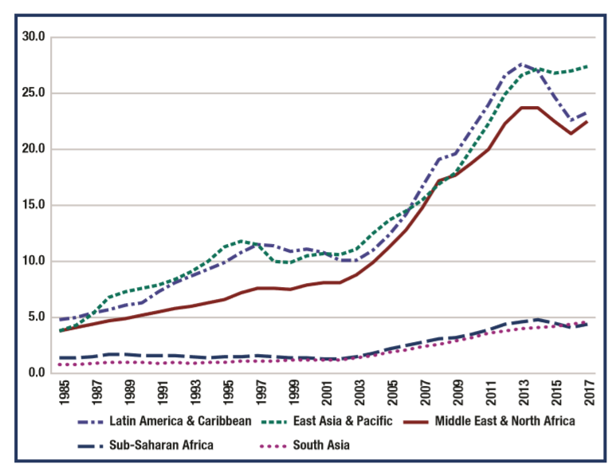
The Rise of Daily Income Levels, by Region, in U.S. Dollars
Sources: L. Chandy, N. Ledlie, and V. Penciakova, The Final Countdown: Prospects for Ending Extreme Poverty by 2030, Policy Paper 2013–14 (Washington, DC: Brookings Institution); Economist, “Poverty’s Long Farewell,” February 28, 2015, p. 68; World Bank, GNI per capita, Atlas method (current US$), 2017, http://data. worldbank.org. Note: The figures show average daily income per capita, in U.S. dollars, adjusted for inflation.

Slide 38

Societal Consequences of Globalization
Effect on Sustainability and the Natural Environment. Globalization harms the environment by promoting industrialization and other activities that generate pollution, habitat destruction, and other environmental harm.
E.g., As China and India
industrialize, air and
water pollution have
become major hazards.

Slide 39
Societal Consequences of Globalization
However, as nations develop their economies, they tend to pass laws that protect the environment. e.g., This happened in Japan from the 1960s to the 1980s. In Mexico, the government is gradually adopting policies to protect the air, water, etc.
Effect on National Culture. Globalization opens the door to foreign firms, global brands, unfamiliar products, and new values. Increasingly, consumers buy similar products, modeled according to Western countries, especially the U S. In this way, traditional norms, values, and behaviors may homogenize over time. National identity may be lost to ‘global’ culture.

Slide 40
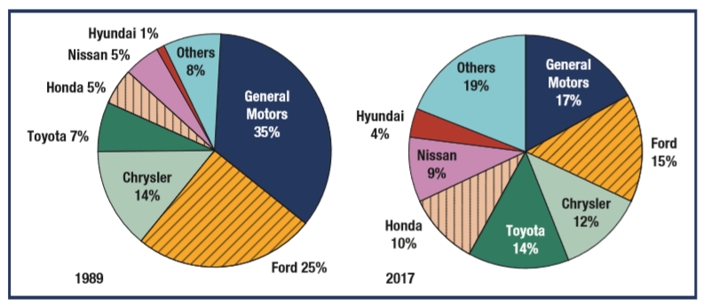
Automaker Market Shares, Passenger Car Sales in the U.S, 1989 and 2017
Sources: Based on Craig Trudell, “U.S. Automakers Seen Losing Market Share amid 2012 Growth: Cars,” Bloomberg BusinessWeek, February 8, 2012, www.businessweek.com; J. Muller, “Automakers Gold Rush,” Forbes, June 8, 2009, pp. 70–77; Wall Street Journal, “Sales and Total Share of Market by Manufacturer,” February 1, 2018, www.wsj.com/mdc/ public/page/2_3022-autosales.html

Slide 41
Ethical Connections
In six years, Nigeria increased its telecom infrastructure from just 500,000 phone lines to more than 30 million cellular subscribers.
This led to a big rise in productivity and commerce, which has helped improve living standards.
Access to cell phones saves wasted trips, provides access to education and healthcare, and facilitates communication between suppliers and customers.
M N E telecom investment in Africa allows firms to fulfill social responsibilities and improve the lives of millions of poor people.

Slide 42
You Can Do It: Recent Grad in I B
TERRANCE ROGERS
Terrance’s majors: Finance and
International Business
Objectives: Exploration, international perspective, self-awareness, career growth, learning about foreign markets
Internships during college: Deutsche Bank
Jobs held since graduating: All at Deutsche Bank, Business Analyst, Management Associate,
Executive Management Rotation, in New York. Most recently, Executive Management Associate at Deutsche Bank, London.

Slide 43
You Can Do It (1 of 2)
Terrance’s Advice for an International Career:
Early exposure at his university to international business and study abroad
Success Factors:
Work on projects that expose you to people in different regions across the globe
Mention your interest in working abroad early and bring it up in your annual review

Slide 44
You Can Do It (2 of 2)
Find a way to impress the people who can make the decision. It becomes easier to make the move when the “right people” know you can deliver.
Challenges:
Language and cultural barriers should be faced early in your career. Learn from cultural missteps early, so that you can be a better leader tomorrow.

Slide 45

Copyright

