Slide 1
COMPUTER LAB CONCEPTUAL design.
By : Student Name & NUMBER

Slide 2
BUILDING A COMPUTER LABORATORY
A preferrebly rectangular room is chosen to be used as a computer laboratory.

Slide 3
Assemble and arrange the furniture
After identifying your rectangular room, assemble all the furniture to be used in the room and their arrangement in space you decided while planning. arrange the seven desks in a raw facing the length of the building, place chairs which are adjustable to face the desks.

Slide 4
Set up the computers and the conditioning/AC(PowerPoint)
The seven computers are then arranged systematically on top of the desk.
All the computer out put devices mice, monitors and keyboards attached. later the computers are plugged into functioning sockets. boot up the computers and confirm that the plugged power sockets and the cables are in good condition and configured in the right manner.

Slide 5
Preventing Trip Hazards
The use of certified floor card covers help minimize the risks of users tripping as opposed to exposed cables as the provide safe walking surface on top of being water resistant.
They are cheap and with ease in installation. vector tiles are then used to assemble cables hence creating a clear pathway.
NB: Cables clip are excellent in preventing unnecessary hazard.

Slide 6
Computer Lab Network Connection
Ethernet cable connection would be utilized with double twisted-pair category 5, 6 and 5e cables that have rj45 connectors and a TP-LINK TL-SG1008PE unmanaged switch. The six personal computers would be connected to the switch each using a different cable and each of them will be connected via the different ports on the switch. The printer will be connected using a different cable such as the cat 6 to any of the ports with an exception of the uplink port.

Slide 7
Rj45 connectors and Cables
The task will commence by having a bulk of rj45 connectors for cat 5, cat 5e and cat 6. Additionally, there will be a RJ-45 crimping tool. Cables made will be straight through and cross-overs. The plastic sheath on the cables will be cut about one inch from both edges using the razor blade on the crimping tool. The wires will be unwound before pairing them with similar colors and pushing them to the connectors in the correct order. After this, the crimping will ensure there is a tight connection.

Slide 8
The Switch
The connection is done directly without the need for any configuration options and interfaces as the switch is a plug and play device. The TP-LINK TL-SG1008PE switch is equipped with 8 PoE and supported ethernet ports for the purpose of transferring electrical power and data over a single cable to any of the devices.
The switch will have an overload arrangement among the PoE ports where the priority function of the switch will help to protect the system against power overload. This will be by cutting off the power of the lowest priority port.

Slide 9
Network Protocol
And IP addresses
Since the laboratory will be under a small LAN (local area network) the printer and computer addresses will be set. The addresses in this laboratory will be similar but not exactly the same in the format 192.168.1.x, where x can be in the range of 0-255.For instance, the printer address will be set to 192.168.1.2 while the other computers will be set to 192.168.1.3 and so forth.
With the computers running on windows the set up will be done via the network connection window which is accessible following the command windows+ R then typing “ncpa.cpl”. The first thing would be to set the internet protocol by selecting the option TCP/IPv4 then set the unique IP addresses for each.

Slide 10
Cont. IP ADRESSES
As for the subnet mask and the default gateway they will be set at 255.255.2555.0 and 192.168.1.1 respectively and verified using the ipconfig command prompt. The printer address will be set via the control panel of the printer.

Slide 11
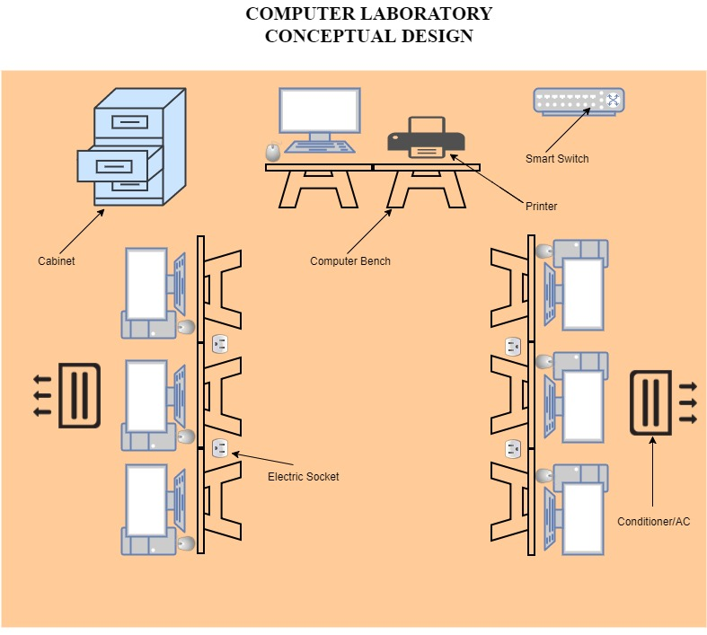

Slide 12
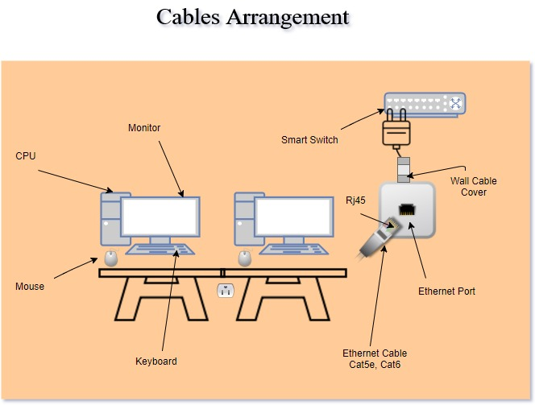

Slide 13


