Slide 1

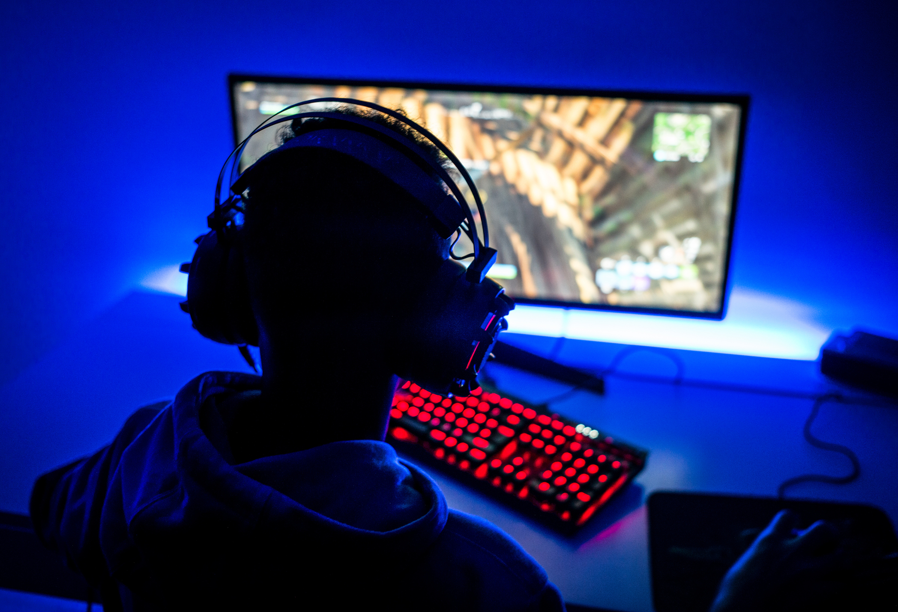

Application of MIS in DG (Decide Your Game)
Decide Your Game

Slide 2
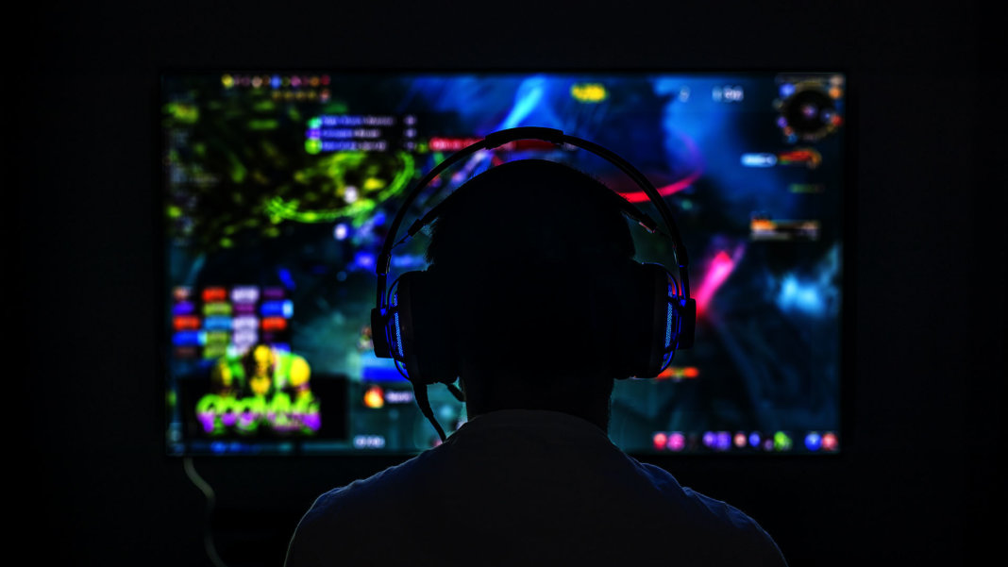
About Us
Our Key Service
Choose Game with High Requirements for Skills and Experience
Produce Program for Beginners to get Real-time suggestions based on their moves
Data comes from experienced player community and real-time collection of anonymous data from experienced players
…And our goal is to create an MIS to improve the functioning of this product
DG is a company focusing on Game Publishing and Promotion, and we have both B2B and B2C services and products

Slide 3


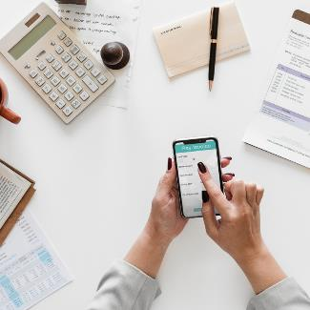
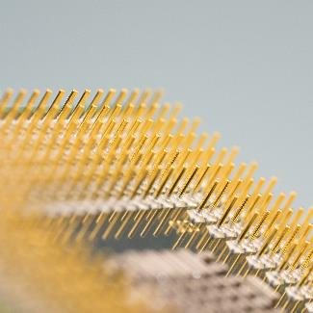
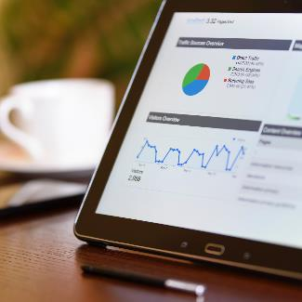
Current Challenges and Why We Need MIS
Data Analysis
Error Rate
Usage Rate
Marketing Optimization
User Feedback

Slide 4
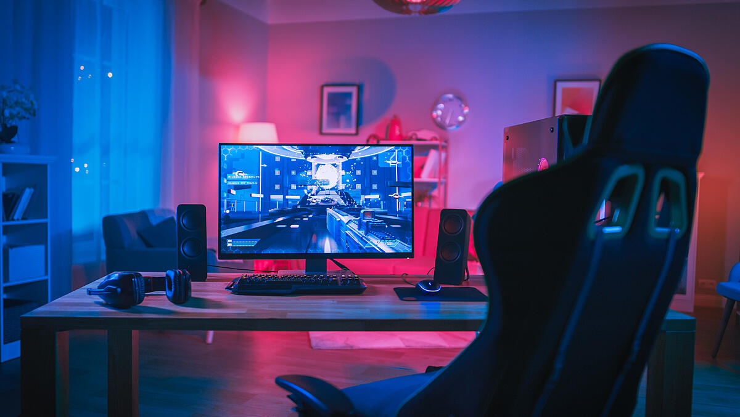
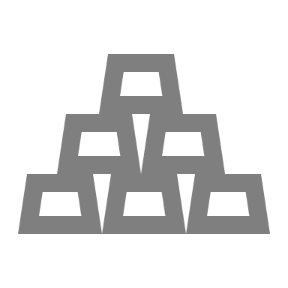


MIS We need
Feedback collection
Real-time analysis
Survey data
This is for collection of reported errors and experiences gathered from the users
This is for collection of data from real-time usage
This is for development and marketing departments

Slide 5





Key data in the system
Ratings
Success Rate
Users’ interest in other games, especially in those they have not tried
How well do the suggestions help the players?
Usage Rate
User skill data
What’s the proportion of actions actually taken according to the suggestions?
Data including click per second, system specs for each error in each scenario

Slide 6
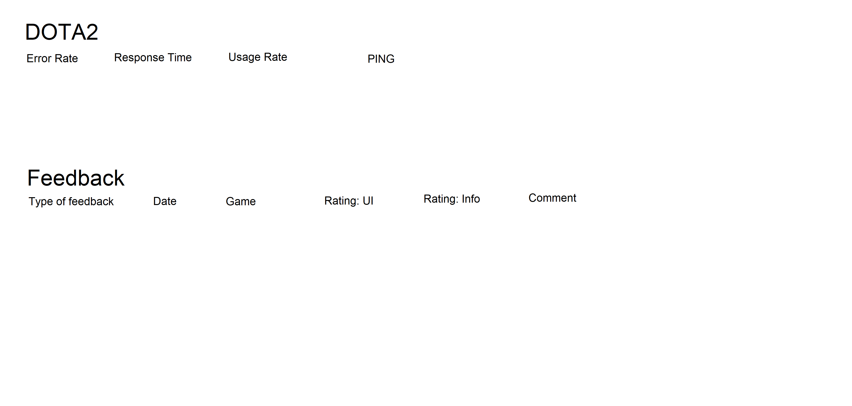
Template
What the MIS will show
Error Rate
Response time
Usage Rate
PING
Type of feedback/date/game/version/rating about different aspects/comment

Slide 7
Improved Financials
$100,000
$3M
We project an $100,000 increase in monthly revenue. Given that our membership costs $20 per month, it is an increase about 5,000 users.
For the marketing function, we expect our revenue to increase by $3 million dollars as this function will attract more game companies that will potentially cooperate with us.
We also anticipated reduction in marketing cost (employee#, etc.)

Slide 8
Financial
Forecasting for success
 | Profit (App) | Profit (Marketing)
2020-Q2 | 100,000 | 1,350,000
2020-Q4 | 120,000 | 1,650,000
2021-Q1 | 140,000 | 1,750,000
2021-Q2 | 145,000 | 1,750,000
2021-Q3 | 150,000 | 1,750,000

Slide 9
Cost
$500k
$40,000
For the development of the system
For monthly maintenance

Slide 10
Growth Strategy
How will we scale in the future
Phase 1
Introduction
Phase 2
Growth
Phase 3
Maturity
Implementation of the system to the game with moderate number of players online
Offer incentives for filling out the survey (membership points for hours extension)
Implementation to part of the games and try to implement it in a game that is relatively high in player volume
In-game reward for filling out the survey
Implementation to all of the games using the program
Further marketing effort, focus groups, etc. Initial stage of marketing research has completed.

Slide 11
Porter’s Five Force Model (1)
Threat of New Entrants
Threat of substitution
Very low threat of new entrants
  Few companies will bring about the similar products because such products require a customer base and while DG has a pre-established community of players using its products, new entrants might not have the chance to develop a customer base that is large enough
Low threat
  However, as there are mobile apps that currently provide similar functions as they provide suggestions to players when they’re playing the game, it is possible to be substituted

Slide 12
Porter’s Five Force Model (2)
Supplier Power
Buyer Power
We make our own supply, so we have the supplier power and there is no external supplier having bargaining power over us
Buyers have the power to choose whether to use the product
  There are free alternatives that might use some effort and those who care about costs more might shift away from the product
  We mainly target at customers of games that are not free to play, and players are more likely to subscribe
  Each customer will pay around $20, and there are no close substitutes offer the saame services

Slide 13
Porter’s Five Force Model (3)
Competition Rivalry
Summary
With the established customer base and integration, as long as customers are retained to the games published by the DG, they are more likely to keep using the product
The company has more advantages than disadvantages in the competition and it has a unique standing that will gain some bargaining power for the company, and the technological improvements is likely to draw a larger customer base

Slide 14

Summary
The company needs MIS to provide feedback for the development team to revise the algorithm
The company can use MIS to further perfect its publishing and marketing services so that it can get more information about the market
MIS is important for the company because…

