Slide 1

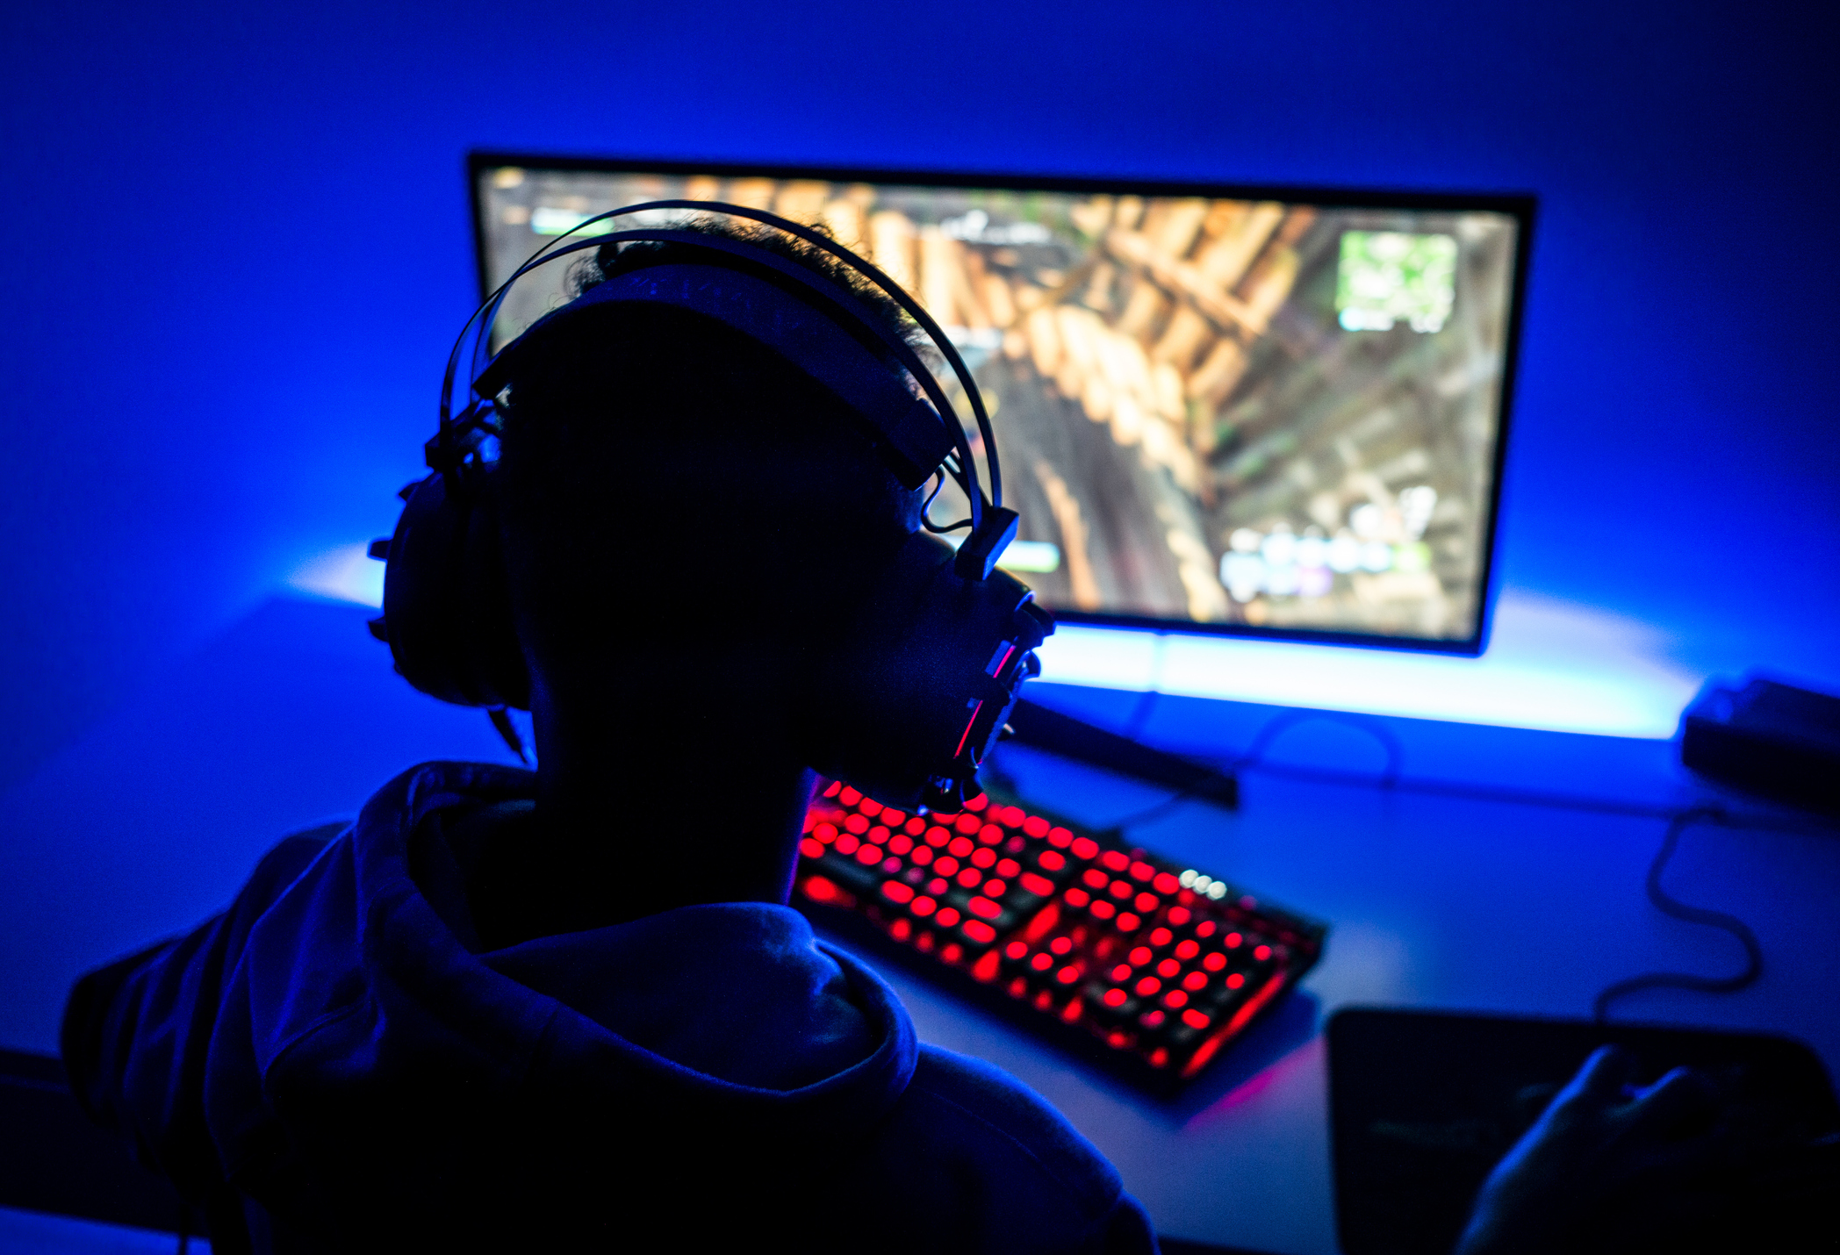

Application of MIS in DG (Decide Your Game)
Decide Your Game
[Members of Group]

Slide 2
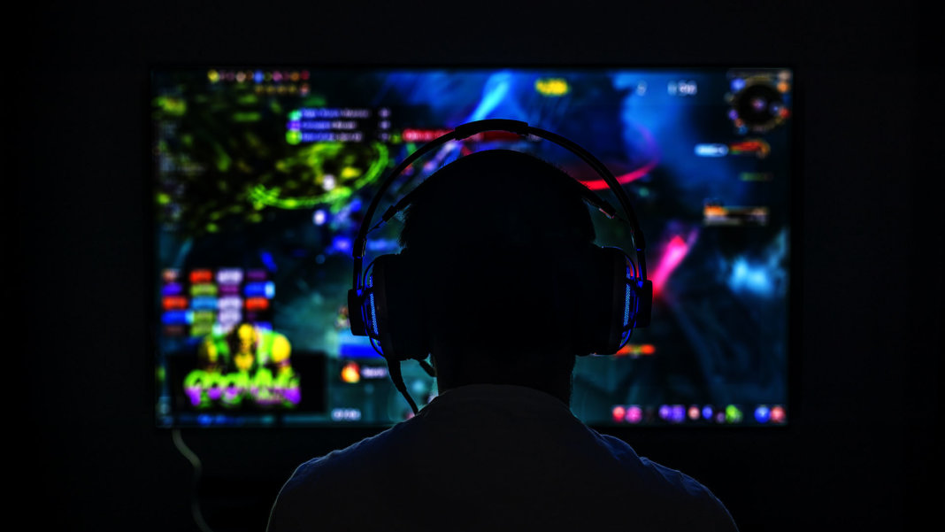
About Us
Our Key Service
Choose Game w/ High Requirements for Skills and Experience
Produce Program for Beginners to get Real-time suggestions based on their moves
Data comes from experienced player community and real-time collection of anonymous data from experienced players
…And our goal is to create an MIS to improve the functioning of this product
DG is a company focusing on Game Publishing and Promotion, and we have both B2B and B2C services and products
Notes:
DG is a company focusing on game publishing and promotion, and we have both B2B and B2C services and products. We have established partnership with some major game companies and our main service is the marketing and publishing of games.
Our key service is the new product that aims to improve experience for beginners for a game, and we would need to explain how it works.
Firstly, we will choose some games that incorporate high requirements for proficiency and experience to begin with, such as games that are comparable to World of Warcraft, Starcraft, and Rainbow Six Siege. Beginners are likely to encounter a bottleneck as they first begin playing these games even though a lot of the player might already have experience with other video games because of the mechanism of these games, and as a result, the retain rate for beginners are likely to be low. We will seek partnership with major game developers and publishing platforms and our company will develop a program that will collect data and analyze strategies from professionals and experienced, and the analysis will be synthesized in our company’s program. This program can help beginners make better decisions the first time the player tries the game, and it will give gamers useful suggestions for leveling up more quickly, and the information provided include what items to collect and level up, where are enemies likely to appear, where to collect certain materials, and what the weaknesses and skills each Boss have. The information will appear on the side or on the mobile App as the player plays the game and it will be updated as the player takes new moves in the game. However, while it will provide players with related information when they play the game, this program will not influence the overall fairness of the game and the information provided is only for reference. The purpose of this program is to create an opportunity for the beginners to familiarize with the game system faster and get an improved experience in the initial stage.
Our goal in this case is to create an MIS to improve the functioning of this product.

Slide 3


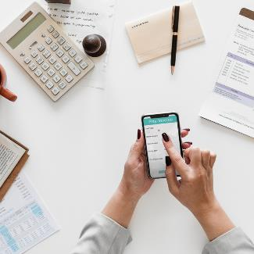
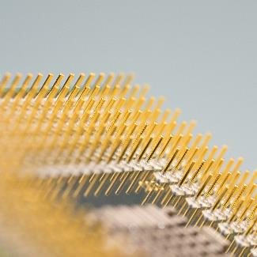
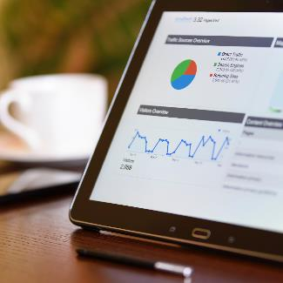
Current Challenges and Why We Need MIS
Data Analysis
Error Rate
Usage Rate
Marketing Optimization
User Feedback
what we need to do to improve the algorithm.
we want to use the MIS to gather information on errors to improve accuracy.
whether users are following the suggestions provided by the program.
We can get a better portrait of the video game market and develop strategies for expansion.
we can have a better understanding of what we need to improve in the near future.
Notes:
We need MIS because:
We want to know how well the entire system is working, and we want to know what we need to do to improve the algorithm.
As some of the suggestions can potentially be wrong, we want to use the MIS to gather information on errors to improve accuracy.
At the same time, we want to feedback about whether users are following the suggestions provided by the program.
We also want to know what other games can we potentially use our program for in the future? We can get a better portrait of the video game market and develop strategies for expansion.
Lastly, users can submit feedback and we need to analyze the feedback in our MIS as well so that we can have a better understanding of what we need to improve in the near future.

Slide 4
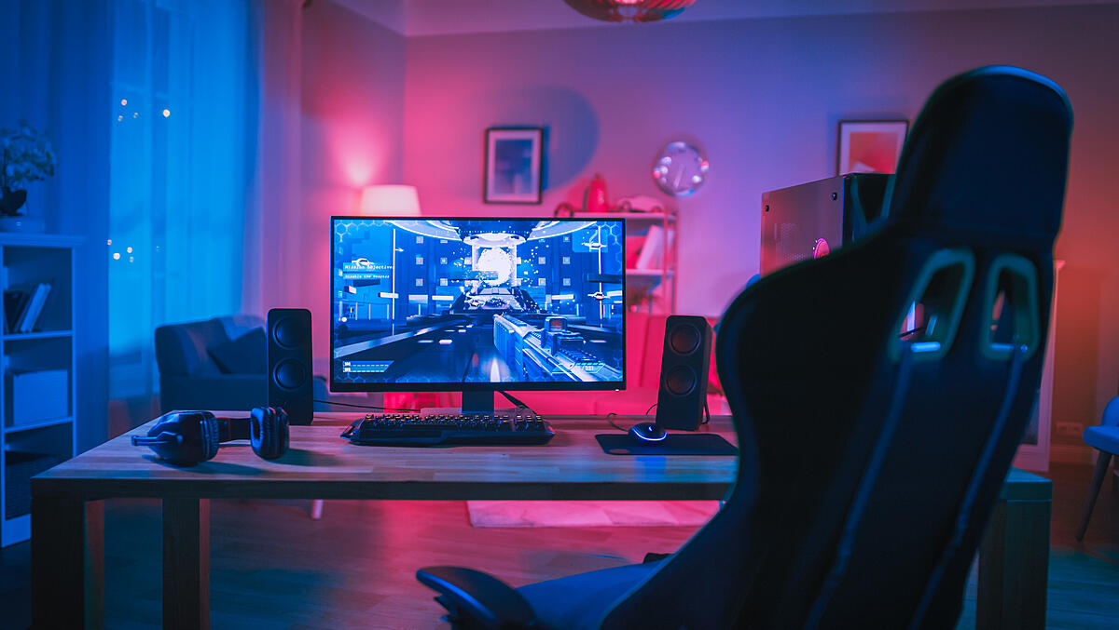



MIS We need
Feedback collection
Real-time analysis
Survey data
This is for collection of reported errors and experiences gathered from the users
This is for collection of data from real-time usage
This is for development and marketing departments
Notes:
What does MIS that we need do?
It will serve the function of feedback collection, real-time analysis, and send survey data back to corresponding departments.
Feedback collection is the collection of reported error and experiences from the users.
Real-time analysis is for collection of data from real-time usage.
Survey data is mainly for development and marketing departments.

Slide 5





Key data in the system
Ratings
Success Rate
Users’ interest in other games, especially in those they have not tried
How well do the suggestions help the players?
Usage Rate
User skill data
What’s the proportion of actions actually taken according to the suggestions?
Data including click per second, system specs for each error in each scenario
Notes:
Key data in the system include ratings, success rate, usage rate, and user skill data.
Rating refers to Users’ interest in other games, especially in those they have not tried, and this will be collected in surveys
Success rate refers to the success rate of the actions. It will tell developers how well do the suggestions help the players?
Usage rate refers to the proportion of actions actually taken according to the suggestions.
User skill data include click per second, system specs for each error in each scenario, etc., and it aims to provide the developers with all kinds of information on the user portrait.

Slide 6
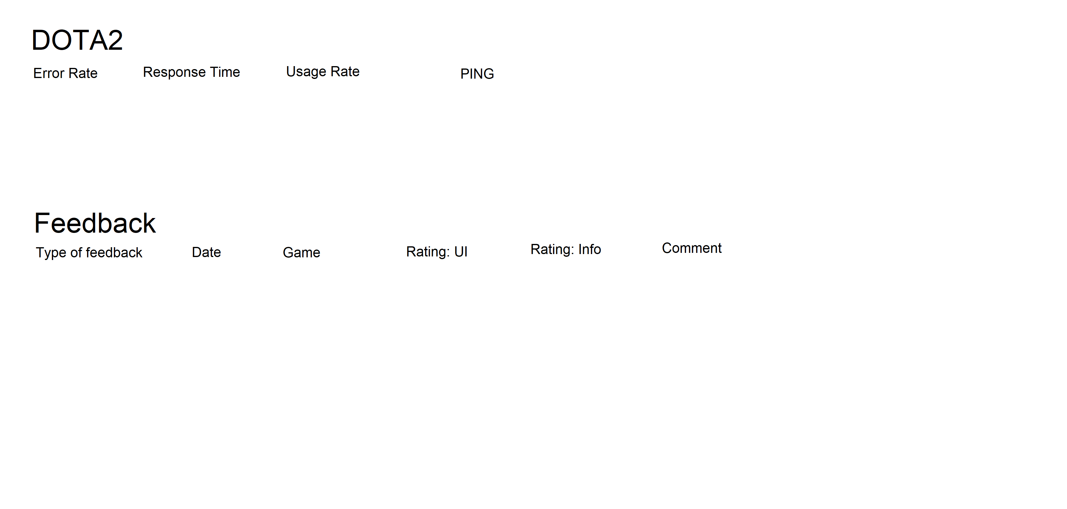
Template
What the MIS will show
Error Rate
Response time
Usage Rate
PING
Type of feedback/date/game/version/rating about different aspects/comment
Notes:
The MIS wil show the error rate, response time, usage rate, PIING, type of feedback, date, game, version, rating, comments, etc. The information will be updated real-time and sent to different departments.

Slide 7
Improved Financials
$100,000
$3M
We project an $100,000 increase in monthly revenue. Given that our membership costs $20 per month, it is an increase about 5,000 users.
For the marketing function, we expect our revenue to increase by $3 million dollars as this function will attract more game companies that will potentially cooperate with us.
We also anticipated reduction in marketing cost (employee#, etc.)
Notes:
With the implementation of MIS is the improvement in financials.
We project an $100,000 increase in monthly revenue. Given that our membership costs $20 per month, it is an increase about 5,000 users.
For the marketing function, we expect our revenue to increase by $3 million dollars as this function will attract more game companies that will potentially cooperate with us.
We also anticipated reduction in marketing cost as lower cost for marketing research will incur.

Slide 8
Financial
Forecasting for success
 | Profit (App) | Profit (Marketing)
2020-Q2 | 100,000 | 1,350,000
2020-Q4 | 120,000 | 1,650,000
2021-Q1 | 140,000 | 1,750,000
2021-Q2 | 145,000 | 1,750,000
2021-Q3 | 150,000 | 1,750,000
Notes:
Here are the projected profit for the future for the Program and the Marketing department.
In Q2 of 2020, we are having 100,000 for app and 1,350,000 for marketing, and by 2021 Q3, when the system is in effect for an entire year, we project 150,000 in profit for app and 1,750,000 profit for marketing as we anticipate new partners.

Slide 9
Cost
$500k
$40,000
For the development of the system
For monthly maintenance
Notes:
The initial development will cost about 500 hundred thousand and monthly maintenance will cost about forty thousand dollars.

Slide 10
Growth Strategy
How will we scale in the future
Phase 1
Introduction
Phase 2
Growth
Phase 3
Maturity
Implementation of the system to the game with moderate number of players online
Offer incentives for filling out the survey (membership points for hours extension)
Implementation to part of the games and try to implement it in a game that is relatively high in player volume
In-game reward for filling out the survey
Implementation to all of the games using the program
Further marketing effort, focus groups, etc. Initial stage of marketing research has completed.
Notes:
In the first phase, which is the introduction stage, we will begin the :
Implementation of the system to the game with moderate number of players online
And Offer incentives for filling out the survey (membership points for hours extension)
In Phase II, we will
Implement the system to part of the games and try to implement it in a game that is relatively high in player volume
And offer In-game reward for filling out the survey
In Phase III, we
Implement the system to all of the games using the program
And Further push marketing effort, focus groups, etc. Initial stage of marketing research has completed and we will begin further development and negotiation with potential partners.

Slide 11
Porter’s Five Force Model (1)
Threat of New Entrants
Threat of substitution
Very low threat of new entrants
  Few companies will bring about the similar products because such products require a customer base and while DG has a pre-established community of players using its products, new entrants might not have the chance to develop a customer base that is large enough
Low threat
  However, as there are mobile apps that currently provide similar functions as they provide suggestions to players when they’re playing the game, it is possible to be substituted
Notes:
Next, we will use Porter’s Five Force Model to analyze the market the company currently is in.
The market that the product is for has a very low threat of new entrants
Few companies will bring about the similar products because such products require a customer base and while DG has a pre-established community of players using its products, new entrants might not have the chance to develop a customer base that is large enough. Compared to new entrants, the company has advantage in the market share it is currently having and it enjoys the network externalities.
There is also a low level of threat of substitution in the market.
Currently there are not many substitutes in the market and because of the exclusive partnership relation, there is not likely to be any in the future either.However, as there are mobile apps that currently provide similar functions as they provide suggestions to players when they’re playing the game, it is possible to be substituted

Slide 12
Porter’s Five Force Model (2)
Supplier Power
Buyer Power
We make our own supply, so we have the supplier power and there is no external supplier having bargaining power over us
Buyers have the power to choose whether to use the product
  There are free alternatives that might use some effort and those who care about costs more might shift away from the product
  We mainly target at customers of games that are not free to play, and players are more likely to subscribe
  Each customer will pay around $20, and there are no close substitutes offer the saame services
Notes:
We make our own supply, so we have the supplier power and there is no external supplier having bargaining power over us
Buyers have the power to choose whether to use the product as…
There are free alternatives that might use some effort and those who care about costs more might shift away from the product
We mainly target at customers of games that are not free to play, and players are more likely to subscribe
Each customer will pay around $20, and there are no close substitutes offer the saame services

Slide 13
Porter’s Five Force Model (3)
Competition Rivalry
Summary
With the established customer base and integration, as long as customers are retained to the games published by the DG, they are more likely to keep using the product
The company has more advantages than disadvantages in the competition and it has a unique standing that will gain some bargaining power for the company, and the technological improvements is likely to draw a larger customer base
Notes:
There is not much competition in the market so far for the app. With the established customer base and integration, as long as customers are retained to the games published by the DG, they are more likely to keep using the product.
Overall, The company has more advantages than disadvantages in the competition and it has a unique standing that will gain some bargaining power for the company, and the technological improvements is likely to draw a larger customer base

Slide 14

Summary
The company needs MIS to provide feedback for the development team to revise the algorithm
The company can use MIS to further perfect its publishing and marketing services so that it can get more information about the market
MIS is important for the company because…
Notes:
Overall, the company needs to use an MIS for the development of the system and for its main service of marketing and promotion of the games.
The company needs MIS to provide feedback for the development team to revise the algorithm. By gathering statistics on users’ usage and choices, the real-time feedback can help the developer team see the potential drawbacks of the application and fix the problems. It can also help them identify the more important types of information that users need.
The company can use MIS to further perfect its publishing and marketing services so that it can get more information about the market

