Slide 1

Fundamental inclusion and classroom management strategies

Slide 2
Importance of inclusion and classroom management
Reduces stigma
Students better understand themselves and
Increased achievements of IEP goals
Greater access to general curriculum
Enhanced skill acquisition and generalization
Maximum utilization of resources
builds a community that increases effectiveness in learning (Evertson, 2014)
Notes:
Children learn better from other children than adults. Therefore effective learning helps provide opportunity for diverse students to learn from each other. Mild to moderately disabled kids are able to learn from the non-disabled and vice versa through observations and interactions.

Slide 3
How to assist mild to moderately disabled individuals develop interpersonal skills
Praising and recognition
Create positive classroom atmosphere
Impact emotional intelligence
Emphasize of effective communication
Develop positivity and high self-esteem
Personal learning
Notes:
To impact help mild to moderately disabled students develop interpersonal skills, its important for the teacher to find opportunities for praising and recognizing them. Creating a classroom that fosters positivity can impact a lot in development of interpersonal skills. Emotional intelligence will help individuals understand working of their body, and be able to control their feelings and emotions. In addition, emphasize on effective communication will ensure that the individuals can express themselves. Positivity and self esteem will create self acceptance while personal learning will help individuals understand themselves and others, hence will be able to build interpersonal skills.

Slide 4
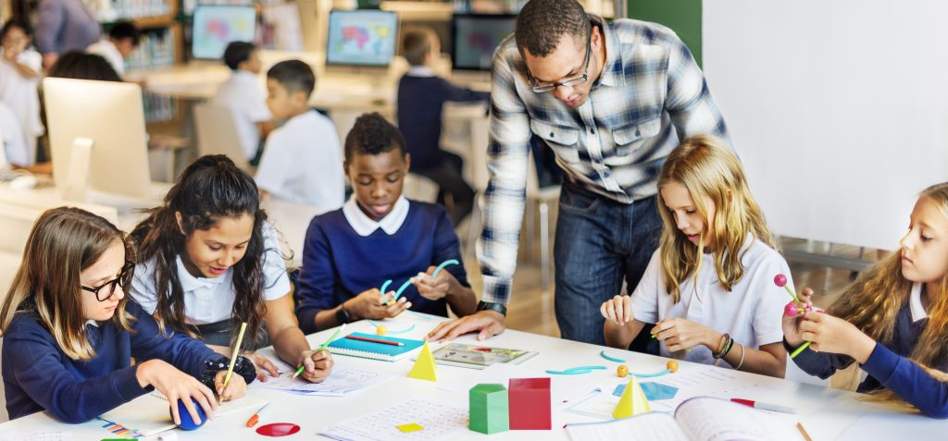
Expected personal and social behavior of mild to moderately disabled students
Seeking too much attention
Student may be trying to avoid situation, place or person
expression of physical needs such as hunger, fatigue and control (Solomon, 2013).
Being emotional
The student may be aggressive
Seeking time alone, and need to be controlled.
Notes:
Mild to moderately disabled students may express behavior such as seeking too much attention, meaning that the student is concerned about recognition in the class, or wants to be heard, and seen. Avoidance of certain situations, persons and places is also social behavior that the teacher should expect. Mild to moderately disabled students also express physical needs and high emotional behaviors and its crucial to understand their changes in mood and feelings. Abrupt passive aggressiveness and need for privacy and control are also some social and personal behaviors expected of mild to moderately disabled students

Slide 5
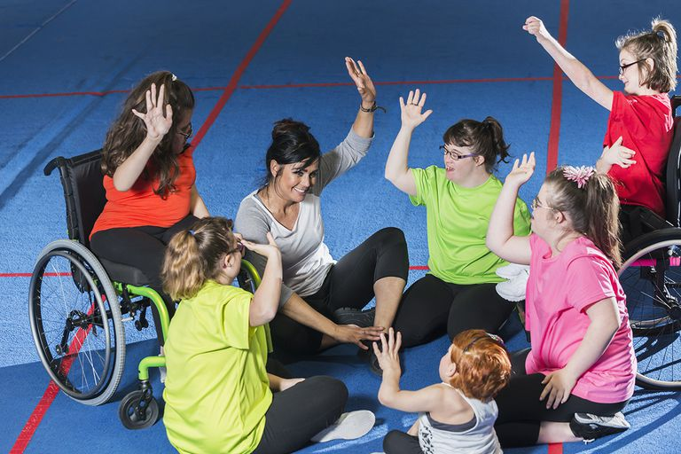
Motivating and participative learning environment for individual with or without disability
Decoding body language
Establish simple rules that are applicable to all
avoid responding negative , threatening or critic response.
Provide opportunity for each to express his/herself
praise and appreciate every participant.
Make the classroom less formal- don’t bee too strict.
Be flexible
Create a desire to learn and teach rather than only learning.
Do not spoon feed, create forum for discussion
Give equal chance to all.

Slide 6
Why is learners motivation and participation in classroom important
It directs learners’ behavior towards learning goals
Increases learners’ tasks
Facilitates understanding
Helps build interpersonal skills
Helps build relationships with teacher and other students.
Notes:
Active participation and motivation is very important to both mild to moderately disabled individuals and non-disabled individuals.

Slide 7
Positive multicultural environment
This is environment that supports and encourages diversity.
It involves formulating strategies that appreciate different individual’s believes, norms and way of live.
Environment that supports positive multicultural experiences makes learning effective .
Students learn better in a diversity .
It helps individuals to learn and appreciate different cultures.
Notes:
Positive multicultural environment is fundamental in learning process. Its therefore important for teacjhers to identify main culture and subcultures in the class and embrace it. Teachers should also help students identify and accept cultural diversity in class. Identification of various elements of diversity in classroom is important as attaining learning goals.

Slide 8
How to create a positive multicultural environment.
Recognize and celebrate various cultural festivals in in class, creating fun and learning.
Provide forum for learning more about background of learners.
Include and increase variety of books, from various cultures.
Redirect teacher’s role from instructor to facilitator
Notes:
Variety of book in class will ensure that students are able to read on various cultures. Also celebrating different cultural festivals does not only make learning fun, but also makes students appreciate diversity.

Slide 9
How to sustain a learning environment that supports positive multicultural environment.
Create polices and rules that facilitate multicultural experiences.
Make learners understand importance of cultural diversity.
Identify multicultural environment that facilitate learning and are likely to last, and embrace them (Wehmeyer, & Hughes, 2010).
Notes:
Sustaining multicultural environment is as important as developing it. Teachers should ensure that environment that supports positive multicultural environment is created and sustained.

Slide 10

Collaborative groups
Collaborative groups are small groups of students who come together for purpose of engaging in learning activity (Pierce, 2011).
It involves organizing students into groups to solve a problem or discuss a question
Notes:
Collaborative groups offer effective learning through collaboration and discusions.They help build interpersonal and cognitive skills. They are very essential in fostering interactions among students especially between mild to moderately disabled and non-disabled.

Slide 11
Project-based activities
This is a learning method in which learners identify real world problem and solve it.
Unlike discussion, it requires more time.
Students do more research.
They are complex and require a collaborative efforts of members (Lewis & Sugar, 2009).
Notes:
Unlike collaborative learning groups, project-based activities require much dedication by the student in terms of work and effort. They are more effective in building interpersonal skills as well as ability to collaborate with others.

Slide 12
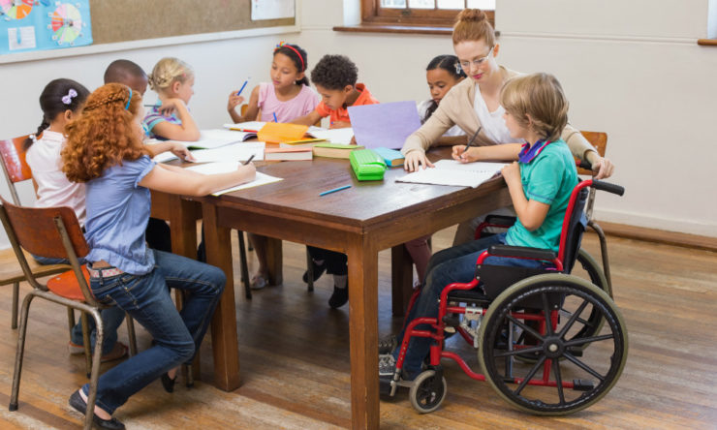
Impacts of collaborative groups and project based activities on self-advocacy and self-determination skills
Enhances students confidence
Leads to high self esteem
Increase feeling of self worth leading to self determination and self –advocacy skills (Pierce, 2011).
Inspires critical thinking
Improves social interactions
It aids in developing individual's self management skills.
Notes:
Collaborative groups and project based activities help individuals both the disabled and to increase their level of confidence. Through peer discussions and collaborations, the individual overcomes fear. The non-disabled y also help in boosting ones self esteem. Through group contributions one is able to discover his/her potential and self worth, increasing self esteem. This helps improve self advocacy and self determination sills. They also lead tio social interactions and individual self-management skills.

Slide 13
References
Everson, C. M. (2014). Classroom management for elementary teachers. Ally & Bacon, A Division of Simon & Schuster, Inc., 160 Gould Street, Needham Heights, MA 02194.. Butler, F. M., Miller, S. P.,
Pierce, T. (2011). Teaching mathematics to students with mild-to-moderate mental retardation: A review of the literature. Mental retardation, 39(1), 20-31.
Wheeler, M. & Hughes, C. (2010). A national survey of teachers' promotion of self- determination and student-directed learning. The Journal of Special Education, 34(2), 58-68.
Lewis, T. J., & Sugai, G. (2009). Effective behavior support: A systems approach to proactive schoolwide management. Focus on Exceptional Children, 31(6), 1.
Solomon, G. (2013). Project-based learning: A primer. TECHNOLOGY AND LEARNING-DAYTON-, 23(6), 20-20.

