Slide 1
Chapter 4
Developing Through the Life Span

Slide 2
Chapter Overview
Developmental Issues, Prenatal Development, and the Newborn
Infancy and Childhood
Adolescence
Adulthood

Slide 3
Developmental Issues, Prenatal Development, and the Newborn
Developmental Psychology’s Major Issues
4-1: WHAT THREE ISSUES HAVE ENGAGED DEVELOPMENTAL PSYCHOLOGISTS?
Developmental psychology: A branch of psychology that studies physical, cognitive, and social change throughout the life span
Focuses on three major issues:
  Nature and nurture: How is our development influenced by the interaction between our genetic inheritance and our experiences?
  Continuity and stages: What parts of development are gradual and continuous and what parts change abruptly in separate stages?
  Stability and change: Which of our traits persist and which change through life?

Slide 4
Developmental Issues, Prenatal Development, and the Newborn
Developmental Psychology’s Major Issues
Nature and Nurture
Nature: unique gene combination
  responsible for shared humanity and our individual differences
Nurture: experiences
  Influence of family, peers, environment
We are formed by the interaction of nature and nurture
  Biological, psychological, social-cultural forces interact

Slide 5
Developmental Issues, Prenatal Development, and the Newborn
Developmental Psychology’s Major Issues
Continuity and Stages
Researchers see development in two ways, depending on whether they emphasize experience and learning or focus on biological maturation:
  Continuous, as in learning, where development is a slow, continuous process
  Stages or steps, as predisposed genetically
    Progress through various stages may be quick or slow, but everyone passes through the stages in the same order

Slide 6
Developmental Issues, Prenatal Development, and the Newborn
Developmental Psychology’s Major Issues
Stability and Change
Research reveals that we experience both stability and change.
  Some characteristics, such as temperament, are stable across the life span
  Some characteristics, such as attitudes, are less stable

Slide 7
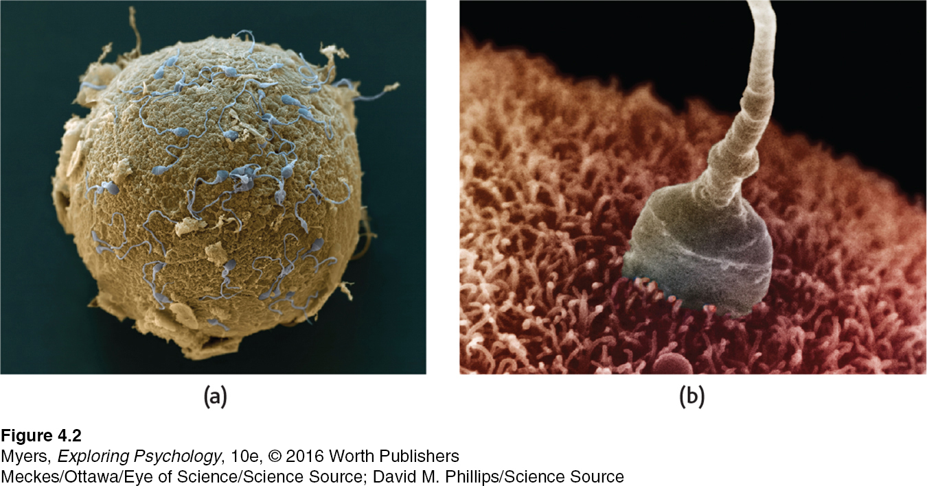
Developmental Issues, Prenatal Development, and the Newborn
Prenatal Development and the Newborn
Conception
4-2: WHAT IS THE COURSE OF PRENATAL DEVELOPMENT, AND HOW DO TERATOGENS AFFECT THAT DEVELOPMENT?
Notes:
Figure 10.2 Life is sexually transmitted
Sperm cells surround an egg.
(b) As one sperm penetrates the egg’s jellylike outer coating, a series of chemical events begins that will cause sperm and egg to fuse into a single cell. If all goes well, that cell will subdivide again and again to emerge 9 months later as a 100-trillion-cell human being.

Slide 8
Developmental Issues, Prenatal Development, and the Newborn
Prenatal Development and the Newborn
Prenatal Development
Zygote
  The life cycle begins at conception, when one sperm cell unites with an egg to form a zygote—a fertilized egg. Less than half survive the first two weeks, but those that do enter a 2-week period of rapid cell division and develop into an embryo
Embryo
  The zygote’s inner cells become the embryo, and the outer cells become the placenta. The embryo is the developing human organism from about 2 weeks after fertilization through the second month
Fetus
  In the next 6 weeks, body organs begin to form and function, and by 9 weeks, the fetus is recognizably human

Slide 9
Developmental Issues, Prenatal Development, and the Newborn
Prenatal Development and the Newborn
Prenatal Development
Though the placenta screens out many harmful substances, some slip by. Prenatal development is not risk free:
  Teratogens
    Agents, such as a chemical or virus, that can reach the embryo or fetus during prenatal development and cause harm.
  Fetal alcohol syndrome (FAS)
    Physical and cognitive abnormalities in children caused by a pregnant woman’s heavy drinking. In severe cases, signs include a small, out-of-proportion head and abnormal facial features.
  Alcohol has an epigenetic effect, as does smoking.

Slide 10
Developmental Issues, Prenatal Development, and the Newborn
Prenatal Development and the Newborn
The Competent Newborn
4-3: WHAT ARE SOME NEWBORN ABILITIES, AND HOW DO RESEARCHERS EXPLORE INFANTS’ MENTAL ABILITIES?
  Newborn arrives with automatic reflex responses that support survival: Sucking, tonguing, swallowing, and breathing
  Cries to elicit help and comfort
  Prefers sights and smells that facilitate social responsiveness
  Sees close objects (such as faces) and smells well, and uses sensory equipment to learn
  Researchers use habituation studies to learn what newborns and infants can see, hear, smell, and think.
Notes:
Research equipment
Eye-tracking machines and pacifiers wired to electronic gear
Habituation
Fetuses adapted to vibrating, honking device on mother’s abdomen
Preferences
Newborns prefer face-like images and smell of mother’s body

Slide 11

NEWBORNS’ PREFERENCE FOR FACES
When shown these two images with the same three elements, Italian newborns spent nearly twice as long looking at the face-like image on the left (Johnson & Morton, 1991). Canadian newborns—average age just 53 minutes in one study—displayed the same apparently inborn preference to look toward faces (Mondloch et al., 1999).
Notes:
Figure 4.4

Slide 12
Infancy and Childhood
  Maturation: Biological growth processes that enable orderly changes in behavior
    Relatively uninfluenced by experience
    Severe deprivation or abuse can slow development, yet genetic growth patterns are inborn
  Maturation (nature) sets the course of development; experience (nurture) adjusts it
Nature and nurture interact

Slide 13
Infancy and Childhood
Physical Development
Brain Development
4-4: DURING INFANCY AND CHILDHOOD, HOW DO THE BRAIN AND MOTOR SKILLS DEVELOP?
Brain cells are sculpted by heredity and experience.
  Birth: Growth spurt of neural networks
  Ages 3 to 6: Rapid frontal lobe growth and continued growth into adolescence and beyond
  Early childhood is a critical period for some skills (e.g., language and vision). Tens of billions of synapses form and organize, while a use-it-or-lose-it pruning process shuts down unused links.
  Throughout life: Learning changes brain tissue
Notes:
Nature and nurture together sculpt our synapses. Brain maturation provides us with a wealth of neural connections.
Experience—sights and smells, touches and tugs—activate and strengthen some neural pathways while others weaken from disuse.

Slide 14
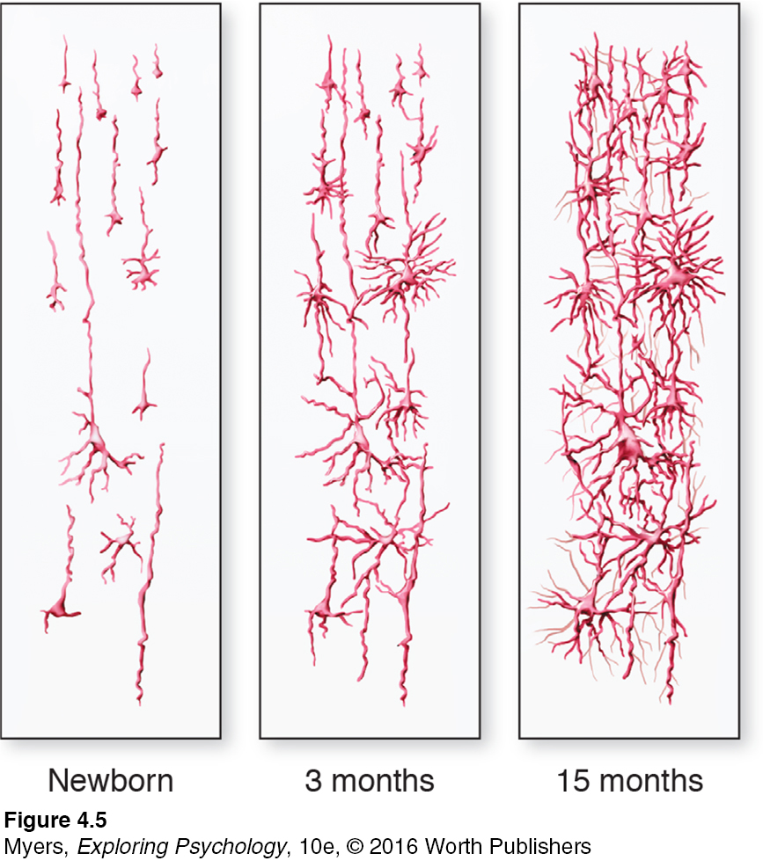
Infancy and Childhood
Physical Development
Brain Development
Notes:
Figure 4.5
Drawings of human cerebral cortex sections
In humans, the brain is immature at birth. As the child matures, the neural networks grow increasingly more complex.

Slide 15
Infancy and Childhood
Physical Development
Brain Development
  Critical period: An optimal period early in the life of an organism when exposure to certain stimuli or experiences produces normal development
  Lacking exposure/experience results in abnormal development
  The brain’s amazing plasticity reorganizes brain tissues in response to new experiences

Slide 16
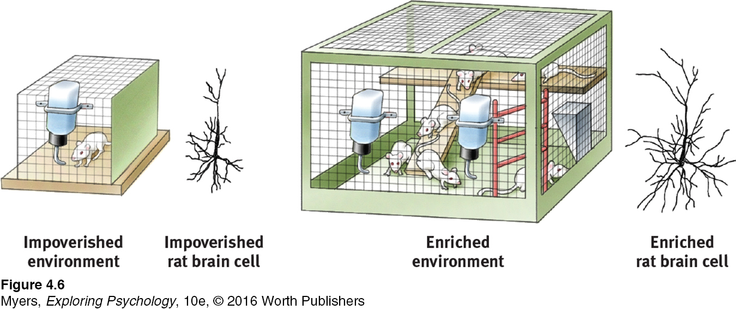
Infancy and Childhood
Physical Development
Brain Development
Notes:
Figure 4.6
Experience Affects Brain Development

Slide 17
Infancy and Childhood
Physical Development
Motor Development
  Developing brain enables physical coordination; as nervous system and muscles mature, skills emerge
  Largely universal in sequence, but not in timing
  Guided by genes and influenced by environment
  The recommended infant back to sleep position (putting babies to sleep on their backs to reduce the risk of a smothering crib death) has been associated with somewhat later crawling but not with later walking

Slide 18
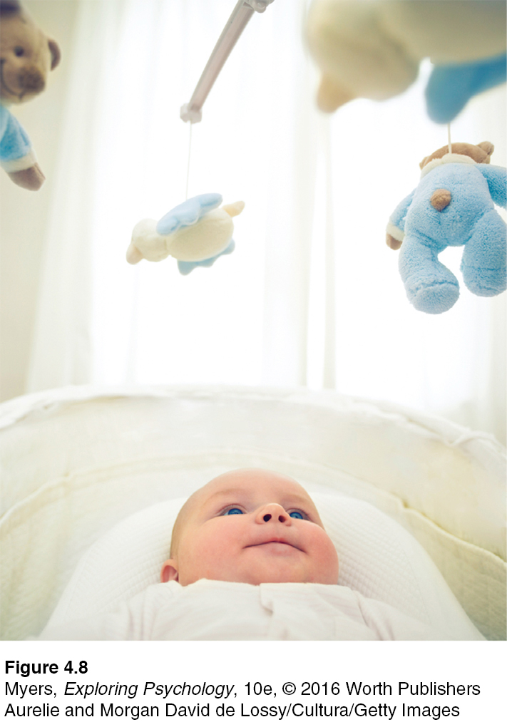
Infancy and Childhood
Physical Development
Brain Maturation and Infant Memory
Infants are capable of learning and remembering.
Waning of infantile amnesia by age 7 or so may reflect brain’s increasing capability of conscious memory.
INFANT AT WORK
Babies only 3 months old can learn that kicking moves a mobile, and they can retain that learning for a month. (From Rovee-Collier, 1989, 1997.)
Notes:
Figure 4.8 What the conscious mind does not know and cannot express in words, the nervous system and our two-track mind somehow remember.

Slide 19
Infancy and Childhood
Cognitive Development
4-5: FROM THE PERSPECTIVES OF PIAGET, VYGOTSKY, AND TODAY’S RESEARCHERS, HOW DOES A CHILD’S MIND DEVELOP?
Jean Piaget was a pioneering developmental psychologist who studied children’s cognitive development
  Children are active thinkers
  Minds develops through series of universal, irreversible stages from simple reflexes to adult abstract reasoning
  Children’s maturing brains build schemas: concepts or frameworks that organize and interpret information
  Schemas are used and adjusted through
    Assimilation: Interpreting new experiences in terms of existing understandings (schemas), and
    Accommodation: Adapting current understandings (schemas) to incorporate new information

Slide 20
Infancy and Childhood
Cognitive Development
Piaget’s Theory and Current Thinking
In Piaget’s view, cognitive development consists of four major stages: sensorimotor, preoperational, concrete operational, and formal operational.
Sensorimotor Stage
From birth to nearly 2 years
Infants know the world mostly in terms of their sensory impressions and motor activities
Infants lack object permanence
    Awareness that things continue to exist even when not perceived
    Mastered around 8 months, when infants begin exhibiting memory for things no longer seen

Slide 21
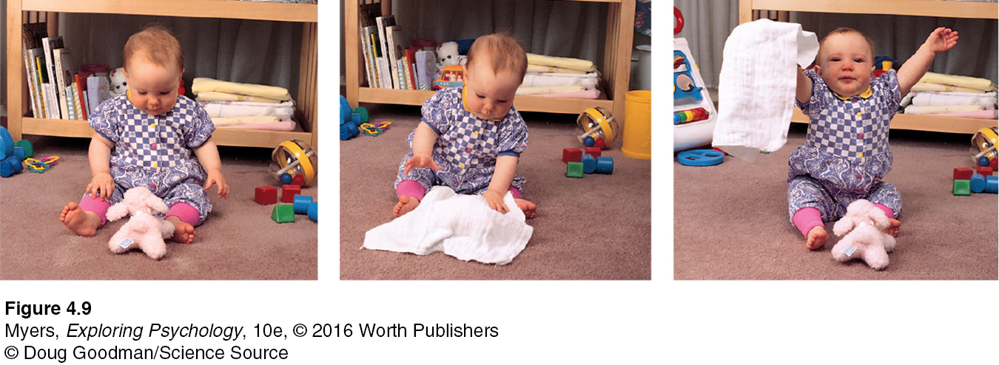
Infancy and Childhood
Cognitive Development
Piaget’s Theory and Current Thinking
Notes:
Figure 4.9 Object Permanence Infants younger than 6 months seldom understand that things continue to exist when they are out of sight. But for this older infant, out of sight is definitely not out of mind.

Slide 22
Infancy and Childhood
Cognitive Development
Piaget’s Theory and Current Thinking
Preoperational Stage
From about 2 to 6 or 7 years
  Child learns to use language but cannot yet perform the mental operations of concrete logic
  Conservation: Principle (which Piaget believed to be a part of concrete operational reasoning) that properties such as mass, volume, and number remain the same despite changes in the forms of objects.
  Children engage in pretend play
  Egocentrism: Children have difficulty perceiving things from another’s point of view.
    Even as adults we may overestimate the extent to which others share our perspectives (the curse of knowledge)

Slide 23
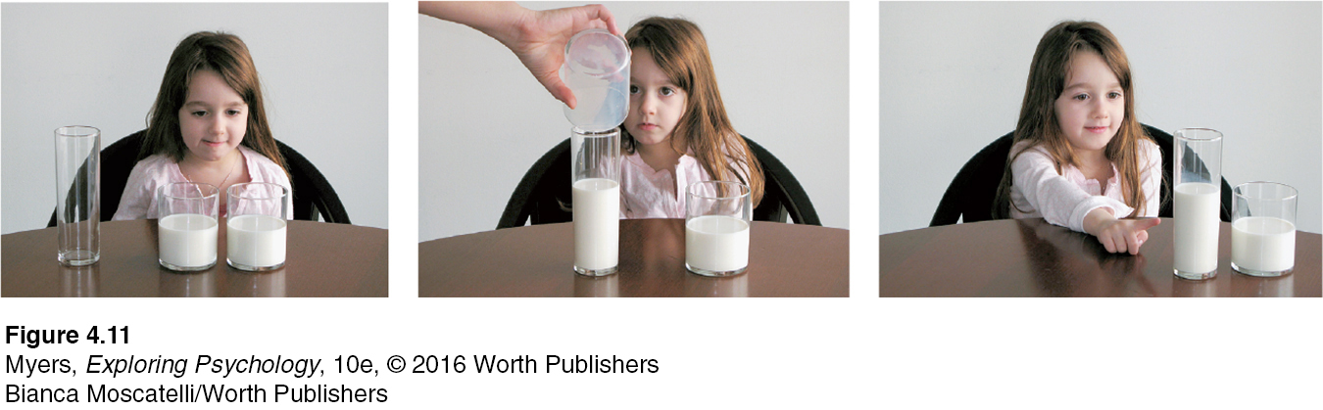
PIAGET’S TEST OF CONSERVATION
This preoperational child does not yet understand the principle of conservation. When the milk is poured into a tall, narrow glass, it suddenly seems like “more” than when it was in the shorter, wider glass. In another year or so, she will understand that the amount stays the same.
Notes:
Figure 4.11

Slide 24
Infancy and Childhood
Cognitive Development
Piaget’s Theory and Current Thinking
Theory of Mind
  Involves ability to read mental state of others
  Between ages 3 and 4½, children worldwide use theory of mind to realize others may hold false beliefs
  By age 4 to 5, children anticipate false beliefs of friends
  Children with autism spectrum disorder have difficulty understanding that another’s state of mind differs from their own.

Slide 25
Infancy and Childhood
Cognitive Development
Piaget’s Theory and Current Thinking
Concrete Operational Stage
From about 7 to 11 years
  Children gain the mental operations that enable them to think logically about concrete events.
  They begin to understanding that a change in form does not mean a change in quantity and become able to understand simple math and conservation.
Formal Operational Stage
From about age 12 through adulthood
  Children are no longer limited to concrete reasoning based on actual experience.
  They are able to think abstractly.

Slide 26
Infancy and Childhood
Cognitive Development
An Alternative Viewpoint: Lev Vygotsky and the Social Child
Piaget emphasized that children’s minds grow through interaction with the physical environment, but Vygotsky focused on how the child’s mind grows through interaction with the social environment.
By age 7, children are able to think and solve problems with words.
By mentoring children, parents and others provide a temporary scaffold to facilitate a child’s higher level of thinking.
Language, an important ingredient of social mentoring, provides the building blocks for thinking.

Slide 27
Infancy and Childhood
Cognitive Development
Reflecting on Piaget’s Theory
Piaget identified significant cognitive milestones and stimulated global interest in cognitive development.
Research findings suggest that the sequence of cognitive milestones unfold basically as Piaget proposed.
Development is more continuous than Piaget theorized.
Children may be more competent than Piaget’s theory revealed.
Notes:
It is useful to remember
Young children are incapable of adult logic.
Children are not passive but active learners.
Child cognition flourishes when adults build on what children know, engage them in concrete demonstrations, and stimulate creative thinking.
Children’s cognitive immaturity is adaptive, keeping them close to protective adults and providing time for learning and socialization.

Slide 28
Infancy and Childhood
Cognitive Development
Autism Spectrum Disorder
4-6: WHAT IS AUTISM SPECTRUM DISORDER?
  Autism spectrum disorder: a disorder that appears in childhood and is marked by significant deficiencies in communication and social interaction, and by rigidly fixated interests and repetitive behaviors
  Children with ASD have impaired theory of mind; reading faces and social signals is challenging for those with ASD.
  Underlying source of ASD’s symptoms seems to be poor communication among brain regions that normally work together to let us take another’s viewpoint.

Slide 29
Infancy and Childhood
Cognitive Development
Autism Spectrum Disorder
  Autism spectrum disorder’s biological factors:
    Genetic influences
    Abnormal brain development
    Prenatal maternal infection, inflammation, psychiatric drug use, or stress hormones
    Childhood MMR vaccines do not lead to ASD
Notes:
ASD has differing levels of severity.

Slide 30
Infancy and Childhood
Cognitive Development
Autism Spectrum Disorder
Prevalence of ASD
  Four boys for every girl
  Risk greater when there are higher levels of prenatal testosterone; Simon Baron-Cohen suggests ASD represents an “extreme male brain”
  Higher when identical co-twin has ASD; younger siblings of those with ASD sibling also at heightened risk
  Random genetic mutations in sperm-producing cells may also play a role; over-40 fathers have much higher risk fathering a child with ASD than do men under age 30
Notes:
By age 8, 1 in 68 U.S. children now gets diagnosed with ASD, though the reported rates vary by place. The increase in ASD diagnoses has been offset by a decrease in the number of children with a “cognitive disability” or “learning disability,” suggesting a relabeling of children’s disorders.

Slide 31
Infancy and Childhood
Social Development
4-7: HOW DO PARENT-INFANT ATTACHMENT BONDS FORM?
  Attachment: Emotional tie with another person; shown in young children by their seeking closeness to the caregiver, and showing distress on separation.
  At about 8 months, soon after object permanence develops, children separated from their caregivers display stranger anxiety.
  Infants form attachments not simply because parents gratify biological needs but, more importantly, because they are comfortable, familiar, and responsive.
Notes:
Stranger anxiety
Fear of strangers that infants commonly display, beginning by about 8 months of age

Slide 32
Infancy and Childhood
Social Development
Human Bonding
Body Contact
  Infant monkeys used “cloth mothers” as secure base to explore and as a safe haven when distressed
  Similar to human infants, who also become attached to parents who are soft and warm—much parent-infant communication occurs via touch

Slide 33
Infancy and Childhood
Social Development
Human Bonding
Familiarity
  Critical period: Optimal period early in the life of an organism when exposure to certain stimuli or experiences produces normal development.
  Imprinting: Process by which certain animals form strong attachments during early life (Lorenz, 1937).

Slide 34
Infancy and Childhood
Social Development
Attachment Differences
4-8: HOW HAVE PSYCHOLOGISTS STUDIED ATTACHMENT DIFFERENCES, AND WHAT HAVE THEY LEARNED?
  Mary Ainsworth designed strange situation experiments, which showed that some children are securely attached and others are insecurely attached
  Infants’ differing attachment styles reflect both their individual temperament and the responsiveness of their parents and child-care providers
Notes:
Secure attachment
Shown by 60 percent of infants
In their mother’s presence, they play comfortably, happily exploring their new environment. When she leaves, they become upset. When she returns, they seek contact with her.
Sensitive, responsive mothers had infants who were securely attached.
Insecure attachment
Infants avoid attachment or show insecure attachment, marked by either anxiety or avoidance of trusting relationships. They are less likely to explore their surroundings. When their mother leaves, they might cry loudly and remain upset, or seem indifferent to her departure and return.
Insensitive, unresponsive mothers often had infants who were insecurely attached.

Slide 35
Infancy and Childhood
Social Development
Attachment Differences
Temperament and Attachment
Temperament: A person’s characteristic emotional reactivity and intensity
  Difficult: Irritable, intense, and unpredictable
  Easy: Cheerful, relaxed, and feeding and sleeping on predictable schedules

Slide 36
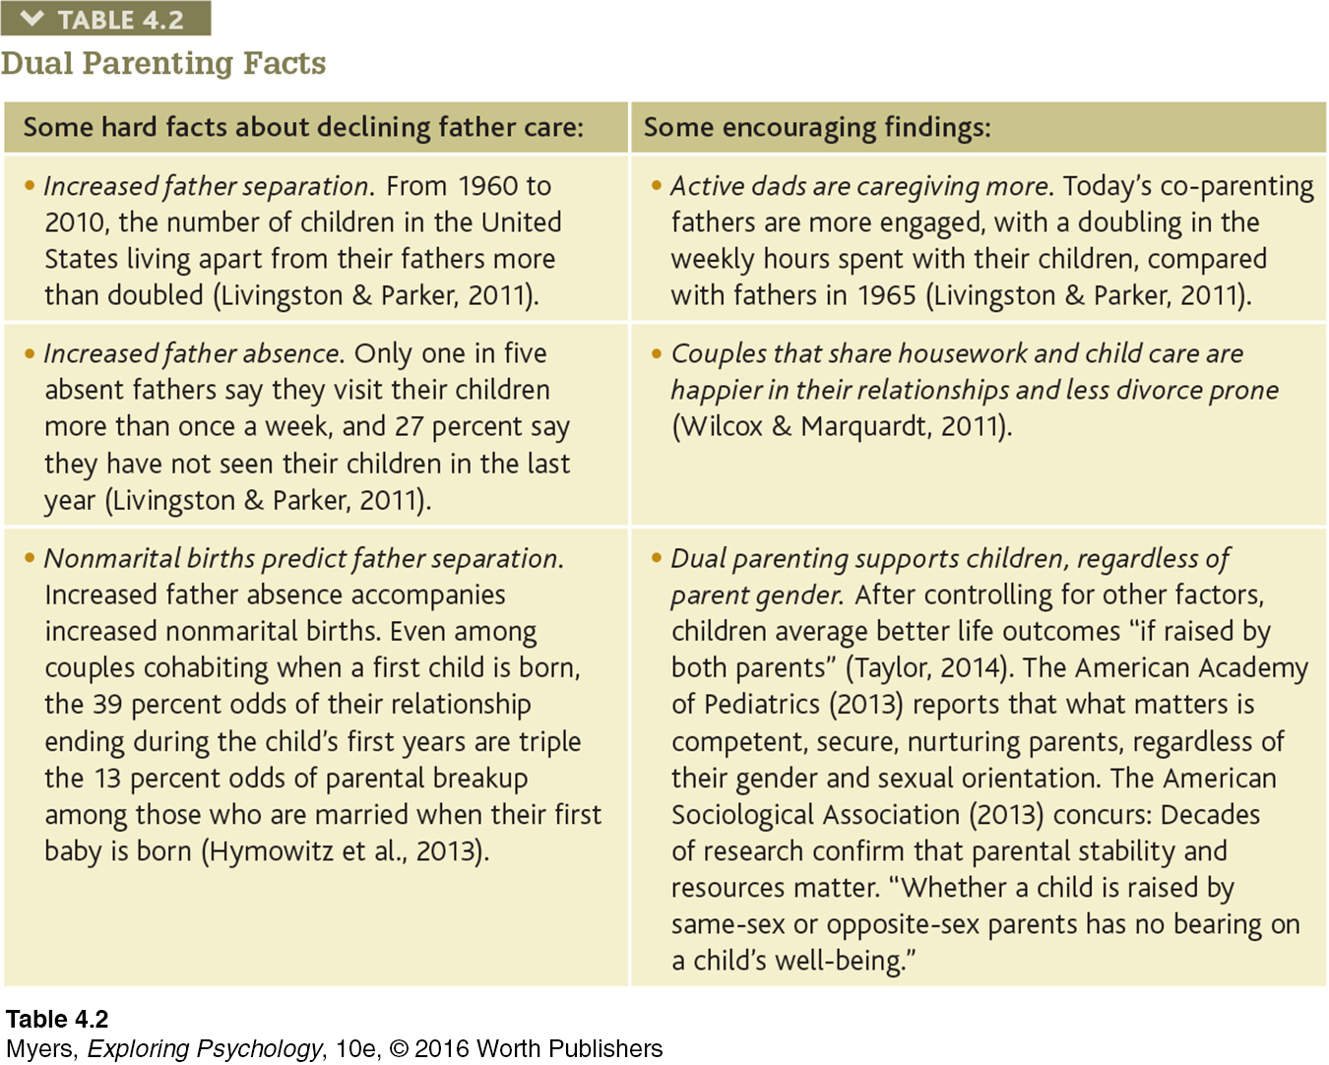
Dual Parenting Facts
Notes:
Table 11.2

Slide 37
Infancy and Childhood
Social Development
Attachment Differences
  Early attachment has impact on later adult relationships and comfort with affection and intimacy
  Adult relationships seem to reflect the attachment styles of early childhood, lending support to Erik Erikson’s idea that basic trust is formed in infancy by our experiences with responsive caregivers.

Slide 38
Infancy and Childhood
Social Development
Attachment Differences
Attachment Styles and Later Relationships
  Basic trust develops in securely attached children
  Basic trust: A sense that the world is predictable and trustworthy
    Said to be formed during infancy by appropriate experiences with responsive caregivers (Erik Erikson, 1902–1994)
  Insecure-anxious attachment: People constantly crave acceptance but remain alert to signs of rejection
  Insecure-avoidant attachment: People experience discomfort getting close to others, and use avoidant strategies to maintain distance from others

Slide 39
Infancy and Childhood
Social Development
Deprivation of Attachment
4-9: HOW DOES CHILDHOOD NEGLECT OR ABUSE AFFECT CHILDREN’S ATTACHMENTS?
  Most children growing up in adversity or experiencing abuse are resilient, withstanding trauma and becoming well-adjusted adults.
  Those who are severely neglected by their parents, or otherwise prevented from forming attachments at an early age, may be at risk for attachment problems.

Slide 40
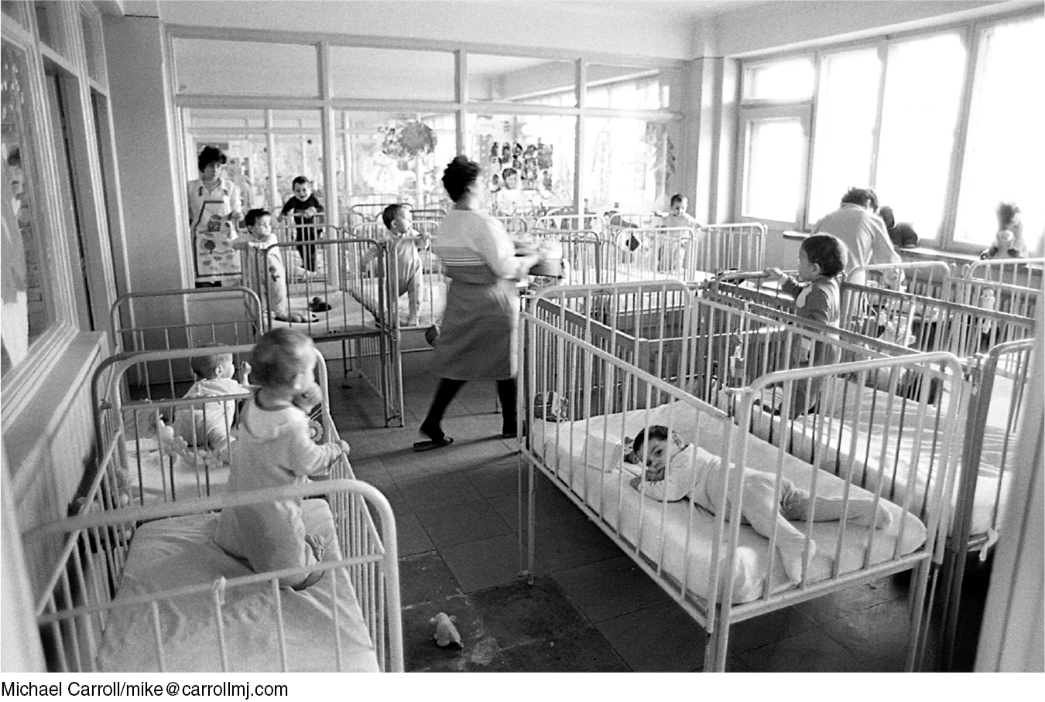
THE DEPRIVATION OF ATTACHMENT
In this 1980s Romanian orphanage, the 250 children between ages one and five outnumbered caregivers 15 to 1. When such children were tested after Romania’s dictator was executed, they had lower intelligence scores and double the 20 percent rate of anxiety symptoms found in children assigned to quality foster care settings (Nelson et al., 2009).

Slide 41
Infancy and Childhood
Social Development
Parenting Styles
4-10: WHAT ARE THREE PARENTING STYLES, AND HOW DO CHILDREN’S TRAITS RELATE TO THEM?
Parenting styles reflect varying degrees of control (Baumrind, 1996, 2013)
  Authoritative parents are warmly concerned and confrontive, and tend to have children with the highest self-esteem, self-reliance, and social competence.
  Permissive parents are unrestraining, and tend to have children who are more aggressive and immature.
  Authoritarian parents are coercive, and tend to have children with less social skills and self-esteem.

Slide 42
Infancy and Childhood
Social Development
Parenting Styles
Culture and Child Raising
  Cultural values vary from place to place and from one time to another within the same place.
  Children have survived and flourished throughout history under various child-raising systems.
  Diversity in child raising should be a reminder that no single culture has the only way to raise children successfully.

Slide 43
Adolescence
4-11: HOW IS ADOLESCENCE DEFINED, AND HOW DO PHYSICAL CHANGES AFFECT DEVELOPING TEENS?
Adolescence is the transition from childhood to adulthood
Extends from puberty to independence
Tension between biological maturity and social independence creates a period of “storm and stress” (Stanley Hall, 1904)

Slide 44
Adolescence
Physical Development
  Puberty: the period of sexual maturity, during which a person becomes capable of reproducing
  Early maturing boys: More popular, self-assured, and independent; more at risk for alcohol use, delinquency, and premature sexual activity.
  Early maturing girls: Mismatch between physical and emotional maturity may encourage search for older teens; teasing or sexual harassment may occur.
  The teenage brain: Frontal lobe development and synaptic pruning occur. Maturation of the frontal lobes lags behind that of the emotional limbic system; this and puberty’s hormonal surge may produce irrational and risky behaviors.

Slide 45
Adolescence
Cognitive Development
Developing Reasoning Power
4-12: HOW DID PIAGET, KOHLBERG, AND LATER RESEARCHERS DESCRIBE ADOLESCENT COGNITIVE AND MORAL DEVELOPMENT?
  Develop new abstract thinking tools (formal operations)
  Reason hypothetically and deduce consequences
  Detect inconsistencies in others’ reasoning, sometimes leading to heated debates with parents and silent vows to never lose sight of their own ideals
  Reason logically and develop moral judgment

Slide 46
Adolescence
Cognitive Development
Developing Morality
Moral Reasoning
  Jean Piaget: Children’s moral judgments build on their cognitive development.
  Lawrence Kohlberg: Agreed, and sought to describe a moral reasoning that develops in universal sequence to guide moral actions
Moral intuition
  Jonathan Haidt: Much of morality rooted in moral intuitions that are made quickly and automatically
Moral action
  Moral action feeds moral attitudes.
  Walter Mischel: Ability to delay gratification linked to more positive outcomes in adulthood
Notes:
Lawrence Kohlberg proposed a stage theory of moral reasoning, from a preconventional morality of self-interest, to a conventional morality concerned with upholding laws and social rules, to (in some people) a postconventional morality of universal ethical principles.

Slide 47
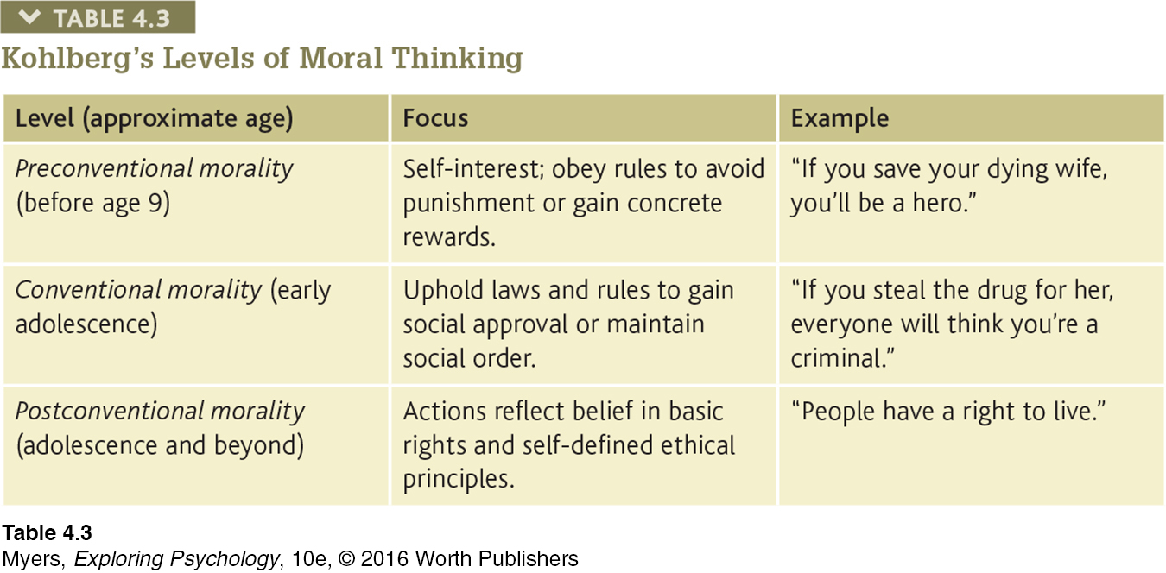
Kohlberg’s Levels of Moral Thinking
Notes:
Table 4.3

Slide 48
Adolescence
Social Development
Forming an Identity
4-13: WHAT ARE THE SOCIAL TASKS AND CHALLENGES OF ADOLESCENCE?
Adolescence struggle involves identity versus role confusion, a struggle that continues into adulthood.
Identity: Our sense of self; according to Erikson, the adolescent’s task is to solidify a sense of self by testing and integrating various roles.
Social identity: Involves the “we” aspect of self-concept that comes from group memberships.
Healthy identity formation is followed by a capacity to build close relationships.
Intimacy: In Erikson’s theory, the ability to form close, loving relationships; a primary developmental task in young adulthood.

Slide 49
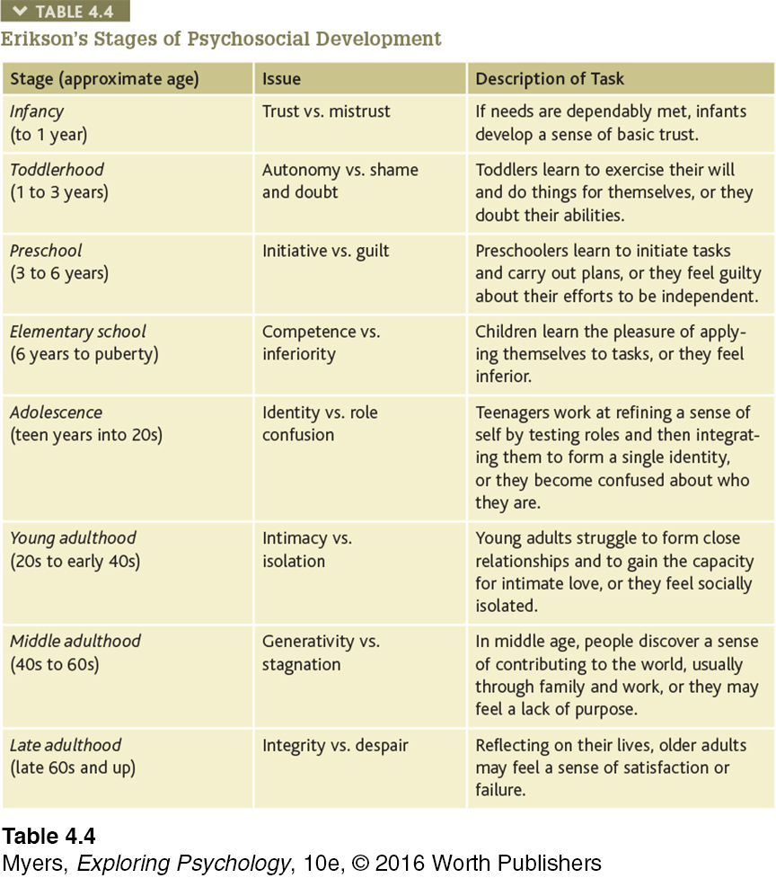
Adolescence
Social Development
Forming an Identity
Notes:
Table 4.4 Erikson’s Stages of Psychosocial Development

Slide 50
Adolescence
Social Development
Parent and Peer Relationships
4-14: HOW DO PARENTS AND PEERS INFLUENCE ADOLESCENTS?
People seek to fit in with and are influenced by their groups, especially during childhood and teen years. Influence of parents and peers is complementary.
Parents: Parent-child arguments increase but most adolescents report liking their parents. Argument content is usually over mundane things, and tends to be greater with first-born than with second-born children.
Peers: Peers influence behavior, social networking is often extensive, and exclusion can be painful or worse.

Slide 51
Adolescence
Social Development
Parent and Peer Relationships
Parents
Are more important when it comes to education, discipline, charitableness, responsibility, orderliness, and ways of interacting with authority figures
Peers
Are more important for learning cooperation, for finding the road to popularity, for inventing styles of interaction among people of the same age

Slide 52
Adolescence
Emerging Adulthood
4-15: WHAT IS EMERGING ADULTHOOD?
  Includes the time from about age 18 to the mid-twenties, when in many Western cultures young people are no longer adolescents but have not yet achieved full independence as adults; they are in a not-yet-settled phase of life
  Characterized by not yet assuming adult responsibilities and independences and by feelings of being “in between”
  May involve living with and emotionally dependent upon parents

Slide 53
Adulthood
Stages of adulthood:
Early adulthood: Roughly twenties and thirties
Middle adulthood: To age 65
Late adulthood: Years after 65
People vary widely in physical, psychological, and social development within each of these stages

Slide 54
Adulthood
Physical Development
Physical Changes in Middle Adulthood
4-16: WHAT PHYSICAL CHANGES OCCUR DURING MIDDLE AND LATE ADULTHOOD?
Early adulthood
  Muscular strength, reaction time, sensory keenness and cardiac output peak in our mid-twenties.
Middle adulthood
  Physical vigor more closely linked to health and exercise habits than age
  Physical decline is gradual; gradual decline in fertility
  Females experience menopause, the time of natural cessation of menstruation; the biological changes a woman experiences as her ability to reproduce declines
  Males experience a gradual decline in sperm count, testosterone level, and erection and ejaculation speed

Slide 55
Adulthood
Physical Development
Physical Changes in Late Adulthood
Sensory Abilities, Strength, and Stamina: Visual sharpness, distance perception, and stamina diminish; pupils shrink and the lens becomes less transparent
Health: Immune system weakens and susceptibility to life-threatening disease increases, though people over 65 suffer fewer short-term ailments
The Aging Brain: Neural processing lag occurs; brain regions related to memory begin to atrophy; inhibition-control from frontal lobes may decline, leading to blunt questions and comments
Exercise and Aging: Exercise slows aging and stimulates brain cell development and neural connections; aids memory by promoting neurogenesis; helps maintain telomeres (tips of chromosomes)

Slide 56
Adulthood
Cognitive Development
Aging and Memory
4-17: HOW DOES MEMORY CHANGE WITH AGE?
Early adulthood is peak time for some types of learning and remembering.
Middle adulthood shows greater decline in ability to recall rather than recognize memory.
Late adulthood is characterized by better retention of meaningful than meaningless information, which rich web of existing knowledge will help retain; longer word and information production time.

Slide 57
Adulthood
Cognitive Development
Sustaining Mental Abilities
Our brains remain plastic throughout life.
Cognitive training (memory, visual tracking, problem-solving exercises) can sharpen the mind, but the effects are limited
Brain training may produce some benefits, but generally short-term gains alone, and only for the trained tasks, not for cognitive abilities in general

Slide 58
Adulthood
Cognitive Development
Sustaining Mental Abilities
Developmental researchers study age-related changes such as in memory with cross-sectional studies (comparing people of different ages) and longitudinal studies (retesting the same people over a period of years).
Age is less a predictor of memory and intelligence than is proximity to death. As death approaches, cognitive decline typically accelerates; this is referred to as terminal decline.
Notes:
Developmental researchers study age-related changes such as in memory with cross-sectional studies (comparing
people of different ages) and longitudinal studies (retesting the same people over a period of years).

Slide 59
Adulthood
Social Development
Adulthood’s Ages and Stages
4-18: WHAT THEMES AND INFLUENCES MARK OUR SOCIAL JOURNEY FROM EARLY ADULTHOOD TO DEATH?
  Midlife transition occurs in the early forties, when people realize that life will soon be mostly behind them instead of ahead of them
  Social clock: The culturally preferred timing of social events such as marriage, parenthood, and retirement
  Social clock varies from era to era and culture to culture
  For the 1 in 4 adults who report experiencing a life crisis, the trigger is not age but rather a major event, such as illness, divorce, or job loss
  Chance events have lasting impact, deflecting us down one road rather than another

Slide 60
Adulthood
Social Development
Adulthood’s Commitments
Love
Adult bonds of love are most enduring when sealed with commitment (marriage or civil unions), with satisfaction related to shared interests and values, mutual emotional and material support, and self-disclosure.
Marriage is predictive of happiness, sexual satisfaction, income, and physical and mental health.
Compared with their counterparts of 30 years ago, people in Western countries are better educated and marrying later; this may help explain why the American divorce rate, which surged from 1960 to 1980, has since leveled off and even slightly declined in some areas.
Trial marriages related to higher rates of divorce and marital dysfunction.
More and more people meeting their partners online.
Notes:
Sigmund Freud (1935) put it most simply: The healthy adult, he said, is one who can love and work.

Slide 61
Adulthood
Social Development
Adulthood’s Commitments
Work
  Work provides a sense of competence, accomplishment, and self-definition for many adults.
  “Who are you?” often depends a great deal upon the answer to “What do you do?”
  Few students in their first two years of college or university can predict their later careers.
  Happiness is about having work that fits your interests and about which you can be proud.

Slide 62
Adulthood
Social Development
Well-Being Across the Life Span
4-19: HOW DOES OUR WELL-BEING CHANGE ACROSS THE LIFE SPAN?
Positive feelings grow after midlife and negative feelings decline.
Older adults report less anger, stress, and worry and have fewer social relationship problems.
Brain-wave reactions to negative images diminish with age.
At all ages, people are happiest when they are not alone.
Notes:
People over 65 report as much happiness and satisfaction with life as younger people do.

Slide 63
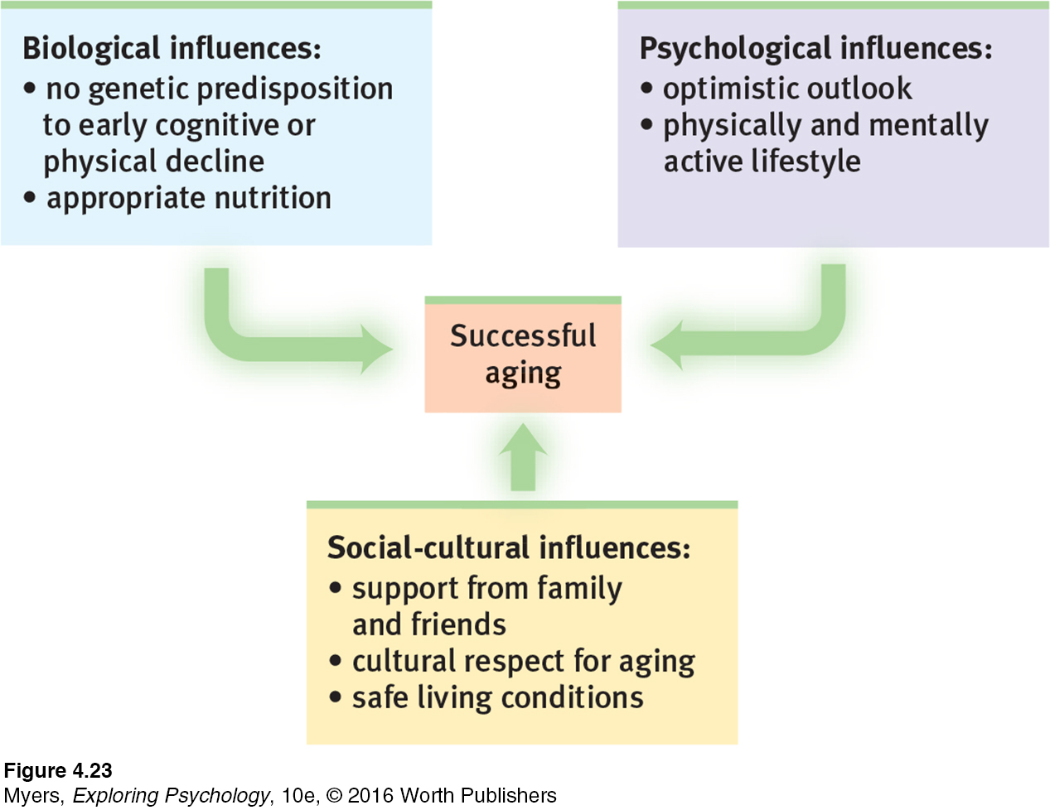
Adulthood
Social Development
Well-Being Across the Life Span
Notes:
Figure 4.23
Biopsychosocial Influences on Successful Aging

Slide 64
Adulthood
Social Development
Death and Dying
4-20: A LOVED ONE’S DEATH TRIGGERS WHAT RANGE OF REACTIONS?
Most of us will suffer and cope with the deaths of relatives and friends. For most people, the most difficult separation is the death of a spouse, a loss suffered by four times more women than men.
Grief is severe when a loved one’s death comes suddenly and before its expected time on the social clock.
Grief reactions vary by culture and individuals within cultures.

Slide 65
Adulthood
Social Development
Death and Dying
Contrary to popular misconceptions:
  Immediately expressed grief is not necessarily purged faster.
  Adjustment time with or without grief counseling is about equally effective.
  Terminally ill and grief-stricken people do not go through identical stages.
Strong expressions of emotion do not purge grief, and bereavement therapy is not significantly more effective than grieving without such aid. Erikson viewed the late-adulthood psychosocial task as developing a sense of integrity (versus despair).

