Slide 1
Chapter 9
Thinking, Language and Intelligence

Slide 2
Chapter Overview
Thinking
Language and Thought
Intelligence and Its Assessment
Genetic and Environmental Influences on Intelligence

Slide 3
Thinking
Concepts
9-1: WHAT IS COGNITION, AND WHAT ARE THE FUNCTIONS OF CONCEPTS?
Cognition: All the mental activities associated with thinking, knowing, remembering, and communicating.
Concepts help to simplify thinking through mental grouping of similar objects, events, ideas, or people.
After placing an item in a category, memory gradually shifts it toward a category prototype.
Categories boundaries begin to blur as movement away from prototypes occurs.
Notes:
Cognition
All the mental activities associated with thinking, knowing, remembering, and communicating
Concepts
Mental grouping of similar objects, events, ideas, or people
New items matched to prototypes for sorting into categories
Prototypes
Mental image or best example of a category
Matching new items to a prototype provides a quick and easy method (feathered creatures to a prototypical bird, such as a robin)

Slide 4
Thinking
Problem Solving: Strategies and Obstacles
9-2: WHAT COGNITIVE STRATEGIES ASSIST OUR PROBLEM SOLVING, AND WHAT OBSTACLES HINDER IT?
An algorithm is a methodical, logical rule or procedure that guarantees a solution to a problem.
A heuristic is a simpler strategy that is usually speedier than an algorithm but is also more error prone.
Insight is not a strategy-based solution, but rather a sudden flash of inspiration that solves a problem.

Slide 5
Thinking
Problem Solving: Strategies and Obstacles
Once we incorrectly represent a problem, it’s hard to restructure how we approach it.
Confirmation bias predisposes us to verify rather than challenge our preconceptions.
Fixation, such as mental set, may prevent us from taking the fresh perspective that would lead to a solution.
Notes:
Fixation
Inability to see problem from a fresh perspective
Mental set
Tendency to approach a problem with previously successful mind-set; example of fixation

Slide 6
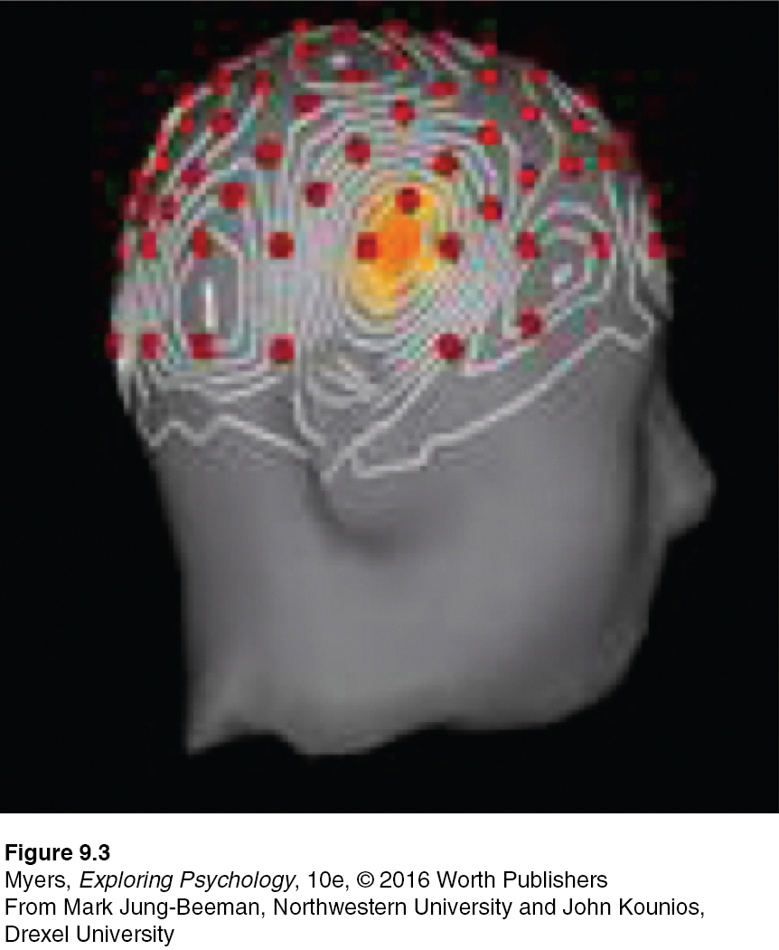
Thinking
THE Aha! MOMENT
A burst of right temporal lobe activity (yellow area) accompanied insight solutions to word problems (Jung-Beeman et al., 2004).
The red dots show placement of the EEG electrodes. The light gray lines show patterns of brain activity during insight.
The insight-related activity is centered in the right temporal lobe (yellow area).

Slide 7
Thinking
Forming Good and Bad Decisions and Judgments
9-3: WHAT IS INTUITION, AND HOW CAN THE AVAILABILITY HEURISTIC, OVERCONFIDENCE, BELIEF PERSEVERENCE, AND FRAMING INFLUENCE OUR DECISIONS AND JUDGMENTS?
Intuition is an effortless, immediate, automatic feeling or thought, as contrasted with explicit, conscious reasoning.
Availability heuristics can distort judgment by estimating event likelihood based on memory availability.
We reason emotionally and neglect probabilities
We overfeel and underthink.

Slide 8
Thinking
THE FEAR FACTOR—WHY WE FEAR THE WRONG THINGS
9-4: WHAT FACTORS CONTRIBUTE TO OUR FEAR OF UNLIKELY EVENTS?
We fear what our ancestral history has prepared us to fear.
We fear what we cannot control.
We fear what is immediate.
We fear what is most readily available in memory.
Notes:
Figure 9.6
Images of 9/11 etched a sharper image in American minds than did the millions of fatality-free flights on U.S. airlines during 2002 and after.
Dramatic events are readily available to memory, and they shape our perceptions of risk.

Slide 9
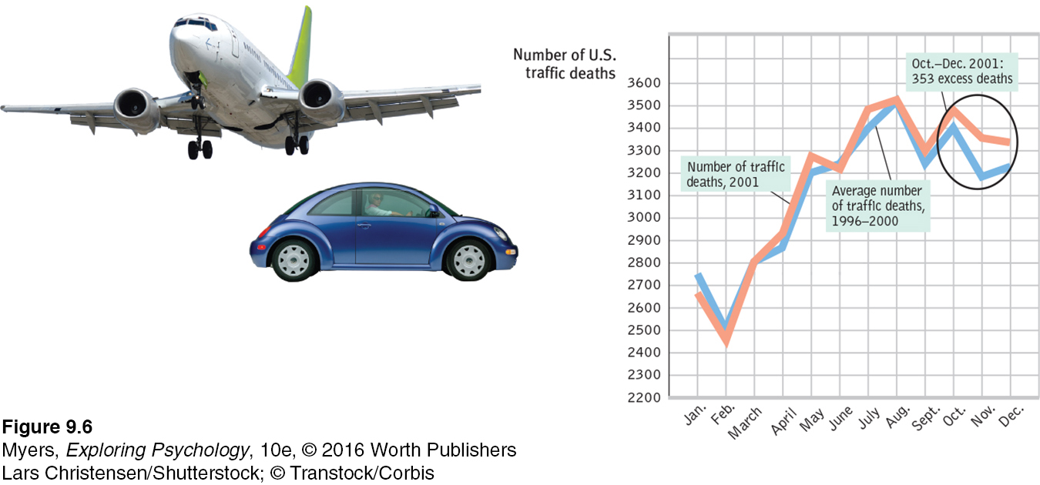
Thinking
THE FEAR FACTOR—WHY WE FEAR THE WRONG THINGS
SCARING US ONTO DEADLY HIGHWAYS In the three months after 9/11, faulty perceptions led more Americans to travel, and some to die, by car. (Data from Gigerenzer, 2004.)
Notes:
Figure 9.6
Images of 9/11 etched a sharper image in American minds than did the millions of fatality-free flights on U.S. airlines during 2002 and after.
Dramatic events are readily available to memory, and they shape our perceptions of risk.

Slide 10
Thinking
Forming Good and Bad Decisions and Judgments
Overconfidence
The tendency to overestimate the accuracy of our knowledge and judgment.
  Across various tasks, people overestimate their performance. Class assignments generally take about twice the number of days students predict they will. This planning fallacy also routinely occurs with construction projects, which often finish late and over budget.
Belief Perseverance
Belief perseverance occurs when we cling to beliefs and ignore evidence that proves these are wrong.
  To rein in belief perseverance, consider the opposite. Comprehensively imagining and really pondering the other side of an issue can help reduce biases.

Slide 11
Thinking
Forming Good and Bad Decisions and Judgments
The Effects of Framing
Framing—the way we present an issue—sways our decisions and judgments. It can be a powerful took of persuasion. Carefully posed options can nudge people toward decisions that could benefit them or society as a whole.
Can you think of any such decisions?
Notes:
Choosing to be an organ donor, depending on where you live (opt in or opt out).
Helping employees decide to save for retirement (by choice or automatic deduction).
Boosting student moral (a “hard” exam can seem easier if scored out of 137, not 100, points).

Slide 12
Thinking
Forming Good and Bad Decisions and Judgments
The Perils and Powers of Intuition
9-5: HOW DO SMART THINKERS USE INTUITION?
Intuition is analysis “frozen into habit.”
  Intuition is implicit knowledge.
Intuition is usually adaptive, enabling quick reactions.
  Learned associations surface as gut feelings.
Intuition flows from unconscious processing.
  Complex decisions often benefit from letting our brain work on the problem without consciously thinking about it.
The bottom line: Our two-track mind makes sweet harmony as smart, critical thinking listens to the creative whispers of our vast unseen mind and then evaluates evidence, tests conclusions, and plans for the future.

Slide 13
Thinking
Thinking Creatively
9-6: WHAT IS CREATIVITY, AND WHAT FOSTERS IT?
Creativity is the ability to produce novel and valuable ideas.
It is supported by
  Aptitude (the ability to learn)
  Intelligence
  Working memory
Aptitude tests such as the SAT, which demand a single correct answer, require convergent thinking. Creativity tests (How many uses can you think of for a brick?) require expansive divergent thinking.

Slide 14
Thinking
Thinking Creatively
Divergent thinking
  Expands the number of possible problem solutions; creative thinking that diverges in different directions
Convergent thinking
  Narrows the available problem solutions to determine the single best solution

Slide 15
Thinking
Thinking Creatively
Robert Sternberg and his colleagues propose five components of creativity (Sternberg, 1988, 2003; Sternberg & Lubart, 1991, 1992):
  Expertise
  Imaginative thinking skills
  A venturesome personality
  Intrinsic motivation
  A creative environment
Ideas to boost your own creativity:
  Develop your expertise
  Allow time for incubation, setting aside problems for a while when needed
  Allow the mind to roam freely, without distractions
  Experience other cultures and ways of thinking

Slide 16
Thinking
Do Other Species Share Our Cognitive Skills?
9-7: WHAT DO WE KNOW ABOUT THINKING IN OTHER ANIMALS?
Researchers make inferences about other species’ consciousness and intelligence based on behavior.
  Many other animals use concepts, numbers, and tools, and can transmit learning from one generation to the next.
  Some species also show insight, self-awareness, altruism, cooperation, empathy, group aggression, and grief.

Slide 17
Thinking
Do Other Species Share Our Cognitive Skills?
Using concepts and numbers
  Several species demonstrate ability to sort (even pigeons and bears).
Displaying insight
  Humans are not the only species to display insight (chimpanzees and even crows).
Using tools and transmitting culture
  Various species have displayed creative tool use (e.g., forest-dwelling chimpanzees; elephants; humans).

Slide 18
Language and Thought
Language: Our spoken, written, or signed words and the ways we combine them to communicate meaning.
As cognitive scientist Steven Pinker (1998) has noted, we sometimes sit for hours “listening to other people make noise as they exhale, because those hisses and squeaks contain information.”
Psychologist Lera Boroditsky (2009): “Language is so fundamental to our experience, so deeply a part of being human, that it’s hard to imagine life without it.”

Slide 19
Language and Thought
Language Structure
9-8: WHAT ARE THE STRUCTURAL COMPONENTS OF LANGUAGE?
Three building blocks of spoken language
  Phonemes are smallest distinctive sound units in language.
  Morphemes are smallest language units that carry meaning.
  Grammar is the system of rules that enables humans to communicate with one another.
    Semantics: How we derive meaning from sounds
    Syntax: How we order words into sentences

Slide 20
Language and Thought
Language Structure
Language is complexity built from simplicity.
Linguist Noam Chomsky: All languages share some basic elements, which he calls universal grammar.
Behaviorist B. F. Skinner: We can explain the wide diversity of languages with familiar learning principles, such as association, imitation, and reinforcement.
No matter what the language, we start speaking it mostly in nouns rather than verbs and adjectives. Biology and experience work together.

Slide 21
Language and Thought
Language Development
When and How Do We Learn Language?
9-9: WHAT ARE THE MILESTONES IN LANGUAGE DEVELOPMENT, AND HOW DO WE ACQUIRE LANGUAGE?
Receptive language: Infant ability to understand what is said to them begins around 4 months, when they start to recognize differences in speech sounds.
Productive language: Infant ability to produce words begins around 10 months, when babbling starts to resemble the household language.
Month (approx.) | Stage
4 | Babbles many speech sounds (“ah-goo”)
10 | Babbling resembles household language (“ma-ma”)
12 | One-word stage (“Kitty!”)
24 | Two-word speech (“Get ball.”)
24+ | Rapid development into complete sentences
Notes:
Table 9.1
Receptive language
Language moves from simple to complex.
Infants start without language.
By 4 months, babies can recognize different speech sounds and read lips. They show preference for face that matches a sound (noticing lip movement).
By 7 months and beyond, babies improve in listening ability to break spoken sounds into individual words.
Productive language
Matures after receptive language.
At 4 months, babbling stage—not imitation of adult speech.
By 10 months, babbling changed so household language can be identified. Babies lose ability to hear and produce sounds and tones found outside their native language.

Slide 22
Language and Thought
Language Development
When and How Do We Learn Language?
One-word stage
  By year one, most children enter this stage.
  They begin to use barely recognizable syllables to communicate.
  First words are often nouns that label objects or people.
Two-word stage
  Around 18 months, word learning explodes—from a word each week to a word each day.
  During this stage, children speak mostly in two-word sentences.
Telegraphic speech
  Early speech stage in which children’s speech resembles a telegram—“go car”—using mostly nouns and verbs
  Speech follows rules of syntax and arrange words in sensible order.
By early elementary school, children understand complex sentences.

Slide 23
Language and Thought
Language Development
When and How Do We Learn Language?
Childhood seems to represent a critical period for mastering certain aspects of language before the language-learning window closes.
People who learn a second language as adults usually speak it with the accent of their native language, and they also have difficulty mastering the new grammar.
Later-than-usual exposure to language (at age 2 or 3) unleashes the idle language capacity of a child’s brain, producing a rush of language. But by about age 7, those who have not been exposed to either a spoken or a signed language gradually lose their ability to master any language.

Slide 24
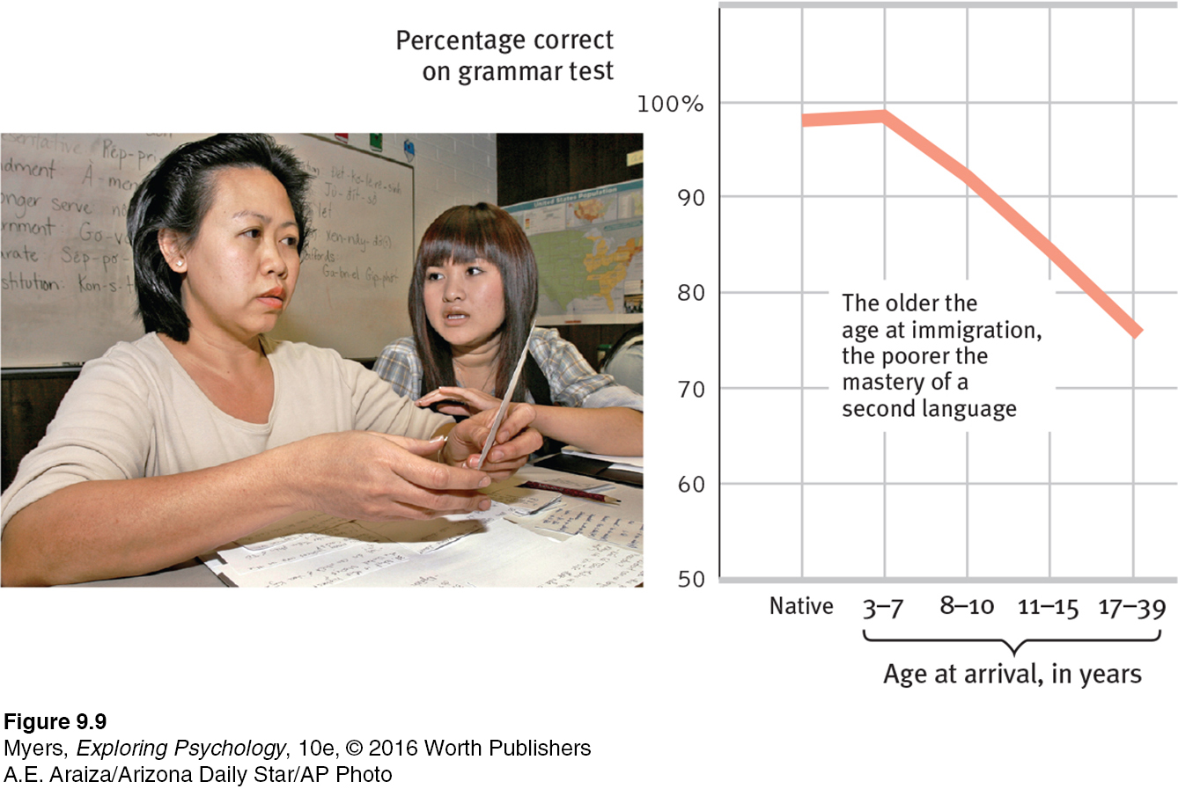
Language Development
Critical Periods
OUR ABILITY TO LEARN A NEW LANGUAGE DIMINISHES WITH AGE Ten years after coming to the United States, Asian immigrants took a grammar test. Although there is no sharply defined critical period for second language learning, those who arrived before age 8 understood American English grammar as well as native speakers did. Those who arrived later did not. (Data from Johnson & Newport, 1991.)
Notes:
Figure 9.9

Slide 25
Language and Thought
Language Development
Deafness and Language Development
Deaf children born to hearing-nonsigning parents typically do not experience language during their early years.
Natively deaf children who learn sign language after age 9 never learn it as well as those who lose their hearing at age 9 after learning a spoken language, or as well as natively deaf children who learned sign in infancy.
Those who learn to sign as teens or adults are like immigrants who learn English after childhood: They can master basic words and learn to order them, but never become as fluent as native signers in producing and comprehending subtle grammatical differences.

Slide 26
Language and Thought
The Brain and Language
9-10: WHAT BRAIN AREAS ARE INVOLVED IN LANGUAGE PROCESSING AND SPEECH?
Aphasia: An impairment of language, usually caused by left hemisphere damage either to Broca’s area or Wernicke’s area.
  Damage to Broca’s area impairs speaking
  Damage to Wernicke’s area impairs understanding
Damage to any one of several areas of the brain’s cortex can impair language.
Today’s neuroscience has confirmed brain activity in Broca’s and Wernicke’s areas during language processing.
In processing language, as in other forms of information processing, the brain operates by dividing its mental functions—speaking, perceiving, thinking, remembering—into smaller subfunctions.

Slide 27
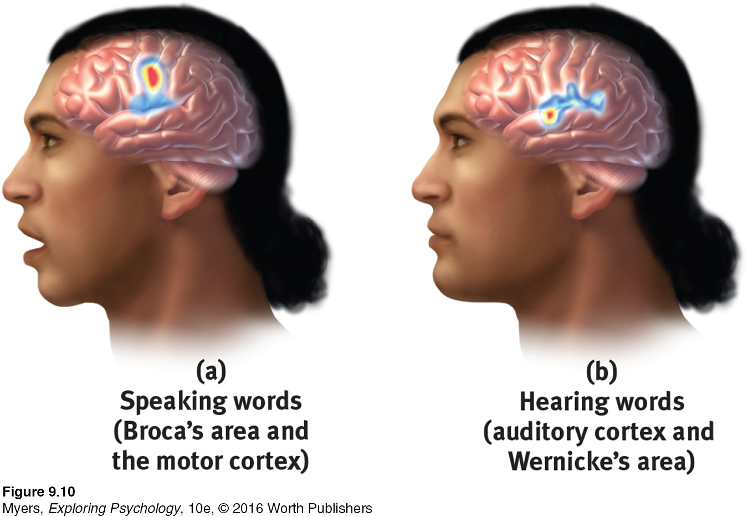
Brain Activity When Speaking and Hearing Words
Broca’s area
Wernicke’s area
Notes:
Figure 9.10
Broca’s area controls language expression—an area of the frontal lobe, usually in the left hemisphere, that directs the muscle movements involved in speech.
Wernicke’s area controls language reception—a brain area involved in language comprehension and expression; usually in the left temporal lobe.

Slide 28
Language and Thought
Do Other Species Have Language?
9-11: WHAT DO WE KNOW ABOUT OTHER ANIMALS’ CAPACITY FOR LANGUAGE?
Animals display a wide range of comprehension and communication.
  Vervet monkeys sound different alarms for different predators.
  Chimpanzees (Washoe, for example) have been taught some sign language. A bonobo (Kanzi) has done even better.
  Critics note that signed ape vocabularies and sentences are simple; vocabulary gained with great difficulties.
If by language we mean verbal or signed expression of complex grammar, most psychologists would agree humans alone possess language.
Notes:
Only humans communicate in complex sentences. Nevertheless, other animals’ impressive abilities to think and communicate challenge humans to consider what this means about the moral rights of other species.

Slide 29
Language and Thought
Thinking Influences Language
9-12: WHAT IS THE RELATIONSHIP BETWEEN THINKING AND LANGUAGE, AND WHAT IS THE VALUE OF THINKING IN IMAGES?
Language Influences Thinking
Benjamin Lee Whorf’s linguistic determinism hypothesis: Language determines the way we think
  Evidence from bilingual speakers suggest people think differently in different languages
  Bilingual parents often switch language to express different emotions (from English to Mandarin when expressing anger by one mother of a Chinese-American student, for example).
Worf’s hypothesis is too extreme: Words influence but do not determine thinking.

Slide 30

Language and Thought
Language Influences Thinking
Words influence our thinking about colors.
Colors seen in same way but we use our native languages to classify and remember them.
Perceived differences expand as we assign different names.
In Papua New Guinea, Berinmo children have words for different shades of “yellow,” which might enable them to spot and recall yellow variations more quickly. Here and everywhere, “the languages we speak profoundly shape the way we think, the way we see the world, the way we live our lives,” notes psychologist Lera Boroditsky (2009).

Slide 31
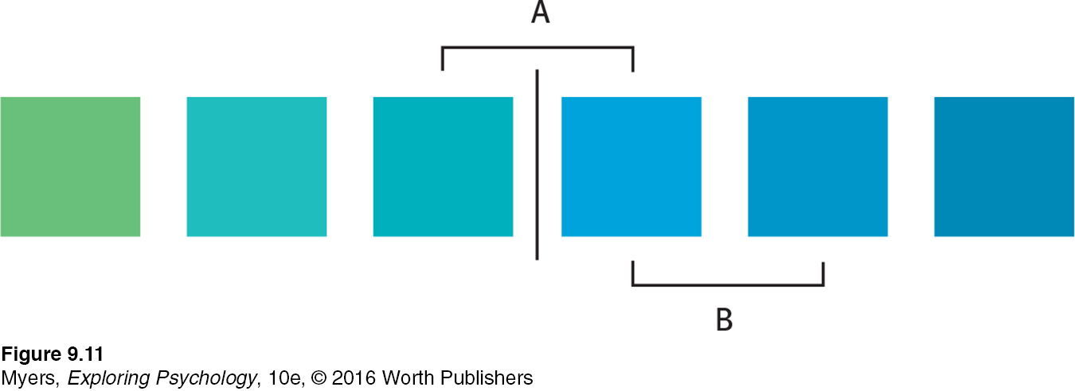
Language and Thought
Language Influences Thinking
Language and Perception
Notes:
Figure 9.11 When people view blocks of equally different colors, they perceive those with different names as more different. Thus the “green” and “blue” in contrast A may appear to differ more than the two equally different blues in contrast B. (Özgen, 2004).

Slide 32
Language and Thought
Language Influences Thinking
Expanding language expands ability to think
Bilingual speakers use executive control over language (the bilingual advantage) to inhibit attention to irrelevant information
Language connects us to each other, and to the past and the future. “To destroy a people, destroy their language” (poet Joy Harjo).

Slide 33
Language and Thought
Language Influences Thinking
Thinking in Images
After learning a skill, watching the activity activates the brain’s internal stimulation of it (fMRI research of Calvo-Merino et al., 2004).
Mental rehearsal can aid in academic goal achievement (process stimulation).
The point to remember: It’s better to spend time planning how to get somewhere than to dwell on the imagined destination.

Slide 34
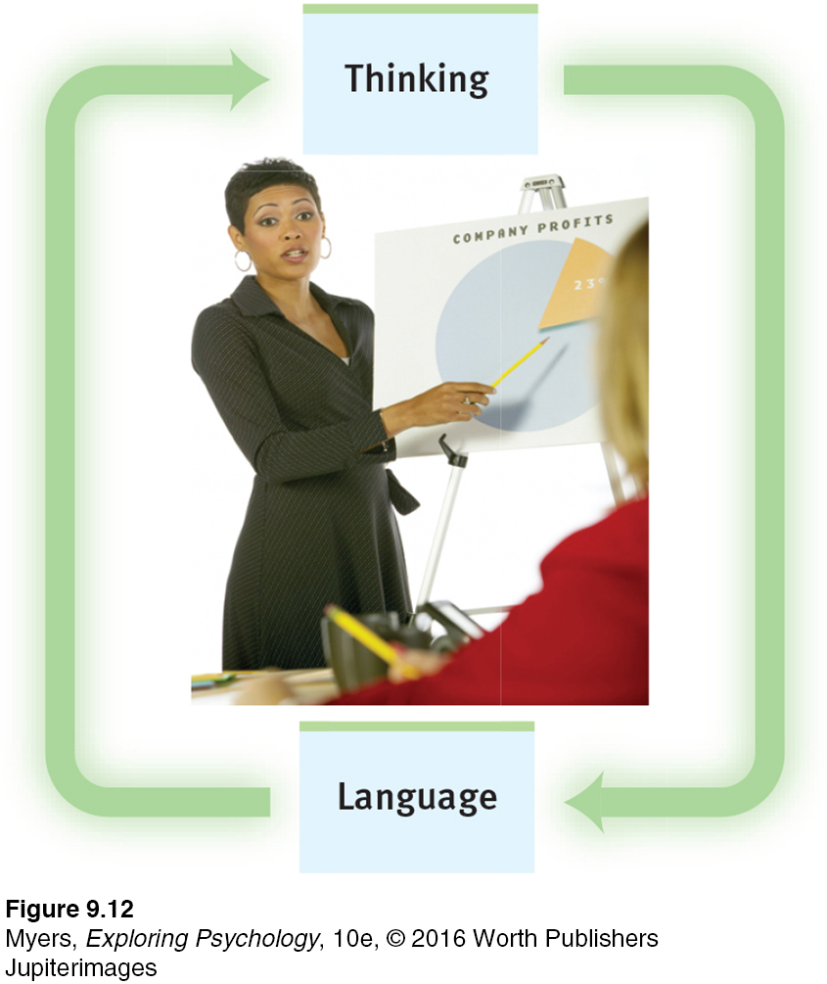
Language and Thought
Language Influences Thinking
The Interplay of Thought and Language
Notes:
Figure 9.12 The traffic runs both ways between thinking and language. Thinking affects language, which affects our thought.

Slide 35
Intelligence and Its Assessment
What Is Intelligence?
9-13: HOW DO PSYCHOLOGISTS DEFINE INTELLIGENCE, AND WHAT ARE THE ARGUMENTS FOR g?
Intelligence: The mental potential to learn from experience, solve problems, and use knowledge to adapt to new situations.
In many studies, intelligence has been defined as whatever intelligence tests measure (which has tended to be school smarts).
Intelligence is a socially constructed concept: It is the qualities that enable success in one’s own time and culture.

Slide 36
Intelligence and Its Assessment
What Is Intelligence?
Spearman’s General Intelligence Factor
General Intelligence (g)
  Charles Spearman (1863−1945) believed that humans have one general intelligence that is at the heart of everything a person does.
  Mental abilities are like physical abilities in that they tend to cluster together.
  Intelligence involves distinct abilities, which correlate enough to define a small general intelligence factor.
  Spearman’s work involved factor analysis, a statistical procedure that identifies clusters of related items.
Notes:
General intelligence (g): General intelligence factor that, according to Spearman and others, underlies specific mental abilities.

Slide 37
Intelligence and Its Assessment
What Is Intelligence?
Theories of Multiple Intelligences
9-14: HOW DO GARDNER’S AND STERBERG’S THEORIES OF MULTIPLE INTELLIGENCES DIFFER, AND WHAT CRITICISMS HAVE THEY FACED?
Gardner’s Eight Multiple Intelligences
  Intelligence consists of multiple abilities that come in different packages.
  Eight relatively independent intelligences exist, including the verbal and mathematical aptitudes assessed by standard tests. Gardner has also proposed an existential, ninth intelligence.
  Evidence of multiple intelligence is found in people with savant syndrome, many of whom also have autism spectrum disorder (ASD).
Notes:
Savant syndrome: a condition in which a person otherwise limited in mental ability has an exceptional special skill, such as in computation or drawing

Slide 38

Intelligence and Its Assessment
What Is Intelligence?
Gardner’s Eight Intelligences
Notes:
Figure 9.13 Gardner has also proposed a ninth possible intelligence—existential intelligence (the ability to ponder deep questions about life).

Slide 39
Intelligence and Its Assessment
What Is Intelligence?
Theories of Multiple Intelligences
Sternberg’s Three Intelligences
  Analytical intelligence (school smarts: traditional academic problem solving)
  Creative intelligence (trailblazing smarts: ability to generate novel ideas)
  Practical intelligence (street smarts: skill at handling everyday tasks)

Slide 40
What Is Intelligence?
Theories of Multiple Intelligences
Gardner and Sternberg’s Theories of Multiple Intelligence
Similarities
  Multiple abilities contribute to life successes.
  Different varieties of giftedness bring spice to life but also educational challenges for education. As a result of this research, many teachers have been trained to appreciate such variety and to apply multiple intelligence theories in their classrooms.
Differences
  Gardner identified eight relatively independent intelligences and views these intelligence domains as relatively independent multiple abilities.
  Sternberg agrees with the concept of multiple intelligences, and the idea that there is more to success than traditional school-smarts conceptions of intelligence, but proposes three intelligences.

Slide 41
Intelligence and Its Assessment
What Is Intelligence?
Theories of Multiple Intelligences
Criticisms of Multiple Intelligence Theories
Research has confirmed that there is a general intelligence factor: g matters. Abilities may be less independent than these theories suppose.
Should all our abilities be considered intelligences?
Modest abilities are not predictors of high achievement: It is extremely high cognitive ability scores, for example, that predict exception educational attainments.
However, success is not a one-ingredient recipe and thus is more than high intelligence; highly successful people are also conscientious, well-connected, and energetic.
  Researchers report a 10-year rule: Expert performers spend about a decade in intense, daily practice.

Slide 42
Intelligence and Its Assessment
What Is Intelligence?
Emotional Intelligence
9-15: WHAT ARE THE FOUR COMPONENTS OF EMOTIONAL INTELLIGENCE?
Emotional intelligence: The ability to perceive, understand, manage, and use emotions.
  Perceiving emotions (recognizing them in faces, music, and stories)
  Understanding emotions (predicting them and how they may change and blend)
  Managing emotions (knowing how to express them in varied situations)
  Using emotions to enable adaptive or creative thinking
Notes:
Emotionally intelligent people achieve greater personal and professional success. Some critics question whether calling these abilities “intelligence” stretches that concept too far.

Slide 43
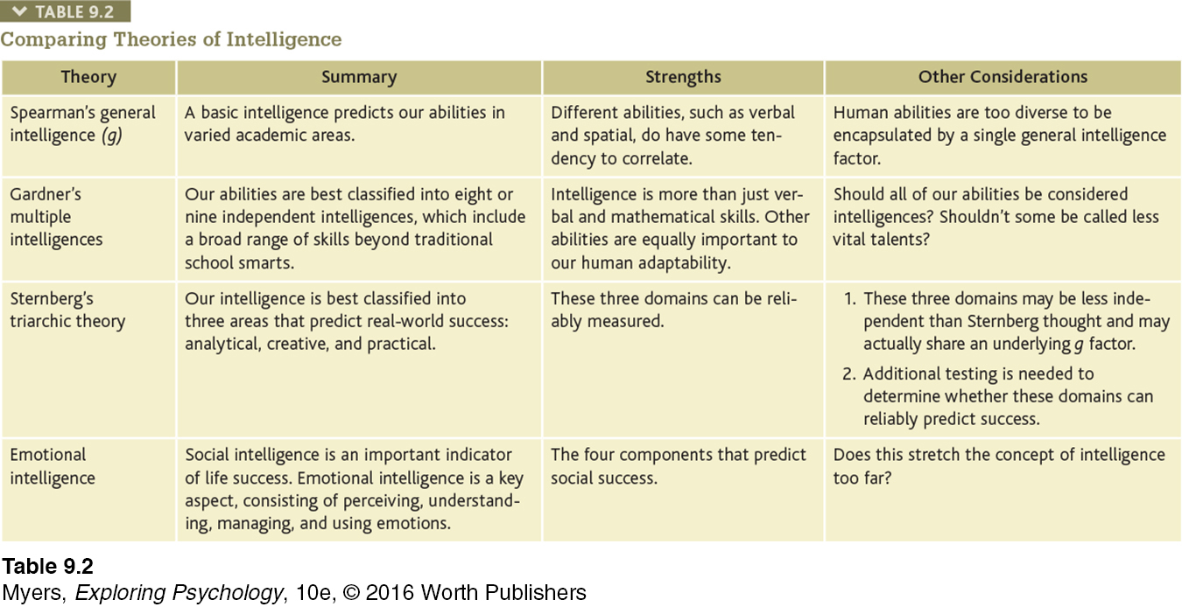
Comparing Theories of Intelligence
Notes:
Table 9.2

Slide 44
Intelligence and Its Assessment
Assessing Intelligence
9-16: WHAT IS AN INTELLIGENCE TEST, AND WHAT IS THE DIFFERENCE BETWEEN ACHIEVEMENT AND APTITUDE TESTS?
Intelligence test: Method for assessing an individual’s mental aptitudes and comparing them with those of others using numerical scores.
Such tests are classified as either
  Aptitude tests: Tests designed to predict a person’s future performance; aptitude is the capacity to learn.
  Achievement tests: Tests designed to assess what a person has learned

Slide 45
Intelligence and Its Assessment
Assessing Intelligence: What Do Intelligence Tests Test?
9-17: WHEN AND WHY WERE INTELLIGENCE TESTS CREATED, AND HOW DO TODAY’S TESTS DIFFER FROM EARLY INTELLIGENCE TESTS?
Alfred Binet: Predicting School Achievement
Tended toward an environmental explanation of intelligence differences, assuming that all children follow same course, but not the same rate, of intellectual development.
Measured each child’s mental age and tested a variety of reasoning and problem-solving questions that predicted how well French children would succeed in school.
Hoped that his test would be used to improve children’s education, but also feared it might be used to label children and limit their opportunities.
Notes:
Binet started the modern intelligence testing movement in France in 1905 when he developed questions to help predict children’s future progress in the Paris school system.
Mental age: A measure of intelligence test performance devised by Binet; the chronological age that most typically corresponds to a given level of performance.

Slide 46
Intelligence and Its Assessment
Assessing Intelligence
What Do Intelligence Tests Test?
Lewis Terman: The Innate IQ
  Binet’s fears were realized when others adapted his tests for use as a numerical measure of inherited intelligence (the intelligence with which people are born).
  Terman revised Binet’s test, as the Stanford-Binet, for wider use in U.S., with the assumption that certain ethnic groups were naturally more intelligent; he supported the eugenics movement.
  Extended upper end of test’s range to “superior adults.”

Slide 47
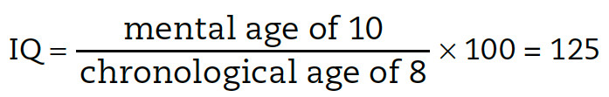
Intelligence and Its Assessment
Assessing Intelligence: What Do Intelligence Tests Test?
German psychologist William Stern derived the famous intelligence quotient (IQ) from such tests, with the ratio of mental age (ma) to chronological age (ca) multiplied by 100 (thus, IQ = ma/ca X 100).
Most current intelligence tests, including the Stanford-Binet, no longer compute an IQ in this manner (though the term IQ still lingers in everyday vocabulary as shorthand for “intelligence test score”). Instead, they represent the test-taker’s performance relative to the average performance of others the same age.

Slide 48
Intelligence and Its Assessment
Assessing Intelligence
What Do Intelligence Tests Test?
David Wechsler: Separate Scores for Separate Skills
Wechsler created most widely used intelligence test today, the Wechsler Adult Intelligence Scale (WAIS).
Also preschool and school-age child versions.
The WAIS (2008) edition consists of 15 subtests, including similarities, vocabulary, block design, and letter-number sequencing.
Yields both an overall intelligence score and separate scores for verbal comprehension, perceptual organization, working memory, and processing speed.
Striking differences between the separate scores can provide clues to cognitive strengths or weaknesses.
Notes:
WAIS: Wechsler Adult Intelligence Scale
WISC: Wechsler Intelligence Scale for Children
These tests differ from their predecessors in the way they offer an overall intelligence score as well as scores for various verbal and performance areas.

Slide 49
Intelligence and Its Assessment
Assessing Intelligence
What Do Intelligence Tests Test?
Three Tests of a “Good” Test
9-18: WHAT IS A NORMAL CURVE, AND WHAT DOES IT MEAN TO SAY THAT A TEST HAS BEEN STANDARDIZED AND IS RELIABLE AND VALID?
To be widely accepted, three questions are asked of a psychological test:
  Was the test standardized?
  Is the test reliable?
  Is the test valid?
If we construct a graph of test-takers’ scores, they will typically form a bell-shaped pattern called the normal curve.

Slide 50
Intelligence and Its Assessment
Assessing Intelligence: What Do Intelligence Tests Test?
Three Tests of a “Good” Test
Standardization: Defining uniform testing procedures and meaningful scores by comparison with the performance of a pretested group.
Reliability: Extent to which a test yields consistent results, as assessed by the consistency of scores on two halves of the test, on alternative forms of the test, or on retesting.
Validity: Extent to which a test measures or predicts what it is supposed to.
  Content validity: Extent to which a test samples the behavior that is of interest.
  Predictive validity: Success with which a test predicts the behavior it is designed to predict; it is assessed by computing the correlation between test scores and the criterion behavior. (Also called criterion-related validity.)

Slide 51
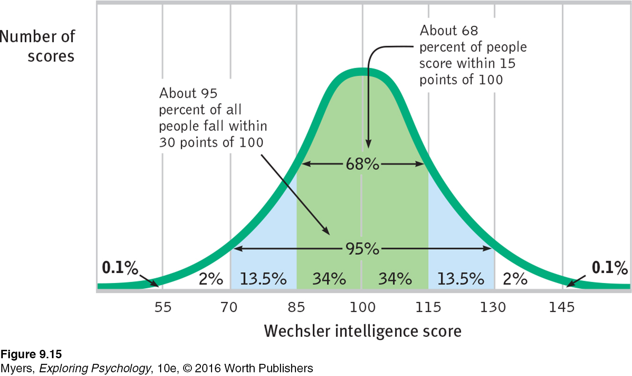
The Normal Curve
Scores on aptitude tests tend to form a normal, or bell-shaped, curve around an average score. For the Wechsler scale, for example, the average score is 100.
Notes:
Figure 9.15

Slide 52
Intelligence and Its Assessment
Assessing Intelligence
The Dynamics of Intelligence
Aging and Intelligence
9-19: HOW DOES AGING AFFECT CRYSTALLIZED AND FLUID INTELLIGENCE?
Crystallized intelligence: Accumulated knowledge, as reflected in vocabulary and analogy tests.
  Increases as we age, up to old age.
Fluid intelligence: Ability to reason speedily and abstractly, as when solving unfamiliar logic problems
  Decreases with age; declines gradually until age 75. and then more rapidly after age 85.

Slide 53
Intelligence and Its Assessment
Assessing Intelligence
The Dynamics of Intelligence
Aging and Intelligence
How do we know about change and stability in intelligence over the life span?
Developmental psychologists use longitudinal studies (restudying the same group at different times across their life span) and cross-sectional studies (comparing members of different age groups at the same time) to study the way intelligence and other traits change with age.
With age we have both gains and losses. For example, we gain vocabulary and knowledge, but lose recall memory and processing speed.

Slide 54
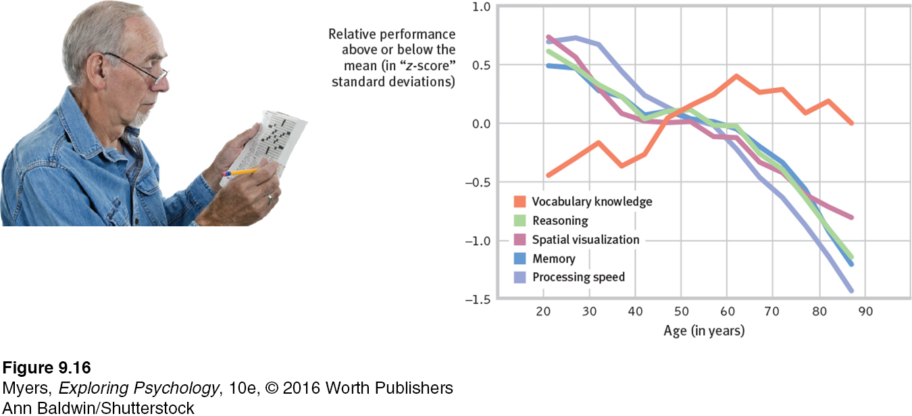
With Age, We Lose and We Win
Studies reveal that word power grows with age, while fluid intelligence dimensions decline (Salthouse, 2010).
Notes:
Figure 9.16

Slide 55
Intelligence and Its Assessment
Assessing Intelligence
The Dynamics of Intelligence
Stability Over the Life Span
9-20: HOW STABLE ARE INTELLIGENCE TEST SCORES OVER THE LIFE SPAN?
Before age 3: Casual observation and intelligence tests only modestly predict future aptitudes
By age 4: Intelligence test performance begins to predict adolescent and adult scores
By age 11: Remarkable stability of aptitude scores

Slide 56
Intelligence and Its Assessment
Assessing Intelligence
The Dynamics of Intelligence
Stability Over the Life Span
Deary et al. study (2004)
  Intelligence test administered to 11-year-old Scots readministered to surviving 80-year-olds
  After nearly 70 years of varied life experiences, the test-takers’ two sets of scores showed a striking correlation of +.66.
Johnson et al. study (2010)
  Study that followed Scots born in 1936 from ages 11 to 70 confirmed the remarkable stability of intelligence, independent of life circumstance.

Slide 57
Intelligence and Its Assessment
Assessing Intelligence
The Dynamics of Intelligence
Intelligent people tend to live healthier and longer. Deary (2008) proposes four possible explanations:
  Intelligence provides better access to resources.
  Intelligence encourages healthy lifestyles.
  Prenatal events or early childhood illnesses could influence both intelligence and health.
  A “well-wired body” as evidenced by fast reaction speeds, may foster both intelligence and longer life.

Slide 58
Intelligence and Its Assessment
Assessing Intelligence
The Dynamics of Intelligence
Extremes of Intelligence
9-21: WHAT ARE THE TRAITS OF THOSE AT THE LOW AND HIGH INTELLIGENCE EXTREMES?
One way to evaluate the validity and significance of any test is to compare people who score at the two extremes of the normal curve. The two groups should differ noticeably, and with intelligence testing, they do.
  The low extreme
  The high extreme
Let’s look at each of these.

Slide 59
Intelligence and Its Assessment
Assessing Intelligence
The Dynamics of Intelligence
The Low Extreme
To be diagnosed with an intellectual disability:
  Low intelligence test score (70 or below on an intelligence test with a midpoint of 100)
  Difficulty in adapting to normal demands of independent living, as expressed in three areas:
    Conceptual skills
    Social skills
    Practical skills
Intellectual disability is a developmental condition that is apparent before age 18, sometimes with a known physical cause, as is the case with Down syndrome.
Notes:
Down syndrome
Condition of mild to severe intellectual disability and associated physical disorders caused by an extra copy of chromosome 21.

Slide 60
Intelligence and Its Assessment
Assessing Intelligence
The Dynamics of Intelligence
The High Extreme
In one famous project begun in 1921, Lewis Terman studied more than 1500 California schoolchildren with IQ test scores over 135.
  High-scoring children (the “Termites”) were healthy, well-adjusted, and unusually successful academically.
  After many decades, Terman’s group had attained high levels of education and accolades, though no Nobel Prize winners (two future physics Nobel laureates Terman tested failed to score above his gifted-sample cutoff).
  About 1 percent of Americans earn doctorates. But among those scoring in the top 1 in 10,000 on the SAT at age 12 or 13, 63 percent had done so.

Slide 61
Genetics and Environmental Influences on Intelligence
Twin and Adoption Studies
9-22: WHAT EVIDENCE POINTS TO A GENETIC INFLUENCE ON INTELLIGENCE, AND WHAT IS HERITABILITY?
  Intelligence test scores of identical twins raised together are nearly as similar as those of the same person taking the same test twice.
  Heritability: The proportion of variation among individuals that we can attribute to genes. The heritability of a trait may vary, depending on the range of populations and environments studied.
  Estimates of the heritability of intelligence (extent to which intelligence test score variation can be attributed to genetic variation) range from 50 to 80 percent.

Slide 62
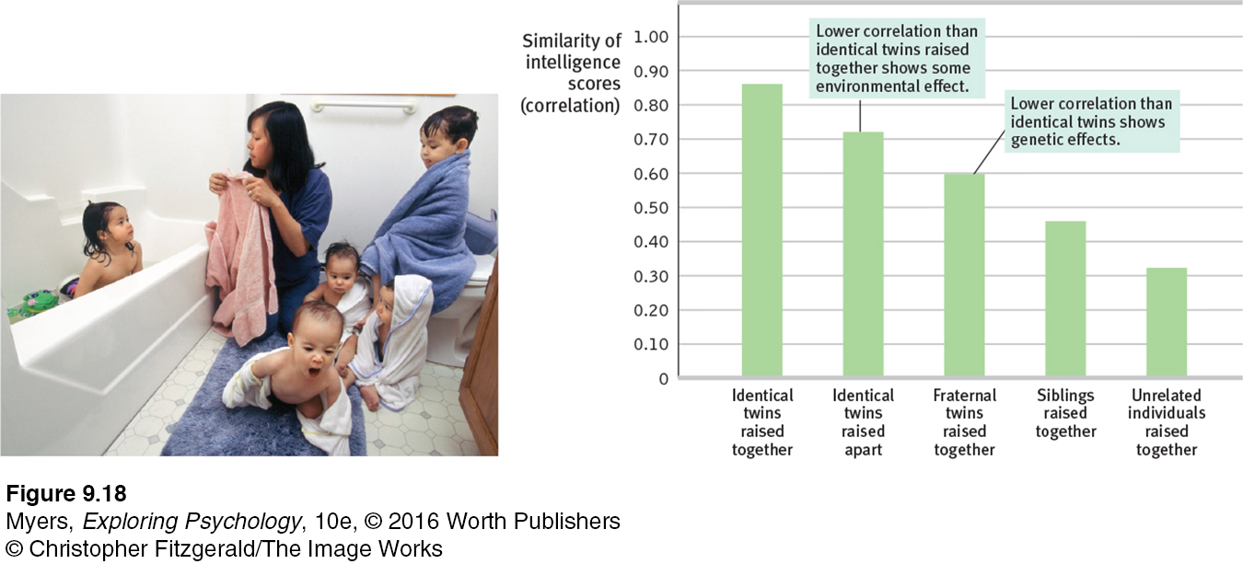
Intelligence: Nature and Nurture
The most genetically similar people have the most similar intelligence scores. Remember: 1.0 indicates a perfect correlation; zero indicates no correlation at all. (Data from McGue et al., 1993.)
Notes:
Figure 9.18

Slide 63
Genetics and Environmental Influences on Intelligence
Twin and Adoption Studies
Although genes matter, is there a known “genius gene?”
  In one massive international study of 126,559 people, no single DNA segment was more than a miniscule predictor of years of schooling; all genetic variations accounted for about 2 percent of schooling differences.
  Intelligence is polygenetic, involving many genes.
  Adoption studies help us assess the influence of environment. Adoption of mistreated or neglected children enhances their intelligence scores, for example.

Slide 64
Genetics and Environmental Influences on Intelligence
Twin and Adoption Studies
Significant evidence for environmental effects:
  Where environments vary widely, environmental differences are more predictive of intelligence scores.
  Adoption enhances the intelligence scores of mistreated or neglected children.
  Intelligence scores of “virtual twins” (same-age, unrelated siblings adopted as infants and raised together) correlate +.28. This suggests a modest influence of their shared environment.

Slide 65
Genetics and Environmental Influences on Intelligence
Twin and Adoption Studies
Surprisingly powerful genetic influences:
  Mental similarities between adopted children and their adoptive families lessen with age, until the correlation approaches zero by adulthood.
  Identical twins’ similarities continue or increase into their eighties.
  In a massive study of 11,000 twin pairs in four countries, the heritability of general intelligence (g) increased from 41 percent in middle childhood to 55 percent in adolescence to 66 percent in young adulthood.
  Similarly, adopted children’s verbal ability scores over time become more like those of their biological parents, not their adoptive parents.

Slide 66
Genetic and Environmental Influences on Intelligence
Environmental Influences
  9-23: WHAT DOES EVIDENCE REVEAL ABOUT ENVIRONMENTAL INFLUENCES ON INTELLIGENCE?
  J. McVicker Hunt (1982) study at a destitute Iranian orphanage found dire, negative effects of extreme deprivation. Extreme conditions, such as malnutrition, sensory deprivation, and social isolation, can slow normal brain development.
  Early intervention has positive results. Intensive, high quality preschool programs can boost intelligence scores. A child's later schooling also pays intelligence dividends and enhances future income.

Slide 67
Genetic and Environmental Influences on Intelligence
Environmental Influences
  Success of early intervention programs doesn’t mean “enriched” preschools will turn out geniuses. There is no environmental recipe for fast-forwarding a normal infant into a genius.
  Motivation and expectations also play a role. Study motivation and study skills may rival aptitude and previous grades as predictors of academic achievement.

Slide 68
  Genetics and Environmental Influences on Intelligence
  Group Differences in Intelligence Test Scores Gender Similarities and Differences
  9-24: HOW AND WHY DO THE GENDERS DIFFER IN MENTAL ABILITY SCORES?
Girls
  Outpace boys in spelling, verbal fluency, and locating objects
  Are better emotion detectors and are more sensitive to touch, taste, and color
Gender similarities and differences
  Minor gender differences in intelligence (greater anatomical and physiological differences)
  Effects of culture
    Social expectations and opportunities matter
    Little gender gap found in gender-equal cultures
Boys
  Outperform girls in tests of spatial ability and complex math problems
  Vary in their mental ability scores more than girls do; thus more boys and the low and high extremes

Slide 69
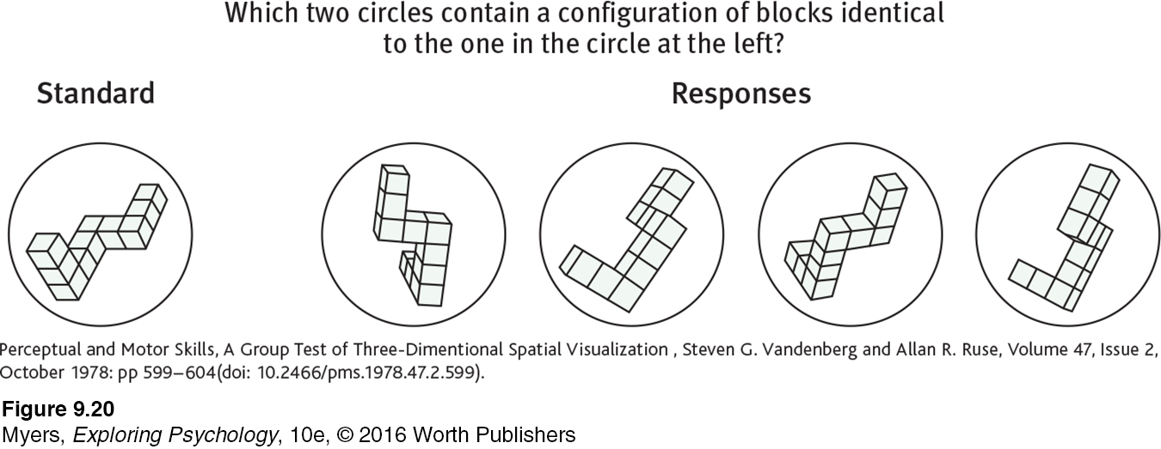
The Mental Rotation Test
This is a test of spatial abilities. (From Vandenberg & Kuse, 1978.)
  Do you know the answer?
Notes:
Figure 9.20 On average, boys outperform girls in tests of spatial ability and complex math problems, though in math computation and overall math performance, boys and girls hardly differ. The most reliable male edge appears in spatial ability tests such as this one.
ANSWER: The first and fourth alternatives.

Slide 70
Genetics and Environmental Influences on Intelligence
Group Differences in Intelligence Test Scores
Racial and Ethnic Similarities and Differences
  9-25: HOW AND WHY DO RACIAL AND ETHNIC GROUPS DIFFER IN MENTAL ABILITY SCORES?
Fueling the group-differences debate are two disturbing but agreed-upon facts:
  Racial and ethnic groups differ in their average intelligence test scores.
  High-scoring people and groups are more likely to attain high levels of education and income.
Heredity does contribute to individual differences in intelligence. But group differences a provide poor basis for judging individuals in a heritable trait, since such differences may be entirely environmental.

Slide 71
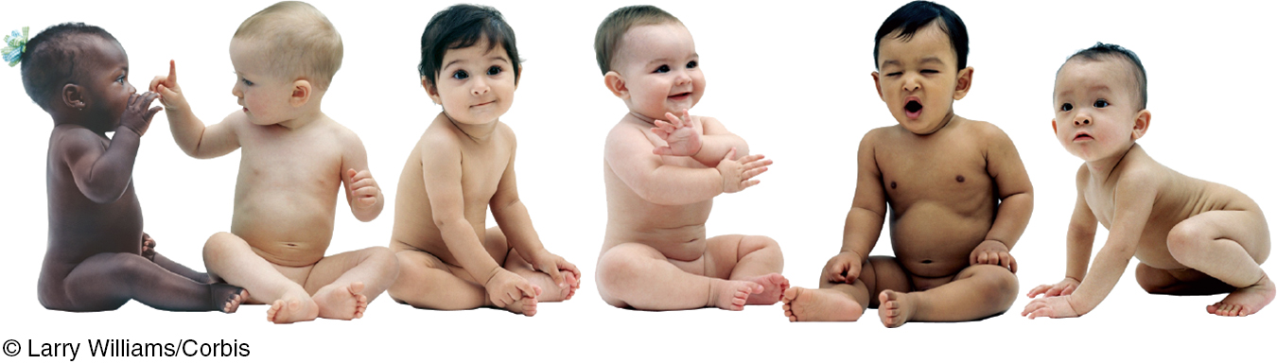
Genetics and Environmental Influences on Intelligence
Group Differences in Intelligence Test Scores
Racial and Ethnic Similarities and Differences
Consider…
Genetics research reveals races are alike.
Race is not a clearly defined biological category.
Within the same population, there are generation-to-generation differences in test scores.
Given the same information, Blacks and Whites show similar information-processing skills.
Schools and culture matter
In different eras, different ethnic groups have experienced golden ages—periods of remarkable achievement.
Notes:
Twenty-five hundred years ago, it was the Greeks and the Egyptians, then the Romans.
In the eighth and ninth centuries, genius seemed to reside in the Arab world.
Five hundred years ago, the Aztec Indians and the peoples of Northern Europe were the superachievers.
Today, people notice Asian technological genius and Jewish cultural success.
Cultures rise and fall over centuries; genes do not. That fact makes it difficult to attribute a natural superiority to any race.

Slide 72
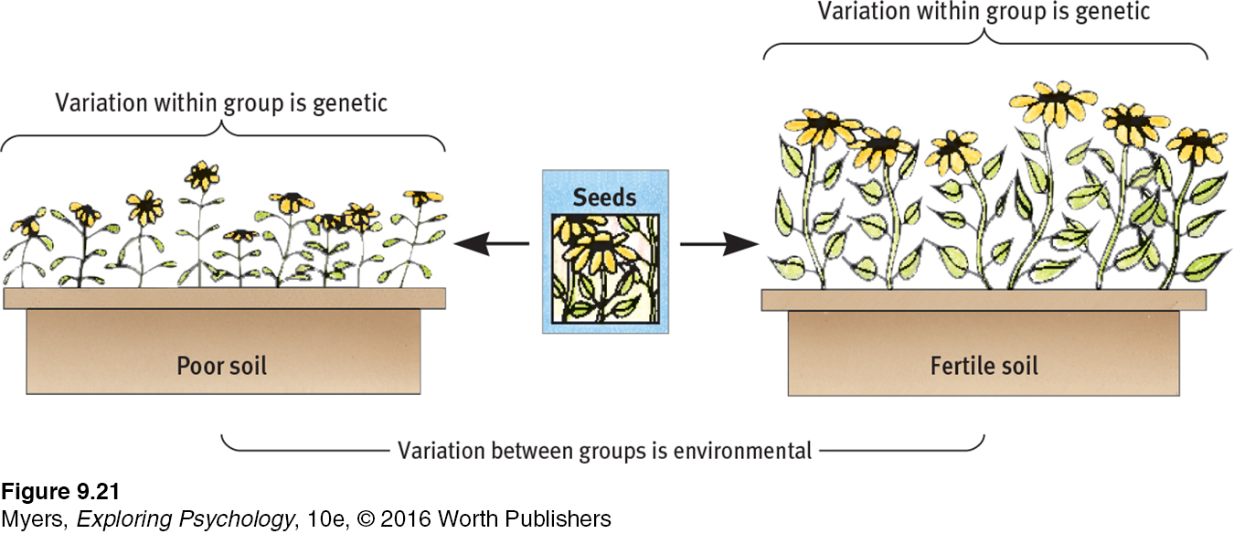
Group Differences and Environmental Impact
Even if the variation between members within a group reflects genetic differences, the average difference between groups may be wholly due to the environment. Imagine that seeds from the same mixture are sown in different soils. Although height differences within each window box of flowers will be genetic, the height difference between the two groups will be environmental. (From Lewontin, 1976.)
Notes:
Figure 9.21

Slide 73
Genetics and Environmental Influences on Intelligence
The Question of Bias
  9-26: ARE INTELLIGENCE TESTS INAPPROPRIATELY BIASED?
Three hypotheses about racial differences in intelligence:
  There are genetically disposed racial differences in intelligence.
  There are socially influenced racial differences in intelligence.
  There are racial differences in test scores, but the tests are inappropriate or biased.
In considering the third possibility, we need to consider which meaning of bias we use.

Slide 74
Genetics and Environmental Influences on Intelligence
The Question of Bias
Two Meanings of Bias
Scientific meaning of bias is based on test predictive validity. If test does not accurately predict future behavior for all groups of test-takers, it is biased. So if it successfully predicted women’s achievement but not men’s, then the test would be biased. Major U.S. aptitude tests have predictive validity for women and men, for various races, and for rich and poor.
But a test can also be biased if it detects not only innate differences in intelligence but also performance differences caused by cultural experiences. This happened to Eastern European immigrants in the early 1900s, who lacked experience to answer questions about their new culture. Tests that make cultural assumptions—that a cup goes with a saucer—can bias the test against those who don’t use saucers.
Notes:
Intelligence researchers suggest use of culture-neutral questions to enable culture-fair aptitude tests.

Slide 75
Genetics and Environmental Influences on Intelligence
The Question of Bias
Stereotype Threat
Stereotype threat is a self-confirming concern that one will be evaluated based on a negative stereotype.
  Stereotype threat may impair attention, performance, and learning.
  In a study by Steven Spencer and his colleagues (1997), women did not perform as well as men on difficult math test unless they had been led to expect that women usually do just as well on the test.
  Another study with Black students showed that they performed worse when reminded of their race before the test (Steele et al., 2002).

Slide 76
Genetics and Environmental Influences on Intelligence
The Question of Bias
Stereotype Threat
Our expectations and attitudes can influences our perceptions and behaviors, including our test performance.
Critics argue that stereotype threat does not fully account for Black-White aptitude score differences or the gender gap in high-level math achievements. But it does address:
  Why Blacks score higher when tested by Blacks
  Why women score higher on math tests when no male test-takers are present
  Why women’s online chess performance drops sharply when they think they are playing a male opponent
  The “Obama effect” of improved test performance by African-Americans after watching then-candidate Barack Obama’s nomination acceptance and later presidential victory speeches

Slide 77
Genetics and Environmental Influences on Intelligence
The Question of Bias
Stereotype Threat
Psychologist Carol Dweck’s (2012, 2015) research has shown that believing that intelligence is changeable fosters a growth mind-set:
  Minority students in university programs encouraged to believe in their potential, to increase their sense of belonging, or to focus on the idea that intelligence is malleable and not fixed have produced markedly higher grades and have had lower dropout rates (Walton & Cohen, 2011; Wilson, 2006).
  To foster this growth mind-set, Dweck teaches early teens that the brain is like a muscle that grows stronger with use as neuron connections grow.
  Praising children’s effort rather than their ability also encourages their growth mind-set and their attributing success to their own hard work.

Slide 78
Genetics and Environmental Influences on Intelligence
The Question of Bias
Believing in our ability to learn, and applying ourselves with sustained effort, we are likely to fulfill our potential. Three goals for tests of mental abilities:
We should realize the benefits that intelligence testing pioneer Alfred Binet foresaw—to enable schools to recognize who might benefit most from early intervention.
We must remain alert to Binet’s fear that intelligence test scores may be misinterpreted as literal measures of a person’s self-worth and potential.
We must remember that the competence that general intelligence tests sample is important, but also that these tests reflect only one aspect of personal competence.
Competence + Diligence → Accomplishment

