Slide 1


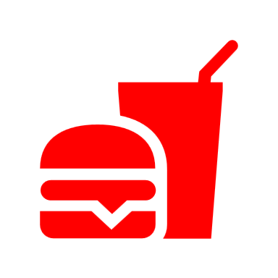


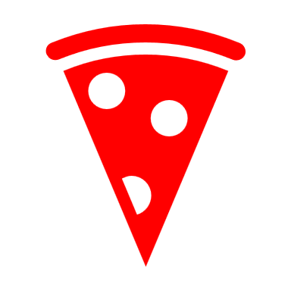




The US Food and Beverage Market
Contributes a high percentage to the GDP.
In the beverage market, alcoholic drinks take the most significant share while in the food industry, meat take the highest percentage.
In consumer distribution, it accounts for 80%.
The number of firms and consumers all around different states in the US are not evenly distributed.
Constraints in the market include; input used in product production, labor supply, and international health organization.
Change in input prices directly affects the cost of operation in the US.
To improve efficiency in the food and beverage market, there’s great need to train the production personnel.
Improvement in production technology leads to increase in speed of production, reduction in operation cost, increase in demand, and sales increase; all for the benefit of the buyer and the seller.
Market outcome looking to be achieved is that demand is equals the supply.

