Slide 1

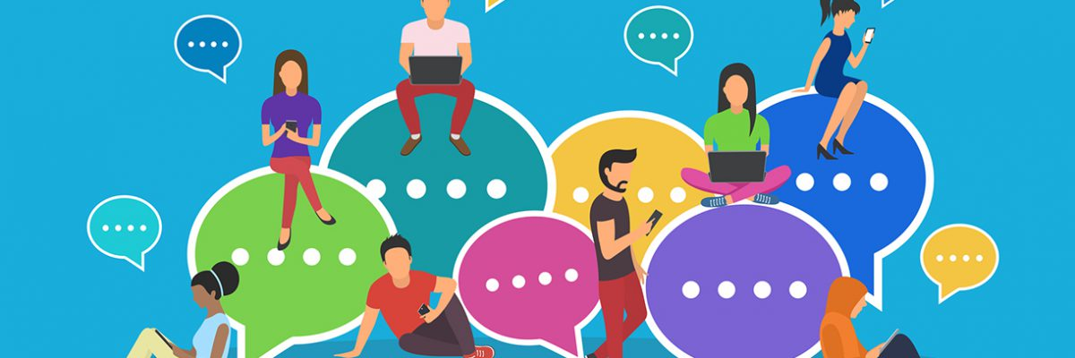
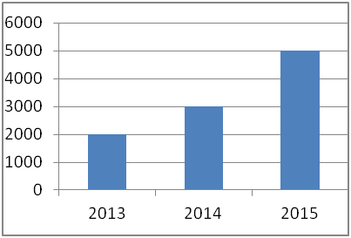
FACE BOOK: THE USE OF SOCIAL MEDIA MAY CAUSE MENTAL DISORDERS
FACE BOOK: THE USE OF SOCIAL MEDIA MAY CAUSE MENTAL DISORDERS
Add authors here
Mercy collage
INTRODUCTION
SOCIAL NETWORKS + SOCIAL MEDIA : MENTAL DISORDERS
Conclusion
Social media is frequently used by the people in the world. People connect with each other as a result of social media . There are various social media platforms that are used to interact . They include face book , what's up and others like Skype.
Face book is the largest social media with almost 2 billion monthly users . The use of face book and other social medial platforms have been found to have negative effects on the mental health of the people by various research studies.
From the research findings of Blackwell (2017), more people in various social networks have been reported to have psychological distress as a result of social networks more so the youth. Socialization from social networks might cause stress and depression to youth due to low self-esteem, discrimination, and bullying. Social networks may have benefits but it also has negative effects on people.
Face book as the leading social media platform with approximately two billion people using it monthly has negative effects on the mental health of the users. A research study shows that a large number of Facebook users from 2013 to 2015 have been reported to have mental disorders and the numbers are increasing (Blackwell,2017 )
What causes mental disorders
Mental disorders are caused by social media through the addiction of social media like Facebook, and what's up. Low self-esteem may result from seeing other people's pictures or reduce by other people. Social media can cause depression through bullying or crime-related activities which causes mental disorders.
Social media has affected many people especially the youth mental health. Mental disorders result from the experience the users get while using which causes them to react differently causing mental disorders . Low self-esteem, depression, and stress due to social medial may cause mental disorders.
References
Blackwell .W (2017 )taking face book face value: why the social may cause mental disorder, Acta Psychiatrica Scandinavica: 136:439-440Maulik P.K, W. W Eaton, CP Eaton, C.P.C Bradshew (2010))the effect of social networks and social support on common mental disorders following specific life events Acta Psychiatrica Scandinavica:122; 118 -128
Statistics' on how social media has caused mental disorders from 2013 to 2015
Digital Media
According to M Maulik , et, el, (2017), the rate of mental disorders as a result of social media has been increasing instantly from 2013 to 2015 by 1000 people. These numbers have increased due to an increase in the use of technology by people and the availability of devices to access the internet like mobile phones.
CONTACT INFORMATION
Student Name and email

