Slide 1
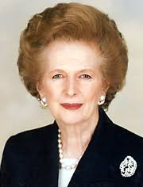
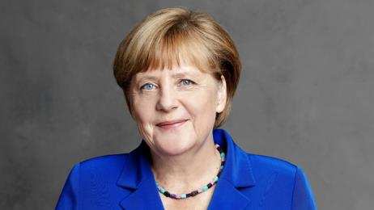
Leading Ladies: an analysis of the female leadership of Angela Merkel and margaret Thatcher
Caitlyn Penter

Slide 2
Overview
Political backgrounds, leadership styles, ideologies, and milestones of the women
Comparison of background, makeup, and governmental structure of both Great Britain and Germany
Key terms: political socialization, systems of government, devolution, political ideology, privatization, liberal internationalism, gender

Slide 3
Female leadership over time
Movement from homemaker to politician
Gender framing of campaigns- feminine candidacy
Ethics of Care- females lead in a different way
  Cooperative, nonviolent
  Carol Gilligan
Example: Reporters were more likely to report on a female candidate’s personal attributes such as appearance and personality. Whereas, reports on male candidates were more likely to look at the male’s public policy.
As of 2013, only 18 of the world’s heads of government were female
Notes:
Carol Gilligan
Female leaders use ethical perspectives of care and responsibility

Slide 4
Margaret thatcher
Political Socialization
Raised under Puritan values
  Father was preacher and community representative
Introduced to American culture at young age
Studied Chemistry
Married a retired oil executive very fiscally conscious
Takeaway: fiscally motivated, detail oriented, devoted to tradition
Great Britain’s Prime Minister: 1979 to 1990
Notes:
US troops stationed near her house

Slide 5
Angela Merkel
Political Socialization
Daughter of devout pastor
Lived in East Berlin
  First political memory was riding on the elevated train beside the Berlin Wall
Studied Chemistry
  Was asked to be a spy in her workplace
Takeaway: detail oriented, more inclined toward cooperation, conservative undertones
Chancellor of Germany 2005 to present
Notes:
Was asked to spy on her colleagues while working as a chemist
Never vocally supported Germany’s vote for gay marriage..instead let people decide

Slide 6
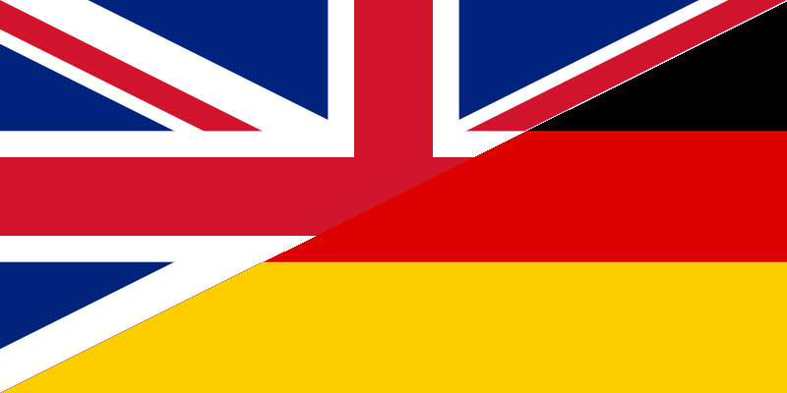
Comparison of states
UK
Germany
Parliamentary
Dual Executive
Two party system
Regional governments with devolved power
House of Lords and House of Commons
Federal
Branches of government
Increasingly ethnically diverse
Multiparty system
Bundestag and Bundesrat

Slide 7
Merkel ideology
Christian Democratic Union (CDU)
Fiscally conservative
  Instrumental in 2003 German employment crisis
  Aided in current government surplus
Liberal internationalist- ‘informal leader’ of European Union
  Friendship with President Obama
Pro-immigration- point of contention in both her country and her party
  Syrian refugees
Notes:
Earlier this year, Merkel was set to meet with Trump but then ended up meeting with Obama and Trump on the same day

Slide 8
Thatcher ideology
Traditionalist
Laissez fairre economics, extreme free market
Privatization
  Successful privatization of well known companies- British Aerospace and Cable and Wireless, British Telecom, British Airways
Civil service reform
  Many called it a failing system until Thatcher
Decreased welfare spending- some people called this authoritarian
Notes:
A lot like Reaganomics- trickle down spending

Slide 9
Merkel Milestones
2013- Merkel accused US of tapping her cell phone
Fukushima Moment- fast switch against nuclear power after Fukushima disaster
  Not a financially savvy decision- highest electricity bills in Europe
“He’s at work” Phenomena- Merkel’s husband was absent at Chancellor swearing in ceremony
  Independent leadership
Eurocrisis- projected Merkel into international spotlight, good and bad
  Paints Germany in a more authoritarian light
Notes:
Husband is also a chemist, similarity between Merkel and Thatcher- her husband also stayed out of the spotlight
Germany seen as stalwart power
Not afraid to stand up to other world powers

Slide 10
Thatcher milestones
1982- Falkland Island debacle- Britain’s proudest moment with Thatcher
  British citizens lived on the islands and she saved them
“The Troubles”- continued struggle between Northern Ireland republicans and British parliament- devolution
  Assassination attempt in 1984- usher the Anglo-Irish Agreement (gave more power to Northern Ireland government)
Double recession- poverty/interest rates/cost of living rose in 70s and 80s, highest unemployment in 1981
  Critics said this occurred because of Thatcher’s crusade against inflation

Slide 11
European union
Thatcher
Merkel
Euroskeptic
Thought UK contributed to much to EU budget
“We have worked all these years to free Britain from paralysis of socialism only to see it creep through the back door of central control and bureaucracy in brussels”
Critics say this was main reason Thatcher was ousted
Foresaw Brexit?
Pro-EU
Brexit pushed Merkel into the informal leadership of EU
Accepts the common currency
Struggles with her party who is more weary of EU involvement
Notes:
Merkel- same stance domestically that she has internationally- accepting of diverse culture in europe

Slide 12
Impact for women
Both women set precedence by being their country’s first female heads of government
  All about reputation left behind
Thatcher’s mixed legacy- played into her role as a female, did not follow the Ethics of Care ideology
Merkel
  Forbes “Most Powerful Woman” 7 times throughout political career
  Tries to keep gender out of discussion
    When asked why she didn’t embrace her gender in her campaign, she did not even entertain the question
  Cooperative attitude gives her a more positive reputation

Slide 13
“If Angela Merkel is convinced of the inevitability of a process, she moves on unsentimentally. But that is remarked on differently for her than it would be for a man. And should she seek a compromise, which would called political talent in a man, the newspapers call her hesitant. If she gets her own way, she’s called the iron lady whose path is littered with corpses of her male opponents.”
-Evelyn Roll, Angela Merkel’s biographer

Slide 14
Final Comparison
Merkel
Thatcher
Moderate policies
Accepting of diversity
So far, positive international and national reputation
Liberal internationalist
Much more rapid change to country
Negative reputation after term
Neo-conservative devoted to British tradition and authority
Both women illustrate the impact of political socialization and geopolitics on political leaders’ ideologies, leadership styles, and actions. Although both are relatively conservative, each have a vastly different way of governing and thus have wildly different personas in the eyes of their citizens and the international community.

