Slide 1
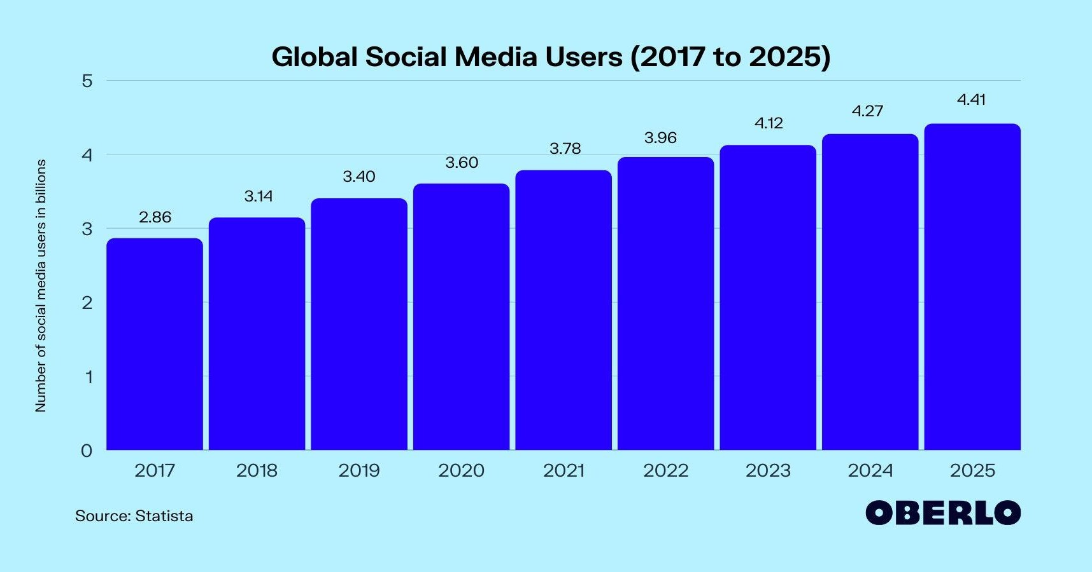
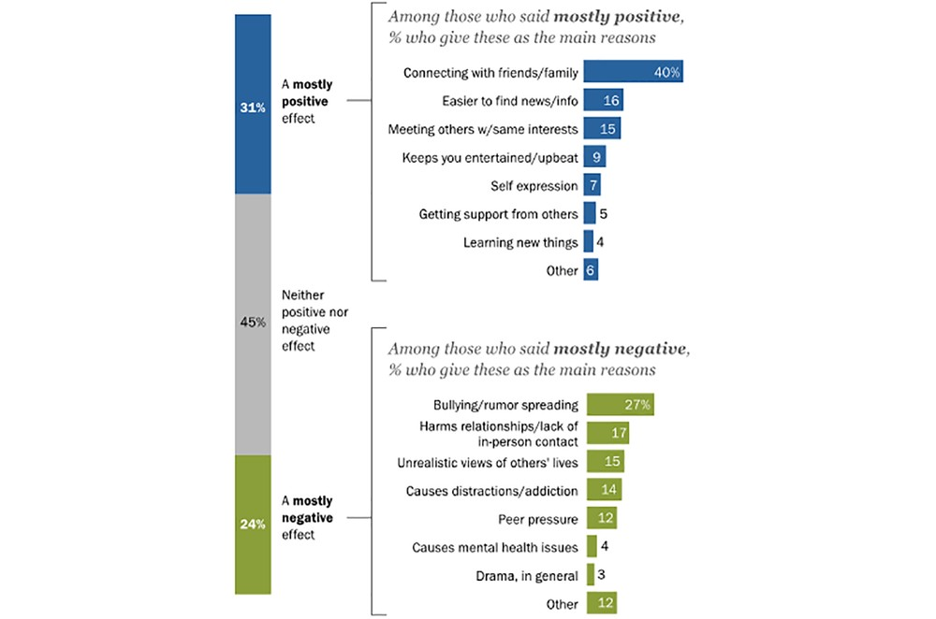
The Effects of Social Media Use on Mental Health
Brandy Barlow, Richard Sears. Abnormal Psychology, West Ga technical College.
Title of the Research Project
Your name, advisors’ name, names of any other collaborators Name of department, Dartmouth College
Funding source (you can either put this info here or down towards the bottom in an “acknowledgements”section)
INTRODUCTION
Social media can be defined as interactive technologies that are used for the sharing of information, interests, ideas. The developments of the internet of the past couple of years have enhanced connection and sharing of information. Social media has however, enhanced connection. Many people in the world today have access to electronic devices that use social media networks alerting them of global events and updates on friends. Social media is an important communication tool that has changed how
humanity interacts. Despite its benefits in enhancing communication, reliance on it has negative consequences on the mental health of users.
CONCLUSION
EFFECTS
ROLE OF MENTAL HEALTH
Social media plays an important role in connecting
Whereas social media do not provide the same psychological benefits as those achieved through real-world or face to face human interaction, there are still positive aspects connected to these platforms (Booth,2020).
Social media enables people to;
Socialize and network.
Help seek or offer emotional support during challenging times.
Provides a platform for self-expression and creativity. The negative effects include;
Triggering feeling of inadequacy about appearance or life.
Anxiety and depression
Fear of missing out.
Self-absorption
Cyber bulling
People are social creatures that require companionship from others to succeed in life. The strength of this connection to other people has a significant impact on their mental health. Social connections to other people can ease anxiety, depression, stress, prevent loneliness, and boost self- worth. Lack of social connections on the other hand can be a challenge for mental and emotional health.
While social media platforms such as Facebook, Instagram, Twitter, YouTube and Snapchat have it
benefits in connecting people and sharing information and ideas, they cannot replace real-world human
connection.
Social media can harm mental health as it is associated with anxiety, depression, low quality sleep, and low self-esteem.
Studies show that people who spend more time on social media are more likely to have to be affected by
mental health issues such as anxiety, low self-esteem
and depression than occasional users (Berryman, Ferguson & Negy,2018).
people, sharing ideas, experiences and information. Their use however has been associated to negative consequences on mental health including anxiety, depression, fear of missing out, and isolation. It is a critical aspect that needs to be addressed to avoid negative consequences and achieve positive health outcomes.
References
Berryman, C., Ferguson, C. J., &Negy, C. (2018). Social
media use and mental health among young adults. Psychiatric quarterly, 89(2), 307-314.
Coyne, S. M., Rogers, A. A., Zurcher, J. D., Stockdale, L., & Booth, M. (2020). Does time spent using social media
impact mental health?: An eight year longitudinal study. Computers in Human Behavior, 104, 106160.

