Slide 1

INTRODUCTION
ENERGY BMW 2000 HYDROGEN VEHICLE 750 HL

Slide 2
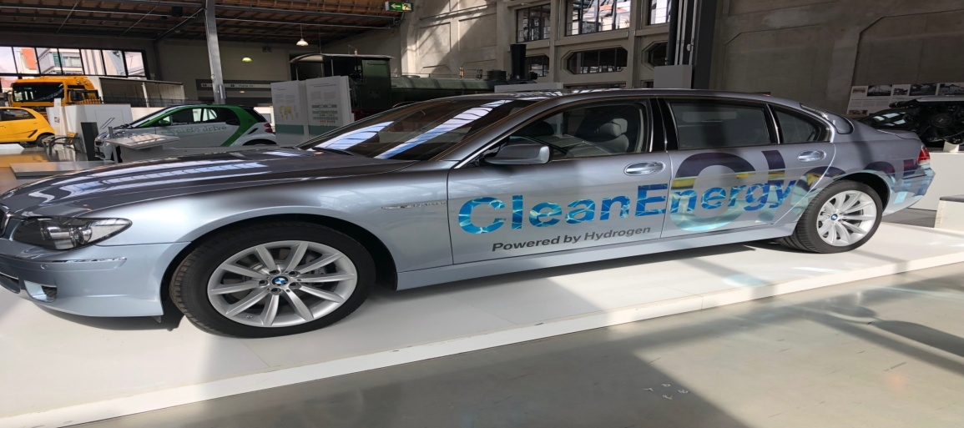
Energy BMW 2000 hydrogen vehicle 750 HL
The vehicle can operate by either gasoline or hydrogen
It is environmental friendly because its by product is water vapor.
Its dual tank system is capable of switching from hydrogen to gasoline when the vehicle is running without change of behavior or drive
Notes:
Energy BMW 2000 hydrogen vehicle 750 HL runs on either liquid hydrogen or gasoline
When it is running on hydrogen, the by product is water vapor
Inside the hydrogen tank, there is the nature’s lightest element that is super-chilled to 423degrees below zero.
The tank leaves a small space for the trunk

Slide 3
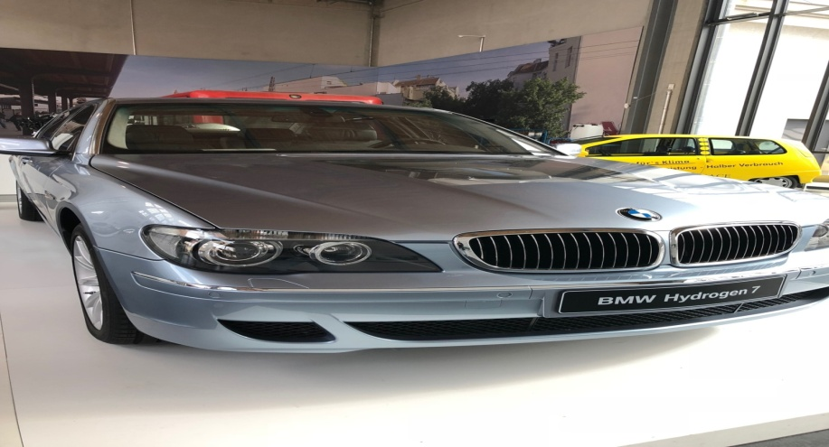
Energy BMW 2000 hydrogen vehicle 750 HL
The vehicle builds pressure when it is parked for a long time.
This happens due to hydrogen evaporation.
When the pressure is too high, there is need to safely release it.
Additionally , the vehicle has a vent on its roof that can enhance release of the gaseous hydrogen directly.
Notes:
When it is parked for long , the evaporating hydrogen happens to build pressure which must be safely released.
In the event the pressure inside the tank is too high, then the vent in the roof can release gaseous hydrogen directly.
In case of an accident and the car rolls over and blocks the vent on the roof, the hydrogen would reroute through the underbody.
The car has a hydrogen detection system. In case there is hydrogen leak, the doors will glow red warning of the hydrogen leak.

Slide 4
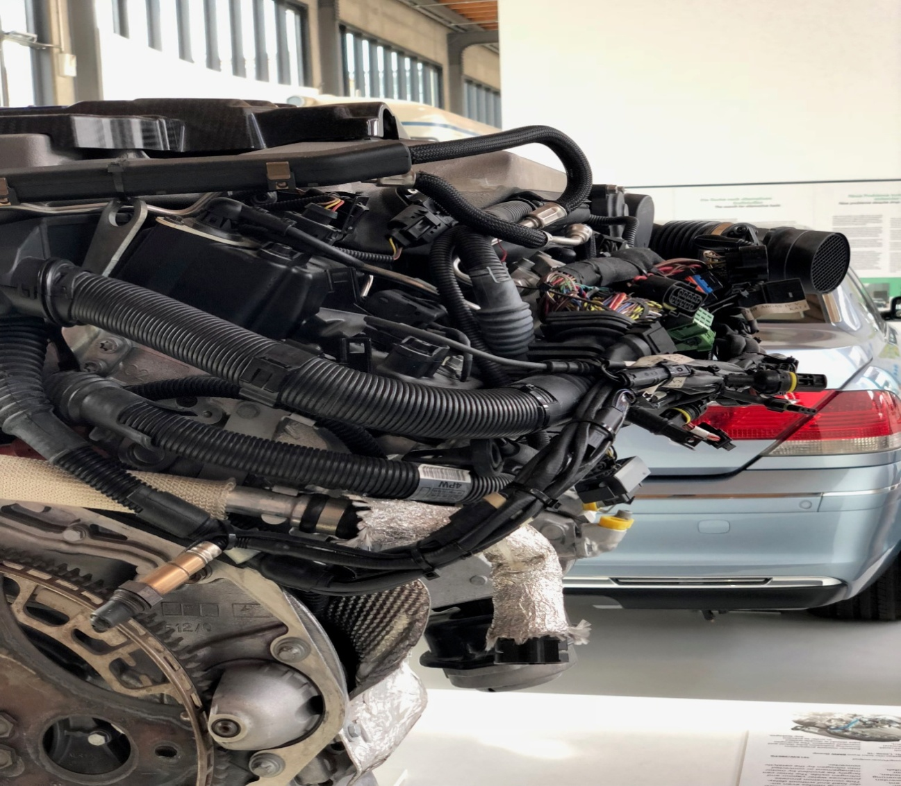
Energy BMW 2000 hydrogen vehicle 750 HL
The gas only version of the vehicle makes 438 horsepower.
The BMW 750HL makes merely 260 horsepower
This is low compared to the gas only version .
Notes:
Its engine makes a mere 260 horsepower which is lower compared to the 438 gas only version
regardless of the tepid acceleration and weight gain, the car is a pleasure to drive.
It is different from the fuel cars in that; it can rely on today's gasoline station to carry it between hydrogen pumps.

Slide 5
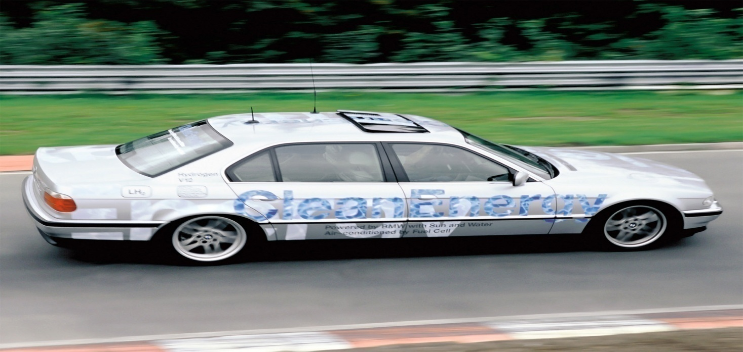
Energy BMW 2000 hydrogen vehicle 750 HL
The vehicle has two independent fuel induction systems.
the systems facilitates the vehicles ability to switch to either hydrogen or gasoline.
This improves the vehicles performance
Notes:
BMW750HL has two independent fuel induction systems
The two fuel induction systems allow the vehicle to run either by hydrogen or gasoline
The car has hybrid 12-cylinder combustion engine capable of running either by gasoline or hydrogen

Slide 6
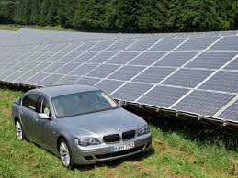
Energy BMW 2000 hydrogen vehicle 750 HL
The 750HL has an excellent torque and acceleration
since its energy is generated from solar power, it facilitates the splitting of water into hydrogen and oxygen.
Notes:
The hydrogen engine offers excellent torque and acceleration
On the other hand, the specially insulated 140 liter tank for liquid hydrogen provides a range of 400 kms
The electricity that is generated from solar is used to split water into hydrogen and oxygen.

Slide 7
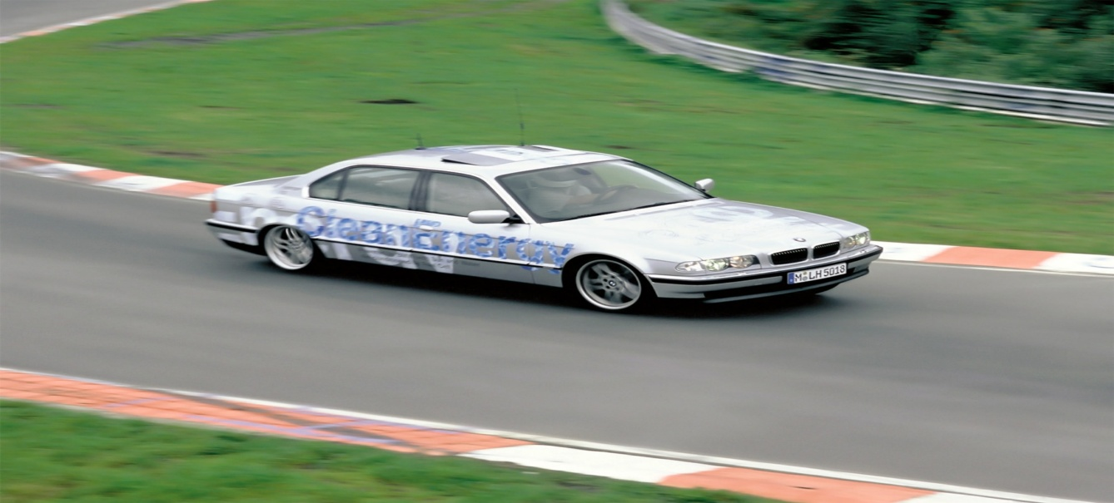
Energy BMW 2000 hydrogen vehicle 750 HL
Hydrogen combines with oxygen when the vehicle is running.
The vehicle is then powered by the energy that is produced
The emission or rather the by product of the process is water vapor.
This is what is returned to the environment.
Notes:
When the vehicle is running and internal combustion is taking place, hydrogen combines with oxygen.
The energy that results powers the vehicle.
Hydrogen is then returned to the environment as water.

Slide 8
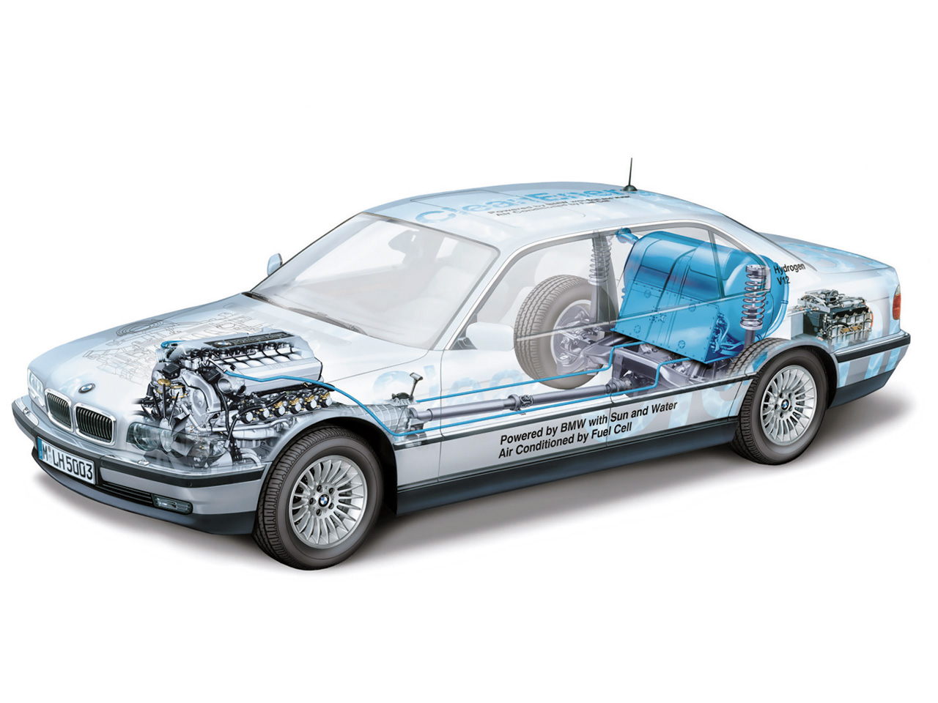
Energy BMW 2000 hydrogen vehicle 750 HL
The vehicle’s process enhances elimination of the harmful emissions.
The 70 layers of aluminum and fiberglass between the interior and interior walls of the vehicle enhances maintenance of the hydrogen at low temperatures.
This is what is appropriate for the car’s performance.
Notes:
The harmful emissions are virtually eliminated
When hydrogen is cooled to the -253 degrees Celsius, hydrogen is then shrunk to a thousandth of its initial volume.
There are 70 layers of aluminum and fiberglass sheets that is between the interior and the exterior walls of the vehicle. They ensure that the liquid hydrogen remains in low temperatures

Slide 9
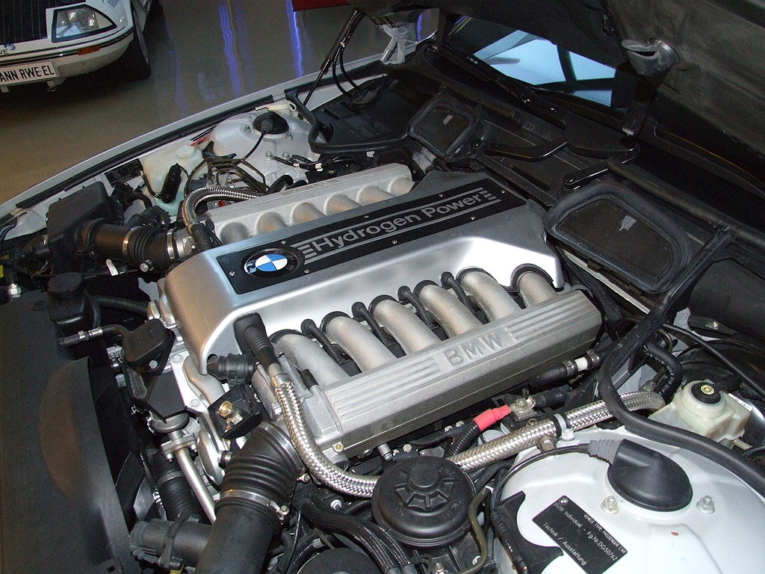
Energy BMW 2000 hydrogen vehicle 750 HL
It has a dual mode combustion engine.
The dual mode engine facilitates the switching from gasoline to hydrogen and vise versa without changing behavior or the driving experience of the car when its running.
Notes:
The dual mode combustion engine proves that BMW group has supreme engineering skills.
Without change of driving, behavior or experience, the vehicle is able to switch from hydrogen to gasoline and vise versa.

Slide 10
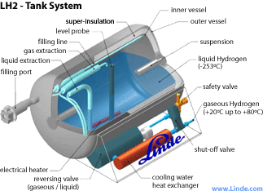
Energy BMW 2000 hydrogen vehicle 750 HL
Its tank system s able to store hydrogen in cryogenic state or its gaseous state.
Notes:
With this tank system, hydrogen can be stored in its original cryogenic state as a fluid or in its gaseous state. This way, it is relatively easy to transport.

Slide 11
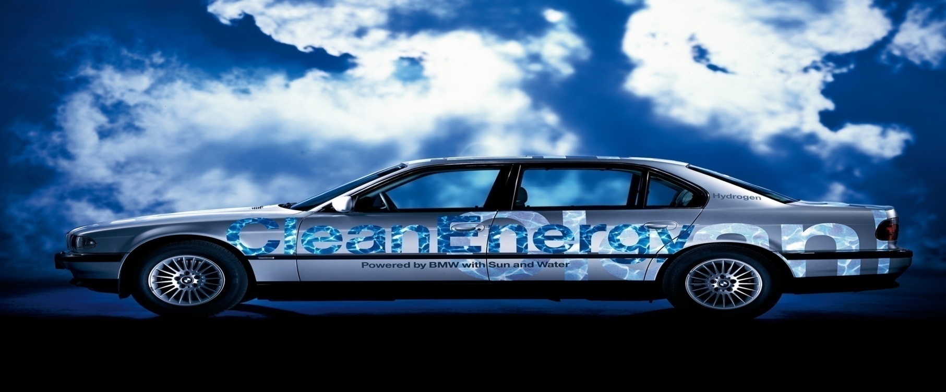
Energy BMW 2000 hydrogen vehicle 750 HL
The BMW group has been able to deliver reliable and safe vehicle through.
This is due to its delightful features/components
Notes:
The BMW 750 HL is able to deliver, safety, reliability and motoring pleasure.
The new components such as the tank systems, engine technology and the electronics for hydrogen drive have made the vehicle m0ore delightfu.

Slide 12
Energy BMW 2000 hydrogen vehicle 750 HL
The vehicle has proved to be environmental friendly
This is because its emission to the environment is water vapor.
Unlike other vehicles that use other forms of fuel and release carbon to the environment.
Notes:
Generally, the vehicle is appropriate especially in terms of conserving the environment.
After the internal combustion, the by product is vapor. This is what is released to the environment. It is not harmful to the in any way.

Slide 13
Energy BMW 2000 hydrogen vehicle 750 HL
When operating on gasoline, the vehicle operates on direct fuel injection.
This improves the vehicles convenience and efficiency.
The valves that are conceived and designed for gaseous hydrogen are larger than the convection gasoline injections. The valves also have a large volume flow.
Notes:
This is a feature that is not likely to be seen on other ordinary vehicles. This shows the level of sophistication that the vehicle is. It also shows how comfortable the vehicle is. There is no struggle when it comes to emissions. Additionally, the emissions are environmental friendly.

Slide 14
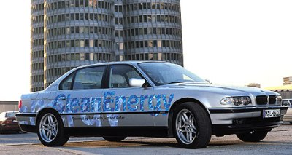
Energy BMW 2000 hydrogen vehicle 750 HL
Finally, the characteristics of the vehicle, exhibit high degree of sustainability in every day use.
Notes:
The 750HL was developed on the basis of a standard vehicle for conventional fuels.
in the same way as its predecessors, the vehicle can be operated on petrol or gasoline.
These characteristics enhance a high degree of vehicle sustainability in everyday use.

Slide 15
References
Pehr, K., Burckhardt, S., Koppi, J., Korn, T., & Partsch, P. (2002). Hydrogen—the fuel of the future—The BMW 750hl. ATZ worldwide, 104(2), 6-9.
Burkert, A. (2017). Hydrogen Is Also a Superb Combustion Fuel. MTZ worldwide, 78(4), 8-13.
https://link.springer.com/article/10.1007/BF03224539
http://www.hydrogen-motors.com/bmw-750hl.html
https://www.press.bmwgroup.com/usa/article/detail/T0020361EN_US/bmw-group-clean-energy:-the-hydrogen-powered-bmw-750hl-to-appear-at-new-york-international-auto-show?language=en_US
Notes:
https://link.springer.com/article/10.1007/BF03224539
http://www.hydrogen-motors.com/bmw-750hl.html

