Slide 1
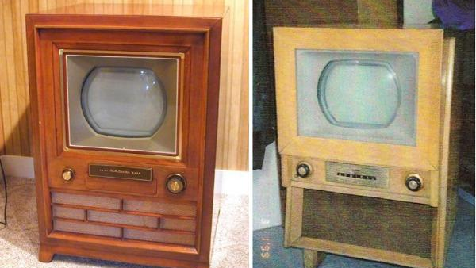
Week 4: Monday
Hilmes, Ch. 8
“The Domesticated Medium, 1955 to 1965”
Notes:
Color TV: 1956 (“RCA color system had won the standardization war”) 215
# of hours per day spent with TV in the average household reached 5.5 in 1965 (2 hours only for radio in 1960).
TV’s oliogopoly of the 1960s until 1980s. ABC, NBC, CBS (this was considered the classic network system). Vast majority of audiences watched
Mid-1970s: black-and-white TVs still popular (changing infrastructure for nation’s local stations was challenging)
Cable TV: (“terrestrial technology”; competitor and threat to network broadcasters and commercial television)
Emergence of satellite transmission

Slide 2
Agenda
Reminder: Sign-Up for Group Presentations is Live.
  Deadline: Monday, Oct. 28, 1pm
Pages: Final Paper Prompt is posted
Key points: Hilmes Ch. 8
“The Domesticated Medium”
Group Work: Ch. 8 questions
For Wednesday: Boddy’s “Live Television”
Notes:
Re: Final Paper prompt – show the students the checklist box. Remind them to ask questions or make an office-hours appointment if they need guidance.
Boddy’s “Live Television: Program Formats and Critical Hierarchies” is relatively short. There will be annoying issues with the PDF viewing through Canvas. Might be better to download this reading and view it in Adobe Acrobat instead.
I will be updating the Canvas #2 assignment grades (complete/incomplete) before class Wednesday.

Slide 3
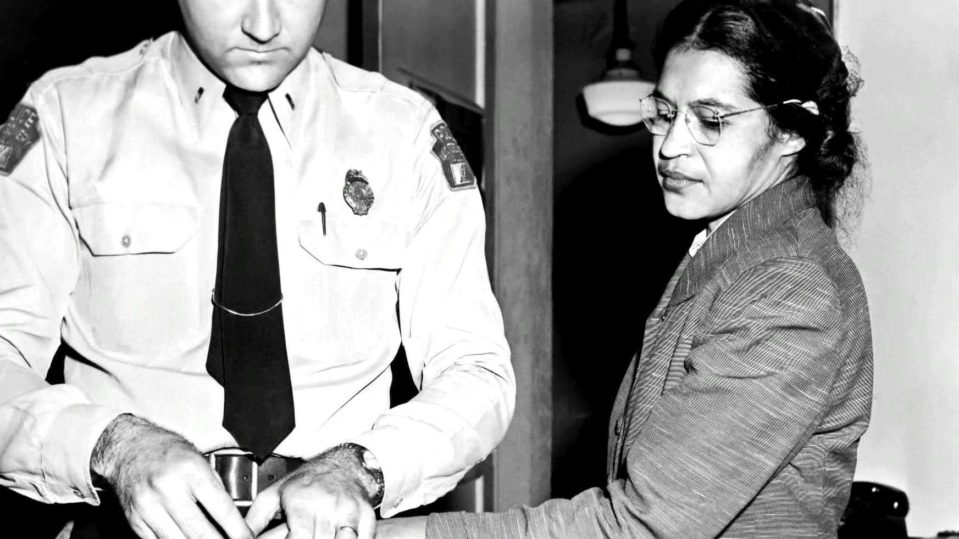
TV as a tool for drawing awareness of racism on the domestic front
Television begins to play a major role in the broadcast of struggles for civil rights
Critics argued that TV’s representational system far behind (old-school depictions of women in domesticated roles rather than activist roles)
Notes:
See pg. 207 → decades of struggles → people of color and women are experiencing the benefits now.
However, much is at stake and at risk of being reduced to ideological views of progress rather than actual progress “on the streets.”
For example, TV viewers became more aware about the struggle for civil rights as people such as Rosa Parks garnered attention from the new medium with their political acts that defied Jim Crow laws.
Example: The Montgomery Bus Boycott, 1955:
https://youtu.be/ABcXaN6OhEA
Consumer culture: “radio and rock ‘n’ roll to television, movies and those who would study and regulate them” (208) → “The Kids Are Coming For You” = modern-day depiction of this struggle.

Slide 4
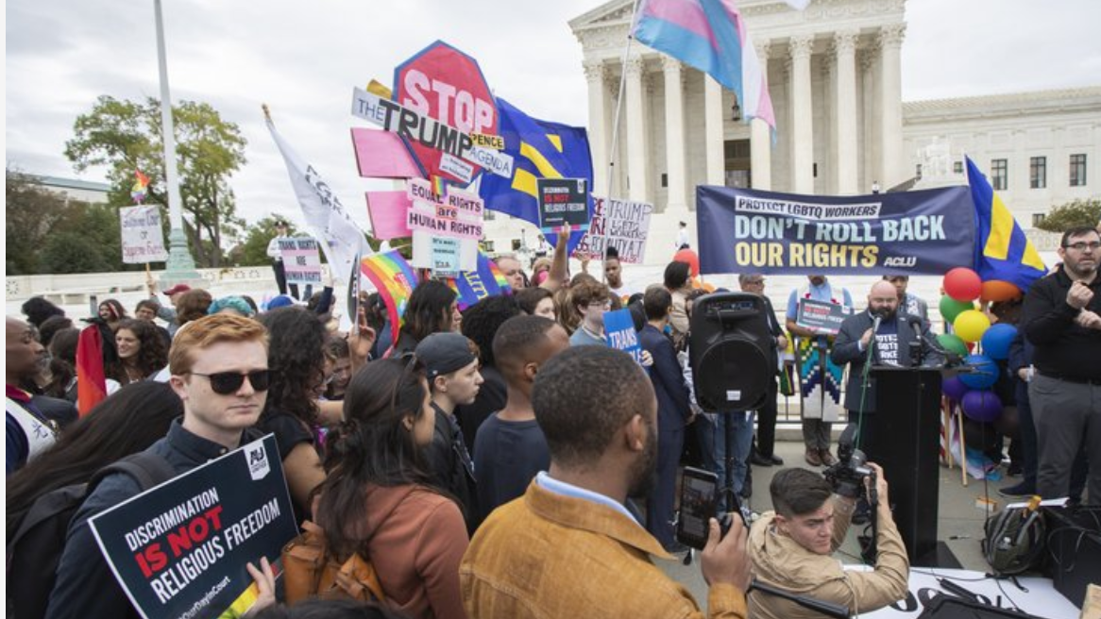
Discuss…
Back then: “That all of these movements – from civil rights to gay rights to antiwar activities – were being organized by the emerging baby boom generation created a deep-seated dread in the hearts of parents and authorities everywhere. What was happening to this privileged, pampered generation of the nation’s children? Was it television? Or was it rock ‘n’ roll?” (208).
And today: Is it social media creating this deep-seated dread in the hearts of parents and authorities everywhere? Or perhaps something else?
Notes:
Late counter-culture groups from 1960s take over FM airwaves, and music culture goes throughout another shift. We will discuss this convergence of radio to television to social media in more detail on Wednesday.

Slide 5
Group Work
Answers will be posted in a master document before class Wednesday.
We will aim to go over a few today and more Wednesday if there is time.

