Slide 1

Week 4: Wednesday
William Boddy: “Live Television and Critical Hierarchies”
Notes:
Show survey results!
Independent Research Days: Friday, Nov. 1 and Friday, Nov. 8

Slide 2
Agenda
Reminder: Sign-Up for Group Presentations
  Deadline: Monday, Oct. 28, 1pm
Pages: Final Paper Prompt is posted
Revisit: Answers to Monday’s Group Questions
Revisit: Radio and rock ‘n’ roll to television
Will post “study guide” with questions & terms by 10pm Wednesday (tonight).
For Friday: Take-Home Test #1
  Review and Practice Run
  Test No. 1 Preparation Friday
Notes:
Some of you reserved 2 spaces total (2 readings selected total) for group presentations. Please be sure to reserve only 1 spot for presentations.
Reminder: show the results of surveys

Slide 3
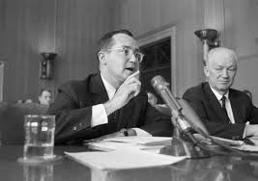
“vast wasteland”
turning point in
content history for TV
“castigation of
commercial broadcasting”
Speech is more about creating a favorable public perception of FCC rather than making infrastructural changes to the Classic Network System
Newton Minow addresses the National Association of Broadcasters

Slide 4
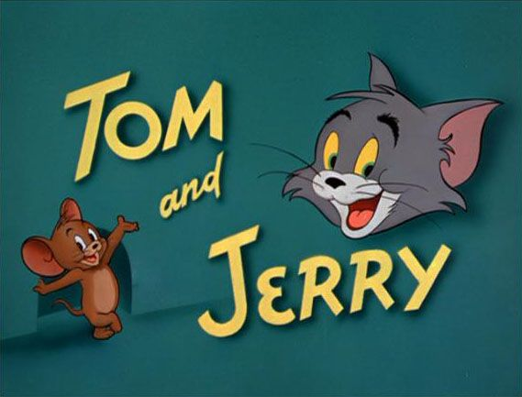
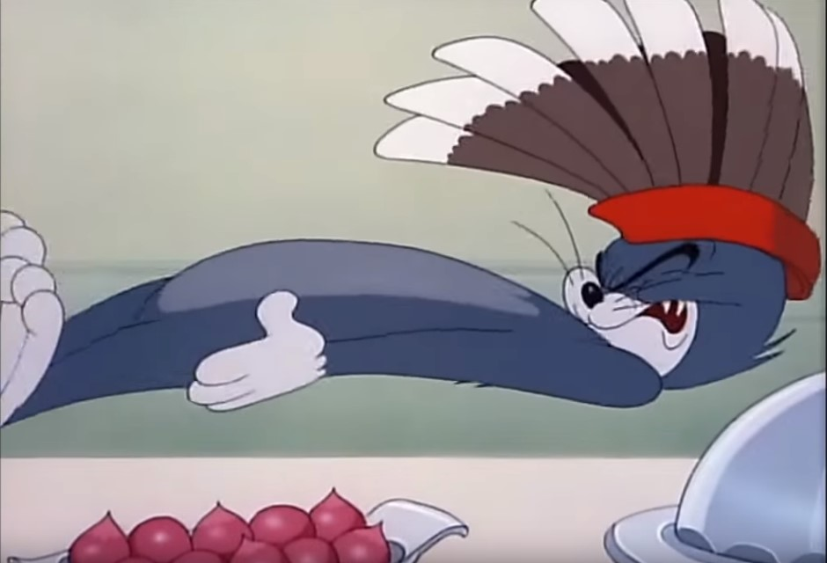
Saturday Morning World
Hilmes: “What messages of disorder and mayhem were young viewers soaking up? What consumer desires were they fomenting?” (231).
Notes:
Cartoons: - Saturday Morning World (231): “…By 1965 cartoons had definitively taken over Saturday morning land. Bugs Bunny, Porky Pig, Tom and Jerry…”
“For all the attention that child audiences have received over the years,” the programming sparked conservations about what it was children were actually watching.

Slide 5
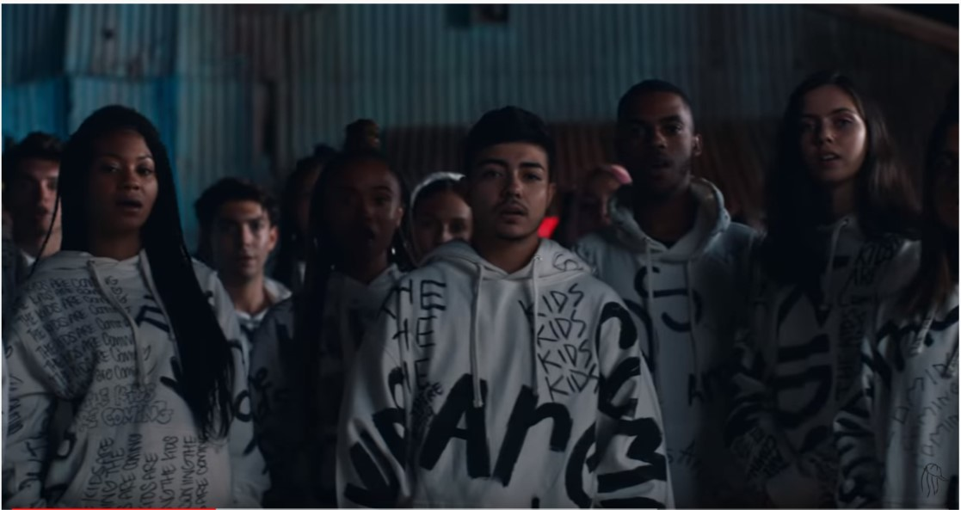
Contemporary example of music going through a shift, shaping ideologies of future generations
Recall Hilmes:
“That all of these movements – from civil rights to gay rights to antiwar activities – were being organized by the emerging baby boom generation created a deep-seated dread in the hearts of parents and authorities everywhere. What was happening to this privileged, pampered generation of the nation’s children? Was it television? Or was it rock ‘n’ roll?” (208).
Tones and I: “The Kids Are Coming” (2019)
Notes:
Here is one way that radio has changed after the emergence of television.
Impact of the payola scandal → “put an end to the system that had briefly given diverse cultural groups a certain amount of freedom. It substituted the control of more ‘responsible’ centralized players and in radio led to a period of consolidation and standardization” (210).
Late counter-culture groups from 1960s take over FM airwaves, and music culture goes throughout several shifts, eventually leading to the formation of MTV (Music Television), a TV channel launched in New York City in 1981.
Today, there are multiple venues that enable the distribution of music over global “airwaves.”
She has cracked the U.S. charts → https://theindustryobserver.thebrag.com/tones-and-i-billboard-charts/
Lyrics: https://genius.com/Tones-and-i-the-kids-are-coming-lyrics

Slide 6
Final key points from Hilmes Ch. 8
1965: National Endowment for the Arts and the National Endowment for the Humanities are established, which helped pave the path of programming for public television
Hollywood’s reach → 1955: producing 71% of primetime network programming; 1965 almost 90%

Slide 7
Key points:
William Boddy
“Live Television”
The viewer becomes a spectator of the technology rather than a partner with it.
Spectators get to decide who they let into their living rooms (83).
The role of the writer becomes tantamount to the creative and production processes (86).
Writers Guild of America membership explodes

