Slide 1
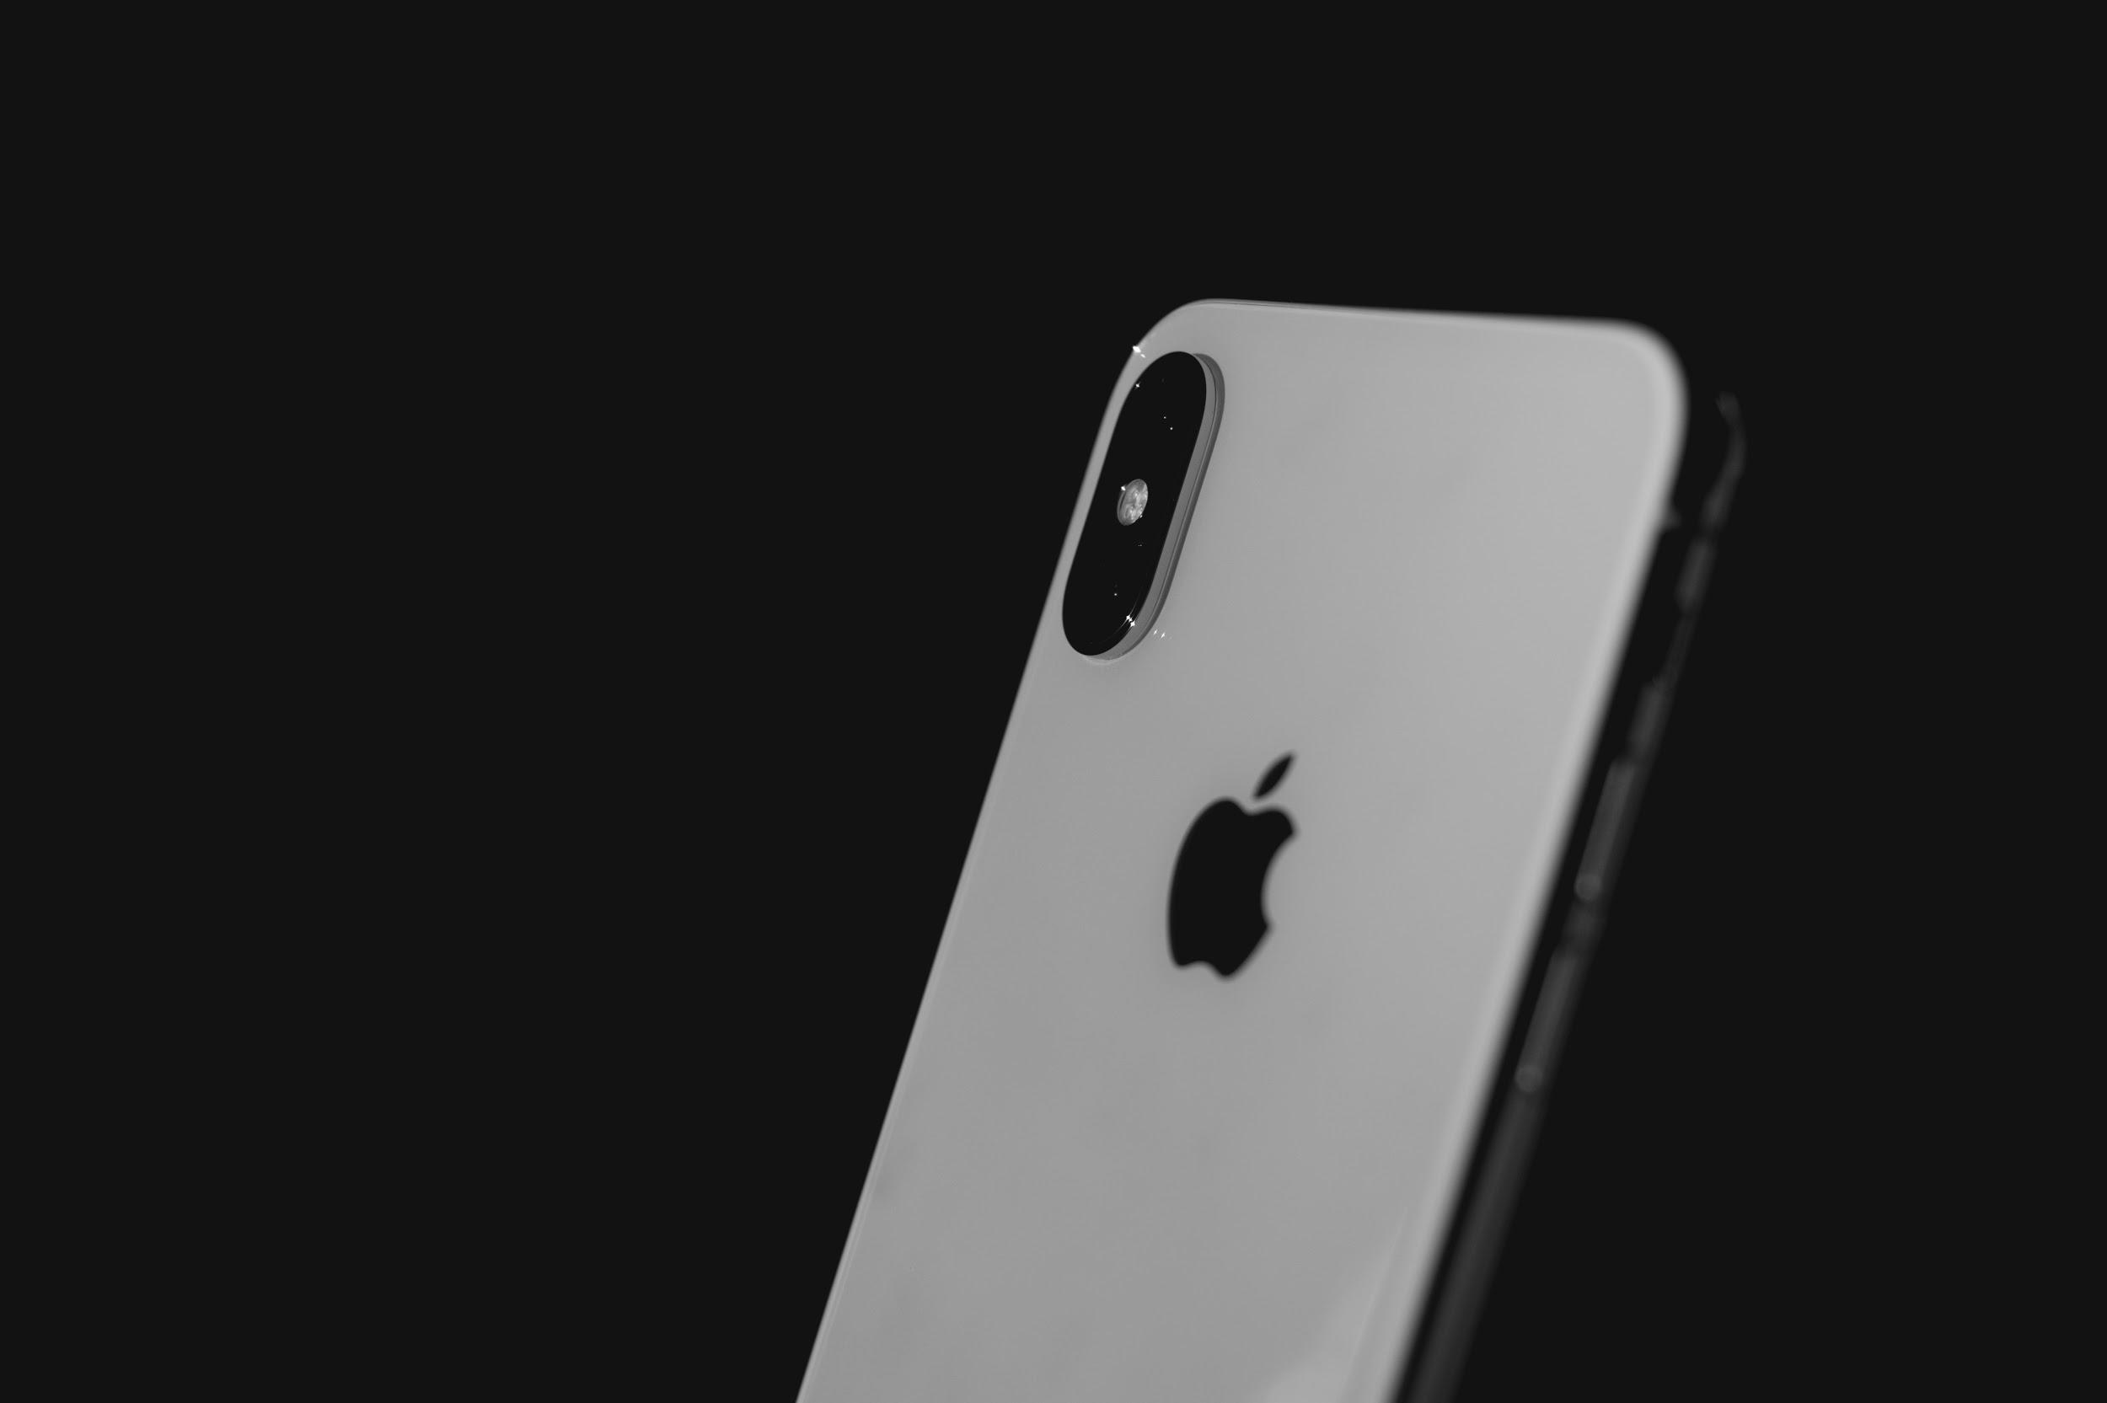

Iphone X Mapping the Product Life Cycle (PLC)
Name:
Course:
Date:

Slide 2
INTRODUCTION
Product Life Cycle (PLC)
  The concept of PLC business management strategy based on the fact that every product has a limited lifetime
  Dibb et al defines PLC as a four stage/phase that involves product introduction, growth, maturity and lastly decline. It is critical in addressing sales and cost measures of a product throughout its life cycle (Kerin, & Hartley, 2017).
  It enhances understanding of the market, customer and competitor hence promoting marketing effectiveness, product quality and sales opportunities necessary to ensure sustainability and successful till product end of life.
  It helps the marketing manager to plan and oversee strategic decisions and actions at different stages of the product life time. It helps the manager make strategic adjustment in terms of marketing mix, platforms , product price , target market and promotional strategies with aim of maximizing returns at every stage.

Slide 3
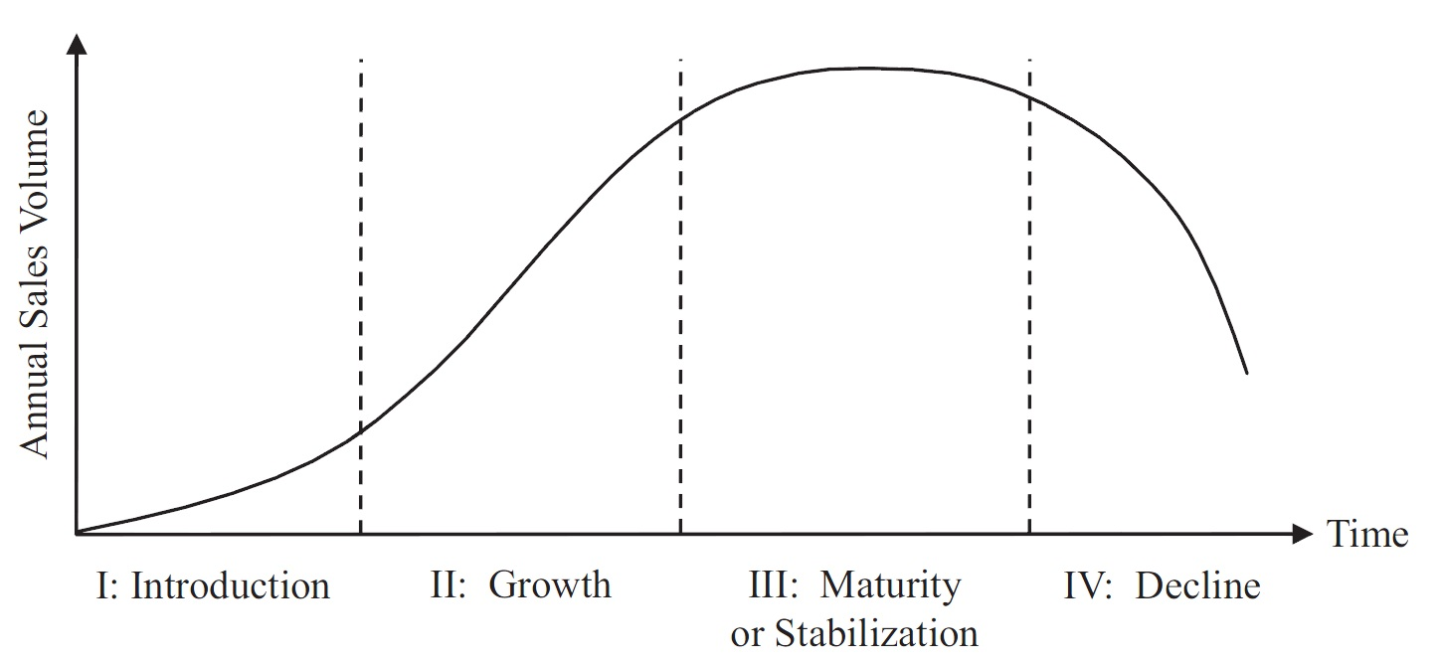
PLC Stages
Step 1:Introduction
First appearance of the product in end consumer market. Negative or low sales and profits
Free samples, aggressive advertising to gain market footprint and creation of distribution outlets
Step 2: Growth
Marketers might start targeting new market
seek quality addition of new feature
focus on brand image
Establishing command in the market share.

Slide 4
PLC Stages
Step 3: Maturity
maximize profits
optimizing product usage
increasing and maintaining market share through
promotion strategies and differentiation to snatch market share from competition
Research and development intensify to enable replacement of the maturing product
Step 4: Decline
Product profitability and sales have attained market saturation and starts diminishing due to very high competition.
Negative growth rate as cost counter cash flows.

Slide 5
WHY IT IS IMPORTANT
Sales and profit forecasting
Market entrance planning
Suitainability control tool
Price determination
Product differentiation in respect with competition and market condition
PLC is important to marketing managers

Slide 6
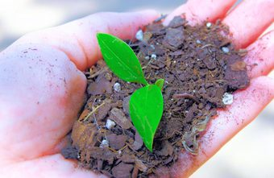
PLC is important to marketing managers
IMPLICATIONS
Poor market entrance: poor marketing and distribution tactics at the introduction stage.
Unsustainable business strategies leading to loss of market share
Loss of opportunities and inability to address vulnerabilities through R&D
Reduced ability to maximize sales and profits during the maturity stage(Nagashima, Wehrle, Kerbache & Lassagne, 2015).

Slide 7

Target Market
Youths with high expendable income
Young employed
Students

Slide 8


The product/service presentation to target clientele.
Short and effective sales pitch in popular social media platforms such as Facebook and Youtube(Li, Tao, Cheng,& Zhao,2015).
Interactive partnership with colleges campus and entertainment players.
These presentations offer a rich ground for word of mouth among the tech savvy youths.

Slide 9
Apple should always strive to ensure the Iphone X brand equity exist in the mind of the consumer.
The marketing mix should incorporate thoughts, phrases and beliefs that enhance the consumer recognition with the brand.
Brand equity is great asset in enhancing the product relevant in the consumer daily life (Giachetti & Marchi, 2010).
Positive brand equity builds loyal customer base’ s positive reviews and referrals.
Positive customer image creates a sense of belonging and couscous effort to be associated with the business's products.
Brand Equity relation with Customer Equity

Slide 10
Positive brand impression on the customer helps enhance customer willingness to meet premium prices even when there are cheaper options from competitors.
Successful consumer branding means word of mouth from the large consumer base reduces marketing and advertising spending thus availing more funds for investment research and development.
Brand Equity relation with Customer Equity

Slide 11
Describe each stage of the PLC, and analyze the implications that each stage may have on pricing.
Identifying features | Stages
 | Introduction | Growth | Maturity | Decline
pricing | Low | High | High | Low
Product definition | Very high | High (lower than intro stage) | Low | Low
Competition | Low or no competition | High | Very high | Very High
Profitability | Low | High | High | Low

Slide 12
REFERENCES
Li, J., Tao, F., Cheng, Y., & Zhao, L. (2015). Big data in product lifecycle management. The International Journal of Advanced Manufacturing Technology, 81(1-4), 667-684.
Giachetti, C., & Marchi, G. (2010). Evolution of firms' product strategy over the life cycle of technology-based industries: A case study of the global mobile phone industry, 1980–2009. Business History, 52(7), 1123-1150.
Nagashima, M., Wehrle, F. T., Kerbache, L., & Lassagne, M. (2015). Impacts of adaptive collaboration on demand forecasting accuracy of different product categories throughout the product life cycle. Supply chain management: an international journal, 20(4), 415-433.
Kerin, R. A., & Hartley, S. W. (2017). Marketing (13th ed.). Retrieved from https://phoenix.vitalsource.com/books/1260177580/epubcfi/6/2!/410@0:0

