Slide 1
Marketing and Advertising effort
Name:
Course name:
Course code:
School:
Instructor:
Date:

Slide 2
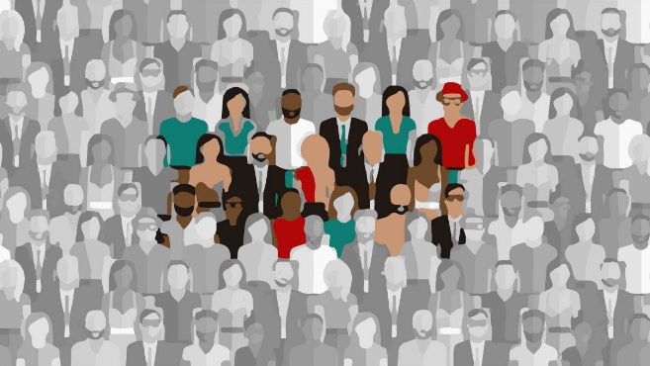
Target audience
Any marketer should right from the start understand the target customer and discover a number of things such as;
What are their needs/wants?
How can the needs be satisfied?
Their age, social status, marital status, sex, religion etc. (Dave, 2011).
Notes:
In any marketing endeavor, it is important to recognize the target market or audience/customer.
This is one step towards understanding of the demographic features present in the target group. For example, age, income, geographical location, sex, social status and many more
It is easily to capture the attention of the target customer once the marketer have understood who they are, what they want, and where they come from as well as their needs.

Slide 3
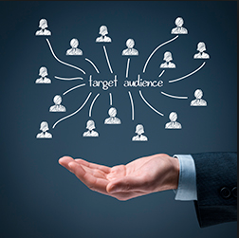
Listen to the target audience
Listening to the customers to get crucial information
For example,;
Their needs
Market gaps they have identified in the market
What they like e.g. sports
How they would wish their want satisfied.
Information can be captured using;
Questionnaires
Interviews
Observation (Dave, 2011)
Notes:
After identifying the target audience, it is time for the marketer to approach the target audience and listen to them
This is an opportunity for the marketer to get information on what the client/customer wants fulfilled.
The marketer should be able to create a strong relationship with eth customer
It is important for the marketer to get the market gap right

Slide 4
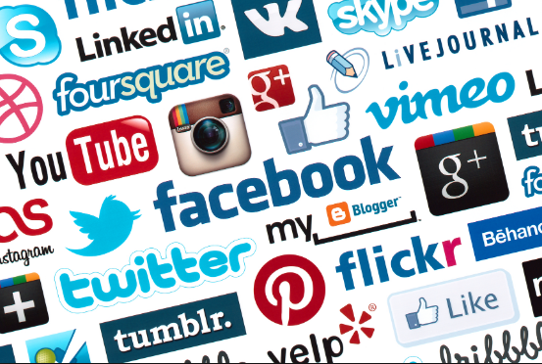
Choose the best channel of marketing
There are many channels that can be used to communicate to the customer. For example;
a. The social media such as Instagram, Facebook, Twitter, LinkedIn and many more.
The customer should be able to get the information in time and well detailed (Dave, 2011).
Notes:
As a marketer, a right channel or channels of advertising is crucial in any marketing or advertising agenda.
It is important to choose the right channel that will ensure that the customer gets the organization’s information in time and can go for the product or service on offer.
Information ought to be clear and understandable to the consumer
There are many channels that can be used to communicate to the customer. For example;
a. The social media such as Instagram, Facebook, Twitter, Linkedln and many more.

Slide 5

Sell and search for feedback
The target customer will like the product or service and buy if the marketer did the job well.
However, the work of marketing and advertising does not end there, it is the duty of the marketer to press on and discover whether the client was satisfied.
This calls for collection of feedback and find out what needs to be done to ensure maximum customer satisfaction.
For example, need for innovation, re-branding among many other ways to improve and develop a product (Dave, 2011).
Notes:
The target customer will like the product or service and buy if the marketer did the job well.
However, the work of marketing and advertising does not end there, it is the duty of the marketer to press on and discover whether the client was satisfied.
This calls for collection of feedback and find out what needs to be done to ensure maximum customer satisfaction.

Slide 6

Target Audience
The topic relates to the understanding that are a marketer need to develop about the target audience. This topic related to the marketing agenda of the class readings (Dave, 2011).

Slide 7
Questions for discussion
What is the impact of the marketer to production or manufacturing?
Is the customer always right? Why?
What is the right way to deal with customer complaints?
Which is the best marketing channel for college students for food products/joint and why?
What is the difference between marketing and advertising.

Slide 8
Reference
Dave Kerpen, (2011). Likeable Social Media; How to delight your customers, create an irresistible brand, and be generally amazing on Facebook (and other social network); summer 2011

Slide 9
END

