Slide 1

Using M I S
Tenth Edition
Chapter 7
Processes, Organizations, and Information Systems
Slides in this presentation contain hyperlinks. JAWS users should be able to get a list of links by using INSERT+F7
Copyright © 2018, 2017, 2016 Pearson Education, Inc. All Rights Reserved
Notes:
If this PowerPoint presentation contains mathematical equations, you may need to check that your computer has the following installed:
1) MathType Plugin
2) Math Player (free versions available)
3) NVDA Reader (free versions available)

Slide 2
“We Could Also Sell Virtual Spinning Classes”
How is A R E S going to make money?
  Selling an app to consumers
  Revenue sharing with instructors
  In-app advertising revenue
  Celebrity rides
Corporate wellness programs?
  Healthy employees might have fewer health issues, be more energetic, and have fewer sick days.
Notes:
These questions get to the issue of how to monetize the ARES system.
Provide a setting for students “to assess, evaluate, and apply emerging information technology to business.” (One of the major goals of the text from Chapter 1.)
Connect applications of IS to the fundamentals presented in Chapters 1–6.
Show a realistic application of digital reality + cloud technology.
Demonstrate the need for, the creation of, and some of the issues involving an inter-enterprise IS.
Illustrate one realistic outcome for a startup … the originator, here Dr. Flores, cannot make a go of it, so an investor buys it for pennies on the dollar and changes the strategy. Will there be success?

Slide 3
Who Will Pay?
Health clubs.
Employers.
Selling ad space to health clubs and manufacturers.
Social media–driven.
Can A R E S support 30 people in a virtual group ride at the same time?

Slide 4
Learning Objectives
7.1 What are the basic types of processes?
7.2 How can information systems improve process quality?
7.3 How do information systems eliminate the problems of information silos?
7.4 How do C R M, E R P, and E A I support enterprise processes?
7.5 What are the elements of an E R P system?
7.6 What are the challenges of implementing and upgrading enterprise information systems?
7.7 How do inter-enterprise I S solve the problems of enterprise silos?
7.8 2027?

Slide 5
Learning Objective 7.1
What are the basic types of processes?

Slide 6
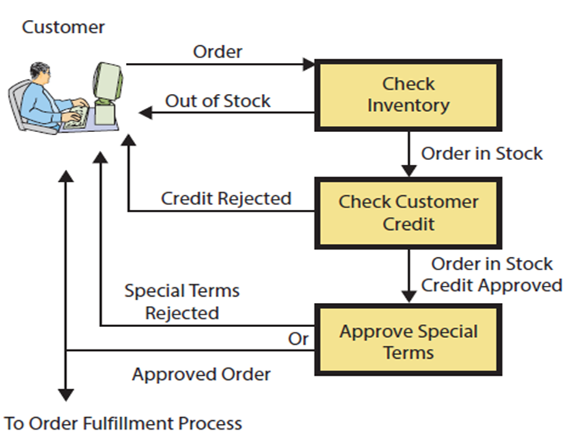
Figure 7-1 Business Process with Three Activities
Notes:
This is a simplified view of a three-activity process for approving customer orders.

Slide 7
How Do Structured Processes Differ from Dynamic Processes?
Figure 7-2 Structured Versus Dynamic Processes
Structured | Dynamic
Support operational and structured managerial decisions and activities | Support strategic and less structured managerial decision and activities
Standardized | Less specific, fluid
Usually formally defined and documented | Usually informal
Exceptions rare and not (well) tolerated | Exceptions frequent and expected
Process structure changes slowly and with organizational agony | Adaptive processes that change structure rapidly and readily
Example: Customer returns, order entry, purchasing, payroll, etc. | Example: Collaboration; social networking; ill-defined, ambiguous situations
Notes:
Structured processes are formally defined, standardized processes involving day-to-day operations: accepting a return, placing an order, purchasing raw materials, and so forth.
Dynamic processes are flexible, informal, and adaptive processes normally involving strategic and less structured managerial decisions and activities.

Slide 8
How Do Processes Vary by Organizational Scope? (1 of 2)
Figure 7-3 Common Workgroup Processes
Workgroup | Workgroup Example Processes
Sales and marketing | • Lead generation • Lead tracking • Customer management • Sales forecasting • Product and brand management
Operations | • Order entry • Order management • Finished goods inventory management
Manufacturing | • Inventory (raw materials, goods-in-process) • Planning • Scheduling • Operations
Notes:
The workgroups represent six of the nine value-added activities.

Slide 9
How Do Processes Vary by Organizational Scope? (2 of 2)
Figure 7-3 [Continued]
Workgroup | Workgroup Example Processes
Customer service | • Order tracking • Account tracking • Customer support
Human resources | • Recruiting • Compensation • Assessment • H R planning
Accounting | • General ledger • Financial reporting • Cost accounting • Accounts receivable • Accounts payable • Cash management • Budgeting • Treasury management
Notes:
The workgroups represent six of the nine value-added activities.

Slide 10
Figure 7-4 Characteristics of Information Systems
Scope | Example | Characteristics
Workgroup | Doctor's office/medical practice | Support one or more workgroup processes. 10–100 users; procedures often formalized; problem solutions within group; workgroups can duplicate data; somewhat difficult to change
Enterprise | Hospital | Support one or more enterprise processes. 100–1,000+ users; procedures formalized; problem solutions affect enterprise; eliminate workgroup data duplication; difficult to change
Inter-enterprise | Healthcare exchange | Support one or more inter-enterprise processes. 1,000+ users; systems procedures formalized; problem solutions affect multiple organizations; can resolve problems of duplicated enterprise data; very difficult to change
Notes:
Processes are used at three levels of organizational scope: workgroup, enterprise, and inter-enterprise.
Characteristics of departmental information systems are summarized in Workgroup. Often, procedures are formalized in documentation, and users frequently receive formal training in use of those procedures.

Slide 11
Learning Objective 7.2
How can information systems improve process quality?

Slide 12
Improving Process Quality (1 of 2)
Process efficiency
  Ratio of outputs to inputs.
Process effectiveness
  How well a process achieves organizational strategy.
How can processes be improved?
  Change process structure.
  Change process resources.
  Change both.
Notes:
Processes are means people use to organize an activity to achieve organization’s goals.
Two dimensions of process quality are efficiency and effectiveness.

Slide 13
Improving Process Quality (2 of 2)
Performing an activity.
  Partially automated, completely automated.
Augmenting human performing activity.
  Ex: Common reservation system.
Controlling data quality.
  Ensure data complete and correct before continuing process activities.

Slide 14
Learning Objective 7.3
How do information systems eliminate the problems of information silos?

Slide 15
Eliminating Information Silos
What are the problems of information silos?
  Data duplicated.
  Data inconsistency.
  Data isolated.
  Disjointed processes.
  Lack of integrated enterprise information.
  Inefficiency: decisions made in isolation.
  Increased cost for organization.
Notes:
An information silo exists when data are isolated in separated information systems.
Information system silos arise when:
IS supports departmental processes rather than enterprise-level processes.
Personal and workgroup support applications are created over time.
Organizations grow, especially by merger and acquisitions.

Slide 16
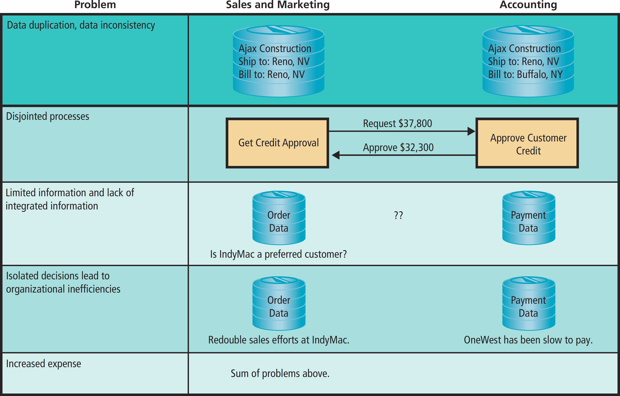
Figure 7-5 Problems Created by Information Silos
Notes:
This table summarizes problems of information silos.
Duplicated and inconsistent data
Separated supporting applications; difficult for two activities to reconcile their data, getting approvals will be slow and possibly erroneous
Lack of integrated enterprise data as a consequence of disjointed systems
Inefficiency results from making decisions in isolation
Information silos increase costs — duplicated data, disjointed systems, limited information, and inefficiencies all mean higher costs

Slide 17
Solving the Problems of Information Silos (1 of 2)
Integrate into single database.
Revise applications.
Allow isolation, manage to avoid problems.

Slide 18
Solving the Problems of Information Silos (2 of 2)
Figure 7-6 Information Silos as Drivers
Scope | Example | Example Information Silo | Enabling Technology
Workgroup | Doctor's office/ medical practice | Physicians and hospitals store separated data about patients. Unnecessarily duplicate tests and procedures. | Functional applications.
Blank | Blank | ↓ | Enterprise applications (C R M, E R P, E A I) on enterprise networks
Enterprise | Hospital | Hospital and local drug store pharmacy have different prescription data for the same patient. | Blank
Blank | Blank | ↓ | Distributed systems using Web service technologies in the cloud.
Inter-enterprise | Healthcare exchange | No silo: Doctors, hospitals, pharmacies share patients’ prescription and other data. | Blank
Notes:
The arrows in Figure 7-6 show this resolution at two levels of organization.
First, isolated data created by workgroup information systems are integrated using enterprise-wide applications.
Second, today, isolated data created by information systems at the enterprise level are integrated into inter-enterprise systems using distributed applications.

Slide 19
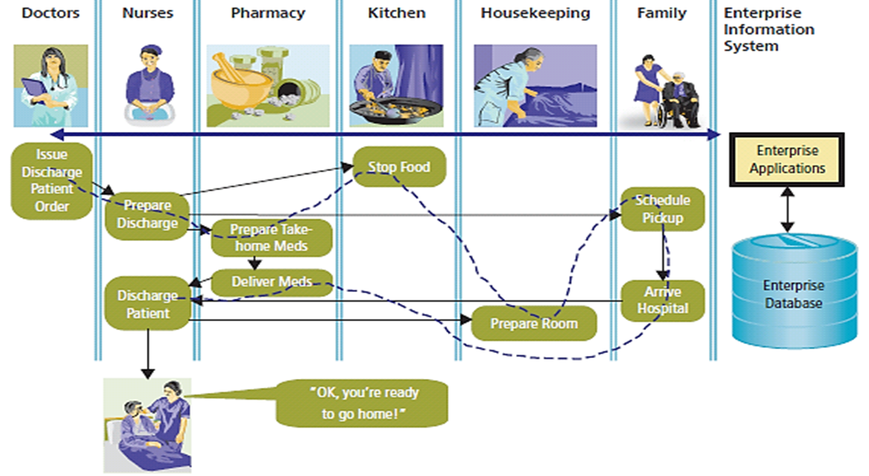
An Enterprise System for Patient Discharge
Figure 7-7 Example Enterprise Process and Information System
Notes:
Hospital uses an enterprise-wide information system to support this process. IS provides data entry forms, reports, and notifications to human actors in this process. It also controls the flow of process activity as shown by dotted arrow.
To use new system, staff needs to transition from a paper-based system to computer-based one.

Slide 20
Learning Objective 7.4
How do C R M, E R P, and E A I support enterprise processes?

Slide 21
Business Process Reengineering
Business Process Reengineering (B P R)
  Integrated data, enterprise systems create stronger, faster, more effective linkages in value chains.
  Difficult, slow, exceedingly expensive.
  Key personnel determine how best to use new technology.
  Requires high-level and expensive skills and considerable time.

Slide 22
Emergence of Enterprise Application Solutions
Inherent processes
  Predesigned processes for using application.
  “Industry best practices.”
Customer relationship management (C R M).
Enterprise resource planning (E R P).
Enterprise application integration (E A I).
Notes:
Organizations can license software and obtain prebuilt procedures. Over time, three categories of enterprise applications have emerged: customer relationship management, enterprise resource planning, and enterprise application integration.

Slide 23
Customer Relationship Management (C R M)
Suite of applications, database, set of inherent processes.
Manage all interactions with customer through four phases of customer life cycle.
  Marketing, customer acquisition, relationship management, loss/churn.
Supports customer-centric organization.

Slide 24
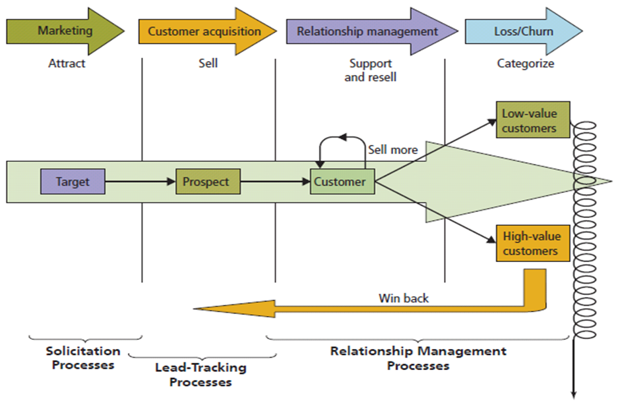
Figure 7-8 Customer Life Cycle
Source: Used with permission from Professor Douglas MacLachlan, Foster School of Business, University of Washington.
Notes:
Notice that components exist for each stage of the customer life cycle. As shown, all applications process a common customer database. This design eliminates duplicated customer data and removes the possibility of inconsistent data.
Marketing sends messages to target market to attract customer prospects. When prospects order, they become customers who need to be supported. Additionally, relationship management processes increase the value of existing customers by selling them more products.
Over time, organization loses some customers. When this occurs, win-back processes categorize customers according to their value and attempt to win back and turn them into high-value customers.

Slide 25
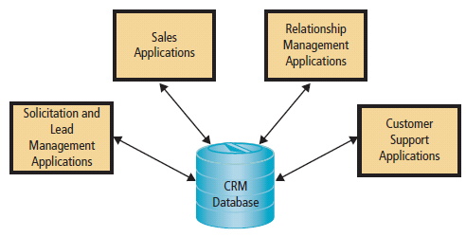
Figure 7-9 C R M Applications
Notes:
CRM components exist for each stage of the customer life cycle. As shown, all applications process a common customer database. This design eliminates duplicated customer data and removes the possibility of inconsistent data. It also means that each department knows what has been happening with the customer at other departments.

Slide 26
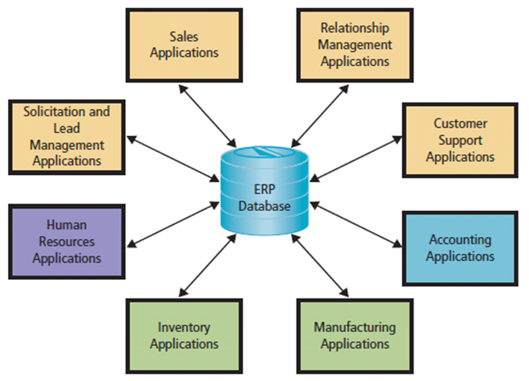
Figure 7-10 E R P Applications
E R P is a suite of applications
The primary purpose of an E R P system is integration
Integration allows real-time updates
Notes:
ERP is a suite of applications (modules), a database and a set of inherent processes for consolidating business operations into a single, consistent, computing platform. ERP systems are an IS based on ERP technology.

Slide 27
Who Fixes a Workflow Problem?
So What?
Computer programmer? No.
Network engineer? No.
Database administrator? No.
Someone with knowledge of business. Yes!
  If workflow involves information system, someone knowledgeable and comfortable working with technical people.
  You with help of a business analyst.
Notes:
To do this well, you need to know IS and something: IS and marketing, IS and operations, IS and finance.

Slide 28
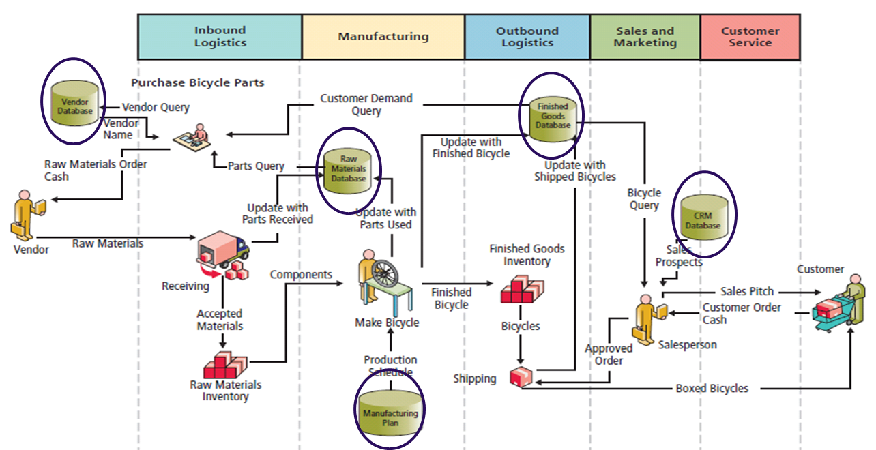
Pre-E R P Information System: Bicycle Manufacturer
Figure 7-11 Pre-E R P Information Systems
Notes:
This diagram represents processes used by a bicycle manufacturer. There are five non-integrated databases. Assume the company has a separate accounting system (not shown) that is not integrated. With such a pre-ERP system, financial statements are always outdated and weeks late.

Slide 29
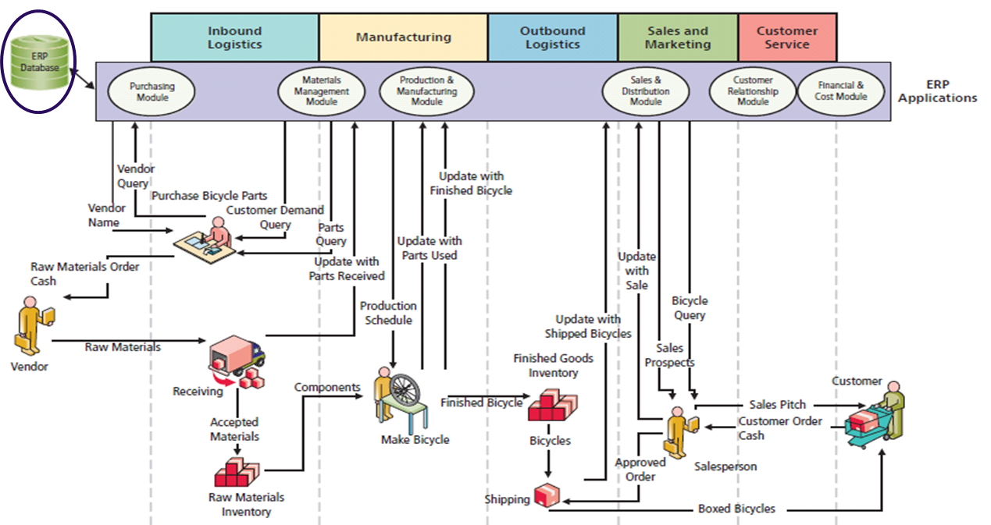
Figure 7-12 E R P Information Systems
Notes:
All activity processed by ERP applications and consolidated data are stored in a centralized ERP database.

Slide 30
Paid Deletion (1 of 2)
Ethics Guide
A company experiences negative press.
  Manufacturing company dealing with environmental protection violations.
  A popular chain of restaurants had a long list of health-code violations.
Companies offer Eric money to tweak the results of Web searches using key terms relevant to these negative incidents.
Eric buries or deletes negative results without his employer knowing.
Notes:
Goals
Understand how business pressures motivate people to act unethically and sometimes illegally.
Discuss ethical principles about employee behavior harming his/her employer.

Slide 31
Paid Deletion (2 of 2)
What happens if someone finds out search results are being manipulated?
  Eric could be fired
  Company could be severely harmed
  Robin could lose her job too
How might have Eric rationalized his fraudulent behavior?
Even if Eric were caught, would he be guilty of a crime?
Notes:
Do you think that removing content on the Internet and manipulating search engine results for money is ethical according to:
The categorical imperative?
The utilitarian perspective?

Slide 32
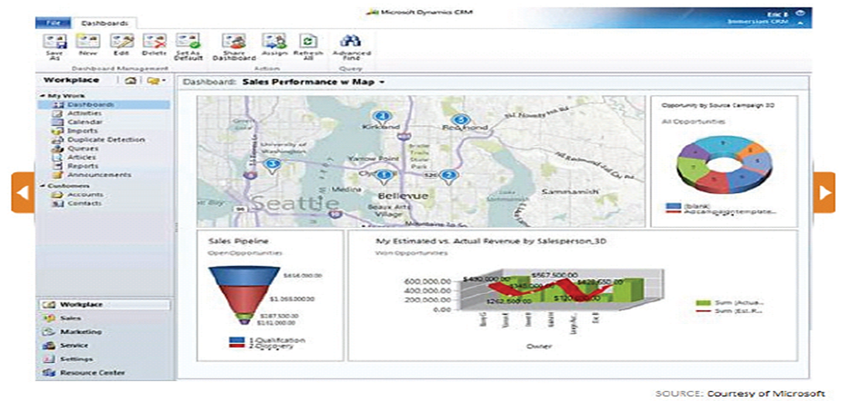
E R P Enabled Sales Dashboard
Figure 7-13 Sales Dashboard
Source: Microsoft Corporation
Notes:
With integration, ERP systems can display current status of critical business factors to managers and executives.

Slide 33
Enterprise Application Integration (E A I)
Connects system “islands.”
Enables communicating and sharing data.
Provides integrated information.
Provides integrated layer on top of existing systems while leaving functional applications “as is.”
Enables gradual move to E R P.
Notes:
EAI is a suite of software applications that integrates existing systems by providing layers of software that connect applications.

Slide 34
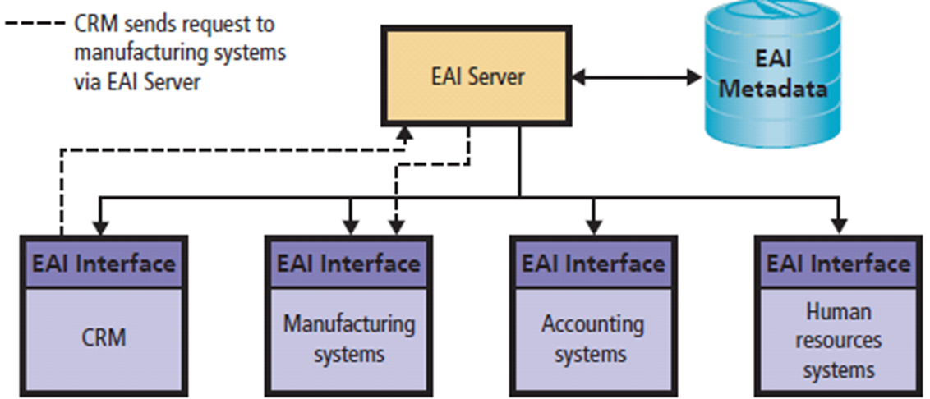
Figure 7-14 Design and Implementation for the Five Components
Notes:
EAI enables organizations to use existing silo applications while eliminating many serious problems of isolated systems.

Slide 35
Learning Objective 7.5
What are the elements of an E R P system?

Slide 36
Elements of an E R P System
Hardware
E R P Application programs
E R P Databases
Business process procedures
Training and consulting

Slide 37
E R P Applications
True E R P Have Application that Integrate:
  Supply chain
  Manufacturing
  C R M
  Human resources
  Accounting
(http://www.erpsoftware360.com/erp-101.htm)
Notes:
Supply chain (procurement, sales order processing, inventory management, supplier management, and related activities)
Manufacturing (scheduling, capacity planning, quality control, bill of materials, and related activities)
CRM (sales prospecting, customer management, marketing, customer support, call center support)
Human resources (payroll, time and attendance, HR management, commission calculations, benefits administration, and related activities)
Accounting (general ledger, accounts receivable, accounts payable, cash management, fixed asset accounting)

Slide 38
E R P Solution Components (1 of 2)
E R P Application Programs
  Configurable vendor applications.
E R P Databases
  Trigger
    Computer program within database to keep database consistent when certain conditions arise.
  Stored Procedure
    Enforces business rules.
Notes:
Vendor applications: Configurable, can be altered without changing program code. Set configuration parameters specifying how ERP application programs will operate: Hourly payroll application configured to specify number of hours in standard workweek, hourly wages for different job categories, wage adjustments for overtime and holiday work, etc.
ERP Databases:
- Trigger: Database program to keep database consistent when certain conditions arise
- Stored procedure: Database program to enforce business rules

Slide 39
E R P Solution Components (2 of 2)
Business Processes and Procedures
  Adapt to inherent processes and procedures, or design new ones?
Training & Consulting
  Training to implement.
  Top management support, preparing for change, dealing with resistance.
  Training to use.
Industry-Specific Solutions
Notes:
Super Users become in-house trainers; train the trainers
Vendor and third-party consultants

Slide 40
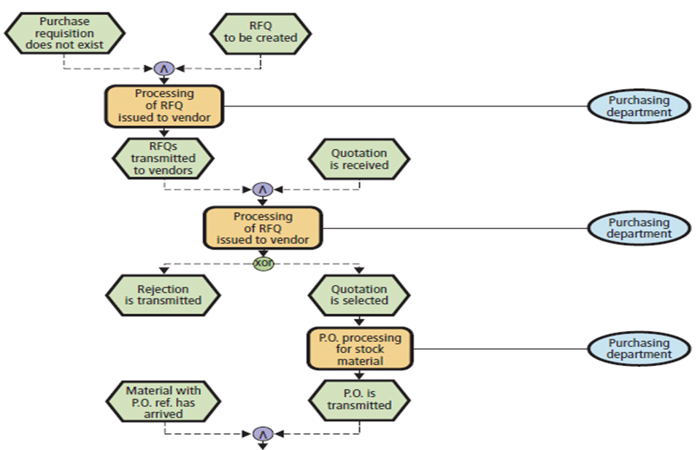
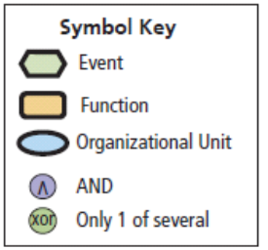
Example of S A P Ordering Business Process Blueprint (1 of 2)
Figure 7-15 S A P Ordering Process
Source: Based on Thomas A. Curran, Andrew Ladd, and Dennis Ladd, S A P/R/3 Reporting Business and Intelligence, 1st ed. copyright 2000.
Notes:
Top half of Figure 7-15

Slide 41
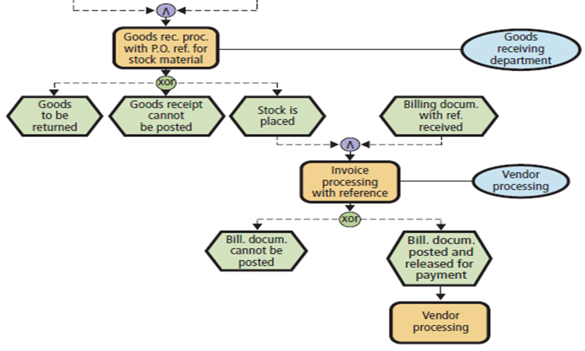
Example of S A P Ordering Business Process Blueprint (2 of 2)
Figure 7-15 [Continued]
Source: Based on Thomas A. Curran, Andrew Ladd, and Dennis Ladd, S A P/R/3 Reporting Business and Intelligence, 1st ed. copyright 2000.
Notes:
Bottom half of Figure 7-15

Slide 42
Figure 7-16 Characteristics of Top E R P Vendors (1 of 2)
Company | E R P Market Rank | Remarks | Future
SAP | 1 | Led E R P success with client-server hardware. Largest vendor, most comprehensive solution. Largest customers. Expensive. | Technology older, but SAP is adapting to mobility and cloud trends. Expensive and seriously challenged by less expensive alternatives. Huge customer base. Future depends on effectively migrating traditional customers to the cloud. Claims number 1 in C R M.
Oracle | 2 | Combination of in-house and acquired (PeopleSoft, Siebel) products. Expensive. | Intensely competitive company with strong technology base. Large customer base. Flexible S O A architecture. Will leverage strong technology base into innovative and effective cloud-based solutions. Strong challenge to SAP market leadership. Claims number 1 in C R M.
Notes:
Although more than 100 different companies advertise ERP products, not all of those products meet the minimal ERP criteria. Even of those that do, the bulk of the market is held by the five vendors.

Slide 43
Figure 7-16 Characteristics of Top E R P Vendors (2 of 2)
Figure 7-16 [Continued]
Company | E R P Market Rank | Remarks | Future
Infor E R P | 3 | Privately held corporation that acquired an E R P product named Baan, along with more than 20 others. | Many solutions, not integrated, particularly specialized for manufacturing and supply chain management. Evolving with revolution in 3D printing practices.
Microsoft Dynamics | 4 | Four products acquired: A X, Nav, G P, and S L. A X and Nav more comprehensive. S L on the way out? Large V A R channel. | Products not well integrated with Office. Not integrated at all with Microsoft development languages. Solutions not integrated and product direction uncertain. Microsoft Azure hosts Oracle and SAP products. Conflict with Azure hosting of Microsoft E R P products.
Sage | 5 | Offers E R P, C R M, and financial-oriented functional system solutions. | Sage adapted many of its legacy applications and solutions for the cloud and for mobile computing. Offers inexpensive, cloud-based solutions for startups and small businesses. Broad product suite.
Source: Panorama Consulting Solutions, “Clash of the Titans 2016,” Panoramaconsulting.com, November 2015, http://go.panoramaconsulting.com/rs/603-U J X-107/images/Clash-ofthe-Titans-2016.pdf; Gartner, “E R P Software, Worldwide, 2015,” Gartner.com, April 29, 2016, www.gartner.com/doc/3300322/market-shareanalysis-erp-software.
Notes:
Although more than 100 different companies advertise ERP products, not all of those products meet the minimal ERP criteria. Even of those that do, the bulk of the market is held by the five vendors.

Slide 44
Learning Objective 7.6
What are the challenges of implementing and upgrading enterprise information systems?

Slide 45
Challenges of Implementing and Upgrading
Figure 7-17 Five Primary Factors
Collaborative management
Requirements gaps
Transition problems
Employee resistance
New technology
Notes:
Implementation is challenging, difficult, expensive, and risky. It is not unusual for enterprise system projects to be well over budget and a year or more late.

Slide 46
Learning Objective 7.7
How do inter-enterprise I S solve the problems of enterprise silos?

Slide 47
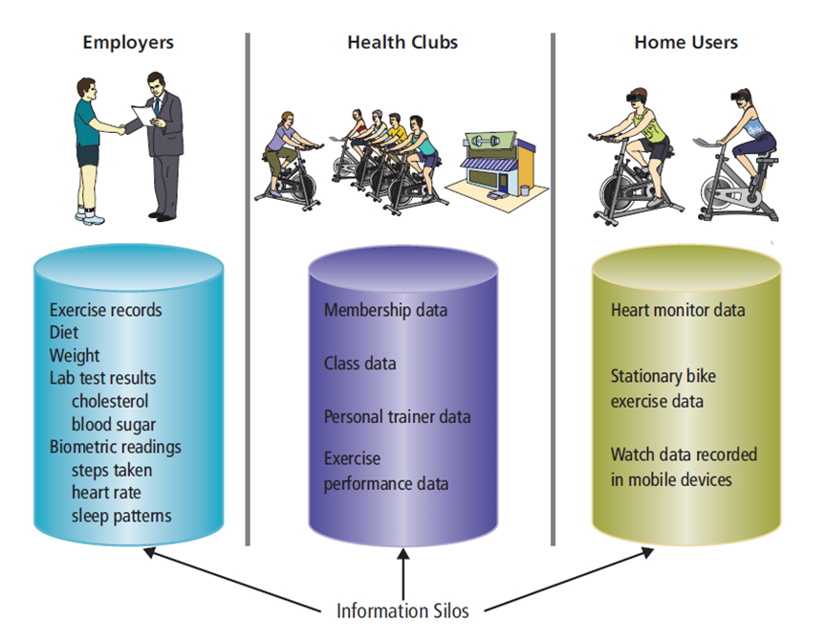
Enterprise I S Solve the Problems of Information Silos
Figure 7-18 Information Silos Without A R E S
Notes:
Figure 7-18 shows the information silos that exist among employers, health clubs, and home users, the principal ARES users.
Isolation of data causes problems. Employers want reports on exercise data stored on user devices in health clubs. Users want data from their employers as well as exercise data from their health clubs. Health clubs want lab readings and biometric readings from employers, and home workout data to integrate with data they have.

Slide 48
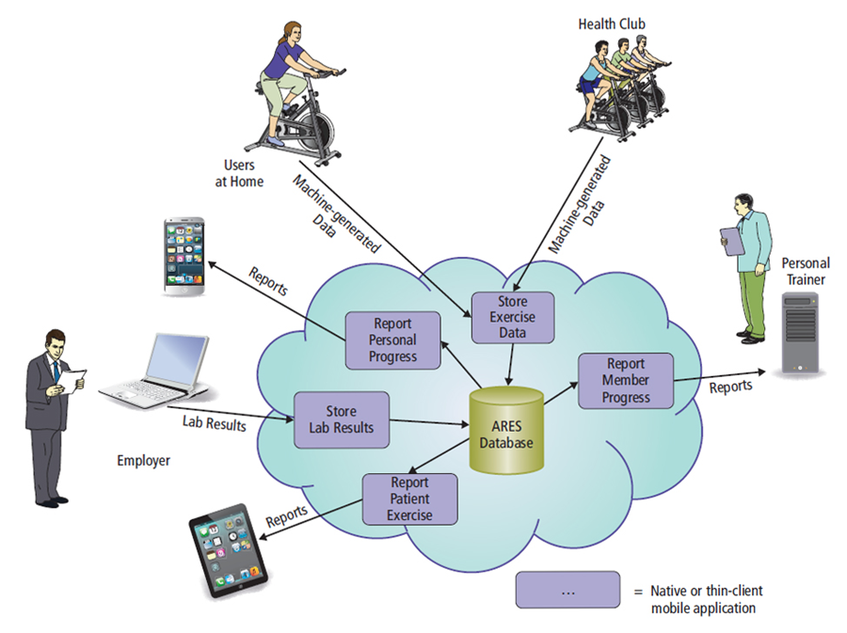
Figure 7-19 Inter-Enterprise A R E S System
Notes:
ARES is a distributed system because processing is distributed across multiple computing devices. Standards such as http, https, html5, CSS3, JavaScript, and others enable programs on varied and disparate devices to flexibly communicate with cloud servers and databases, and indirectly communicate with each other.

Slide 49
Learning Objective 7.8
2027?

Slide 50
Processes, Organizations, and Information Systems in 2027
E R P vendors and customers resolved problems of cloud-based E R P.
Hybrid model
  E R P customers store most of their data on cloud servers managed by cloud vendors and store sensitive data on their own servers.
Gov’t, accounting, financial standards for monitoring organizations for appropriate compliance.
Machines able to employ E R P system to schedule own maintenance.
Notes:
Companies want to move to lower costs of the cloud, but cannot plunge into new cloud-based solutions without causing considerable organizational turmoil, if not failure.
Cloud-based SaaS now applications enable organizations to keep their core SAP installation and data, while adding mobile-enabled cloud applications to that data.

Slide 51
It’s Not Me, It’s You (1 of 2)
Security Guide
Employees leaving a job may take advantage of their last moments with their employers.
A survey of 945 adults who had been laid off, fired, or changed jobs:
  Sixty percent reported stealing data
  Seventy-nine percent knew that taking company data was wrong
  They took email lists, customer contact lists, employee records, and financial information
  Damage was $5,000 to $3 million per incident
Notes:
Goals
Understand potential security problems when employees leave organizations.
Understand the impact of insider data theft.

Slide 52
It’s Not Me, It’s You (2 of 2)
The fraud triangle contends that pressure, opportunity, and rationalization are the three key factors in white-collar crime.
Organizations are working to develop predictive tools that will help identify employees who may be preparing to steal data.
Encryption and continual monitoring of data can be used to thwart data theft.
Employee access to internal systems must be revoked when an employee leaves.
Notes:
Goals
Understand potential security problems when employees leave organizations.
Understand how pressure, opportunity, and rationalization contribute to fraud.
Understand how to prevent internal data theft.

Slide 53
IT Technical Manager
Career Guide
Andrew Yenchik at U S A A
  Q. What attracted you to this field?
    A. “I wanted to find a field that mixed business and technical skills and that requires a problem-solving mind-set. I spent time with professors and professionals in fields that interested me. This included job shadowing, lunch meetings, phone calls, and private meetings.”
  Q. What advice would you give to someone who is considering working in your field?
    A. “Stretch yourself to gain a broad range of skills and experiences while in school and in the early years of your career. Take a difficult class in an area outside your comfort zone that will require a commitment of learning, work, and sacrifice on your part.”

Slide 54
A Tale of Two Inter-organizational I S
Case Study 7
Access C T
  Enrolled 208,301 and model for state-run exchanges.
Cover Oregon
  Spent $250 million for system clearly inoperable.
  Exchange’s board of directors decided to stop development and utilize the federal exchange.
Notes:
Goal
Have students create a process diagram similar to Figure 7-23
See the questions at the end of the case for exercises to assign to students

Slide 55
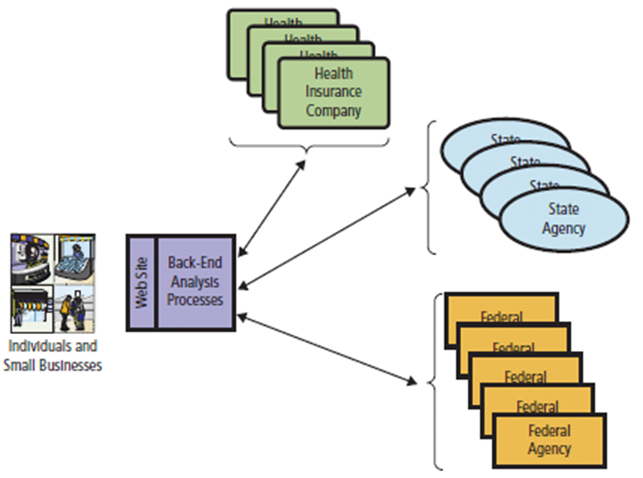
Figure 7-23 Healthcare Exchange Interorganizational I S

Slide 56
Access C T (1 of 2)
Exchange went live in only 12 months.
Counihan
  More than 30 years of experience working in insurance industry.
  Key player in development of Massachusetts healthcare system.
Hired senior staff with deep experience in insurance.
Notes:
Discuss IS development success factors and common failure factors.

Slide 57
Access C T (2 of 2)
Wadleigh, director of application development for C I G N A, a health services organization.
Primary assignment
  Hire and manage an outside contractor to develop exchange website and supporting backend code, and manage implementation of exchange information system.
Created project plan and began search for contractor to develop the site.

Slide 58
Cover Oregon (1 of 3)
Did not hire a supervising contractor for project, instead took an active role in software’s development.
Agency suffered high employee turnover, and had difficulty hiring and keeping qualified personnel.

Slide 59
Cover Oregon (2 of 3)
O H A hired software development company to create major software components.
  Two of three finalists dropped out at last minute, leaving Oracle Corporation a sole source vendor.
  Oracle negotiated time and materials contracts instead of contract for specific deliverables at specific prices.
  When problems developed, Oracle was paid tens of millions of additional money for change orders on same time and materials basis.
Notes:
Explain problem of time-and-materials contract problems using home construction example.

Slide 60
Cover Oregon (3 of 3)
Oregon legislature required state to hire a quality assurance contractor, Maximus Corporation, to oversee project.
Maximus reported significant problems involving divided control, lack of clear requirements, inappropriate contracting methodology, lack of project planning, and lack of progress.
Unclear who got those reports or what was done with them.
Head of O H A project threatened to withhold Maximus’ payment.
End result: Exchange development failed.

Slide 61
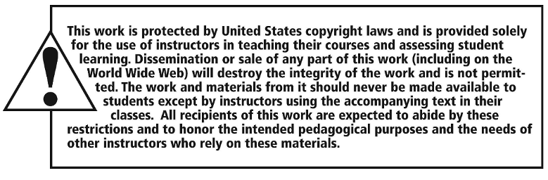
Copyright

