Slide 1
Lecture 10
Simple linear regression

Slide 2
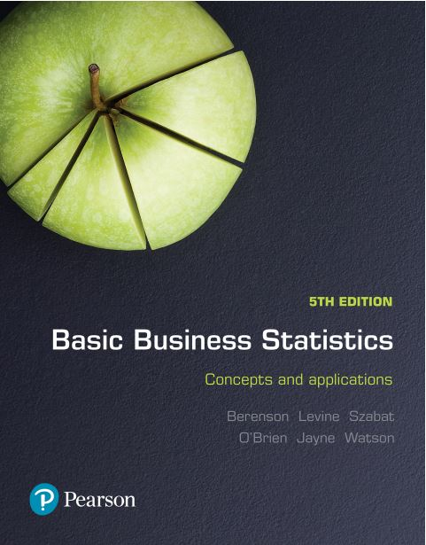
Basic Business Statistics
Concepts and Applications, 5th edition
Chapter 12
Simple linear regression
Copyright © 2019 Pearson Australia (a division of Pearson Australia Group Pty Ltd)
9781488617249 / Berenson / Basic Business Statistics, 5e

Slide 3
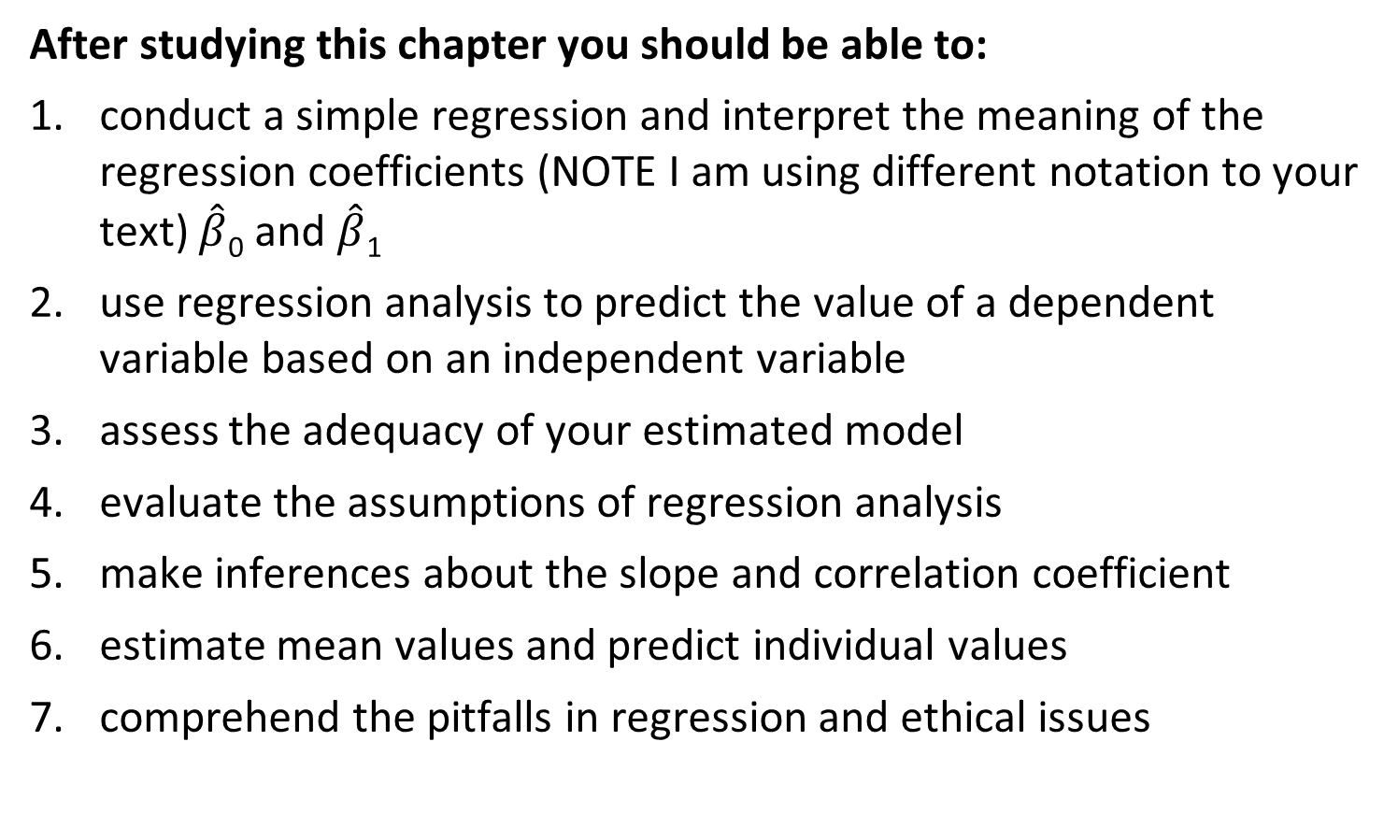
Learning Objectives
After studying this chapter you should be able to:
conduct a simple regression and interpret the meaning of the regression coefficients (NOTE I am using different notation to your text) $\hat{β}$₀ and $\hat{β}$₁
use regression analysis to predict the value of a dependent variable based on an independent variable
assess the adequacy of your estimated model
evaluate the assumptions of regression analysis
make inferences about the slope and correlation coefficient
estimate mean values and predict individual values
comprehend the pitfalls in regression and ethical issues

Slide 4
Intro to Simple Linear Regression Analysis
Regression analysis is used to:
Explain the impact of changes in an independent variable on the dependent variable
Predict the value of a dependent variable (Y) based on the value of at least one independent variable (X)
Dependent variable (Y): the variable we wish to predict or explain (response variable)
Independent variable (X): the variable used to explain the dependent variable (explanatory variable)
Only one independent variable, X
Relationship between X and Y is described by a linear function

Slide 5
Types of Linear Relationships
Strong relationships
Weak relationships
Y
Y
X
X
Y
Y
X
X

Slide 6
Types of Non-linear Relationships (continued)
Curvilinear relationships
No relationship
Y
Y
X
X
Y
Y
X
X

Slide 7
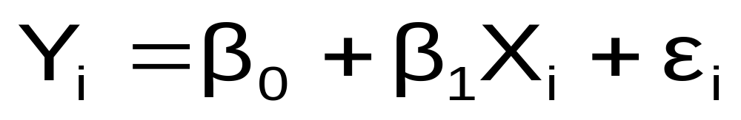
Simple Linear Regression Model:
Population Regression
Population slope
coefficient
Random error term
Population
Y intercept
Independent variable
Linear component
Random error
component
Dependent variable

Slide 8
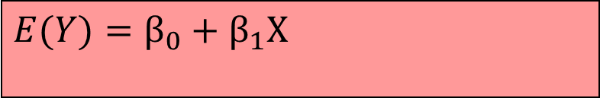

Simple Linear Regression Model (continued)
$$Y_{i}=β_{0}+β_{1}X_{i}+ε_{i}$$
$$E(Y)=β_{0}+β_{1}X_{}$$
Y
Observed value of Y for X_{i}
ε_{i}
Slope = β₁
Predicted value of Y for X_{i}
Random error for this X_{i} value
Intercept = β₀
X_{i}
X

Slide 9
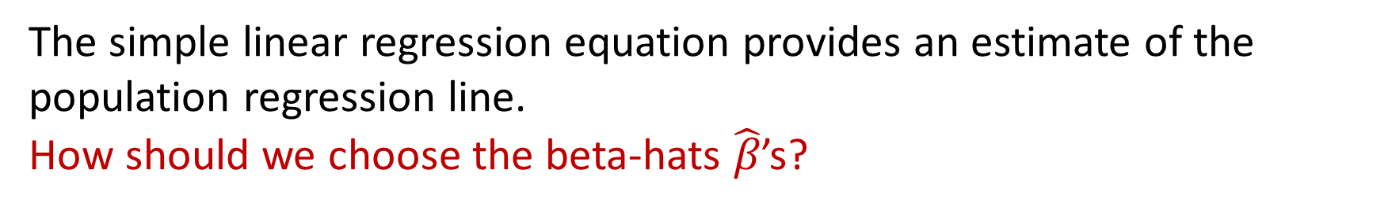
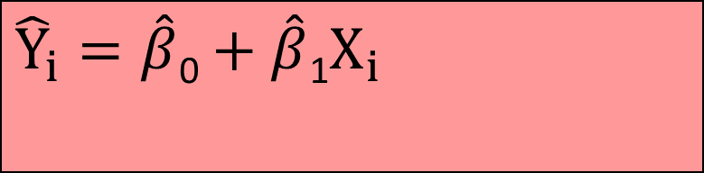
Simple Linear Regression Equation
The simple linear regression equation provides an estimate of the population regression line.
How should we choose the beta-hats $\hat{β}$’s?
Estimate of the regression
intercept
Estimated (or predicted) Y value for observation i
Estimate of the regression slope
$${\hat{Y}}_{i}=\hat{β}\text{0}+\hat{β}\text{1}X_{i}$$
Value of X for observation i

Slide 10
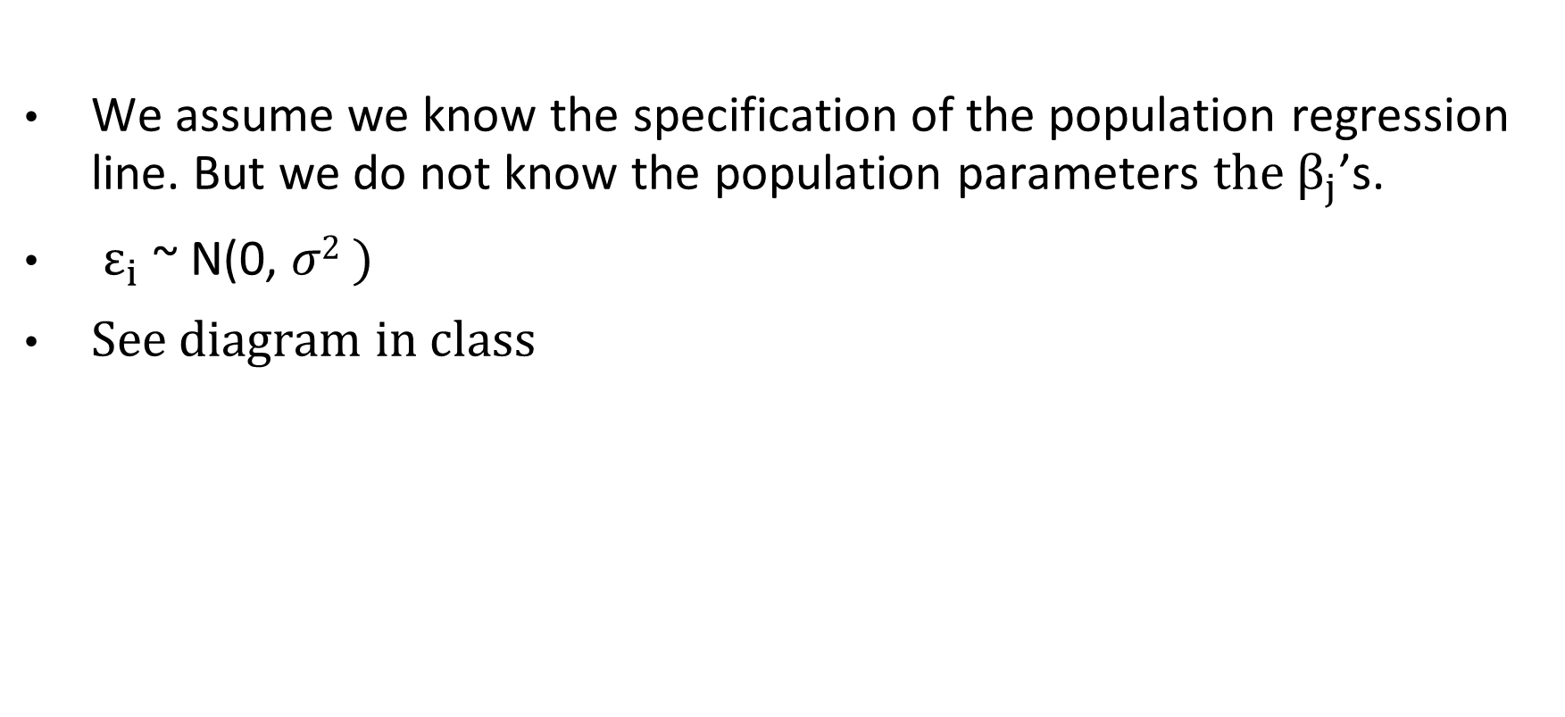
Assumptions
We assume we know the specification of the population regression line. But we do not know the population parameters ${the β}_{j}$’s.
$ε_{i}$ ~ N(0, 𝜎² )
See diagram in class

Slide 11

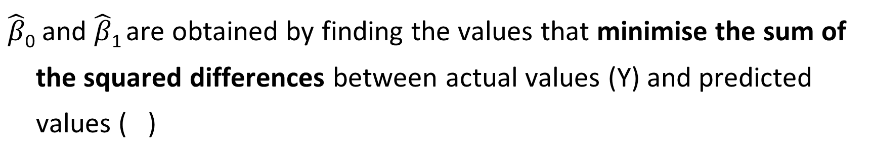
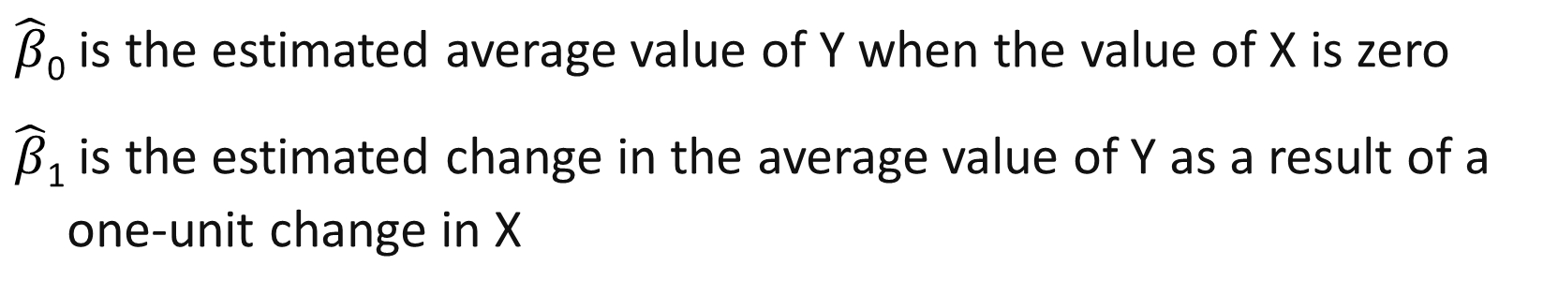
Least Squares Method
$\hat{β}$₀ and $\hat{β}$₁ are obtained by finding the values that minimise the sum of the squared differences between actual values (Y) and predicted values ( )
$$\min{\sum{(Y_{i}−}}{\hat{Y}}_{i})^{2}=\min{\sum{(Y_{i}−}} (\hat{β}\text{0}+\hat{β}\text{1}X_{i}))^{2}$$
$\hat{β}$₀ is the estimated average value of Y when the value of X is zero
$\hat{β}$₁ is the estimated change in the average value of Y as a result of a one-unit change in X

Slide 12
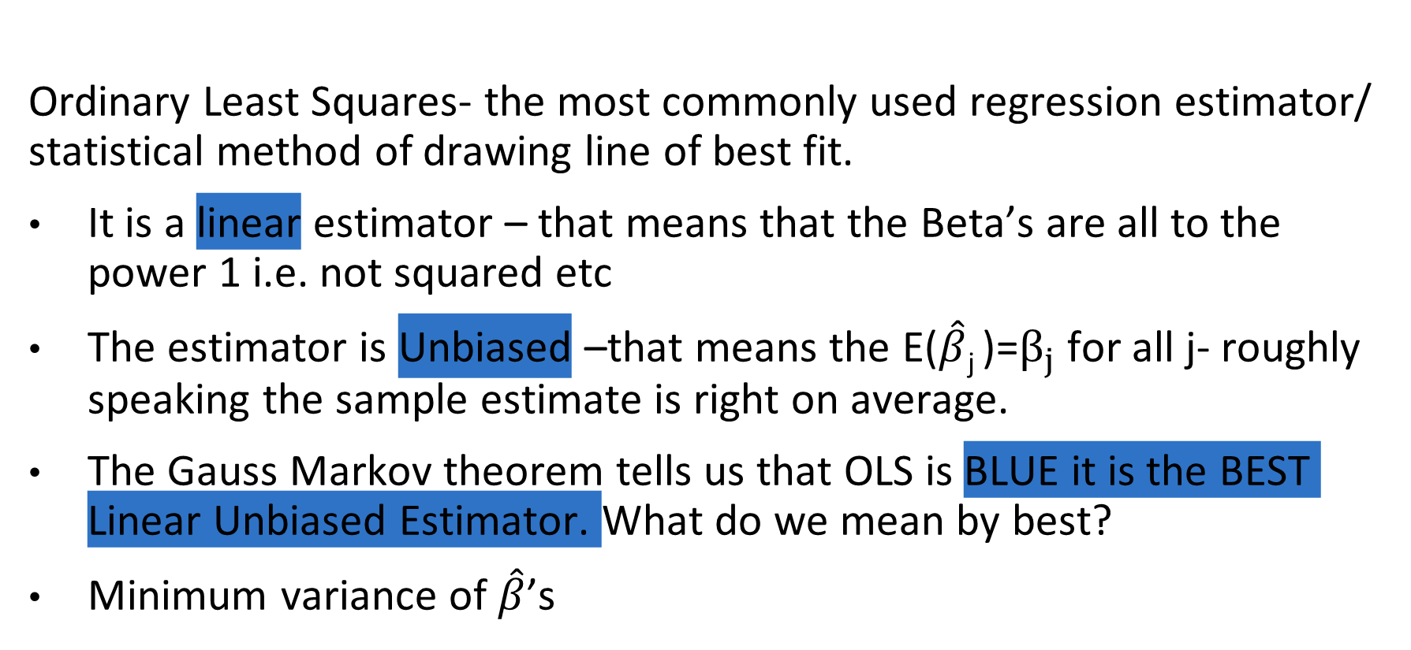
A few pointers: WHY OLS?
Ordinary Least Squares- the most commonly used regression estimator/ statistical method of drawing line of best fit.
It is a linear estimator – that means that the Beta’s are all to the power 1 i.e. not squared etc
The estimator is Unbiased –that means the E($\hat{β}\text{j}$)=$β_{j}$ for all j- roughly speaking the sample estimate is right on average.
The Gauss Markov theorem tells us that OLS is BLUE it is the BEST Linear Unbiased Estimator. What do we mean by best?
Minimum variance of $\hat{β}$’s

Slide 13
Simple Linear Regression
In class we will use this alternative Example:
Let say I want to understand wages in the Australian population
What kind of data would you collect?

Slide 14
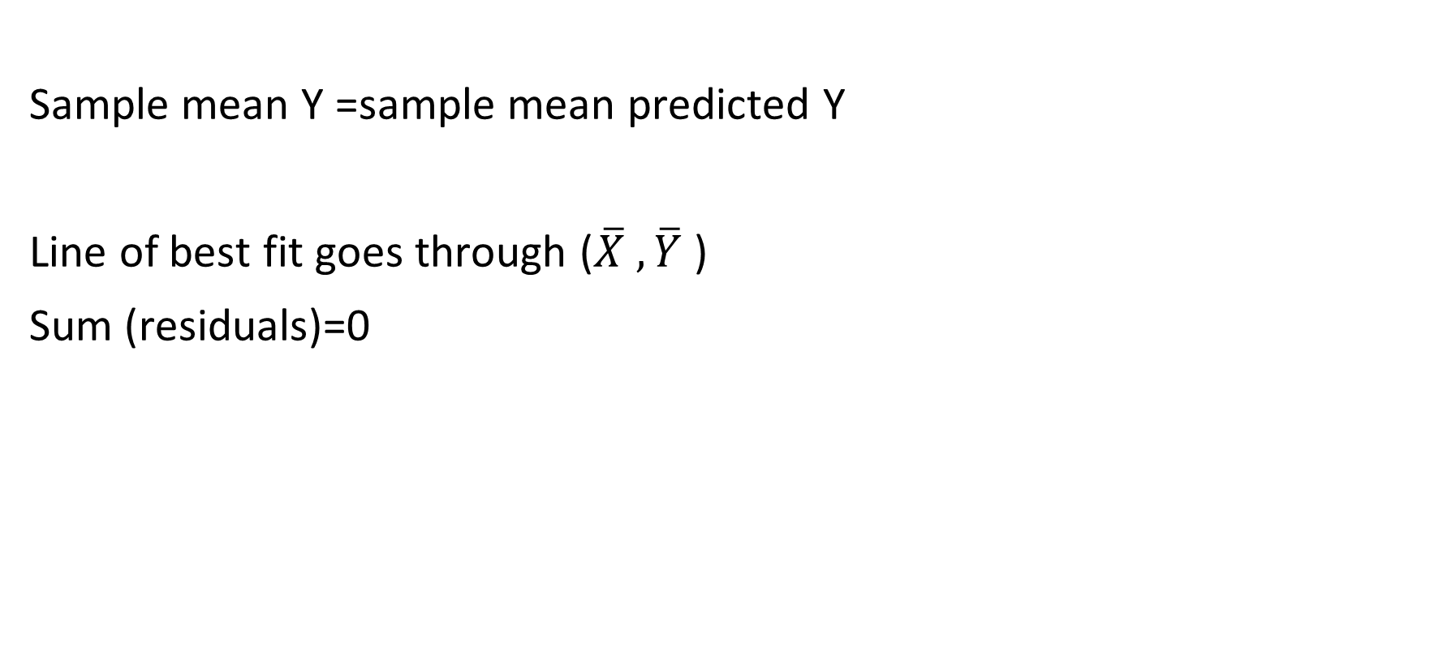
Simple Linear Regression
Implications of OLS
Sample mean Y =sample mean predicted Y
Line of best fit goes through ($\overline{X} , \overline{Y}$ )
Sum (residuals)=0

Slide 15
Simple Linear Regression
In class we will use an alternative Example:
A manager of a local computer games store wishes to:
examine the relationship between weekly sales (Y) and the number of customers making purchases (X) over a 10 week period; and
use the results of that examination to predict future weekly sales

Slide 16
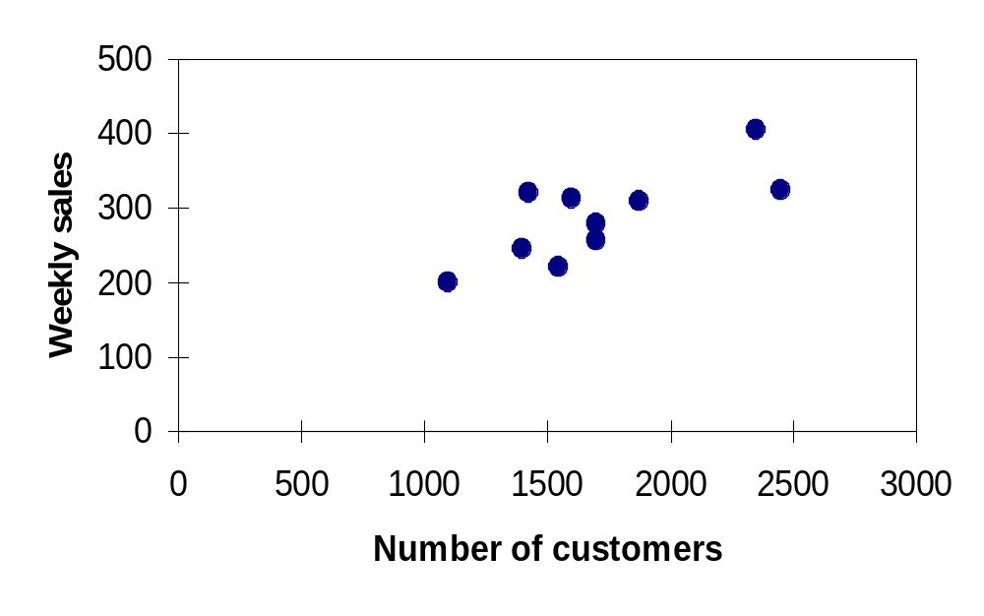
Simple Linear Regression
Example: (continued)
Weekly sales in $1,000s (Y) | Number of Customers (X)
245 | 1400
312 | 1600
279 | 1700
308 | 1875
199 | 1100
219 | 1550
405 | 2350
324 | 2450
319 | 1425
255 | 1700
Scatter plot
What do you think the equation of the line of best fit might be?

Slide 17
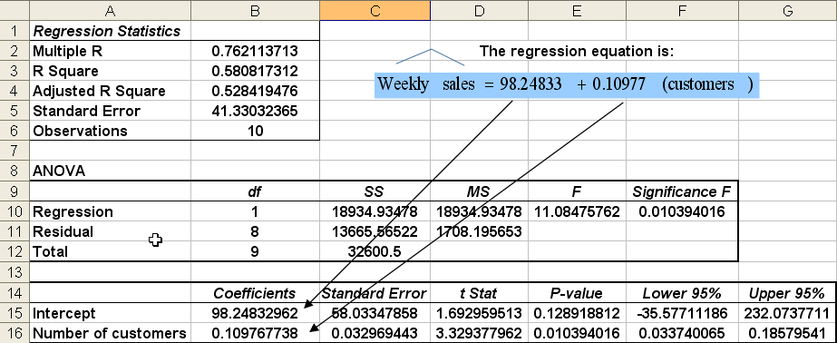
Simple Linear Regression
Example: (continued)

Slide 18
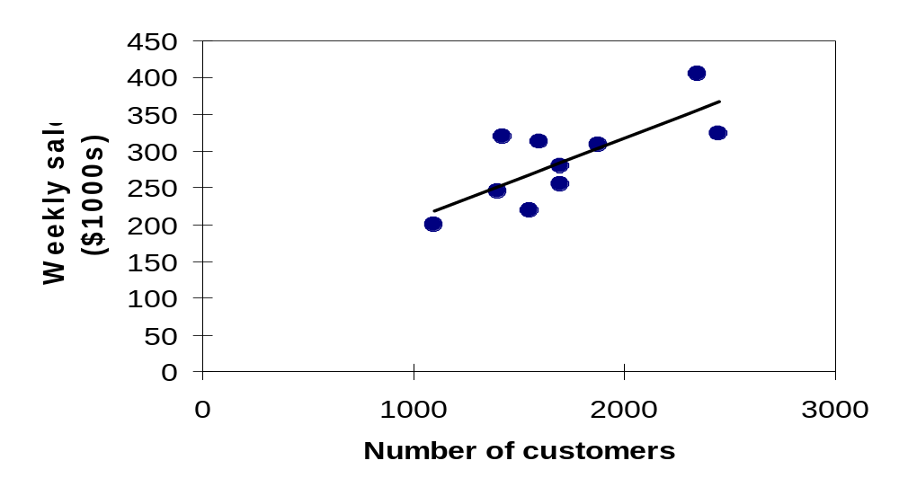
Simple Linear Regression
Example: (continued)
Weekly sales model: scatter plot and regression line
Slope = 0.1098
Intercept
= 98.248
$$\text{Weekly} \text{sales} =\text{98.248 }+\text{0.109}\text{8} (\text{customers} )$$

Slide 19
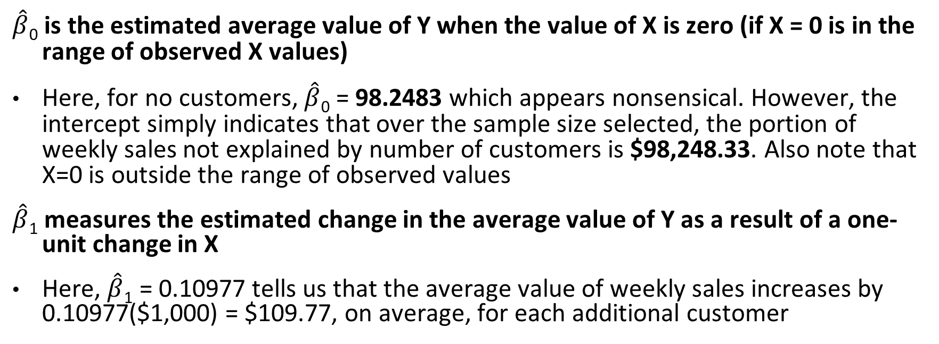
Simple Linear Regression
Example: (continued)
$\hat{β}$₀ is the estimated average value of Y when the value of X is zero (if X = 0 is in the range of observed X values)
Here, for no customers, $\hat{β}$₀ = 98.2483 which appears nonsensical. However, the intercept simply indicates that over the sample size selected, the portion of weekly sales not explained by number of customers is $98,248.33. Also note that X=0 is outside the range of observed values
$\hat{β}$₁ measures the estimated change in the average value of Y as a result of a one-unit change in X
Here, $\hat{β}$₁ = 0.10977 tells us that the average value of weekly sales increases by 0.10977($1,000) = $109.77, on average, for each additional customer

Slide 20
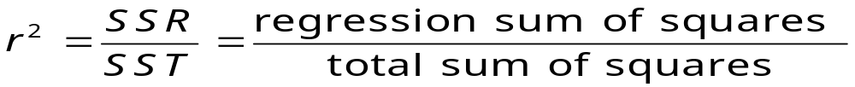

How well does the regression model fit?
Coefficient of Determination, r²
The coefficient of determination is the portion of the total variation in the dependent variable that is explained by variation in the independent variable
The coefficient of determination is also called r-squared and is denoted as r²
Note:

Slide 21
Examples of r² values
Perfect linear relationship between X and Y
100% of the variation in Y is explained by variation in X
Y
Y
X
X
r² = 1
r² = 1
Y
No linear relationship between X
and Y
The value of Y does not depend
on X (none of the variation in Y
is explained by variation in X)
r² = 0
X

Slide 22
Examples of r² values
0 < r² < 1
Y
Weaker linear relationships between X and Y:
Some, but not all, of the variation in Y is explained by variation in X
X
Y
X

Slide 23
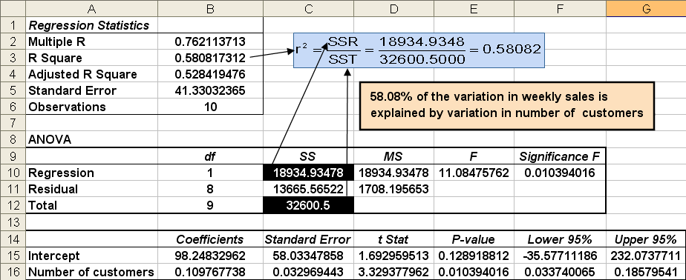
Excel Output

Slide 24
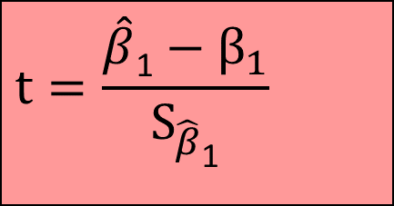
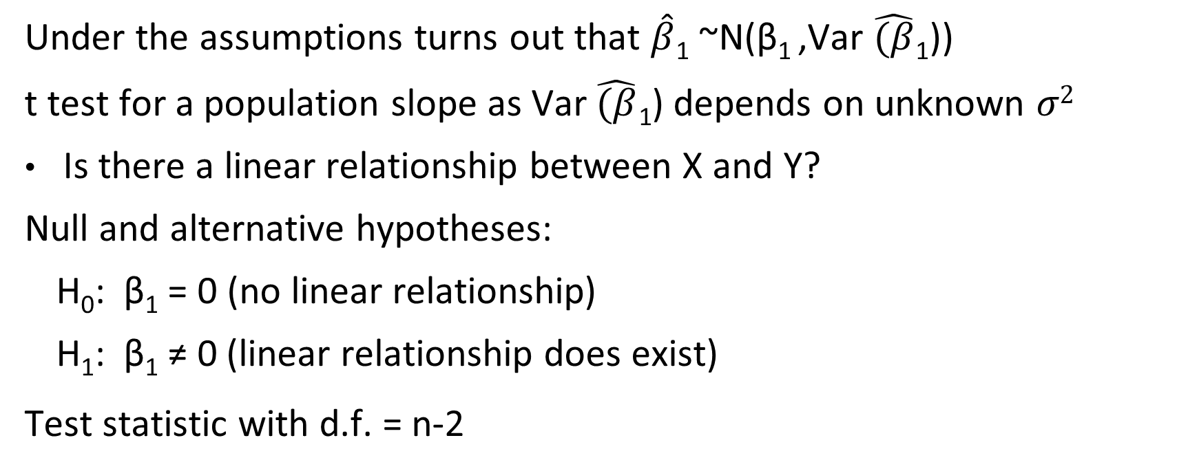
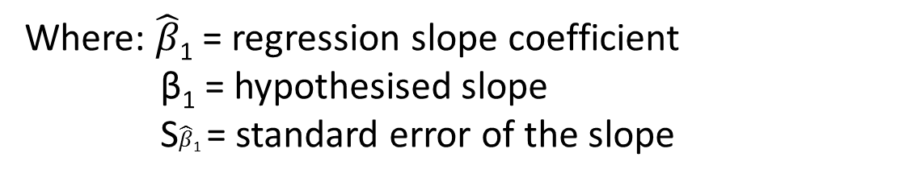
Hypothesis test within regression context: t Test
Under the assumptions turns out that $\hat{β}\text{1}$ ~N(β₁ ,Var $\hat{(β}\text{1}$))
t test for a population slope as Var $\hat{(β}\text{1}$) depends on unknown 𝜎²
Is there a linear relationship between X and Y?
Null and alternative hypotheses:
  H₀: β₁ = 0 (no linear relationship)
  H₁: β₁ ≠ 0 (linear relationship does exist)
Test statistic with d.f. = n-2
Where: $\hat{β}$₁ = regression slope coefficient
β₁ = hypothesised slope
S$\hat{β}$₁ = standard error of the slope
$$t=\frac{\hat{β}\text{1}−β_{1}}{S_{\hat{β}\text{1}}}$$

Slide 25
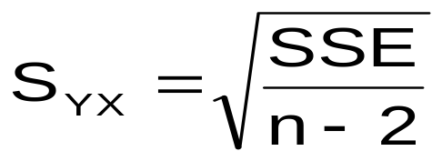
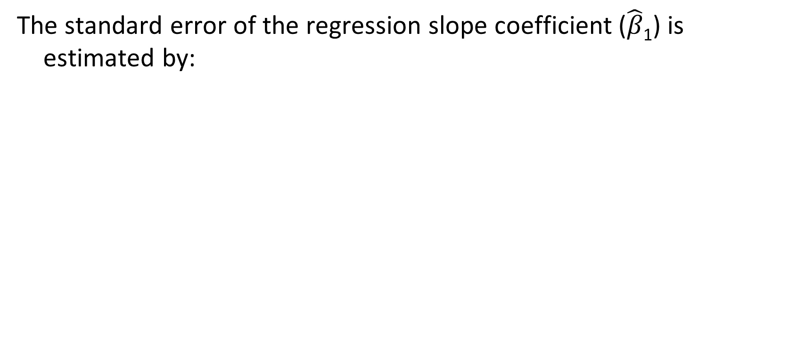

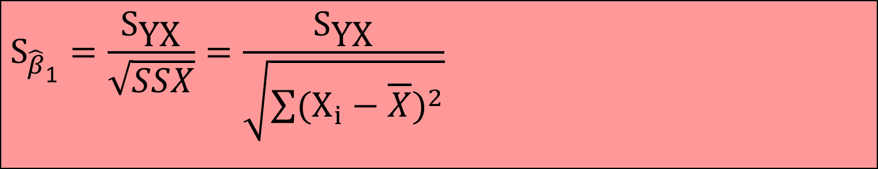
(can ignore) Hypothesis testing within regression context: Inferences About the Slope
The standard error of the regression slope coefficient ($\hat{β}\text{1}$) is estimated by:
$$S_{\hat{β}\text{1}}=\frac{S_{\text{YX}}}{\sqrt{SSX}}=\frac{S_{\text{YX}}}{\sqrt{\sum{(X_{i}−\overline{X})^{2}}}}$$
where:
= Estimate of the standard error of the least squares slope
= Standard error of the estimate
$$S_{\hat{β}\text{1}}$$

Slide 26
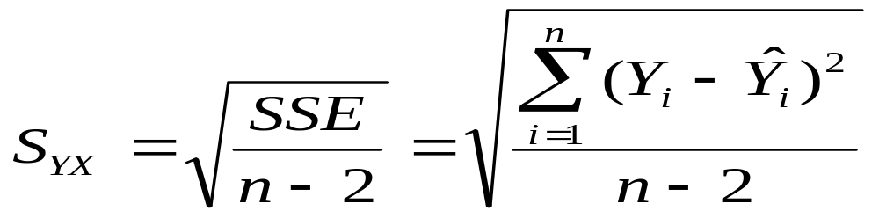
(can ignore) The Standard Error- crucial for hypothesis testing
The standard deviation of the variation of observations around the regression line is estimated by
Where:
SSE = error sum of squares
n = sample size

Slide 27
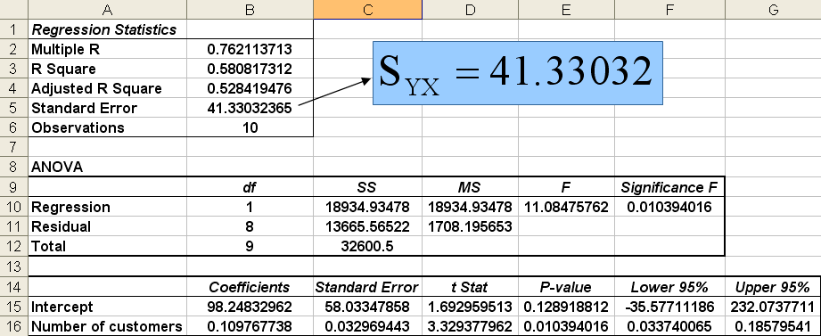
Excel Output

Slide 28
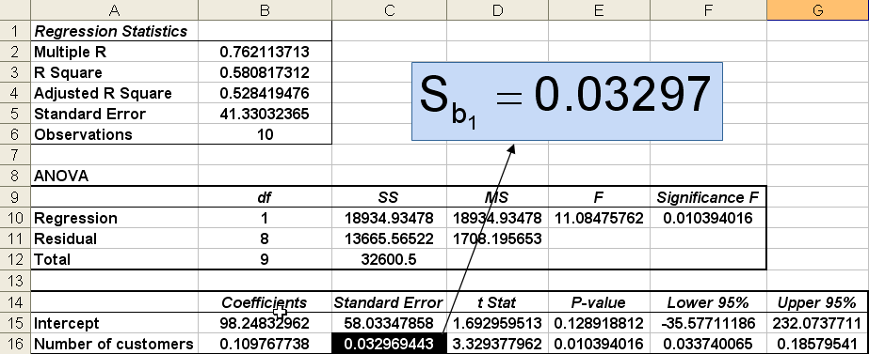
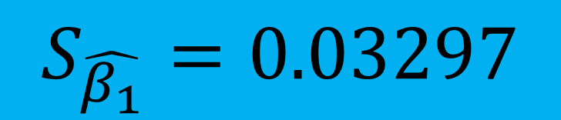
Excel Output
$$S_{\hat{β_{1}}}=0.03297$$

Slide 29

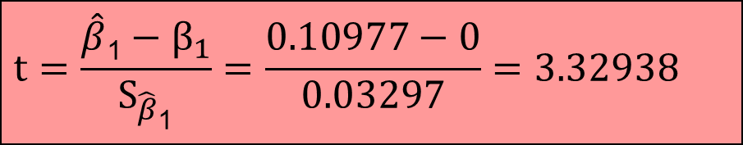

Inference about the Slope: t Test
Example:
The slope of this model is 0.1098
Does number of customers affect weekly sales?
H₀: β₁ = 0
H₁: β₁ ≠ 0
$\hat{β}$₁
$$S_{\hat{β}\text{1}}$$
 | Coefficients | Standard Error | t Stat | P-value
Intercept | 98.24833 | 58.03348 | 1.69296 | 0.12892
Number of customers | 0.10977 | 0.03297 | 3.32938 | 0.01039
$$t=\frac{\hat{β}\text{1}−β_{1}}{S_{\hat{β}\text{1}}}=\frac{0.10977−0}{0.03297}=3.32938$$

Slide 30
Inferences about the Slope: t Test
Example (continued):
H₀: β₁ = 0
H₁: β₁ ≠ 0
Test Statistic: t = 3.329
T critical = +/- 2.3060 (from t tables)
Decision: Reject H₀
Conclusion: There is sufficient evidence that number of customers affects weekly sales
d.f. = 10-2 = 8
α/2=.025
α/2=.025
Do not reject H₀
Reject H₀
Reject H₀
-t_{α/2}
0
t_{α/2}
-2.3060
2.3060
3.329

Slide 31
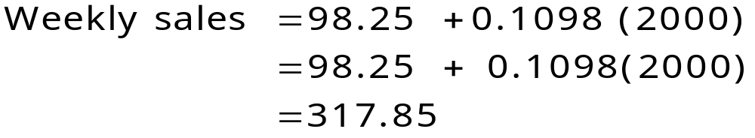
Simple Linear Regression for prediction:
Example (continued):
Predict the weekly sales for the local store for 2,000 customers:
The predicted weekly sales for the local computer games store for 2,000 customers is 317.85 ($1,000s) = $317,850

Slide 32
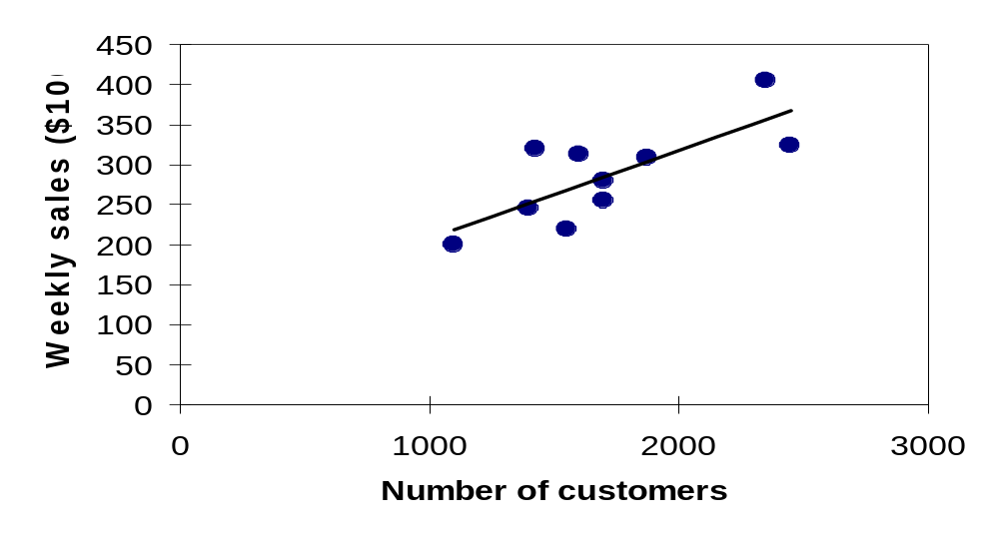
Interpolation vs. Extrapolation
When using a regression model for prediction, only predict within the relevant range of data
Relevant range for interpolation
Do not try to extrapolate beyond the range of observed Xs

Slide 33
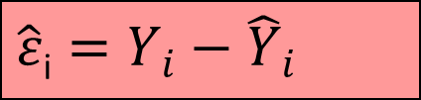
Residual Analysis
The residual for observation i, e_{i}, is the difference between its observed and predicted value
Check the assumptions of regression by examining the residuals:
Examine for linearity assumption
Evaluate independence assumption
Evaluate normal distribution assumption
Examine for constant variance for all levels of X (homoscedasticity)
Graphical Analysis of Residuals
Can plot residuals vs. X
$$\hat{ε}\text{i}=Y_{i}−{\hat{Y}}_{i}$$

Slide 34

Residual Analysis for Linearity
Y
Y
x
x
residuals
x
x
residuals
Not Linear
Linear

Slide 35

Residual Analysis for Independence
Not Independent
Independent
residuals
X
X
residuals
residuals
X

Slide 36
Residual Analysis for Normality
A normal probability plot of the residuals can be used to check for normality:
100
Percent
0
-3 -2 -1 0 1 2 3
Residual

Slide 37

Residual Analysis for Equal Variance (Homoscedasticity)
Y
Y
x
x
residuals
x
x
residuals
✓
Non-constant variance
Constant variance

Slide 38
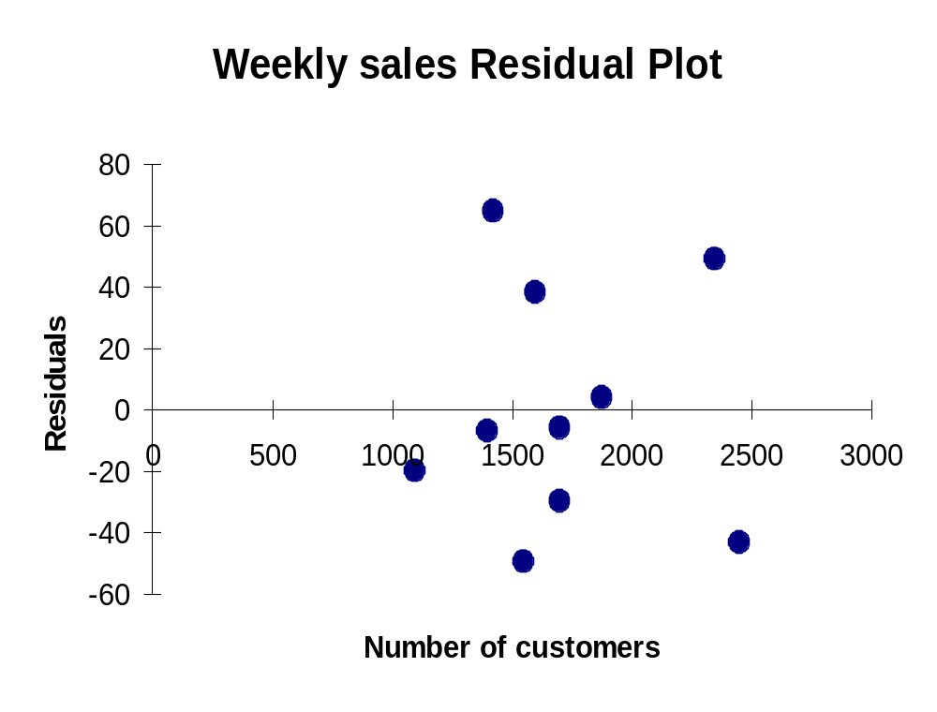
Excel Residual Output
RESIDUAL OUTPUT
 | Predicted Weekly Sales | Residuals
1 | 251.92316 | -6.923162
2 | 273.87671 | 38.12329
3 | 284.85348 | -5.853484
4 | 304.06284 | 3.937162
5 | 218.99284 | -19.99284
6 | 268.38832 | -49.38832
7 | 356.20251 | 48.79749
8 | 367.17929 | -43.17929
9 | 254.6674 | 64.33264
10 | 284.85348 | -29.85348
Does not appear to violate any regression assumptions

Slide 39
Pitfalls of Regression Analysis
Lacking an awareness of the assumptions underlying least-squares regression
Not knowing how to evaluate the assumptions
Not knowing the alternatives to least-squares regression if a particular assumption is violated
Using a regression model without knowledge of the subject matter
Extrapolating outside the relevant range
Concluding that a significant relationship in observational study is due to a cause and effect relationship

