Slide 1
Lecture 9:
Hypothesis testing: Part II
and brief introduction to relationships between two variables

Slide 2
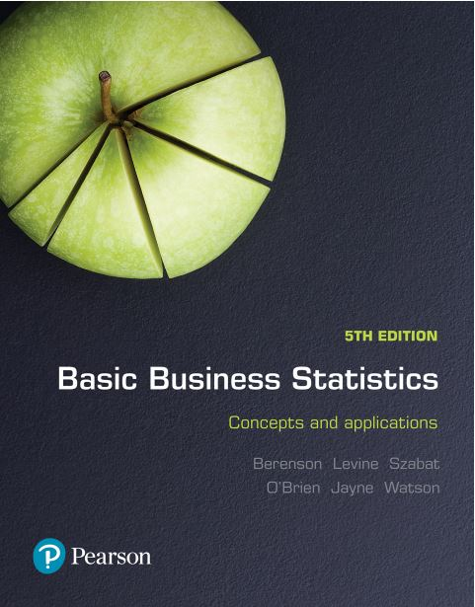
Basic Business Statistics
Concepts and Applications, 5th edition
Chapter 9
Fundamentals of hypothesis testing: One-sample tests
Copyright © 2019 Pearson Australia (a division of Pearson Australia Group Pty Ltd)
9781488617249 / Berenson / Basic Business Statistics, 5e

Slide 3
Basic Business Statistics
Concepts and Applications, 5th edition
Chapter 10
Hypothesis testing: Two-sample tests
Copyright © 2019 Pearson Australia (a division of Pearson Australia Group Pty Ltd)
9781488617249 / Berenson / Basic Business Statistics, 5e

Slide 4
Learning objectives
Hypothesis test relating to the population mean when σ is unknown
How to carry out and interpret a one tail hypothesis test
**********************************************************
Introduction to relationships between 2 variables – covariance and correlation.

Slide 5
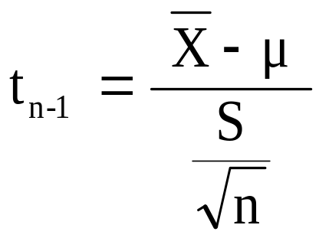

t Test of Hypothesis for the Mean (σ Unknown)
Hypothesis
Tests for μ
σ Known
σ Unknown
σ Unknown
(Z test)
(t test)
The test statistic is:
Convert sample statistic ( ) to a t test statistic
$$\overline{X}$$

Slide 6
Two-tail Test (σ Unknown)
Example:
The average cost of a hotel room in Sydney is said to be $168 per night. A random sample of 25 hotels resulted in an average of $172.50 and standard deviation of $15.40
Test at the α = 0.05 level.
(Assume the population distribution is normal)
H₀: μ = 168 H₁: μ ≠ 168

Slide 7
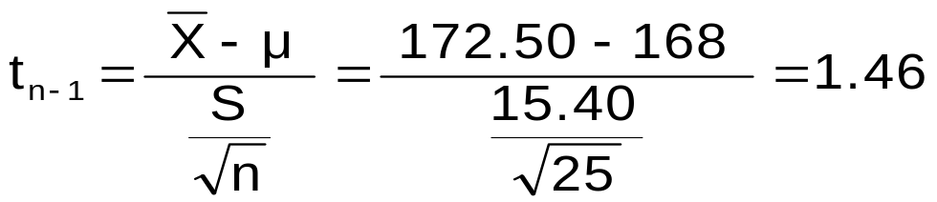
Two-tail Test (σ Unknown)
Example: (continued)
H₀: μ = 168
H₁: μ ≠ 168
α / 2=0.025
Do not reject H₀
α /2=0.025
α = 0.05
n = 25
σ is unknown, so use a t statistic
Critical value: t₂₄ = ± 2.0639
Reject H₀
Reject H₀
-t _{n-1,} α _{/2}
t _{n-1,α/2}
0
-2.0639
2.0639
1.46
Do not reject H₀: not sufficient evidence that true mean cost is different than $168

Slide 8
So far we’ve focussed on 2 tail tests.
Now lets look at One-tail Tests
The alternative hypothesis often focuses on a particular direction
H₀: μ ≥ 72
H₁: μ < 72
This is a lower-tail test since the alternative hypothesis is focused on the lower tail below the mean of 72
H₀: μ ≤ 72
H₁: μ > 72
This is an upper-tail test since the alternative hypothesis is focused on the upper tail above the mean of 72

Slide 9

Lower-tail Tests
H₀: μ ≥ 72
H₁: μ < 72
α
Do not reject H₀
Reject H₀
-Z
Z
0
μ
$$\overline{X}$$
There is only one critical value (in this case – Z), since the rejection region is in only one tail (the lower tail)

Slide 10
Upper-tail Tests
H₀: μ ≤ 72
H₁: μ > 72
α
Do not reject H₀
Reject H₀
+Z
Z
0
μ
X
There is only one critical value (in this case – Z), since the rejection region is in only one tail (the upper tail)

Slide 11
Upper-tail Z Test for Mean (σ Known)
Example:
A phone industry manager claims that customer monthly mobile phone bills have increased (in other words, the status quo has changed) and now average over $72 per month. The company wishes to test this claim
(Assume σ = 10 is known)
State H_{o} and H₁
H₀: μ ≤ 72 the average is not over $72 per month
H₁: μ > 72 the average is greater than $72 per month (i.e. sufficient evidence exists to support the manager’s claim)

Slide 12
Upper-tail Z Test for Mean (σ Known)
Example (continued):
Suppose that α = 0.10 is chosen for this test.
What is Z ?
Do not reject H₀
α = 0.10
0.90
Rejection region
Using the Standardized Normal Distribution Table, P(Z>1.28) ≈
1-P(Z<1.28) = 0.10
0
Z = 1.28
Reject H₀ if Z > 1.28

Slide 13
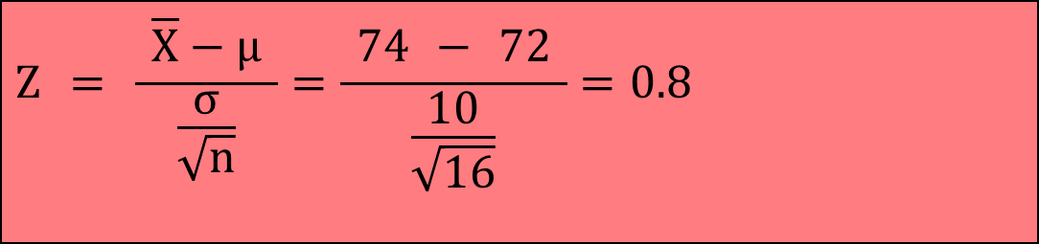
Upper-tail Z Test for Mean (σ Known)
Example (continued):
Obtain sample and calculate the test statistic
Suppose sample n = 16 is taken and sample mean is 74
Assume (σ=10 is known)
Then the test statistic is:
$$Z = \frac{ \overline{X}−μ }{\frac{σ}{\sqrt{n}}}=\frac{ \text{7}4 − \text{72} }{\frac{\text{10}}{\sqrt{\text{16}}}}=\text{0.8}$$

Slide 14
Upper-tail Z Test for Mean (σ Known)
Example (continued):
Reach a decision and interpret the result
α = 0.10
Do not reject H₀
Reject H₀
0
1.28
Z = 0.8
Do not reject H₀ since Z = 0.8 ≤ 1.28
i.e. there is not sufficient evidence that the
mean bill is over $72

Slide 15
p-value approach
As before we have Z=0.8, so what is P(Z≥0.8) ?
Look at the table =1- 0.78814=0.2119
p-value = 0.2119
Reject H₀
α = 0.10
Do not reject H₀
Reject H₀
0
1.28
Z = 0.8
Do not reject H₀ since p-value = 0.2119 > α = 0.10

Slide 16
Pitfalls and Ethical Considerations
Use randomly collected data to reduce selection biases or coverage errors
Do not use human subjects without informed consent
Choose the level of significance, α, and the type of test (one-tail or two-tail) before data collection
Do not employ ‘data snooping’ to choose between one-tail and two-tail test, or to determine the level of significance
Do not practice ‘data cleansing’ to hide observations that do not support a stated hypothesis
Report all pertinent findings
Distinguish between statistical significance vs. practical significance

Slide 17
We will now start by looking at relationships between 2 variables: say X and Y
Covariance and correlation between X and Y.
We will then look at covariance within a Finance context.

Slide 18
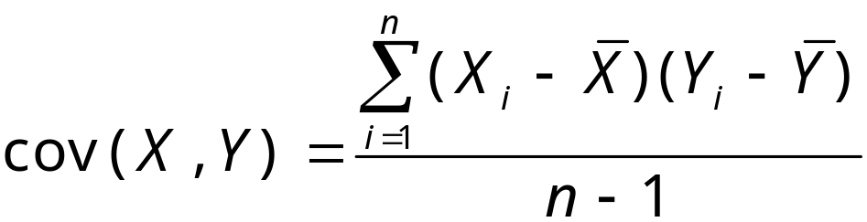
The Sample Covariance
The sample covariance measures the strength of the linear relationship between two numerical variables:
  Only concerned with the direction of the relationship
  No causal effect is implied
  Is affected by units of measurement

Slide 19
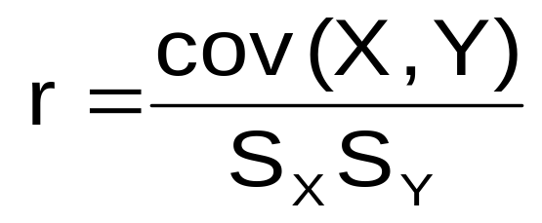
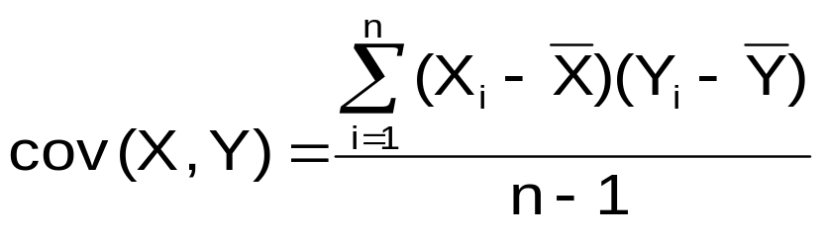
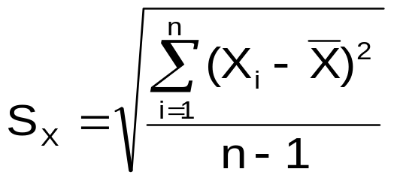
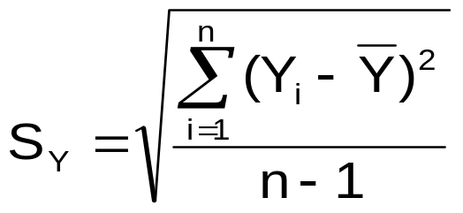
Correlation
Measures the relative strength of the linear relationship
between two variables
where:

Slide 20
Features of Correlation Coefficient, r
Also called Standardised Covariance i.e. invariant to units of measure
Ranges between –1 and 1
The closer to –1, the stronger the negative linear relationship
The closer to 1, the stronger the positive linear relationship
The closer to 0, the weaker the linear relationship

Slide 21
Scatter Plots of Data with
Various Correlation Coefficients
Y
Y
Y
X
X
X
r = -1
r = -0.6
r = 0
Y
Y
Y
X
X
X
r = +1
r = +0.3
r = 0

Slide 22
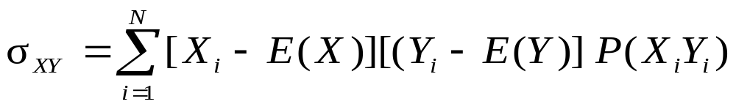
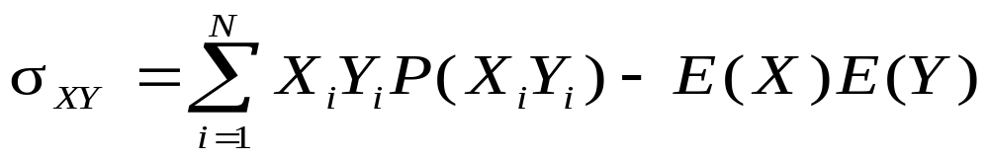
The population Covariance formula
The covariance measures the direction of a linear relationship between two variables.
Covariance – definition formula
Covariance – alternative calculation formula
Where: X_{i}Y_{i} = the i^{th} outcome of the discrete random variables X and y respectively
P(X_{i}Y_{i}) = probability of the i^{th} occurrence of X and Y

Slide 23
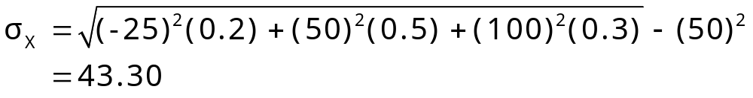
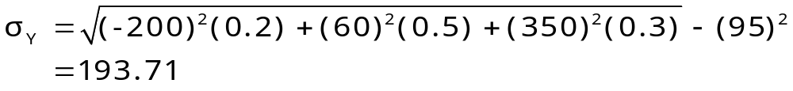
Example: Computing the Mean, standard deviations and covariance for Investment Returns
Return per $1,000 for two types of investments
 |  | INVESTMENT
P(X_{i}Y_{i}) | Economic condition | Passive Fund X | Aggressive Fund Y
0.2 | Recession | -$25 | -$200
0.5 | Stable Economy | +50 | +60
0.3 | Expanding Economy | +100 | +350
E(X) = μ_{X} = (-25)(0.2) +(50)(0.5) + (100)(0.3) = 50
E(Y) = μ_{Y} = (-200)(0.2) +(60)(0.5) + (350)(0.3) = 95

Slide 24
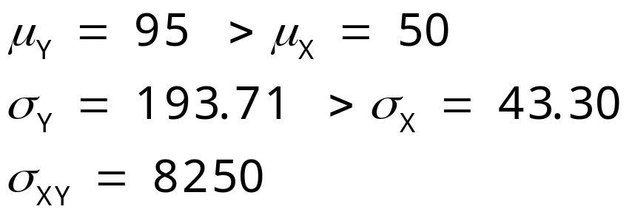
Interpreting the Results for Mean Returns
The aggressive fund has a higher expected return (mean), but much more risk.
The covariance of 8250 indicates that the two investments are positively related and will vary in the same direction.

Slide 25
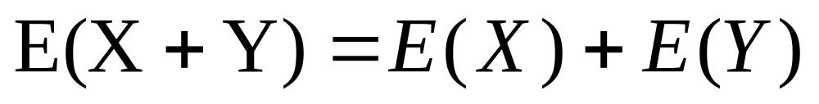
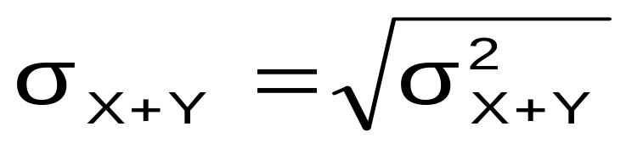
The Sum of Two Random Variables
Expected value of the sum of two random variables
Variance of the sum of two random variables
Standard deviation of the sum of two random variables

Slide 26
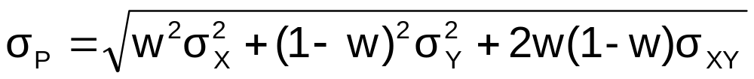
Portfolio Expected Return and Portfolio Risk
Portfolio expected return (weighted average return)
Portfolio risk (weighted variability)
Where E(P) = portfolio expected return
w = portion of portfolio value in asset X
  (1 - w) = portion of portfolio value in asset Y

Slide 27
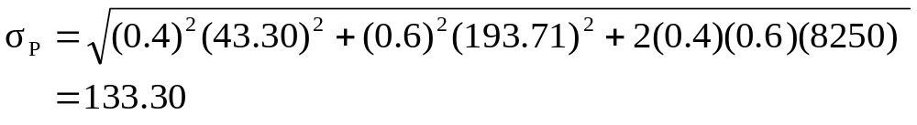
Portfolio Example
Investment X: μ_{X} = 50 σ_{X} = 43.30
Investment Y: μ_{Y} = 95 σ_{Y} = 193.71 σ_{XY} = 8250
Suppose 40% of the portfolio is in Investment X and 60% is in Investment Y.
The portfolio return and portfolio variability are between the values for investments X and Y, considered individually.

