Slide 1
Name
Institution
Date
Renaissance Tragedy Project

Slide 2
Introduction
The Aristotle definition of a tragedy is best illustrated by this quote,” tragedy then, is an imitation of an action that is serious and complete, and which has some greatness about it. It imitates in words with pleasant accompaniments, each type belonging separately to the different parts of the work. It imitates people performing actions and does not rely on narration. It achieves, through pity and fear, the catharsis of these sorts of feelings.”
When Macbeth is evaluated through the seven elements that Aristotle believes makes a genre of work a tragedy, it fits the definition in a precise way. “Macbeth displays all the seven aspects that were suggested by Aristotle as the elements of a true tragedy in a genre of work.” (Shakespeare et al, pg. 13)

Slide 3
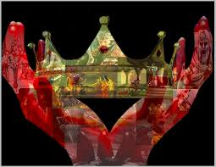
Macbeth as a Tragedy

Slide 4
Macbeth as a Tragedy
The first element of Aristotle`s definition of a tragedy is that a genre should be serious. Macbeth is a serious story. This can be seen from the first line of the book where the mood features witches that speaks more of witchcraft, apparitions, and potions. Macbeth is not only made a serious story by the three witches but them appealing to Elizabethans who believed in such phenomena them also makes it a serious story. War taking place between Scotland and Norway which occurred for many centuries provided a dark component. This represented feuding and killing. “Murder that happens throughout the Macbeth story is an aspect that is very essential in helping us approve that indeed Macbeth is a serious play.” (Hollingsworth et al, pg. 22)

Slide 5

Macbeth as a Tragedy

Slide 6
Macbeth as a Tragedy
The Macbeth story follows through with its theme which is blood where at the end of the story, both its leads characters dies. Lady Macbeth commits suicide after feeling guilty for the bloodshed. Macbeth is beheaded by Macduff who is a noble from Scotland. Despite what happens to Macbeth at the end of the story he was a great and a good man which is one element of a tragedy according to Aristotle. He was a man of honor whose position was Thane of Glams and was very victorious in the battle. Every great man must have a flaw, his flaw was ambition which was breathed to him by lady Macbeth and the witches. They created him as a bold, valiant, and a triumphant king. His flaw led to a disaster, deceit, treachery, and murder. It is unfortunate that he could not overcome this flaw even by fate. This is another element in Aristotle`s definition of a tragedy (Shakespeare et al, pg. 70)

Slide 7
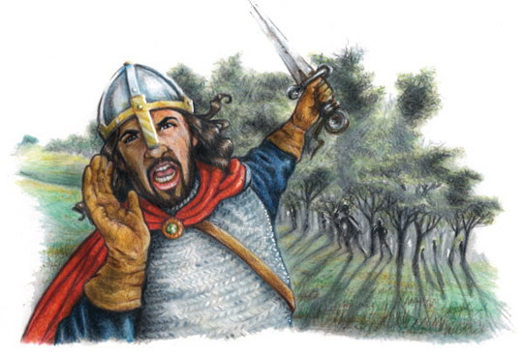
Macbeth as a Tragedy

Slide 8
Macbeth as a Tragedy
The last element of the Aristotle`s definition of a tragedy is seen in Macbeth where the Macbeth`s circumstances are described. He suffers and is punished. He gets the worst form of punishment which is beheading. Death is what his ambitions costs him.
Macbeth play fits all the seven elements of Aristotle`s definition of a tragedy. One can argue that the seven elements of a tragedy as written by Aristotle were written specifically for Macbeth (Bloom, Harold, pg. 78)

Slide 9

Macbeth as a Tragedy

Slide 10

Macbeth as a Tragedy

Slide 11
Works Cited
Shakespeare, William, James Marsters, Joanne Whalley, and Martin Jenkins. Macbeth. Los Angeles: L.A. Theatre Works, 2011. Sound recording.
Hollingsworth, Tamara, Harriet Isecke, and William Shakespeare. William Shakespeare's the Tragedy of Macbeth. Huntington Beach, CA: Teacher Created Materials, 2010. Print.
Bloom, Harold. Macbeth. Philadelphia: Chelsea House Publishers, 2005. Print.

