Slide 1
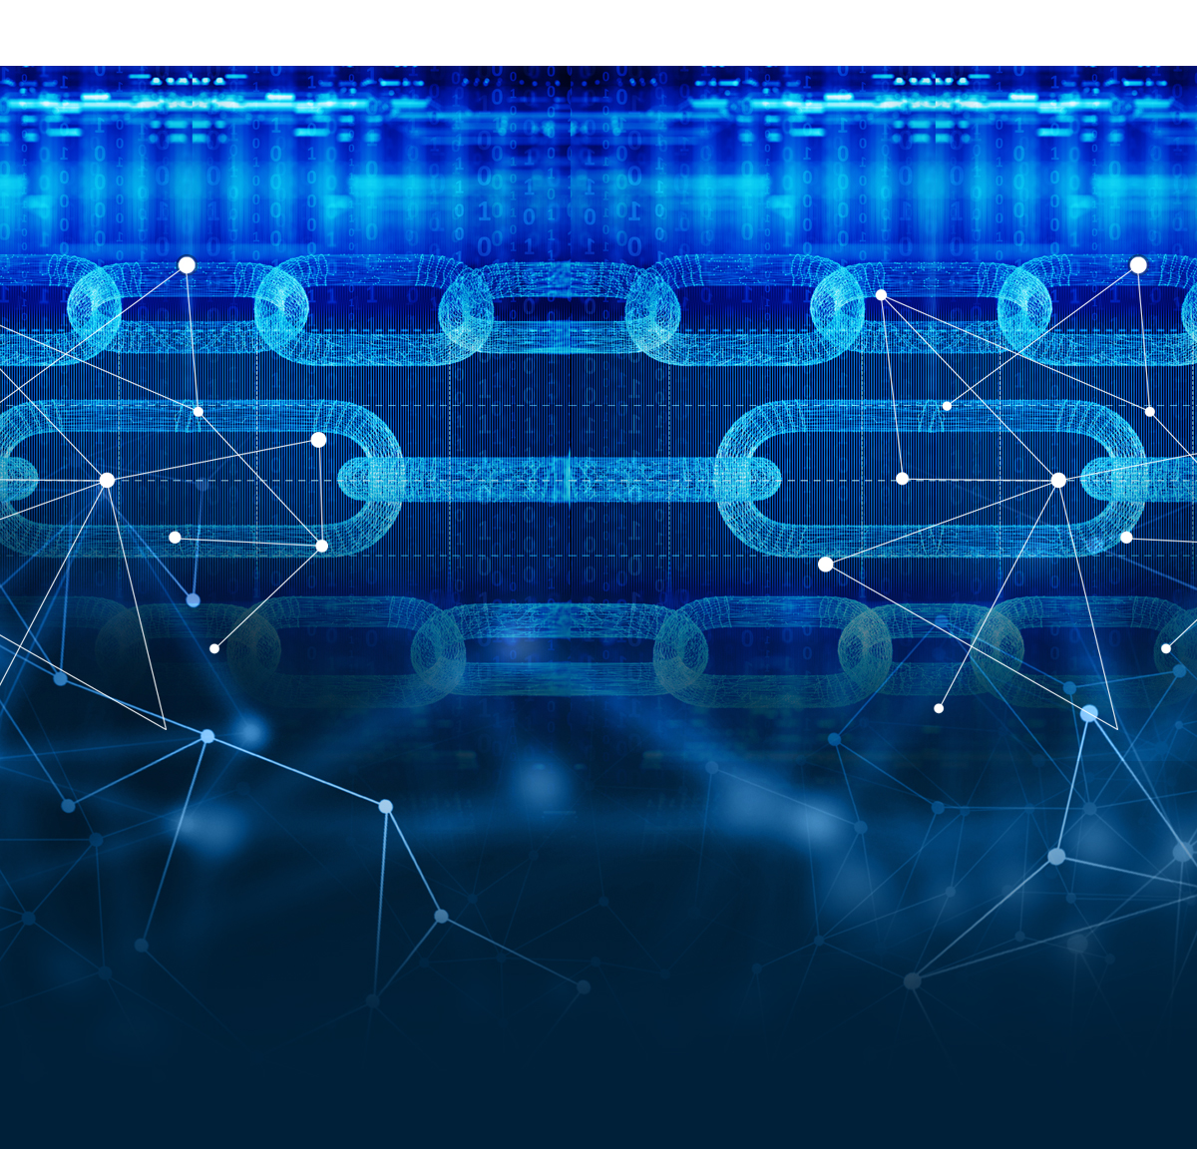
Blockchain or Distributed Ledger Technology (DLT)
A groundbreaking Technology in the Field of Medicine

Slide 2

Intended and Unintended Purposes
Blockchain is a data recording system that records transactions in multiple decentralized and remote areas.
The ability to decentralize, distribute, and ensure data security has increased the application of blockchain in healthcare.
Intended purposes include complimenting digital medical record systems, increasing efficiency, improving safety and integrity.
Unintended consequences of blockchain are mainly increased authority over personal data and increased opportunities for remote access to information.
Notes:
Generally, blockchain or distributed ledger technology (DLT) is a modern data recording system used to record asset transactions by recording the transactions and their details in multiple places in real-time (Fekih & Lahami, 2020). The increased decentralization, distribution, and security of information features characterizing blockchain or DLT have contributed to increased interest in healthcare applications. The growth in healthcare data has prompted the application of a data management system that is efficient and secure (Badr, 2019). Therefore, the application of DLT in healthcare is intended to complement digital medical records by making health data storage more efficient, improve the integrity, ensure safety and access control of health data, and to address the challenges of multiple patient data synchronization (Badr, 2019). However, some of the unintended consequences of blockchain in healthcare include giving the patient increased authority over their personal data, as they possess the power to grant or revoke access to their blockchains. Additionally, blockchain has opened the opportunity for patients to access their medical data remotely (Nachimuthu, 2017).

Slide 3
How it Functions
Blockchain or distributed ledger technology creates a platform for safe and easy transmission of information.
The blockchain comprises miners, blocks, and nodes as the fundamental concepts.
Blocks are individual chain constituents and comprise of data, nonce, and hash.
Miners are the initiators of the blockchain who generate hash-generating nonce in a process called mining.
Nodes are the individual electronic devices that form an active functioning network and keep copies of the blockchain.
Notes:
The fundamental concept of operation behind blockchain or distributed ledger technology is creating a platform where individuals can share valuable information securely and freely. The process comprises three fundamental concepts, miners, blocks, and nodes (Kuo, Kim, & Ohno-Machado, 2017). Blocks are the individual constituents of a chain, consisting of data, nonce, and hash, as its constituents. Therefore, the creation of the first block in a chain prompts the nonce to generate the cryptographic hash, and the data in the block is said to have been signed, meaning it is tied to the nonce unless it is mined (Kuo, Kim, & Ohno-Machado, 2017). The second concept, miners, refers to the block creators, who achieve this in a process called mining. Mining is not an easy process since each block contains its unique nonce and hash, which reference the previous block (Kuo, Kim, & Ohno-Machado, 2017). Therefore, the miners use computer software to solve the complex math problems for finding the nonce that can generate an acceptable hash. Nodes refer to the electronic devices that are interconnected and which maintain copies of the blockchain to maintain active network functioning (Kuo, Kim, & Ohno-Machado, 2017).

Slide 4
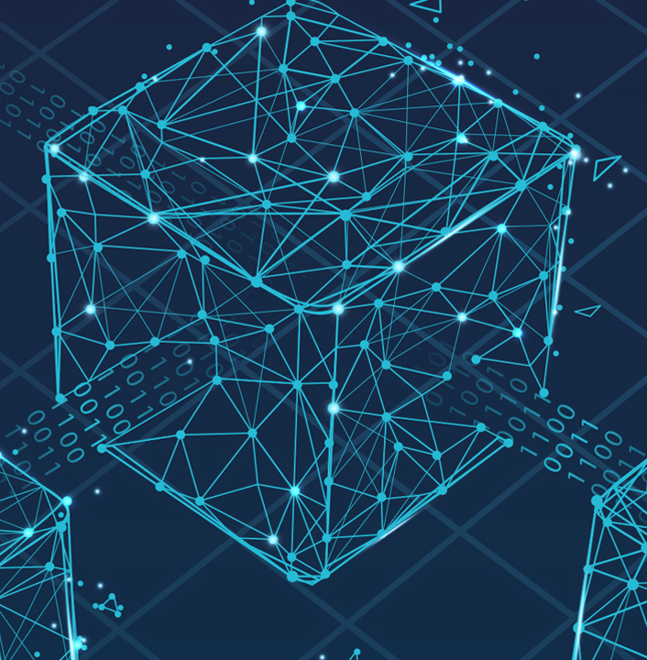
Who invented it, When, How, Why
The distributed ledger technology is a relatively older concept that can be traced back to the Roman Empire.
The inventor of the modern-day peer-to-peer version of DLT is an anonymous inventor known as Satoshi Nakamoto.
The version was first applied in 2008 as a way of facilitating direct online transactions.
The main idea behind the introduction of this version was to curb the double-spending challenge that was prevalent in the bit gold transactions.
Notes:
Though blockchain recently found its way into the contemporary world, the distributed ledger technology (DLT) is a generally older concept. Traces of its earliest application dating back to the Roman Empire, where banking systems allowed people to transact in various regions throughout the empire (Yun, 2018). However, in recent history, a famously anonymous innovator who goes by the pseudonym Satoshi Nakamoto was the first to introduce the peer-to-peer version of DLT that has been adopted in healthcare (Yun, 2018). The innovator introduced this concept in 2008 to solve the bit gold's double-spending problem by facilitating direct online transactions between two parties without the intervention of a third party.

Slide 5
Implications
Blockchain and DLT technologies are set to improve the management of health data within healthcare organizations.
The technology holds the potential to facilitate telehealth's growth and expansion by facilitating information storage, sharing, and retrieval.
The technology has the potential to improve the supply of pharmaceuticals, including the elimination of counterfeits.
The main social institutions to be impacted by this technology are hospitals, whose efficiency and productivity will increase and creation of employment opportunities.
Notes:
Blockchain or (DLT) is considered to have significant potential on various levels within the healthcare industry. One of the most impacted areas is the management of health data using electronic medical records (Fekih & Lahami, 2020). The technology is set to revolutionize the management of EHRs, including managing authorizations, data sharing, and relevant permissions. Another area is remote patient monitoring. With the onset and expansion of telehealth, the technology will facilitate information sharing, storing, and retrieval, enabling remote treatment (Fekih & Lahami, 2020). Thirdly, the application of blockchain in the pharmaceutical supply chain will help reduce instances of medication inadequacies and supply and delivery of counterfeit medication (Fekih & Lahami, 2020). In doing so, this technology is bound to impact hospitals positively. Additionally, the technology is set to create employment opportunities, for instance, for software engineers to act as miners and IT personnel to maintain the systems.

Slide 6

Accessibility
When applied in healthcare, it is important to maintain full access to this technology for relevant parties.
Ensuring patient accessibility empowers them to take charge of their medical records, which constitute diagnosis and prescriptions.
Allowing accessibility for physicians and clinicians will facilitate patient care delivery, particularly remote care provided through telehealth.
Various factors should be considered, particularly restrictive access to the data and age relevance in using the technology.
Notes:
Once fully integrated into the healthcare industry, all the relevant parties will have access to this technology. Patients will use this technology to remain updated with their medical records, including medication prescriptions and disease diagnosis (Agbo, Mahmoud, & Eklund, 2019). Additionally, physicians and clinicians will use the technology to gain knowledge on a patient's medical history and facilitate remote patient monitoring in the form of telehealth and through wearables. Furthermore, the administrative personnel will employ this technology in the billing process and maintain patient medical records (Agbo, Mahmoud, & Eklund, 2019). However, various factors need to be considered, including security and privacy, attained through restrictive access, and technological competence, especially when dealing with the older generation.

Slide 7
Association With Factor Of Change
Innovation has been identified as one of the major drivers of change throughout history.
Innovation contributed to the development of blockchain technology and the implementation of peer-to-peer concepts to improve the process.
The intrinsic human drive to satisfy personal needs and make individual lives comfortable is the driving force that propels innovation.
The need for improving information sharing, storing, and retrieval in healthcare facilitated the adoption of block technology in the industry.
Notes:
Innovation is often considered one of the most compelling factors of change driven by the intrinsic human drive to satisfy personal wants and needs and make individual life as comfortable as possible (Antonelli, 2016). Similarly, this technology is directly linked to innovation as the driving force towards its development and implementation. For instance, during the development and implementation of the initial peer-to-peer version of DLT, Satoshi Nakamoto relied on innovation to develop a better and improved method of undertaking transactions (Antonelli, 2016). Therefore, through innovative minds, the technology has been adopted from finance to healthcare and has shown promising improvements in the industry.

Slide 8
References
Agbo, C. C., Mahmoud, Q. H., & Eklund, J. M. (2019, June). Blockchain technology in healthcare: a systematic review. In Healthcare (Vol. 7, No. 2, p. 56). Multidisciplinary Digital Publishing Institute.
Antonelli, C. (2016). Localized technological change and factor markets: Constraints and inducements to innovation. Structural Change and Economic Dynamics, 17(2), 224-247.
Badr, N. G. (2019). Blockchain or Distributed Ledger Technology What Is in It for the Healthcare Industry? In KMIS (pp. 277-284).
Fekih, R. B., & Lahami, M. (2020, June). Application of Blockchain Technology in Healthcare: A Comprehensive Study. In International Conference on Smart Homes and Health Telematics (pp. 268-276). Springer, Cham.
Kuo, T. T., Kim, H. E., & Ohno-Machado, L. (2017). Blockchain distributed ledger technologies for biomedical and health care applications. Journal of the American Medical Informatics Association, 24(6), 1211-1220.
Nachimuthu, S. (2017). Unintended consequences of new technologies in health care – thoughts on blockchains [Blog Post]. 3M Health Care Inside Angle. Retrieved from https://www.3mhisinsideangle.com/blog-post/unintended-consequences-of-new-technologies-in-health-care-thoughts-on-blockchains-part-one/
Yun, Y. (2018). Before Blockchain, There Was Distributed Ledger Technology [Podcast]. BlockStreet HQ Team. Retrieved from https://medium.com/blockstreethq/before-blockchain-there-was-distributed-ledger-technology-319d0295f011#:~:text=In%202008%2C%20the%20famously%20anonymous,parties%20without%20a%20third%20party.

