Slide 1

MODULE 11
GOVERNMENT & POLITICS

Slide 2
OBJECTIVEsS
Define Government
Differentiate between government & power
Different form of government
Theoretical Perspectives

Slide 3
SUMMARY OF THE GOVERNMENT
http://www.youtube.com/watch?v=N4r0VUybeXY

Slide 4
Government
Political Institution where all the means and processes by which a society maintain order.
Government is a political institution with formal methods of acquiring and exercising power and authority

Slide 5
Power
Power: Ability to exercise one’s will
over others
  2 Sources of power in political systems:
  Force: Actual or threatened use of coercion to impose one’s political dissidents
  Influence: Exercise of power through a process of persuasion or coaxing
    Reward, Informational, Expert and Referent
  Authority: Institutionalized power that is recognized by the people over whom it is exercised

Slide 6
Power Structure
Mills’ Model
  Power elite: Small ruling elite of military, industrial, and governmental leaders
  Power rests in the hands of few,
  inside and outside of government
  Operates as self-conscious,
  cohesive unit

Slide 7
Power Structure
Pluralist Model
  Competing groups within the community have access to government, so no single group can dominate
  Variety of groups play significant roles in decision making
    Fails to address potential power of elites to keep matters out of government debate

Slide 8
Types of Authority
Authority: Institutionalized legimate power recognized by people over whom
it is exercised
  Max Weber ([1913] 1947) developed classification system for authority
    Traditional
    Legal-Rational
    Charismatic

Slide 9
Types of Authority
Traditional authority: Legitimate
power conferred by custom and
accepted practice
Examples:
  Monarchy
  Royal family of England
  Family & Clergy (ex. Kennedy, Roosevelt

Slide 10
Types of Authority
Legal-rational authority: Power is made legitimate by law
Examples:
  Based on “What the rules says”
  United States - Constitution

Slide 11
Types of Authority
Charismatic authority: Power is made legitimate by leader’s exceptional personal or emotional appeal to his or her followers
Examples:
  Based on “who said it”
  Jesus Christ, Martin Luther King, John F. Kennedy, Ronald Regan, Adolph Hitler, Fidel Castro, Ayatollah Khomeni

Slide 12
TYPES OF GOVERMENT
Authoritarian
  Not controlled by the people leadership; leadership does not reflect the will of the people
Democracy
  Controlled by the people

Slide 13
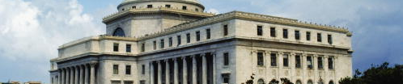
Types of Government
Authoritarian
Monarchy: Form of government headed by a single member of a royal family
Oligarchy: Form of government in which a few individuals rule

Slide 14
Types of Government
Dictatorship and Totalitarianism
  Dictatorship: Government in which one person has nearly total power to make and enforce laws
  Totalitarianism: Involves virtually complete government control and surveillance over all aspects of a society’s social and political life
  Military Junta – ruled by military leaders

Slide 15
Types of Government
Democracy
  Direct – Hunter/Gathering society – a few people make decisions for the masses
  Representative – Society stared to grow, so we had to elected representative democracy
    Democratic Republic

Slide 16
Voter participation
Party Affiliation
Social Class
Parent’s Are Voters/Receive their support
Older and Middle people
Better educated people
Europeans Americans
Males

Slide 17
FUNCTIONS OF THE GOV’T
Planning & Directing society
Meeting social needs
Maintaining law and order
Maintaining international relations

Slide 18
Terrorism
Terrorism: Use or threat of violence against random or symbolic targets in pursuit of political aims
  The end justifies the means
  Essential aspect of contemporary terrorism involves use of media

Slide 19
War and Peace
War: Conflict between organizations that possess trained combat forces equipped with deadly weapons.
Peace: Absence of war and proactive effort to develop cooperative relations among nation:
90% of armed conflicts occurred within states

Slide 20
THEORECTICAL PERSPECTIVES
Functionalist Theory – Functions of the Government
Conflict Theory – Control of Power
Symbolic Theory – Political involvement, voting behavior, political socialization

Slide 21
The Economy
Economic system: Social institution through which goods and services are production, distribution, and consumption

Slide 22
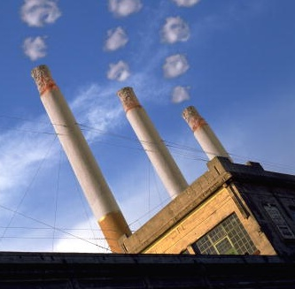
Economic Systems
Industrial society:
Society that depends
on mechanization to
produce its goods
and services
  Capitalism
  Socialism
  Communism
  The Informal Economy

Slide 23
Capitalism
Capitalism: Economic system in which means of production are held largely
in private hands
  Main incentive for economic activity is accumulation of profits
  Laissez-faire: Businesses compete with minimal government intervention
  Monopoly: Exists when a single firm controls the market
http://www.youtube.com/watch?v=TtOtV-gE3YQ

Slide 24
Socialism
Socialism: Means of production and distribution owned collectively rather
than privately owned
http://www.youtube.com/watch?v=rMqNL7sIhGs&feature=related

Slide 25
COMMUNISM
  Communism: Economic system under which all property is communally owned and no social distinctions are made on the basis of people’s ability to produce
http://www.youtube.com/watch?v=Qra0hlO6hZk

Slide 26
Informal Economy
Transfer of money, goods, or services is not reported to the government, i.e., a haircut in exchange for a computer lesson
  Difficult to measure
In developing nations, informal
economy represents significant
part of total economic activity

Slide 27
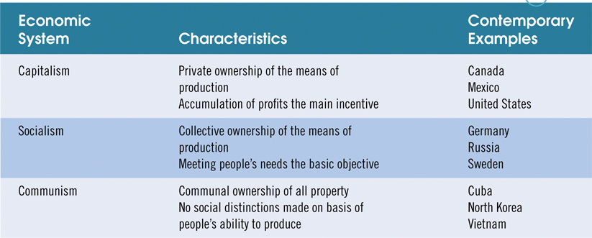
Table 14-1: Characteristics of the Three Major Economic Systems

Slide 28
TYPES OF PRODUCTION
Primary – deals with extraction of natural resources
Secondary – deals with the processing of nature resources
Tertiary – deals with information and services.

Slide 29
FUNCTIONS OF THE ECONOMY
Production and distribution of goods and services
Distribution of Power
Distribution of Political Power (labor unions)
Welfare (job, no job, charity)
Consumptions

Slide 30
CHANGES IN THE
AMERICAN ECONOMY
Microfinancing
Deindustrialization
Downsizing
Offshoring

Slide 31
Microfinancing
Microfinancing: Lending small sums of money to the poor so they can work their way out of poverty
  Works well in countries that experienced severe economic devastation
Estimated 90% of recipients of microcredit are women

Slide 32
The Changing Face of the Workface
Sociologists and labor specialists foresee a workforce increasingly composed of women and racial and ethnic minorities
  From 1984 to 2014, 54% of new workers expected to be women
  Workforce will reflect diversity of population, as ethnic minorities join labor force

Slide 33
Deindustrialization
Deindustrialization: Systematic, widespread withdrawal of investment in basic aspects of productivity
  Targets and location of investment change
  Need for labor decreases
  Can take the form of corporate restructuring
  Downsizing: Reductions taken in a company’s workforce as part of deindustrialization

Slide 34
Global Offshoring
The Issue
  Offshoring is process of transferring types of work to foreign contractors
  It is global and effects people all over
  the world

Slide 35
Global Offshoring
The Setting
  Offshoring began when U.S. companies transferred manufacturing jobs to foreign factories where wage rates were much lower
  No longer limited to manufacturing

Slide 36
Global Offshoring
Sociological Insights
  Offshoring tends to improve efficiency of business operations
  Conflict theorists charge that offshoring furthers global inequality
  Long-term impact of offshoring on India and developing countries hard to predict

Slide 37
Global Offshoring
Policy Initiatives
  Offshoring may not lead to large-scale unemployment, but will likely produce shift in Western labor markets
  Most policy makers see offshoring
  as part of the “natural” process
  of globalization

Slide 38
THEORECTICAL PERSPECTIVE
Fuctionalist Theory – Adam Smith
Conflict Theory – John Keynes
Symbolic Theory – Buying Behavior

