Slide 1

MODULE 12
ECONOMY

Slide 2
OBJECTIVEsS
Define Economy
Different types of economic systems
Industrial Society
Theoretical Perspectives

Slide 3
The Economy
Economic system: Social institution through which goods and services are production, distribution, and consumption

Slide 4
Economic systems
Agricultural Revolution
Industrial Revoluation
Post-Industrial Society and the Information Age

Slide 5
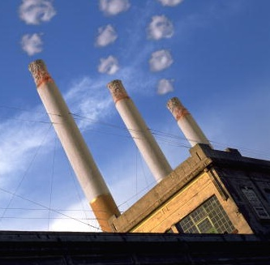
Economic Systems – industrial society
Society that depends
on mechanization to
produce its goods
and services
  Capitalism
  Socialism
  Communism
  The Informal Economy

Slide 6
Capitalism
Capitalism: Economic system in which means of production are held largely
in private hands
  Main incentive for economic activity is accumulation of profits
  Laissez-faire: Businesses compete with minimal government intervention
  Monopoly: Exists when a single firm controls the market
http://www.youtube.com/watch?v=TtOtV-gE3YQ

Slide 7
Socialism
Socialism: Means of production and distribution owned collectively rather
than privately owned
http://www.youtube.com/watch?v=rMqNL7sIhGs&feature=related

Slide 8
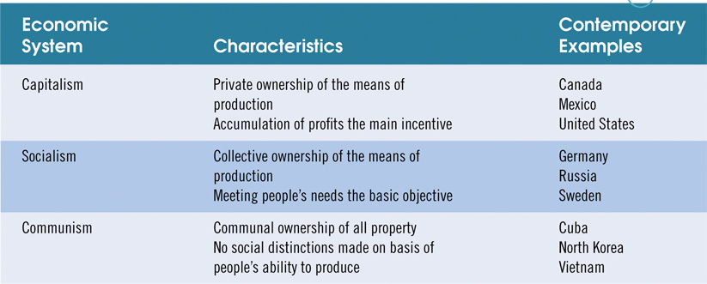
Table 14-1: Characteristics of the Three Major Economic Systems

Slide 9
THEORECTICAL PERSPECTIVE
Functionalist Theory – designed for maximum efficiency. Davis-Moore Theory
Conflict Theory – The economy is not a source of stability society. Bourgeoisie vs Proleteriat
Symbolic Theory – Day to day interaction; economy is based on career inheritance.

Slide 10
GLOBALIZATION
Refers to the process of integrating governments, cultures, and financial markets through international trade into a single world market.

Slide 11
GLOBALIZATION TERMINOLOGY
NAFTA - p. 459
WSF – p. 460
WEF – p. 460
GDP – p. 460-461

